Slide 1
VMPRO 3.0
Service TOI
(Guadalupe River)
Ping Hu
June 19th, 2012

Slide 2
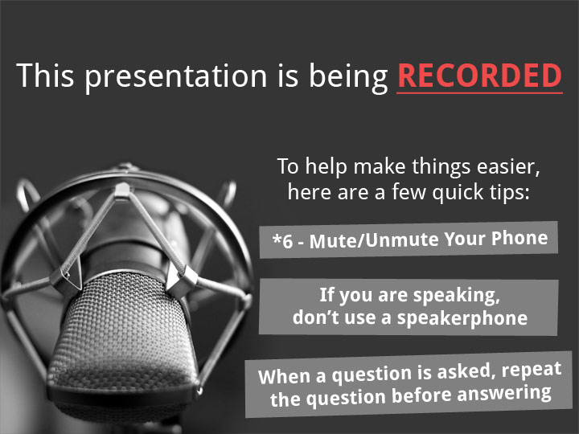

Slide 3
Agenda
Product Management (10 minutes): Mark Thacker/John Cramer
  Product Overview, Terminology, Functionality
  Licensing changes / Conversions
  System Serial #’s
Service (5 minutes): Ping Hu
  High Level Service Strategy
Educational Services (5 minutes): Jim Bell/Tom Sajbel
  Available training/documents/videos
Software Engineering (30 minutes): Barry Herman/Tom Newton
  CentOS Port and Migration from 2.3.3
  VDDK V5 support
  Performance Enhancements
  SmartMotion Enhancements
  VSS Enhancements
  Capacity-based Licensing
  Other Enhancements
Q/A (Remaining time): All

Slide 4
VMPRO 3.0 Product Overview
Mark Thacker
June 19th, 2012

Slide 5
vmPRO 3.0 Key Features
Releases
June 22
2012
Capacity-based licensing
  SmartMotion and SmartView combined into one offering
  Silver and Gold Software support available
Multiple backup policies, retention periods and backup targets
  Group several VMs together to be backed up to a specific DXi
    A different group of VMs to target a totally different DXi
  Have a longer retention period for one group of VMs
  Each backup policy can have a unique time of day to execute
    Still only exactly one backup per day
Snapshots of Microsoft SQL Server & Exchange
  Allows application save consistent backups
Status and reporting through Quantum Vision
Support for Scalar LTFS in future update
  Scalar LTFS presents tapes as a NAS share for vmPRO use

Slide 6
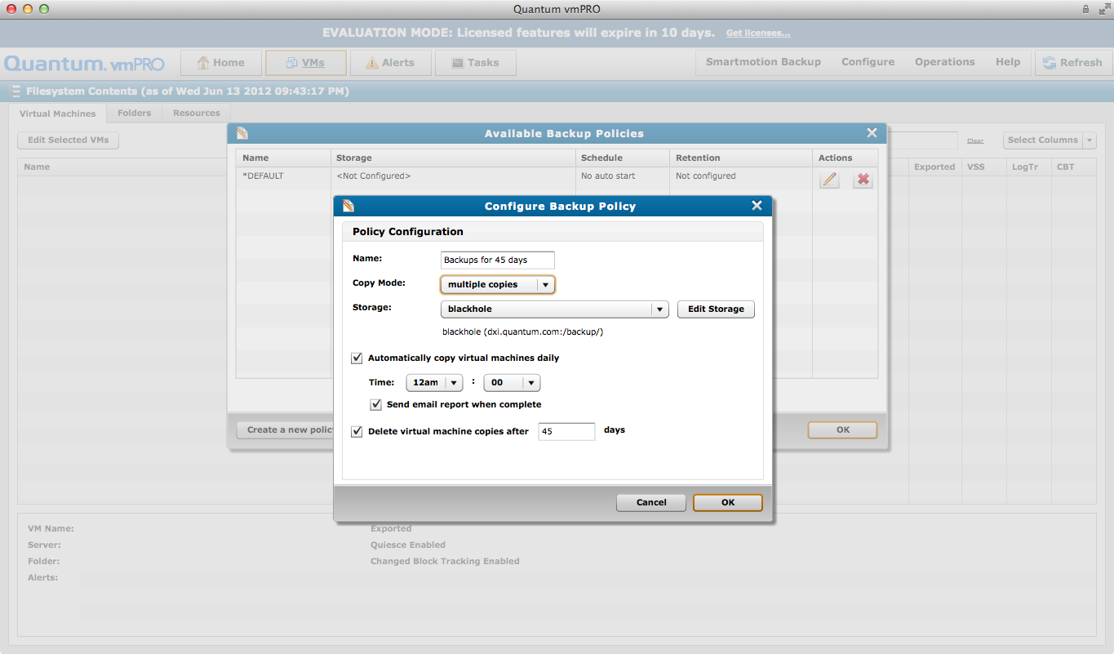
Backup Policy with Schedule & Target Selection Options

Slide 7
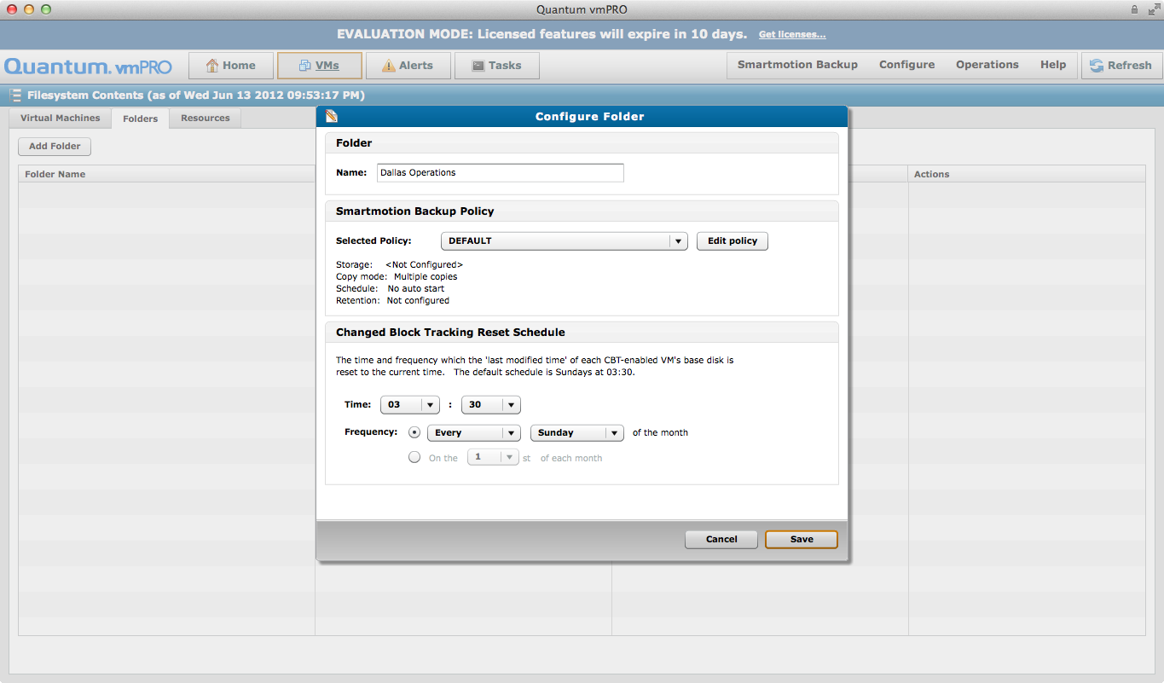
Backup Policies Applied to Folders of VMs

Slide 8
vmPRO 3.0 Model Numbers and Pricing
Model | Description | List Price | QDR | Non-QDR
WVRSP-ALSE-001A | vmPRO 30-day trail, 1TB capacity | No cost | No cost | No cost
WVRSP-FLS1-001A | vmPRO Initial License, 1TB | $2,250 | $1,238 | $1,800
WVRSP-FLSC-001A | vmPRO Additional Capacity, 1TB, at Initial Sales | $2,250 | $1,238 | $1,800
WVRSP-ULSC-001A | vmPRO Additional Capacity, 1TB, Field Upgrade | $2,250 | $1,238 | $1,238
Product Warranty: 90 Days (Material defects/no phone support)
Included Support: None (Customer required to purchase support contract)
Standard channel and QDR price:
          45% QDR, 20% Non-QDR off product list price
          10% off MSRP for service
Annual pricing with no uplift upon renewal
ASP/AFCP support options available

Slide 9
What to order – vmPRO QTM Support
Case | Model # | Description | Annual List Price | QDR | Notes
Demo / Trial Customers | Service included for period of Demo
All other customers | SVRSP-FLS1-GL10 | Quantum vmPRO Software, per 1TB Capacity of Data to Protect, Gold Software Support Plan, annual | $450 | $405 | Annual Support Pricing Per TB
 | SVRSP-FLS1-SL10 | Quantum vmPRO Software, per 1TB Capacity of Data to Protect, Silver Software Support Plan, annual | $338 | $304
Support is Mandatory with vmPRO purchase

Slide 10
What to order – vmPRO AFCP/ASP Support
Case | Model # |  | Description | FCP/ASP Annual List Price | Notes
Demo / Trial Customers | Service included for period of Demo
All other customers | SVRSP-FLS1-FG10 | Quantum FCP, vmPRO Software for Data Center, per 1TB Capacity of Data to Protect, Gold Software Support Plan, annual |  | $450 | Annual Support Pricing Per TB
 | 7-00913-04 | ASP - vmPRO Software, per 1TB Capacity of Data to Protect - 7x24 software phone support - annual - all zones |  | $338
 | 7-00913-05 | ASP - vmPRO Software, per 1TB Capacity of Data to Protect - 5x9 software phone support - annual - all zones |  | $254
Support is Mandatory with vmPRO purchase
ASP / FCP’s must be VMware certified at an Administrator level or better

Slide 11
Rules for Ordering
One Initial sales (WVRSP-FLS1-001A) per instance
Quantity of Additional Capacity license determines actual capacity sold to the customer
  Qty 5 = 5TB additional data to protect
Indicate which “Additional Capacity, Initial Sales” license applies to which Initial Sales license in the purchase order
  WVRSP-FLSC-001A ordered ONLY with an Initial license
For field upgrades, customer must supply serial number of existing installed system
  Will be asked for sales order number and serial number at time of license redemption in order to truly assign additional capacity
  Use Additional Capacity, Field Upgrade (WVRSP-ULSC-001A)

Slide 12
vmPRO 3.0 Licensing Example
Sold on per 1TB Primary Data to Protect
All 1TB licenses include SmartView, SmartMotion and Progressive Optimization
  How to calculate Data to Protect
    Amount of provisioned (not used) data backed up in a 24hr period
    Includes all VMs being protected by that instance of vmPRO
  Example
    Single instance (copy) of vmPRO 3.0
    50GB of fully provisioned data per VM
    10 VMs / physical host * 50GB = 500GB per physical host
    4 physical hosts * 500GB per host = 2TB data to protect
    Sell quantity 1 of the 1TB Initial license (WVRSP-FLS1-001A)
    Sell quantity 1 of the 1TB Additional Capacity, Initial Sale
    (WVRSP-FLSC-001A)
    Sell quantity 2 of either Silver Software support or Gold Software support

Slide 13
Capacity License Enforcement
License is enforced per instance of vmPRO
Customer receives warning when reaching 90% of capacity license within a 24 hour period
Customer receives capacity exceed warning when exceeded
Quantum receives capacity allowed and capacity used stats daily to the mosaic.quanutm.com support site
Future work to add link to capacity used percentage in Quantum Salesforce.com for follow-up.
Fail safe mode : backups & alerts continue

Slide 14
Old to New License Transition
Socket-based licenses supported but cannot be purchased going forward
If an existing customer needs additional licenses they will need to convert to capacity based licensing
We assume 4 sockets = 1TB Capacity License
  SmartView and SmartMotion calculated independently
vmPRO 3.0 is a ‘side-by-side’ installation with 2.x
  No accidentally upgrading and not having a license
  Easy to export configuration from vmPRO 2.x to 3.0
  Allows Quantum time to work with customer on proper license
vmPRO 4000 is NOT affected by license transition
  Has always included both SmartMotion and SmartView
  Uses a ‘target-based license’ which IS continued with vmPRO 3
  Will transition to vmPRO 3.0 when it is posted to download site – June 20, 2012 (GA)

Slide 15
VMPRO 3.0 Service Overview
Ping Hu
June 19th, 2012

Slide 16
vmPRO Service Strategy
Service Strategy for standalone software
  Global Call Handling (GCH/CDS): 1st Call
  Advance Solution Product Support (ASPS): Tech Support
  Service Engineering Specialists (SES): Sustaining Level One
  Data Virtualization (DV): Sustaining Level Two
  No Field Service for SW
  Added Service Uplifts (Gold) and Service Extensions (Silver and Gold)
  TBD: A PAID Installation Service is being considered
Best Practices Guide
  Almost content complete, will be posted to CSWeb around GA
  Still reviewing to determine if it is ready for external release

Slide 17
VMPRO 3.0 educational services
Tom Sajbel & Jim Bell
June 19th, 2012

Slide 18
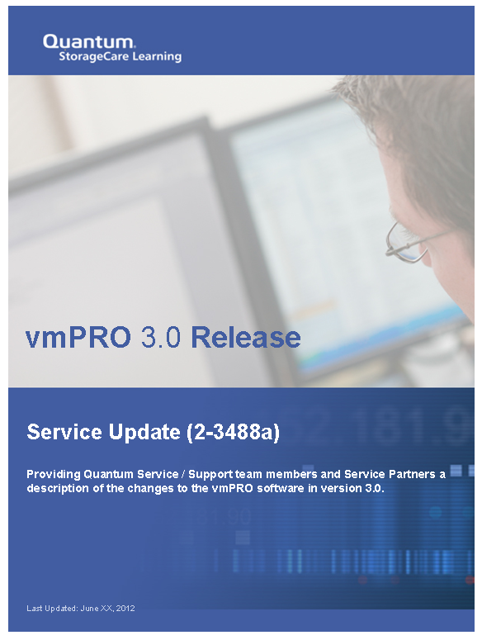
Educational Services
Training Available in StorageCare Learning
  New – Quantum vmPRO 3.0 Service Update (2-3488a Online Self-Paced)
  New – Quantum vmPRO 3.0 Pre-Sales Update (3-3788a Online Self-Paced)
  Updated – Quantum vmPRO Installation for Service (2-3425 Online Self-Paced)
  Updated – Quantum vmPRO Installation for Pre-Sales (3-3729 Online Self-Paced)
Training Available on Qwikipedia and CSWeb
  Updated – Troubleshooting vmPRO Issues
  Updated – Quantum vmPRO Service and Support Training
Resources on mosaic.quantum.com
  Videos
  Knowledge Base
  Documentation
Resources on quantum.com
  Videos
  Documentation
Documents on CSWeb
  New – Quantum vmPRO Software At a Glance
  Updated – Quantum vmPRO Status and Log Locations
  Quantum vmPRO 4000 At a Glance

Slide 19

Educational Services
eQuip – Global Services Extended Learning Library
Related courses:
  VMware vSphere 4 training course
  VMware vSphere 5 training course
Access:
  URL: http://equip.quantum.com
  Username: quantum email address
  Password: welcome1

Slide 20
VMPRO 3.0 software development
Barry Herman &
Tom Newton
June 19th, 2012

Slide 21
Software Development Outline
CentOS Port and Migration from 2.3.3
VDDK V5 support
Performance Enhancements
SmartMotion Enhancements
VSS Enhancements
Capacity-based Licensing
Other Enhancements

Slide 22
CentOS Port and Migration from 2.3.3
Appliance ported from Fedora 9 to CentOS 6.2
  Includes port from 32-bit to 64-bit application
  Moves to current versions of components
  Larger internal filesystems
  Includes VMware Tools
Prepares for future features and OS support
Steps to Migrate from previous (pre-3.0) release:
  Upgrade existing appliance to 2.3.3 (an RPM only release); adds an “Export vmPRO Configuration” action in the GUI
  Export the current configuration from 2.3.3 GUI to a file on another host
  Deploy the 3.0 OVF (CentOS-based)
  Log in to the 3.0 GUI, and select the “Import vmPRO Configuration” action

Slide 23
VDDK V5 Support
Moved to the current VDDK, 5.0U1
  This SDK is used by datastore_fs to access a disk’s data
We use the new PrepareForAccess and EndAccess functions
  prevents vMotion from moving a VM during our backup
Worked around memory leak in lib by restarting datastore_fs
  datastore_fs.restart.time = 604800
How the interface is used:
  Call PrepareForAccess
  Create snapshot and perform backup
  Remove snapshot
  Call EndAccess

Slide 24
Performance Enhancements
vm_proxy_fs (/export) now reads directly from /vmfs/volumes
  rather than through device mapper and loop device layers
Additional buffering and read-ahead of disk data
Improved datastore_fs stats in log
More efficient thread locking

Slide 25
SmartMotion Enhancements
Overview
  New multiple policy support for backup operations
    Allows multiple storage targets
    Allows multiple backup schedules
    Allows multiple retention policies
Installation
  No additional steps are required, upgrade handles the configuration automatically
Troubleshooting
  New log file in /var/log/smartmotion (SmartMotion specific information)

Slide 26
VSS Enhancements
Overview: Expanded VSS support
  Operating Systems: Windows Server 2005, 2008 and 2008 R2
  Applications: Exchange 2007, 2010, Sql Server 2008 and Active Directory.
Installation
  Online documents in the Knowledge Base to guide a user through the installation. Essentially, for each Windows VM the QuantumVSS agent needs to be installed (32-bit or 64-bit)
Configuration
  Once the agent has been installed, the VM needs to be configured for VSS. This is done through the VM configuration screen within the vmPRO interface.
Troubleshooting
  For basic troubleshooting, the vmPRO interface will display any errors contacting the agent within the VM. Double check authentication, etc.

Slide 27
Capacity-based Licensing
Overview
  New Capacity-based licensing has replaced the separate SmartMotion/SmartView licensing
  Capacity is defined as the (thick) disk size of VMs being backed up, regardless of actual data read
  Capacity-based licenses are sold with an initial capacity of 1TB, plus 1TB increments
  30-day trials will also be granted based on capacity (1TB)
  When the capacity limit is exceeded, warnings are generated for the customer (not a hard stop) to allow for corrective action
  Licensing an appliance with both capacity and target-based models is not supported, old licenses still supported
Installation: no changes
Troubleshooting: no changes

Slide 28
Other Enhancements
Changed sysadmin default password from “pancetera” to “sysadmin”
Integration with Quantum’s Vision product
New TSM restart command

Slide 29
Q/A
  Questions?

