Slide 1
vmPRO 3.3
TOI for Global Service
May 12, 2015

Slide 2
Agenda
Program Overview
Software Overview
Bug Fixes
Training and Documentation Updates
Service Updates
Notes:
Please mute your line unless asking a question.
Ask questions as we go.
We are recording the session and will post online.

Slide 3
Program Overview
Presented By: Mark Thacker

Slide 4
Program Overview – vmPRO 3.3
Key Features:
VSAN Datastore Backup and Recovery
vSphere V6 Support
New Online User Guide & Online Help
Converting to a new authoring tool, Madcap Flare
Various bug fixes and smaller enhancements
Customer SR Fixes
Additional Bug Fixes
Including security updates, for example, Open SSL Poodle & Ghost GLibC
Enhancements
Upgrades : Customers connected to Internet will receive notification of upgraded software when it’s released
Manual upgrade packages available for download at same time
Revised GA date of May 15, 2015

Slide 5
vmPRO Licensing Reminder
vmPRO 3.3 supports same licensing as 3.2:
Capacity-based : licensed on allocated capacity of customer’s VMs
Target-based : unlimited capacity, single target IP address
Used by Service Providers and by older vmPRO 4000 bundles
Socket-based : SmartMotion & SmartView sockets per deployment
Not in price book, no new licenses issued without Mark Thacker approval
Socket-based to Capacity Conversions
Used when customer wants more sockets
Switch them to capacity at 1 socket : 1 TB Capacity basis
Ex : 20 SmartMotion + 20 SmartView = 40TB Capacity license
Work with Mark Thacker on these conversions
License Expiration Types
Standard Edition : free perpetual; 1TB capacity ( same as DXi-V1000)
Community only support
Support optional purchase
Upgradable to Enterprise Edition
Enterprise Edition : perpetual at least 1TB capacity
support is a required purchase
30-day Trial : 1TB Capacity; includes 90-days support
Subscription based : capacity for a given time
Used by Service Providers

Slide 6
Software Overview
Presented By: Barry Herman

Slide 7
vmPRO 3.3 Features
VSAN Datastore Backup and Recovery *
Bug 6138 - Customer URS, SR 3464052: Support backup & recovery of VMs on VSAN datastores
Bug 6390 - Support VSAN of VMware vSphere 6
Online Help *
Bug 6366 - RFE: On-board html documentation and integration with GUI
vSphere 6.0
Bug 6390 - Support VSAN of VMware vSphere 6 (as above)
Bug 6418 - Upgrade VDDK to 5.5.4 for vSphere 6.0 support
Bug 6441 - Recovery fails for a VM with 2TB+ disk on vSphere 6
* Covered on later slides.

Slide 8
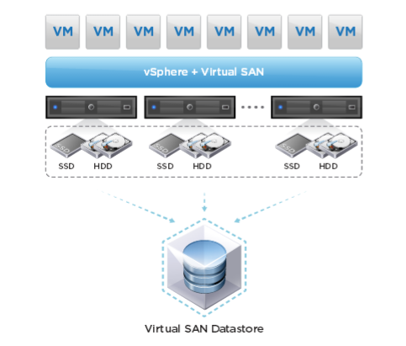
VSAN – The VMware Feature
Virtual SAN, SW-defined storage
Added in 5.5.x, enhanced in 6.0
Simplifies provisioning and mgmt
VM-centric policy-based mgmt
Hardware independent
Host requirements
3 ESXi hosts
Each contributes local disks (SSD and HDD)
Must have 1Gb Ethernet for interconnect
Must be managed by vCenter
From http://www.vmware.com/files/pdf/products/vsan/VMware_Virtual_SAN_Datasheet.pdf and http://kb.vmware.com/selfservice/microsites/search.do?language=en_US&cmd=displayKC&externalId=2058424

Slide 9
VSAN Datastore
vmPRO must manage at the vCenter level, not ESXi direct
The VSAN datastores are a cluster-wide resource, across a cluster of ESXi servers
Supports backing up from one type and recovering to either
Backup from VSAN or non-VSAN, recover to VSAN or non-VSAN datastores
More at http://panwiki.quantum.com/index.php/VSAN_Feature
Feature done in these RFEs
Bug 6138 - Customer URS, SR 3464052: Backup & recovery of VMs on VSAN datastores
Bug 6390 - Support VSAN of VMware vSphere 6
Conventional vs VSAN Datastore
[datastore] --> ds:///vmfs/volumes/<UUID>/ -- local or remote (NFS)
[vsanDatastore] --> ds:///vmfs/volumes/vsan:<UUID>/ -- clustered storage (VSAN)
Disk data (flat.vmdk or delta.vmdk) in VSAN DS is a VSAN object
Not visible in VMFS namespace, vSphere Web interface, or MOB (managed object browser)
It is accessible through VDDK and vSphere Perl SDK

Slide 10
VSAN & vmPRO
Datastore_fs creates object for data file (disk extent) in /vmfs/volumes
/vmfs/volumes/vsan:<UUID>/<vm-folder-UUID>/<disk-UUID>
Where <disk-UUID> is the disk's extent UUID in its descriptor file, vdisk.vmdk
The /export namespace maps to these files in /vmfs/volumes
For VMs in a conventional Datastore:
/export/.../vm.vmx -> /vmfs/volumes/<UUID>/<vm-folder>/VM.vmx
vdisk.vmdk -> /vmfs/volumes/<UUID>/<vm-folder>/vdisk.vmdk
vdisk-flat.vmdk -> /vmfs/volumes/<UUID>/<vm-folder>/vdisk-flat.vmdk
For VMs in VSAN Datastore:
/export/.../vm.vmx -> /vmfs/volumes/vsan:<UUID>/<vm-folder-UUID>/VM.vmx
vdisk.vmdk -> /vmfs/volumes/vsan:<UUID>/<vm-folder-UUID>/vdisk.vmdk
vdisk-flat.vmdk -> /vmfs/volumes/vsan:<UUID>/<vm-folder-UUID>/<disk-UUID>
Datastore_fs redirects I/O for files to VDDK & Perl SDK interfaces
No changes to other vmPRO components
Log messages: Folder name is replaced with its VSAN uuid
... vm_proxy_open_vmdk_flat: opening /vmfs/volumes/543fa91b-c0f7f7a0-171d-a4badb39a148/TestVM-in-non-VSAN/TestVM-in-non-VSAN.vmdk ... (conventional)
... vm_proxy_open_vmdk_flat: opening /vmfs/volumes/vsan:5274f65f9db41a4a-27dd1a3e39e797eb/78ea4c55-eb6a-7d78-8851-a4badb3d2a73/TestVM-in-VSAN.vmdk...(VSAN)

Slide 11
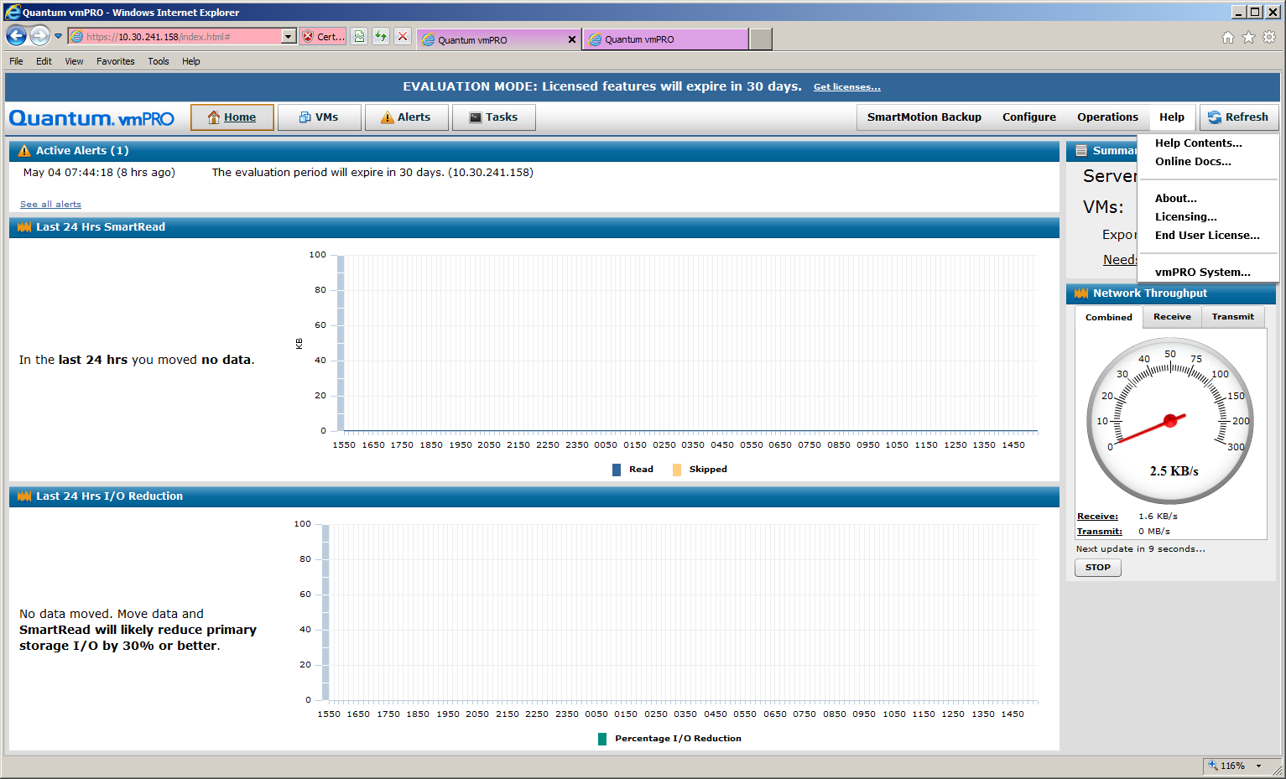
Online Help - Launch

Slide 12
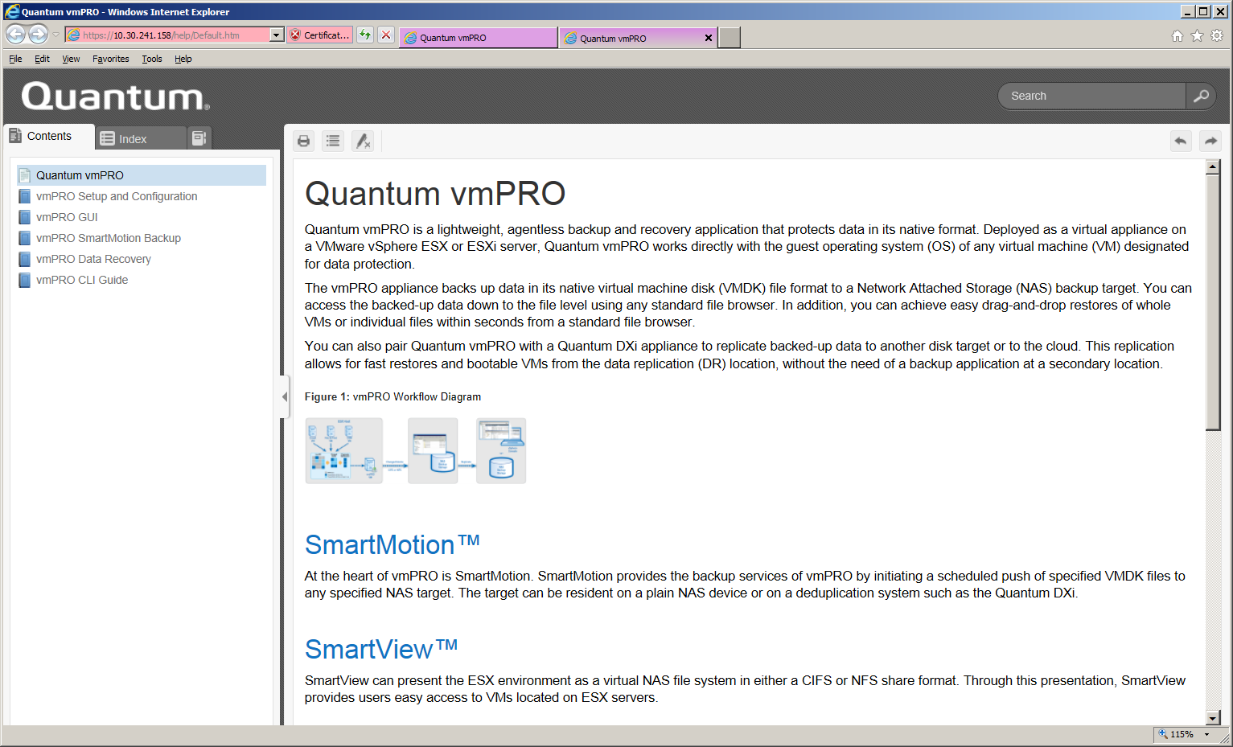
Online Help - Content

Slide 13
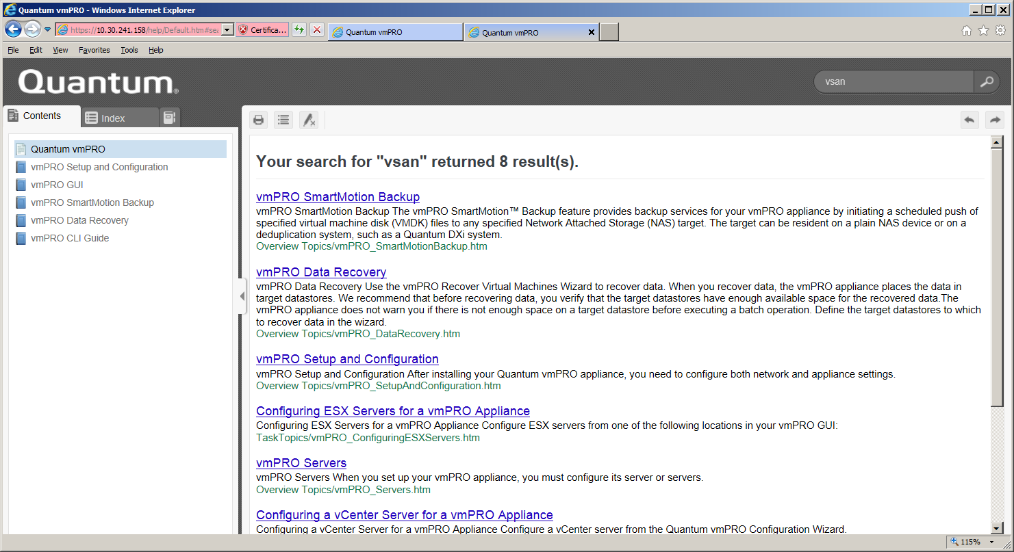
Online Help - Search

Slide 14
Bug Fixes
Presented By: Barry Herman

Slide 15
Bug and Enhancement Metrics
All fixes have been verified by QA
101 Bugs and Enhancements Resolved-Fixed
64 Bugs
37 Enhancements
17 Customer bugs resolved
Severity distribution for the 64 bugs:
Blocker: 1
Critical: 3
Major: 15
Normal: 35
Minor: 10

Slide 16
Fixes for Serviceability & Security
Serviceability Improvements
Bug 5934 - RFE: Include tracebacks for all python threads/processes in support bundle
Bug 5972 - "SmartMotion failed" alerts should specify policy name
Bug 6084 - Customer UMass, SR1644912: Reduce frequency of db reconnect attempts to avoid log spam
Bug 6305 - Add link to appliance in Alert Email
Bug 6306 - Add link with IP address to SmartMotion backup report
Security Changes
Bug 5148 - Nexpose: DOM-based Cross Site Scripting Vulnerability historyFrame.html
Bug 6321 - Nexpose: Severe Click Jacking (http-generic-click-jacking) vulnerability
Bug 6322 - Nexpose: CVE-2014-7186 bash possible out-of-bounds mem & CVE-2014-7187 off-by-one error
Bug 6330 - OpenSSL TA14-290A: SSL 3.0 Protocol Vulnerability and POODLE Attack
Bug 6335 - Upgrade OpenSSL RPM to address vulnerabilities CVE-2014-3513 and CVE-2014-3567
Bug 6342 - Upgrade the VDDK to 5.5.3, to fix recent OpenSSL vulnerabilities
Bug 6355 - Upgrade the ntp RPMs to address security vulnerabilities
Bug 6382 - CVE-2015-0235: Linux glibc "Ghost" Remote Code Execution Vulnerability via gethostbyname
Bug 6398 - Update Samba RPMs to fix vulnerability CVE-2015-0240, Remote Code Execution
* Covered on later slides.

Slide 17
Customer Bug Fixes, 1 of 2
Bug ID | Summary
4500 | Customer UMass Dartmouth, SR 3440286: Unable to initialize SmartMotion database on storage
5751 | Customer City of Calgary, Hipskind SR 3456434: Unable to connect to vCenter error during recovery, when selecting vSphere Folder within wizard
6084 | Customer UMass Dartmouth, SR1644912: Reduce frequency of database reconnection attempts to avoid log spam
6138 | Customer URS, SR 3464052: Support backup and recovery of VMs on VSAN datastores
6186 | Customer Hospice of Kitsap County: SmartMotion failed with Error in copying vm '</export/.../...vm>'... Cannot concatenate 'str' and 'tuple' objects
6315 | Customer Grassland Dairy, SR 3436550: No RPMs displayed in GUI, after displaying "Software updates are available..."
6325 | Customer Aleris International, SR 3445822 - ls_bitmap_fs core dumps in pan_partition_type at pandev_io.c:44
6326 | Customer Earthlink: vm_proxy_fs core dump in is_zero_size_thin_disk from inconsistent disk info
6327 | Customer Earthlink: Empty directories in /export for vCenter with an unavailable host (SmartMotion error "VM was not found in /export")
6358 | Customer Hipskind/Salvation Army, SR 3449262: Unexpected full backups after retention

Slide 18
Customer Bug Fixes, 2 of 2
Bug ID | Summary
6360 | Customer UMass Dartmouth, SR SR3482476: DXI Stale Data requiring manual deletion
6368 | Customer Agnico-Eagle Mines Limited : datastore_fs core dump in jdr_ds_config() because of tc_ds_config_t.dc == 0x0
6371 | Customer Valley Presbyterian Hospital: vm_proxy_fs core in _errdesc_set_extended_err while handling EIO when vmPRO hit the connection glitch with vCenter
6373 | Customer Affiliated Monitoring, SR 3467304: Documentation: Retention policies
6381 | Customer Black Country PNHSFT, SR 3491408: Limit for the maximum number of semaphores reached
6404 | Customer University Hospital Of South Manchester NHS Foundation Trust: backup fails with "Cannot find which virtual machine the disk <disk name> belongs to: ..." after changed disk(s) to independent
6421 | Customer Greywolf Capital, SR 3521920: backups fail when recovery_fs restarts repeatedly when iSCSI write area is not mounted

Slide 19
Training and Documentation
Presented By: Tabar Smith

Slide 20
Training and Documentation Updates
Technical Documentation (All are available from Quantum.com, Mosaic Website, and CSWeb)
New: Embedded Help System in the vmPRO 3.3 GUI
Same content as the vmPRO 3.3 User's Guide and Upgrade Guide in an easy-to-navigate format.*
Updated: Quantum vmPRO 3.3 Release Notes
Updated: Quantum vmPRO User’s Guide
Updated: Quantum vmPRO 3.3 Open Source Licenses
Updated: vmPRO Installation Guides (Mosaic)
Updated: vmPRO Upgrade Guide (Mosaic)
*Discussed in more detail in following slides
Training Courses and Job Aids
New: Quantum vmPRO 3.3 Service Update (2-3488d Online Self-paced) course (StorageCare Learning)
Updated: Quantum vmPRO Installation (2-3425 Online Self-Paced) course (StorageCare Learning)
Updated: DXi-Series Status and Log Locations document (CSWeb)
Updated: Quantum vmPRO Software At A Glance document (CSWeb)

Slide 21
Searchable Format

Slide 22
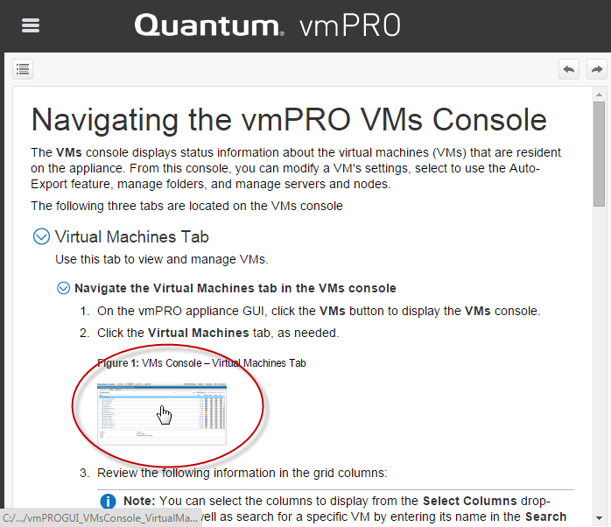
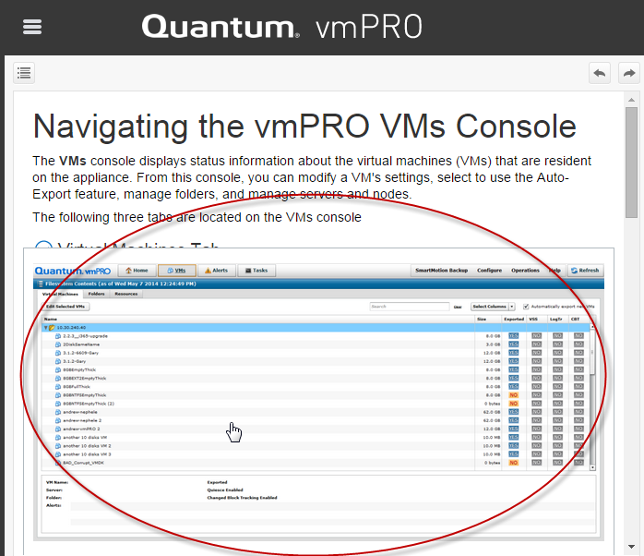
Interactive Format

Slide 23
Service Updates
Presented By: Jim Hibbard

Slide 24
Service Model
No changes to existing Service Model
Service Model Summary
Case Management: Global Service Center (GSC), CDS, Kuala Lumpur
Technical Support: Advanced Solutions Product Support (ASPS)
Field Support: No SW Field Support.
Escalation Support: Service Engineering Specialists (SES), Data Virtualization Team
Service Offerings
Standard Warranty:
None. Enterprise customers must purchase Silver Software Support. Standard Edition customers have no support contract and get support from ForumV.
30 Day Free Trial version includes 90 days Silver Software Support.
Support Contracts
SILVER Software Support Plan: 5x9 telephone support Monday through Friday (5 days a week),
GOLD Software Support Plan: 24x7 phone support (7 days a week)
Warranty uplifts
Gold uplifts and extensions for Enterprise Edition only
Warranty renewals
Gold and Silver annual renewals for Enterprise Edition only
Installation and Integration Services
vmPRO software is customer installable and no installation services are available.

Slide 25
Service Plan Updates
Clarify escalation resources and process
ASPS can escalate to SES
SES can further escalate to DV (Data Virtualization) team
Barry Herman’s team
Details are documented in the Service Plan update
License Troubleshooting
Licenses created on mosaic.quantum.com
Licenses associated with customer account and SN
GSC and ASPS can look-up, modify, or re-issue licenses if required
Docs and Software are posted on CSWeb, Quantum.com, and Mosaic

