Slide 1
vmPRO 3.1
(Santa Maria Program)
TOI for Global Service
23APR13
Quantum Confidential / Internal Use Only

Slide 3
Agenda
Marketing Overview – Mark Thacker
SW Engineering Update – Barry Herman, Andrew Clark, Gary Faith
Bug Fixes/Known Issues – Barry Herman
Documentation and Training Updates – Mike Pavalus/Jim Bell
Service Strategy Update – Jim Hibbard
Note: Ask questions as we go. Q&A also at the end.

Slide 4
Marketing Overview
Presented By: Mark Thacker

Slide 5
vmPRO 3.1 (Santa Maria) Overview
Performance improvements
SmartRead technology
Skipping of paging & virtual memory files
VMware HotAdd disk backups
Additional support for the latest Windows operating systems
Integration of on-demand software upgrades through Vision technology
Ability to send second copies of backups to tape via Scalar LTFS
Subscription-based licensing
Scheduled release date of April 26, 2013

Slide 6
Management Enhancements
Automated configuration protection
Exports vmPRO configuration to a file and backs up that file to the target system for easier restoration or DR.
Detailed progress reporting of jobs
What VM is being backed up, progress, time remaining
Group member stats displayed on master node
Vision initiated software updates
Vision customer can request vmPRO to do an update [requires future Vision update]
Each vmPRO appliance will contact Quantum update site
Improved performance meter
Showing output performance rather than input and output
Integrity check of guest VM
Performed before backup of guest VM

Slide 7
Policy & Retention Enhancements
More refined backup periods
Daily, weekly, monthly, yearly backups
Each policy with it’s own number of retention copies and target
Multiple backup policies per virtual machine
Eliminates the one policy per VM rule today
Ideal to leverage with the refined backup periods
Each policy with it’s own backup target
Use case : daily backups to DXi, weekly fulls to tape via Scalar LTFS appliance (to present tape libraries as a NAS share)
Parallel execution of up to 4 policies
Allows execution of four different policies per vmPRO appliance
Today’s vmPRO is one policy executing, up to four VM’s
Testing with Scalar LTFS appliance
Backup / restore to tape through NAS presentation
Specifically to be used with the refined backup periods

Slide 8
Performance Enhancements
Higher performance backups using HotAdd
Allows direct access to the VM’s data store
Results in faster backup performance, eliminating network bottleneck
Only applicable for VM’s with SCSI VMDKs, not IDEs
SmartRead file inspection
Skips “noisy” files such as virtual memory page files
More efficient data movement
SmartMotion only looks at live blocks, beyond what CBT offers
Use of sparse write on CIFS shares to skip writing blank data
In addition to sparse write support on NFS today
Testing of NFS Asynchronous mode on DXi

Slide 9
New Platform and Application Support
Windows Server 2012 and Windows 8
Guest support only, Hyper-V support is a separate project
vSphere 5.1 added to 4.0U2 and 5.0
Full certification for ESX 5.1
vmPRO 3.0.1 has been tested & works on vSphere 5.1
Exchange 2013, SQL Server & Active Directory
Latest versions
Linux LVM2 single-disk volumes
Previously a configured option

Slide 10
License Enhancements
Service-provider style subscription license
Good until canceled capacity licenses
Centrally administrated by service provider using license server
Reporting and monitoring of license use through server
Daily contact with license server
Upon expiration :
30 day grace period
SmartMotion backup policies cease to run
Data still available to read / restore
License type reporting included in Vision
Customer-settable capacity warning threshold

Slide 11
ISV Support
Independent Software Vendors (ISV)
VMware Ready Certification completion planned for end of May
ISV certification for Tier 1 ISVs
Symantec NetBackup & BackupExec
IBM TSM
CommVault Simpana
EMC Networker
HP Data Protector
Quality
ORT lab performing Beta test

Slide 12
Standard Edition Notes
Same capabilities as in prior releases
Support available through ForumV
1TB perpetual capacity license
Notification & installation of vmPRO updates
Nightly phone-home of customer data to Mosaic
Customer has no Mosaic account and no access to this data
Data shows up as ‘orphaned’ within Mosaic
Historical data could be associated with a customer when/if they purchase a support contract

Slide 13
SW Engineering Update
Presented By: Barry Herman

Slide 14
vmPRO 3.1 Dev and Test Team
Development
Andrew Clark
Barry Herman
Gary Faith
HY Chen
Jerry Simon
Ryhwei Yeh
Vikrant Potnis
QA / DVT
Caroline Burns
Fereydoun Babaei
Kathy Murtha
Tony daSilva
Performance
Jimmy Lee
Kip Davidson
Mike Bravdica
SVT
David Allen
Ivan Tuma
Jim Peters
Justin Reynolds
Vincent Horn

Slide 15
vmPRO 3.1 Features
SmartMotion Enhancements
Application Support via MS Windows VSS
Scalar LTFS
Performance Improvements
Sparse Write to CIFS, NFS Async, HotAdd, Skip Pagefiles and Swap Partitions, Smartcp
Filesystem Integrity Check
Subscription-based Licensing
Password Reset Feature
OS, Samba, PostgreSQL Changes
Software update via vmPRO UI and Vision product

Slide 16
SmartMotion Enhancements
Extended scheduling & retention management
Added support for multiple concurrent backup policies
Improved UI status display and reporting
Enhanced Recovery Selection
Backup of appliance’s own configuration

Slide 17
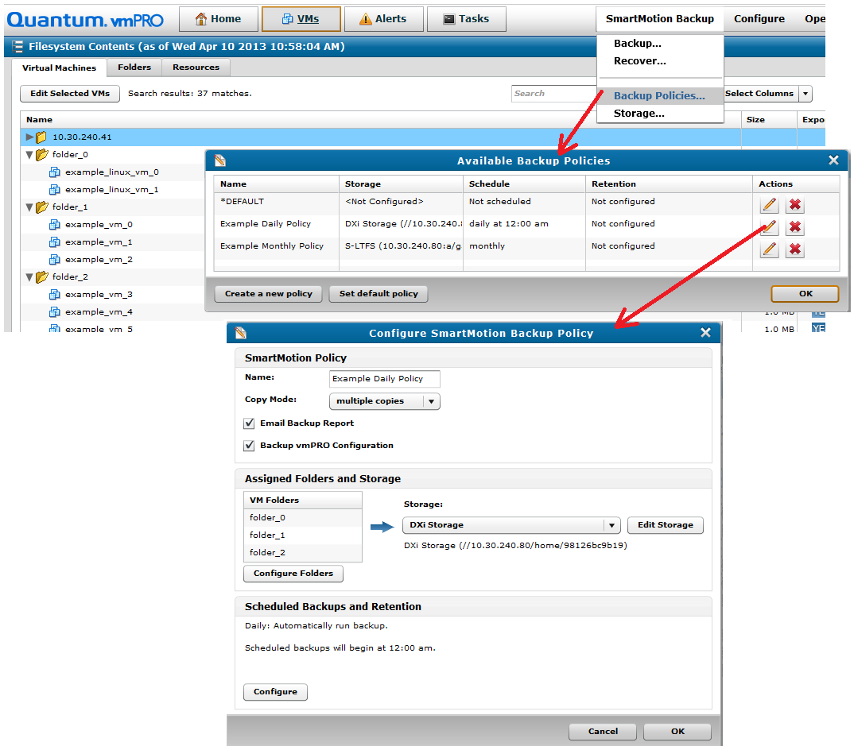
Extended Scheduling and Retention

Slide 18
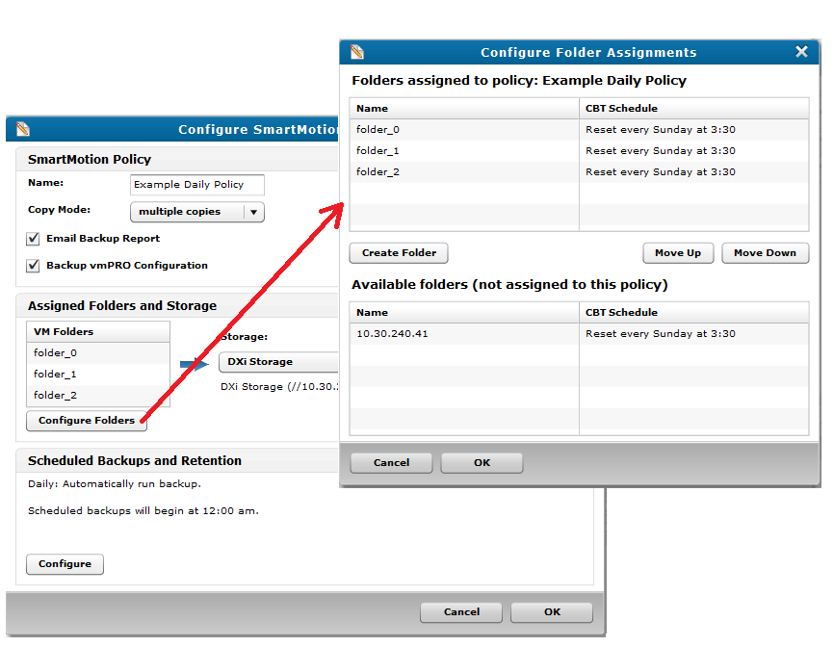
Extended Scheduling and Retention
Folder Assignment

Slide 19
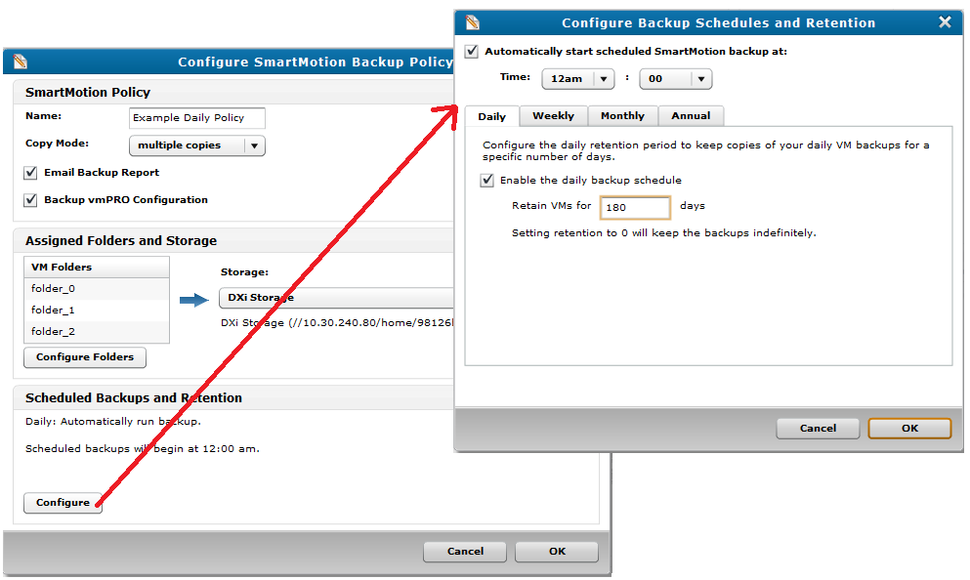
Extended Scheduling and Retention
Daily Schedule

Slide 20
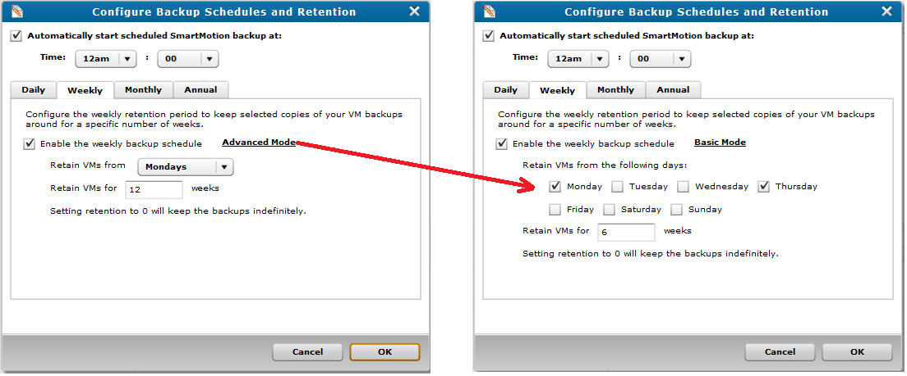
Extended Scheduling and Retention
Weekly Schedule

Slide 21
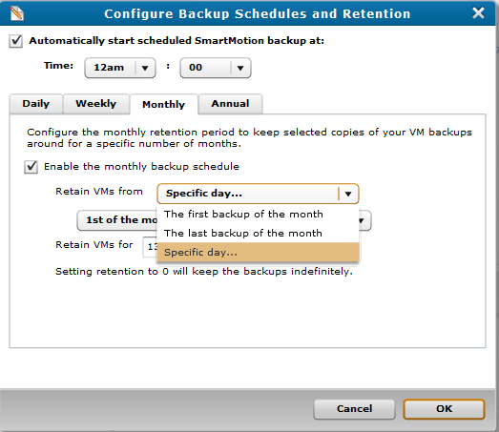
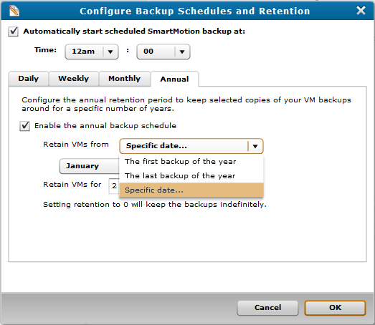
Extended Scheduling and Retention
Monthly
Annual

Slide 22
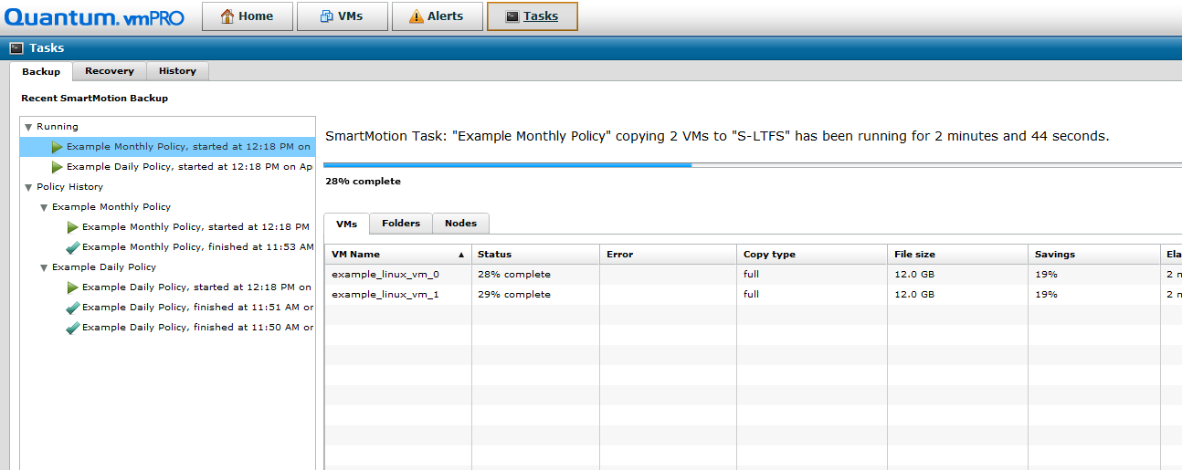
Concurrent Backup & Improved Status
Policy Tree View
Progress bar
Merged node status
Direct view of VMs
Savings %
File size

Slide 23
Compared to Previous Release
New
Version
Previous
Version

Slide 24
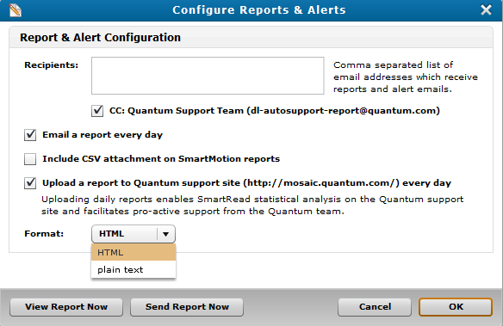
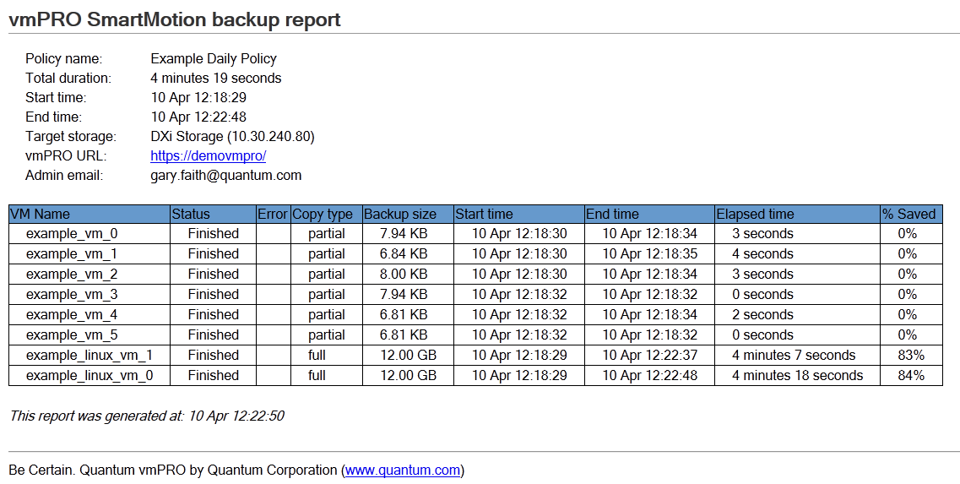
SmartMotion Report – CSV & HTML

Slide 25
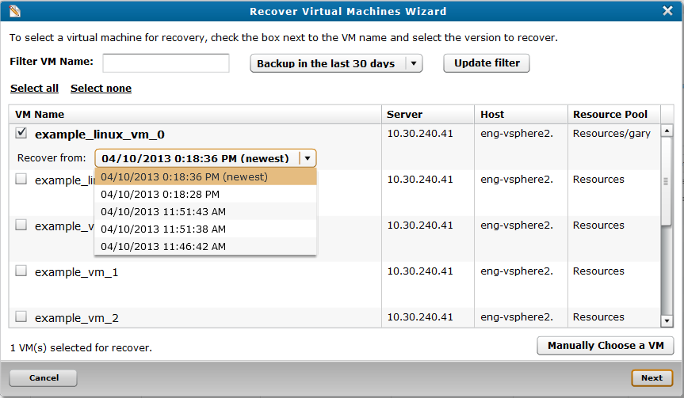
Enhanced Recovery Selection

Slide 26
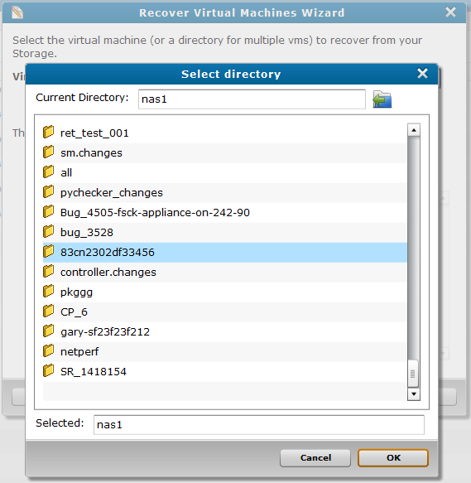
Compared to Previous Release
New
Version
Previous Version & from “Manually” button

Slide 27
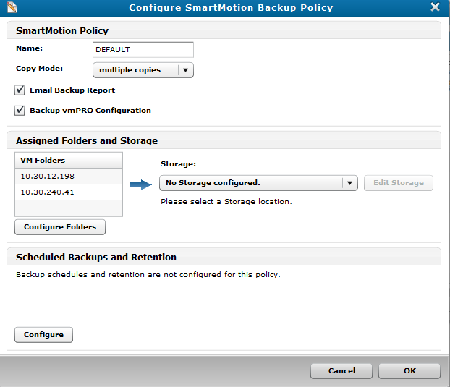
SmartMotion – Appliance DR
Backs up the appliance’s own configuration
Named db-package.tar.bz2.enc
Written to target storage, at base on that policy's backup
Runs at the end of the Policy

Slide 28
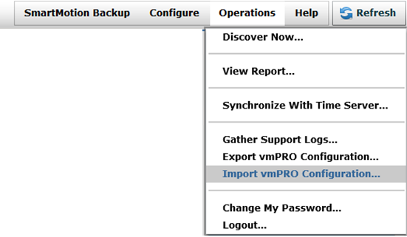
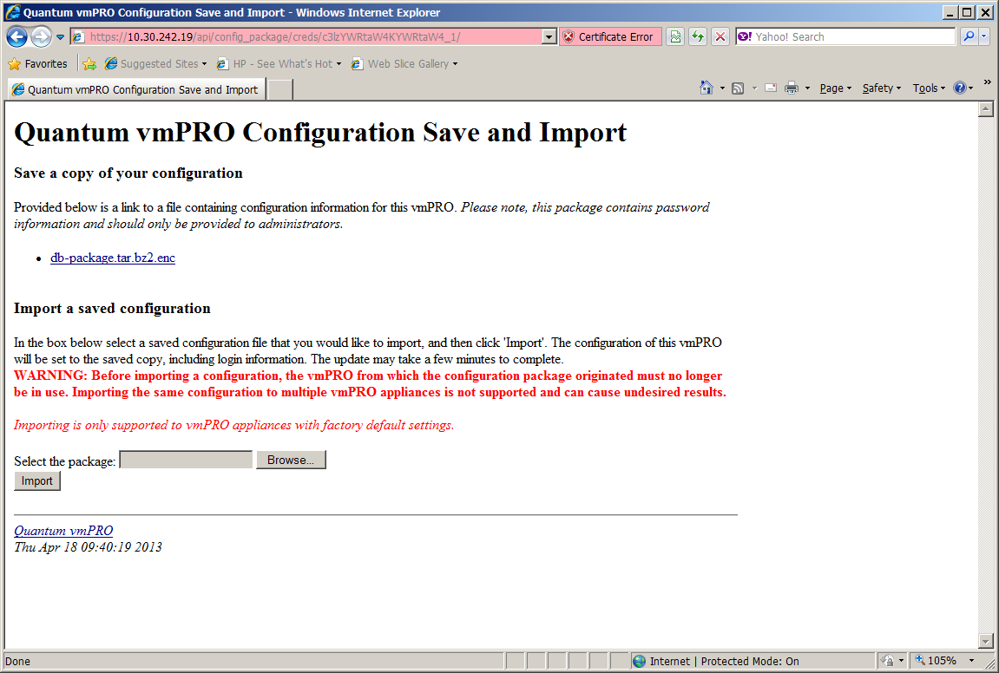
SmartMotion – Appliance DR
In order to use the backed up configuration
Mount target storage on another host where the vmPRO UI is running
From vmPRO UI, select Operations > Import vmPRO Configuration…
Use Browse button to locate appropriate db-package.tar.bz2.enc
For example: ..\10.20.12.13\2013-04\2013-04-18-092309

Slide 29
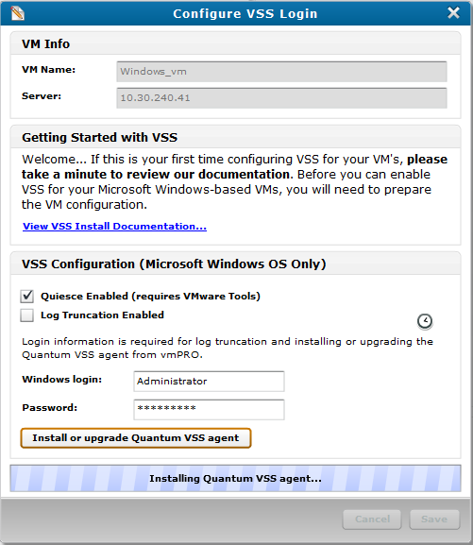
Application Support via MS Windows VSS
Added Support of
Windows Server 2012
SQL Server 2012
Exchange 2013
Install VSS Agent from vmPRO UI

Slide 30
vmPRO 3.1 Features
SmartMotion Enhancements
Application Support via MS Windows VSS
Scalar LTFS
Performance Improvements
Sparse Write to CIFS, NFS Async, HotAdd, Skip Pagefiles, Smartcp
Filesystem Integrity Check
Subscription-based Licensing
Password Reset Feature
OS, Samba, PostgreSQL Changes
Software update via vmPRO UI and Vision product

Slide 31
Scalar LTFS Support
Made changes to accommodate device behavior
Share the same mount across policies
Increased timeouts to deal with longer mounts
Allow CIFS mount without user and password
Bug 5094: Character limitations of Scalar LTFS that can result in SmartMotion error: No such file or directory.
Workaround: When using Scalar LTFS for storage, do not use a colon (“:”) in any file names.

Slide 32
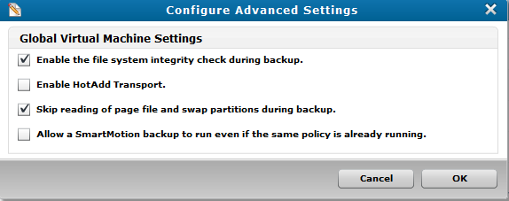
Performance Improvements
Sparse Writing to DXi CIFS Shares
NFS Asynchronous Support
HotAdd Transport
Skip pagefile.sys and swap partition
New datamover, smartcp

Slide 33
HotAdd Transport Support
Offloads ESX Server and Network
Standard NBD (Network Block Device) uses network
HotAdd attaches another VM’s disk to the appliance
Not always faster
Only applies to a shared storage config
Falls back to NBD Transport, if not applicable
Disabled by default; enable in Advanced Settings
See datastore_fs log if actually used:
“Obtained (and using) Transport Mode: hotadd”
Cross ESX Server requires them to be managed by same vCenter

Slide 34
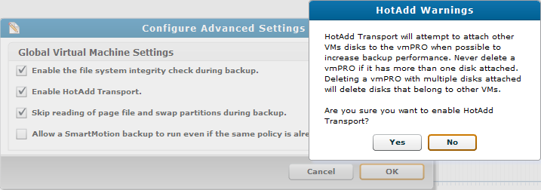
HotAdd Transport Support
Warning: HotAdd devices left attached to appliance, can be deleted by mistake by user.
Can happen if appliance goes down during backup and its VM is removed before restarting.
This is a VMware limitation
User receives warning when enabling feature

Slide 35
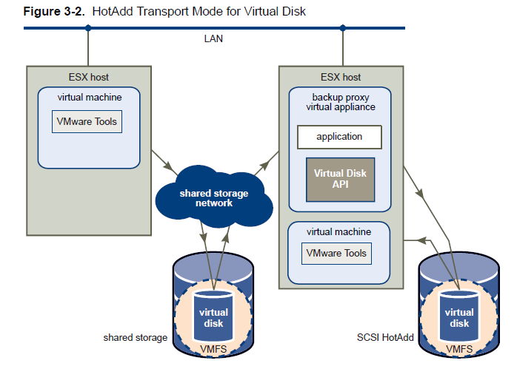
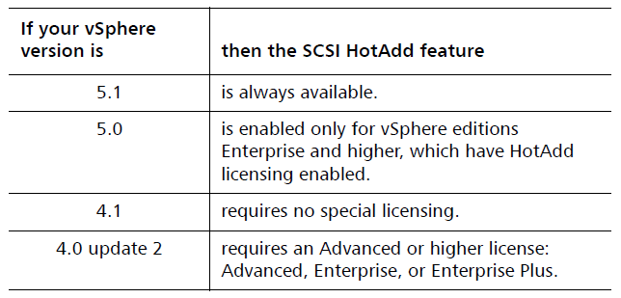
HotAdd Transport Support
vmPRO Appliance
VM on another host to backup
VM on same host to backup
Licensing for VMware HotAdd Feature
Figure 3-2 from “Virtual Disk Programming Guide, V5.1” from VMware.

Slide 36
Live Block Aware Data Mover (smartcp)
New feature shown in blue
Skips reading zero extents of disk file from /export
Provides progress info
Datastore on ESX Server
/export on
appliance
live block
read from datastore
zero filled
Old ‘cp’ reads entire file from /export
DXi
Skipped by SmartRead
live block
read from
datastore
zero filled
New ‘smartcp’ reads only live blocks
read
Old and new methods do sparse writes to target storage
. . .
. . .

Slide 37
Performance Test Results
Performance and Regression testing complete
Regression tests exceed requirements (3.1 vs 3.0, in green below)
6 Streams over 3 vmPRO Instances in Group Mode
 |  |  | PRD0345 PRD0365 |  |  |  | PRD0300 | PRD0305
 |  |  | PRD Requirement | vmPro 3.1 NBD Regression | vmPro 3.1 vs vmPro 3.0 |  | vmPro 3.1 HotAdd Baseline | vmPro 3.1 CBT Baseline (10% change)
 |  |  | (MB/sec) | (MB/sec) | % Diff |  | (MB/sec) | (MB/sec)
Small Reference | 1Gb Eth | CIFS | 72 | 218 | 203% |  | 219 | 1757
 |  | NFS-Sync | 196 | 235 | 20% |  | 233 | 1850
 |  | NFS-Async | NA | 234 | NA |  | 210 | NA
 | 10Gb Eth | CIFS | 184 | 493 | 168% |  | 491 | 2716
 |  | NFS-Sync | 263 | 463 | 76% |  | 414 | 3062
 |  | NFS-Async | NA | 462 | NA |  | 446 | NA
Large Reference | 1Gb Eth | CIFS | 92 | 215 | 134% |  | 211 | 1716
 |  | NFS-Sync | 175 | 223 | 27% |  | 220 | 1831
 |  | NFS-Async | NA | 232 | NA |  | 229 | NA
 | 10Gb Eth | CIFS | 259 | 422 | 63% |  | 409 | 2675
 |  | NFS-Sync | 329 | 450 | 37% |  | 391 | 3051
 |  | NFS-Async | NA | 553 | NA |  | 496 | NA
 |  |  | All measurements in effective rate

Slide 38
Filesystem Integrity Check
Ensures that backed up filesystems are consistent
Occurs when disk file is opened, at start of backup
Supports same filesystem types as SmartRead
FAT, FAT32, NTFS, EXT2, 3, 4
Mounts each partition of the virtual disk
Runs “fsck” on supported partitions
Posts alert for filesystems that are not correctable
Does not change backed up data

Slide 39
Subscription-based Licensing
Previous license types continue
vmPRO 4000, Socket, Capacity
Vision Reporting of Capacity Used and Expiration
License Type Reporting in GUI and CLI
Support Site View:

Slide 40
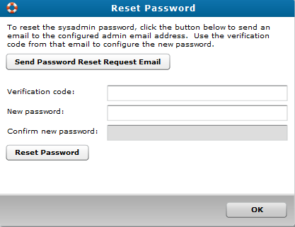
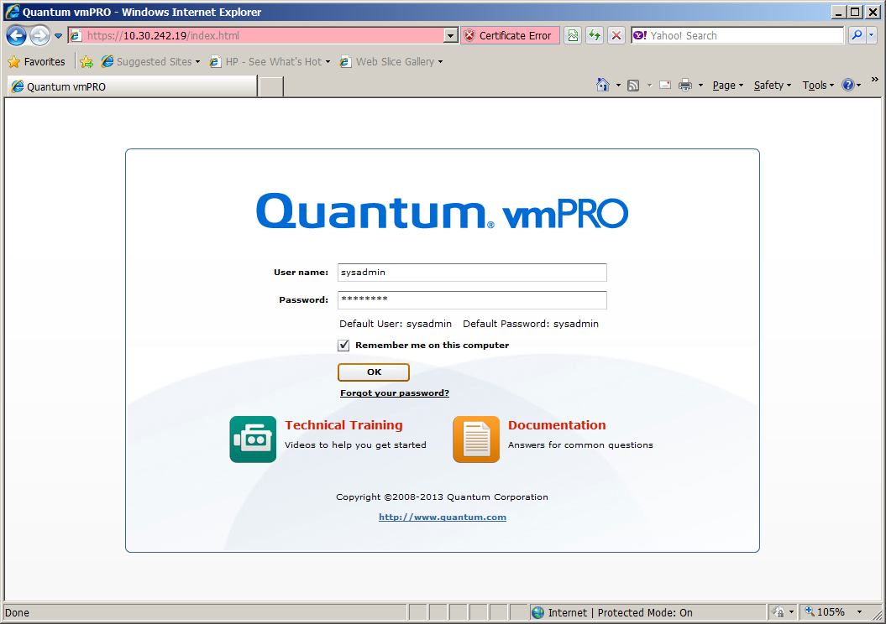
Password Reset Feature
Emails verification code to admin user
User needs to have been entered in “From Address” of Config Email dialog
Verification code expires when password is changed or wrong code is entered.

Slide 41
OS, Samba, PostgreSQL Changes
Updated from CentOS 6.2 to 6.3
New installs will already be at this version
Upgrade process from pre-3.1 will include OS RPMs, in addition to vmPRO RPMs
Updated Samba RPMs to 3.6.9
Addressed Security Scan issues
Used shared code with Dxi 2.3
Added netperf RPM, to facilitate tests with DXi
Converted internal DB from MySQL to PostgreSQL
New installs will have the new DB
Updated appliances will be converted
Should follow best practice of exporting configuration first
Could use snapshot of appliance as temp backup before update

Slide 42
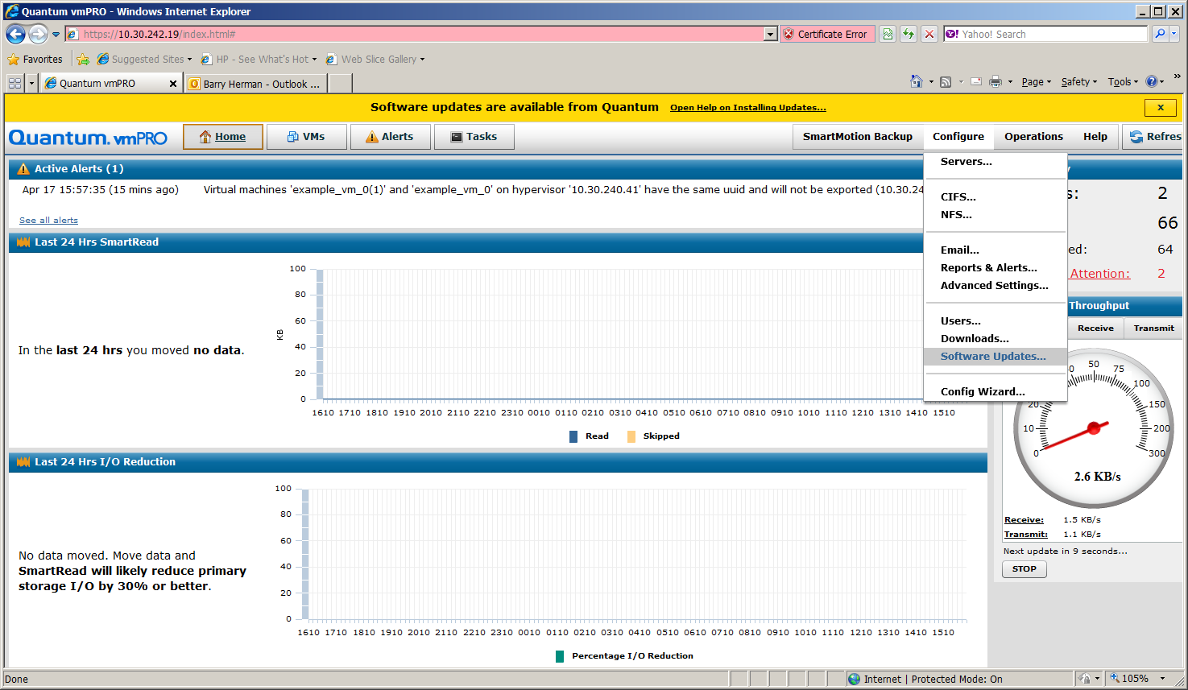
Upgrade from 3.0.x Appliance
Existing 3.0.x appliances will display “Software updates…” message
Next
Slide

Slide 43
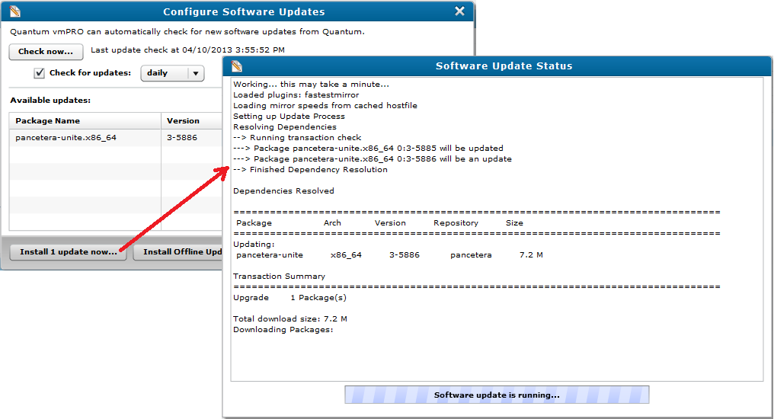
Software Update via vmPRO UI

Slide 44
Bug Fixes/Known Issues
Presented By: Barry Herman

Slide 45
Bug Fixes and Enhancements in 3.1
351 Bug fixes and 151 Enhancments
16 Direct Customer bugs and Enhancements addressed:
2528 maj Customer Rex, Riverbed: Need to show VM size in GB in main grid
4518 nor Customer UOP, SR #1447640 - vmPro licensing window in GUI showing incorrect email address and expired licenses
4629 maj Customer Quantum IT, SR 1492150: Add option to prevent starting a new SmartMotion policy on long running policy
4895 nor Customer Southeast Alabama Medical Center: files_fs core dump in json-c library
81 enh Customer B-Hive, Clemson: MR0440: need ability to start upgrade from GUI
1440 enh Customer Becton Dickinson: NFSv4 support for export directory mount required
2003 enh Customer IBM, IMS Health, Drobo: problem in performance stats reporting
2052 enh Customer Rex Healthcare: Rename 'pancetera-upgrade' to 'upgrade'
2617 enh Customer Clemson: Run software upgrade from console UI and GUI
2828 enh Customer LAHD: Request no scrubbing of SmartMotion log events for at least one month (independent of 1000 events)
2852 enh Customer Pancetera: Upgrade bogus failure when sysadmin is not root
2880 enh MR0320: Customer UOP: Wants SmartRead 2.5, skip reading pagefile.sys and swap partitions
2897 enh Customer Clemson: Controller slow to come up, but console looks ready
4003 enh MR0360: Customer UMassDartmouth, SR #1412998: Needs ASYNC NFS support with DXi for SmartMotion
4519 enh Customer Quantum IT: MR0450 generalize retention policy to support legal compliance requirements
4978 enh Customer SouthEast Alabama, SR #1502532: Enhance SmartMotion email report

Slide 46
Known Issues
HotAdd Transport
Deleting vmPRO VM will delete disks that were attached to VM by hotadd
vmPRO appliance unable to boot after a VM that was backed up with hotadd is deleted, when hotadd disks are still attached to appliance
VMware limitation
SmartMotion
The pass/fail summary in the new backup report is missing
Watch for overloaded configs, especially with overlapping backup policies
Symptoms such as high CPU, slower backups, and timeouts
After license expires and a new one is added, appliance needs to be rebooted

Slide 47
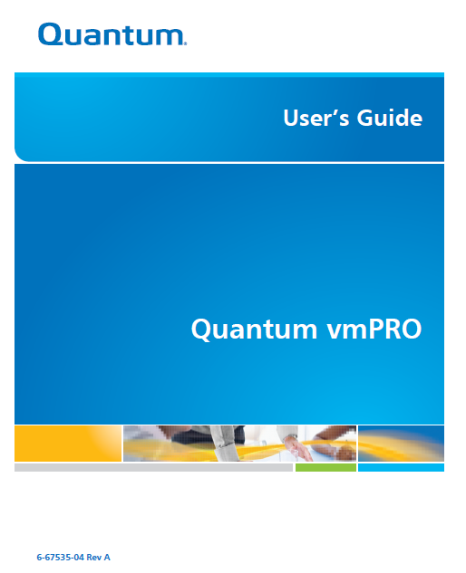
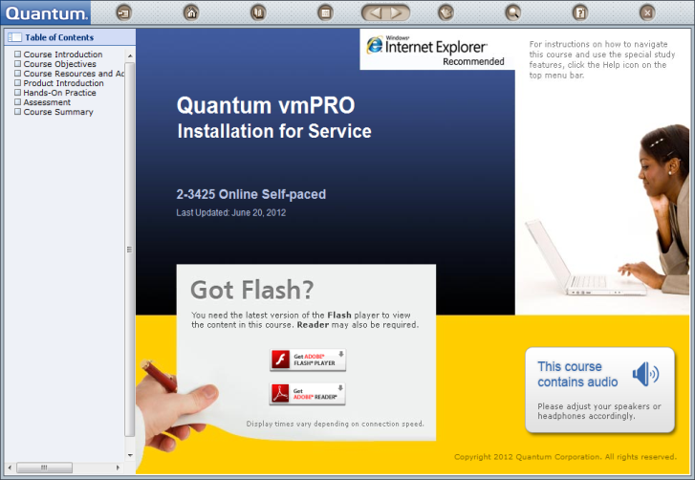
Documentation and Training Update
Presented By: Mike Pavalus/Jim Bell

Slide 48
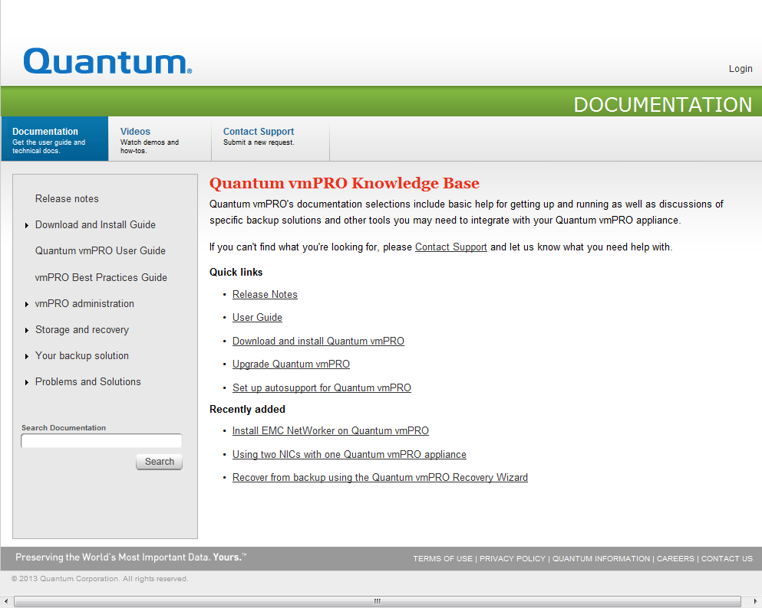
Documentation
User’s Guide – 6-67535-04
Release Notes – 6-67534-07
Open Source Licenses (if necessary)
Online Installation Guides
Internet access and non-Internet access
Mosaic Web Site (Knowledge Base Articles)
ForumV

Slide 49
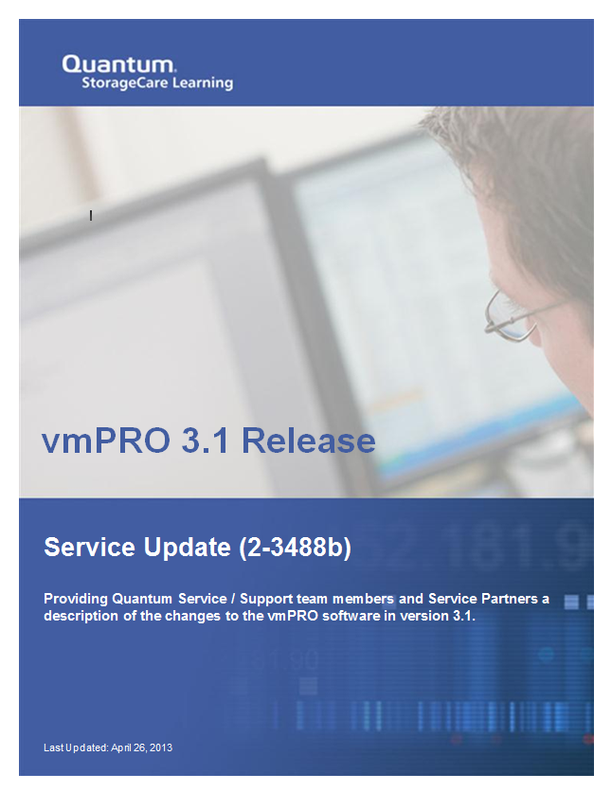
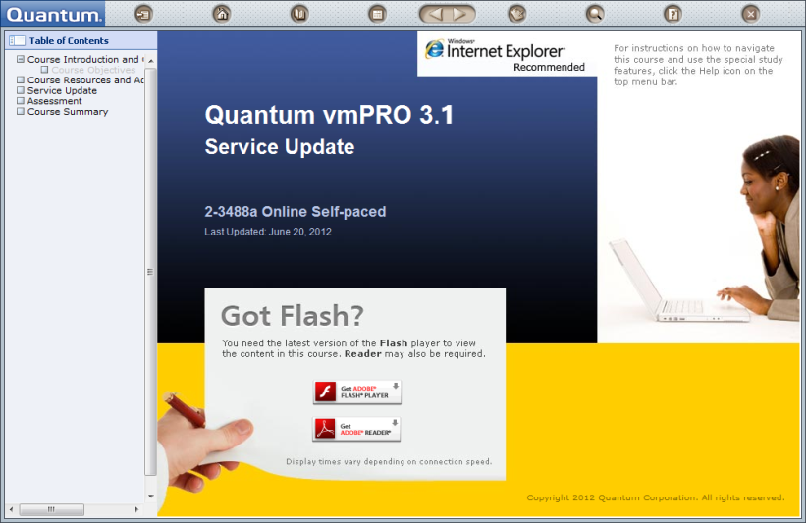
New Training
For vmPRO 3.1, the following course is new
Quantum vmPRO 3.1 Service Update (2-3488b Online Self-Paced)

Slide 50
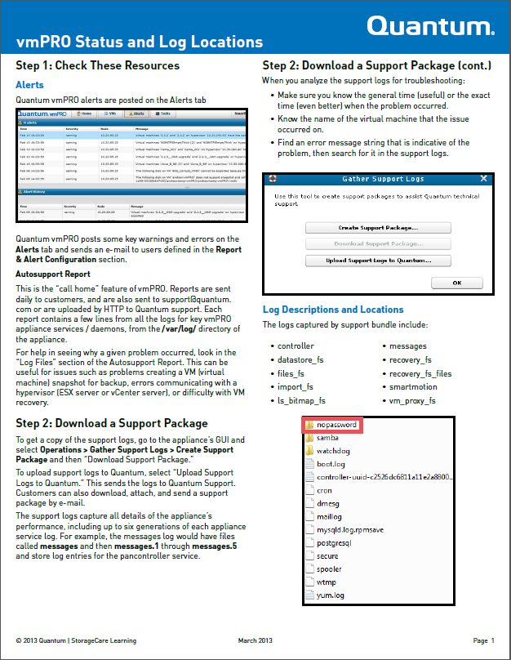
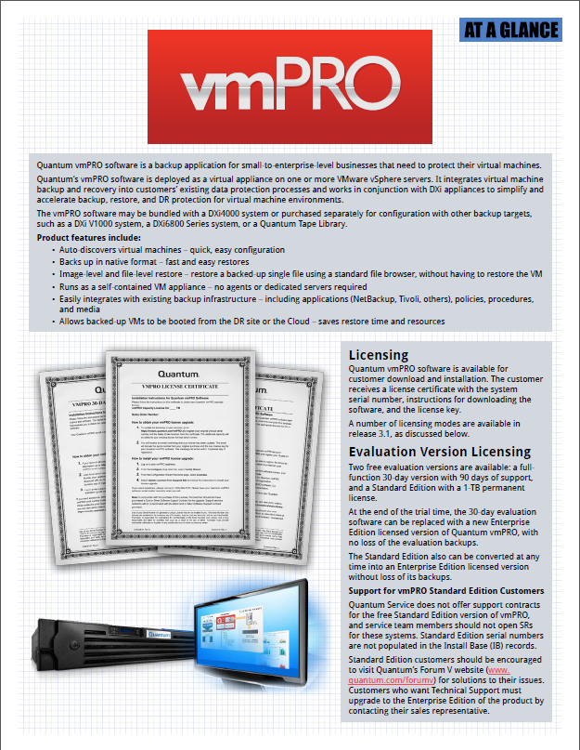
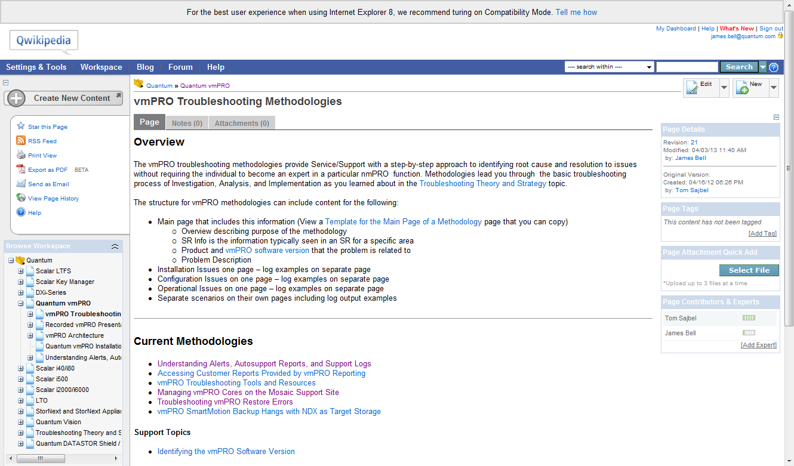
Updated Training
For vmPRO 3.1, the following courses and materials are updated
Quantum vmPRO Installation (2-3425 Online Self-Paced)
Quantum vmPRO At a Glance Job Aid
Quantum vmPRO Status and Log Locations Job Aid
Qwikipedia troubleshooting topics

Slide 51
Service Strategy Update
Presented By: Jim Hibbard

Slide 52
Service Strategy
No change to current vmPRO Service Model
Service Model Summary
Case Management: Global Call Handling (GCH), CDS
Technical Support: Advanced Solutions Product Support (ASPS)
Field Support: No SW Field Support.
Escalation Support: Service Engineering Specialists (SES), Data Virtualization (DV), Regional Technical Specialists (RTS)
Licensing Troubleshooting
Licenses created on mosaic.quantum.com
Licenses associated with customer account and SN
GCH can look-up, modify, or re-issue licenses if required

Slide 53
Q&A

