Slide 1
LTO Advanced Path Failover
Intro to HP-UX and Linux Drivers
Curtis Ballard / July, 2013

Slide 2
Linux Driver Interface

Slide 3
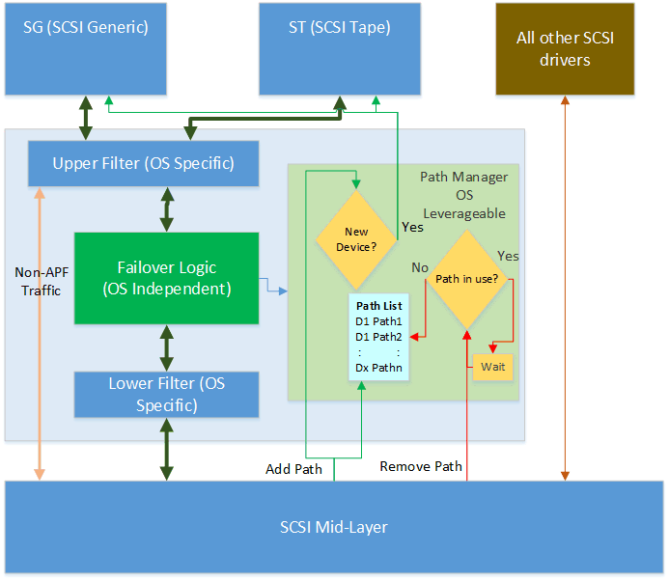
Linux Driver Architecture

Slide 4
Linux Driver: Definitions
active_drive = A path to an auto-changer via an APFO active drive.
down = The driver is aware of this path, but if the driver attempted to use this path now, it would fail.
last = The path that the driver was most recently able to successfully perform a SCSI command on. This is probably the path that will be used next. There are no /dev files open to this device.
open = The path that the driver was most recently able to successfully perform a SCSI command on. This is probably the path that will be used next. There is at least one /dev file open to this device.
prefer = The driver will attempt to send the next command on this path after the next device file open() call. This path will be override last.
session_key = The identifier number of the open session, in hexadecimal.
wwnn = World-wide node name of the device

Slide 5
Linux Driver: User Interface Overview
Built into the driver – no special tools
Uses standard Linux mechanisms for reporting
Information is available in the ‘/sys’ directory
Similar to the more familiar ‘/proc’ but for system information
APFO driver uses the ‘pfo’ class
APFO devices are numbered within the pfo class
/sys/class/pfo/pfo# contains all information about the driver and devices

Slide 6
Linux Driver: Status Reporting Example
# cat /sys/class/pfo/pfo5/paths
sg=/dev/sg5 st=/dev/st1 wwnn=50014382c6c2f007 type=tape session_key=99e90717
9:0:1:0 up open -
9:0:2:0 up - -
8:0:1:0 up - -
8:0:2:0 up - -
In this example – pfo device number 5 is a tape drive
First line – device information
SG path, ST path, WWNN, device type, and the failover session key (if one exists)
Following lines list available paths with status information
In this example hardware path 9:0:1:0 is the currently selected path to try first for future commands and an application has opened the device

Slide 7
Linux Driver: Status Reporting Example
# cat /sys/class/pfo/pfo4/paths
sg=/dev/sg4 st=none wwnn=50014382c6c2f800 type=changer
9:0:0:1 up last - active_drive
9:0:1:1 up - - -
9:0:2:1 down - - -
9:0:3:1 up - - active_drive
8:0:0:1 up - - active_drive
8:0:1:1 up - - -
8:0:2:1 up - - -
8:0:3:1 up - - active_drive
In this example – pfo device number 5 is a medium changer
First line – device information
SG path, ST path <none>, WWNN, device type, and the failover session key (if one exists)
Following lines list available paths with status information
In this example hardware path 9:0:0:1 is ‘last used’ path and will be the first one tried for future commands but no application has opened the device

Slide 8
Linux Driver: Control
Control is similar to reporting commands are sent to: /sys/class/pfo/pfo#/ctrl
Can select a ‘preferred’ path
# echo prefer=8:0:3:0 > /sys/class/pfo/pfo3/ctrl
# cat /sys/class/pfo/pfo3/paths
sg=/dev/sg3 st=/dev/st0 wwnn=50014382c6c2f001 type=tape
9:0:0:0 up last -
9:0:3:0 up - -
8:0:0:0 up - -
8:0:3:0 up - prefer
Same status report as previous example
Hardware path 9:0:0:0 is still the ‘last used’ path
Hardware path 8:0:3:0 is no the ‘preferred’ path and will be tried first for future commands

Slide 9
Linux Driver: Control, cont
Preference can be cleared by setting an empty preference
# echo prefer= > /sys/class/pfo/pfo3/ctrl
# cat /sys/class/pfo/pfo3/paths
sg=/dev/sg3 st=/dev/st0 wwnn=50014382c6c2f001 type=tape
9:0:0:0 up last -
9:0:3:0 up - -
8:0:0:0 up - -
8:0:3:0 up - -
Hardware path 9:0:0:0 is still the ‘last used’ path
Hardware path 8:0:3:0 is no longer the ‘preferred’ path
Further control commands are still TBD

Slide 10
HP-UX Driver

Slide 11
HP-UX Driver Overview
Not a separate installation -- No special download
Initially distributed in a ‘Hardware Enablement Pack’
Built into the standard HP-UX distribution after that
Three different drivers
estape: The enhanced (multipath) SCSI tape driver
schgr: The SCSI changer driver
spt: The SCSI pass-through driver
Each driver has the failover functionality built in
Detects whether device has APF enabled at discover
If APF enabled – automatically use APF
If APF not enabled – use legacy mode

Slide 12
HP-UX Driver: Status Reporting
HP-UX drivers already support multiple path resolution and path selection
Tools for reporting are built into HP-UX today, extensions may be created
Most functionality in the ‘scsimgr’ tool
Lots of functionality
Full documentation available with ‘man scsimgr’
Available online: http://bizsupport2.austin.hp.com/bc/docs/support/SupportManual/c01914672/c01914672.pdf
NAME
scsimgr - SCSI management and diagnostic utility
SYNOPSIS
/usr/sbin/scsimgr [-fpv] command [-d driver] [identifier] [keyword]... [argument]...
/usr/sbin/scsimgr [-h] [-d driver] [command]

Slide 13
scsimgr operations
Activate standby or active non-optimized LUN paths for asymmetric devices.
Display and clear global statistics or statistics for SCSI objects.
Clear kernel metric data for SCSI objects.
Display status and other information for SCSI objects.
Display information for all the LUN paths to a LUN.
Get, set and save attributes for SCSI objects.
Add, remove and list settable attribute scopes for drivers
Validate the change of LUN associated to a LUN path (replace WWID).
Validate the change of LUN associated to a legacy DSF (replace a legacy DSF).
Disable or enable SCSI objects.
Perform SCSI task management functions such as LUN reset, cold target reset, warm target reset.
Set or get the user friendly character string identifying a LUN (helpful when the LUN is relocated).
Synchronize cache for block devices.
Erase blocks of optical memory devices.
Inquire SCSI devices for its characteristics.

Slide 14
HP-UX scsimgr useful examples for APF
List hardware paths to the devices:
# /usr/sbin/scsimgr lun_map -D /dev/rchgr/autoch11
LUN PATH INFORMATION FOR LUN : /dev/rchgr/autoch11
Total number of LUN paths = 2
World Wide Identifier(WWID) = 0x50014380023567f0
LUN path : lunpath102
Class = lunpath
Instance = 102
Hardware path = 0/4/0/0/0/0.0x50014380023560ce.0x1000000000000
SCSI transport protocol = fibre_channel
State = UNOPEN
Last Open or Close state = ACTIVE
LUN path : lunpath174
Class = lunpath
Instance = 174
Hardware path = 0/4/0/0/0/0.0x50014380023560d4.0x1000000000000
SCSI transport protocol = fibre_channel
State = UNOPEN
Last Open or Close state = ACTIVE

Slide 15
HP-UX scsimgr useful examples for APF
Show if a device is locked to a single path:
# /usr/sbin/scsimgr get_attr -a lpt_to_lockdown -a lpt_lockdown -D /dev/rchg>
SCSI ATTRIBUTES FOR LUN : /dev/rchgr/autoch11
name = lpt_to_lockdown
current =
default =
saved =
name = lpt_lockdown
current = 0/4/0/0/0/0.0x50014380023560ce.0x1000000000000
default =
saved =

Slide 16
Ioscan – also supports multipath devices
ioscan example to list all hardware paths to devices
# ioscan -kfNClunpath
Class I H/W Path Driver S/W State H/W Type Description
==================================================================
lunpath 1 0/2/0/0/0/0.0x0.0x4000000000000000 eslpt CLAIMED LUN_PATH LUN path for disk2
lunpath 2 0/2/0/0/0/0.0x0.0x4000000000000001 eslpt CLAIMED LUN_PATH LUN path for disk3
lunpath 36 0/4/0/0/0/0.0x50014380023560ce.0x0 eslpt CLAIMED LUN_PATH LUN path for tape337
lunpath 102 0/4/0/0/0/0.0x50014380023560ce.0x1000000000000 eslpt CLAIMED LUN_PATH LUN path for autoch11
lunpath 40 0/4/0/0/0/0.0x50014380023560d4.0x0 eslpt CLAIMED LUN_PATH LUN path for tape341
lunpath 174 0/4/0/0/0/0.0x50014380023560d4.0x1000000000000 eslpt CLAIMED LUN_PATH LUN path for autoch11

Slide 17
ioscan – example 2
Using ioscan to show mapping from hardware paths to ‘cooked’ paths
# ioscan -m hwpath
Lun H/W Path Lunpath H/W Path Legacy H/W Path
====================================================================
64000/0xfa00/0x1
0/2/0/0/0/0.0x0.0x4000000000000000
64000/0xfa00/0x2
0/2/0/0/0/0.0x0.0x4000000000000001
64000/0xfa00/0x1e4
0/4/0/0/0/0.0x50014380023560ce.0x0
64000/0xfa00/0x1e9
0/4/0/0/0/0.0x50014380023560d4.0x0
64000/0xfa00/0x232
0/4/0/0/0/0.0x50014380023560ce.0x1000000000000
0/4/0/0/0/0.0x50014380023560d4.0x1000000000000

