Slide 1
Advanced Path Failover Training
22 July 2013

Slide 2
NEW dial-in information
1-866-692-4541
Participant code: 8586201

Slide 3
Overview
Goals
Windows driver architecture
Demonstrations
Utilities
Documentation review

Slide 4
Overview
Goals
Windows driver architecture
Demonstrations
Utilities
Documentation review

Slide 5
Goals
Hide SAN or device failures from applications
Primum non nocere
(First, do no harm – failure conditions must be no worse than without APFO)
Can’t fix an unstable system

Slide 6
Overview
Goals
Windows driver architecture
Demonstrations
Utilities
Documentation review

Slide 7
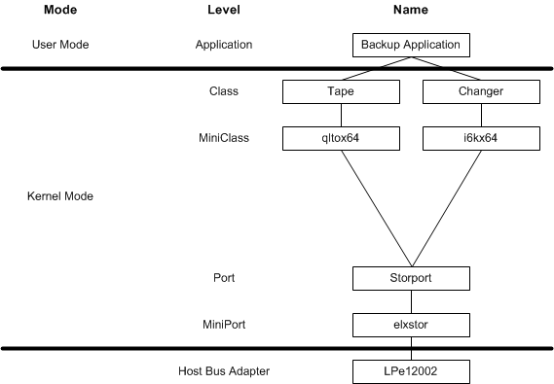
This is your stack

Slide 8
Windows driver architecture
Windows APFO driver consists of one filter driver and one intermediate class driver
Fit below miniclass drivers (tape and changer) and above port driver

Slide 9
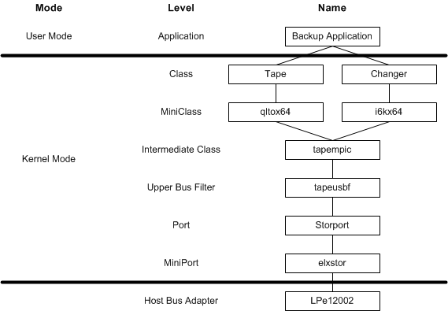
This is your stack on APFO

Slide 10
tapeusbf filter driver
Attaches to all storage port drivers
During discovery recognizes devices which may have APFO capability
Presents a FFDO and FPDO for each path to each device
FFDO and FPDO identifiers are recognized by tapempic
Notes:
2^{nd & 3rd} bullet items are modified from what was shown in the presentation

Slide 11
tapempic intermediate class driver
Attaches to devices presented by tapeusbf
Presents a FDO and PDO for each enabled device to the tape and media changer miniclass drivers above
Performs the APFO functionality:
Manages failover sequence counters (FSCs)
Manages failover session keys
Passes commands to devices, modified as required
Changes path when a failure occurs

Slide 12
Device objects
Windows manages devices using …
Physical Device Objects (PDO)
Functional Device Objects (FDO)
Filter drivers add FPDOs and FFDOs
tapempic selects active path
Notes:
CDO provides an API for the diagnostic application

Slide 13
Overview
Goals
Windows driver architecture
Demonstrations
Utilities
Documentation review

Slide 14
Demonstrations
Configure library
Install drivers on host
Fail switch port to trigger failover
Fail drive to trigger failover
Utilities

Slide 15
Configuration guidelines
Configure APFO in library first
Install APFO drivers in hosts second
When updating from pre-release to release drivers, manually uninstall pre-release drivers first.
Cannot mix basic and advanced failover within a partition
Notes:
If enable library then boot host w/o drivers, half of the changers will not load a changer miniclass driver. Caused by reservation conflict in passive control path drives. Exclamation points in device manager display. Solution is to install APFO drivers and reboot.

Slide 16
Library configuration
Enable storage networking (SNW) license
Set up partitions
Select control path drives
Select data path drives
Verify host access
See User’s Guide

Slide 17
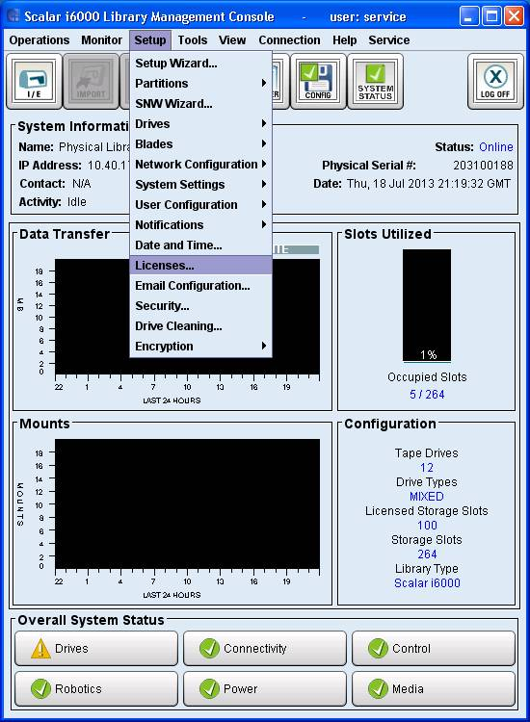
SNW license

Slide 18
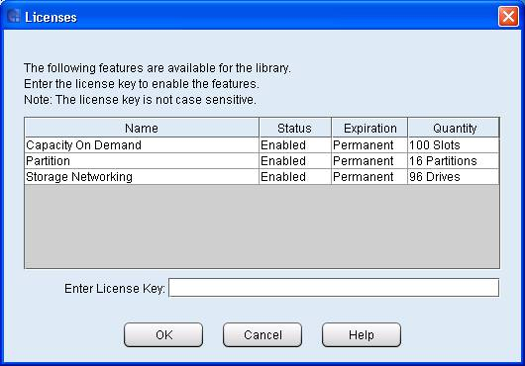
Licenses

Slide 19
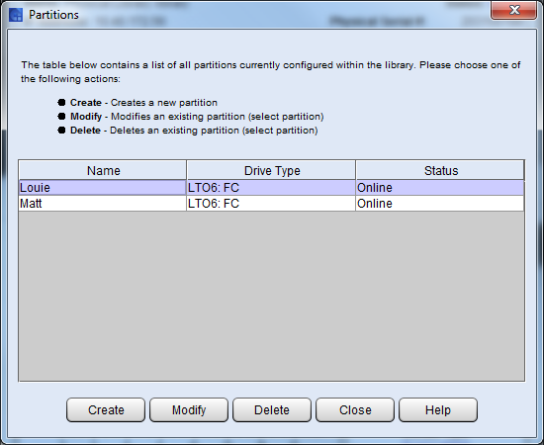
Partitions – configure
Setup >> Partitions >> Configure

Slide 20
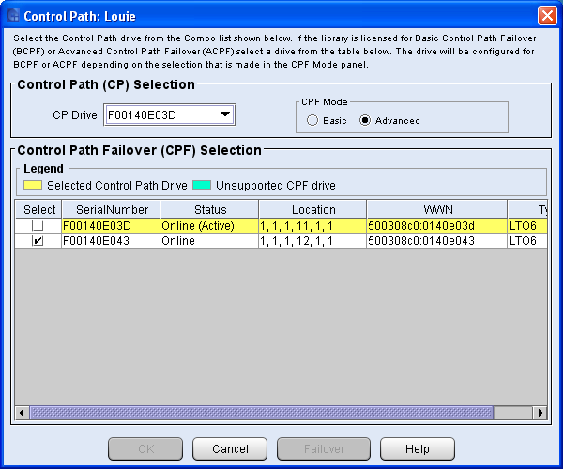
Configure control path
Setup >> Partition >> Control Path
Select CP Drive
Select CFP Mode: Advanced
Select Passive CP Drive
Notes:
Enable both drive ports in Security Manager.
Yellow is active CP drive

Slide 21
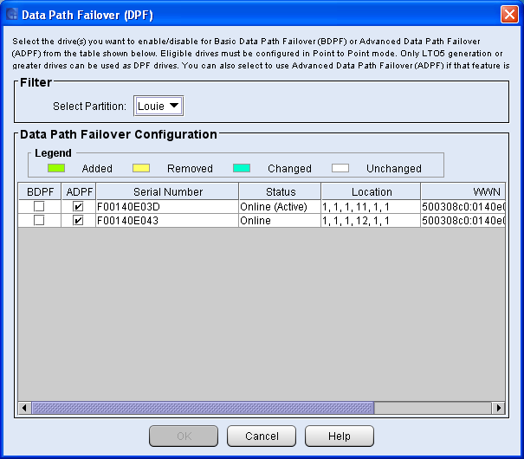
Configure data paths
Setup >> Drives >> Data Path Failover
Select Partition
Select Drives and enable ADPF
Notes:
Enable both drive ports in Security Manager.

Slide 22
Configure host access
Setup >> Drives >> Access >> SNW Wizard
Host Access
Host Access Group configuration
Host Access Configuration
All drives in a partition must use either basic or advanced failover; no mixing.
Notes:
Enable both drive ports in Security Manager.

Slide 23
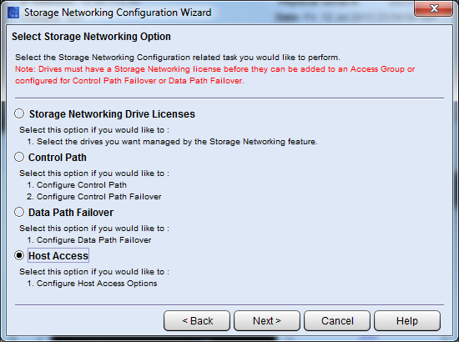
SNW Wizard – host access

Slide 24
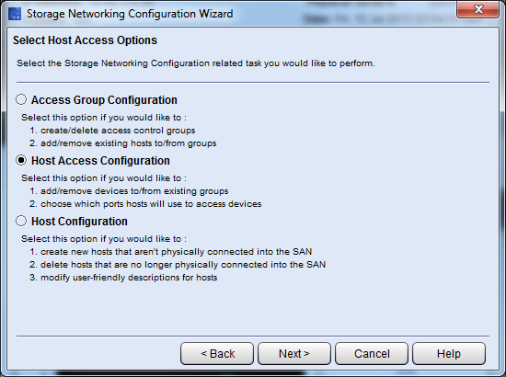
SNW Wizard – host access options

Slide 25
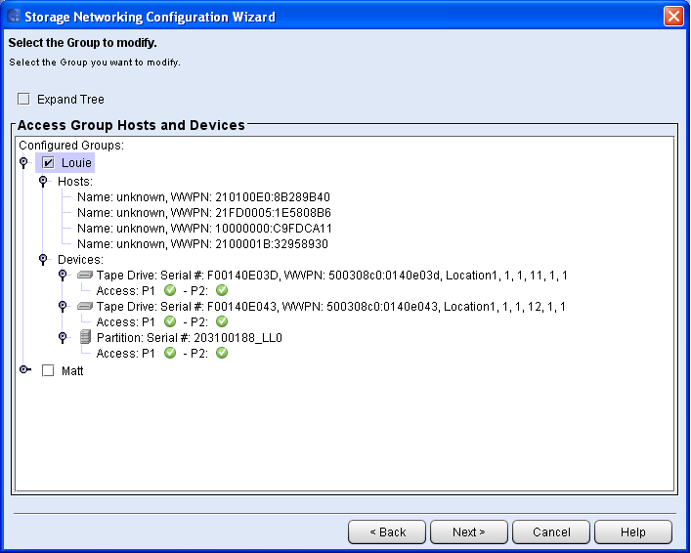
SNW Wizard – groups
Notes:
Security Manager

Slide 26
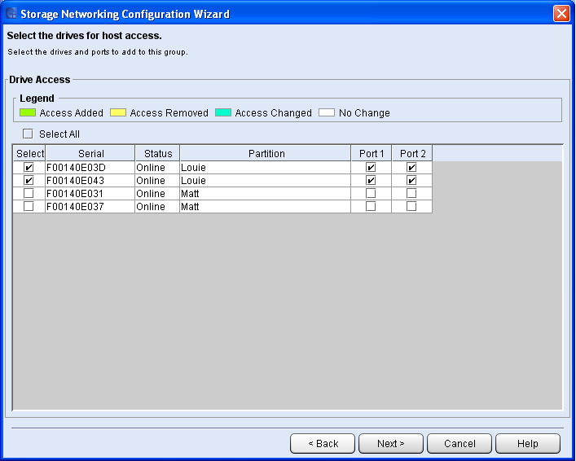
SNW Wizard – drive access
Notes:
Selected ports will be available to all hosts selected at this point.

Slide 27
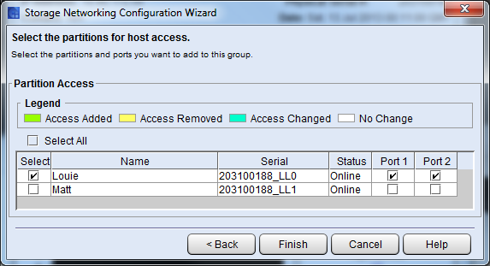
SNW Wizard – host access

Slide 28
Driver installation
Limited distribution; not on Quantum web site
Pre-release drivers must be uninstalled manually before upgrading to newer drivers
Single installer application for both drivers
Windows 2012 Server
advfo2K12.exe
Windows 2008 Server x64 and 2008 R2 Server
advfox64.exe
32-bit (x86) Windows 2008 is not supported
C:\Program Files\Quantum\Failover\
Driver signatures
Released drivers will be signed by Microsoft
Using a test signed driver requires putting Windows in test mode
Notes:
Quantum presentation only
Win 2012 x64 only, hence name
Put in test mode first, else attempt to boot will enter recovery mode
“bcdedit testsigning on” and reboot

Slide 29
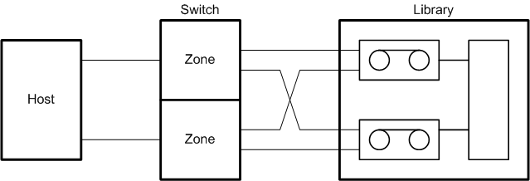
System topology
One server with two HBAs
One switch with two zones
One library with a partition containing two drives
Each drive has two ports and is configured for bridging
Each drive contains an SSC and an SMC device server
Notes:
This will help explain the Device Manager view which will have sixteen instances of “AdvFO Tape Multi-Path Intermediate Class Driver SCSI FDO.”

Slide 30
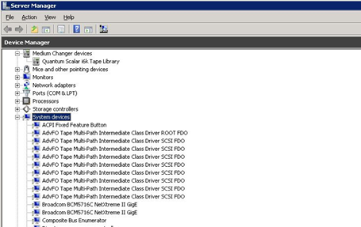
Device manager
Notes:
Multiple instances of the library or of each drive indicate that APFO is not enabled in the library.
Eight changer, eight drives
Replace this with screen shot from Louie

Slide 31
Failover demonstration

Slide 32
Diagnosis
Objective: Restore failed link or drive before the redundant element fails.
Identify the failed element
Link or drive?

Slide 33
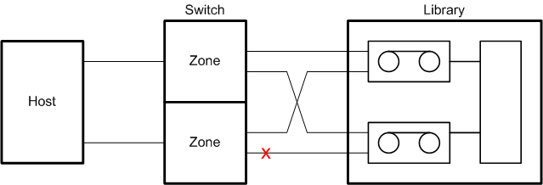
Data and control path failover

Slide 34
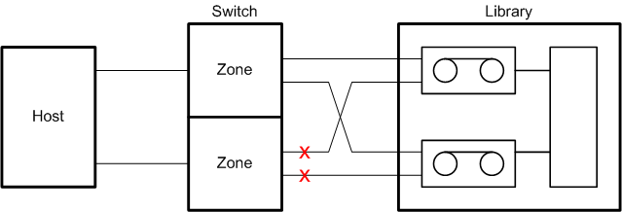
Control path failover across drives

Slide 35
Diagnosis process
Library RAS tickets
Windows system event log
Diagnostic application
Debug (checked) drivers to generate debug logs
Crash dumps to debug BSODs
Notes:
Ask service people how much of this should be given to customer and how much to give only to field service
Debug drivers will be signed

Slide 36
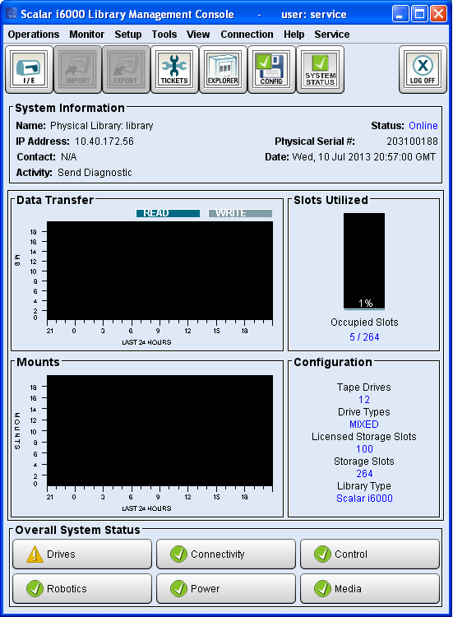
RAS ticket available

Slide 37
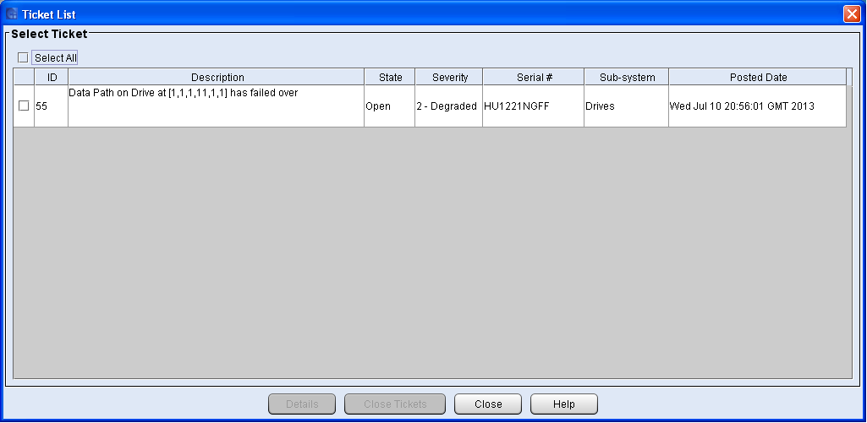
RAS ticket list

Slide 38
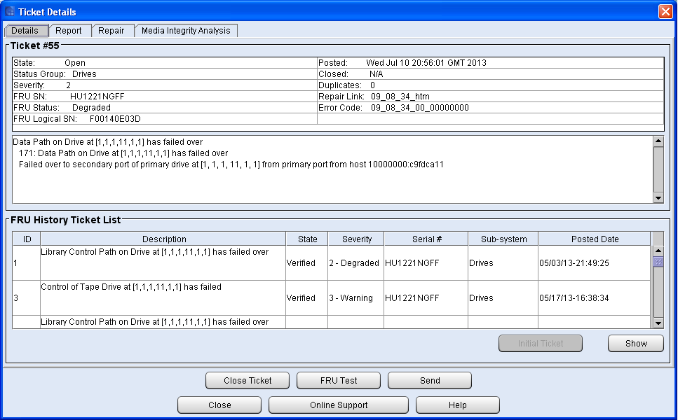
RAS ticket details
Notes:
Coordinates of failed element

Slide 39
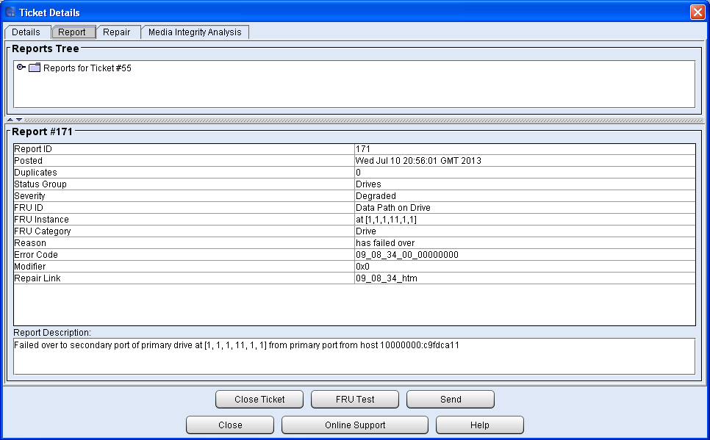
RAS ticket report

Slide 40
Windows event log
Event | Severity | Message
Driver loaded | Informational | “Path failover driver loaded”
Driver unable to load | Error | “Path failover driver unable to load”
Path failure detected | Error | “Path failure detected on SCSI Port %s Bus %3 Target Id %4 Logical Unit %5”
Failover session established | Informational | “Failover session established on SCSI Port %2 SCSI Bus %3 Target Id %4 Logical Unit %5”
Failover session establishment error | Error | “Failover session establishment error on SCSI Port %2 SCSI Bus %3 Target Id %4 Logical Unit %5. Reason code %6.”
Hint: Filter current log event sources for tapeusbf and tapempic.

Slide 41
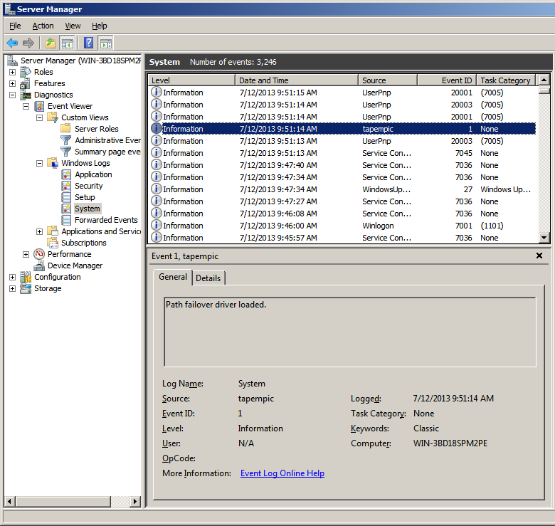
Event log – driver loaded

Slide 42
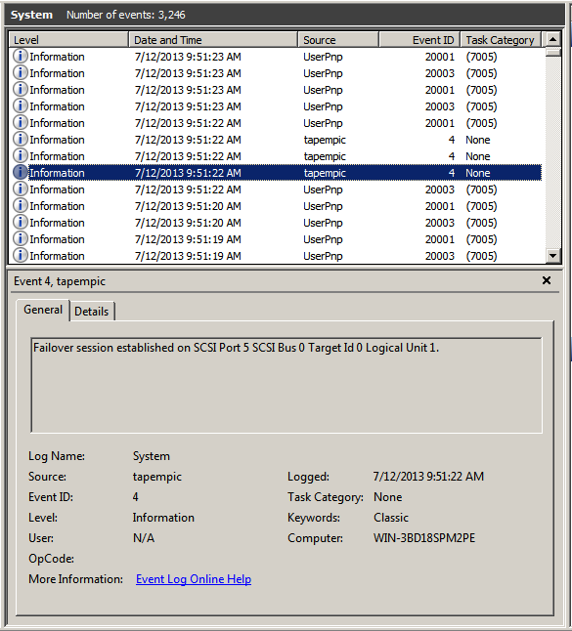
Event log – session established

Slide 43
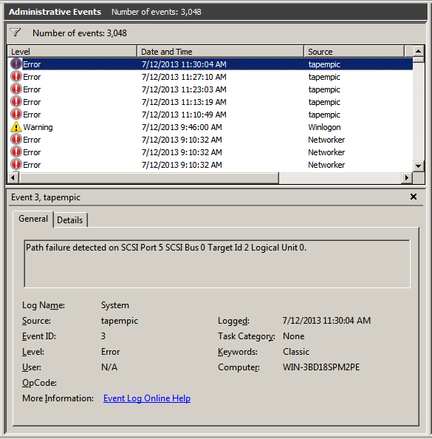
Event log – path failure
Notes:
Check AdvFoDgn to see which drive is missing a path

Slide 44
Overview
Goals
Windows driver architecture
Demonstration
Utilities
Documentation review

Slide 45
Utilities
AdvFoDgn – failover session states and device names
Crash dumps for debugging BSODs – see Customer Essentials
Notes:
Quantum version

Slide 46
AdvFoDgn diagnostic
Shows states of failover sessions
Shows names of devices
Communicates with the driver
Some ISV applications may need to use symbolic names of drives and changers.

Slide 47
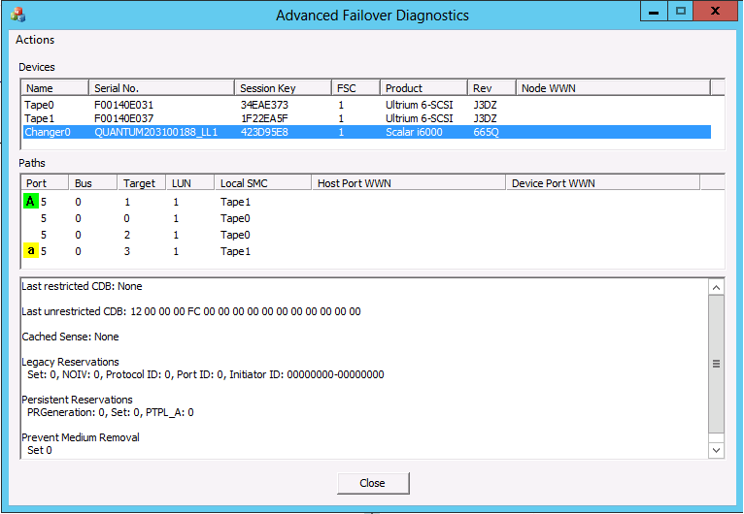
AdvFoDgn display
Notes:
Bottom pane is driver state

Slide 48
AdvFoDgn actions
Show WWN
Report Device
Enabled
Session Status
Session List
Report Local SMC
Legacy Reservations
Prevent Media Removal
Persistent Reservations

Slide 49
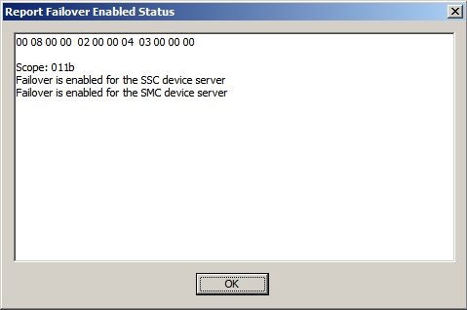
AdvFoDgn device enabled status

Slide 50
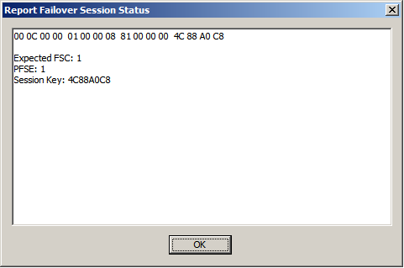
AdvFoDgn device session status

Slide 51
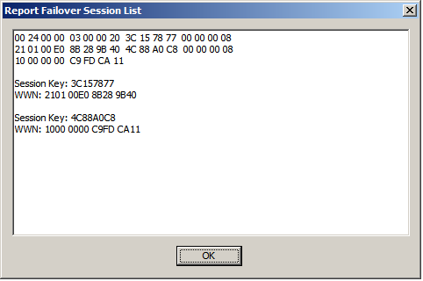
AdvFoDgn device session list

Slide 52
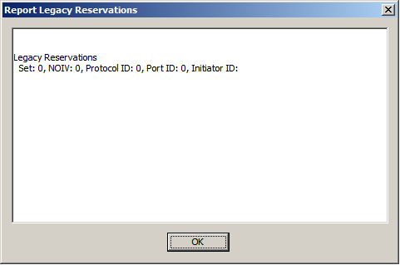
AdvFoDgn SMC legacy reservations

Slide 53
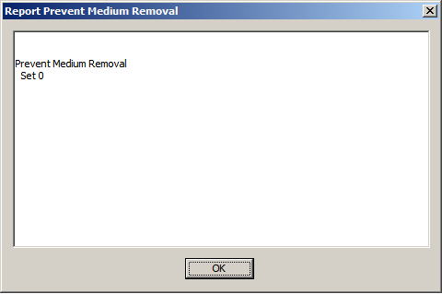
AdvFoDgn SMC prevent removal

Slide 54
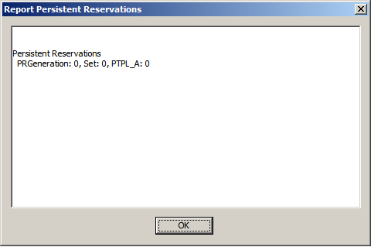
AdvFoDgn SMC persistent reservations

Slide 55
Clearing reservations – AfoClrRs
Some failures may leave a drive or library with a reservation placed by a dead host.
AfoClrRs will clear reservations manually.
Installed along with drivers.
Notes:
Will go into AdvFoDgn

Slide 56
Overview
Goals
Windows driver architecture
Demonstration
Utilities
Documentation review

Slide 57
References
Advanced Path Failover User Essentials
Release notes (TBD)

