Slide 1
Installing libraries larger than 12 frames
Rob Yang
August 2012
Filename goes here (e.g., P12345A-v01)
Notes:
To change the image, go to View→slide master.
Next, move the Q out of the way to access the image behind the Q
Right click on the image and select “change image”. This will allow you to select an alternate image in the same area.
Reposition the Q around the image, centering as needed

Slide 2
When to Use this Procedure
0
1
2
3
4
5
6
7
8
9
10
11
12
Frames to be Added
Use this procedure when you’re adding a 13th module to a 12-module library
Notes:
Use this procedure when you’re adding a 13th module to a 12-module library. If the library has less than 12 modules when you begin, add modules up to 12 before you start this procedure, then begin the procedure before adding a 13th module.
Single robot libraries with 12 modules consist of a control module and 11 expansion modules.
Dual robot libraries with 12 frames consist of a control module, 11 expansion frames, and a left parking module.
For the purposes of this procedure, we don’t count the left parking module.

Slide 3
Why is a 16-Frame Installation Different?
Three main issues can affect installations of more than 12 frames:
As frames are added, the library grows longer in relation to the X-Axis rail, which might cause problems with robot operations
The X-Axis rail attachment slots could be too short for some installations – after snapping into the existing rail, you couldn’t attach it to the library with the hex screws
The difference in length between the top and the bottom of the library increases in some installations – this could cause excessive robot tilt, creating positioning issues

Slide 4
Why Are the Top and Bottom Different Lengths?
It’s possible – probable even – that the top and the bottom of the library will be different lengths. The frames are 599 mm wide, within a .5 mm tolerance. A frame is measured in several spots, and if the frame is no wider at any spot than 599.5 mm, and no shorter than 598.5 mm, it’s considered to be the correct width.
If the tolerances stacked up in the most unfavorable way, it’s possible to have a 17 mm difference between the top and the bottom of the library.

Slide 5
Before you begin…
Two people are necessary for an accurate measurement
The right cover must be removed
The door of the module second from the left must be open
Don't make any adjustments to the first 12 frames
Notes:
Two people are necessary. Given the large distance to be measured and the small variance allowed, the only way you can measure accurately is if someone else helps you.
The right cover must be removed to add a module. It’s mentioned here because there is no way you can take an accurate measurement if the cover is on.
The procedure could have directed you to measure from the leftmost module. That would have required you to remove the left cover, which you normally wouldn’t do when adding expansion modules. Also, some libraries are installed close to a wall. The procedure was written to avoid these complications.
Never adjust any modules that have already been installed. This is true even if the variance is much more than 4mm. We want to avoid disturbing or adjusting a functioning library.

Slide 6
Measure the Top
First, measure the top of the library. Record the measurement.
(We’ll talk about how to measure a little later.)
top: 7197 mm
0
1
2
3
4
5
6
7
8
9
10
11
12

Slide 7
Measure the Bottom
Measure the bottom of the library. Record the measurement.
top: 7197
bottom: 7193
0
1
2
3
4
5
6
7
8
9
10
11
12

Slide 8
Subtract
top: 7197 mm
bottom: 7193 mm
4 mm
4 > 4
Subtract the smaller measurement from the larger measurement.
If the difference is greater than or equal to 4 mm, add a shim. If the difference is less than 4 mm, don’t add a shim, attach and level the next module.
0
1
2
3
4
5
6
7
8
9
10
11
12

Slide 9
Install a Shim Set if Needed
top: 7197 mm
bottom: 7193 mm
4 mm
4 > 4
The difference in this example is 4 mm, so you would install a shim set.
The top is shorter so you’d add a shim set to the top.
Place Shim Set
0
1
2
3
4
5
6
7
8
9
10
11
12

Slide 10
Attach and Level the Next Module
After installing the shim set, attach and level the next module.
0
1
2
3
4
5
6
7
8
9
10
11
12
13

Slide 11
Measure and Subtract
top: 7797 mm
bottom: 7794 mm
3 mm
4 > 3
After adding the module, measure again, record the measurements, and subtract.
0
1
2
3
4
5
6
7
8
9
10
11
12
13
The difference is less than 4 mm, so you would not install a shim set. Attach and level the next module.

Slide 12
Repeat
top: 8396 mm
bottom: 8393 mm
3 mm
4 > 3
Measure, subtract, install.
0
1
2
3
4
5
6
7
8
9
10
11
12
13
14
15

Slide 13
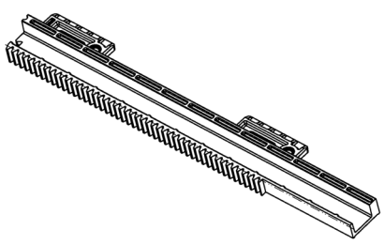
Install the X-Axis Rail Terminators
After installing the X-Axis rails according to the Installation Guide, install the X-Axis rail terminators in the rightmost module. The terminators are 9mm longer than a regular half rail, and they don’t have gear teeth on the right end.
Install he X-Axis rail terminators exactly like any other half rail.
0
1
2
3
4
5
6
7
8
9
10
11
12
13
14
15
16

Slide 14
How to Measure
?
0
1
2
3
4
5
6
7
8
9
10
11
12

Slide 15
Measuring – Joint 1 to Right Side End
1
2
3
4
5
6
7
8
9
10
11
12
Joint 1 is on the right side of the CM for a single robot library
Right end, no cover installed
Joint 1 is on the left side of the CM for a dual robot library
0
1
2
3
4
5
6
7
8
9
10
11
12

Slide 16
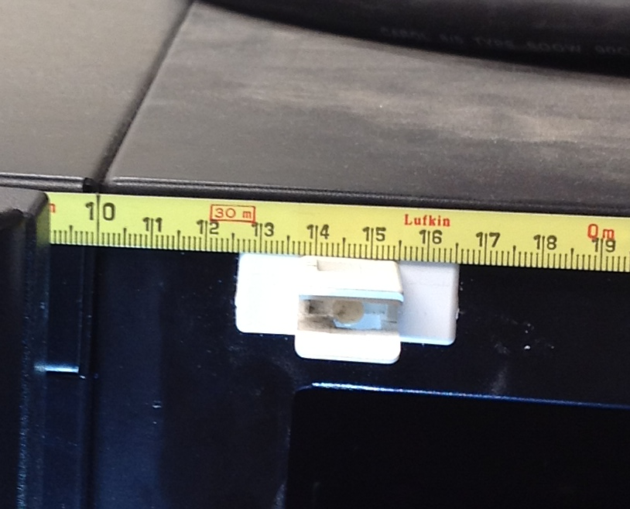
Don’t Use the Tang
You must hold the tape precisely to get an accurate measurement. Don’t measure from the end of the tape – the metal tang will degrade your accuracy. Choose an increment with a mark that spans the width of the tape. Measure from that mark.

Slide 17
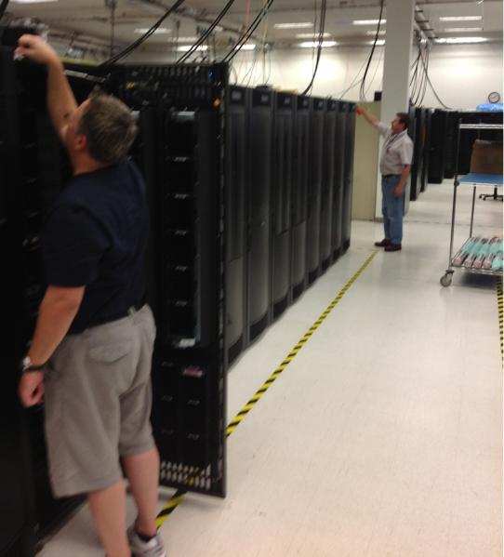
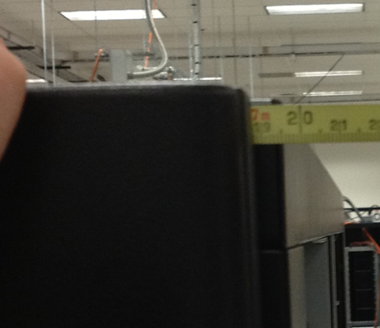
Hold the Tape Level
Before you note the measurement, make sure your helper is holding the tape level with the spot you’re measuring. If you’re measuring with the top of the tape even with the top, your helper must hold their end of the tape even with the top.
Don’t let the tape sag in the middle.

Slide 18
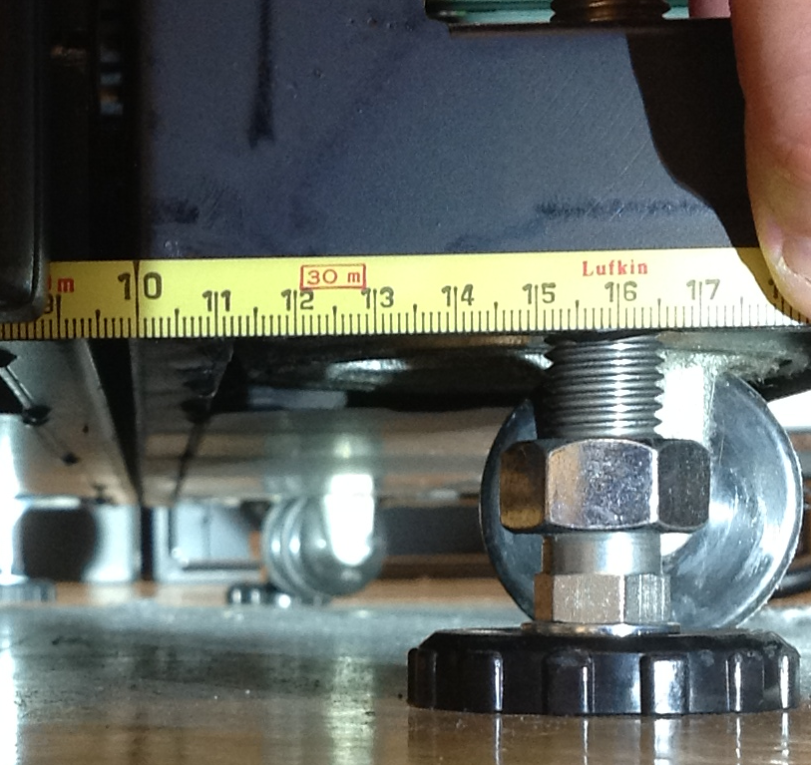
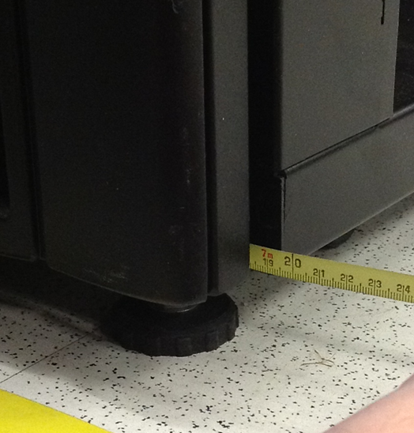
Measure the Bottom the Same
Measure the bottom the same way you measured the top

Slide 19
Questions:
What happens over time as the floor moves. If 4mm difference needs a shim, will we have a PM schedule to inspect and re-align for movement before an outage occurs?
Do we inspect and realign systems today? I would say no. The chances of movement in the floor I would say is very slim and the amount of movement would be minor.
How many shims are provided, and at what point – included with all modules beyond 12? Upgrades etc as customers expand.
A set of shims will be included with each expansion module beyond 12. The shims are a kit so a kit would just be added to each EM.
Have we considered visual indicators that are installed post-installation across joins – like paper stickers – that would give quick visual indication of movement?
We have not considered this. I would chalk this up to a couple of items. As a group the idea of a simple shim and measure was the approach we took. The idea of a visual indicator would need more investigation.
Will isle lights be mandatory to ensure visibility of any tapes or obstruction on library floor? (16 cabs must be dark?!)
Quantum Branded units the lights are optional and HP they are standard

