Slide 1
Xcellis Foundation
TOI for Global Service
September 26th, 2017

Slide 2
Agenda
Product Overview
Connect Support
Service Model
Training and Documentation Updates
Notes:
Please ask questions as we go. Your lines are muted on entry so *6 to unmute
Recording will be posted on Qwikipedia

Slide 3
Product Overview
Nick Elvester – Product Management

Slide 4
Xcellis Foundation
What it is
Entry-level Xcellis configuration; complete ‘turnkey’ system in 3RU
Three SKU’s based on capacity; 48, 72 & 96 TB options
Ships on a single pallet w/2 boxes – NICs and drives pre-installed
Simplified Out-Of-Box Experience & Configuration
Configuration
Single Xcellis Workflow Director & QXS-3 storage array chassis
Converged user data & metadata
48 TB raw; 2-10GbE NIC (Twinax)
Powered by StorNext 6
NAS client connectivity included - unlimited
10 Clients for iSCSI connections
One year NBD Support
Options
40 GbE NIC
Storage expansion arrays
Other add-ons available – No substitutions

Slide 5
Xcellis Foundation Target Customer
The Xcellis Foundation customer:
Price sensitive, No HA required; Ethernet/NAS connectivity
Large file unstructured data; streaming media; low IOPs
Compares to G-Tech, GB Labs, SNS, Facilis, EditShare
The Xcellis customer:
Needs high availability due to critical workflow and 100% uptime expectations
Workloads that would benefit from dedicated metadata storage
Numerous high-resolution streams and users
Fibre Channel clients

Slide 6
Xcellis Foundation Use Cases
Post-Production
Small shops; 3-5 video editors
Small TV/broadcast studios
Ethernet/NAS
No dedicated IT support
Corporate Video
Smaller teams, many projects
Large file unstructured data
Streaming media; Low IOPs
In-house creative departments; House of Worship
Disaster Recovery
Multi-site locations
Small departments within larger organizations
Leverage FlexSync add-on

Slide 7
Xcellis Foundation Notes
Xcellis Foundation uses the normal Xcellis in a packaged configuration
Single Node, QXS-3, iSCSI Xcellis (normally one part number)
Adds optional NAS license and 2x 10GbE Twinax kits
Differences between Xcellis Foundation and Xcellis Workflow Director
Xcellis Foundation ships with NAS, NICs, and drives installed from the factory
Xcellis Foundation has a different price and discounting structure
Add-on items use normal Xcellis parts
RAIDs, expansions, licensing, network cards, controller upgrade
No unique limitations versus normal Xcellis
Same scalability, options, rules

Slide 8
StorNext Connect Install V11
John Koniges – Engineering

Slide 9
Install v11 Design Philosophy
Changes to make installing with Connect Easier on all platforms
Xcellis Foundation is treated like any single node Xcellis install
Single node systems can now be install with only the following hardware:
Xcellis Single Node System
QXS Array (iSCSI or FC) (will be direct connected to node, less FC or iSCSI switch exists)
4+ port switch (does not need to be connected to anything)
Laptop to upload the connect firmware and run the installation process from
No outside network needed
You still need to connect them to a switch, however the switch can be isolated

Slide 10
Changes to Required Services
DNS is no longer required to be set
If not set, all services configured must use ip addresses
NTP is optional on single node systems
This can cause issues with your stats
This can cause issues with multiple StorNext services

Slide 11
Single Node Standalone Install
Connection to a Management Gateway is option
You will still need to connect to a switch, however the switch can be standalone
The switch is for communication between the Xcellis node and QXS array later
Only link active is checked.
Metadata will only need to be connected to a switch
Only link active is checked
All other services are optional, and if left blank will allow standalone install

Slide 12
Prepopulate Settings with Suggested Defaults
Metadata network now gives suggested settings for Gateway and IP Address
Defaults to 192.168.200.X subnet
iSCSI Network now gives suggested settings for both subnets
Subnet A is on the 192.168.211.X subnet
Subnet B is on the 192.168.212.X subnet

Slide 13
Service Model
Jim Hibbard/Bob O’Brien – Service NPI

Slide 14
Xcellis Foundation Service Model
Same as Xcellis Workflow Director
Xcellis Foundation is a single-node XWD with QXS-312 iSCSI disk and two 10GbE Twin-AX cards pre-installed
Disks and cards will be installed in mfg.
Will be shipped on one pallet
3 configs, based solely on the disk size in QXS-312: 4TB, 6TB or 8TB
Supported by Connect
Refer to the Xcellis Workflow Service Plan
Rev D update in AGILE (C050677) will be posted to CSweb upon release
FRU List Update
New column for Xcellis Foundation added to the Xcellis FRU List (6-68340-01) Rev M – in CCB (C050667)

Slide 15
StorNexct Connect Doc and Training Updates Install V11
Andrea O’Brien & John Love

Slide 16
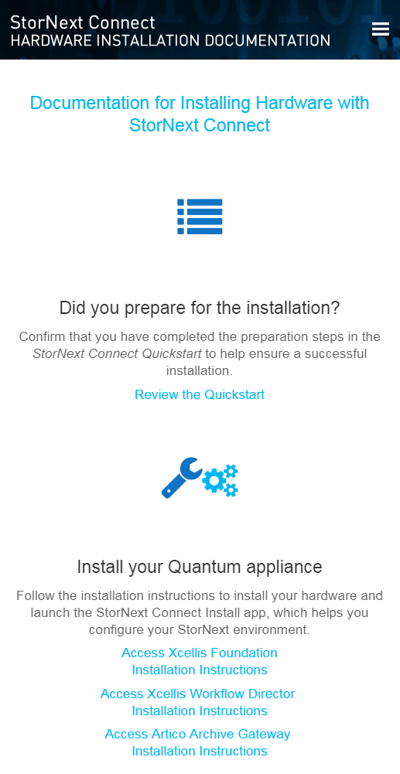
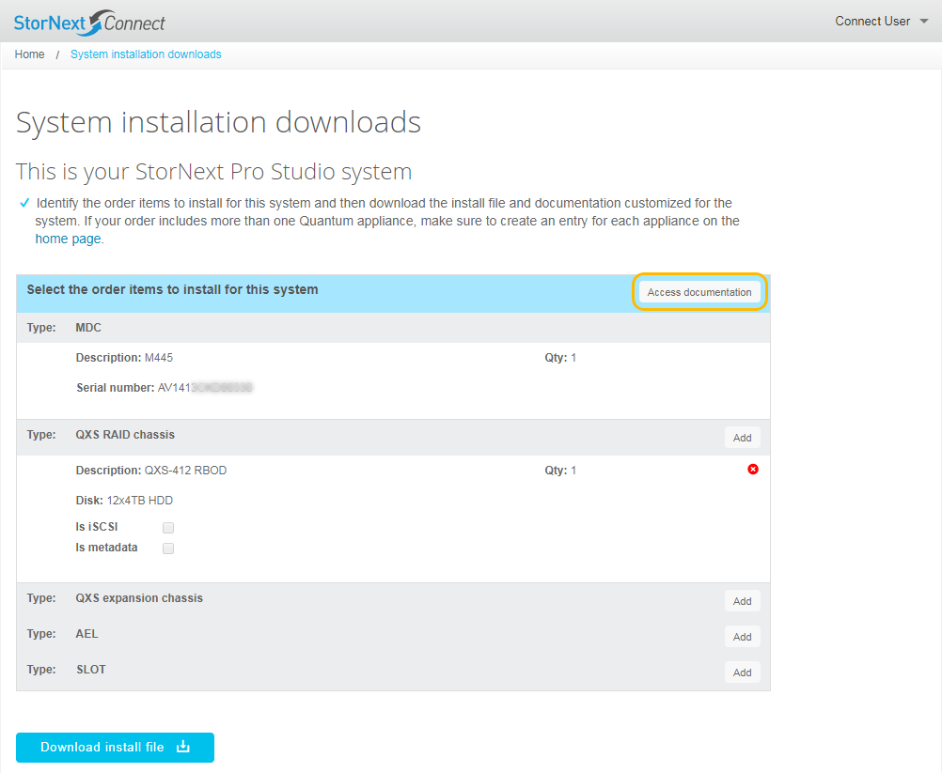
Customer-Facing Documentation
Hardware Installation Documentation Page
http://www.quantum.com/snchwinstalldocs

Slide 17
Customer-Facing Documentation
Stornext Connect Documentation Center
www.quantum.com/sncdocs
Refreshed home page
Updated the online version of the Stornext Connect Quickstart
Updated the Network Settings Worksheets
Updated the Release Notes and Compatibility Guide
Additional documentation changes related to Install V11
Includes a “sitemap” (TOC)

Slide 18
Service-Facing Documentation
StorNext Connect Service Documentation Center
http://qsweb.quantum.com/sncdocs
Refreshed home page
Documentation changes related to Install V11
Includes a “sitemap” (TOC)

Slide 19
Training Updates
No training updates

Slide 20
Xcellis Foundation Initial Release: Appliance Training Updates
Matthew Howell

Slide 21
Updated Customer and Service Training
Updated Courses
Basics of Quantum Appliances: Xcellis Workflow Director, Xcellis Foundation, Xcellis Workflow Extender, and Artico Archive Gateway (R630) (1-4660 Online Self-Paced)
Installation and Configuration: Xcellis Workflow Director, Xcellis Foundation, and Artico Archive Gateway (R630) (1-4650 Online Self-Paced)
Content
Existing courses updated to include Xcellis Foundation information.
Availability
Available now
Customer version: Xcellis | Artico Documentation Center > Available Training page
Service version: StorageCare Learning

Slide 22
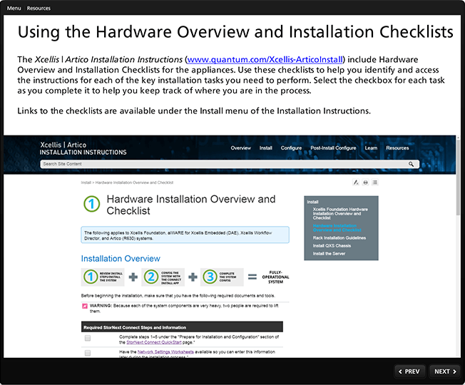
Updated Course Highlights
Basics course includes Xcellis Foundation overview information.
Installation/Configuration course addresses Xcellis Foundation and how its installation differs from other Workflow Directors and Artico Archive Gateway.

Slide 23
New Product Update Training for Service
New Course
Xcellis Foundation, Initial Release, Product Update for Service (2-4729b Online Self-Paced)
Content
Recording of this TOI followed by a short assessment
Availability
Course available 9/29/2017 on StorageCare Learning for Quantum team members and Service Partners
TOI recording/presentation to be posted 9/29/2017 to Qwikipedia for Quantum Service team members

Slide 24
Xcellis Foundation Initial Release: Appliance Documentation Updates
Keith Lenehan

Slide 25
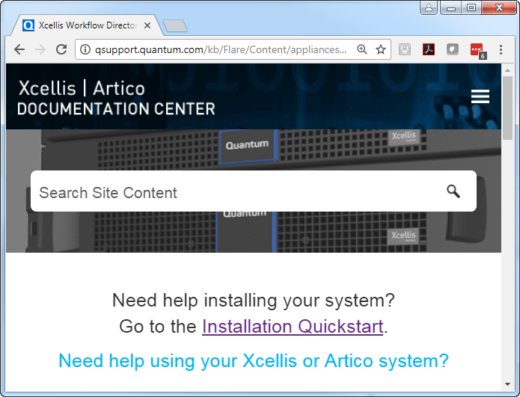
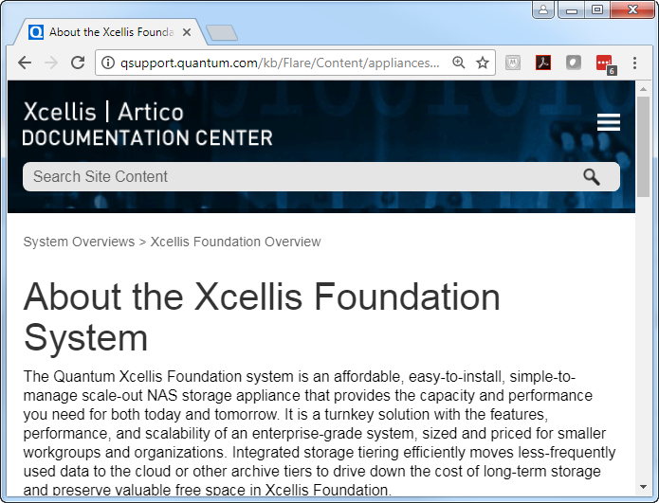
Customer-facing Documentation
Xcellis-Artico Doc Center:
New! Xcellis Foundation Overview page
Added installation link on the home page
Availability
Launched!

Slide 26
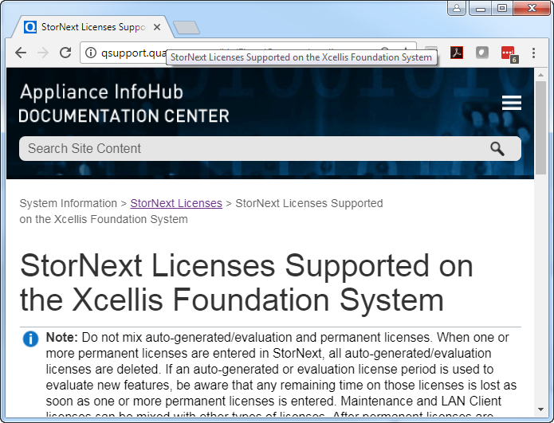
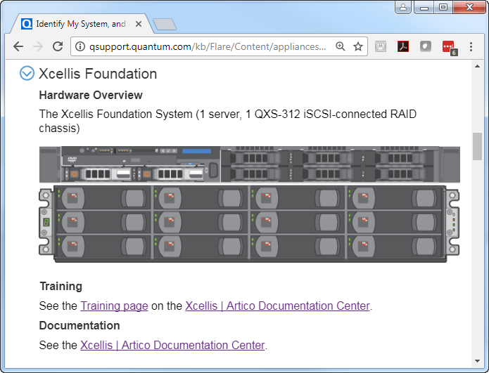
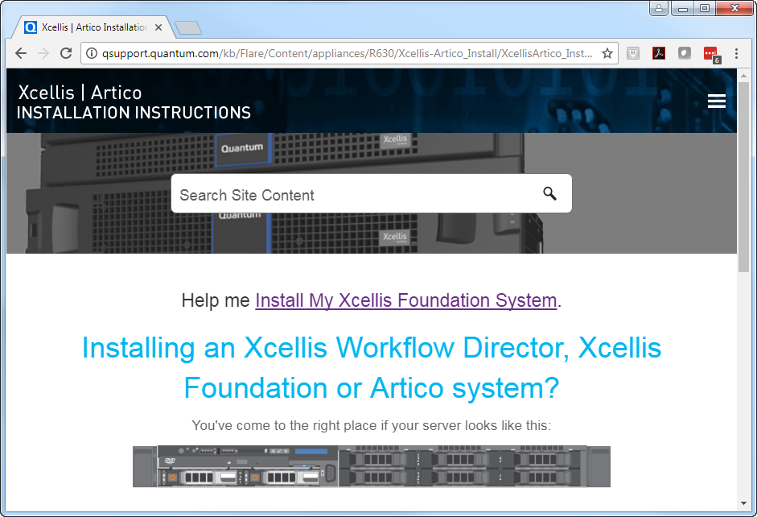
Customer-facing Documentation
Updated Appliance InfoHub:
Xcellis Foundation added to the Identify My System page
Added Xcellis Foundation Licenses page
Availability
Launched!
Xcellis-Artico Installation Instructions:
Simplified installation flow/checklists
Direct link on the home page for the Xcellis Foundation Install checklist
Availability
Launched!

Slide 27
Xcellis Foundation T&D Links
Live content walkthrough:
quantum.com documentation portal
StorNext Connect Documentation Center
StorNext Connect Network Worksheets
Xcellis | Artico Documentation Center > Available Training page
Xcellis-Artico home page
Xcellis-Artico training page
Xcellis Foundation Overview
Link to the Xcellis Foundation Checklist on the Xcellis-Artico Install Instructions home page
Xcellis Foundation Overview on the Appliance InfoHub
Xcellis Foundation StorNext Licenses on the Appliance InfoHub

