Slide 1
Support/Sustaining Overview
Vision 4.2
May 2012

Slide 2
Vision 4.2
What You Need to Know
Primary Goal: support virtualization product line, improve DXi and Scalar support
GA: May 21, 2012:
  New sales
  Download upgrade for existing customers at quantum.com
Documentation at www.quantum.com/VisionDocs:
  Release notes, Quick Start, User Guide
  Videos showing new features and training
Upgrade from all Vision versions 4.X supported
Vision Mobile for iPhone and Android updates for Vision 4.2 available now
Notes:
Support for v1000 and vmPRO enhance Quantum’s virtualization offering.
Scalar LTFS supported
DXi Capacity Upgrade Estimator allows customers to judge when they’ll need more disk
DXi Accent reporting shows bandwidth savings and deduplication for Accent media servers
EDLM reporting in Media console gives customers a quick way to check on media health

Slide 3
Vision 4.2
Customer Experience
Training videos and documentation available from Vision help dropdown menu including:
  Quantum Vision 4.2 Features Update
  Quantum Vision: Monitoring Scalar LTFS Devices
  Quantum Vision: Monitoring and Analyzing vmPRO Devices
  Release Notes, Quick Start and Users Guides
  And more…
Updated GUI makes navigation more intuitive
  View devices by type with dropdown from breadcrumbs
  Topology shows more devices with more information and navigation options
  More descriptive icons
Customer install and upgrade
  NEW: OVF install to virtual appliance through ESX/vCenter; see Quick Start Guide.
  OVF and Traditional Linux /Windows install/upgrade on CD or downloaded from quantum.com
  Online license generation at quantum.com/licensekeys
Database changes make database maintenance very fast
Notes:
OVF installation as a virtual appliance is new in Vision 4.2
Instructions for installation are in the Vision 4.2 Quick Start Guide
Administration of the Virtual Appliance is documented in the Users Guide
Weekly database compression takes < 5 minutes with 100 devices monitored

Slide 4
Vision 4.2
Providing Support
Three year support contract sold with Vision: all customers who have Vision 4.X are supported at least until calendar 2013
SR’s will be created with the customer’s Vision server serial number
Escalation path: Support -> Sustaining -> Development
Diagnostic files: http://[vision ip]/rws/diag creates zipped logs
Notes:
Vision support is 3 years from the initial install of Vision 4.0.X – earliest install was April 2010

Slide 5
Vision 4.2
What’s New?
OVF Install as a Virtual Appliance
Support for vmPRO and DXi v1000 virtual appliances
DXi Capacity Upgrade Estimator
DXi Accent Reporting
Scalar Extended Data Life Management support
Scalar LTFS Support upon release of Scalar LTFS

Slide 6
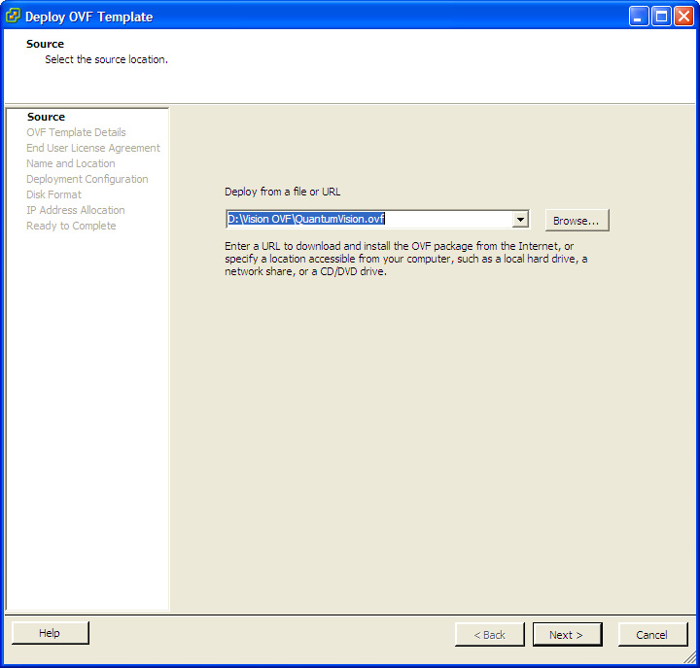
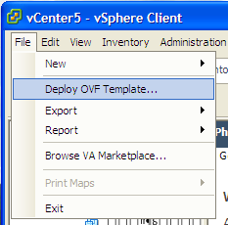
Vision 4.2
OVF Install as a Virtual Appliance
Using vCenter or ESX/ESXi hypervisor, deploy the OVF; details are provided in the Vision 4.2 Quick Start Guide.
An OVA file will be available at quantum.com, deploy the same as OVF on CD.
Notes:
Vision installs as virtual appliance, deploying CentOS and Vision software
The Quick Start Guide provides details on installation: use vCenter or ESX/ESXi to deploy the OVF
When downloading from quantum.com the customer will receive and OVA file that contains the OVF and supporting files in a tar-like file. Install just like OVF.

Slide 7
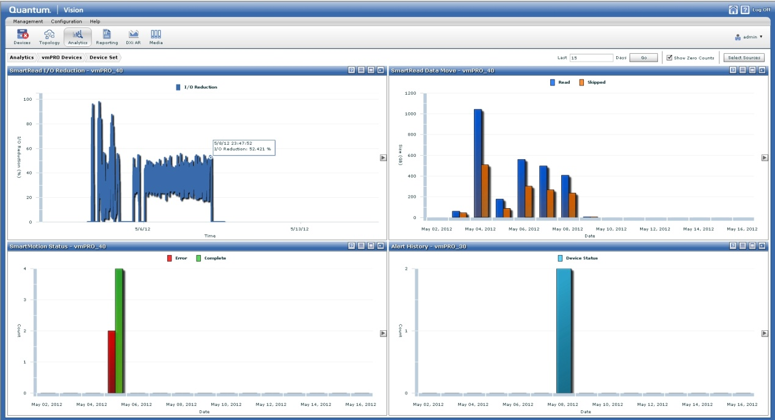
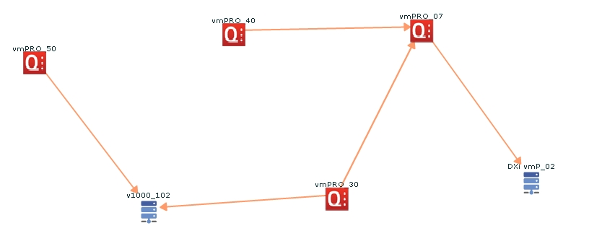
Vision 4.2
Support for vmPRO and DXi v1000 virtual appliances
Vision 4.2 supports the Quantum Virtualization product line with monitoring and reporting for vmPRO and DXi v1000
vmPRO 2.3 supports console and alerting. vmPRO 3.0 additionally supports topology view and analytics reports.
DXi v1000 supported just like physical DX in alerts, topology, analytics, and DAR console.
Notes:
vmPRO 2.3 is supported with alerts and console view
vmPRO 3.0 provides analytics reporting and topology view when vmPRO 3.0 is available
DXi v1000 looks like physical DXi appliances, but the console information won’t have RAID or other hardware information

Slide 8
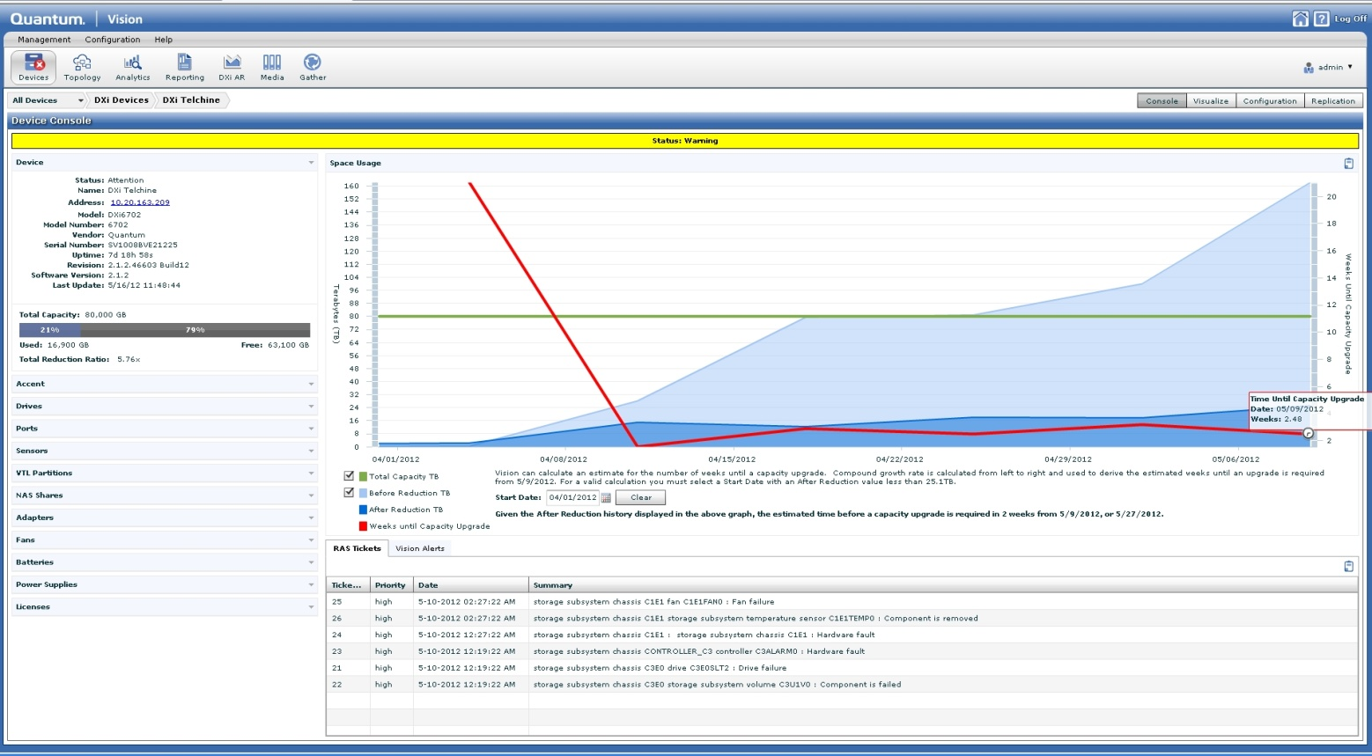
Vision 4.2
DXi Capacity Upgrade Estimator
DXi Capacity Upgrade Estimate is provide on the DXi console; requires DAR 2.0.3 for DXi 2.X.
Up to 12 months of disk usage data displayed
Must choose 5 or more weeks from latest data
Displays weeks until upgrade estimate
Notes:
DXi Capacity Upgrade Estimator is available in Vision 4.2
Relies upon DXi Advanced Reporting data collected from DXi 2.0.3 or higher; note DXi AR 2.0 and 2.0.1 will not working with Capacity Upgrade Estimator. Get DAR 2.0.3 from quantum.com
Can take 3 or more days to collect data from the DXi; data collected in chunks starting from the earliest date to avoid network flooding
Best estimates are at steady state which is when data expiration schedule matches data ingest schedule
Steady state growth will be the true data growth at the customer. Growth in the number backups, increase or decrease in retention, and new installations won’t create accurate estimates
See the Vision 4.2 Users Guide for details on usage

Slide 9
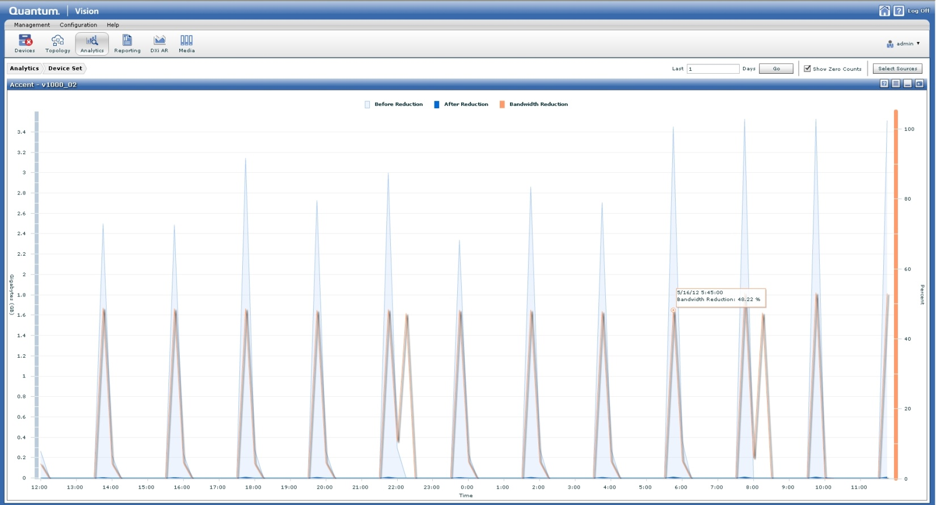
Vision 4.2
DXi Accent Support
Data deduplicated by DXi Accent on Netbackup or Backup Exec Media servers now shown in DXi Analytics reporting
Before Reduction, After Reduction, and bandwidth savings
Notes:
DXi Accent reporting is now part of DXi Analytics reporting
If Accent is not configured no report will be displayed in Analytics

Slide 10
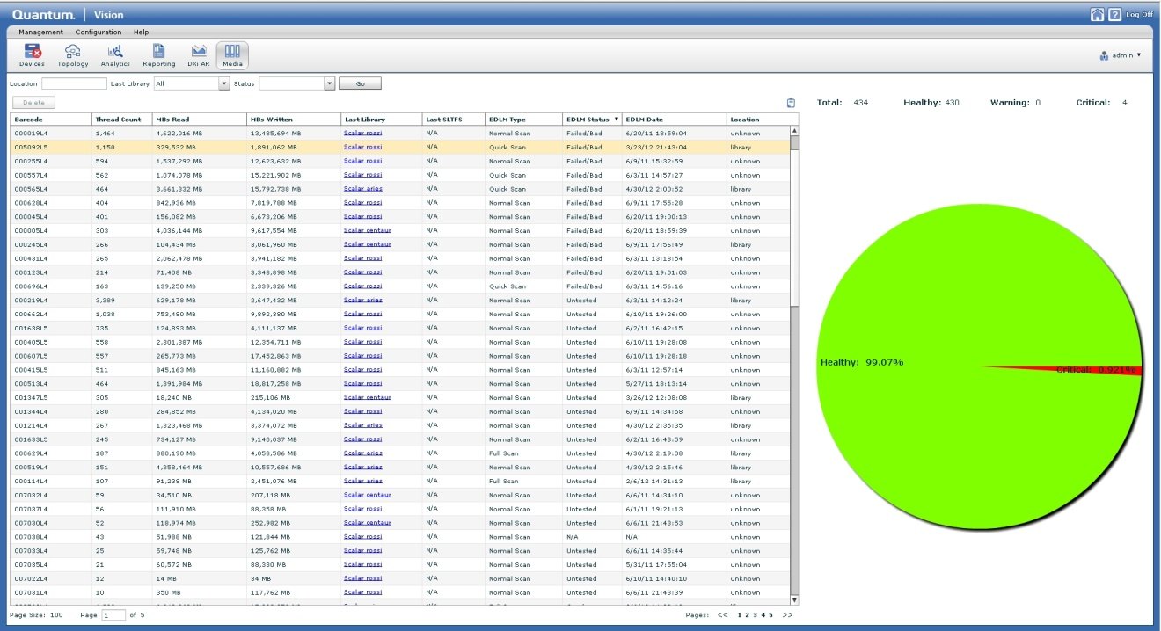
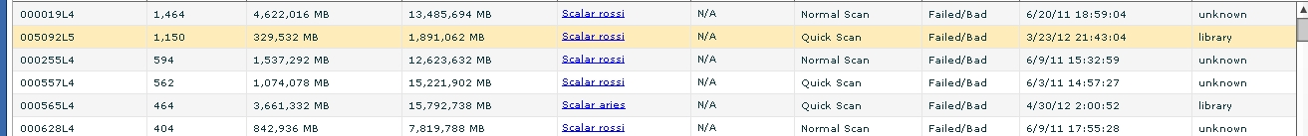
Vision 4.2
Scalar Extended Data Life Management (EDLM) reporting
EDLM scan status and date now part of the consolidated media console
Bar code, library, status, and date of scan are shown
Scalar must have an EDLM license
Notes:
EDLM allows customers to protect their data that resides on physical media in Quantum Scalar libraries
All Scalar media is shown in the Vision media console
Eases the burden of checking on media in multiple libraries

Slide 11
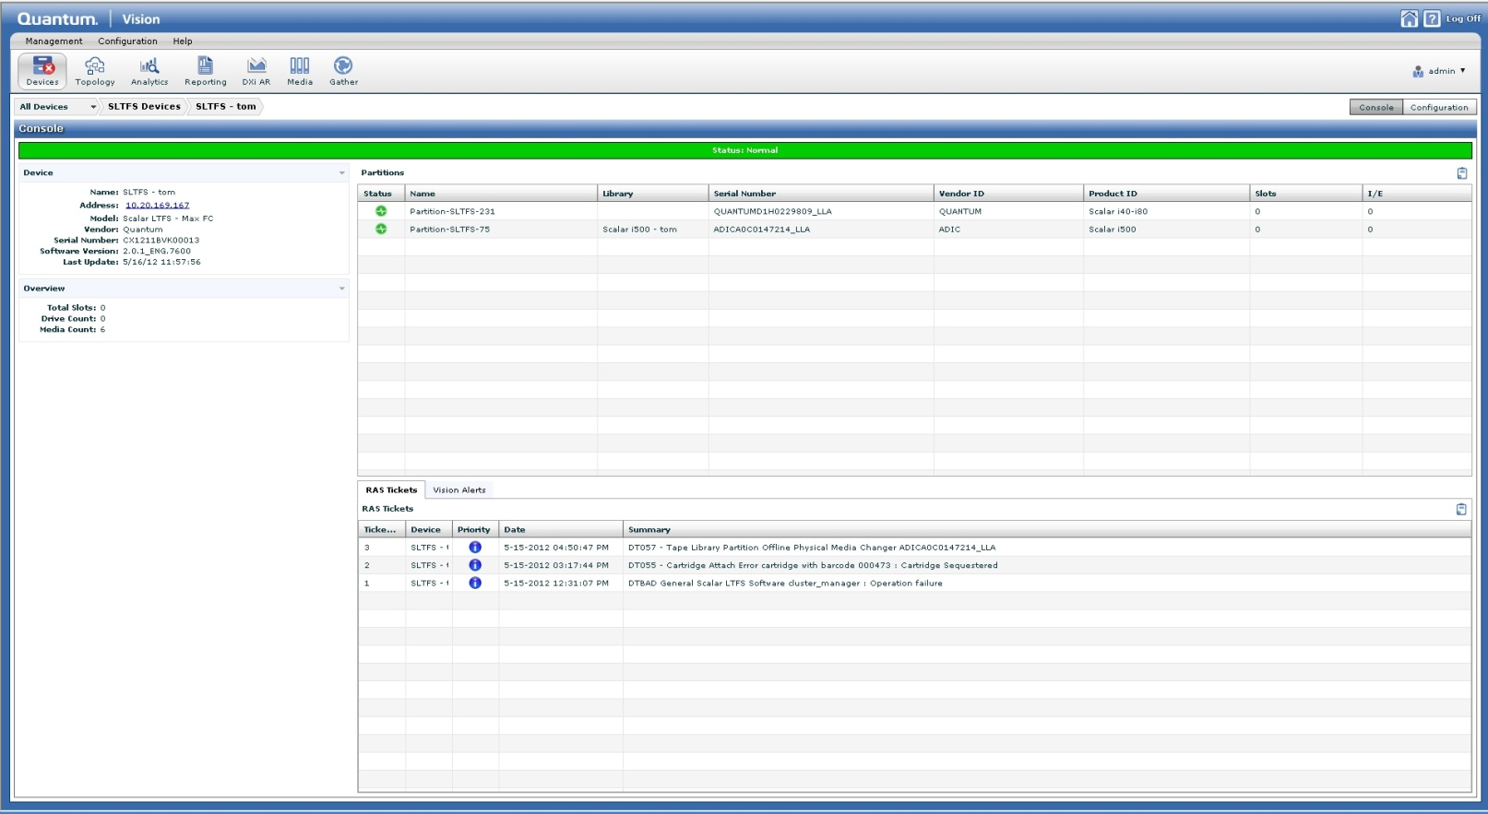
Vision 4.2
Scalar LTFS Support
Scalar LTFS console view and alerting available
Shows scalar partitions and media defined for use by LTFS file system
Notes:
When Scalar LTFS is released is will be supported as a device recognized by Vision 4.2

Slide 12
Vision 4.2
Summary
Supports Quantum Virtualization Product line
  DXi v1000
  vmPRO 2.3 and 3.0
  Installs as a virtual appliance
DXi Capacity Upgrade Estimator provides critical disk usage and upgrade information
DXi Accent reporting now part of DXi Analytics
EDLM information from a single location

