Slide 1
Vision 4.1 Walkthrough
July 2011

Slide 2
Goals
Provide overview of vision 4.1 major features
Make sure everyone are on the same page
Get your feedback

Slide 3
Agenda
Vision 4.1 schedule
Review Vision 4.1 features
  New interactive reports console
    DXI interactive reports
    Scalar interactive reports
  New alerts
  Media console enhancements
  Dxi AR integration
Demo
Q&A

Slide 4
Vision 4.1 schedule
Development started
We are here - FC

Slide 5
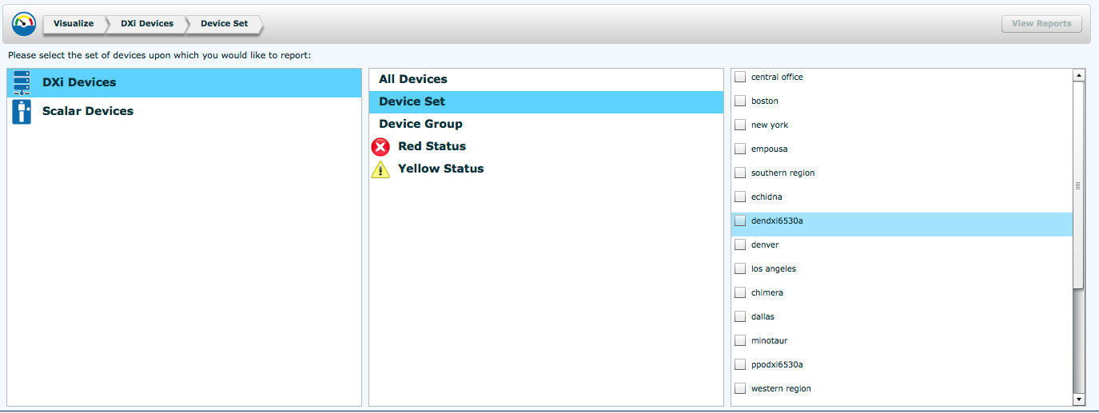
New Interactive reporting console
New reporting area in vision which allows customers to customize the reports they want to look at by:
  Selecting device types: scalar or Galaxy dxi
  Selecting a specific device, all devices or a device set
  Selecting the sample period (in days)
Notes:
The new reporting area – called visualize (name about to change) provides interactive reports for dxi and scalar
The user need to select first which type of device he want to look at (dxi or scalar) than he could select all devices, devices which are in red or yellow status and customize a set of devices he in interested in looking at.

Slide 6
New DXI Interactive reports
Space reclamation progress
  Graph reclamation progress over time
Replication status
  Graphing replication status summary report using different colors for success/failure etc
After reduction growth
  Graphing deduplicated data growth over time
Alert history
  Graphing alert count over time using different colors for each alert type (device status, replication status, disk threshold, SNMP trap)
Notes:
When selecting DXI interactive reports, there are 4 reports displayed for the selected device/s
Space reclamation: graph of the space reclamation progress (percentage) for a specific period of time (by default 3 days but can be changed by the user)
The goal of this graph is to visualize when GC is working and identify if it is working for a long period of time, which than would require investigation for the cause of long GC periods.
Replication status: graphing the replication summary reports, showing number of successful/failed/paused/queued/partial replications stacking them on a bar chart
Also a replication trend line is showing the failure trend
This graph is intended to help identifying issues with replications (source/target/namespace)
After reduction growth: graphing the deduplicated data growth on the dxi in GB,
Alert history: graphing alerts on a specific dxi for a period of time, stacking different alert types in a bar chart each type in a different color (device status, replication status, disk threshold, SNMP trap)

Slide 7
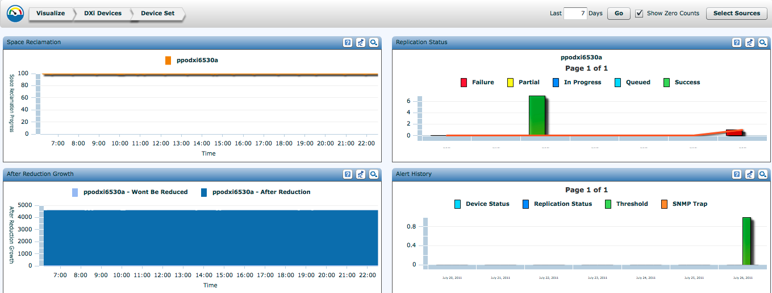
DXI interactive reports
Zoom to see this report
Set the period of time

Slide 8
New scalar interactive reports
Tape alerts by drive and media
  A heat map showing tape alerts to media and drives, heat is calculated by severity
Mount counts per drive
  Showing how many times a drive has been mounted, also possible to highlight a partition
Tape alerts to media
  Alert count per barcode
Tape alerts to drive
  Alerts count to drive
Alert history
  Graphing alert count over time using different colors for each alert type (device status, SNMP trap)
Notes:
Added new Scalar advanced reporting data.
Tape alerts by drive and media: a heat map that shows list of barcodes(Y axis) and list of drives (X axis) the heat for any combination of barcode and drive It is calculated by number of alerts per alert severity as follows:
Heat severity is between 1-10 (1 is green, 10 is red)
Alerts Severity = (G) Good, (I) Info, (W) Warn, (C) Critical
Good and Info are always 1
Warning is between 4-6, when 4 is when there is 1 alert, 5 is when there are 2 alerts and 6 when there are 3 or more alerts
Critical is between 7-10, when 7 is 1 alert, 8 is 2 alerts, 9 is 3 alerts and 10 is 4 or more alerts
Mount counts per drive: Graphing the total number of mount per drive
Tape alerts to media: Graphing the number of tape alerts for each barcode (could be from multiple drives)
Tape alerts to drive: Graphing the number of tape alerts for each drive (Could be from multiple barcodes)
Alert history: graphing alerts on a specific library for a period of time, stacking different alert types in a bar chart each type in a different color (device status, SNMP trap)

Slide 9
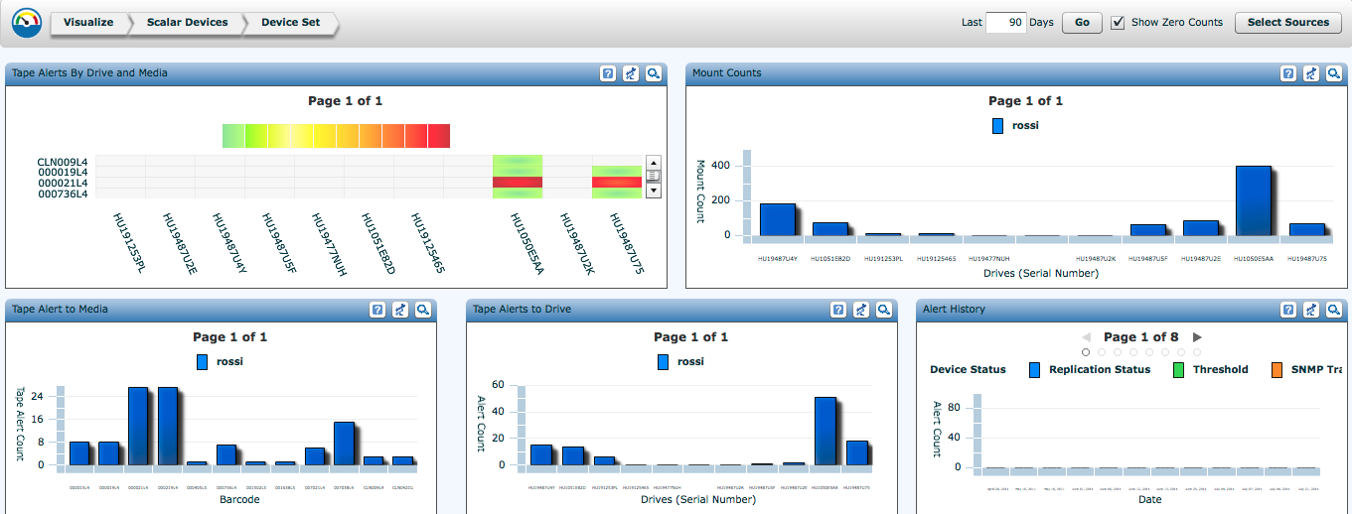
Scalar interactive reports
Notes:
i40/80 and i500 we do not get the export log from the device (media security logs)
For i2k/i6k only for modern firmware versions (i8)
We need to create a table of devices/firmwares that are supported.
For i2k/i6k modern firmware we get 4 reports:
Drive utilization
Media alerts (tape alerts)
Media usage (data read and write on a media)
Media security (exported media)

Slide 10
Alerts
New alerts
  garbage collection takes longer than a specified time
  total reduction ratio at or below a specified value
  “Deduplicated Reduced Area” exceeds specified value
Enhancements to existing alerts
  add a priority value to alert rule (high, medium, low)
  specify a from and to value for the existing replication status and device status alerts
Notes:
Garbage collection duration alert: alerting if the duration of garbage collection on a specific DXI exceeds a number of minutes/hours/days
Total reduction ratio alert: alerting if the reduction ratio is below a number
Dedupe reduced area alert: alert if the deduplicated data is above a number of GBs

Slide 11
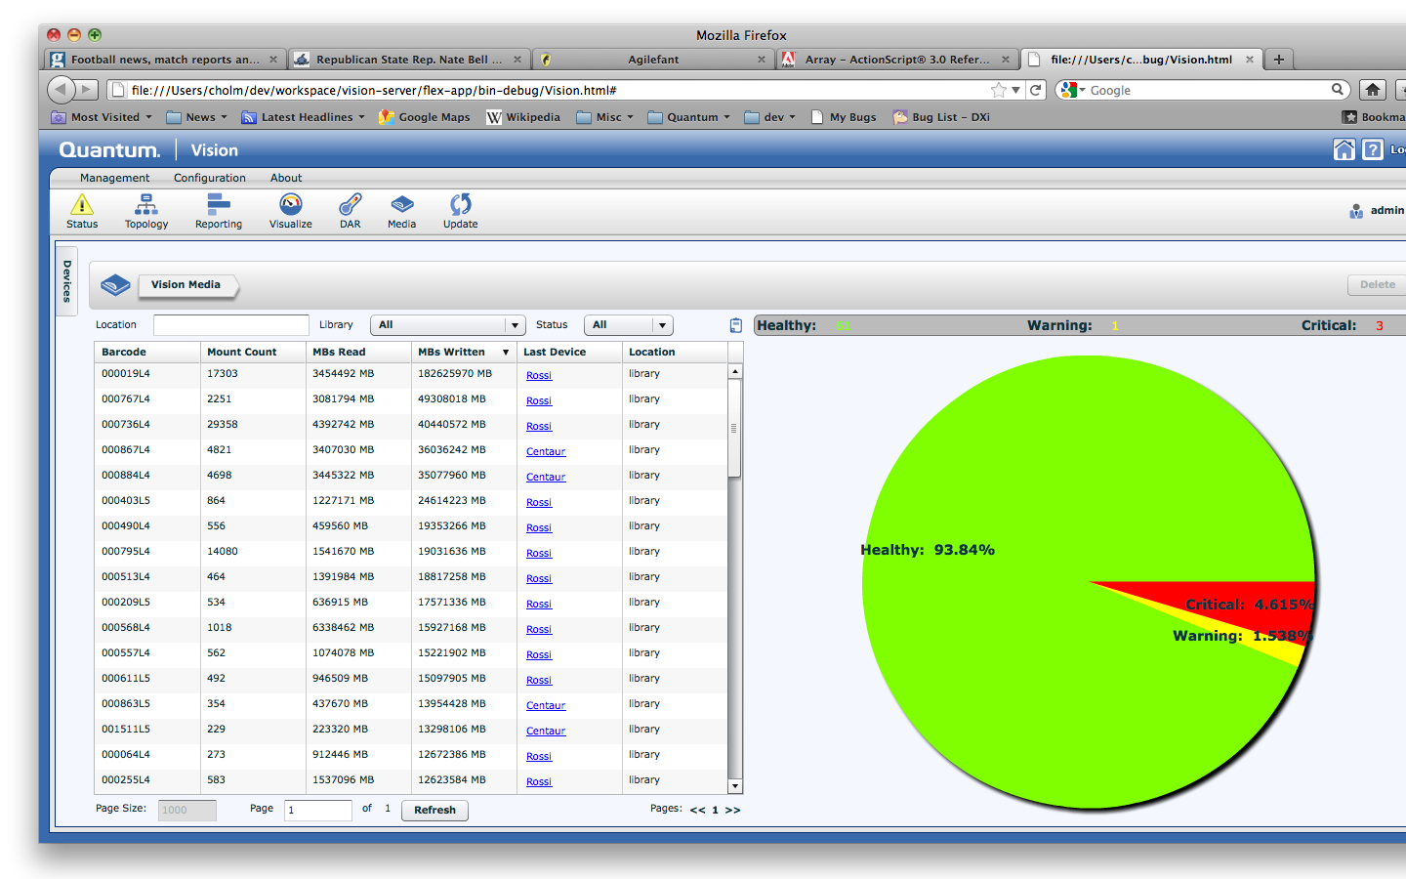
Media console enhancements
Scale to large number of media
  Filtering by location, last library and status
  Paging if there is more than 100 barcode for a specified filtered search
Identifying exported media, and specifying a location
Allowing deletion of exported media
Removed the interactive slider, using the industry standard counts (8000, 10000)
We are using the Thread count instead of mount count
Filtering
Paging
Notes:
Media console enhancements:
The media console had an issue with scaling to a large number of barcodes, we had this problem with at least 2 customers who have a very large number of barcodes (~30000) and the media console was timing out.
We have done several modifications:
- Enhancements to the database for improved performance.
- A separate query for counts (number of healthy/warning/critical barcodes) in order to build the pie chart quickly
- Media console GUI enhancements to allow filtering and paging.
The filtering apply to the whole console both the table and the pie chart.
You can filter by:
Location: typing where the media is currently located, possible values: library, exported or a customer defined location (such as Iron Mountain)
Last Library: Last library the barcode has been seen at. Either all or a specific library
Status: all or a specific status healthy/warning/critical
Customers can specify a location of a barcode by editing the location field for this specific barcode, for example if this barcode was exported to a remote location, and than they can also filter by this location by typing it on the location filter.
When more than 100 barcodes are found for a specific filter, the media console show the first 100 and provide he ability to page through the rest of the barcodes, by fetching 100 at a time
Note: export to a file will export only the result set displayed on the screen
We plan to add streaming capability to the next release of vision (4.2) to allow to export the entire barcode list per filter to a single file
Deletion of media is a new feature added to this console to allow deletion of exported media which are no longer in use from the vision database, and do not show them anymore at the media console
Delete is possible for 1 or more barcodes, by selecting them from t he list using SHIFT or CTRL for multiple barcode selection

Slide 12
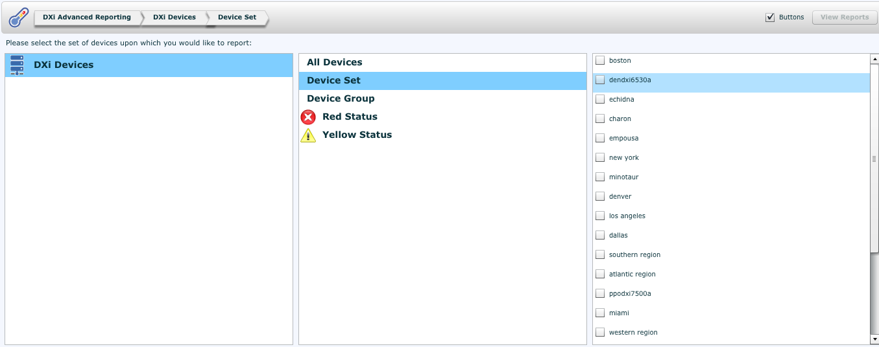
Dxi Advanced Reporting integration
Dxi advanced Reporting is now integrated into vision
Similar to the new interactive reporting are, the DAR page allows customers to customize the reports they want to look at by:
  Selecting a specific device, all devices or a device set
  Selecting the sample period (in days)

Slide 13
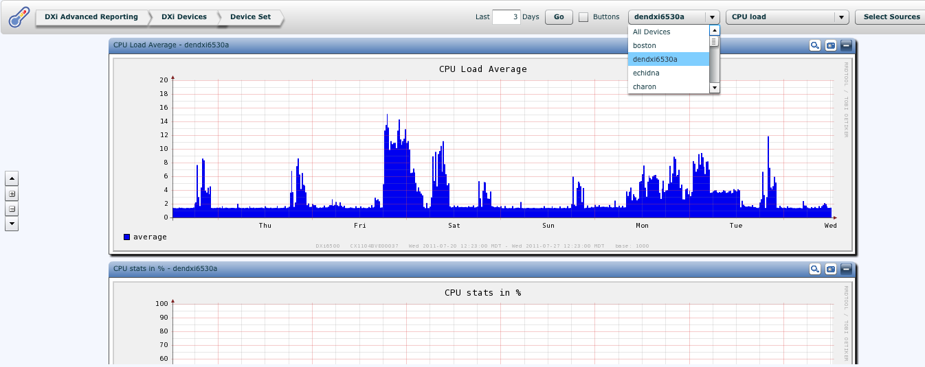
DXI Advanced Reporting
Filter the reports by devices - to see a specific report across devices at the same page
Filter by a specific device to see several DAR reports for the same device (same as DART)
Select device
Select report
Notes:
DXI Advanced reporting is now integrated into vision.
There are 2 possible views:
Select multiple devices, and see the same graph across devices.
For example if you want to compare the capacity across your DXIs
2) View specific reports for a single DXI – similar to what DART provide today.

Slide 14
Demo

