Slide 1
Teton
TOI for Service
Jim Hibbard
June 26, 2012

Slide 2


Slide 3
Agenda
Marketing Overview – Waiming Mok
DXi HW Engineering – Maged Motaweh
DXi SW Engineering – Jurgen van der Linden
Data-at-rest Encryption – Jurgen van der Linden
Metadata Field Capacity Expansion – Jurgen van der Linden
Bug fixes and Known Issues – Rick Courrau/Jurgen van der Linden
Enabler Updates (DAR, Vision, Guardian) – Jim Hibbard
Training Strategy – Tom Sajbel
Service Strategy – Jim Hibbard
Note: Ask questions as we go. Q&A also at the end.

Slide 4
Marketing Overview
Waiming Mok

Slide 5
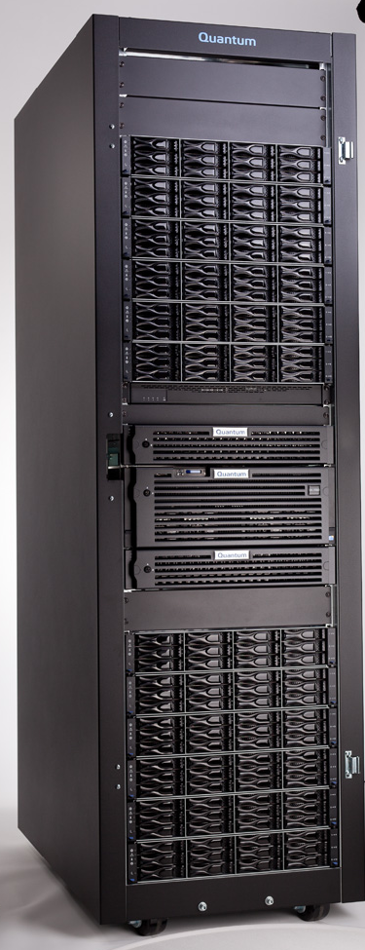
DXi8500 – 3TB Overview
Program Objectives Delivered
  Time to market
  Latest drive technologies (3TB)
  DXi 2.x only
  Data-at-Rest Encryption
  Same or better performance as 2TB version
  Same network connectivity
  Same (2.x) software features
  Upgrade option for existing 2TB-based DXi8500 (add capacity but no encryption support)

Slide 6
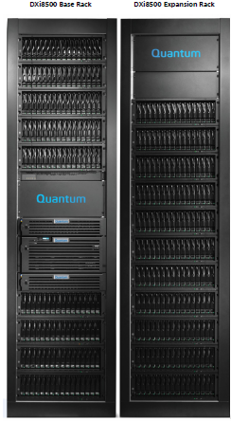
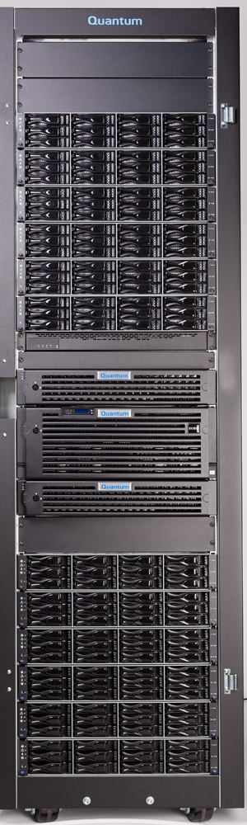
DXi8500 Delivering 330TB in One Rack
Different Appearance from 2TB
330TB Usable
Using 3TB drives
In one rack
320TB Usable
Using 2TB drives
In 2 racks

Slide 7
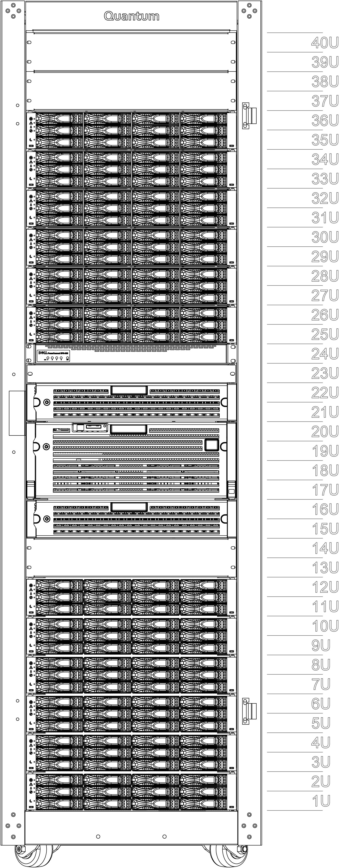
DXi8500 (3TB) Capacity Growth
45TB
12U
75TB
14U
105TB
16U
135TB
18U
165TB
20U
180TB
24U
210TB
26U
240TB
28U
270TB
30U
300TB
32U
330TB
34U
1 Array Module, 1 Metadata controller
2 Array Module, 2 Metadata controllers
© 2012 Quantum Corporation. Company Confidential. Forward-looking information is based upon multiple assumptions and uncertainties, does not necessarily represent the company’s outlook and is for planning purposes only.

Slide 8
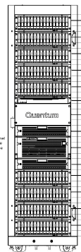


DXi8500 Storage Architecture: 3TB vs 2TB
3TB
2TB
256GB memory
3 internal RAID
SAS to storage
No FC switch
All SED Drives
128GB memory
3 internal RAID
FC to storage with FC switch
No SED Drives
Array
Array
Array
Array
146GB / 15Krpm
2.5” drives
2nd Metadata Module
Added on 5th RAID
Array
300GB / 15K rpm
2.5” SED drives
2nd Metadata Module
Added on 2nd RAID
Array
Array
Array
Array
Array
Array
Array

Slide 9
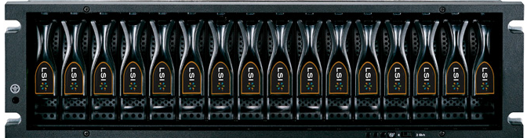
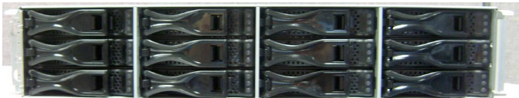
DXi8500 Data Disk Trays - 3TB vs 2TB
DXi8500 Data Disk Tray for 3TB
2U
12 x SATA drives
SAS connect to server
RBOD (Array), EBOD (Expansion)
Management via Ethernet
RAID6 layouts: 5+2 in Array, 5 hot-spares
10+2 in Expansion, 0 hot-spares
DXi8500 Data Disk Tray for 2TB
3U
16 x SATA drives
FC connect to server
RAID and JBOD
Management via Ethernet
RAID6 layouts: 5+2, 2 hot-spares

Slide 10
Optimal Number of Drives in DXi8500 with 3TB
Fewer components => increased system reliability
Little impact on read performance

Slide 11
Similar Performance to 2TB
Inline Deduplication:
  VTL, up to 11TB/hr
  OST, up to 10TB/hr
  CIFS, up to 9TB/hr
  NFS (sync), up to 5.5TB/hr
Read performance similar to 2TB.
Performance without 10% for 45TB and 330TB systems.
Performance Memo by end of June

Slide 12
42% Less Power Consumption with 3TB Drives
42% less power consumption using 3TB drives

Slide 13
DXi8500 Encryption, Separately Priced
Encryption | Feature | Protection | Implementation
Data-at-Rest | Encryption (except China, Russia, Belarus, Kazakhstan) | Physical removal of disk drives or arrays | SED drives Encryption keys on RAID controllers
Data-in-Transit | Replication | Access to data on the wire | Encryption on the fly before transmission
 | Accent (2.2, soon to be new) | Access to data on the wire | Encryption on the fly before transmission
NEW

Slide 14
DXi8500 – Mixing SED and non-SED
SED = Self Encrypting Drive ~ FDE = Full Drive Encryption
Encryption Not Supported:
Mixing SED 3TB and non-SED 3TB (China/Russia/…) drives
  Should never occur – controlled by FRU List
Mixing 2TB and 3TB in DXi8500(2TB)
  Get increased capacity, but encryption is not supported

Slide 15
Base $/GB List Price Benchmarks
~9% premium/TB (range 4-15%):
3TB (no encryption) vs 2TB
High density: 330TB in a single rack (space/power savings)
Latest 3TB technology

Slide 16
Stronger Value of DXi8500 over DD
How much performance does $1000 buy an end user?
DXi8500 w/ Premium Price Very Competitive
2X performance of DD860
40% better price / performance value than DD890
© 2011 Quantum Corporation. Company Confidential. Forward-looking information is based upon multiple assumptions and uncertainties, does not necessarily represent the company’s outlook and is for planning purposes only.
Notes:
© 2010 Quantum Corporation. Company Confidential. Forward-looking information is based upon multiple assumptions and uncertainties, does not necessarily represent the company’s outlook and is for planning purposes only.
16

Slide 17
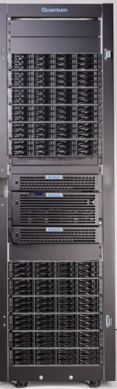
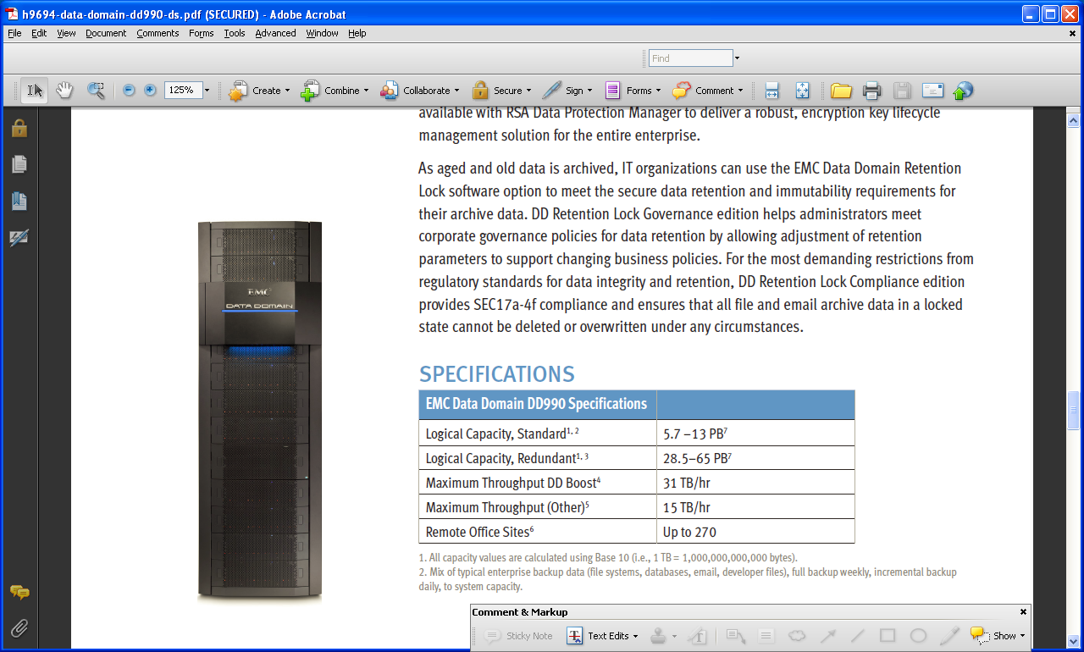
DXi8500 Better Value than DD990
 | 2 x DXi8500 (3TB) |  | EMC DD990
Usable Capacity | 660TB |  | 570TB
Performance (OST) | 20TB/hr (aggregate) |  | 15TB/hr
List Price (includes NAS, VTL, replication, encryption, 10GbE) | $2.28M |  | $2.60M
$ / TB (w/ encryption) | $3,455 - $8,444 |  | $5,324 - $19,629
Value for $1K (w/ encryption) | 2x better |  | -

Slide 18
DXi8500 Orderable Items
 |  | NAM / LAM | EMEA / APAC, except Russia, | China, Russia, Belarus, Kazakhstan | Notes
DDY85-CR00-045A | DXi8500 Base 45TB, Rack, NEMA L6-30 / 230VAC | √
DDY85-CR00-045G | DXi8500 Base 45TB, Rack, IEC 60309 /230VAC |  | √
DDY85-CR00-045C | DXi8500 Base 45TB, Rack, IEC 60309 /230VAC |  |  | √ | No encryption, non-TPM
DDY85-CR00-045J | DXi8500 Base 45TB, Unrack | √ | √
DDY85-CR00-045M | DXi8500 Base 45TB, Unrack |  |  | √ | No encryption, non-TPM
DDY85-FDAM-015A | Array Module (15TB usable, 5 hot spares), factory, Data-at-Rest Encryption | √ | √ |  | Incl. Metadata Module
DDY85-FDEX-030A | Expansion Module (30TB), factory, Supports Data-at-Rest Encryption | √ | √
DDY85-FDAM-015C | Array Module (15TB usable, 5 hot spares), factory, No Encryption |  |  | √ | Incl. Metadata; No encr
DDY85-FDEX-030C | Expansion Module (30TB), factory, No Encryption |  |  | √ | No encryption
DDY85-FLDE-001A | Data-at-Rest Encryption License, initial order (45TB to 165TB) | √ | √
DDY85-FLDE-001B | Data-at-Rest Encryption License, initial order (180TB to 330TB) | √ | √
tbd | Array Module (15TB usable, 5 hot spares), field upgrade, Encryption support | √ | √ |  | Incl. Metadata Module
tbd | Expansion Module (30TB), field upgrade, supports Data-at-Rest Encryption | √ | √
tbd | Data-at-Rest Encryption License, field upgrade (45TB to 165TB) | √ | √
tbd | Data-at-Rest Encryption License, field upgrade (180TB to 330TB) | √ | √
tbd | Array Module (15TB usable, 5 hot spares), field upgrade, no Encryption |  |  | √ | Incl. Metadata; No encr
tbd | Expansion Module (30TB), field upgrade, no Encryption |  |  | √ | No encryption
tbd | FC Array Module (15TB usable, 5 hot spares), field upgrade, for 2TB DXi8500 only | √ | √ | √
tbd | FC Expansion Module (30TB), factory, field upgrade, for 2TB DXi8500 only | √ | √ | √
After July 31, 2012

Slide 19
DXi8500 Options
Options |  | 3TB | 2TB | 1TB
Data-at-Rest Encryption License |  | √ | - | -
Rack or unracked |  | √ | √ | √
Capacity Expansion |  | √ | √ | √
Add-on 10GbE Twinax Copper, dual-port | Existing | √ | √ | √
Add-on 10GbE Optical, dual-port | Existing | √ | √ | √
10GbE Twinax Copper SFP+ Cable Kit | Existing | √ | √ | √
10GbE Optical SFP+ Cable Kit | Existing | √ | √ | √
Increased VTDs (to 512) | Existing | √ | √ | √
Enablers: DXi Advanced Reporting | Standard | √ | √ | √
Enabler: Vision | Existing | √ | √ | √
Enabler: Guardian | Existing | √ | √ | √
Enabler: vmPRO | Existing | √ | √ | √
Gunnison (mike s?) | Q3 | √ | √ | √

Slide 20
DXi8500 Upgrade Paths
 | 1TB | 2TB | 3TB
DXi 1.x -> 2.1.2_85 | No* | No* | n/a
Memory (64->128) | Yes* | n/a | n/a
512 VTD | Yes* | Yes* | Yes
Storage Expansions:
(1TB – FC) | Yes | - | -
(2TB – FC) | Yes | Yes | -
(3TB – FC) | - | Yes* | -
(3TB – SAS) | - | - | Yes
Metadata performance for systems > 200TB, (determined by service only) | n/a | Yes* | n/a
* Only if system has upgraded to 2.x. Supported on cased by case bases.
1.x to 2.x requires 2 step…

Slide 21
DXi8500 Software Versions
Software Versions | DXi 8500 (3TB) | DXi8500 (2TB) | DXi8500 (1TB)
2.2 (est FQ2) | Yes | Yes | Upg for 2.x only
2.1.2_85 (Jun 2012) | Yes | Yes, for 2.x only | Upg for 2.x only
2.1.1.1 LCR | - | Yes, for 2.x only | Upg for 2.x only
2.1.1 | - | Yes, for 2.x only | -
2.1 | - | Yes, for 2.x only | -
1.6_85 | - | Yes | Yes
1.5_85 | - | Yes | Yes
1.4.x_85 | - | Yes | Yes

Slide 22
DXi8500 Roadmap, Subject to Change
 | MA | GA/FCS | Last Ship
1TB-based systems (FC) | Oct 8, 2010 | Nov 16, 2010 | Jun 30, 2012
2TB-based systems (FC) | Aug 11, 2011 | Aug 31, 2011 | ~ Dec 31, 2012
3TB-based systems (SAS) | May 21, 2012 | ~Jun 25, 2012 | -
1TB (FC) upgrade expansions | ~ Oct 8, 2010 | ~ Nov 16, 2010 | ~ Dec 31, 2012
2TB (FC) upgrade expansions | Aug 11, 2011 | Aug 31, 2011 | ~ Mar 31, 2013
3TB (SAS) upgrade expansions | May 21, 2012 | Jul 31, 2012 | -
3TB (FC) upgrade expansions | Jul 31, 2012 | Jul 31, 2012 | -
DXi 2.1 | Dec 7, 2011 | Dec 12, 2011 | -
DXi 2.1.1 | Feb 6, 2012 | Feb 8, 2012 | -
DXi 2.1.1.1 LCR | - | ~ May 2012 | -
DXi 2.1.2_85 | May 21, 2012 | Jun 28, 2012 | -
DXi 2.2 | Q3 C2012 | Q3 C2012 | -

Slide 23
Launch Schedule
Dates | Actions
July 9 | MA
June 15 | First Order Date
June * | GA/FCS
June 30 | Performance Memo
July | Web site, collateral updates
July | External Launch

Slide 24
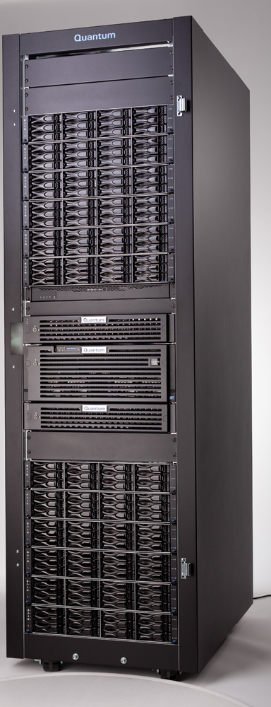
Summary
DXi8500 Supports 3TB Drives
330TB in a Single Rack
Up to 42% Power Savings
Data-at-Rest Encryption
DXi 2.1.2_85 Software
Similar Performance as 2TB
Target June GA/FCS
© 2011 Quantum Corporation. Company Confidential. Forward-looking information is based upon multiple assumptions and uncertainties, does not necessarily represent the company’s outlook and is for planning purposes only.
24

Slide 25
DXi HW Engineering
Maged Motaweh

Slide 26
DXi8500 (3TB) Base System and Expansions
DXi8500 Base System (using 3TB SED Drives), 45TB
Processing node (2x8 core, 256GB), 2x10GbE, 4x1GbE, 6x8gb FC, redundant power, out-of-band IPMI service management, 8x6Gb SAS, 3xMetadata RAID controllers, 15xinternal disks for boot and metadata
Array Module with dual redundant RAID controllers, redundant power, supporting 15TB usable storage (RAID6), 5 hot-spare 3TB FDE drives
Expansion Array with 30TB usable storage (using 12 x 3TB FDE drives)
Metadata controller with 17x300GB/15krpm SED drives
Ethernet switch for internal systems management
Inline deduplication, VTL, NFS, CIFS, OST, PTT, DXiAR, Accent licenses included
1-year Bronze level 5x9xNBD support
DXi8500 30TB Expansion Module
Expansion Array with 30TB usable storage (using 12 x 3TB FDE drives)
6Gb SAS interface, with Ethernet based management
Up to 5 expansion modules per RAID+Metadata controllers
Max 10 expansion modules in a fully populated DXi8500
DXi8500 15TB Array Module, with Hot Spares
RAID Array with 15TB usable storage and 5 hot-spare FPEdrives
6Gb SAS interface, with Ethernet based management
Add this module when growing from 165TB to 180TB
Max 2 array modules in a fully populated DXi8500
DXi8500 Metadata Controller
17 x 300GB/15krpm SED drives
6Gb SAS interface
Add this module when growing from 165TB to 180TB
Max 2 metadata controllers in a fully populated DXi8500
© 2012 Quantum Corporation. Company Confidential. Forward-looking information is based upon multiple assumptions and uncertainties, does not necessarily represent the company’s outlook and is for planning purposes only.

Slide 27
DXi8500-3T (Teton) System Functional Block Diagram

Slide 28
DXi8500 Internal Configuration Comparison (1TB, 2TB and 3TB)
 | 8500-1TB | 8500-2TB | 8500-3TB
Software (initial) | 1.4.1_85 | 1.4.5_85 | 2.1.2_85
R910 | Nehalem | Westmere | Westmere
 | 64GB +64GB Expansion | 128GB | 256GB
 | 146GB HDD (13) | 146GB HDD (13) | 300GB HDD (15)
 |  | 900GB HDDs upgrade*
 | Quad 8GB FC (2) for storage | Quad 8GB FC (2) for storage | Quad SAS (2) for storage
MD1220 | 146GB HDD | 146GB HDD | 300GB HDD
 | 2nd @ 50TB (5A) | 2nd @ 100TB (5A) | 2nd @ 180TB (2R,5E)
FC Switch | Included | Included | Removed
Rack | 2nd @ 100TB | 2nd @ 200TB | 1 Rack
 | Pentair | Pentair or PMM | PMM
Capacity Expansion | 1TB Matterhorn Array/JBOD (10TB)
 | 2TB Matterhorn Array/JBOD (20TB) | 2TB Matterhorn Array/JBOD (20TB)
 |  | 3TB FC Snowmass RBOD (15TB) then EBOD (30TB) | 3TB SAS Snowmass RBOD (15TB) then EBOD (30TB)
Storage HDD | 1TB Muskie, Jupiter K
 | 2TB Muskie, Jupiter K, Mars K | 2TB Muskie, Jupiter K, Mars K
 |  | 3TB Manta Ray* | 3TB Manta Ray SED, non-SED
 |  | 3TB Mars K* | 3TB Mars K SED, non-SED
Capacity Limits | 20TB to 200TB | 40TB to 200TB (1.x code)
 | 20TB to 320TB (w/mem,2.x code) | 40TB to 320TB (2.x code) | 45TB to 330TB (2.1.2_85)
 | *HDD will be either non-SED or SED (disabled)
Notes:
© 2008 Quantum Corporation. Company Confidential. Forward-looking information is based upon multiple assumptions and uncertainties, does not necessarily represent the company’s outlook and is for planning purposes only.
28

Slide 29
DXi8500-3T (Teton) – Configuration Table & Stack-up
Teton Configurations
Capacity (TB) | Rack | R910 | Eth SW | MD1220 | Net APP RBOD | Net APP EBOD
45 | 1 | 1 | 1 | 1 | 1 | 1
75 | 1 | 1 | 1 | 1 | 1 | 2
105 | 1 | 1 | 1 | 1 | 1 | 3
135 | 1 | 1 | 1 | 1 | 1 | 4
165 | 1 | 1 | 1 | 1 | 1 | 5
180 | 1 | 1 | 1 | 2 | 2 | 5
210 | 1 | 1 | 1 | 2 | 2 | 6
240 | 1 | 1 | 1 | 2 | 2 | 7
270 | 1 | 1 | 1 | 2 | 2 | 8
300 | 1 | 1 | 1 | 2 | 2 | 9
330 | 1 | 1 | 1 | 2 | 2 | 10
Notes:
© 2008 Quantum Corporation. Company Confidential. Forward-looking information is based upon multiple assumptions and uncertainties, does not necessarily represent the company’s outlook and is for planning purposes only.
29

Slide 30
DXi8500-3T (Teton) – Cabling
Customer Facing cables:
  Exactly the same as DXi8500 1TB & 2TB
Internal Enclosure management (Ethernet) cables:
  Exactly the same as DXi8500 1TB & 2TB
  Teton uses Fewer Ethernet cables
    Teton uses 9 cables (total)
    DXi8500 1TB & 2TB use 24 cables (total)
Service Cables:
  Exactly the same as DXi8500 1TB & 2TB
Back-end Storage interconnect cables:
  Teton uses SAS cables (2 per storage tray)
  DXi8500 1TB & 2TB use FC cables (2 per storage tray)

Slide 31
DXi8500-3T (Teton) – FW List
Component | Auto-Level/ Auto-Upgrade/ Version Check Only | SW Version 2.1.2_85
R910 backplane | N/A | Product Revision Level: 1.09 A00
R910 SAS BP Expander | N/A | 1.09 A00
R910 on-board Broadcom 1G Ethernet | AL | 6.4.5(A11)
R910 on-board Broadcom 10G Ethernet | AL | 6.4.5(A11)
Optional Broadcom 10GbE card | AL | 6.4.5(A11)
Intel Quad 1G Eth NIC | N/A | 1.5-1
H700 RAID Controller | AL | 12.10.3-0001 A09
H800 RAID Controller | AL | 12.10.3-0001 A09
LSI Quad SAS HBA 9201-16e | AL | F/W: 13.00.01.00 NVDATA: 0C.00.00.02 X86-BIOS: 07.25.00.00
R910 BIOS | AU | 2.7.0 QTM Custom 80D7
R910 iDRAC | AL | IDRAC6: 1.85 A01
OM (Built with the SW) | N/A | OM 6.5
MD1220 | N/A | 1.0.1
Dell 6224 1GbE switch | VCO | 3.3.2.3

Slide 32
DXi8500-3T (Teton) – FW List cont.
Component | Auto-Level/ Auto-Upgrade/ Version Check Only | SW Version 2.1.2_85
Brocade 5120 8Gb FC switch | VCO | Teton: N/A Drambuie: 6.4.0
NetApp RAID Array (Wrigley/Matterhorn) 4980H | AL | CFW; Chessie 2 (Ver 07.77.20.00) NVSRAM (Ver N49XX-777893-400)
Net App EBOD - Ebbets | AL | ESM FW (Ver 0362)
NetApp JBOD (Wrigley) | AL | ESM FW (Ver 98E4)
NetApp HDD's 1TB & 2TB SATA | N/A | Seagate Muskie 1TB & 2TB: MS01 Hitachi Jupiter K 2TB: JKA0A3NA Hitachi Mars K 2TB: MK70A6Q0
NetApp HDD's 3TB NL SAS | N/A | Seagate Mataray 3TB FDE: MS01 Seagate Mataray 3TB Non-FDE: MS01 Hitachi Mars K 3TB FDE: MS04 Hitachi Mars K 3TB Non-FDE: MS03
New version for that release | For reference ONLY

Slide 33
DXi8500-3T (Teton) – PMM Rack
PMM rack has many similarities to previous Pentair rack:
  40U space and same overall height
  PDUs similar layout, use
  Inside mounting rails, utilizes simple “hanger style fixed rails”
Differences or improvements of PMM rack:
  Square holes instead of round, more of a standard mounting type
  Primary and Secondary PDUs are labeled as such
  Front, Lower panel is removable, so you can take off shipping foot and replace with a black lower panel
  Branding on front door as well as branding on top inside front panel (Quantum logos)
  PDU cord length is 3 feet longer than previous rack, for easier plug in overhead in data centers

Slide 34
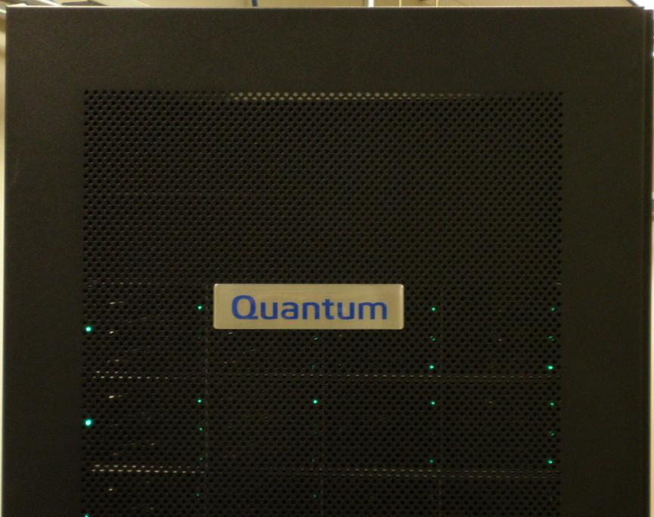
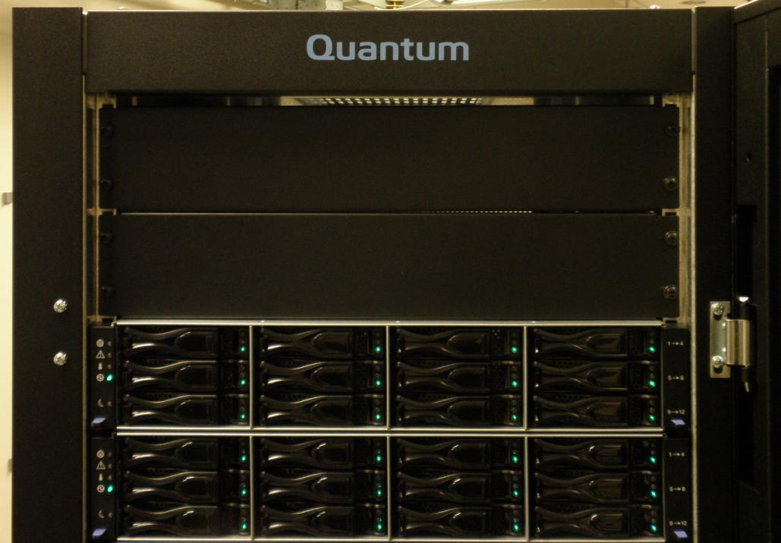
DXi8500-3T (Teton) – PMM Rack new items
Quantum branding on front door and inside top of unit

Slide 35
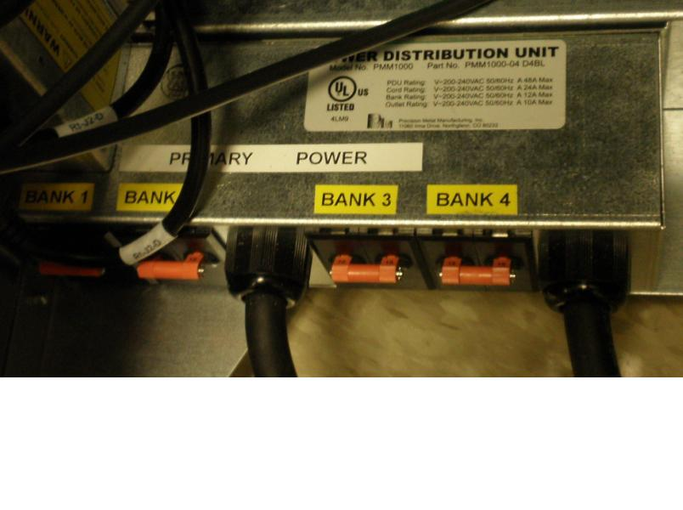
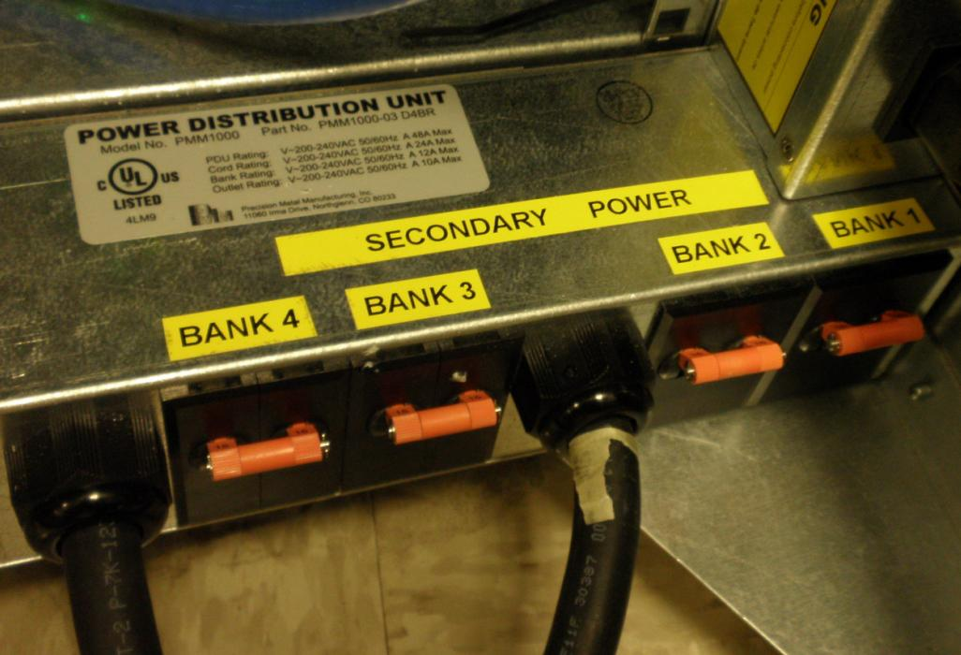
DXi8500-3T (Teton) – PMM Rack new items
Labeling of Primary and Secondary Power on PDUs

Slide 36
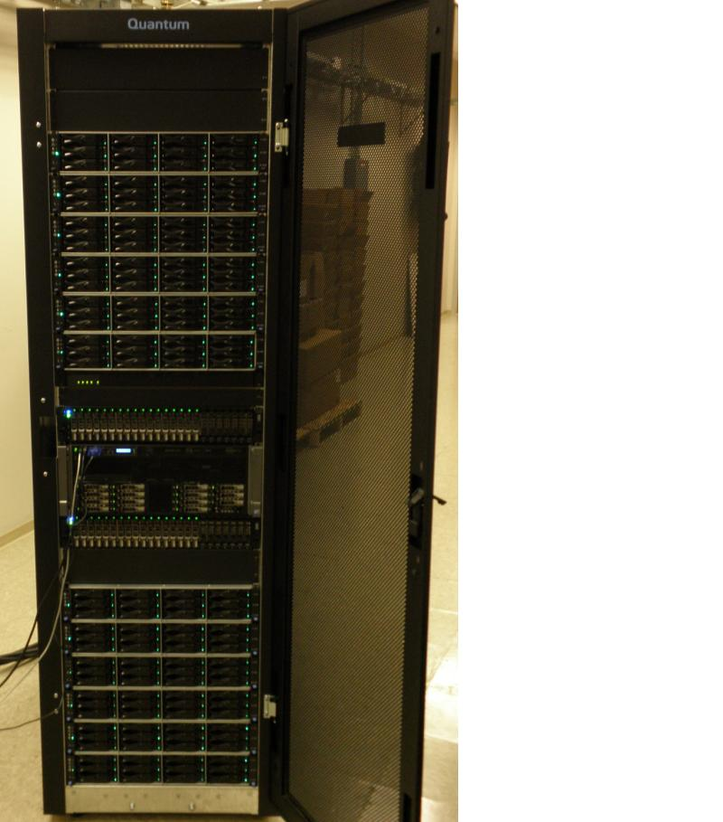
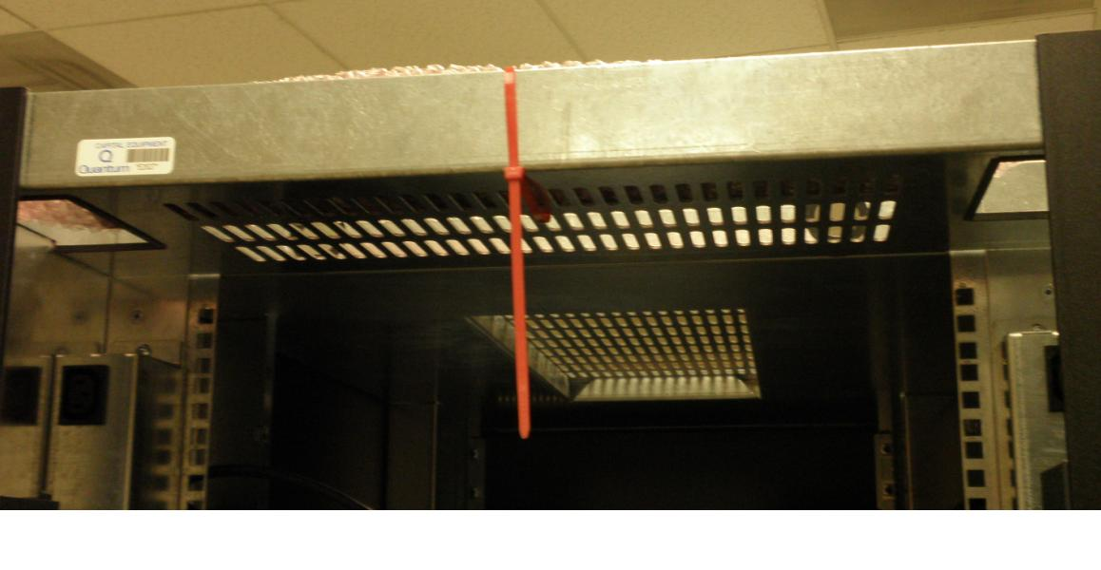
DXi8500-3T (Teton) – PMM Rack new items
Removable lower panel, shown with and without panel, panel shipping position shown on upper back of rack

Slide 37
DXi8500-2T – Capacity Upgrade using Ebbets/Snowmass with 3TB HDDs
Strategy is to add one 3TB array module (RBOD) first and then begin adding 3TB expansion modules.(EBOD).
RBODs has a FC Host Interface Card (HIC)
If the system has only a single metadata module, you must add a second metadata module when adding the first 3TB array module (RBOD).
3 additional 900GB 10K rpm HDDs may be added to the R910 server when expanding systems for some specific customer use cases (details in SW section).
A second 3TB array module (RBOD) is required for 6 or more 3TB expansion modules (EBODs).
The system’s total capacity is limited by the system maximum usable capacity of 330TB.
An expansion rack is required if the rack space required for all array modules and expansion modules (2TB or 3TB) exceeds 27U.

Slide 38
DXi SW Engineering
Jurgen van der Linden

Slide 39
DXi Software Engineering
From a software perspective the changes are in largely in 3 areas:
  Add support for Disk Security (SED drives)
    GUI
    Service menu
    Low level scripts (see /opt/DXi/Encryption)
  Add support for new NetApp Snowmass controllers using SAS/Ethernet
    Updates to enclosure services
    Updates to RAID init and layout
    Updates to storage expansion
  Bug fixes and improvements
    Stay in sync with the pending DXi 2.1.2 release.
    Several updates from DXi 2.2 back-ported

Slide 40
DXi 2.1.2_85 Replication Compatibility

Slide 41
DXi 2.1.2_85 Software Upgrades
DXI 2.1.2_85 Software Upgrades are supported only from 2.1.x releases.
1.x to 2.x is only supported with a 2-step upgrade process, using 2.1.1.
Note however that the read performance problem has not been improved in any 2.x release.
From: To: | 1.4.x | 2.0.x | 2.1.x
Teton | n/a | n/a | YES

Slide 42
DXi 2.1.2_85 Software Upgrades
The software upgrade is just like any other upgrade.
  Upload through GUI
  Activate
  Sit back and have some coffee (bring a newspaper, it will take a while)
Note that the NetApp (Matterhorn) array firmware is not changed, FW stays at the same level as in 2.x (07.77.20)
NetApp arrays Media scan is now enabled.
Same Operating System version.
Same kernel version.
Updated PERC controllers firmware.
Updated BIOS.
Updated iDRAC.
Updated Open Manage.

Slide 43
DXi 2.1.2_85 Storage Expansion
New DXi8500-3T system can only be expanded with 12-bay Snowmass RBOD or EBOD, with 3T drives. All trays are SAS connected.
Existing (Matterhorn based) 8500-2T systems can be expanded with either 16-drive 2T Matterhorn RBOD or EBOD, or with 3T 12-bay Snowmass RBODs or EBODs. All trays are FC connected.
Note, no Snowmass 3T expansion on the 8500-1T systems!
FRU handling is more complicated, larger set of drives to deal with.
RAS ticket will indicate what kind of drives/size failed.
1T and 2T drives are always of the non-self-encrypting type.
Adding a encrypting drive is always allowed (transparent).
Adding a non-SED drive to an Snowmass tray with SED drives not recommended, though it will work. (no RAS, no warnings)

Slide 44
Data-at-Rest Encryption
Jurgen van der Linden

Slide 45
Data at Rest Encryption
A Self Encrypting Drive will always encrypt any data written, and will always decrypt any data read.
By default this is completely transparent to the controller.
  Could use an SED drive to replace any non-SED drive.
Optionally the controller can limit the access to the encrypted data on the drive.
  If enabled, this ties a SED drive to a specific controller by use of an encryption key, agreed between drive and controller.
  No other controller can get to the drive data without the encryption key.
  If such a configured drive gets “lost”, nobody can read the data.
    In fact drive is unusable, unless secure erased.
  Encryption keys managed (invisible) by controllers.
  Keys can be optionally saved (in encrypted form!) to a file, this is where the “passphrase” comes in.
  In some use-cases the encrypted keys are needed for a FRU.

Slide 46
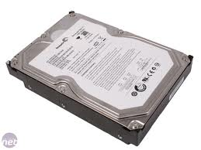
Keys, Password, Keys Recovery File
DXi8500 (3TB), Data-at-Rest Encryption
What Users See: What’s Happening Inside the System:
DXi8500 System
RAID Controllers
SED/FDE Drives
DXi Data-at-Rest Encryption License
Authentication
Key A
Authentication
Key B
Password to Keys Recovery File
Unique Data Encryption Key
(each drive has unique DEK)
Not accessible
Authentication
Key C
Authentication Keys
Recovery File
(Can be stored anywhere)
Authentication
Key D
Seagate: 128-bit AES
Hitachi: 256-bit AES
Authentication
Key E
Each RAID controller is unique with the authentication key
Do not swap RAID controllers without reloading authentication key

Slide 47
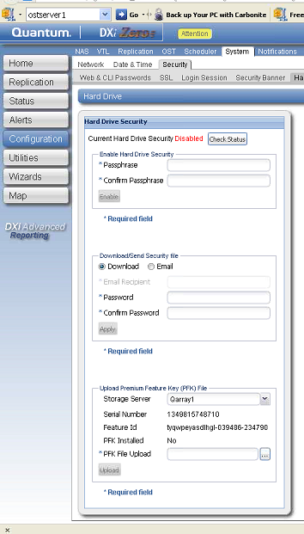
Data-at-Rest Encryption GUI, 4 Actions
STEPS:
Load PFK files for DATA arrays
Setup passphrase, Enable Encryption
Save Recovery File
Re-enable encryption
USAGE:
Once per first setup of data RAID
Once
Multiple times
Multiple times if necessary

Slide 48
Data at Rest Encryption
Service menu also supports Encryption commands:
0) Verify Disk Security Capability - Check if Disk Security is supported.
1) Show Status of Disk Security - Is each LUN Encrypted?.
2) Show Hardware Information - Info needed to create PFK files.
3) Show Premium Feature Status - Shows Premium Feature in RBODs
4) Download Premium Feature file - Sent PFK file to an RBOD.
5) Backup Disk Security Keys - Export Encryption keys info in a ZIP-file.
6) Enable Disk Security - Turn on Encryption for all LUNs.

Slide 49
FRU handling and Encryption
Controller Replacement:
  NetApp: 2 controllers, if 1 fails, simply replace bad one. All settings will be inherited from the good controller.
  NetApp: if both controllers fail at the same time, escalate, this is considered very rare. Any new controller will need to be given the backup encryption files of the old controllers.
  Dell Hx00 PERC controllers, replacement will require going into the Controller BIOS, and supply the passphrase.

Slide 50
FRU handling and Encryption
Drive Replacement:
  Required strategy, “like for like”.
  If a non-SED drive is used in a SED tray:
    If encryption was enabled ➔ continue to encrypt, but the non-SED drive will not have its data encrypted. This is not flagged!
    If encryption was not enabled ➔ continue to work as usual, but enabling encryption will fail due to the non-SED drive.
  If a SED drive is used in a non-SED tray:
    Will operate as usual, transparent.
  Applies to both Dell and NetApp modules
Re-using Drives:
  If encryption was enabled, drive will not work with any other controller. Fix is to “secure erase” the drive. (not recommended nor supported )
  If encryption was not enabled, drive may work.
  On PERC controllers drive must be “imported as foreign”. (not recommended nor supported)

Slide 51
Metadata Field Capacity Expansion
Jurgen van der Linden

Slide 52
Metadata Field Capacity Expansion
All new 8500-3T systems have additional space for SNFS metadata.
An 8500-1T or 8500-2T that may require additional SNFS metadata space can be identified by:
  a) a RAS ticket indicating that the metadata filesystem space is exceeding 85%,
  b) messages in the hourly cvlog statistics that indicates that all metadata stripe groups are becoming full
  c) using the cvadmin show command to identify that all metadata stripe groups are becoming full, Total metadata free space is more important that individual stripe groups running out of space.

Slide 53
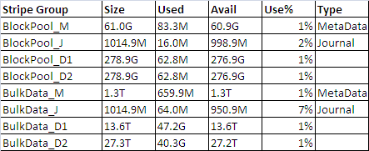
Metadata Field Capacity Expansion
  /opt/DXi/RAID/ls-SG.sh will show all stripegroups sizes:

Slide 54
Adding More Metadata Space
Stop DXi software (service heartbeat stop)
Insert 3x 900GB drives to the R910. (hot-pluggable)
Use service menu to create RAID1 + hotspare
  Service menu ➔ Hardware ➔ Setup internal RAID ➔ Add Metadata Drives
Start DXI software (reboot or service heartbeat start)
Effectively the new RAID1 is added as another stripegroup to the SNFS metadata for /snfs. (bulkdata.cfg)
New installs of 2.1.2_85 will automatically see and use the extra 3 drives.
Be aware of the dedicated hot-spare (last drive), it is only a hot-spare for the 900 GB RAID1, not for anything else
54

Slide 55
Bug Fixes and Known Issues
Rick Courrau/Jurgen van der Linden

Slide 56
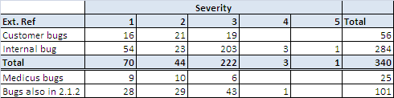
Bug Fixes - Summary
Severity Key
  Sev1 - Catastrophic and unrecoverable.
  Example: data loss, massive system unavailability (reboot loop).
  Sev2 - Severely broken and no workaround.
  Example: short system unavailability, major functionality not working (panic, reboot).
  Sev3 - A defect that needs to be fixed but there is a workaround.
  Example: minor functionality not working.
  Sev4 - Annoyance.
  Example: error messages aren't very clear.
  Sev5 - Request for Enhancement
  Example: Any new functionality, or proposed change to current feature.
Bug Fixes List located in Appendix of this deck.
Strategy for customers waiting for 2.1.2_85 SW upgrade
56

Slide 57
Known Issues
PTR 29792
  IO Operation hang
  During DXi 2.1.2_85 Maturity run a problem was uncovered, where IOs to the backend NetApp arrays run very slow, appearing as if the system was hanging. GUI is unresponsive.Despite extensive reproduction attempts, no controlled reproduction of another occurrence has happened.Not enough information was available from the original occurrence to find a root cause.An infinite timeout for the SNFS fsm process is changed to 600 seconds, such that IOs taking > 600 seconds will produce a fsm core dump and throw a RAS ticket. The fsm will restart, and possibly make the system available for use again.
  TSB generated

Slide 58
Known Issues (cont.)
Name Space Replication performance issue
  The results depend upon the how much data already exists on the target system. For completely empty target, meaning all the data needs to be sent from the source to the target, the improvement is about 20% above existing 2.1.1 code. This was still well below what was seen for 1.4.X code.
  When the target had 95% of the data that was on the source the time to replicate was 86% faster than the entirely empty blockpool. This is MUCH closer to what I’d expect upgrade customers to have in their environment.
  Because of the limited data, I’d prefer to say the range would be 20% - 40% improvement above what was seen in 2.1.1.
  Take away:
    Upgrade from 2.0.X or 2.1.X will improve performance ~20% if the target has no data and ~40% with some data already on the target. Other issues fixed in 2.1.2 would justify upgrade to 2.1.2 from 2.0.X or 2.1.X.
    Upgrade from 1.X is NOT recommended and will decrease replication performance (I assume the upgrade path is ONLY for 4000/6000 running 2.0.1 or higher for 2.1.2)

Slide 59
Known Issues (cont.)
Read Performance issue between 1.x and 2.x (not Teton related)
  The concern here was the G2.0 architectural change in how data is actually dedup’ed. Galaxy 2.0 moved to inline processing and eliminated the disk landing pad (cache). In Galaxy 1.x the data was landed on the disk and then processed for dedup’ed . A side effect of the landing pad was the ability to read back data that was recently written in its non-deduplicated form as long as the disk cache had not flushed it already. So applications that were already running (i.e. 1.x installations) that used this side effect, PPT and write/read/verify use cases, would see a perceived loss of functionality that would preclude them from moving to G2.x architecture.
  We are making improvements to the datapath to optimize read performance. These enhancements will be in future releases of Galaxy post G2.2. It must be noted that we will not be able to reach the G1.x architecture read data performance levels of recently written data but we will be able to close the gap.

Slide 60
Enabler Updates
Jim Hibbard
60

Slide 61
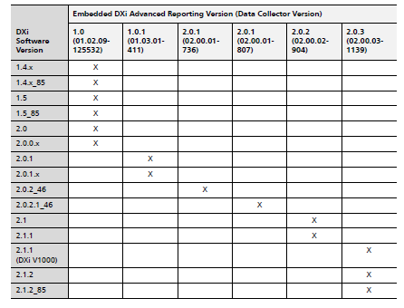
Enabler Updates
DXi AR 2.0.3
  No functional changes for Teton/2.1.2_85
  New Release Notes content for embedded DXi AR versions
Vision 4.2
  No functional changes for Teton/2.1.2_85
Guardian
  No functionall changes for Teton/2.1.2_85

Slide 62
Training Strategy
Tom Sajbel
62

Slide 63
New / Updated Training Courses and Resources
StorageCare Learning
  New: DXi8500 with 3TB Drives Service Update (2-3471a Online Self-Paced)
  Updated: DXi8500 Installation and Support (2-2417 Online Self-Paced)
  Updated: DXi-Series Installation and Hardware Replacement (2-0413 Classroom)
CSWeb
  New: DXi8500 3 TB User Essentials document
  Updated: DXi8500 2 TB User Essentials document
  Updated: DXi8500 Hardware Component Overview document
  Updated: DXi8500 Cabling Overview Job Aid
  Updated: DXi8500 At a Glance document
  Updated: DXi-Series Status and Log Collection

Slide 64

eQuip Training Courses
eQuip – Global Services Extended Learning Library
Related courses:
  RH 033 Linux Essentials Part 1 (2:46)
  RH 033 Linux Essentials Part 2 (2:14)
  RH 033 Linux Essentials Part 3 (2:33)
Access:
  URL: http://equip.quantum.com
  Username: quantum email address
  Password: welcome1

Slide 65
Service Strategy
Jim Hibbard
65

Slide 66
Service Offerings
Same offerings as DXi8500-1T and 2T systems
Standard Warranty
  Bronze Support Plan - 1 year NBD on-site support M-F, 5x9 telephone support and online resources.
Warranty uplifts & extensions
  NEXT BUSINESS DAY GOLD: 1 year 5x9 NBD on-site support, 24x7 telephone support, priority call handling and online resources.
  GOLD SUPPORT PLAN: 1 year 24x7 on-site support, four-hour on-site target response time, 24-hour telephone support, priority call handling and online resources.
  Annual extensions are available for the various warranty offerings supported by this program (Bronze, NBD Gold, and Gold).
Warranty renewals
  Annual renewals are available for the various warranty offerings supported by this program (Bronze, NBD Gold, and Gold).
Installation and Integration Services
  DXi8500 is not customer installable and thus Installation and Integration services are required for a fee. Installation/Integration must be performed by a Quantum Field Engineer (QFE) or a Quantum-authorized service provider (ASP) or a Quantum Third Party Maintainer (TPM).
Upgrade Services
  Post sale capacity upgrades are available for DXi8500 for a fee. Capacity upgrades must be performed by a QFE or a Quantum ASP or a Quantum TPM.

Slide 67
Service Strategy
CSWeb Postings
  Version 2.1.2_85 SW and Release Notes
  Updated DXi8500 user and field service documentation updates
  Updated DXi8500 Service Plan
Release Note Strategy
  Current strategy is to only document bug fixes that customers have hit
  We’re exploring options for Service visibility to all bugs fixed
    Complete list of bug fixed in 2.1.2 and 2.1.2_85 is located in the appendix
Install Base Strategy (DXi8500-1T and 2T based systems)
  No field SW upgrades to 2.1.2_85 supported until 7/31/12
  No field capacity upgrades supported until 7/31/12
  Capacity and SW upgrade Test in progress
  Controlled rollout to select customers ahead of 7/31/12
    Driven by Quality
Dell Support improvements (not connected to Teton program)
  Dell Escalation contacts for US, EMEA, and APAC
    We’re pursuing Dell dedicated resources
  Dell OEM Queue
    Pilot program on the US
  Online portal for monitoring case status
    Coming in mid July

Slide 68
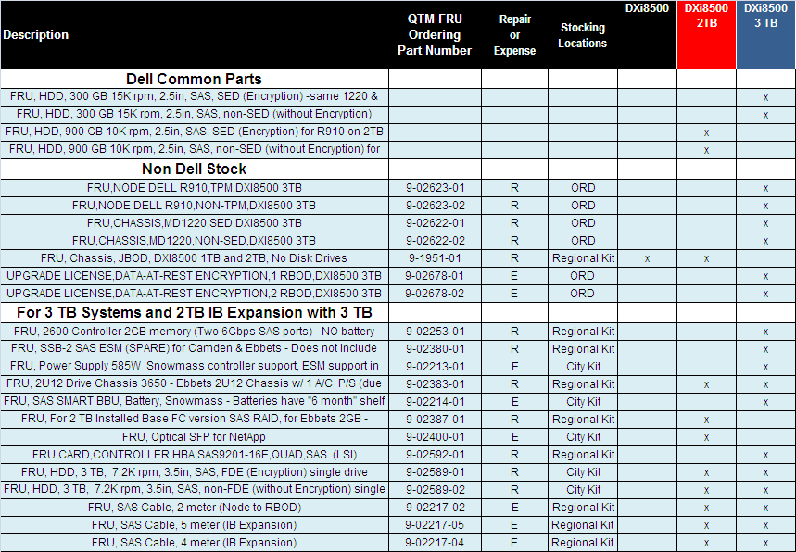
FRU List Updates

Slide 69
Appendix
© 210 Quantum Corporation. Company Confidential. Forward-looking information is based upon multiple assumptions and uncertainties, does not necessarily represent the company’s outlook and is for planning purposes only.
Notes:
© 2008 Quantum Corporation. Company Confidential. Forward-looking information is based upon multiple assumptions and uncertainties, does not necessarily represent the company’s outlook and is for planning purposes only.
69

Slide 70
DXi8500-3T (Teton) – Capacity Points

Slide 71
DXi8500-3T (Teton) – IB Capacity Points

Slide 72
RAID Rebuild Time for DXi8500
Drive Size | RAID Rebuild Time Reconstruct to hot spare No I/O | RAID Rebuild Time Reconstruct to hot spare With I/O | RAID Rebuild Time Copy back to Hot Spare No I/O | RAID Rebuild Time Copy back to Hot Spare With I/O
 | RAID 6 |  | Mirroring
1TB | 06 Hrs 16 Min | Not available | 05 Hrs 12 Min | Not available
2TB | 13 Hrs 02 Min | 23 Hrs 59 Min | 11 Hrs 0 Min | 14 Hrs 01 Min
3TB | 14 Hrs 36 Min | 23Hrs 19 Min | 12 hrs 40 Min | 21 Hrs 15 Min

Slide 73
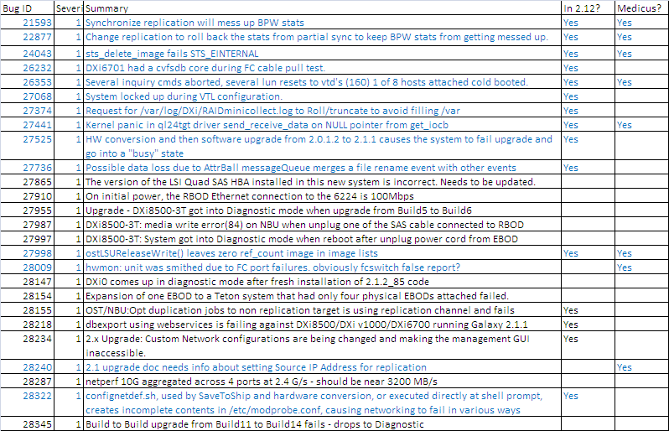
Bug Fixes
Note: Release Notes bug fixes are highlighted in blue.

Slide 74
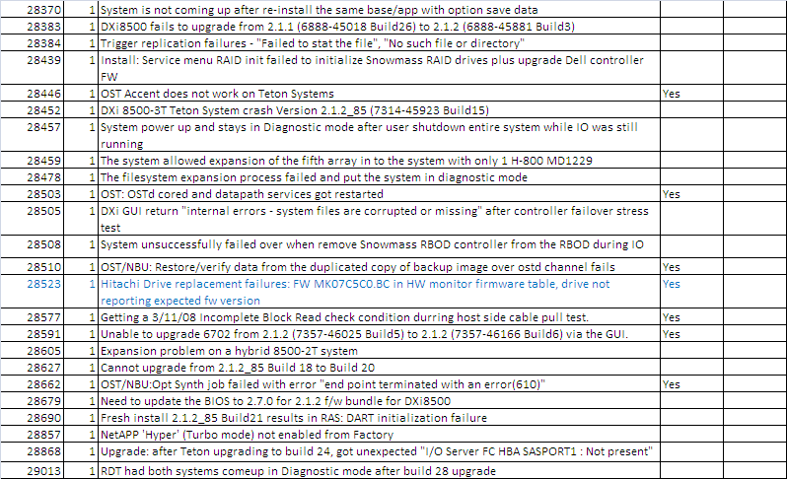
Bug Fixes (cont.)
Note: 2.1.2_85 Release Notes bug fixes are highlighted in blue.

Slide 75
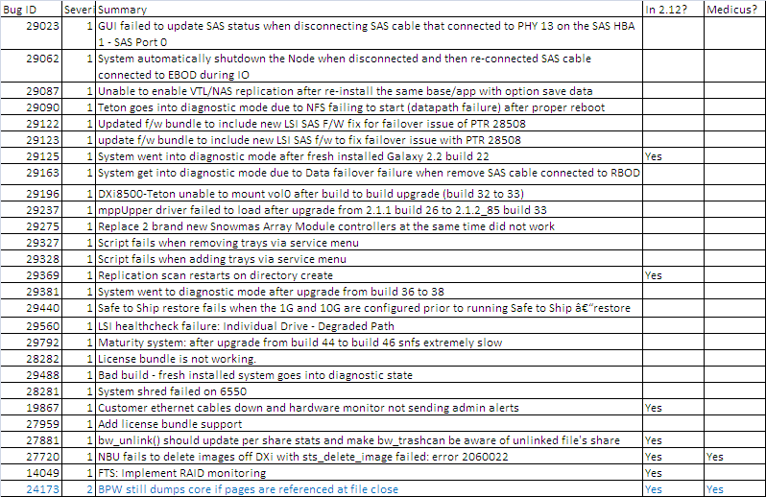
Bug Fixes (cont.)
Note: Release Notes bug fixes are highlighted in blue.

Slide 76
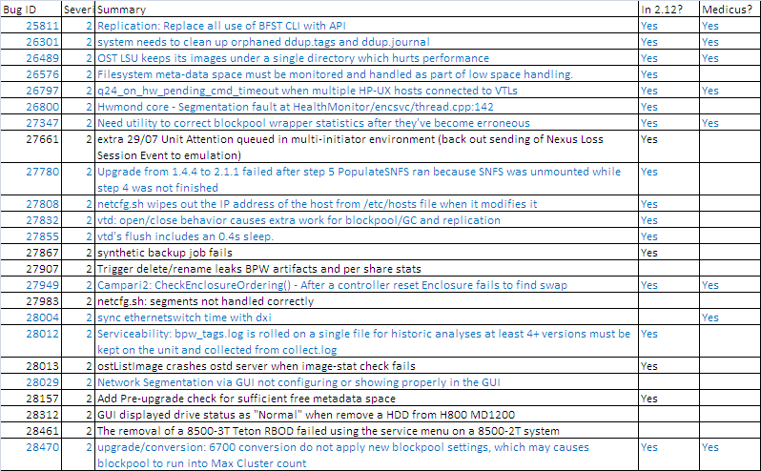
Bug Fixes (cont.)
Note: Release Notes bug fixes are highlighted in blue.

Slide 77
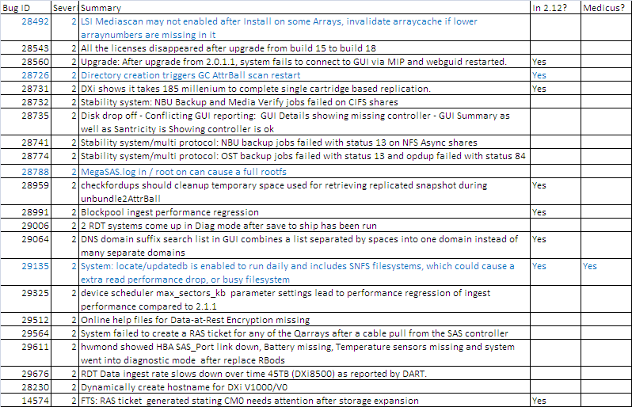
Bug Fixes (cont.)
Note: Release Notes bug fixes are highlighted in blue.

Slide 78
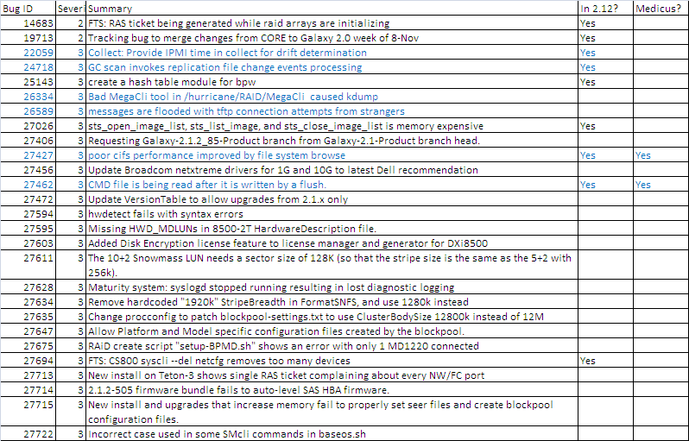
Bug Fixes (cont.)
Note: Release Notes bug fixes are highlighted in blue.

Slide 79
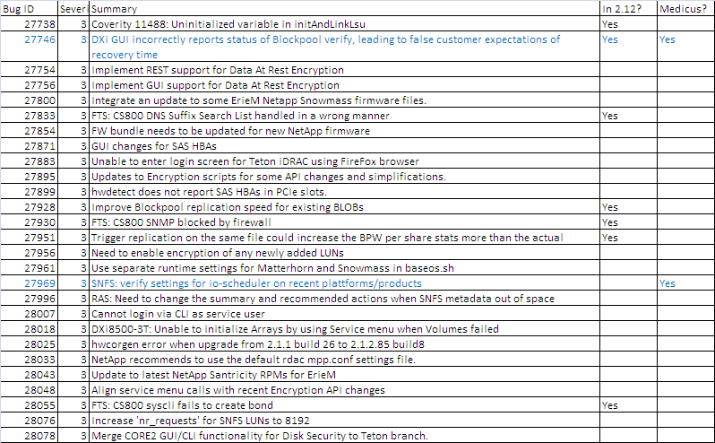
Bug Fixes (cont.)
Note: Release Notes bug fixes are highlighted in blue.

Slide 80
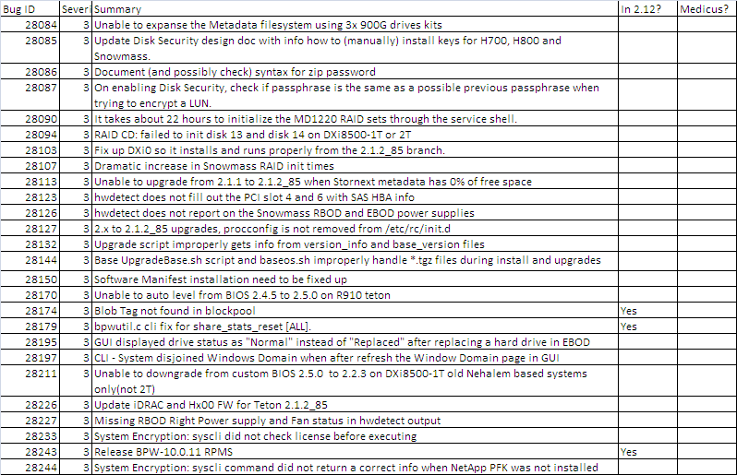
Bug Fixes (cont.)
Note: Release Notes bug fixes are highlighted in blue.

Slide 81
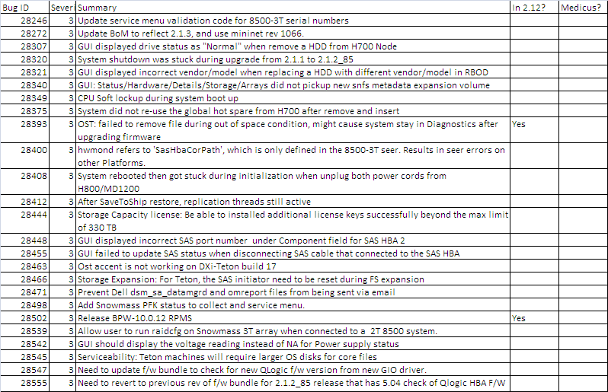
Bug Fixes (cont.)
Note: Release Notes bug fixes are highlighted in blue.

Slide 82
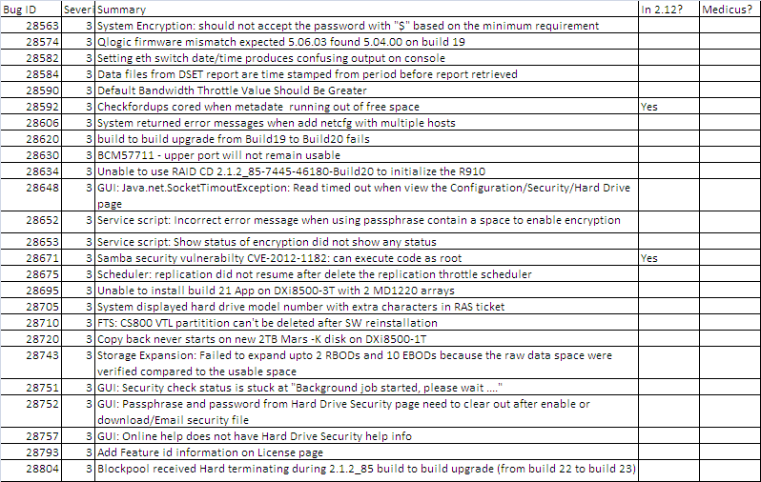
Bug Fixes (cont.)
Note: Release Notes bug fixes are highlighted in blue.

Slide 83
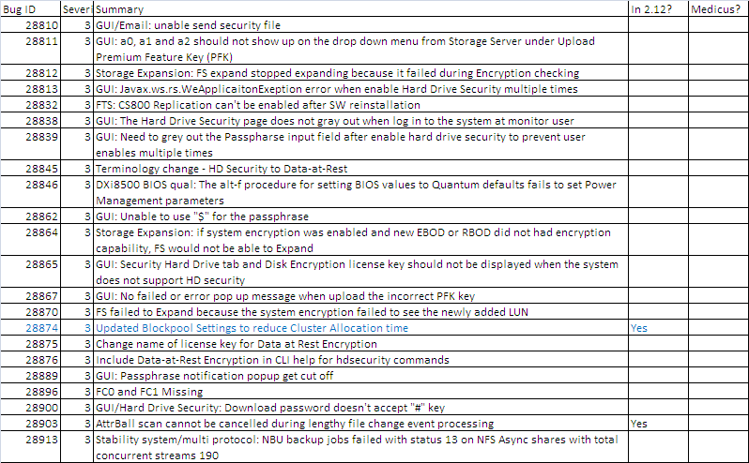
Bug Fixes (cont.)
Note: Release Notes bug fixes are highlighted in blue.

Slide 84
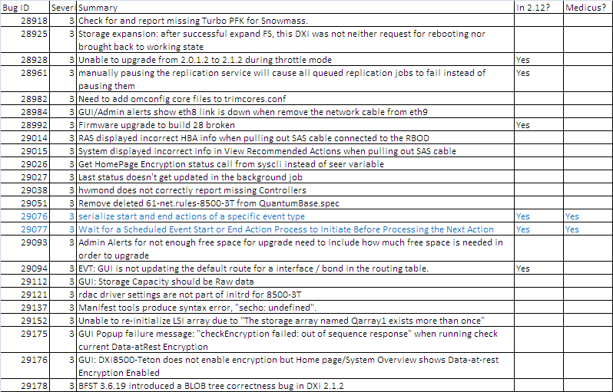
Bug Fixes (cont.)
Note: Release Notes bug fixes are highlighted in blue.

Slide 85
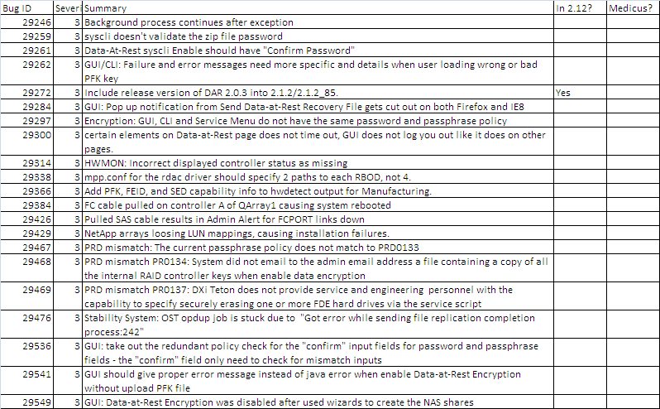
Bug Fixes (cont.)
Note: Release Notes bug fixes are highlighted in blue.

Slide 86
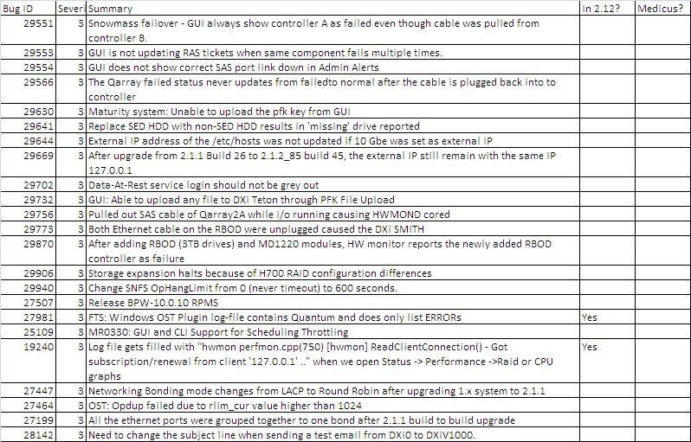
Bug Fixes (cont.)
Note: Release Notes bug fixes are highlighted in blue.

Slide 87
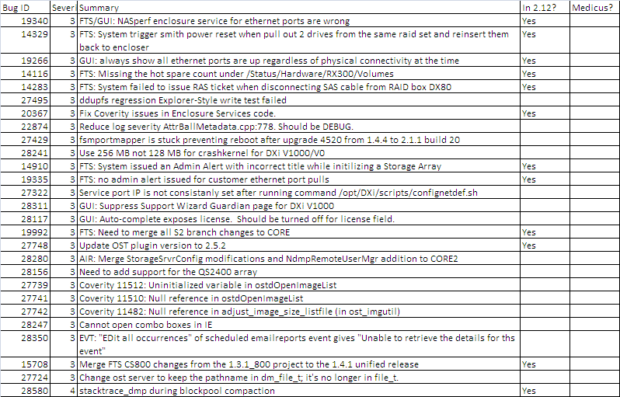
Bug Fixes (cont.)
Note: Release Notes bug fixes are highlighted in blue.

Slide 88
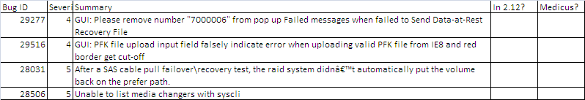
Bug Fixes (cont.)
Note: Release Notes bug fixes are highlighted in blue.

Slide 89
Known Issues in 2.1.2/2.1.2_85 Release Notes

Slide 90
DXi8500 (3TB) – Data-at-Rest Encryption Mode of Operation
Where | Use Cases | Functionality | Recovery
In China, Russia, Belarus, Kazakhstan | No encryption | Normal operation | Same as usual
Rest of the world | No need for encryption | Normal operation | Same as usual
 | Use encryption | Normal operation | -
 |  | Secure Erase feature (2.2) | Restart from beginning
 |  | Drive failure, single data RAID failure | Replace component
 |  | Metadata RAID failure | Reload saved authentication key
 |  | Double Data RAID failure | Rebuild authentication keys
 |  | System upgrade | No issue
 |  | System re-install | Reload saved authentication keys

Slide 91
Questions
91

