Slide 1
StorNext M220 TOI
for Global Service
October 3, 2014

Slide 2

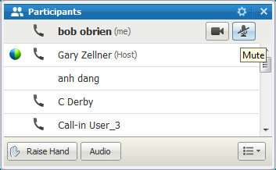
Before we begin…
Please note that we are now using WebEx Audio for the Service NPI con calls. With 50-70 participants on each call, this can represent a significant cost savings to Quantum.
Here are some things you need to know about WebEx Audio:
  Using “*6” does not work on WebEx Audio to mute/un-mute your line.
  You can mute your phone in two ways when using WebEx Audio:
    You can mute your phone from your end (using the mute feature on your phone)
    Within the WebEx, in the participants list, use the button next to your name showing a microphone. Press once to mute. Press again to un-mute.
    If we need to mute all lines, use the “Raise Hand” feature to let us know you need to speak and we will un-mute your line.
Notes:
© 2007 Quantum Corporation Confidential
2

Slide 3
Agenda
Product Overview
Product Hardware
Product Software
Service Model
Notes: Ask questions as we go. Q&A also at the end.
TOI will recorded and posted on Qwikipedia

Slide 4
Product Overview
Presented By: Nick Elvester

Slide 5
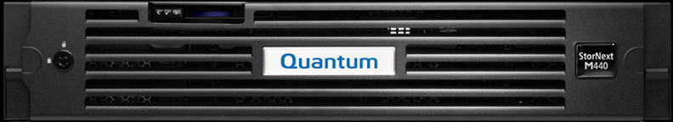
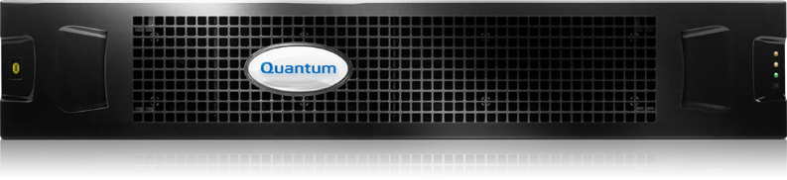
StorNext M220 Overview
Based on M440 MDC node + QXS-1200
Contains metadata and data on one array
Starts with one array, can scale with expansions
Starts at 48TB raw (38.8 TB actual)
Scales to 192TB raw (155.2 TB actual)
2 SAN Clients
Unlimited Xsan Clients
Support for ~100M files
Up to 4 file systems
Ideal Xsan replacement
Powered by StorNext 5
Supports AEL500 for archive
Competes with: Promise A-Class, Facilis, Metasan, Editshare, Scalelogic

Slide 6
StorNext M220 Initial Release via Express
Sold initially through Express program to support accelerated release for EOQ revenue opportunities.
M220 bridges the gap between today’s M440 appliance and the next generation appliance family
Key elements to achieving a short time to market
  Reuse existing M440 server hardware
    No dual SAS HBAs
  No automated setup/installation
    QXS array setup will be done manually via the Radar GUI using “one button” FW
  No monitoring of QXS disk component from MDC node
    No NetApp array
Uses StorNext 5.1

Slide 7
M220, etc.
Available only via select partners
M220 software build separate from M440
StorNext/MDCs and QXS are managed independently
Expect QXS “One Button” for metadata configuration

Slide 8
HW Engineering
Presented By: Brian Raccuglia

Slide 9
M220 Platform
The M220 hardware will consist of the following major components:
  Dual HA servers based on M440 equivalents
  QXS 1200 RBOD and EBOD disk
Features
  Supports the same features and functionality as the current M440 except as defined herein.
  Offered in an HA configuration only.
  Will not support DLC, SMB or NFS.
  Will not support DDM.
  Release on the StorNext 5.1 codebase.
  Provides Storage Manager support identical to M440. A two tray (24 drive) or larger solution will be capable of sustained data transfer rates from the active node to two LTO 6 tape drives at a rate within 20% of their uncompressed throughput capability.

Slide 10
M220 Storage
QXS 1200 disk storage system data path connectivity to the MDCs and clients are FC.
QXS 1200 disks are 4TB NL-SAS.
QXS 1200 disk storage system will include dual controllers.
QXS 1200 disk storage health will not be monitored by the MDCs.
QXS 1200 disk storage system will not include hot spares.

Slide 11
M220 LUN Layout
Building block
  (10+2) RAID-6
  4 TByte Drives
  3 Volumes sliced horizontally
    Volume 0 – StorNext metadata - 1% of capacity
    Volume 1 – HA shared – 2% of capacity
    Volume 2 – StorNext data – 97% of capacity

Slide 12
One Enclosure – 1 file system
1 File System
Maximum Files | 195,312,500
Metadata + HA - GBytes | 1200
Total Capacity - GBytes | 40000
Metadata overhead - GBytes | 1200
Data Capacity - TBytes | 38.80
Average file size - KBytes | 198.66

Slide 13
Two Enclosures – 1-2 file systems
1 – 2 File Systems
Maximum Files | 390,625,000
Metadata + HA - GBytes | 2400
Total Capacity - GBytes | 80000
Metadata overhead - GBytes | 2400
Data Capacity - TBytes | 77.60
Average file size - KBytes | 198.66

Slide 14
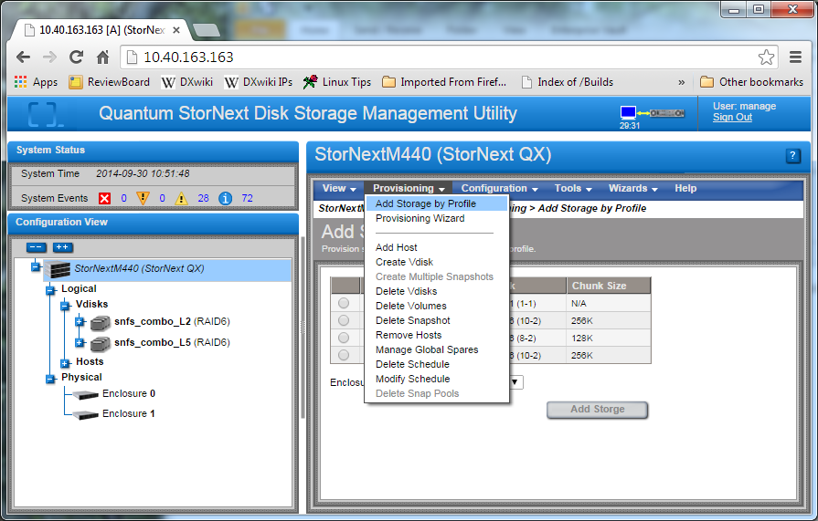
QXS One-Button Config
A new preconfigured RAID layout option is defined for the M220 configurations

Slide 15
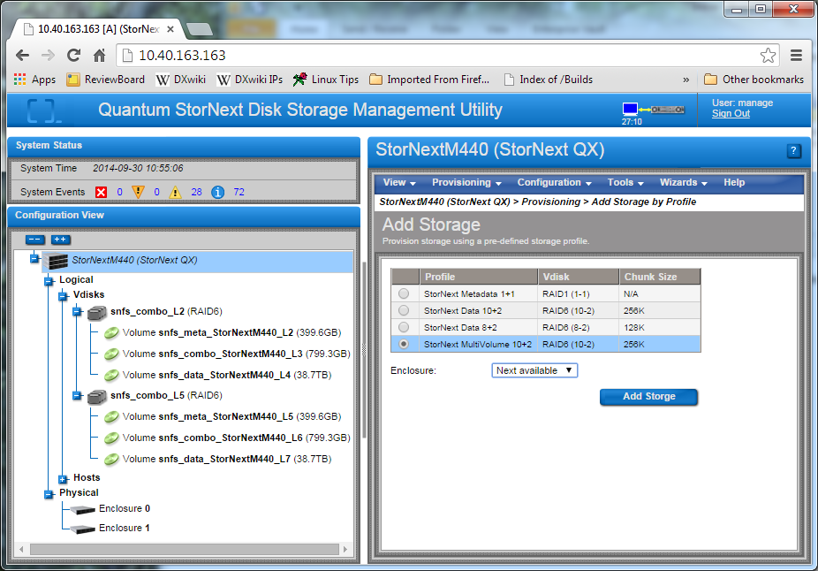
QXS One-Button Config

Slide 16
QXS One-Button Config (cont.)
Each tray of QXS 1200 storage system shall contain 3 SNFS labels of the following format:

Slide 17
M220 Server
M220 servers utilize the same Dell R520 servers as the current M440 with the following exceptions:
  Dual 6Gbps SAS HBA removed
  Bezel badge changed from M440 to M220

Slide 18
M220 Server
FC Cabling options
  The cabling of the QXS array to the MDC nodes can be done using direct connect as shown above or with an optional switch
  Quantum offers a low-cost Brocade 6505 24-port switch for purchase but is not included in the M220 offering

Slide 19
SW Engineering
Presented By: Brian Raccuglia

Slide 20
M220 Service Menu Changes (vs. M440)
The M220 service menu will be very similar to the M440 service menu.
All service menu items referring to the NetApp array are removed.
All service menu items referring to the SAS HBA card and ports are removed.
A new shared file system expansion option is added to perform expansion of the HA shared file system on newly added QXS JBOD trays.

Slide 21
StorNext GUI
There were no StorNext software changes required to support the M220 platform. All changes were done in the platform code so the initial release will contain the exact same StorNext 5.1.0 software image.
There are visible changes on the GUI though due to the removal of the NetApp array.
  On the Hardware Status page in the GUI, you will no longer see a “Cluster Array” entry.
The GUI will also now display “StorNext 5 M220” in the top title bar on the GUI to designate the new M220 model.
All other pages and options on the GUI should remain unchanged from an M440 system.

Slide 22
Licensing
M220 will come preinstalled with 4 StorNext client licenses (2 for customer use and 2 for the MDC server nodes).
HA Failover License pre-installed

Slide 23
Software Installation
M220 RAID CD for the internal server boot drives is equivalent to the M440 RAID CD
The OS installation boot menu contains a new “M220” selection for the OS software installation
The OS file system partitions and sizes stay the same as the M440 image.
All network IP factory defaults and devices are equivalent to an M440 installation.

Slide 24
Service Strategy
Presented By: Jim Hibbard

Slide 25
Service Model
Service Model is identical to existing M-Series Service Model
Service Model Summary:
  Case Management: Global Service Center (GSC), CDS, Kuala Lumpur
  Technical Support: Software Product Support (SPS)
  Field Service: TPM led with Quantum Field Engineer (QFE) as alternate
  Escalations: Dell, Dot Hill Solutions, StorNext Sustaining Engineering (SUS) and Quantum HW Engineering
  Replacement Part Fulfillment: Field Replaceable Units (FRUs) and Customer Replaceable Units (CRUs).
Installation Strategy
  StorNext M220 is NOT customer installable thus Installation and Integration services must be purchased along with the HW. Installation/Integration will be performed by Quantum Professional Services (PS) or a Quantum Authorized Partners.
Upgrade Services
  Software/Firmware is customer upgradable. Customer can choose to purchase a Professional Services (or a Quantum Authorized Partners) engagement to assist with the upgrade.
  Field disk expansion services will be offered and performed by Quantum Professional Services and Quantum authorized partners could also be utilized in special situations.

Slide 26
Service Model (cont.)
Standard Warranty
  NBD Gold – Includes 1 year on-site support Monday to Friday, next-day on-site target response time, 7x24 telephone support and online resources.
Warranty uplifts & extensions
  NEXT BUSINESS DAY GOLD: Includes 5x9 Next Business Day on-site support, 24 telephone support, priority call handling and online resources.
  GOLD SUPPORT PLAN: Includes 24x7 on-site support, four-hour on-site target response time, 24-hour telephone support, priority call handling and online resources.
  Annual extensions are available for the various warranty offerings supported by this program (Bronze, NBD Gold, and Gold).
Current M-Series Service Plan (p/n 0-13940-01) will be updated to include M220 details.

Slide 27
Part Numbers
9-03890-01 QUANTUM STORNEXT,48TB,M220 METADATA APPLIANCE.
9-03890-02 QUANTUM STORNEXT,96TB,M220 METADATA APPLIANCE.
Oracle IB construction in progress
  We’ll make sure Service has the necessary visibility to Express initiated sales vs. formal GA M220s.

Slide 28
FRU/CRU Model
FRU/CRU list p/n 6-68219-01
FRU/CRU list will release initially with support for Express M220 sales and eventually to support formal M220 program
Separate Columns for “Express M220” and “M220”
Separate sections for Quantum vs. Dell field inventory

Slide 29
Documentation and Training
Documentation
  No documentation updates for Express sales
    No M220 doc selection in GUI
  Normal documentation updates for formal M220 GA
  Leverage M440 documentation in the interim
Training
  No training course updates for Express sales
  Training course updates for formal M220 GA

Slide 30
Online Postings
Aside from updated Service Plan and FRU/CRU list, no other docs will be updated for Express sales of M220.
  Service Plan and FRU/CRU list should get posted to CSWeb week of 10/6.
Formal M220 Release will support typical postings on CSWeb, Quantum.com, and CSSP.

Slide 31
Q&A

