Slide 1
Q-Cloud
TOI for Global Service
November 14, 2012

Slide 2
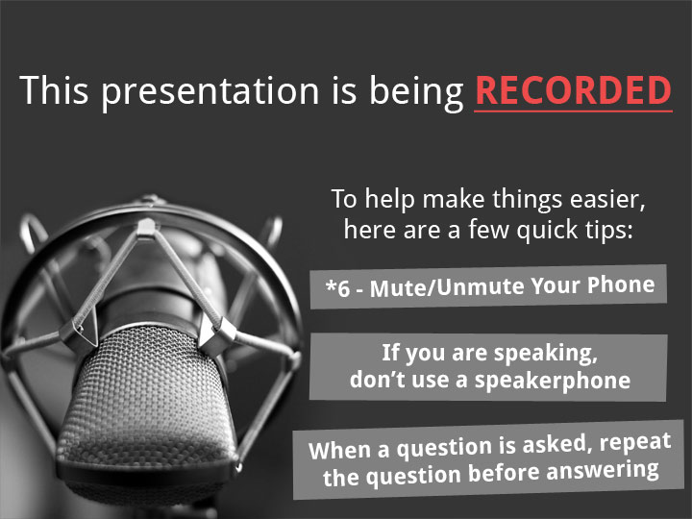

Slide 3
Agenda
Marketing Overview – Robert McDonald
Procurement Process – John Cramer
DXi and Cloud Configuration – Fred Rybczynski
Service Strategy – Jim Hibbard
Note: Ask questions as we go. Q&A also at the end.

Slide 4
Marketing Overview
Presented By: Robert McDonald

Slide 5
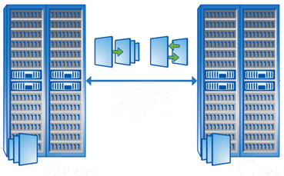



Q-Cloud Overview
On August 28th we changed the economics of cloud based BaaS and DRaaS by applying deduplication to cloud storage
( from $.01/GB protected/Month)
Array-Based Replication Solutions - $10/GB/Month
Filling a Critical Gap in Cloud-Based Data Protection for Enterprise Customers
Cost
Cloud-Only
$0.10-$0.45/GB/Month
Quantum Q-Cloud 1¢/GB/Month
Minutes
Hours
Days
Recovery Time
Notes:
Quantum-branded backup-as-a-service (BaaS) and DisasterRecovery-as-a-service (DRaaS) subscription offering
Business-Class data protection at consumer cloud prices, enabled by Quantum’s patented deduplication technology
1 Cent/GB/Month*
1TB to 1PB of protected data*
Foundation: DXi-Series Deduplication Storage Platform & Quantum vmPRO
Supports all backup solutions on the market
BaaS available 8/27/2012 in US and UK. Dallas, Pittsburgh, Telford UK.
*Assumes an average deduplication ratio of 15:1

Slide 6
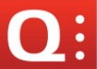

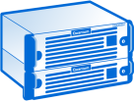




Quantum Q-Cloud –What's included?
Customer Premise (Existing or Purchased Separately)
DXi in Cloud Data Centers
Protected data
Data mover
DXi
What’s included?
A dedicated DXi (until we get multi-tenancy)
DXi Gold support, hosting, incident management, licensing,
20 Mbps public bandwidth (requires 3TB minimum order)
Performance target SLA 99.5%
SQL
Quantum vmPRO
DXi V1000
or other DXi Appliance
VMs
email
Or other
CRM
+ Options
Data transfer for 1-2TB capacity
Private network connectivity (1Gbps)
Public bandwidth upgrades (5,10 or 20 Mbps)
Network engineering services etc.

Slide 7

Quantum Q-Cloud –Pricing
Customer Premise (Existing or Purchased Separately)
DXi in Cloud Data Centers
Protected data
Data mover
DXi
SQL
Quantum vmPRO
Pricing: MSRP based on Capacity
1 to 3TB $0.75/GB/Month
4 to 8TB $0.50/GB/Month
9 to 23TB $0.35/GB/Month
24 to 55TB $0.25/GB/Month
56 to 71TB $0.20/GB/Month
72 to 80TB $0.15/GB/Month
Protected data (e.g. 15 TB)
Deduplication
Deduplicated data (e.g. 1TB*)
DXi V1000
or other DXi Appliance
VMs
email
Or other
CRM
1TB to 1PB
Of protected data
=
1TB to 80TB
Deduplicated, compressed
Q-Cloud Pricing Details
Minimum 12 months cloud storage contract
MSRP incl. all cloud charges (DXi, gold support, hosting and basic management)
20% Distribution/Channel Discount
Assuming a 15:1 dedupe ratio
$0.15/GB/Month of Q-Cloud Storage
Represents $0.01 cost
per protected GB/month
  *Assumes an average deduplication ratio of 15:1

Slide 8
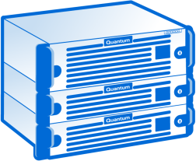
Q-Cloud BaaS: Ideal Use Cases
Single site enterprises needing backup & DR protection
Customer A (existing DXi or Purchased Separately)
Quantum vmPRO
DXi V1000
or other DXi Appliance
OR
other
Multi-site Enterprises using edge-to-core data protection (but Core data are not under DR)
Customer B (ROBO)
Quantum vmPRO
DXi V1000
or other DXi Appliance
Customer B (primary site)
OR
other
Quantum vmPRO
DXi Appliance
Customer B (ROBO)
Quantum vmPRO
DXi V1000
or other DXi Appliance
OR
other
OR
other
Notes:
© 2010 Quantum Corporation. Company Confidential. Forward-looking information is based upon multiple assumptions and uncertainties, does not necessarily represent the company’s outlook and is for planning purposes only.
8

Slide 9
Q-Cloud Benefits
Opportunity for Quantum
  Many of our customers purchase only 1 DXi at a time
  Now we have another way to sell that “2nd” DXi, as Q-Cloud
  Drive DXi sales
  More choices for existing customers
    Multi-site Enterprises using edge-to-core pattern
    Smaller or single site enterprises needing DR protection
Status
  Strong interest and coverage: over 100 articles
  Quotes in the pipe
  1st customer order rec’d
© 2012 Quantum Corporation. Forward-looking information is based upon multiple assumptions and uncertainties, does not necessarily represent the company’s outlook and is for planning purposes only.
Notes:
© 2010 Quantum Corporation. Company Confidential. Forward-looking information is based upon multiple assumptions and uncertainties, does not necessarily represent the company’s outlook and is for planning purposes only.
9

Slide 10
Procurement Process
Presented By: John Cramer

Slide 11
Backup as a Service (BaaS)
Customer Order:
Service Initiation part number – sets up the IB record
Capacity of Service, 1 to 80 TB
  Number of TB’s customer is storing in cloud (deduped)
  Priced per TB per month – with 12-month minimum term
Setup part number for 3-11TB systems
Network Bandwidth
  1TB & 2TB – customer must purchase (not included in base price) : 10Mbps (not to exceed)
  3TB - 23TB: 20Mbps included
  24TB – 55TB: 30Mbps included
  56TB – 80TB: 40Mbps included
  Customer may purchase additional network bandwidth of 5Mbps, 10Mbps, or 20Mbps
Optional - Private Network, 1Gb port

Slide 12
Product Fulfillment

Slide 13
DXi Installation and Configuration
Presented By: Fred Rybczynski

Slide 14
What are the Q-Cloud BaaS Options ?
Any ISV backup to local DXi, replicate to the cloud
  vmPRO backup to local DXi, replicate to the cloud
  Namespace replication
  File & Cartridge-based replication
OST Optimized Duplication (OpDup) from local DXi to the cloud
OST Accent backup to the cloud

Slide 15


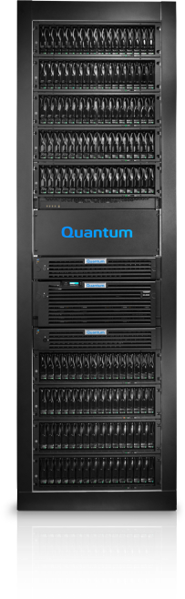
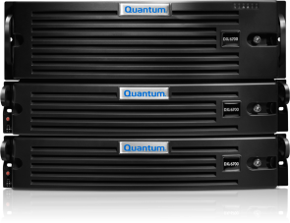
Local BU with any ISV & Replicate to Q-Cloud
Leverage existing BU application, training, and processes
Backup Server
Internal IP 10.xx.xx.70
Backup using any ISV
NAT IP
146.xx.xx.71
NAT IP
13.xx.xx.xx
NAT
server
NAT
server
Cloud DXi
Internal IP 10.xx.xx.xx
DXi Replication
Local DXi
Internal IP 10.xx.xx.71
Firewall
Firewall
Open TCP Ports
80, 1062
Open TCP Ports
80, 1062

Slide 16
Local OST BU & OpDup to Q-Cloud
Build an Archive in the Cloud with full BU App Involvement & Access
OST Management
Backup Server
Internal IP 10.xx.xx.70
NAT IP
146.xx.xx.70
Route B
OST backup and OpDup
Route A
Management
NAT
server
NAT IP
146.xx.xx.71
NAT
server
Cloud DXi
Internal IP 10.xx.xx.xx
Route B
OpDup
Local DXi
Internal IP 10.xx.xx.71
NAT IP
13.xx.xx.xx
Requires DXi CLI command opduptranslate at this DXi
Firewall
Firewall
Open TCP Ports
80, 1062, 3095-3102,
10001, 10002
Open TCP Ports
80, 1062, 3095-3102,
10001, 10002

Slide 17
What does opduptranslate do
Local Symantec master
  Knows cloud DXi by NAT IP address
  Knows local DXi by local IP address
  Does not know that local DXi has NAT IP address
Local DXi knows cloud DXi by NAT address
Cloud DXi knows local DXi by NAT address
When Symantec master OpDups from local to cloud DXi
  cmd: OpDup from local IP to cloud NAT IP … no problem
When Symantec master OpDups from cloud to local DXi
  cmd: OpDup from cloud NAT IP to local DXi IP … problem
    Cloud DXi is not aware of local DXi IP, only NAT IP
    Cloud DXi doesn’t know what to do without opduptranslate
opduptranslate says
  When you see a reference to IP_A (local), convert it to IP_B (NAT)

Slide 18
OST Accent BU to Q-Cloud
Minimal investment, low cost offsite copy, BU App direct access
OST Accent
Backup Server
Internal IP 10.xx.xx.70
NAT IP
146.xx.xx.70
NAT
server
NAT
server
Cloud DXi
Internal IP 10.xx.xx.xx
NAT IP
13.xx.xx.xx
Firewall
Firewall
Open TCP Ports
80, 1062, 3095-3102,
10001, 10002
Open TCP Ports
80, 1062, 3095-3102,
10001, 10002

Slide 19
Q-Cloud Replication & OST Compatibility
The Simple View
 | to Q-Cloud | OST OpDup to Q-Cloud
DXi FW 1.x (Includes DXi7500 and some 8500 & 6700) | Yes | Yes
DXi FW 2.x | Yes | Yes
Accent Backup | Yes | NA

Slide 20
Q-Cloud Replication & OST Compatibility
 | to Q-Cloud that is DXi 2.1 | to Q-Cloud that is DXi 2.2 | to Q-Cloud that is DXi 2.2.1 | OST OpDup to Q-Cloud
DXi FW 1.x (DXi7500, and some 8500 & 670x) | Yes (1) | Yes | Yes | Yes (2)
DXi FW 2.1 | Yes (1) | Yes (1) | Yes (1) | Yes
DXi FW 2.2 | Yes (1,3) | Yes (3,4) | Yes (3,4) | Yes
DXi FW 2.2.1 | Yes (1) | Yes (4) | Yes | Yes
Accent Backup | Yes | Yes | Yes | NA
FW 2.1 requires manually editing replication.conf to add target IP due to source-target authentication checking that is incompatible with the use of NAT servers. Fixed in 2.2.1.
Requires DXi command opduptranslate on cloud target, which is not available in FW 1.x, so cloud target must always be FW 2.x or higher
FW 2.2 has a replication bug that generates some Invalid Packet Size (IPS) packets. Some firewalls, including Quantum IT, block IPS packets so replication cannot occur across those firewalls. This is fixed in FW 2.2.1
FW 2.2 introduces new replication authentication protocol that doesn’t work when NAT servers are involved. The workaround is to manually edit replication.conf. This will be fixed in FW 2.3.

Slide 21
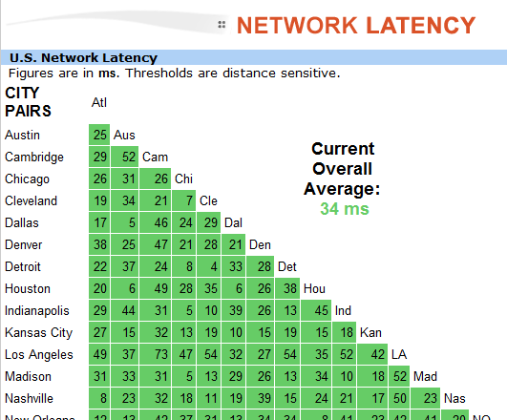
Why Always Pair for Replication w OST OpDup
Network Propagation Latency
OST OpDup will use ostd by default
  One stream per OpDup, DXi default is up to 2 streams in parallel
  BUE OpDup will always use ostd
OST OpDup will use replicationd if configured as a source-target replication pair
  Uses all 8 replication streams
  in parallel
  FW 2.2⁺ uses Continuous
  Replication during BU
Use traceroute to estimate
propagation latency
  It will take you to the cloud
  “front door”
  Blocked at the cloud firewall
Source: http://ipnetwork.bgtmo.ip.att.net/pws/network_delay.html

Slide 22
Pairing for replication – Current Challenges
Why setting up Q-Cloud replication pairing in the traditional way WILL NOT WORK on the source DXi today
  Enter source IPs on the target … No Problem
  FW 1.x and 2.1 require ping, which is blocked at FWs
  FW 2.2 requests a list of authorized sources from the target
    Will have the NAT address of the source
    But the source doesn’t recognize its NAT address
    So pairing fails
  FW 2.3 will fix this
Interim workaround
  Edit /data/hurricane/replication.conf on the source DXi
  Add the target IP at the end of line ReplicationDestination=

Slide 23
Internet Bandwidth Throttle
Customers may have limited BW to the internet that must be shared between normal business requirements and Q-Cloud replication
  Eg, QIT has 4.5 MB/s at CoSprings as well as other access points
There is no Q-Cloud seeding available today
  First-ever replication to Q-Cloud will generate the most traffic
  First-ever traffic could “starve” standard operations
  Routine replication will need much less, but it might still be desirable to limit BW during some business hours
BW Throttle options
  Consider using the DXi BW scheduler
  If V1000, can also use vCenter throttling (used by QIT)

Slide 24
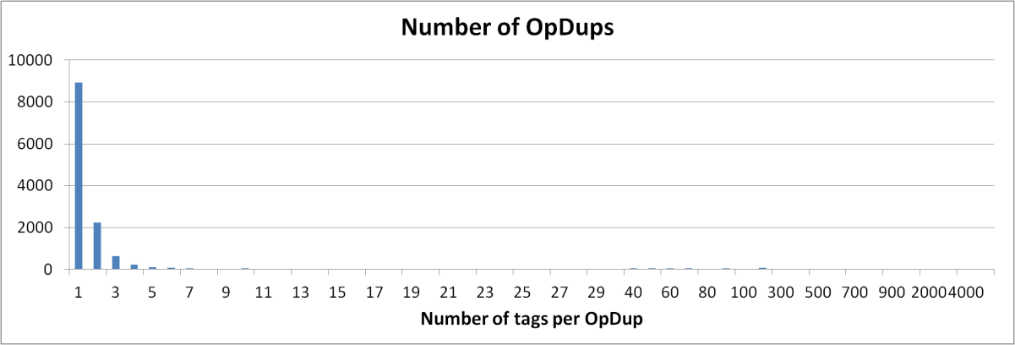
OST OpDup Performance Challenges
Customer Expectation: DXi should fully use 1GbE BW
  NBU log: NBU reports “logical throughput”
  23:32:28.688 [21500.14524] <4> copy_data: begin copying backup id lvvsexch04_1347728667 (duplicate-optimized), copy 1, fragment 1
  23:32:28.751 [21500.14524] <4> copy_data: successfully copied (duplicate-optimized) backup id lvvsexch04_1347728667, copy 1, fragment 1, 106171 Kbytes at 106171000.000 Kbytes/sec (101GB per second. )
  Customer sees DARt Ethernet average as low as 8.5 MB/s – Why so low ?
  Reason for tiny OpDups
    Many DB journal files backed up hourly
    Incrementals with no changed data that only generate NBU header records
  May improve performance by
    NBU Storage-Unit fragment size should be 512 GB (it was)
    Do not configure NBU policies for multi-streaming (generates lots of tiny files)
    More OpDup threads (using 2 threads here)
    <Work with Sustaining Engineering>
SR1448258 – C. Hoare & Co

Slide 25
The Diagnostic Challenges
Network Address Translators (NAT)
  Important when configuring replication pairing
  IE, local IP versus NAT IP
  Important to implement opduptranslate on cloud DXi if using OST OpDup
Some sites have Double-firewalls
  EG: Installed at Xerox
  Sometimes one FW is configured and the other forgotten, resulting in blocked replication
Implementing Quantum Vision (mainly in the cloud)
  Another IP address to add to the firewall rule
  What about remote access to the Vision console?
    Your laptop IP address depends on where you connect to the Internet
    So the firewall rule would need to allow *any* source IP address … Not Likely
StorageCare Guardian

Slide 26
Service Strategy
Presented By: Jim Hibbard

Slide 27
Service Model
Service Offerings
  Source DXi system – normal DXi offerings apply
  Target DXi system – DXi systems installed at Xerox will always have Gold level contract
  Cloud service – Gold level phone support, no onsite support available
Oracle IB Records
  Source DXi and Q-Cloud service share IB record under source DXi system serial number
    The External Reference field (visible in the SR) will show target DXi serial number
  Target DXi always shows installed at Xerox
    The External Reference field (visible in the SR) will show source DXi serial number
Service Model
  Quantum Global Service takes first call
    Source DXi system
      GCH will see two components when opening the SR; DXi system and cloud service
      GCH will always open SR against the DXi system
    Target DXi system
      Calls will come from Xerox
      ASPS will notify the end user that their target DXi system is being serviced
    Cloud service
      ASPS may triage SR against DXi system as an issue with the cloud service for which they will close the original SR and open a new one against the cloud component
  ASPS provides technical support over the phone
    Normal DXi support model processes exist for DXi systems used in Q-Cloud
    Phone support only is available for the Q-Cloud service
  Field Service
    Normal DXi support model processes exist for DXi systems used in Q-Cloud
    No onsite support is available for the cloud service component

Slide 28
Service Model (cont.)
Installation Model
  Normal DXi installation strategy for Source DXi
  QFE will always install the dedicated target DXi at Xerox
    Xerox Data Centers – Dallas, Pittsburgh, Telford, UK
  QFE may assist with setting up Replication source and target. Level of engagement will come from Installation Coordination Team
Xerox Technical Support
  Will engage as an extension of Quantum Global Service for assistance with cloud service related issues.
  Engagement details are located in the Q-Cloud Service Plan
Q-Cloud Service Plan
  Will get submitted to Agile this week
  Will post on CSWeb
Site Survey Updates
  Customer questionnaire with configuration details. Would like to add to standard DXi Site Survey.
Vision
  Installed at Xerox to be used for Xerox monitoring and billing purposes
StorageCare Guardian
  Will be installed at Xerox with Quantum Service access

Slide 29
Q&A

Slide 30
Appendix Slides

Slide 31
Quantum Q-Cloud –How it works?
Customer Premise (Existing or Purchased Separately)
DXi in Cloud Data Centers
Protected data
Data mover
DXi
SQL
Protected data (e.g. 15 TB)
Quantum vmPRO
DXi V1000
or other DXi Appliance
Deduplication
(e.g. 1TB*)
Deduplicated data (e.g. 1TB*)
VMs
email
Or other
CRM
  *Assumes an average deduplication ratio of 15:1

Slide 32









Cloud Landscape
Cloud Backup Solutions
Pros
Pros
Cons
Rip and replace
Gateway Providers
Pros
Local cache
Cons
Costly
Q-Cloud
Pros
Enterprise
Cloud Storage / Archive
All in one
Perceived low cost
Bandwidth reqs
No local copy
Not designed for backup
Local copy
No rip and replace
Dedupe
Cons
Does not support REST
Supports OST
Cons
Not enterprise
Costly
REST based
Use any cloud
Notes:
Cloud Landscape
Cloud Backup Solutions: Costly, don’t scale, must use their backup software
Symantec BUE.cloud $.47/GB/Month without dedupe gets expensive fast
Barracuda BaaS: Dedupe gateway plus cloud storage; must use barracuda bu agent. Barracuda cloud storage is $.25/GB/month
Axcient: Backup appliance and cloud storage;
Asigra:
Cloud Storage: None provide deduplication and all require a gateway to back up applications; no local copy of data
Amazon and others – $0.10 to $0.125 GB/Month (not scalable and not cost effective without dedupe for larger implementations)
Amazon Glacier Amazon Glacier is optimized for data that is infrequently accessed and for which retrieval times of several hours are suitable. Longer recovery times; likely tape.
Softlayer (object based cloud storage; without dedupe, what will recovery times look like and what is cost for larger implementations)
Rackspace
Gateway Providers:
Riverbed Whitewater: Dedupe “gateway” appliance that maxes out at 32TB (deduped capacity, claming 10-30x dedupe). 3x slower ingest than DXi 6700.
Panzura
Twinstrata
SOHO and other cloud solutions (typically no local copy of data)
Evault $0.24 - $0.48/GB/Month (formerly i365 part of seagate) rip and replace
Venyu $2.00/GB/Month rip and replace and expensive
Nirvanix
Mozy (consumer, no scale, Mac or Windows only. No more than 30 days retention)
Carbonite (consumer, no scale, backup Mac or Windows only)
Quantum Cloud Replication Storage
$0.01 - $0.05 GB/Month (based on average15:1 dedupe ratio)

Slide 33
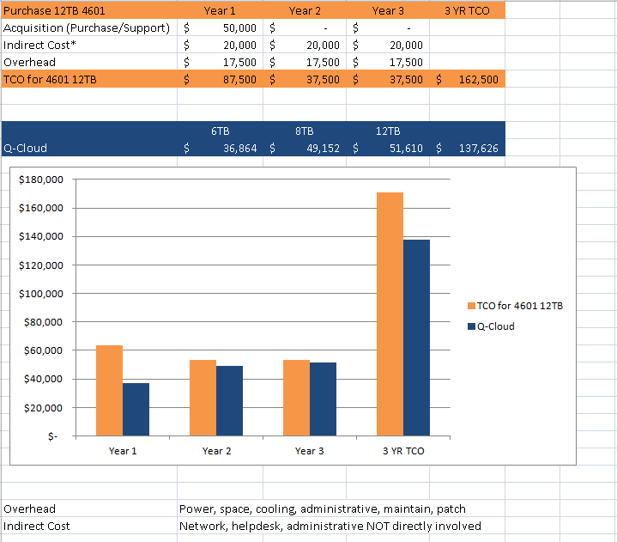
Price Does NOT Equal Cost
The cost of acquisition has gone from 50-60% of the TCO to less than 20-25%. Relying on Moore’s Law to provide lower $/GB will not deliver lower costs of ownership.
What’s The Point?
If TCA is 25% of Total TCO, for every $1 spent on acquisition, an additional $3 is spent on ownership
And remember:
  No physical asset to deal with/dispose of
  Start/Stop on demand
33
Notes:
Total Cost of Ownership (TCO) = Direct cost + Indirect Cost + Overhead Cost
Direct Cost – 3 Year Total Cost of Acquisition
Indirect Cost - Infrastructure costs to support (network, help desk, NOC/mgmt …)
Overhead Costs: Facilities, ping, power, pipe administration

