Slide 1
Lattus Bootcamp
Information Solutions
Presenters: Charlotte Taylor, Keith Lenehan
July 15, 2013

Slide 2
LATTUS RESOURCES
StorNext 4.6, 4.6.1, 4.7

Slide 3
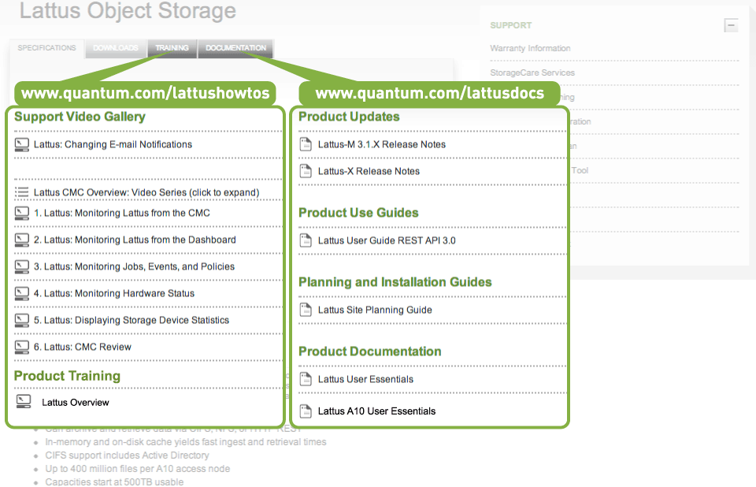
Customer-facing Resources (Ready at GA)

Slide 4
Training Resources for Service (Ready at GA)
Lattus Overview (1-4548 online self-paced)
Lattus Hardware & Network Architecture (2-4552 online self-paced)
Lattus Installation Overview (2-4539 online self-paced)
Lattus Support Overview (2-4540 online self-paced)
StorNext 4.6.1 Service Update (2-4550 online self-paced)
Lattus Installation and Configuration (2-4541 classroom)
Lattus Support and Troubleshooting (2-4542 classroom)

Slide 5
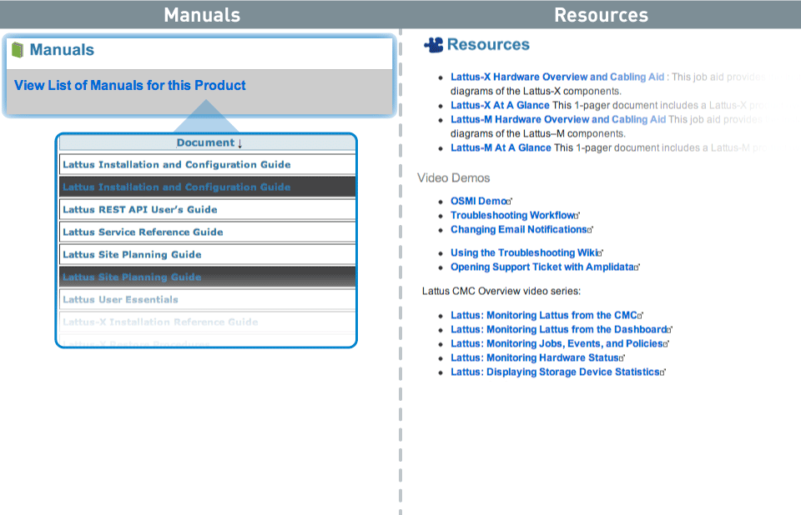
Support & Troubleshooting Resources: CSWeb

Slide 6
Qwikipedia Resources: Quantum Service Only

Slide 7
Installation Resources: CSWeb (Ready at GA)
Lattus Site Planning Guide
Lattus Installation and Configuration Guide
Unpack and Rack Components
Cable the Components
Configure the Switches
Configure the Controller Nodes
Configure the Storage Nodes
Create Storage Policies and Namespaces
Apply Software Patches
Configure Interfaces
Run Performance Verification
Install/Configure the A10 Access Node or M662
Lattus Hardware Overview and Cabling Aid
Lattus A10 Installation Guide
Lattus MDC Configuration and Conversion Guide
StorNext M660 Installation Guide

Slide 8
Doc Enhancements (Ready at GA)
Install/Configure the M662
Doc Enhancement
StorNext content included in these guides.
No need to jump back and forth between guides.
Lattus MDC Configuration and Conversion Guide
StorNext M660 Installation Guide

Slide 9
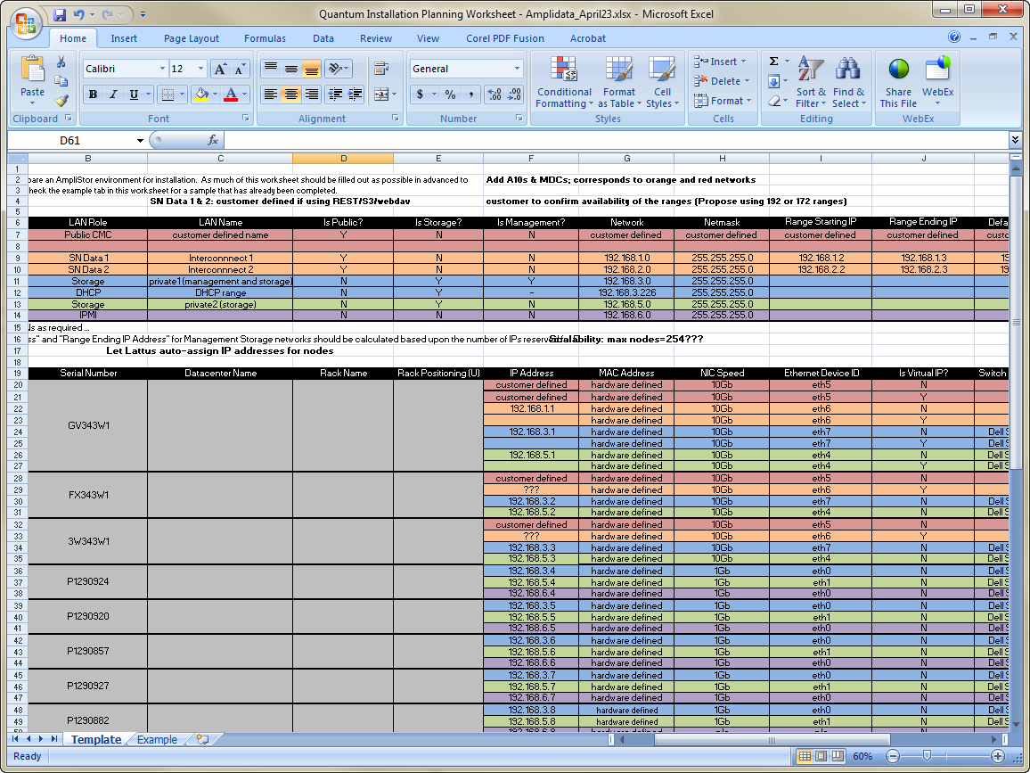
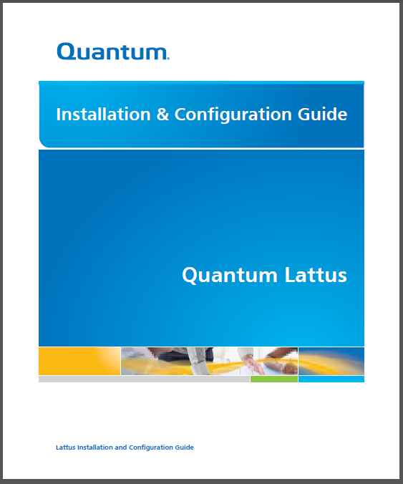
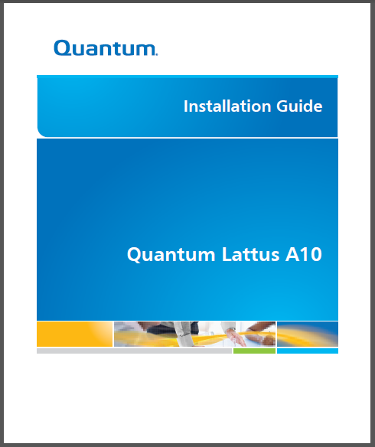
Using Documents 4.6.0, Install and Configure Lattus system components
Which documents?
Lattus Installation Prep Worksheet for your customer's system (pre-sales)
Lattus Installation Guide (now includes cabling)
A10 Installation Reference Guide

Slide 10
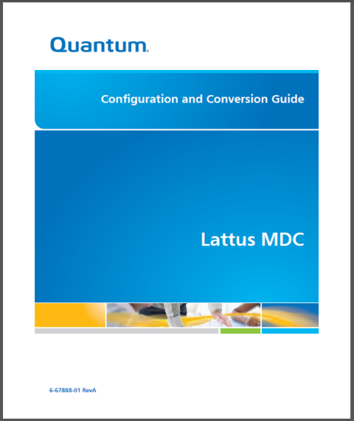
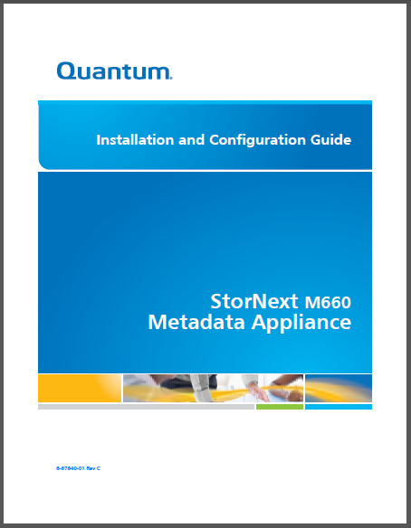
Using Documents 4.6.1, Install and Configure StorNext MDC
Which documents?
Lattus Installation Prep Worksheet for your customer's system (pre-sales)
Lattus MDC Conversion and Configuration Guide - M662 and RYO installation scenarios (SN User’s Guide info.)
StorNext M660 Installation and Configuration Guide (SN User’s Guide info.)

Slide 11
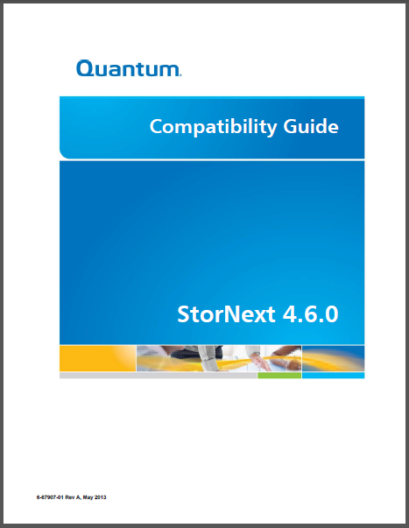
Using Documents 4.6.1, Install and Configure StorNext MDC
Which documents?
Lattus Installation Prep Worksheet for your customer's system (pre-sales)
Lattus MDC Conversion and Configuration Guide
StorNext M660 Installation and Configuration Guide
StorNext Compatibility Guide (SN upgrades)

Slide 12
Contributing Team Members
Docs and Training
Fedri Marrugo, Keith Lenehan, Steve Ino, Dave Goff, Matthew Howell
Media
Dave Mason, Jason Wyatt, Matthew Howell
Edit/QA and Production
Ed Winograd and Jason Wyatt

