Slide 1
StorNext 4.6 Lattus
TOI
Amplidata Topics
Name: Larry Kriewald, StorNext QA
July 2013
Quantum Confidential

Slide 2
Agenda
Day 1
Introduction
  Expectations
  Available Resources
Amplidata Basics
  Lattus Hardware Lineup
  Amplidata System Features
    Interfaces
      CMC
      OSMI, CLI
      AXR
    Monitoring
    qshell
    Logging
    Using the Log Collector
    Networking
  Amplidata System Functions
    DCOS
    Metastores
    Blockstors
    Cache Daemon
    Client Daemon
    Storage Daemon
    Maintenance Agent
Amplidata Basics
  Amplidata System Functions (cont)
    Arakoon
    HTTPS Proxy Server
      Certificates
  Data Structures
    Storage Policies
    Namespace
    Superblocks
    Object
    Check-blocks
Lattus 3.1.4 Install Overview
Lattus Operational Issues
  Start-Up
  Shutdown
  Thresholds
  Admin Email
  Crawl
  Disks (Decommission/Replace)
Multi-Geo Overview
Critical Issues

Slide 3
Expectations
1
Not a end-to-end tutorial of the Amplidata System.
Not a replacement for Quantum provided online training.
This will focus on QA experience with:
  Overview of Amplidata Components
  Amplidata issues
  Amplidata bugs
  Special Recovery to resolve potential Amplidata product defects.
2

Slide 4
Resources
CSWeb https://qsweb.quantum.com/wiki/tiki-index.php?page=Homepage - Public
  Lattus Software
    A10 ISO distributions (OS, packages, system bios setting)
    M662 ISO distributions
    Amplidata ISO, and patch distributions
  Documentation
  Training Links
  Videos
Box https://quantum.box.com/login
  Engineering exchange of project Information
    Project Documentation
    Amplidata Released Documentation
    Amplidata Released Builds
Amplidata Confluence https://confluence.amplidata.com/display/KBEX/Troubleshooting+guide
  Username: quantum_wiki
  Password: wiki4quantum

Slide 5
Next Section
Amplidata Basics – Hardware Lineup

Slide 6

Lattus Hardware Lineup
The Amplistor Lattus Storage System is uses a Dell OEM hardware for (C10) controllers nodes.
C10 Front View
C10 Rear View
The Amplistor Lattus Storage System uses Dell OEM Network Rack Switches (S60).
S60 Front View

Slide 7
Lattus Hardware Lineup
S60 Rear View
The Amplistor Lattus Storage System uses a Dell OEM Network System Switch (S4810).
S4810 Front View
S4810 Rear View
The Amplistor Lattus Storage System uses a Dell OEM Network Interconnect Switch (8132F).
  Or a customer can use their own supplied switch.

Slide 8

Lattus Hardware Lineup
The Amplistor Lattus Storage System uses (S10) Storage Nodes built by Avnet, and the chassis is built by Aaon.
AS-36 Front View
AS-36 Rear View

Slide 9


Lattus-X Hardware Lineup
The Lattus-X A-10 uses Dell OEM hardware R720xd for (A10) Access Node. Used for Lattus + NAS +CIFS File Access
A10 Front View
A10 Rear View

Slide 10
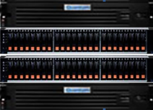
Lattus-M
The Lattus-M M662 Dell and NetApps OEM hardware for Lattus-M M662 for StorNext Managed Use.
2 – Dell Servers (R710)
1 – NetApp Metadata Array (CDE2600-24)
1 – NetApp Metadata Expansion Chassis (CDE2600-24)

Slide 11
Next Section
Amplidata Basics – Lattus System Features

Slide 12
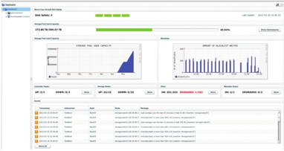
Lattus System Features - CMC
Lattus CMC – Lattus Management Console
  Recommended Interface for QTM customer to access Lattus.
    Installation
    Management
    Monitoring
    Reporting

Slide 13
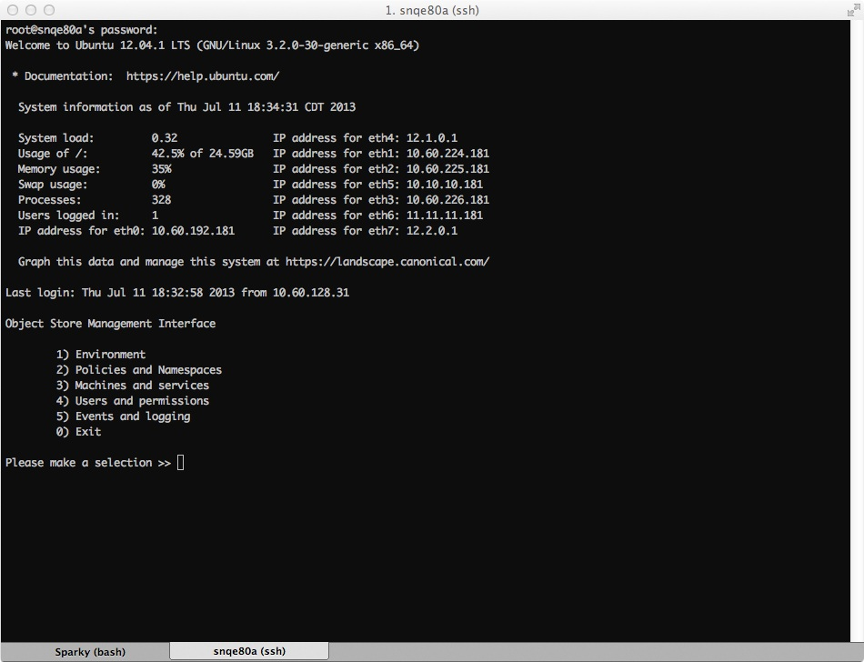
Lattus System Features - OSMI
OSMI (Object Storage Management Interface)
  Menu driven CLI for Administrators for commonly used “qshell” commands (written in python).
  OSMI is presented once a Administrator logs into a terminal for a Lattus controller.

Slide 14
Lattus System Features - OSMI
OSMI (cont)
  Backing up to a previous menu in OSMI sometimes require CTRL+C.
  Exiting OSMI bring you to an OS root shell.
  OSMI usage is documented in the Lattus documentation

Slide 15
Lattus System Features - Interfaces
Interfaces
  AXR (Amplidata REST Interface)
    Can be configured to use HTTP or HTTPS
    By default only 1 client daemon is configured.
    Additional client daemons can be configured using the Lattus CMC
    http and https client daemons can co-exist in one configuration.
  AXR (HTTP)
    Uses the default port 8080
      Different port number can used per customer requirements.
    With http & https configured in one configuration, http requires using ports 8090 & 8091 for http client daemons configurations with (no TLS).
  AXR (HTTPS)
    Default ports recommended for use with StorNext
      Port 443 - Lattus CMC
      Port 444 - Primary Client Daemon
      Port 445 – Secondary Client Daemon

Slide 16
Lattus System Features - Interfaces
Interfaces
  HTTPS (cont)
    Configuration Files:
    RSA encryption Ciphers AES-128, & AES-256 modes are supported.
      AES-128 is more restrictive.
      AES-128 is only supported on some browsers that support TLS 1.1 or higher.
  Certificates:
    Self signed certificates can be generated using openssl commands.
      Required a number of openssl commands.
        Build certificates using a template
Use: | File Location:
CMC | /opt/qbase3/cfg/pound/ui.cfg
REST | /opt/qbase3/cfg/pound/rest.cfg

Slide 17
Lattus System Features - Interfaces
Interfaces
  Certificates
    Generating certificates using StorNext GUI.
      Gets populated to /usr/cvfs/config/ssl
      No import required for Public key
      Required the private key to be uploaded to C10 controllers

Slide 18
Lattus System Features - Interfaces
Interfaces (Certificates cont)
    Build a template for using openssl commands.
root@snqe80a:~/SSL# cat cert.temp [req] distinguished_name = sn-lattus x509_extensions = v3_req prompt = no [sn-lattus] C = US ST = Texas L = Richardson O = Quantum Corporation OU = StorNext Engineering CN = snqe80a.sn.quantum.com [v3_req] keyUsage = nonRepudiation, digitalSignature, keyEncipherment, keyCertSign subjectAltName = @alt_names [alt_names] DNS.1 = snqe80a DNS.2 = snqe80a.sn.quantum.com DNS.3 = snqe80-vip DNS.4 = snqe80-vip.sn.quantum.com DNS.5 = snqe80a-10 DNS.6 = snqe80a-10.sn.quantum.com DNS.7 = snqe80-vip-10 DNS.8 = snqe80-vip-10.sn.quantum.com DNS.9 = snqe80a-11 DNS.10 = snqe80a-11.sn.quantum.com DNS.11 = snqe80-vip-11 DNS.12 = snqe80-vip-11.sn.quantum.com IP.1 = 10.60.192.181 IP.2 = 10.60.192.185 IP.3 = 10.10.10.181 IP.4 = 10.10.10.185 IP.5 = 11.11.11.181 IP.6 = 11.11.11.185

Slide 19
Lattus System Features - Interfaces
Interfaces
  Certificates
    Generate a certificate using openssl commands with a template
    Uploaded .pem files to each controllers using the Lattus CMC.
      Get saved to /opt/qbase3/cfg/pound/server.pem
    Public key needs to be extracted and imported into the StorNext client.
Generate a private key: # openssl genrsa -des3 -out server.key 1024 Generate a CSR from the key: # openssl req -new -key server.key -out server.csr -config cert.temp Remove the password from the key: # cp server.key server.key.org # openssl rsa -in server.key.org -out server.key Generate a self-signed certificate: # openssl x509 -req -days 1460 -in server.csr -signkey server.key -out server.crt Concatenate a crt and private key in the pem file: # cat server.crt server.key > server.pem Verify your pem file: # openssl verify server.pem

Slide 20
Lattus System Features - Interfaces
Example or private key
    Public key needs to be extracted and imported into the StorNext client.
root@snqe80a:# cat /opt/qbase3/cfg/pound/server.pem -----BEGIN PRIVATE KEY----- MIICeAIBADANBgkqhkiG9w0BAQEFAASCAmIwggJeAgEAAoGBAL3M0oCzW0mDI0XN tMQQnhJ+IeRTxYxMJ0YHmsrlaTW5ZXM6YZ8c4+L+sAs2BFxo24yhil5Fcqirm05z uPuMeaP9w/V/SiYr+BU1d3oQXuNfuXjKHzPxTiOm2ScqbHTaNbW0Y9OXIIMVeXZZ nydgcZFfytiG8yv6M5usnyG7WLNDAgMBAAECgYA2zK5yblaLEQvcGZp5iXq6SCSs 8er1qP8l3wg4UKhh1JeP/2k0MXkyjupxMjVsIPJS1klHErIaNQHwUsU0C8kKqs4r iJG4xNGsV9W9ztj5XcgLar0cA2VJE+76duXVrVm036SAob6Vlf6y5CsBs5SK2BnZ vMonP/mgfwUVPgKloQJBAOZ8S6enT0myviVPgAzuPLAfFNglHn7Ftb+GmnGlDmYT b6u4azV2P/5p4oGHHn+EAeG6vxUffxxpue1CTKNuGYsCQQDSz4vg7V4IlGOf+H5t 9WWgkQn+Ca+zZsoMVnDTgjQ3ld0+y37PQy2t06GND+s93tXBKI/6ose05DQM8eTT n1QpAkEAuwuJ1g/YL4Xn+51t3JCGHaPLpbFR8y191mVk9u8tJTeGu4PZNTS2sD+7 usQtwuwdHtQPeBPscuF2Ko5QZZzXCwJBAL+Hr6epIZEb+LPD2mJe3XmXrQNwm4Cc eB/jfVi9aGHEOCIwUsNOXrcamyGFgA5TYdO/3agyss0HtL66G1Ol45kCQQDfAw5p Ks5YJLyb6UlwLCQc3BpCGzCXHKpqsU+FozunNcqdLaGe0kWO8kvA7/+nwWhy85dN 6zRdDSyNibDWhgAn -----END PRIVATE KEY-----

Slide 21
Lattus System Features - Interfaces
Example of Public Key
snqe41a# cat /usr/cvfs/config/ssl/snqe80a.client.pem -----BEGIN CERTIFICATE----- MIID2DCCA0GgAwIBAgIJAO2aijTZryhGMA0GCSqGSIb3DQEBBQUAMIGQMQswCQYD VQQGEwJVUzEOMAwGA1UECBMFVGV4YXMxEzARBgNVBAcTClJpY2hhcmRzb24xHDAa BgNVBAoTE1F1YW50dW0gQ29ycG9yYXRpb24xHTAbBgNVBAsTFFN0b3JOZXh0IEVu Z2luZWVyaW5nMR8wHQYDVQQDExZzbnFlODBhLnNuLnF1YW50dW0uY29tMB4XDTEz MDUxNTIwMTQyOVoXDTE3MDUxNDIwMTQyOVowgZAxCzAJBgNVBAYTAlVTMQ4wDAYD VQQIEwVUZXhhczETMBEGA1UEBxMKUmljaGFyZHNvbjEcMBoGA1UEChMTUXVhbnR1 bSBDb3Jwb3JhdGlvbjEdMBsGA1UECxMUU3Rvck5leHQgRW5naW5lZXJpbmcxHzAd BgNVBAMTFnNucWU4MGEuc24ucXVhbnR1bS5jb20wgZ8wDQYJKoZIhvcNAQEBBQAD gY0AMIGJAoGBAL3M0oCzW0mDI0XNtMQQnhJ+IeRTxYxMJ0YHmsrlaTW5ZXM6YZ8c 4+L+sAs2BFxo24yhil5Fcqirm05zuPuMeaP9w/V/SiYr+BU1d3oQXuNfuXjKHzPx TiOm2ScqbHTaNbW0Y9OXIIMVeXZZnydgcZFfytiG8yv6M5usnyG7WLNDAgMBAAGj ggE2MIIBMjALBgNVHQ8EBAMCAuQwggEhBgNVHREEggEYMIIBFIIHc25xZTgwYYIW c25xZTgwYS5zbi5xdWFudHVtLmNvbYIKc25xZTgwLXZpcIIZc25xZTgwLXZpcC5z bi5xdWFudHVtLmNvbYIKc25xZTgwYS0xMIIZc25xZTgwYS0xMC5zbi5xdWFudHVt LmNvbYINc25xZTgwLXZpcC0xMIIcc25xZTgwLXZpcC0xMC5zbi5xdWFudHVtLmNv bYIKc25xZTgwYS0xMYIZc25xZTgwYS0xMS5zbi5xdWFudHVtLmNvbYINc25xZTgw LXZpcC0xMYIcc25xZTgwLXZpcC0xMS5zbi5xdWFudHVtLmNvbYcECjzAtYcECjzA uYcECgoKtYcECgoKuYcECwsLtYcECwsLuTANBgkqhkiG9w0BAQUFAAOBgQCWmugg 1XwadV1+wzE67fbOG0ysvOYhhp+mjJTvXT8v5iDwI4AiZ7ce787TiWHckaNqhjLY 1Xj2cvXe7QEef2R8qpGQkKSYyFtFWsgwkSBdORTvAtiN49+zEVYKoBpKCPkcemjD K0pHdfIcZQ0gbkPqoZ37yuYlPzrPJekZtsh0HQ== -----END CERTIFICATE-----

Slide 22
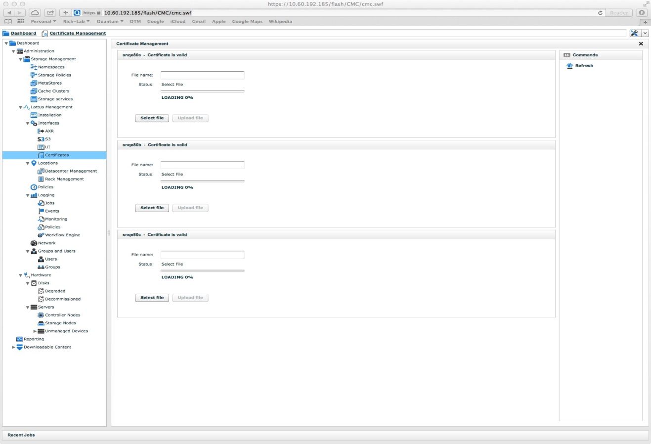
Lattus System Features - Interfaces
Interfaces
  Certificates generated by a Public Certificate Authority have not been tested. i.e. (Symantec, VeriSign)
  Install Certificates
    Select .pem file and upload for each controller

Slide 23
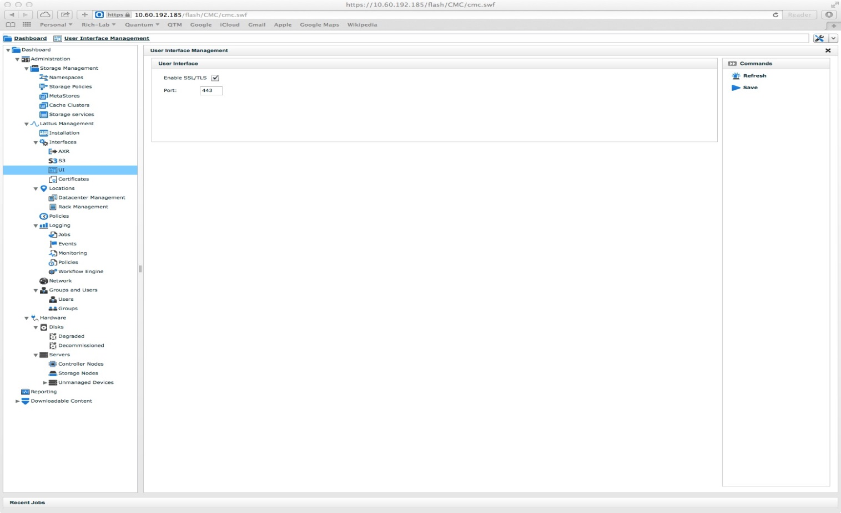
Lattus System Features - Interfaces
Interfaces
  S3 Interface is not implemented in StorNext 4.6.1
  Enabling CMC HTTPS
    Select enable, verify port 443 is populated, and save

Slide 24
Lattus System Features - Logging
Logging
  Most logs use log rotate rules.
    Log rotations happen daily and or weekly.
    Log rotation rules are located in /etc/logrotate.d
  Analyzing logs can be achieved with most OS related utilities used for viewing logs.
  Logs are not in one place.
Log Type: | Path to Log | Lattus Component
Application Server | /opt/qbase3/var/log | Controller and Storage Nodes
Monitoring Agent | /opt/qbase3/var/log/monitoring | Controller and Storage Nodes
Arakoon | /opt/qbase3/var/log/arakoon | Controller Node
Cache Daemon | /opt/qbase3/var/log/dss/cachedaemons | Controller Node
DSS Client Daemon | /opt/qbase3/var/log/dss/clientdaemons/ | Controller Node
Pound Log | /opt/qbase3/var/log/pound | Controller Node

Slide 25
Lattus System Features - Logging
Log Type: | Path to Log | Lattus Component
Hardware, OS, DHCP | /var/log | Controller and Storage Nodes
DHCP - Install | /opt/qbase3/var/log/dhcpd.log | Management Controller
Apache | /opt/qbase3/var/log/apache | Management Controller
Workflow Engine | /opt/qbase3/var/log | Management Controller
Log Collector | /opt/qbase3/var/log/log_collector | Management Controller
Upgrade | /opt/qbase3/var/log | Controller and Storage Nodes, main upgrade log is on the management controller.
DSS Storage Daemon | /opt/qbase3/var/log/dss/storagedaemons | Storage Node
DSS Maintenance Agent | /opt/qbase3/var/log/dss/maintenanceagents | Storage Node

Slide 26
Lattus System Features - Logging
Quickly finding issues in DSS client.log
  Using “grep” for some keywords yields the best results for triage of potential issues between StorNext and Lattus.
  Each connections between StorNext and Lattus has a unique thread ID in the client log.
  You can get a good determination of REST operations from specific keywords to use with “grep”.
Keyword: | Synopsis when it appears in the Log:
put:Namespace | At the completion of a successful PUT
get: Namespace | At the completion of a success GET
delete | At the completion of a successful delete action
blacklist | Whenever a blacklist operation occurs
error | Any DSS operational failure.
[thread id] | All operational logs have a thread ID.

Slide 27
Lattus System Features – Log Collector
The log collector tool is installed in 3.1.4, previous releases had to be manually installed from the “qshell”
  i.qp.findByName('log_collector')
  i.qp.lastPackage.install()
  i.qp.lastPackage.configure()
Using the log collector:
  Logs can be collected from all nodes by using the log collector tool on the management controller.
  The log collector can upload files to Amplidata Support once it completes collection.
  The log collector is run from the OS shell
    # cd /opt/qbase3/apps/log_collector
    # ./log_collector_trigger.py -t all alllogs -d 2013-06-15 -n snqe80a -n snqe80b -n snqe80c -n snqe80-stor-03 -n snqe80-stor-06 -n snqe80-stor-09 -n snqe80-stor-16 -H -N quantum -U 'quantum' -P '!mplist0rN4xt' -D 'QUANTUM-390’
  Multiple logs from a single Lattus system are organized and renamed by the tool.

Slide 28
Lattus System Features – Log Collector
Logs are moved on the management controller in gziped tarballs identified by the dates and system of the collection.
Logs can be collected by type, severity, date, or keyword.
Amplidata support prefers that requested data and logs be uploaded to their evidence site.

Slide 29
Lattus System Features – “qshell”
Using the “qshell”
  CAUTION: The “qshell” should used with direction of Amplidata support.
  Treat the “qshell” with extreme caution, use of commands in the “qshell” can many times cause irreversible damage. Requiring downtime and can cripple a configuration. Be aware of what the command you are going to issue does!
    If you need help understanding what a command does, use the command with "(? “ to get a help information.
  The “qshell” is a python command environment.
    “qshell” commands can only interact with services that are local.
    Commands are methods and are completed with “()”
  Evoke from the OS prompt on the controller
    /opt/qbase3/qshell
  Use standard python syntax
    String syntax: Use single and double quotes
    Integers syntax: uses no quotes
    List syntax: use square brackets “[]”

Slide 30
Lattus System Features – “qshell”
Using the “qshell”
  Command Reference:
“qshell” extension | Extension component affected | Description of Use
i.config.cloudApiConnection.find('main') | Cloud Database Connection | Creates an extension to the cloud database to manipulate it.
q.dss.client | DSS client services | Used for REST. Includes writing files, reading files, deleting files, and inspecting file information in storage.
q.dss.clientdaemons | DSS Client daemons | Used for starting, stopping, restarting, and rotating logs for DSS client daemon processes
q.dss.maintenanceagents | DSS Maintenance agents | Used for starting, stopping, restarting, and rotating logs for DSS maintenance agent processes
q.dss.storagedaemons | DSS Storage daemons | Used for starting, stopping, restarting, and rotating logs for DSS storage daemon processes
q.manage | Apache, workflowengine, dhcp, tftp, arakoon | Used for auxiliary Lattus services to list service status and restart services.
q.qp | Q-Packaging | Used for Qpackage repository interaction

Slide 31
Lattus System Features - Monitoring
Lattus Monitoring
  Access for monitoring is accessed by the Lattus CMC
    Use the Lattus CMC VIP address.
  Main Dashboard in the Lattus CMC
    Worst case Disk safety
    Storage pool capacity
    Blacklist read/write status
    Repair status

Slide 32
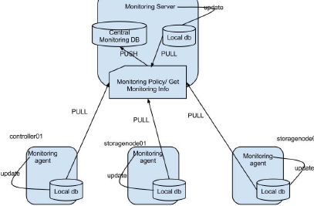
Lattus System Features - Monitoring

Slide 33
Lattus System Features - Monitoring
Each node in Lattus has a monitoring agent.
  A monitoring cycle is on 60 second intervals
  Agent results are updated in the local DB.
    Only modified results will be updated locally.
  When the management node monitoring policy is run.
    it will pull all local copies and synchronize them into the central DB on the central monitoring DB.
    Generates aggregated storage pool usage.
    Populate blacklist suspects, update blacklist graphs.
    Validate the state of remote controllers and storage nodes running status.
    Validate the status of remote controllers and storage nodes agents.

Slide 34
Lattus System Features - Monitoring
The events displayed in the dashboard are the most current and considered “live events”
  Recent events no longer active role and can be seen using “all events” button on the second event screen. Using the more button will get you to the second screen.
  Events older than 7 days role off the dashboard by default. Depending on your log rotation scheme, these logs can disappear after 7 days.
  Event detail can be viewed by selecting the specific event.
  Phone Home “event escalation” can be configured for a collections of daily events depending on the severity level chosen
  Hardware status monitoring can be viewed from the hardware tab.
    Provides Node status
    Degraded disks and metastore SSD’s

Slide 35
Next Section
Amplidata Basics – Lattus System Functions

Slide 36
Lattus System Functions
Where is my data??
  Metadata resides in the Metastores
  Data resides in the Blockstores
The Amplidata System is built upon Ubuntu Operating System and has a unique software stack.
  DCOS Operating System
    Ubuntu version 12.04 LTS
    Uses a modified kernel modified by Amplidata
    Controller Node HDD’s use Linux RAID 1
    Storage Node also uses Linux RAID 1
MetaStores:
  Depends on a Arakoon Cluster underneath the Metastores, with 2 active members.
  (C10) Controller Node SSD is required.
  Metastore’s requires 3 SSD (1 for each controller).

Slide 37
Lattus System Functions
Metastores (cont)
  Internal defined metastores
    env_metastore - 5GiB
    framework metastore – 20 GiB
  User defined metastores
    Objects
Blockstores
  A blockstore has a unique identifier within a Lattus configuration.
    The blockstore ID is recorded in a file under the dss mountpoint as well as the configuration database.
    Blockstore ID can also be acquired by using the qshell command “print q.dss.manage.showLocationHierarchy()”
    Decommissioned disks will show a “ABANDONED, failed” status.
  A storage node contains blockstores, 1 blockstore per disk.
  Blockstore states are managed by the DSS processes, or can manually by changed.

Slide 38
Lattus System Functions
A blockstore tlog directory structure looks like:
  /mnt/dss/dss5/blockstore/ns/0/0/2Sc3UShWB=of6lzExBsISN/_tlog
Note the following:
  All storage nodes have all blockstores in /mnt/dss/
  The dssX number is not the same as the blockstore ID. On AS36 nodes, there will be a dss1, dss2, dss3 etc… on every single node.
  The directory 2Sc3UShWB=of6lzExBsISN translates to a specific namespace. This is a coded version of the namespace that only DSS understands. The coded version of this will be the same on all storage nodes.

Slide 39

Lattus System Functions - Daemons
Client Daemons
  REST API
  (DSS) BitSpread Encoder
  One or more per controller
Cache Daemons
  Caches superblocks
  Max size is configurable
Storage Daemons
  2 instances per S10
  Is responsible for a set of blkstores
Maintenance Agents
  Polls the storage daemon:
    For Objects to be repaired
    For Object to be deleted
SN Client 1
SN Clients n
CONTROLLER NODE
Distributed Metadata Store 1
Distributed Metadata Store n
Storage Node 1
Storage Node n
STORAGE NODE
Storage
Daemon
Maintenance
Agent
Storage
Daemon
Maintenance
Agent
Blockstore 1
Blockstore n
Blockstore n
Blockstore n
* 1 Blockstore = storage space on 1 physical disk

Slide 40
Lattus System Functions - Daemons
Client Daemons
  One by default is configured on each controller, additional client daemons can be enabled.
  The client daemon(s) is responsible for handling REST requests from the client application. (IOPATH between Amplidata and StorNext )
    Read
    Write
    Update
    Delete
  Each Client daemon listens for REST request on specific ports.
    Public Networks: Port 8080
    Private Networks: Port 23510
  Each Client Daemon has the same view of the underlying storage.

Slide 41
Lattus System Functions - Daemons
Cache Daemon
  One by default is configured on each participating controller.
  Each Cache Daemon can read from any physical location.
  Client Daemons check for cache data from the cache daemons before going to underlying storage.
    Communication happens internally from a specific port.
  The cache resides on one or more SSD’s which can reside on one or more controllers in the configuration.
    The cache is configured upon creation and is not software controlled.
    Modification to the cache size is manual and will require Amplidata or QTM Support intervention.
    There are tunable in the cache daemons that can be tuned. QA has not evaluated these as yet.
  Note: If you have multiple SSD’s in the same controller, 1 cache daemon will handle them both, so that effectively means only 1 cache daemon per controller node.

Slide 42
Lattus System Functions - Daemons
Storage Daemon
  Each storage node has 2 storage daemons.
  Each storage daemon is the gateway for the blockstores, when receiving requests from client and maintenance daemons.
  Storage Daemons listen for requests on specific internal ports (23520, 23521)
  Each storage daemon is responsible for a number of blockstores on that specific storage node.
  A storage daemon is responsible for management of a namespace. a.k.a “master storage daemon”
    A daemon can be the master for multiple namespaces.
    Master storage daemon keeps track for a list of objects that are in need of repair or deletion.
  Determine the master storage daemon:
q.dss.manage.listNameSpaces() 'RTX-SM-EP1': {'creation_date': 'May 31 2013 21:30:56.6213', 'custom': {}, 'encryption_policy_id_scheme': ('4', 'AES-256-CTR'), 'id': 'a1f0eedf518f493880e33d838a241748', 'kind': 'NATIVE', 'master_node_id': 0, print q.dss.manage.showLocationHierarchy() | +- node 1: 12.1.0.9:23521, bs 0: OK, online

Slide 43
Lattus System Functions - Daemons
DSS Maintenance Agent
  One Agent is on each storage node.
  Its responsibility is to repair the underlying storage.
  The maintenance agent and storage daemon check for needed repairs to underlying storage every 900 seconds.
  The namespace “master storage daemon” takes instructions from the maintenance agent on processing deletions in the namespace.

Slide 44
Daemon interactions with the Arakoon
Do the daemons need access to the Arakoon as clients?
  The storage daemons need access to the env_metastore, and are accessed as a Arakoon client.
  The monitor_agent needs access to the framework metastore, and are accessed as a Arakoon client.
  The application server needs access to the framework metastore, and are accessed as a Arakoon client.
    Access goes through the Arakoon on the client ports.
    The port used on the storage node is not specific.
    See the Arakoon configuration file for the ports details.
    Note: Each metastore configuration is located:
      /opt/qbase3/cfg/qconfig/arakoon
      /opt/qbase3/cfg/qconfig/arakoon/env_metastore
      /opt/qbase3/cfg/qconfig/arakoon/framework
      /opt/qbase3/cfg/qconfig/arakoon/Object

Slide 45
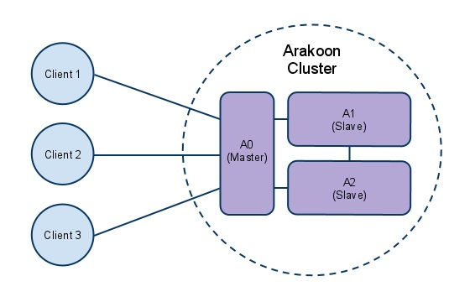
Lattus System Functions - Arakoon

Slide 46
Lattus System Functions - Arakoon
In the previous slide:
  The Arakoon database cluster consist of a instance on each controller.
    The majority of 3
  Each controller instance carries the same data, and one is set to be the “master” arakoon.
    The master instance manages all the updates from clients.
    Clients can be controller or storage nodes.
    Clients only talk to the master, but slaves can be contacted to inquire who is the master.
  The Arakoon can become corrupt very easily in a unplanned shutdown.
    Each arakoon instance also has an associated transaction log, called a tlog, which resides on an HDD local to each controller.
      Location of the tlogs can be acquired from the configuration file.
      You only need 1 intact copy of the database or tlogs to rebuild the entire arakoon array.

Slide 47
Lattus System Functions
HTTPS Proxy Server
  Lattus uses pound, a reverse SSL proxy
    Pound uses openssl for encryption and decryption.
    Pound supports the UI, AXR, and S3 interfaces in Lattus.
    Pound supports any certificate supported by openssl
    In some cases tuning is required to overcome timeouts.
      Tuning requires modifying:
        /etc/pound/pound.cfg
        /opt/qbase3/cfg/dss/clientdaemons

Slide 48
Lattus Data Structures
Storage Policies (single geo)
  Quantum recommends a 20/4 policy on a configuration of 20 storage nodes.
    In this configuration we have a safety of 4, which defines 4 simultaneous failures that can be sustained.
    Objects spread across 20 storage nodes, using 1 disk per storage node.
      Using "force dispersion"
  Quantum recommends a 12/4 policy on a configuration of 6 storage nodes.
    In this configuration we have a safety of 4, which defines 4 simultaneous failures that can be sustained.
    Objects spread across 6 storage nodes, using 2 disk per storage node.
      Using "force dispersion"

Slide 49
Lattus Data Structures
Force Dispersion (single geo)
  Examples:
  Six storage node scenario
    2 data centers, 1 rack in each data center, each rack has 3 storage nodes (for a total of six)
  10 storage node scenario
    2 data centers, 1 rack in each data center, each rack has 5 storage nodes (for a total of ten)
  Summary:
    In each case, we can use force dispersion (dispersion at the node, rack, and data center level).
  Note:
    In the case where we have an un-even number of storage nodes either at the data center or rack level, or if you had an unequal number of racks in each data center, depending upon what type of failure you would like to protect against, force dispersion should not be used.

Slide 50
Lattus Data Structures
Namespace’s
  Only 5000 namespaces are supported in a single configuration.
  There are 2 namespace types that can be defined in Lattus
    Namespace (no encryption)
    Namespace (with encryption enabled)
  To configure a Namespace these prerequisites must be met.
    A namespace is created once you have configured a Storage Policy.
    Requires a active and optimal Metsstore.
    Need to choose between “encryption” or “no encryption”
    Need to choose if small filze size support is needed.

Slide 51
Lattus Data Structures
Namespace Encryption
  Namespace Encryption uses AES-256-CTR
  When creating a namespace and encryption is selected:
    On the first namespace that is set to be encrypted, you will be prompted for 2 new fields to fill in.
      Password (This related to a password for the encrypted namespace)
      Password confirmation
    The password is used to generate the master key.
    This master key is used when encrypting the namespace.
    The master encryption key is local to each controller node.
    If other namespaces are created after the first one, it will use the same password, but generate a new key for the added namespace.
root@snqe80a:~# cat /home/dss/.master_encryption.key salt=3760841ED3F34D3B key=C50DE2927A1FDEDE7963FC846DE71FA961E05ACD1A8CBD6589F10F9BA03BFAA5 iv =32DEE0CA4D20D5587CF73ACE58CBB2ED

Slide 52
Lattus Data Structures
Be sure to backup the key database periodically
  Run the “qshell” to export the key database
    q.dss.manage.exportMetadataEncryptionPolicy('<localpath>')
    For example, <localpath> could be: /root/my_key_db_0710.txt
root@snqe80a:/tmp# cat my_key_db_0710.txt { "version": 1, "deployment_id": "3760841ed3f34d3b88cf3520b2ef2d87", "encryption_policy_list": [ "0 AES-256-CTR 53F3D2543E6C467FADDE202AA08AD23BF1AB33AFEB264624934847DCCCCDAAC6", "1 AES-256-CTR A3EAC4C5275640138EE6CE9C900572392D60188BAE984BA9819828A635E539C1", "10 AES-256-CTR 1BE4CFF3AA944C068302DFCA8117F7D6A199715464C8480AA856CBC8A79CCB23", "11 AES-256-CTR 4140DD61E7FE4CDCAC82C2752D896CB3796504CEF3274B138B7BAAF9379220F6", "12 AES-256-CTR 8DBAD9667F2648C8B9012F1475441046DD59311B55D9481191D2C2ACB812AB46", "13 AES-256-CTR A2BFB0F81391495A8DA961495DF54EBA1ED78602709341E78AC5EF509BF57CCE", "14 AES-256-CTR 6E8FCF89CDF7466E8B1D2E3D6D0D5ADFFE7EC48A267E4AA887C0DF2E261283D4", "15 AES-256-CTR 61F77B0D75E643D9966602ABE4BA7E7F14F2070BFA324ACC99E9A742F8B1E31E", "16 AES-256-CTR 0C70F09199FE40BAA6C2D9F0F44DCB1F29542B2C86FA49B0934137014BB28727", "2 AES-256-CTR 1D5C792713C444F68CE527BBB1F166508231146258A740A49F1B9940B75CD6F0", "3 AES-256-CTR F51D38191EC94C089235503EFE828D8A8B7ACE8CFD0E4212A49F8D3B99550563", "4 AES-256-CTR 63588D4D5334406EAF4AA33B971DE0FF9167B20388544852BBF7A86244472330", "5 AES-256-CTR 8F6D54F2BE8243D5839717E005B7713F142F59EC3F314023974081A7A170F906", "6 AES-256-CTR A81823EE29D84EFC8673CDC752FC3442634AFB41FAAD46359509B997CC557164", "7 AES-256-CTR 7D2EAE627FEF4C759CE75F08236D7334BF6261D2659D4F9DA3BC353ACFE66A39", "8 AES-256-CTR 4D019A718E3247C2B21124B41AD965BA322E149F3E6D44008209D76603F53895", "9 AES-256-CTR 2BF5B3B15A7A4416B3F35A2044F3E656A5FD0DDC2A95452C9D5B73A8A6374B74" ]

Slide 53
Lattus Data Structures
Superblocks
  When a object is ingested into Lattus from StorNext, the client daemon divides the object into one or more superblocks before Amplidata encodes the data.
  When a policy is defined you will need to determine what superblock size the storage policy will have.
    The superblock size defined in the Storage Policy should never equal to the customer potential object size.
    Different superblocks size have different effects. They relate to:
      Lager SB size – Increased performance
      Larger SB size – Lower Metadata Overhead
      Smaller SB size – Increases Partial Read Overhead
    For Lattus and StorNext configurations StorNext recommends a superblock size of 64MiB.
      If a special customer use cases arise that have a requirement to set the SB size differently.
        If this is the case, there will be required StorNext parameter settings that may be needed to offset the SB size from the default recommended.

Slide 54
Lattus Data Structures
Objects
  Whatever you store in Lattus, it is logically defined as a object and will reside in its own specific namespace.
  With the recommended default of 64MiB SB size on a storage policy. An object is limited to 4TiB.
  A Stored Object on Lattus:
    Metadata will be stored in the associated metastore used for the specific namespace.
    Data will be encoded and spread across the blockstores associated with the Storage Policy defined for this object.
  Viewing objects using a browser
    You can use a browser to view a list of namespaces, within a Lattus configuration. Under the root of namespaces, each namespace will reside in a different folder.
    You can use a browser to view the objects within a namespace. In this version of the software, no concept of tags or virtual folders within a namespace.
      Each Object ID name will be unique within a namespace.

Slide 55
Lattus Data Structures
Check-Blocks
  Lattus splits and encodes data objects into multiple check-blocks that encode redundancy.
  Check-Blocks are spread dynamically over the entire storage pool.
    Example: (Spreading across storage nodes used)
      In a configuration where we have a storage policy and namespace defined with a 14/4 policy, we are using a disk safety of 4 and spreading data over 14 storage nodes, using 1 disk per storage node.
        Lattus will store these objects in the namespace for this policy.
        Lattus will then choose a different set of 14 drives to generate the check-block on.
        In the event a object needs to be rebuilt and restored, Lattus only requires a subset of the check-blocks to restore the data object. This is determined by the policy that was defined in the example.
        From the example above with a policy of 14/4, Lattus can decode and assemble any object by reading from 10 drives of the 14 defined in the policy.

Slide 56
Next Section
Lattus 3.1.4 Install Changes

Slide 57
Lattus 3.1.4 Install Changes
Due to a critical Amplidata Bug (AMIF-3216), new installs could be affected by this issue.
  With 3.1.3 all metastores will have to be manually converted after upgrading to 3.1.4.
    Currently the workaround has not been tested.
    This will be an impact to customers that involves a lengthy process to workaround the issue.
  Issue was discover in the large system test that was previously done in Colorado Springs.
    Currently it is unknown if this affects only multi-rack configurations.
  Amplidata Engineering has recommended the install and configuration for a new installation be changed in the order tasks are done in the current published documentation to get to 3.1.4.
Brief Outline of Install Procedure.
  Management Node
    Install 3.1.GA Build (quantum_usb_stick_3.1.0.35.iso) ‘same procedure as before’
    Configure Networks

Slide 58
Lattus 3.1.4 Install Changes
  Add Lans; Name, Description, Role
Cloud initial install
Set time zone, NTP
Perform 3.1.4 Patch procedures.
  Copy 3.1.4 patch to the management node.
  Run a health check: qshell - q.amplistor.systemCheck()
  Extract the patch: follow published documentation.
  Verify the patch
  Apply the patch
    Note: When applying the path, use the “-s” to skip the healthcheck
    Note: You will observe a error on Backup of application qpackagesserver failed. This will be resolved in a later step.
    Check the “About tab” in the CMC or run the qshell command to make sure it has installed the patch and show release: 3.1.4.

Slide 59
Lattus 3.1.4 Install Changes
Continue to install remote nodes.
  Follow published documentation
  Initialize the remote nodes: follow published documentation.
Backup the qpackageserver
  Follow published documentation
Configure Phone Home
Configure Metastores, bring them into a optimal state.
  Follow published documentation
If you are implementing https
  Follow published documentation
  Configure certificates
  Configure the UI for https
  Configure AXR

Slide 60
Lattus 3.1.4 Install Changes
Install the Storage Nodes
  Follow published documentation
  Power on storage nodes
  Perform PXE install
  Initialize the store nodes
Configure the Storage Policy
  Follow published documentation
Configure the Namespace(s)
  Follow published documentation
Initialize Reporting
  Follow published documentation
Run a health check
  Run a health check: qshell - q.amplistor.systemCheck()

Slide 61
Lattus 3.1.4 Install Changes
Validate the Install
  Follow published documentation

Slide 62
Next Section
Multi-Geo

Slide 63
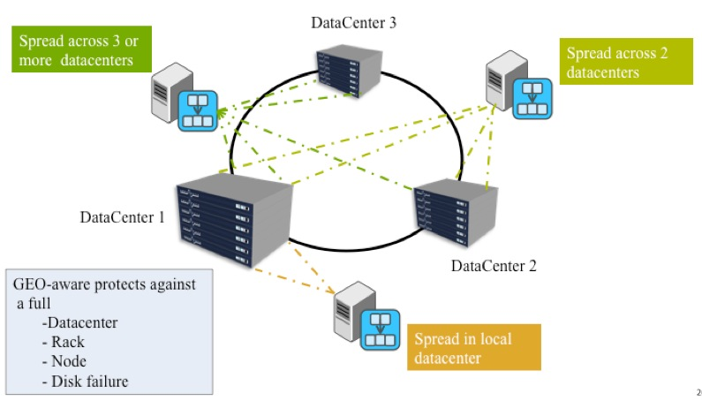
Lattus Multi-Geo

Slide 64
Multi-Geo
Currently QA status
  Have qualified Lattus-X with 3.1.4 using StorNext 4.6.1.
  Lattus-M is not complete, it is still under qualification and expected for Lattus 3.1.4 and StorNext 4.6.1.
    Still working through some product defects.
Current Targeted Configurations
  2-site Multi-Geo
  3-site Multi-Geo
Brief Background on Multi-Geo
  Lattus can geographically spread a single instance of data across multiple sites, to provide additional site failure protection, without the overhead of storing multiple copies of the data.
    The system can then ensure that data remains available and fully protected, even in the event of a site failure.
  Unlike a Single Geo configurations,Multi-Geo behaves differently.

Slide 65
Lattus Data Structures
Force Dispersion (Multi-geo)
  Depending on customer specific requirements, some multi-geo scenario’s choosing dispersion over the level cannot be a one-size-fits-all recommendation.
    Datacenter (site)
    Rack
  Questions that may be applied to a customer requirements:
    Are you willing to lose a rack?
    Are you willing to lose a datacenter?
    Or are you willing to lose both??

Slide 66
Multi-Geo
A few of the differences between Single and Multi-Geo we know at this point.
  Storage Policies can be created that tolerate site failures, and even have sufficient durability to still protect against rack and additional disk or storage node failure.
    The rules for storage policy between a single site configuration compared to multi-site configuration are quiet different and have different obstacles that need to be considered in deployment
      Example: (controller and storage node requirement)
        Single Geo 20/4 policy is configured
          1 site
          3 C10 Controllers
          20 Storage nodes
        Multi-Geo 20/11
          2 sites
          3 C10 Controllers (1 controller at each site, 3rd controller will co-exist at 1 of the 2 sites)
          20 Storage Nodes (10 storage nodes per site)

Slide 67
Multi-Geo
Networks
  Multi-Geo Networks are very complex and require a lot of planning and configuration.
    S60 switches will not use the default preloaded configuration.
      Configurations have to be modified to support Multi-geo.
    Private networks are required to be routed between sites.
    Network Latency is a concern.
Small file support (batch mode)
A number of configuration changes have to be implemented.
Cache Clusters use is not possible
Management Node failover is not possible

Slide 68
Multi-Geo
Early Performance numbers (provided by Gordon Chace)
  Distributed gateway measurement was to store N files (each 1GiB) from an A10 to Lattus, N being powers of two from 1 to 128. Since the A10 was configured for a large threadcount limit, each filecount tier was also the same threadcount tier. This was done with zero versus 100ms additional latency in the REST API paths. The Lattus was singlegeo with 20:4 policy.
Files Ingest Retrieve <1ms latency
1 3.39 9.48
2 3.89 12.34
4 4.30 17.07
8 5.51 30.04
16 9.30 48.60
32 17.13 96.35
64 34.44 186.84
128 67.29 381.09
Files Ingest Retrieve 100ms added latency
1 48.76 46.91
2 48.70 49.51
4 48.77 56.99
8 48.93 62.44
16 48.87 76.36
32 93.28 151.82
64 183.72 276.24
128 404.28 522.57
  The files were 1 GiB, so the total bandwidth is underwhelming with latency. It was a large fraction of lightspeed with no latency and 16++ threads.
  QA Observation it leveled off for bandwidth at about 16 threads. 100 ms latency penalty is about 5:1.

Slide 69
Multi-Geo
Early Performance Numbers
  Multigeo measurement was made without StorNext, simply running Amplidata’s PUT/GET burn-in utility on controller #1. This had a 20:12 policy so GET is inherently 2.5 times easier than PUT. Blacklisting (BL columns in the table) behavior was noticed for latencies of 25 ms and more. Latency is applied to the controller #1 paths to other controllers and controller #1 to 10 of the 20 storage nodes.
Latency Put elapsed BL Get elapsed BL
0 49.90 0 21.97 0
10 69.18 0 23.76 0
20 101.15 0 34.72 0
25 117.89 0 40.36 0
25 114.99 1 40.46 0
30 130.17 4 45.65 0
37 145.55 18 50.75 0
50 168.66 48 64.30 0
60 179.97 54 70.98 0
75 197.48 75 82.32 0
100 246.60 147 101.42 2
140 308.62 274 121.12 22
200 432.28 514 143.16 62
  QA Observation: The short version of this is that 20 ms latency halved bandwidth for PUT, and 25 ms latency halved bandwidth for a GET. Blacklisting could just barely happen at 25 ms latency, but grew rapidly for higher latencies when doing a PUT. Blacklisting for a GET would only happen at 100ms latency and beyond.

Slide 70
Multi-Geo
Latency was also experimented during install & initialize of controllers and storage nodes. There were failures (which could be retried)
  QA Observation: It looks like 25 ms latency is more or less clean, and high latencies get increasingly dirty. This applies to both the remote installs and to data transfers once installed.
Amplidata presented Quantum with some results from their latency tests.
  Will not be shown in this presentation!
  QA Observation: Looks like Amplidata also saw roughly 5:1 performance penalty at 100 ms latency.

Slide 71
Next Section
Operational Issues

Slide 72
Operational Issues
Potential QA Issues observed:
  Rack shutdown.
    In some cases, a rack shutdown will cause the rebooted controllers to boot without setting a route.
    A manual workaround is required to get them operational.
      From the OS a qshell needs to be run on the troubled interface:
        /opt/qbase3/qshell -f "/opt/qbase3/utils/network_post_config.qshell" eth0
Due to related issues, Amplidata Support recommends the following procedure to boot-up a configuration that was shutdown using the rack shutdown in the UI.
  Startup Procedure
Thresholds
  Process Thresholds
Change Admin Email
Determine when Crawl has run last. (bring up write up)

Slide 73
Operational Issues
Decommission Disks
  One of the most common issues in Lattus is disk failures.
    Due to the consumer level drives in the current storage nodes, multiple failures can be seen.
    The good news is the Lattus platform has the capability to take the drive out-of-active state, using the decommission feature.
      When a failures occurs, an administrator can first attempt to reset the drive using the CMC.
      If that fails, then the decommission routine can be run. The drive will then be taken out of commission.
        When a decommission event occurs, the system moves the data off to other participating drives.
        If the drive is in a state where it cannot be accessed, the data has to be rebuilt and moved to other participating drives.
      A failing decommission procedure will require a intervention with QTM or Amplidata Support to resolve.
        This involves identifying the suspect disk drive.
        Manually set the blockstore to an abandon state.
        Manually set the storage daemons to an abandon state.
        Manually set the repair manager to run.

Slide 74
Operational Issues
Replacing Disks
  The Lattus system has issue it you insert a replacement disk with active partitions.
    If a replacement disk has been drawn out of the RSL and returned and you get it as replacement be sure no active partitions exist.
    Once you have decommissioned a disk, it cannot be reused in the Lattus system again.

Slide 75
Next Section
Critical Issues

Slide 76
Critical Issues - 42052
42052 Too many tlog files (250) from C10 controllers on MetaStore Object
  A workaround exist. 42052 Documented Workaround
  Very lengthy process.
  The workaround can be applied with active I/O
  The fix is a temporary workaround.
  Tlogs can get in this state, depending on the amount of metadata traffic.

Slide 77
Critical Issues - 41485
41485 Too many tlog files (435) for node node_1_9005 on MetaStore objectMetastore.
  A workaround exist, see 42052 resolution. 42052 Documented Workaround
  Very lengthy process.
  The workaround can be applied with active I/O
  The fix is a temporary workaround.
  Tlogs can get in this state, depending on the amount of metadata traffic.

Slide 78
Critical Issues - 41376
42376 powered up MDH-2 after shutting it down cleanly and many dssblockstores are OFFLINE
  3 Amplidata bugs identified here
  In this case a rack shutdown was run to shutdown the configuration.
  Disk safety showed “-16”
  A race conditions exists on boot-up
    This caused the blockstores to delay in coming online.

Slide 79
Critical Issues - 42315
42315 check block stores failing after system power failure.
  Related to blockstores with empty blockstore.id files.
  Prevents repairs to run after the storage node is booted.
  Amplidata Support intervention is required.

Slide 80
Critical Issues – 42128, 43114
42128 Too many open files filedescriptors (4096) for client daemon.
  This issue will cause all I/O operations to halt.
  This creates a number of other issues to pop-up
    Error retrieving cache daemon info for daemon with id [1]
    Monitoring Agent Failed to check lowest disk safety
    Monitoring Agent Failed to verify codec version for namespaces
    Monitoring Agent Failed to retrieve dss storage pool info
    Monitoring Agent Failed to execute monitoring rule check_last_update
  A workaround to this is to restart the client daemons.
    This is a temporary fix.
  With cache cluster configured leads to more issues.
    A client daemon can leak a file descriptor.
    An issue with cache daemon's used space calculation will cause it to believe there is no further room to store data despite having many inodes and space on disk.
      With cluster cache enable a client daemon or storage daemon blacklists, it will next check to see if the cache daemon has sufficient space before using it again. Due to this issue, this check will return that there is not sufficient space, create another blacklist for the cache daemon, and leak another file descriptor. In time, this will lead to all available file descriptors in that specific process being leaked.
      Resolution:
        The simplest workaround would be to disable the cache cluster mechanism. We are currently seeking Amplidata recommendations for support in 3.1.4.
        The imperfect workaround is to restart clientdaemon and storagedaemon services that run out of file descriptors. However, the processes will return to this state eventually without any other action, so this isn't a good short term workaround.
        Increase the number of inodes on the mount cache filesystem.

Slide 81
Triage of REST Failures
REST Failures are caused by a variety of reasons.
  IT could be a failure between Amplidata and StorNext.
  It could be a failure caused internal to the Amplidata configuration.
  In-depth details are real important.
    What type was the REST request?
    What time was the REST request generated?
    In multi client daemon configurations, run down what client daemon and what controller it came in on.
The REST interface numerous times returns HTTP return codes.
  In many cases, the HTTP failure code ends up you looking for a failure and the cause is not define properly by the HTTP published codes.
    Other triage methods are necessary to get at the actual cause.
    Different failures point you at generic http return codes.
    HTTP debug mode may have to be enabled. HTTP debug
Some triage requires debug mode to be enable on the client daemon.
  Modify /opt/qbase3/cfg/dss/clientdaemons
  Restart of the clientdeamon is required q.dss.clientdaemons.restart() NOTE: Client daemon can be restart by each if needed.
#log_level = INFO log_level = DEBUG

Slide 82
Next Topic
Summary

Slide 83
Summary
New Installs
  Setup up your rack switches and verify they work.
  Setup up your public networks and verify they work.
  Install your management node private networks correctly.
    Once you initialize if private networks are wrong, you will have to re-install.
  Be careful on Metstore configurations.
  Other misconfigurations can be corrected.
  Follow the documentation closely.
  Take notes in case you have to go back.
We are all learning the Lattus system, if stuck ask questions.
Good Luck!

