Slide 1
StorNext Pro Solutions
TOI for Global Service
April 24, 2014

Slide 2
2

Slide 3
Agenda
Product Overview
Documentation and Training Strategy
Service Model
Note: Ask questions as we go. Q&A also at the end.

Slide 4
Product Overview
Presented By: Nick Elvester/Richard Tyrrell

Slide 5
StorNext Pro Solutions
Collaborative, high-performance storage solutions for modern file-based workflows
Single model number makes selection and purchase of an optimized configuration easy
Deploys easily and delivers consistent reliable performance
Backed by a Quantum 3 year hardware and software warranty
Delivers the best value for demanding Post and Broadcast operations

Slide 6
StorNext Pro Solutions
A complete, fully supported, highly reliable package
Single product model number for simplified selection and purchase
3 Year hardware and software warranty
24/7/365 support with 30 minute phone response*
Service spares kit included
Unlimited Apple Xsan client support
10 Windows/Linux SAN clients
Unlimited Windows/Linux IP clients via included StorNext Gateway DLC licenses in StorNext Pro Production solution
Three StorNext Pro Solutions Designed for Applications
StorNext Pro Studio – Xsan Refresh and Workgroup
StorNext Pro 4K – 4K Performance Ready
StorNext Pro Production – Complete Content Production and Ownership
* Except for general inquiries

Slide 7
Solutions Summary
Two Versions of the Solutions: ASI and Quantum Installed
ASI Installed:
Product, 3 years of Service, and a spare parts kit
Quantum Installed:
Product, 3 years of Service, Professional Service, and a spare parts kit
Three Solutions
StorNext Pro Studio
M441D and QXS-1200 48TB
StorNext Pro 4K
M445D, QXS-1200 48TB, and (2) QXS-1200 48TB expansions
StorNext Pro Production
M662XL, QXS-1200 48TB, a QXS-1200 48TB expansion, and AEL500
New QDR is 30% off (15% for unregistered) to match M&E channel expectations
New QDR is now the ASP (aka old “70% off” pricing)
Discounting beyond QDR will be highly controlled
Solutions are US only at launch, EMEA to follow in about 30 days

Slide 8
Options
Just like the base solutions options have ASI and Quantum installed pricing
Pricing strategy is the same, options have different pricing than the normal price book parts
Options include 3 yrs. Gold NBD service with 30/60 minute phone response time
Quantum installed Options include PS labor, ASI do not
If options are installed as a field upgrade there is a “Trip Charge” to cover sending out PS for the install
Options and their associated pricing are ONLY for new or existing bundle sales

Slide 9
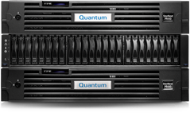
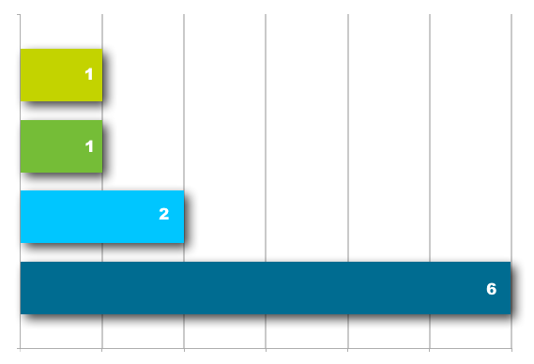
StorNext Pro Studio The Xsan Refresh Solution
100% Xsan compatible
The best storage solution to refresh or add-on to existing Xsan Deployments
Complete, highly reliable and fully scalable as needs grow
Predictable high-performance and outstanding support
Includes:
M441D Metadata Appliance
QXS-1200 48TB RAID Base System
Service Spares Kit
Options:
QXS-1200 48TB Expansion
M440 Metadata Storage Expansion
AEL500 Archive System (3-drive/41 slots)
Number of Streams
No dropped frames for 24 hours
Notes:
Service Spares Kit Includes:
Performance critical spares:
Drives for Metadata Volume
Drives for Storage Systems (varies)
Controller for Storage Systems
QX1200 (1x RAID) optimal state
— 0x streams of 4K Uncompressed
— 1x streams of 4K Prores
— 1x streams of 2K Uncompressed
— 2x streams of 1080i Uncompressed
— 6x streams of 1080i ProresHQ
— More than 30+ number of SD or HDV streams
QX1200 (1x RAID + 1x Expansion) optimal state
— 0x streams of 4K Uncompressed
— 2x streams of 4K Prores
— 2x streams of 2K Uncompressed
— 3x streams of 1080i Uncompressed
— 10x streams of 1080i ProresHQ
— More than 50+ number of SD or HDV streams
QX1200 (1x RAID + 2x Expansion) optimal state
— 1x streams of 4K Uncompressed (NO headroom)
— 3x streams of 4K Prores
— 2x streams of 2K Uncompressed (headroom)
— 4x streams of 1080i Uncompressed (headroom)
— 15x streams of 1080i ProresHQ
— More than 50+ number of SD or HDV streams

Slide 10
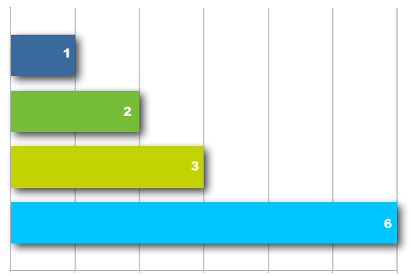
StorNext Pro 4K The 4K Performance Solution
The ideal 4K ready collaborative storage solution for Post and broadcast
Highly optimized for performance and maximum scalability
Perfect for adding 4K capabilities to existing workflows or new deployments
Includes:
M445 SSD Metadata Appliance
QXS-1200 48TB RAID System
2 QXS-1200 48TB Expansion System
Service Spares Kit
Options:
QXS-1200 48TB RAID System
QXS-1200 48TB Expansion
M440 Metadata Storage Expansion
AEL500 Mini Archive System
AEL500 Archive System (3-drive/41 slots)
Number of Streams
No dropped frames for 24 hours
Notes:
Service Spares Kit Includes:
Performance critical spares:
Drives for Metadata Volume
Drives for Storage Systems (varies)
Controller for Storage Systems
QX1200 (1x RAID) optimal state
— 0x streams of 4K Uncompressed
— 1x streams of 4K Prores
— 1x streams of 2K Uncompressed
— 2x streams of 1080i Uncompressed
— 6x streams of 1080i ProresHQ
— More than 30+ number of SD or HDV streams
QX1200 (1x RAID + 1x Expansion) optimal state
— 0x streams of 4K Uncompressed
— 2x streams of 4K Prores
— 2x streams of 2K Uncompressed
— 3x streams of 1080i Uncompressed
— 10x streams of 1080i ProresHQ
— More than 50+ number of SD or HDV streams
QX1200 (1x RAID + 2x Expansion) optimal state
— 1x streams of 4K Uncompressed (NO headroom)
— 3x streams of 4K Prores
— 2x streams of 2K Uncompressed (headroom)
— 4x streams of 1080i Uncompressed (headroom)
— 15x streams of 1080i ProresHQ
— More than 50+ number of SD or HDV streams

Slide 11
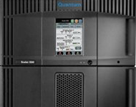
StorNext Pro Production The Content Production and Ownership Solution
Complete collaborative storage for ingest, production, delivery and archive
IP client support for Windows/Linux clients, proxy and transcode servers
for new facilities and workgroups
LTFS capable for fast acquisition, delivery and archive
Includes:
M662XL Metadata Appliance
QXS-1200 48TB Storage RAID System
QXS-1200 48TB Expansion System
AEL500 Archive System (3-drive/41 slots)
Service Spares Kit
Options:
QXS-1200 48TB Storage RAID System
QXS-1200 48TB Expansion System
M660XL Metadata Storage Expansion
Notes:
Service Spares Kit Includes:
Performance critical spares:
Drives for Metadata Volume
Drives for Storage Systems (varies)
Controller for Storage Systems
QX1200 (1x RAID) optimal state
— 0x streams of 4K Uncompressed
— 1x streams of 4K Prores
— 1x streams of 2K Uncompressed
— 2x streams of 1080i Uncompressed
— 6x streams of 1080i ProresHQ
— More than 30+ number of SD or HDV streams
QX1200 (1x RAID + 1x Expansion) optimal state
— 0x streams of 4K Uncompressed
— 2x streams of 4K Prores
— 2x streams of 2K Uncompressed
— 3x streams of 1080i Uncompressed
— 10x streams of 1080i ProresHQ
— More than 50+ number of SD or HDV streams
QX1200 (1x RAID + 2x Expansion) optimal state
— 1x streams of 4K Uncompressed (NO headroom)
— 3x streams of 4K Prores
— 2x streams of 2K Uncompressed (headroom)
— 4x streams of 1080i Uncompressed (headroom)
— 15x streams of 1080i ProresHQ
— More than 50+ number of SD or HDV streams

Slide 12
Documentation and Training Strategy
Presented By: Charlotte Taylor

Slide 13
Installation Guides
StorNext Pro Studio Installation Guide
StorNext Pro 4K Installation Guide
StorNext Pro Production Installation Guide
The guides were created from currently released product documentation.
Each guide includes 4 chapters:
Prepping for Install
Unpacking and Racking the Components
Cabling the Components
Powering on the Components

Slide 14
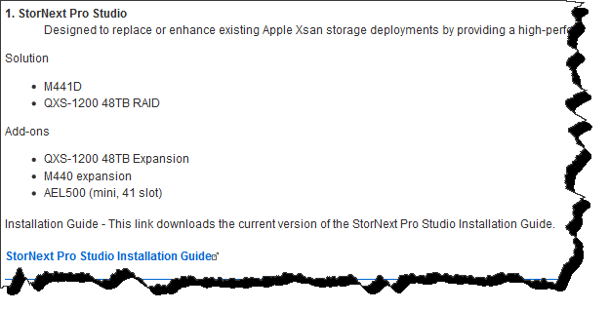
Installation Guides Located on CSWeb
Example section from CSWeb

Slide 15
Sample Cover Page

Slide 16
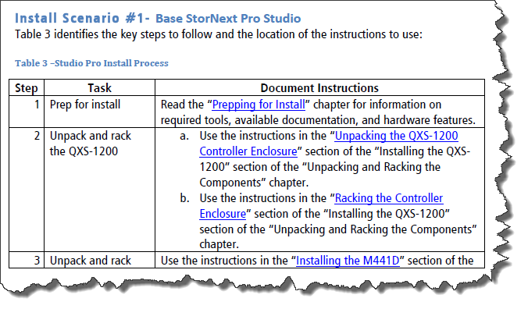
StorNext Pro Studio Example Flow

Slide 17
Training
No new StorNext Pro Solution-specific training is available. However, we’ll leverage the existing training for each of the components.

Slide 18
Service Model
Presented By: Brian Grove

Slide 19
Service Model Summary
Standard Warranty – NBD Gold with Gold uplift available
30 minute call back for critical issues
60 minute call back for all other severity SR
Case Management: Global Call Handling (GCH), CDS, Kuala Lumpur
Technical Support: SPS and WPS (depends on StorNext component versus AEL500)
SPS will own the case and is responsible for all customer interactions. SPS will pull in WPS for AEL500 library assistance.
Field Support: QFE and TPM
Escalation Support: Service Engineering Specialists, StorNext Sustaining Engineering , HW Engineering
The same escalation resources as used today for the individual components.
Replacement Part Fulfillment: FRUs, CRUs, and Onsite Spares
FRU/CRU lists are standard lists used today for each of the components
Onsite spares lists are included in the Parts Logistics Catalogue posted on CSWweb
Spares kit part numbers are in Oracle IB
Spares get replaced via Fast Exchange process
Installations – Quantum Bundles require Professional Services
Quantum Professional Services is not included with ASI bundles

Slide 20
SR Tactical Details
Although there are Top Level Assembly (TLA) part numbers, there are no serial numbers assigned to the bundles themselves.
Customers will open SRs against any base system serial number in the bundle.
GCH will see an Oracle pop-up indicating that the serial number is part of a bundle (“StorNext Pro + all Base System Serial Numbers”).
All SRs will get assigned to SPS. SPS will own the SR and all interactions with the customer.
SPS will pull in WPS to assist with AEL500 support requests.
The support model details are included in the Service Plan (0-15310-01) that will be posted on CSWeb.

Slide 21
Onsite Spares – Logistics Parts Catalogue

Slide 22
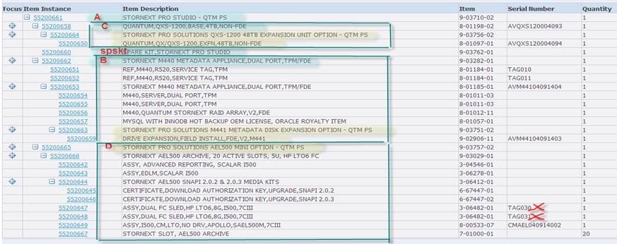
IB Record Screenshot

Slide 23
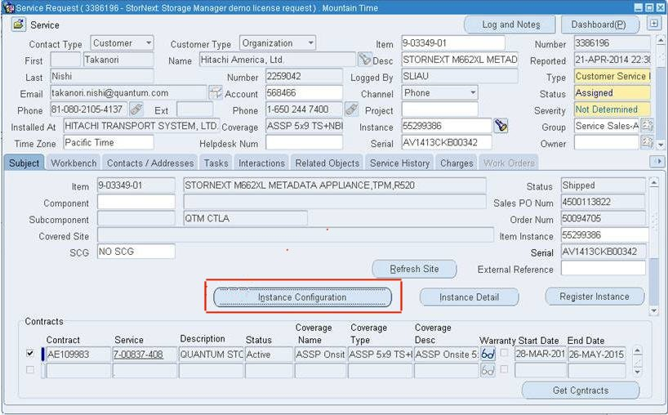
IB Record Access from SR

