Slide 1
StorNext Pro Foundation TOI
for Global Service
January 13, 2014

Slide 2
Agenda
Product Overview
Hardware Overview
Software Overview
Installation Overview
Training and Documentation/Service and Support

Slide 3
Product Overview
Presented By: Nick Elvester

Slide 4
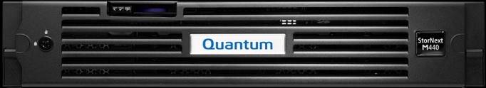
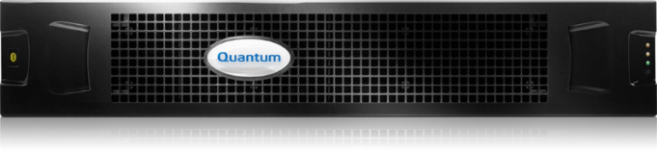
StorNext Pro Foundation
Designed for new customers in Post, Broadcast, Corporate, and Government Video
Pro Foundation Core Components
  Integrated Metadata and Storage
  Powered by StorNext 5
  48TB storage, expandable to 96TB
  2 Windows/Linux SAN clients included
  Highly available with dual MDC nodes and factory installed StorNext HA license
  1 Year support included
Optional Items
  Brocade 6505 12-port switch option
  StorNext AEL500 tape archive option
  Service spares kit option
Solution Sizing
  Up to 4 file systems (volumes), 100 million files
  5-7 Xsan simultaneous clients

Slide 5
Performance
48TB system configured to support an average maximum of 5 SAN Xsan/Windows/Linux clients*
96TB system configured to support an average maximum of 7 SAN Xsan/Windows/Linux clients*
More performance information to come
* Client recommendations based on simultaneous editing of 4 streams of ProRes 422 content; ingest and transcode may affect stream count, actual results may vary

Slide 6
Target Customer Deployments – M&E
Smaller Xsan workgroups looking to renew and upgrade with a 100% Xsan client compatible solution
Facilis Terrablock, ProMax and Small Tree users unhappy with 1Gb Ethernet performance or lack of Xsan compatibility
Promise A-Class users looking for a more capable solution with Xsan compatibility
Current StorNext customers adding smaller remote and local workgroups for graphics, rendering or EFX
Ad agencies, corporate in-house video production, smaller Houses of Worship and faith-based producers
Small mixed Apple-based Final Cut and Media Composer workgroups (use with SAN Fusion)

Slide 7
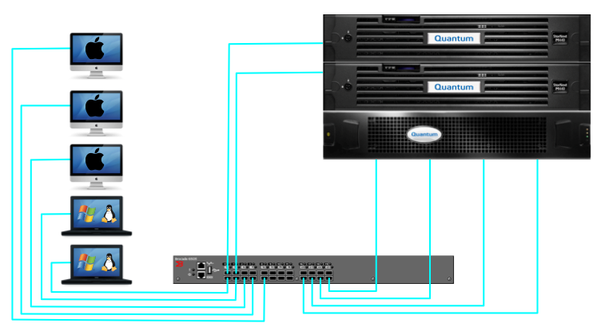
Example Deployment – Typical Configuration
48TB StorNext Pro Foundation
Clients (Up to 5 total)
Redundant
Metadata Controllers
48TB Storage
12 Port Enabled Brocade 6505 Fibre Channel Switch

Slide 8
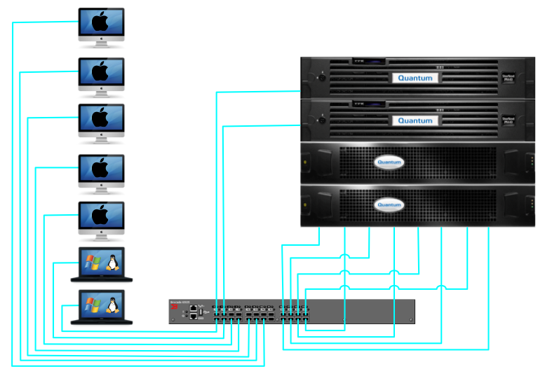
Example Deployment – Typical Configuration
96TB StorNext Pro Foundation
Clients (Up to 7 total)
Redundant
Metadata Controllers
96TB Storage
24 Port Enabled Brocade 6505 Fibre Channel Switch

Slide 9
Hardware Overview
Presented By: Brian Raccuglia

Slide 10
Pro Foundation Platform
The Pro Foundation hardware will consist of the following major components:
  Dual HA servers based on the Dell R520 server
  External FC attached RAID and Expansion disk
Features
  Offered in an HA configuration only.
  Will not support DLC, SMB or NFS.
  Will not support DDM.
  Release on the StorNext 5.1 codebase.

Slide 11
Pro Foundation Storage
Disk storage system data path connectivity to the MDCs and clients are FC.
The disks are 4TB NL-SAS.
The disk storage system will include dual controllers.
The disk storage health will not be monitored by the MDCs.
The disk storage system will not include hot spares.

Slide 12
Pro Foundation LUN Layout
Building block
  (10+2) RAID-6
  4 TByte Drives
  3 Volumes sliced horizontally
    Volume 0 – StorNext metadata - 1% of capacity
    Volume 1 – HA shared – 2% of capacity
    Volume 2 – StorNext data – 97% of capacity

Slide 13
One Enclosure – 1 file system
1 File System
Maximum Files | 195,312,500
Metadata + HA - GBytes | 1200
Total Capacity - GBytes | 40000
Metadata overhead - GBytes | 1200
Data Capacity - TBytes | 38.80
Average file size - KBytes | 198.66

Slide 14
Two Enclosures – 1-2 file systems
1 – 2 File Systems
Maximum Files | 390,625,000
Metadata + HA - GBytes | 2400
Total Capacity - GBytes | 80000
Metadata overhead - GBytes | 2400
Data Capacity - TBytes | 77.60
Average file size - KBytes | 198.66

Slide 15
Software Overview
Presented By: Brian Raccuglia

Slide 16
Service and Support Topics
The Pro Foundation GUI.
All service menu items referring to the NetApp array are removed.
All service menu items referring to the SAS HBA card and ports are removed.
A new shared file system expansion option is added to perform expansion of the HA shared file system on newly added expansion.

Slide 17
Pro Foundation GUI
There were no StorNext software changes required to support the Pro Foundation platform. All changes were done in the platform code so the initial release will contain the exact same StorNext 5.1.0 software image.
There are visible changes on the GUI though due to the removal of the NetApp array.
  On the Hardware Status page in the GUI, you will no longer see a “Cluster Array” entry.
The GUI will also now display “StorNext Pro Foundation” in the top title bar on the GUI to designate the new Pro Foundation model.

Slide 18
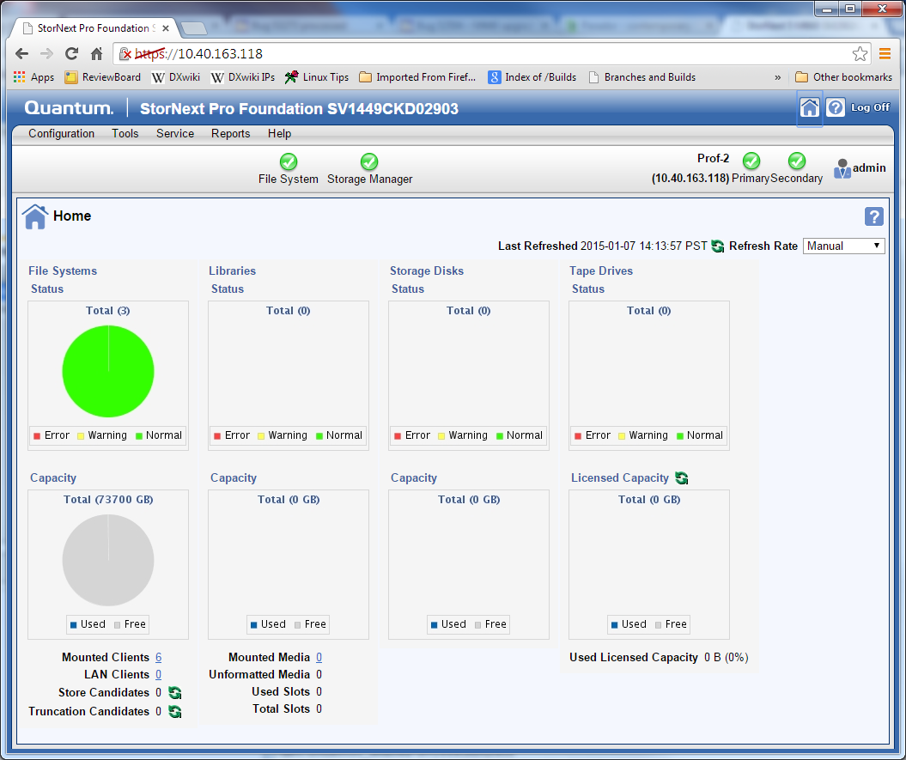
Pro Foundation GUI

Slide 19
Service Menu Changes (vs. M440)
The Pro Foundation service menu will be very similar to the M440 service menu.
All service menu items referring to the NetApp array are removed.
All service menu items referring to the SAS HBA card and ports are removed.
A new shared file system expansion option is added to perform expansion of the HA shared file system on a newly added Pro Foundation expansion.

Slide 20
Installation Overview
Presented By: Brian Raccuglia

Slide 21
Installation Process Overview
Installation steps
  Rack the components
  Install the components
    Controller and expansion enclosures
    Pro Foundation Metadata Controller nodes
  Configure the Pro Foundation system
    Initial system configuration
      Configure storage expansion using Disk Storage Management Utility – controller enclosure comes preconfigured
      Configure Metadata Controller nodes using Service Menu
      Configure StorNext using the StorNext GUI
Installation documentation
  Use the StorNext Pro Foundation Hardware Installation Guide

Slide 22
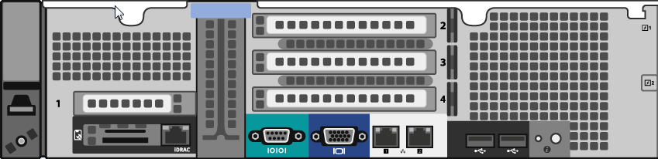


Pro Foundation Metadata Controller Nodes
Pro Foundation controller nodes do not have a SAS cards in slot 2
Fiber connected Nodes
Dual-port 1 Gb NIC
Dual-port 8 Gb Fibre Channel card for
external array (SAN) connectivity

Slide 23
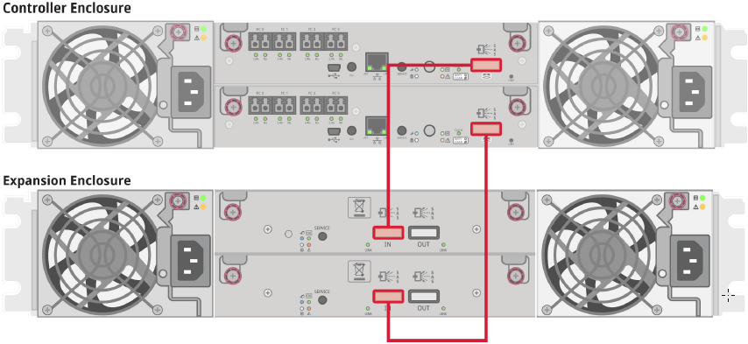
Pro Foundation Storage Array Enclosures
Same hardware as QXS-1200 product line but configured differently
Two different storage enclosures:
  Controller Enclosure w/ FC connectivity to Metadata Controller Nodes
  Expansion Enclosure w/ SAS connectivity to Controller Enclosure
Rear views with SAS cabling

Slide 24
Software Installation
Pro Foundation RAID CD for the internal server boot drives is equivalent to other StorNext appliance RAID CDs
The OS installation boot menu contains a new “ProFoundation” selection for the OS software installation
The OS file system partitions and sizes stay the same as other M-Series images
All network IP factory defaults and devices are equivalent to an M440 installation

Slide 25
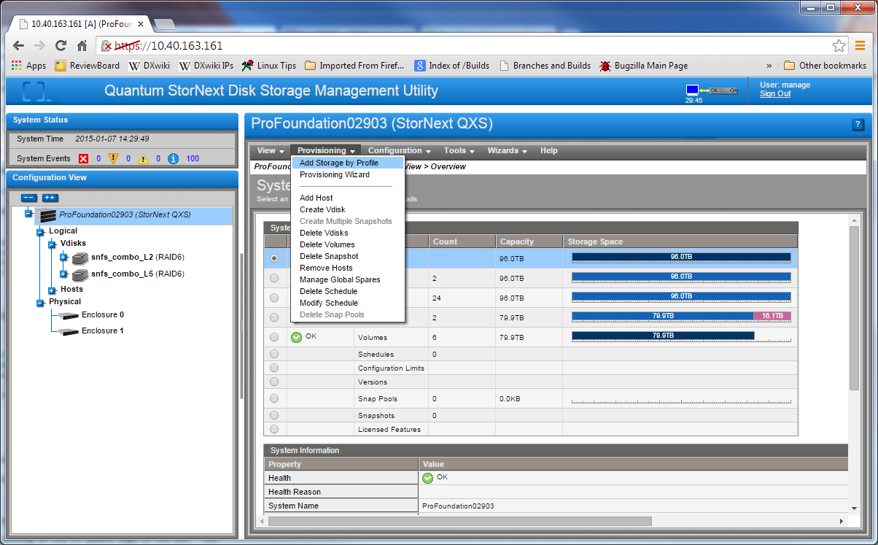
Storage Array One-Button Config
A new preconfigured RAID layout option is defined for the Pro Foundation configurations

Slide 26
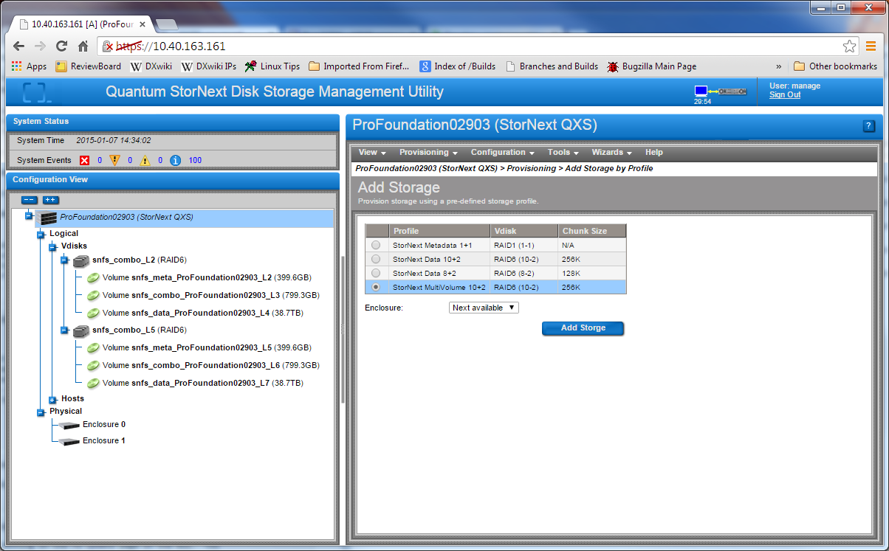
Storage Array One-Button Config

Slide 27
Storage Array One-Button Config (cont.)
Each tray of Pro Foundation storage system shall contain 3 SNFS labels of the following format:

Slide 28
Training and Documentation
Service and Support
Presented By: Charlotte Taylor/Jim Hibbard

Slide 29
Documentation and Training
New Customer-facing Documentation:
  StorNext Pro Foundation Release Notes
New Service-facing Documentation:
  StorNext Pro Foundation Hardware Installation Guide
Re-use Existing Customer-facing Documentation:
  StorNext QXS Storage: Disk Management Utility User’s Guide
  StorNext User’s Guide
  StorNext QXS Storage: CRU Installation and Replacement Guide
Re-use Existing Service-facing Documentation:
  StorNext M440 Field Service Manual
Training:
  StorNext Pro Foundation Product Overview: for TPMs, Service Partners, ASIs, and Quantum Service
  StorNext Pro Foundation Installation Overview: for Service Partners, ASIs, and Quantum Service
  StorNext Pro Foundation Service and Support: for Service Partners and Quantum Service

Slide 30
Service Model
Service Model Summary:
  Case Management: Global Service Center (GSC), CDS, Kuala Lumpur
  Technical Support: Software Product Support (SPS)
  Field Service: TPM led with Quantum Field Engineer (QFE) as alternate
  Escalations: Dell, Dot Hill Solutions, StorNext Sustaining Engineering (SUS) and Quantum HW Engineering
  Replacement Part Fulfillment: Field Replaceable Units (FRUs) and Customer Replaceable Units (CRUs).
    No onsite spares for Pro Foundation
Installation Strategy
  StorNext Pro Foundation is NOT customer installable thus Installation and Integration services must be purchased along with the HW. Installation/Integration will be performed by Quantum Professional Services (PS) or a Quantum Authorized Partners.
  Typically installed by ASI/ASSP
Upgrade Services
  Software/Firmware is customer upgradable. Customer can choose to purchase a Professional Services (or a Quantum Authorized Partners) engagement to assist with the upgrade.
  Field disk expansion services will be offered and performed by Quantum Professional Services and Quantum authorized partners could also be utilized in special situations.

Slide 31
Service Model (cont.)
Standard Warranty
  1 Yr NBD Gold – Includes 1 year on-site support Monday to Friday, next-day on-site target response time, 7x24 telephone support and online resources.
Warranty uplifts & extensions
  GOLD SUPPORT PLAN: Includes 24x7 on-site support, four-hour on-site target response time, 24-hour telephone support, priority call handling and online resources.
  Annual extensions are available for the various warranty offerings supported by this program (Bronze, NBD Gold, and Gold).
Current StorNext Pro Solutions Service Plan (p/n 0-15310-01) is updated to include Pro Foundation details.

