Slide 1
StorNext ‘snapshot & cvgather’ logs analysis using a Parsing logs Application
Quantum
Part 2
Presented by German Krackow
Sep 2, 2015

Slide 2
Quantum
Presentation Goal
Show how to use the application. Hands at work with a couple of real SRs.
Prove that by performing ‘logs Analysis’ with the Parsing Application, you really get :
o Fast access to the -ready- multiple reports collected by the ‘snapshot’
o Easy and fast access to different logs and to Parsed results.
o Going over Parsed logs is faster because the logs are clearer and easier to the eyes.
o Easy to ‘drill down’ into the logs to collect data that allow to connect the dots.
o Global Search on many sets of large logs (messages, TSM, MSM tac).
Confirm that with the help of the computer the chance of getting -valuable- information from the googol size, disparate collection of logs and reports increases exponentially.
Show that a logs Parser application goal of targeting eliminating the very low to zero productivity results of the manual process, is for real (specially during years 0 to 3).
Show that the application helps speeding up the understanding and learning of StorNext, reducing the time to master it from 5 years to around -ONE- year (best case scenario).

Slide 3
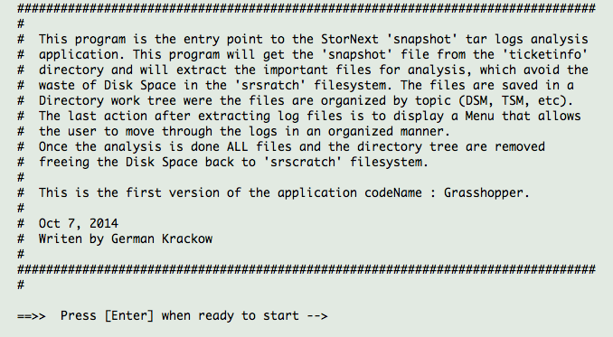
Logging into a Linux Server
Use SSH to open a Terminal Session
There are three systems that have the ‘snapshot & cvgather parser’ application installed.
SPS lab M660 : upm660.lab.quantum.com
SPS lab M440 : upm440.lab.quantum.com
SRSCRATCH system : srscratch.quantum.com
In SPS Lab system log in using your Network UID and the password of the ‘stornext’ UID in the Machine
See example on left panel
germankrackow$ ssh -l ivigil upm440.lab.quantum.com
ivigil@upm440.lab.quantum.com's password: quantum1
/usr/bin/xauth: creating new authority file /stornext/unmantgt/ivigil/.Xauthority
[ivigil@upm440 ~]$ runsnaplg
germankrackow$ ssh -l scole upm660.lab.quantum.com
scole@upm660.lab.quantum.com's password: password
Last login: Thu Aug 27 18:17:26 2015 from ccp.quantum.com
[scole@upm660 ~]$ runsnaplg

Slide 4
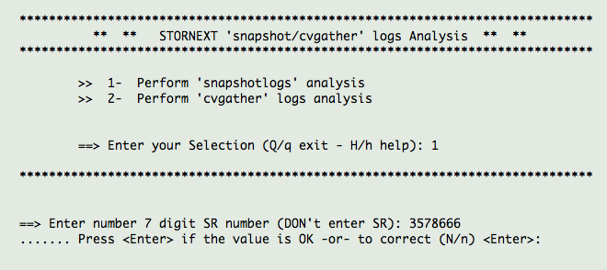
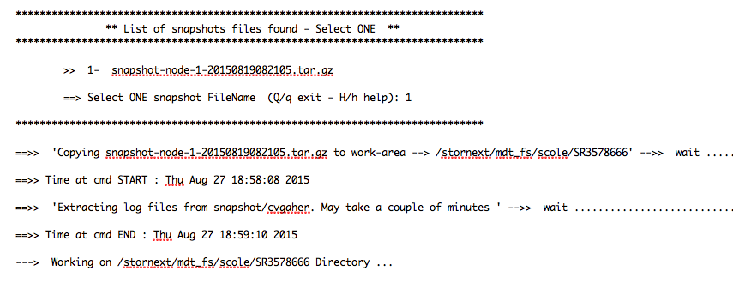
Selecting a snapshot or cvgather file
Select 1 to get a ‘snapshot’ file
Type -just- SR number _NO_ ‘SR’. Press _Enter_ to continue, or N enter to correct typed Number.
If correcting retype the Number
A lists of ‘snapshot’ files that are available in the ‘ticketinfo’ filesystem, SR3578666 directory is provided to select _ONE_ from. Here only one was available.
The snapshot file is copied to user’s work area.
_ONLY_Logs of interest are extracted to work area -flat- directory structure

Slide 5
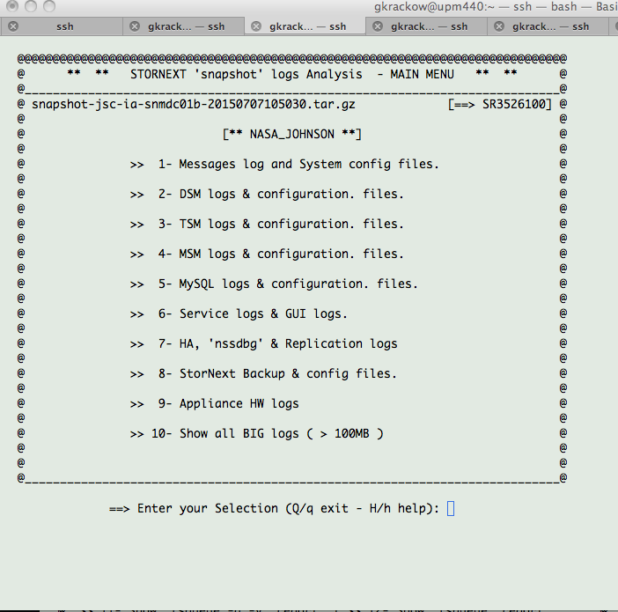
Application running - Menu Driven - Menu sections
TITLE : Shows the Menu you are _running_ now
SUBTITLE : Shows information on Left and Right sides. In this case ‘snapshot-fileName’ _and_ SR number
Customer Name
To _run_ an option, type option Index number here, and press then _ENTER_ key

Slide 6
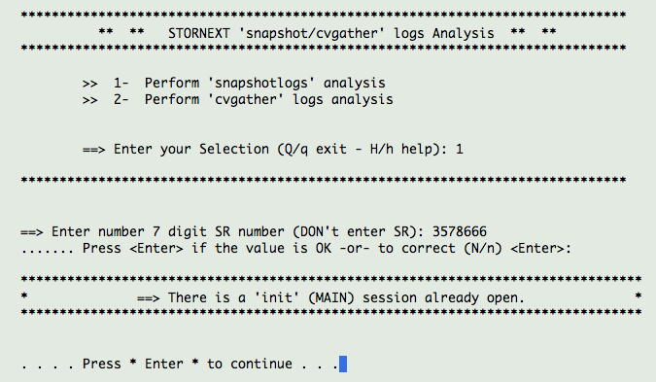
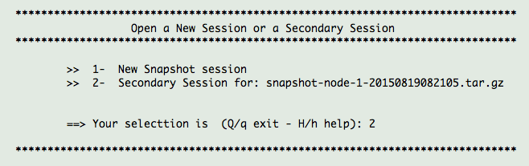
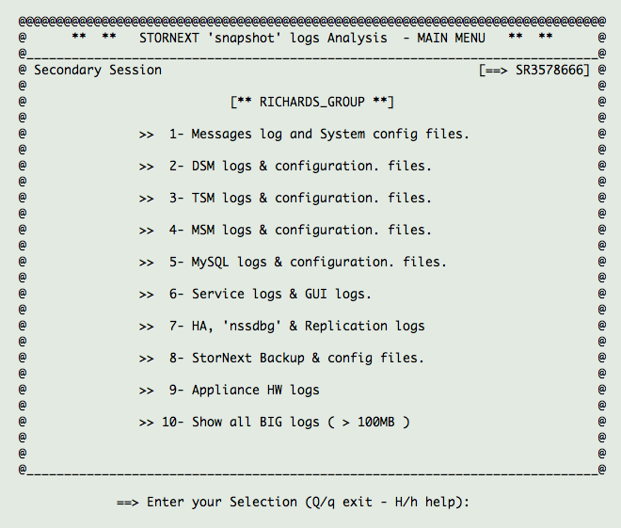
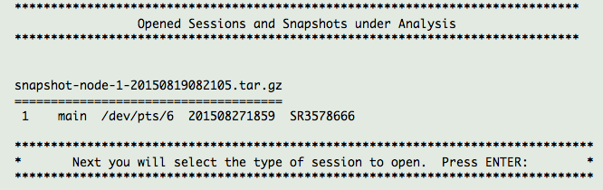
* Multiple windows to view same snapshot *
3
1
2
4

Slide 7
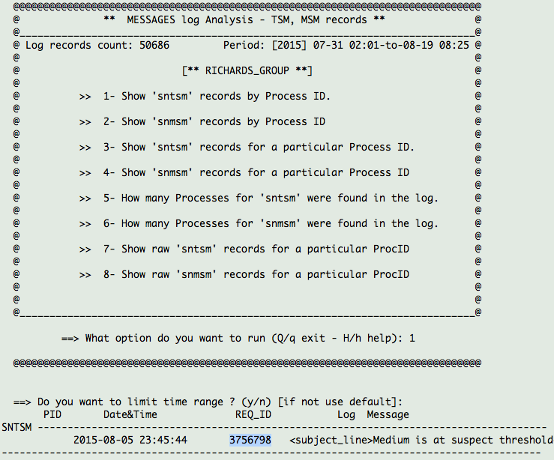
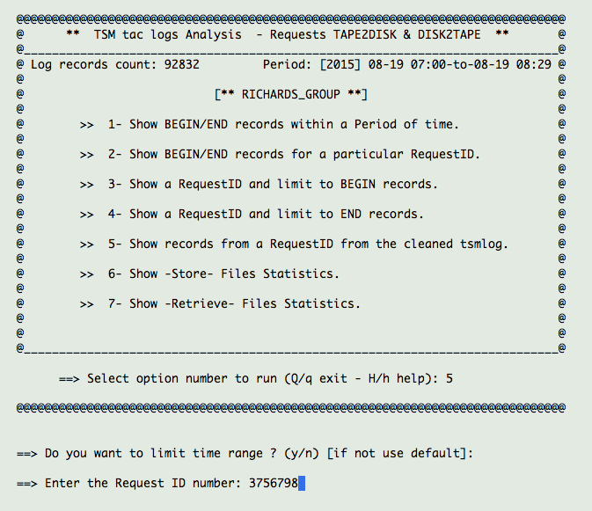
Multiple Windows to view same snapshot

Slide 8
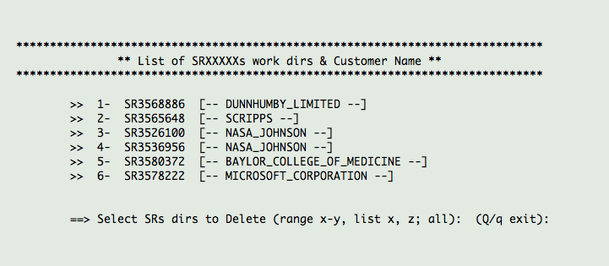
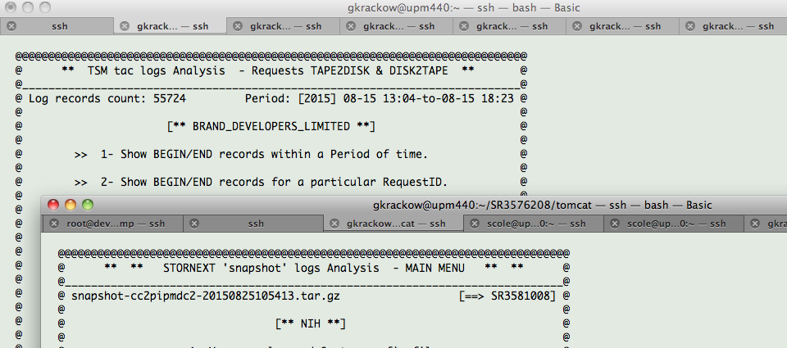
Open Sessions - Older Session - Leftover Session

Slide 9
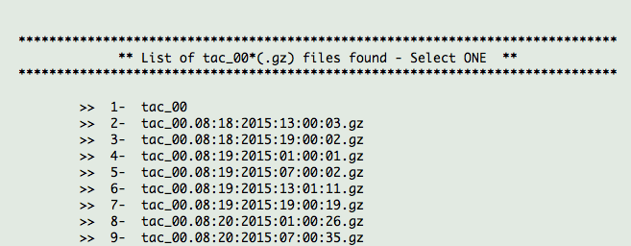
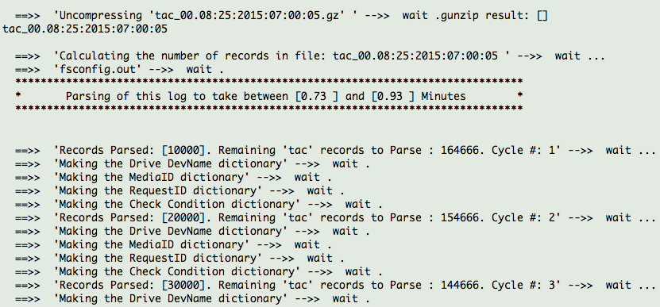
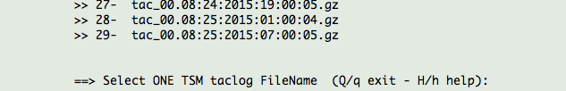
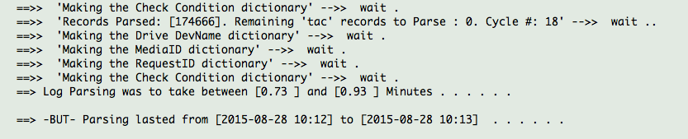
Parsing logs : List - Select - Parse - Analyze

Slide 10
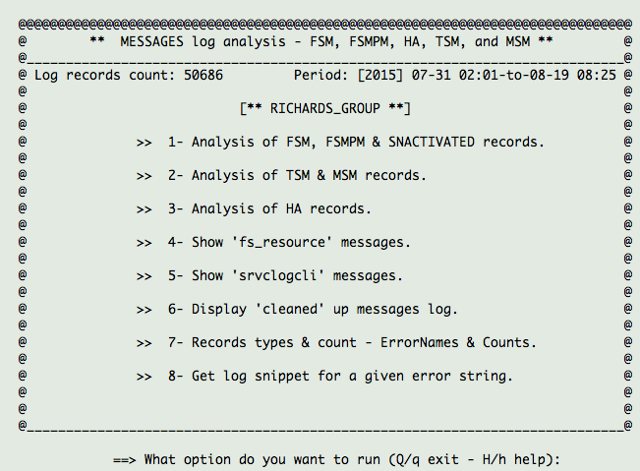
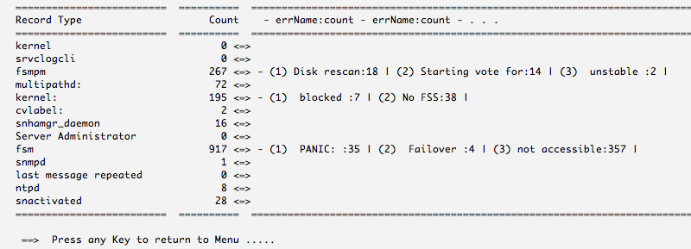
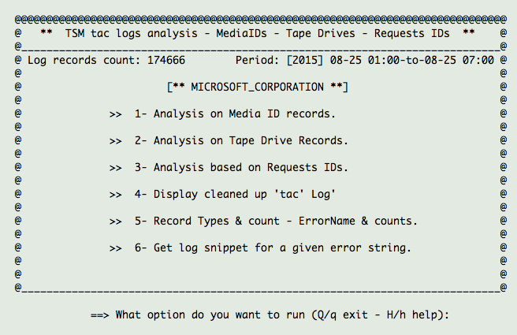
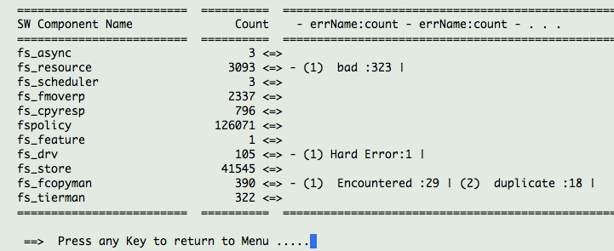
Analyze - error leads - Collect Data - Connect Dots

Slide 11
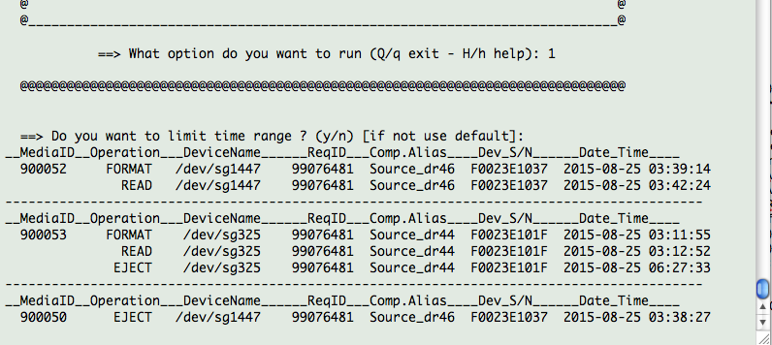
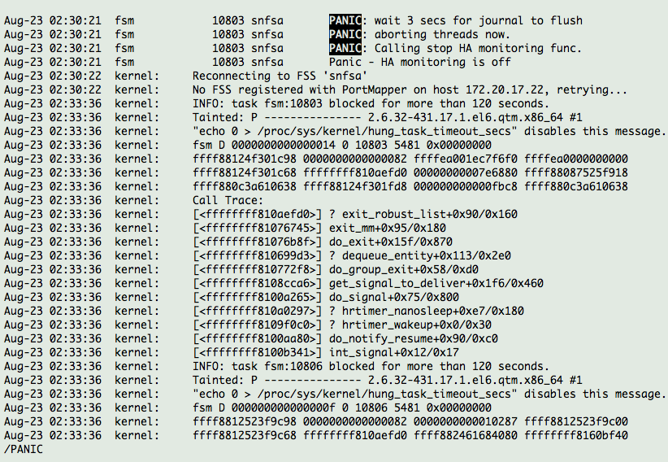
Drill down - Browsing results - On screen - In files
Scrolling the Terminal buffer is the one of the two operations where Mouse _can_ be used.
The other operation is _cut/paste_ to a notepad to collect the relevant analyzed data.
Use the Mouse to scroll Upwards when the output is too long. Sometimes you can dump to ‘less’ but not always.
Less allows scrolling back & forth using the arrow keys, press Space bar to go downwards.
Some other usable ‘less’ commands :
/ search forwards, highlights <expr>
? search backwards
1 G Go to Top of file (1st record)
G Go to bottom of file (last record)
<n> G Go to line <n>
!grep <expr> % | less search for only <exp> in the whole file, dump to ‘less’
v Enters ‘vi’ editor on file.
q Quits browsing file (quit ‘less’)

Slide 12
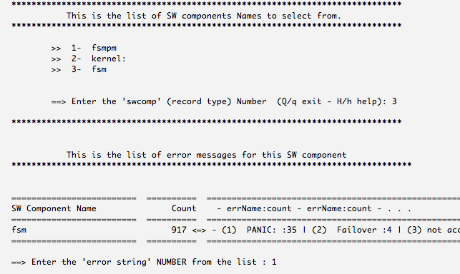
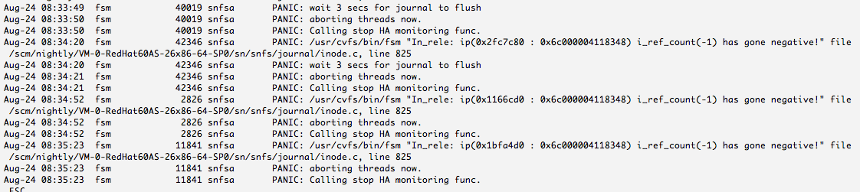
Drill down using ‘error leads’ - Collect Data

Slide 13
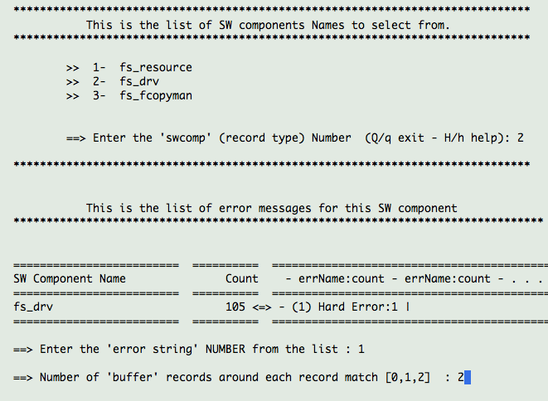
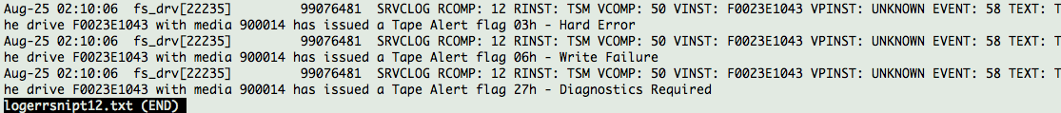
Drill down using ‘error leads’ - Collect Data

Slide 14
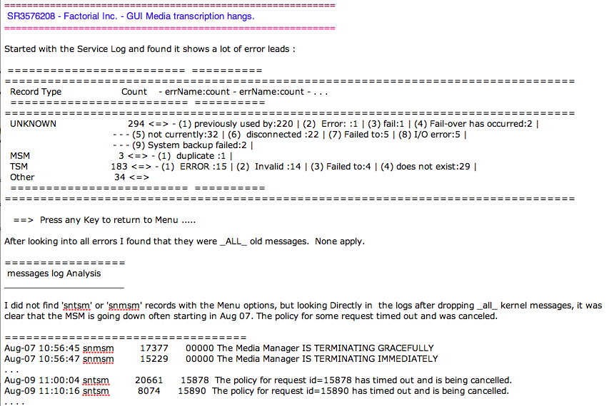
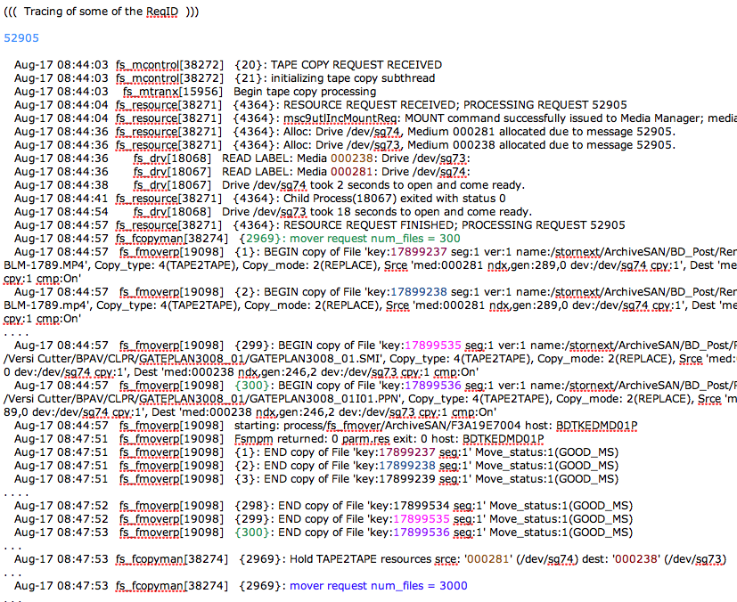
Collect Data - (Cut/Paste) - Complete Analysis

Slide 15
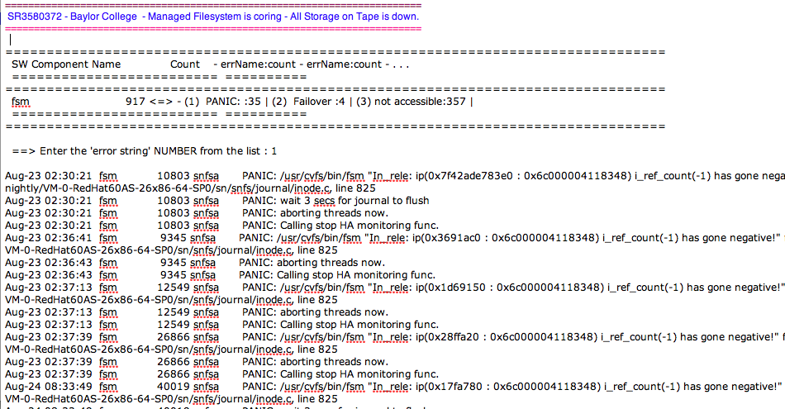
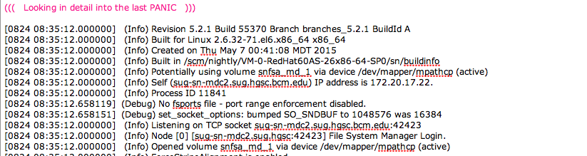
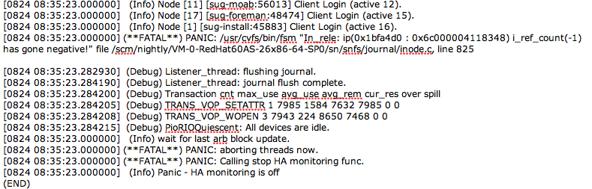
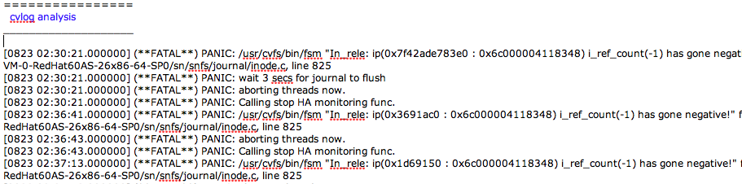
Collect Data - (Cut/Paste) - Complete Analysis

Slide 16
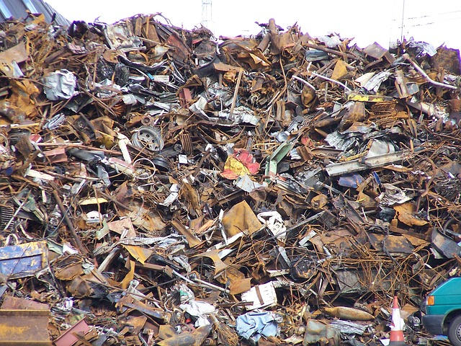
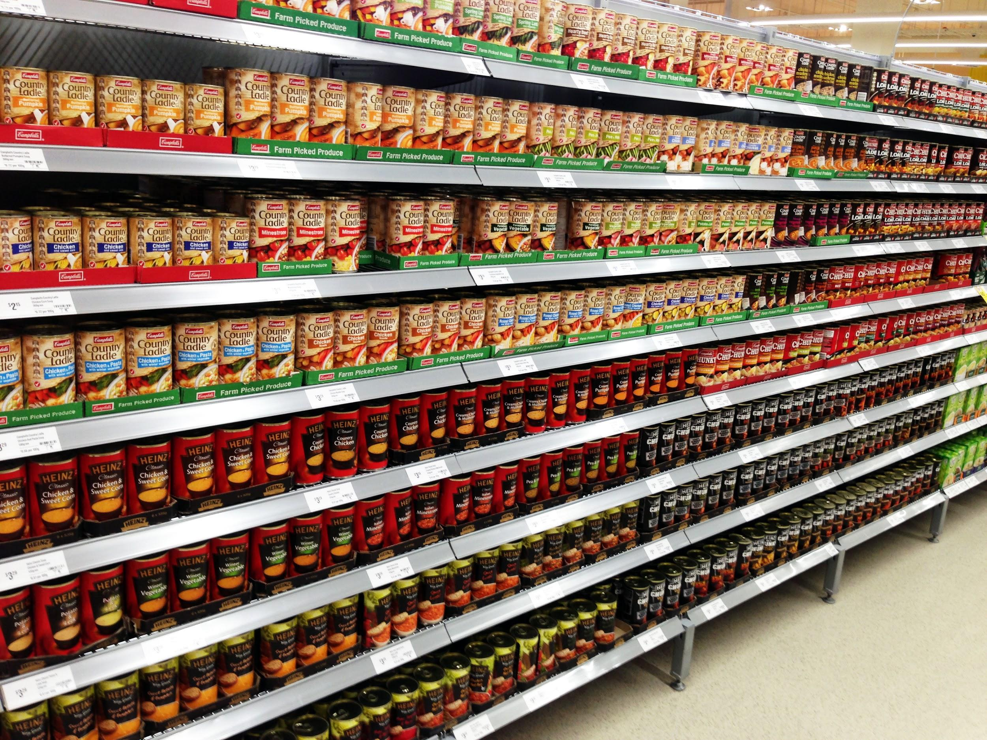
raw snapshot view using application

Slide 17





Moving around the logs with the application
May feel a bit like solving the Rubik’s Cube. _But_ with StorNext background and practice you will make sense of the rules.
This is the Goal -BUT- often this is good enough
Which in our case is how the different major StorNext components work together and in what logs they leave activity records that allows to do the tracking and forensic analysis.

Slide 18
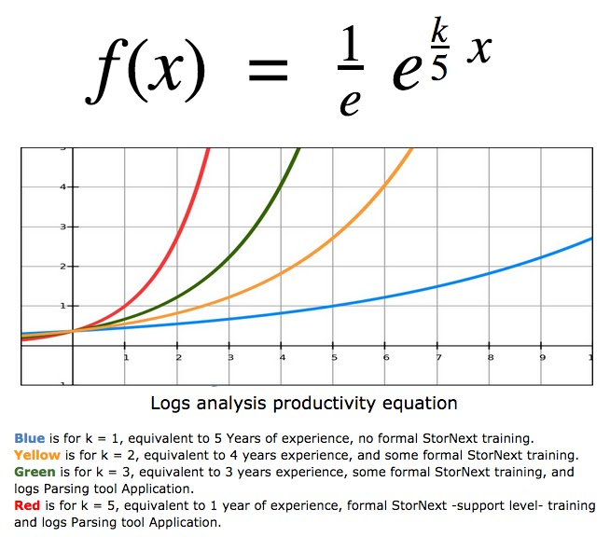
Mathematical model for how a Log Parser improves productivity exponentially
Based on number of years needed to master StorNext, I came up with the following formula, which express very well the very slow productivity when _NO_ support level training and logs Parser application is used. Axis Y mark 1 is the start of meaningful productivity. Mark 5 is the Max.

Slide 19
Done with Part 2
If there is any time left I can try answering a few questions.
If there is no time left for questions, feel free to e-mail the questions to me, I will address them as soon as I can.
There is still material to discuss about using this application, that could include: tips and tricks to collect data in a file, what to to do if CTRL-C by accident, what if stepping in a ‘bug’, accessing the work area dir structure, etc. I will add new slides on these.
Thank you
G.K.

