Slide 1
Quantum
StorNext ‘snapshot & cvgather’ logs analysis using a Parsing log Application
Part 1
Presented by German Krackow
August 19, 2015

Slide 2
Quantum
Presentation Goal
Show how with the help of the computer the chance to get -valuable- information from the googol size, disparate collection of logs and reports increases exponentially.
Show in what context this application works.
Show the advantages of performing ‘logs Analysis’ with a Parsing Application.
o Fast access to the -ready- multiple reports collected by the ‘snapshot’
o Easy and fast access to different logs and the Parsed results.
o Parsed logs are clearer and easy to the eyes.
o Easy to ‘drill down’ into the logs to collect data that allow to connect the dots.
o Global Search on many large logs.
A logs Parser application target eliminating the very low to zero productivity results of the manual process.
The application also helps speeding up the understanding and learning of StorNext, reducing the time to master it from 5 years to around -ONE- year.

Slide 3
StorNext logs Collection
messages, dmesg, network reports and
config files, etc
Snapshot / cvgather
cvlogs, <fsName>.cfgx,
ha_mgr, snactivated, mount_<fsName>
srvcLog, ha_mgr, nssdbg.out, snpolicy.out
tac_00, history, trace for TSM and’
MSM, config files, reports, MySQL logs, GUI logs, etc.
StorNext Filesystems
SN Storage Manager
Connect
Artico
StorNext compiled Linux Kernel
Linux OS
Underlying Hardware - SAN - Lattus - Libraries

Slide 4
StorNext logs Parsing - ‘Snapshot & Cvgather’ application.
Integrates with Quantum SRs workflow.
Upload to Quantum
FTP server
(Denver)
StorNext
ticketinfo
Managed
filesystem
Customer’s
MDC
snapshot or
cvgather
Mount
ticketinfo as
NFS filesystem
Filesystems logs
and config files
reports
System logs parsing
and config files.
reports
snapshot tar.gz file copy to user work area
TSM log parsing &
config files, reports
Snapshot &
cvgather parser
application
MSM log parsing &
config files, reports
SR number
SR3536986
MySQL logs dspl &
config files, reports
StorNext support
Engineer
HA, nssdbg and
replication logs.
StorNext Backup
config files & reports
ServiceLog parsing

Slide 5
snapshot & cvgather application features
Linux server based, Menu driven application written in Python.
Works from -ANY- platform through SSH terminal sessions.
Provides an organized view and easy navigation Method of the content of the ‘snapshot’ & ‘cvgather’ logs collection.
Allows multiple views of the same ‘snapshot’ through multiple SSHs terminal sessions.
Displaying information is fast and to the point.

Slide 6
snapshot & cvgather application features
The heavy lifting work (search, sort, organize, Parse, present) is done by the Computer - Application (_not_ the Human).
Takes advantage of Quantum logs management application workflow (StorNext based) in place, so it can find a ‘snapshot’ file predictably and copy it to work area in a reasonable time.
Using only the SR number, it finds, copy to temp work area, and extract -only- the logs of interest from the snapshot - NO Manual work required - NO Waste of Disk (shared) space.

Slide 7
snapshot & cvgather application features
Use Unix ‘less’ command extensively to display configuration files, log snippets, or full logs.
Uses terminal buffer to scroll up for results review.
Allows multiple views of the same ‘snapshot’ through multiple SSHs terminal sessions.
Allows to work on multiple ‘snapshots’ from same SR case.
Clean after itself (if closing normally), removing all work files and directories created in the work area.

Slide 8
snapshot & cvgather application features
If the server is rebooted, or SSH session is abruptly terminated, work files are left behind under SRnumber directory.
Next application run shows SRs with open sessions. Allows resuming on these SRs (as secondary session) or removing these leftovers. Any leftover older than 30 days is removed silently.
Application installed in ‘srscratch’(1) and Lab M660, M440(2).
Application available to all StorNext support engineers.
srscratch system has very limited resources.

Slide 9
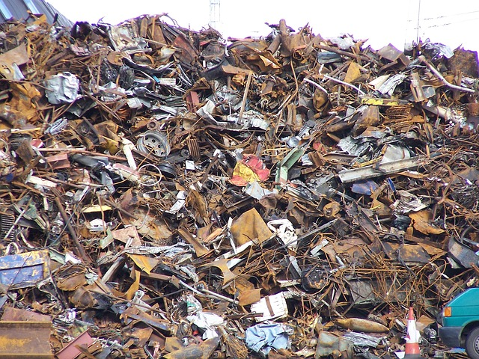
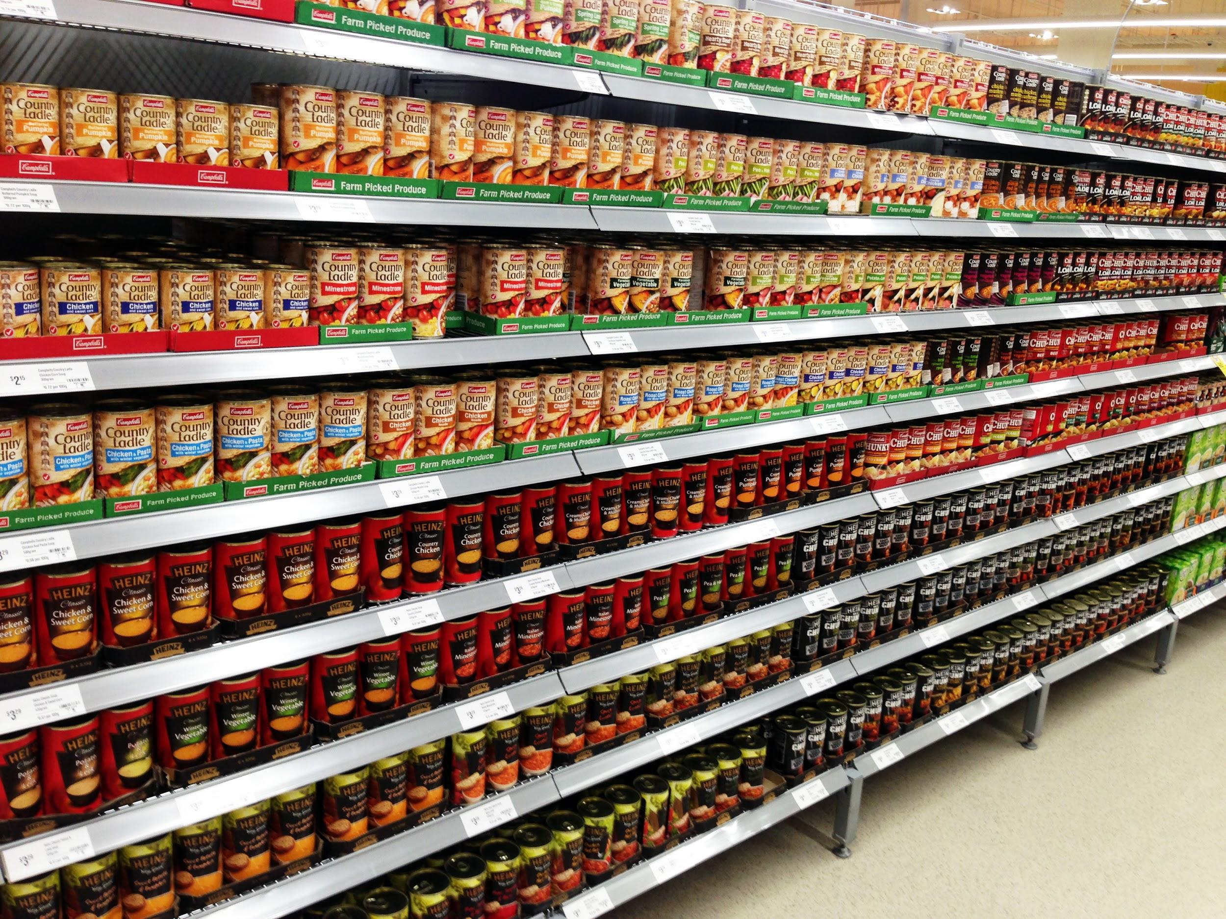
raw snapshot view using application

Slide 10
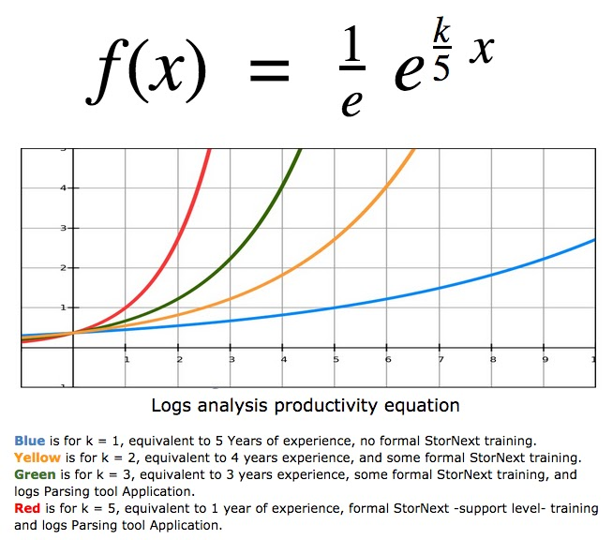
Mathematical proof that a Parser log improves productivity exponentially
Based on number of years needed to master StorNext, I came up with the following formula, which express very well the very slow productivity when _NO_ support level training and logs Parser application is used. Axis Y mark 1 is the start of meaningful productivity. Mark 5 is the Max.

Slide 11
What does the Parsing do ?
Removes the FAT and Clutter from the logs. These are fields on each records that are of NO help for support analysis. Records that contain clutter that is of NO help for support analysis are dropped altogether (think some kernel and ALL qstat records).
Search for error-messages leads.
Group records by Software Component, record type, Req ID, other fields depending on the log, to allow analysis of the logs and to allow taking snippets of the logs based on these fields.
Example (from TSM trace_01 log) :
Jun 03 13:17:15.085088 car-mdc-01 sntsm fs_fmoverp[9629]: E1101(18)<14426293>:mdm3pxy2140: {1}: /dev/sg314(001397) to DISK(DISK) 0 / 0.000283 = 0.00 MB/s Jun 03 13:17:47.560807 car-mdc-02 sntsm fs_fmoverp[17509]: E1101(18)<14427168>:mdm3pxy2140: {1}: /dev/sg238(001343) to DISK(DISK) 0 / 0.000193 = 0.00 MB/s
Jun-03 13:17:15 fs_fmoverp 9629 14426293 {1}: /dev/sg314(001397) to DISK(DISK) 0 / 0.000283 = 0.00 MB/s Jun-03 13:17:47 fs_fmoverp 17509 14427168 {1}: /dev/sg238(001343) to DISK(DISK) 0 / 0.000193 = 0.00 MB/s

Slide 12
System Logs and configuration files
Linux system log is ‘messages’. Contains system messages plus all StorNext Major modules post messages in there.
Filesystem detailed report, license, system information.
Message logs Parsing and analysis.
cvlabel and mutipath configuration files.
Network : Configured I/F, routing Table, statistics.
Unix Disk Space report, SCSI connected Devices.
StorNext high level summary.

Slide 13
Filesystem logs, configuration files and reports
fsnameservers, *.cfgx, fsmlist, ha_peer, ha_vip configuration files.
license.dat, depserver (gateway), ha_smith_interval files.
Display (non parsed yet) of ‘cvlog’ files.
Display of ‘mount.<fsName>’, ‘snactivated’ logs.
Parsing of ‘nssdbg’ logs
Global search on the ‘cvlogs’ included in snapshot.
Global search on the ‘nssdbg’ logs included in the snapshot.

Slide 14
Storage Manager - TSM logs and conf files.
Parsing of the tac_00 logs for analysis.
Parsing of the history logs. (fs* commands)
Parsing of the trace_05 logs. (fs_fsmover)
Parsing of the trace_01 logs. (fs_fsmovep - MB/Sec)
TSM fs_sysparm, Store Steering, Water Marks conf. files.
Media list (fsmedlist), Library/Drives report (fsstate).
Storage Class configured. Files counts to Store, to Truncate.
Storage Requests reports (fsqueue).
Scheduled features, Locked features (fsschedule, fsschedlock)
DDM configuration reports.
Global search in all ‘tac_00’, ‘hist_01’ logs.

Slide 15
Storage Manager - MSM logs and conf. files
Parsing of the ‘tac_00’ and ‘hist_01’ logs for analysis.
VS Archive, Drive & Media query reports
Library report - show all Drive and all Media in Library.
fsconfig report.
fs_scsi -p report.
fsstate, fsqueue, fschedule, fschecklock reports.
File counts to store, truncate (showc, showc -t).
Global Search on all ‘tac_00’ and ‘hist_01’ logs.

Slide 16
HA and Replication logs & conf. files
Parsing of HA (ha_mgr.out) logs.
Display of Replication ‘snpolicy.out’ logs.
Display of ‘snpolicy_gather’ log.
Display of ‘blockpool’ log files.
Network : Routing Table, Configured I/Fs, ha_peer, ha_vip.
Replication and Blockpool configuration files.
Global Search in HA and replication logs.
Parsing of nssdbg logs.

Slide 17
StorNext system backup
Summary report of last backup (snbackup -s)
Report of backups completions, media used and dates.
Display of ‘backup.log’ file.
List of media used by the SN Backup storage class _adic_backup
List of Media in ‘genscratch’.
Display of ‘fs_sysparm’ configuration file.

Slide 18
Service log - MySQL logs.
Service logs parsing - srvcLog
Display of MySQL logs (no parsing).
Display of MySQL configuration file ‘my.cnf’

Slide 19
DEMO
SR3536956 NASA_JOHNSON - Media made Unavail.
SR3547492 Richards Group. No write to Tape
SR3545984 Yahoo - Can’t retrieve a file.
SR527102 Scripps Institute - database duplicate key error
SR3549756 Lynda.com - Library Down

Slide 20
Done with Part 1
If there is any time left I can try answering questions.
If there is no time left for questions, feel free to e-mail the questions to me, I will address them as soon as I can.
Thank you
G.K.

