Slide 1
Dashboard and Monitoring
StorNext Connect
SNC TOI
Seth Battin & Román Saucedo
April 21st & April 22nd, 2015
Mendota Heights

Slide 2
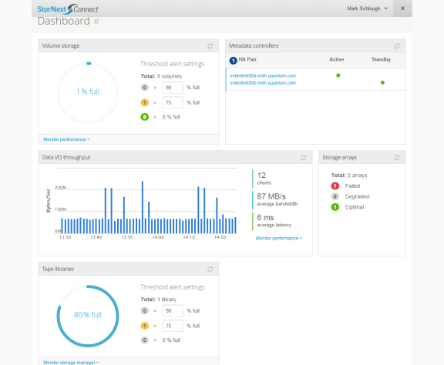
Dashboard

Slide 3
Dashboard: Goals
Provide environment health status at a glance
Easy drill-down capability
Always accessible from everywhere
Adaptable content – widgets
Content updated dynamically or manually
Can represent very large environments on one page

Slide 4
Dashboard: Features
5 Widgets: File System Storage, Metadata Controllers, Data I/O Throughput, Storage Arrays, Tape Libraries (if library present)
Real-time and refreshable
Stoplight concept represents large environments
Stoplight widgets flip for more detail. Also links to login prompts, or to Monitor app pages for more detail.

Slide 5
Dashboard: Roadmap
Expanded set of widgets (selectable)
Configurable layout and settings
Automatic updates, event/problem notifications, and help
What else would be useful to customers? We need their feedback.

Slide 6
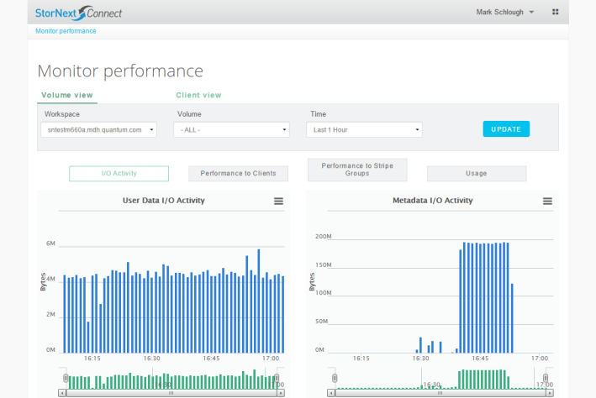
Monitor Performance (File Systems)

Slide 7
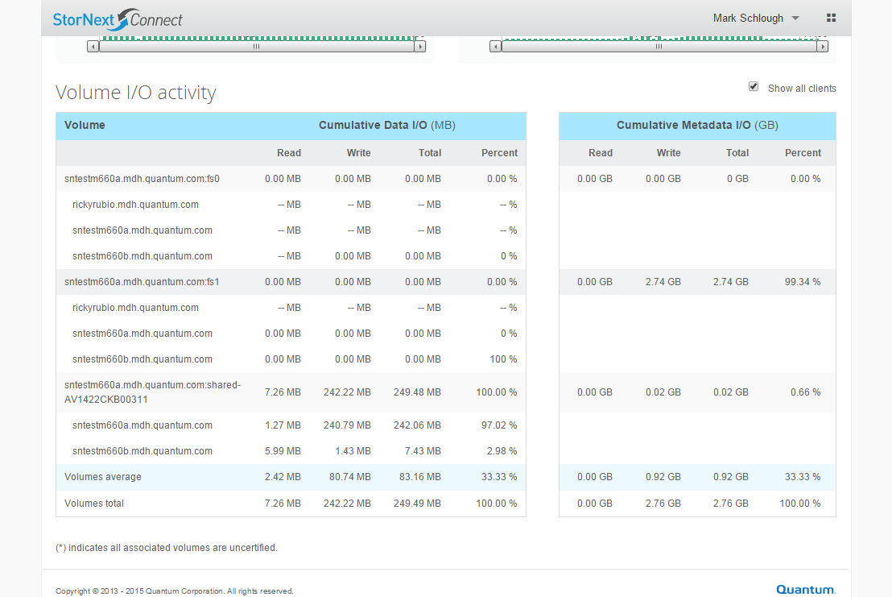
Monitor Performance (File Systems)

Slide 8
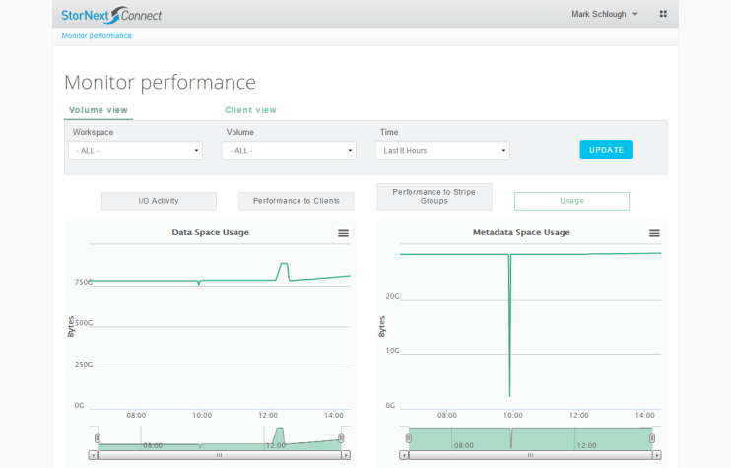
Monitor Performance (File Systems)

Slide 9
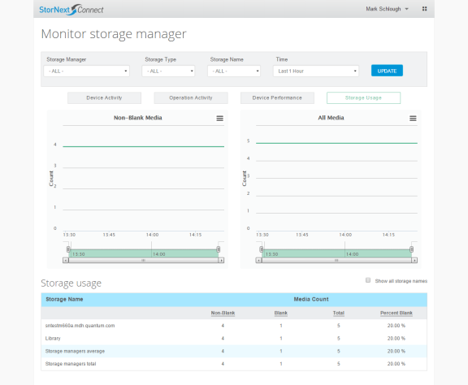
Monitor Storage Manager

Slide 10
Monitoring: Goals
Maximum detail about activity, performance, and resource usage, given available available QuStats
Use third-party, open-source software for data management and display (Graphite queries, Carbon cacheing, Whisper database, Highcharts charting)
Historical trends, current state, aggregate totals
Filtering options and drill-down
Provide multiple view points for clarity (file system broken down by clients that use it, client broken down by file systems that it uses)

Slide 11
Monitoring: Features
Monitor Performance
File System View
I/O Activity
Client Performance
Stripe Group Performance
Usage
Client View
I/O Activity
File System Performance
Usage
Monitor Storage Manager
Device Activity
Operation Activity
Device Performance
Storage Usage

Slide 12
Monitoring and NTP
The third party software upon which Monitoring requires NTP
If NTP is not running, Monitoring statistics may be silently lost, resulting in unreliable charts and tables
Also affect the Health Check Dashboard display

Slide 13
Monitoring: Roadmap
Real-time updates
Intelligent analysis, highlight problems
User-perspective activity and performance (not just device-centric)
What else would be useful to customers? We need their feedback.

