Slide 1
StorNext Connect
SNC TOI
Robert Metcalf
April 21st & April 22nd, 2015
Mendota Heights

Slide 2
Manage Clients Agenda
The problem we solve
What is manage clients
Limitations
Walk through
Enhancements

Slide 3
The problem we solve
Upgrading StorNext clients usually involves…
SSH to the client
Determine release level of each MDC
Transfer StorNext release to the client
Stop, install, and start StorNext
Lather, rinse, repeat for each StorNext client
Time consuming, error prone, and tedious
Ripe for automation

Slide 4
What is Manage Clients
Install StorNext on new clients
One-button install process
Upgrade StorNext on existing clients
Update multiple clients at once
Configure StorNext clients
Add and change file systems and mount points
Start and stop clients
Start and stop multiple clients at once (update MDC)

Slide 5
Limitations
Cannot update a host because…
A task for that host is already running
Will not update appliances
Will not update MDCs or name servers
Will not update hosts with DDM installed
Only Linux hosts (that have a Connector installed)
Connect server must be authoritative to the host
Must be StorNext 4.7.0+ (older releases not supported)

Slide 6
Limitations
Maximum StorNext update
A host cannot exceed the MDC release level
Examples
MDC is 5.1.1
Maximum client update is 5.1.1
Client mounts 2 file systems; each on a different MDC
MDC 1 (snfs_1) is 5.1.1
MDC 2 (snfs_2) is 5.2.0.1
Client update is restricted to 5.1.1 (snfs_1)
Rule: minimum release of all MDCs

Slide 7
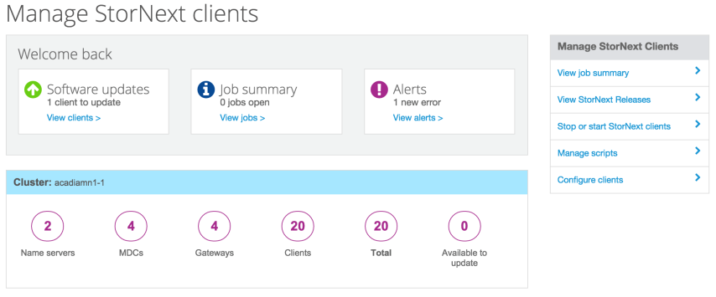
Manage clients application
1
2
3
4
5
6
Update clients – install install StorNext or update
Jobs – updates are asynchronous, done via “jobs”
Alerts – when a job has an error; clear alert to “unblock” the host
Stop or start clients – typically done when updating an MDC
Scripts – customer script run prior to stopping StorNext
Configure clients – change file systems and mount points

Slide 8
Update clients
New version – the maximum SN release
Restart or reboot
Restart StorNext or reboot the server after update is complete
Color
Green – good, the version number is increasing
Yellow – warning, replace the existing version
Red – caution, downgrade to a prior version

Slide 9
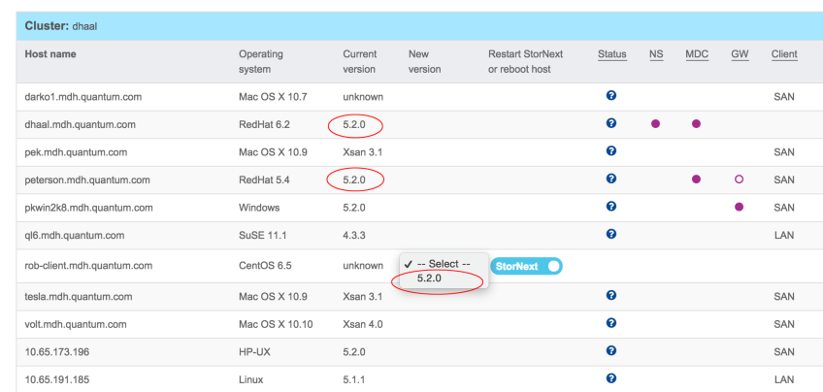
Limitations
Maximum update is 5.2.0
SN 5.2.0.1 is available but MDCs are 5.2.0

Slide 10
Jobs
Clients are updated via “jobs”
Jobs run asynchronously
Connect (web interface) is not blocked
Jobs are put on a queue
“Workers” select jobs from the queue and run them
Job summary
Show all jobs and status
Jobs with an error block the host
Clear the alert before continuing

Slide 11
Alerts
Clear alerts
Host is “blocked” until the alert is cleared

Slide 12
Start and stop hosts
Start and stop multiple hosts
Typical when upgrading an MDC or appliance
Need to stop all clients prior to the upgrade
Previously had to start/stop each host individually

Slide 13
Script to run before stopping StorNext
Stop programs prior to stopping StorNext
Customer wants to automate stopping systems or programs prior to stopping StorNext
Upload a script (text only, binary files are rejected)
Script is run before stopping StorNext

Slide 14
Configure clients
Change file systems and mount points
Add, change, or delete file systems mounted by a client
Mount options are free form (read the manual)
Limited to file systems owned by an MDC

Slide 15
Enhancements
Manage clients
Add structure to mount options (LAN clients)
Better client error reporting (start/stop and upgrades)
Synchronize DDM updates with the MDC
Tool bar to filter host upgrade eligibility
Better workflow when configuring a client
More insight into jobs and their status
Related to discover
Which clients mount a file system
Foreign file systems (name server 2, too)

Slide 16
Thank you

