Slide 1
StorNext Connect
SNC Installation Overview
Mark Reinhardt
April 21st & April 22nd, 2015
Mendota Heights

Slide 2
Installation Overview
Open Me First box
QuickStart Guide
StorNext Connect Web Site
StorNext Pro Hardware Install Guide
Racking
Pre-Install Considerations
StorNext Pro Install Application
Post-Install Considerations

Slide 3
StorNext Connect At-a-Glance

Slide 4
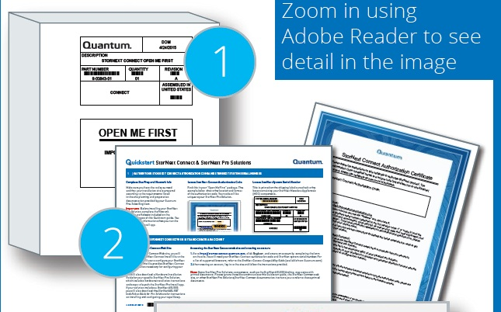
“Open Me First” box
QuickStart StorNext Pro Solutions & StorNext Connect Guide
StorNext Connect Authorization Certificate

Slide 5
QuickStart Guide
1) Site Prep and Info Worksheet, 2) Auth Code, 3) System Serial Number

Slide 6
QuickStart Guide – Worksheet Part 1

Slide 7
QuickStart Guide – Worksheet Part 2

Slide 8
QuickStart Guide – Worksheet Part 3

Slide 9
QuickStart Guide – Worksheet Part 4

Slide 10
StorNext Connect Site - stornextconnect.quantum.com

Slide 11
stornextconnect.quantum.com – Create Account

Slide 12
stornextconnect.quantum.com – download Install file

Slide 13
stornextconnect.quantum.com – download documentation

Slide 14
Hardware Install Guide - Overview
SN Pro Solution-specific guides
Studio, 4K, Workgroup, Production
Racking Info and Overview
QXS Array – User Data Storage
Metadata Appliance – M440 or M660
AEL 500 library (option)
StorNext Pro Install Application
Prerequisites / Considerations
Customer Install Application
Post Installation

Slide 15
Hardware Install Guide – Racking Guidelines

Slide 16
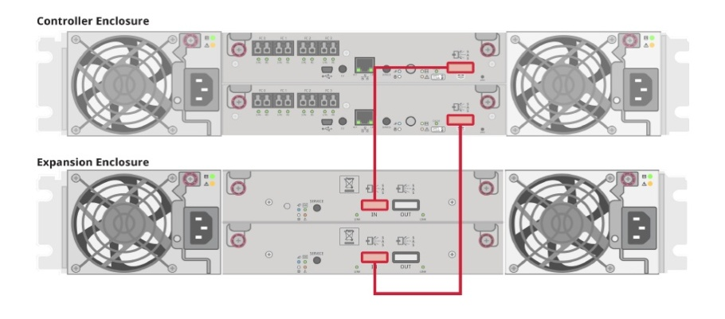
Hardware Install Guide – QXS User Data Arrays
QXS racking steps
NO Fibre Channel connections until instructed during Customer Install Application
Must not have other Fibre Channel Arrays attached to FC switch during Customer Install Application
QXS Expansion SAS Cabling

Slide 17
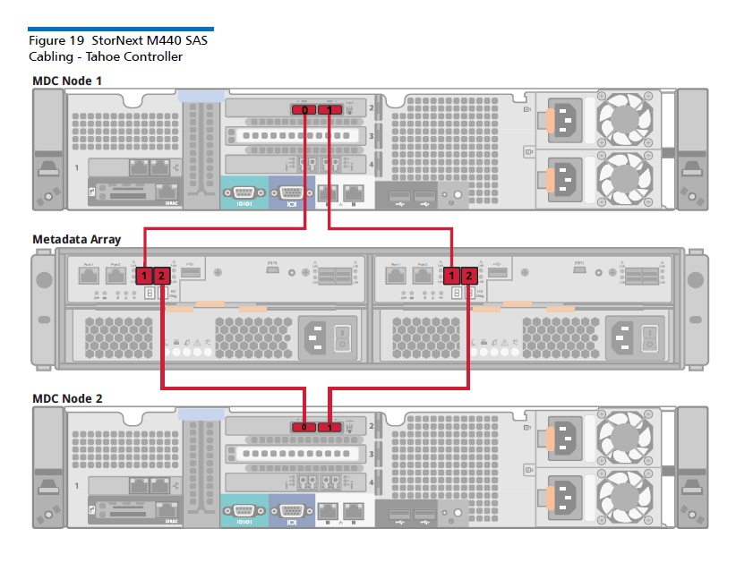
Hardware Install Guide – MetaData Appliance
Appliance racking steps (No ethernet cables attached)

Slide 18
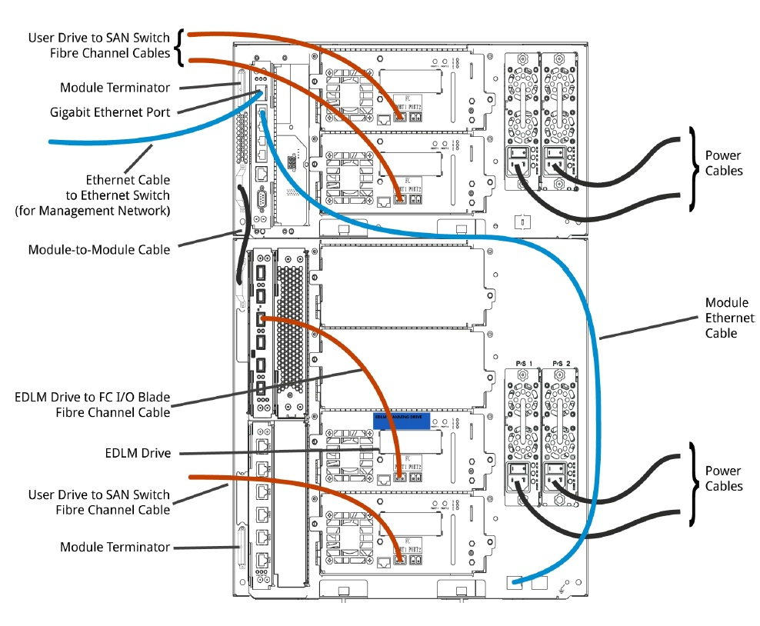
Hardware Install Guide – AEL500 Library option
Use AEL500 Installation Guide for Pro Solutions to complete the unpacking, racking and configuration

Slide 19
Hardware Install Guide – Customer Install Prerequisites
NTP recommendations
All Hardware racked and cabled as instructed
Ethernet switches and bonding
No bonding for unmanaged switches
“recommended”==bonded ; management and metadata networks
Fibre Channel / SAN
Disk and Tape zoning
MDC 2 & 4 FC ports connection options

Slide 20
Hardware Install Guide – Attach laptop to MDC Node 2

Slide 21
Hardware Install Guide – Launch into Customer Install
Open a web browser using URL http://169.254.21.2
Upload StorNext Connect Installation file when prompted by the StorNext Pro Bootstrap.
After uploading file, log on using the same user and password established during account registration on stornextconnect.quantum.com site.
StorNext Pro Install app will guide user through the remaining steps needed to complete the configuration of the StorNext Pro Solution.

Slide 22
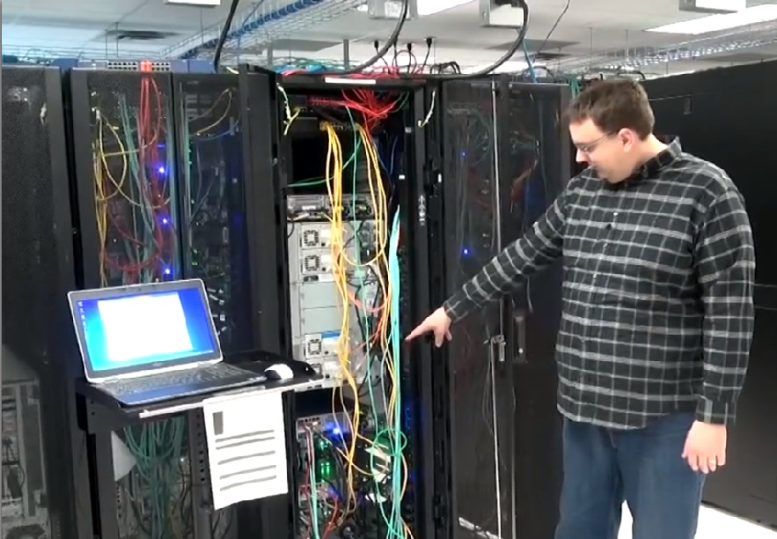
Hardware Install Guide – CI Application

Slide 23
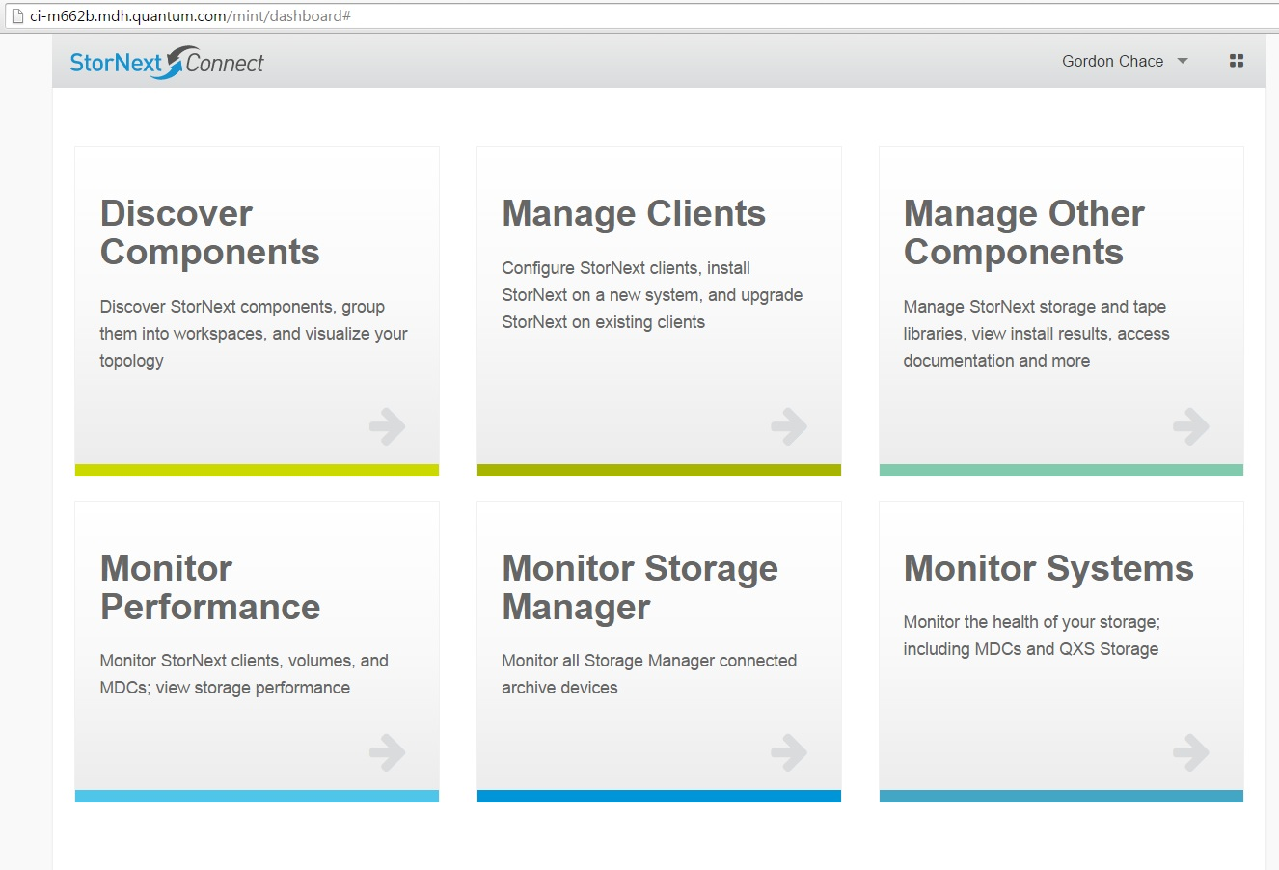
Hardware Install Guide – Post CI
Launch StorNext Connect Node 2 – admin and monitoring

Slide 24
Hardware Install Guide – Post CI
Remove Admin Alerts and RAS Tickets
Via StorNext GUI
StorNext Licenses
Obtain from Quantum (30-day at CI)
Install via StorNext GUI
Add StorNext Clients
Discover Components and Manage Clients apps

Slide 25
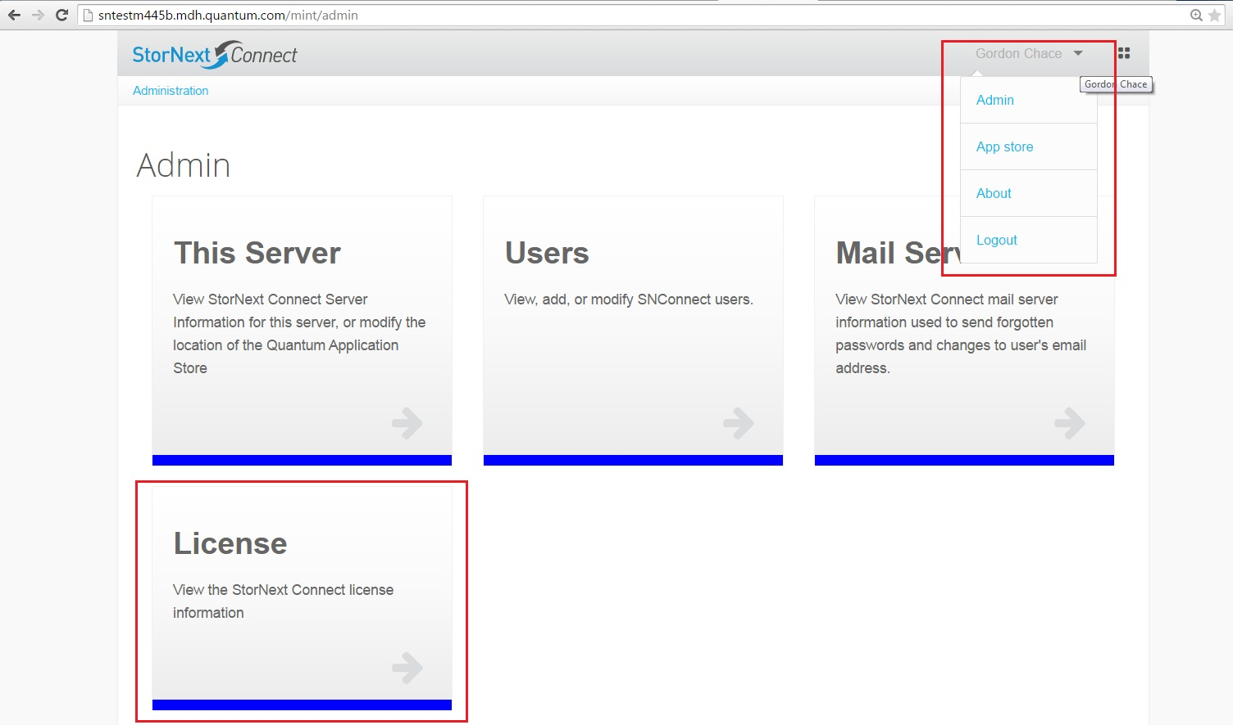
Hardware Install Guide – StorNext Connect License

Slide 26
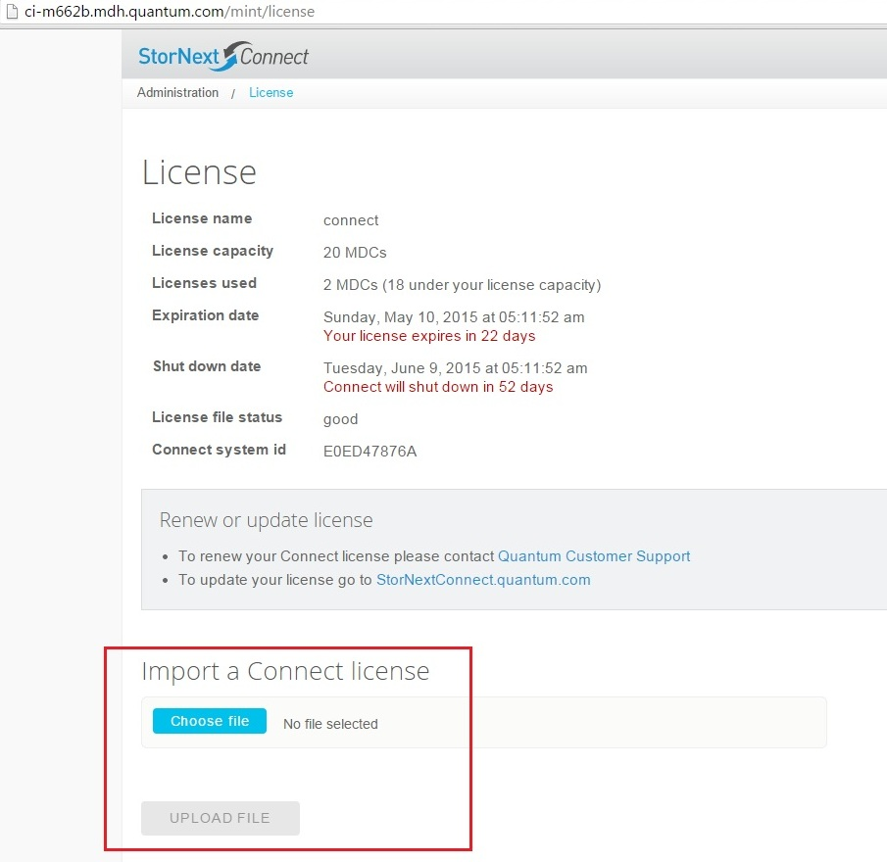
Hardware Install Guide – StorNext Connect License

Slide 27
Hardware Install Guide – StorNext Connect License

Slide 28
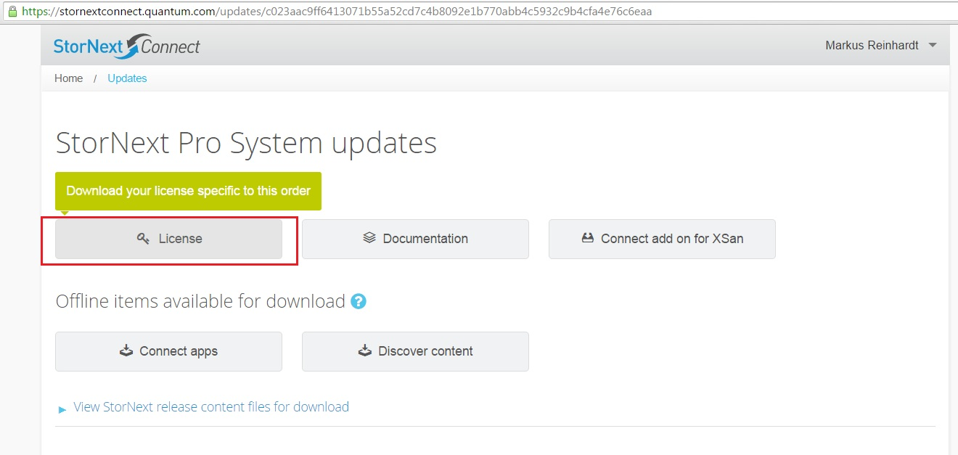
Hardware Install Guide – StorNext Connect License

Slide 29
Hardware Install Guide – StorNext Connect License

Slide 30
Hardware Install Guide – CI Demo

