Slide 1
StorNext Connect
Failover handling
“AJ Lewis”
April 21st & April 22nd, 2015
Mendota Heights

Slide 2
Connect and failover
Connect generates some load on node2, especially graphite stats collection against the system disk.
In order to prevent interference with StorNext, Connect is disabled when StorNext fails over to node2
The carbon cache is shut off – no stats are collected
The connect interface is disabled after login with an appropriate message,
If the user has admin privileges, they can re-enable Connect

Slide 3
Connect and Failover (cont)
Some links still work:
Admin, About, and Logout links still work
Dashboard will work, but no current stats data will show, and all app links will redirect to disabled message

Slide 4
Failback handling
Once node1 is primary again, Connect is automatically enabled again
Carbon-cache is turned back on
Main screen of connect shows tiles instead of warning – all available apps are re-enabled
Enabled state is reset – each time node2 becomes primary, customer must use the link to re-enable Connect Server.

Slide 5
Under the covers
Script runs once per minute via cron
Uses a touch file, /var/www/html/connect/config/connect_disabled, to indicated to Connect that it should run in disabled mode
When the admin clicks the Enable StorNext Connect link:
Another touch file is written out to /var/www/html/connect/config/ignore_disabled.
The carbon cache is turned back on

Slide 6
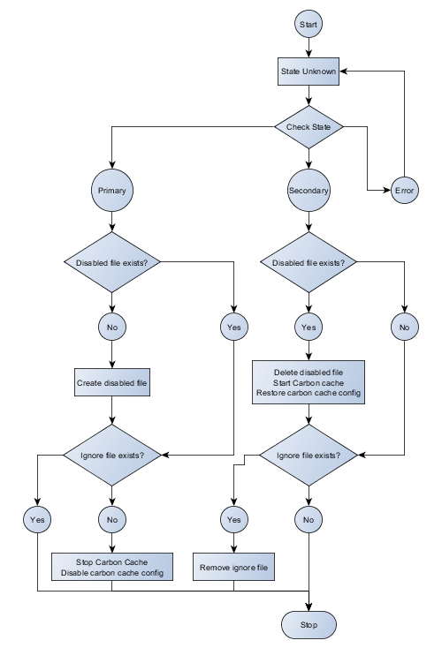
Failover script flow

Slide 7
Connect failover flow

Slide 8
Q&A

