Slide 1
StorNext Connect
SNC TOI
Robert Metcalf
April 21st & April 22nd, 2015
Mendota Heights

Slide 2
Discover Agenda
What is discover
The Connector
Add hosts
Which applications use discover
Limitations
Enhancements
Logging
What discover finds

Slide 3
What is Discover
Discover is a fundamental Connect component
A ha! It discovers StorNext topologies
Start with one or more name servers
Does not scan IP addresses and ports
Create “clusters” as it traverses the topology
Name servers
MDCs and the file systems they OWN
StorNext clients and the file systems they MOUNT

Slide 4
What are clusters
Cluster “A”
Cluster “B”
Name servers
Name servers
MDCs
MDCs
File systems
File systems
Client 2 (fsnameservers) fsforeignservers
Client 4 (fsnameservers)
Client 1 (fsnameservers)
Client 3 (fsnameservers)

Slide 5
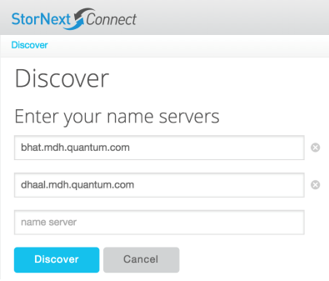
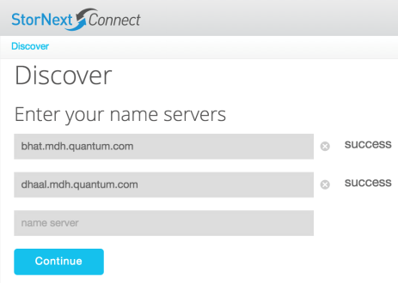
Discover starts with name servers
1
2

Slide 6
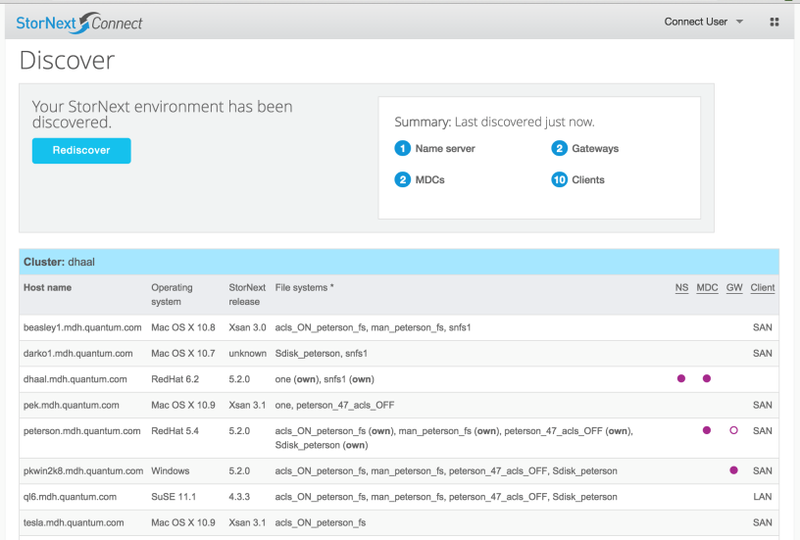
Discover results

Slide 7
What discover does
Keep a database of hosts and file systems
Capture far more than shown to the user
StorNext clients must be online and running
Point-in-time snapshot
No support for real-time updates
Recommend running discover after all client updates
An interface for other applications
Programmatic interface with rich features
Most Connect applications use this interface

Slide 8
How it works
Pseudo code
For each name server
Run snprobe (StorNext hosts, file systems, disks)
For each host
Run deep discovery

Slide 9
How it works
Snprobe
Remote “cvadmin” interface; StorNext-related information
Just enough information to identify hosts and file systems
Deep discovery
Requires the Connector to get “deep” client information
Python scripts used for cross-platform support
Required to manage and monitor hosts
/etc/fstab, fsnameservers, libraries, and installed packages
Linux now; other platforms later (Mac, Windows, etc.)

Slide 10
The Connector
Connector
Installed everywhere (MDCs, gateways, and clients)
Supports CentOS, Red Hat, and SuSE
Secure channel between Connect and a host
Required for…
All Connect-to-host interactions
Obtain deep discovery information
Managing clients
Mount file systems and upgrade StorNext

Slide 11
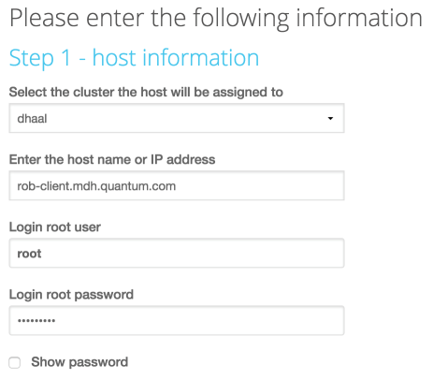
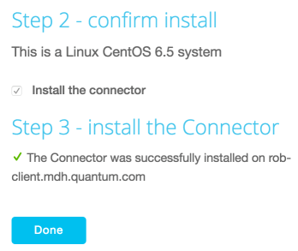
Discover – add hosts
Root credentials are never saved
One-time requirement to install the Connector

Slide 12
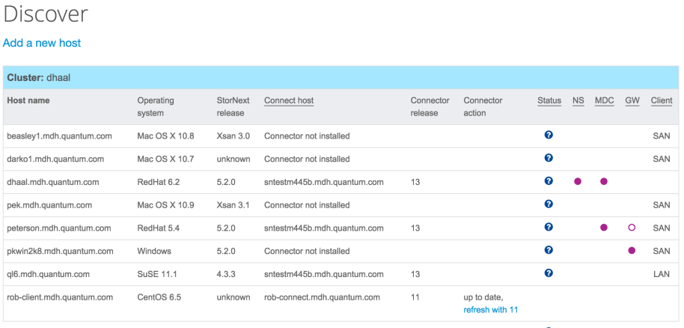
Discover – add hosts

Slide 13
Which applications use discover
These applications rely on discover for cluster and topology information
Manage clients
Monitor other components (tool box)
Monitor performance
Monitor Storage Manager
Monitor systems (dashboard)

Slide 14
Limitations
Discover
MDCs must have file systems to be discovered
Discover takes time to run on large clusters (25+ hosts)
Foreign servers not supported
Hosts with public and private IP addresses potentially appear as two different hosts
SN release number are 3-digits until Connector is installed
Connector
Update the Connector one host at a time
SuSE shown as “Linux” until the Connector is installed

Slide 15
Limitations
Management
Cluster names cannot be changed
Hosts are difficult to drop
Need to manage a host when StorNext is not running
Splitting a cluster has mixed results

Slide 16
Enhancements
Discover
Hosts with StorNext and no file systems mounted
Performance improvements
Foreign servers supported
Multi-home support (multiple public / private IP addresses)
Add name servers as they are encountered
Many user interface enhancements
Connector
Update multiple hosts at once
Proxy support for true “private” hosts

Slide 17
Enhancements
Management
Rename clusters
Split and combine clusters
More views of the topology
Drill down into host details
More real time and less “batch” discovery

Slide 18
Logging
Specific discover log
/var/www/html/connect/logs/discover.log
Contains results from the last discovery
Keeps track of activity and the time it took to run

Slide 19
Logging
start - discover
start - snprobe - name server - dhaal.mdh.quantum.com
st/op - execute_snprobe_command - 20.3090 seconds
start - get_connector_deep_discovery - host - dhaal.mdh.quantum.com
st/op - has_connector - dhaal.mdh.quantum.com - 0.0070 seconds
start - cvfs_mounts.py
file system - snfs1, mount - /stornext/snfs1
file system - snfs_promise, mount - /stornext/snfs_promise
file system - one, mount - /stornext/one
stop - cvfs_mounts.py - 0.0840 seconds
start - fsnameservers.py
name server - 10.65.176.98 - peterson.mdh.quantum.com
stop - fsnameservers.py - 0.1060 seconds
start - is_stornext_installed.py
release - 5.2.0, revision - 50047, packages - snfs, mover, sm
stop - is_stornext_installed.py - 0.1650 seconds
st/op - ntp.py - 0.0680 seconds
st/op - sm_device_info.py - 0.0890 seconds
start - snconnect_client_version.py
connector version - 13, connect host - sntestm445b.mdh.quantum.com
stop - snconnect_client_version.py - 0.2130 seconds
stop - get_connector_deep_discovery - host - dhaal.mdh.quantum.com - 0.7750 seconds
stop - snprobe - name server - dhaal.mdh.quantum.com - 23.3830 seconds
MORE HOSTS WOULD BE LISTED HERE
stop - discover - 23.6060 seconds

Slide 20
What discover finds
Full history for each component
Hosts, file systems, libraries, SN releases, stripe groups
Track these events: adds, changes, and deletes
Could view changes over time
Host
Is… appliance, name server, MDC, primary or secondary MDC, HA peer address, gateway, gateway licensed, LAN client, SAN client, DDM mover
Status… CVFS, Storage Manager, Connector
NTP clock skew

Slide 21
What discover finds
Host OS
Type (AIX, Linux, Windows, etc.)
Distribution (CentOS, RedHat, SuSE)
Version (CentOS 6.5, SuSE 11.1, OS X 10.10, Windows 7)
Kernel (2.6.32-431.el6.x86_64)
Processor (32- or 64-bits)
SN build (5.2.0.1) and release number (53320)
Build platform (Linux 2.6.32-431.el6.x86_64 x86_64)
Build date (Sun Mar 29 01:16:48 CDT 2015)

Slide 22
What discover finds
Host appliance
System ID (AV1422CKB00311)
Manufacturer (AV)
Build year (2014)
Build week (22)
Model (StorNext M660)
Serial number (311)

Slide 23
What discover finds
File system
Cluster name (dhaal) and MDC address (10.10.65.123)
File system name (snfs1)
Managed (yes / no)
Active (yes / no)
Disk certification (branded, certified, or other)
Disk counts for each certification type (3, 1, 0)
Branded – Quantum disks (QXS)
Certified – DDN, Dot Hill, LSI, and NetApp disks
Monitoring application does not show data for “other” disks

Slide 24
What discover finds
Library
Cluster name (dhaal) and MDC address (10.10.65.123)
Library name (i40), ID (1), and Type (SCSI)
Product ID (Scalar i40-i80)
Serial number (QUANTUMD0H0100805_LLA)
Revision (153G)
Device path (/dev/sg18)
Library state (online) and drive state (online)
Slot count (25), drive count (2), and media count (19)

Slide 25
What discover finds
Library drive
Cluster name (dhaal) and MDC address (10.10.65.123)
Library name (i40)
Serial number (C38B73F000), drive ID (1), slot ID (d256l0)
User alias (i40_dr1), and revision (Y64Z)
Device path (/dev/sg17)
Product ID (Ultrium 5-SCSI)
Drive type (LTO) and Media type (LTO)
Drive state (online)
Error count (0) and drive mounts (125)

Slide 26
What discover finds
Library slot
Cluster name (dhaal) and MDC address (10.10.65.123)
Library name (i40)
Media type (LTO, LTOW, etc.)
Media count (25)

Slide 27
What discover finds
Stripe group
Cluster name (dhaal) and MDC address (10.10.65.123)
File system name (snfs1) and stripe group name (sg0)
Enabled (yes / no), metadata (yes / no), journal (yes / no)
Exclusive (yes / no), user data (yes / no)
Breadth (4194304 – 4MB)
Size (234 GB), reserved (4 GB), free (230 GB) bytes
Disk certification (branded, certified, or other)
Disk counts for each certification type (3, 1, 0)

Slide 28
Thank you
Go and discover

