Slide 1
StorNext Connect
Deployment onto all Quantum Appliances
September 2015

Slide 2
StorNext Connect Deployment
The goal is to deploy StorNext Connect onto 100% of the Quantum StorNext Appliance Install Base
Beginning now, September 2015, StorNext Connect is available (by default) to all StorNext Appliance Install Base (IB)
Process to request/activate StorNext Connect
There is no software distribution kit or media
Process to configure StorNext Connect “onsite” or “remote”
All installations must meet the system prerequisites requirements
Tips and Guides for operating StorNext Connect
Looking for continuous feedback, use StorNextConnectFeedback@Quantum.Com
If StorNext Connect is not deployed due to customer/partner preference, the product team would like to capture these exceptions.
Use the StorNextConnectFeedback@Quantum.Com email for feedback to the team

Slide 3
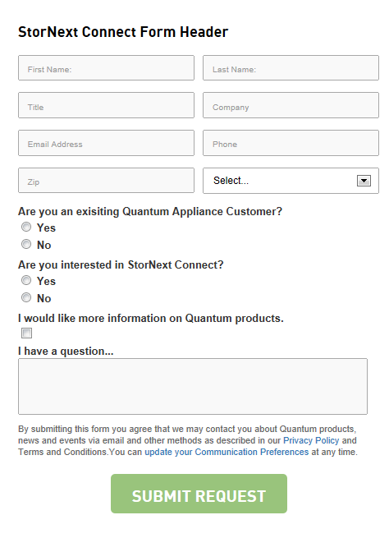
StorNext Connect Availability
StorNext Connect available for all Quantum Appliances
StorNext Connect customer request (or Field initiated) for existing Appliances
Via Website as a Customer request
Request will be validated and scheduled for installation
Via Partners
Training module of ASI/ASSP for (in process)
Via Customer as a Service Request
SN Connect on existing system
This requires Authorization Code to register SN Connect
If there is a customer request for StorNext Connect that does not meet the Compatibility Guide, the request should be processed via eXpress
As eXpress requests are approved, updates will occur to the Compatibility Guide

Slide 4
StorNext Connect
Product Update

Slide 5
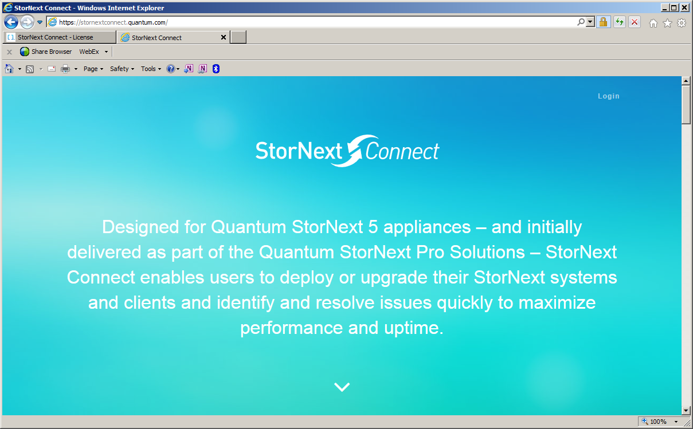
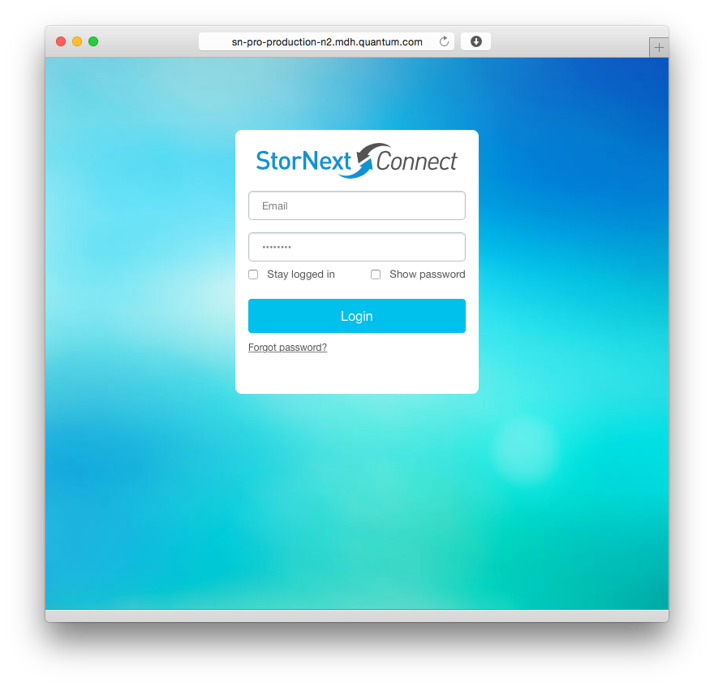
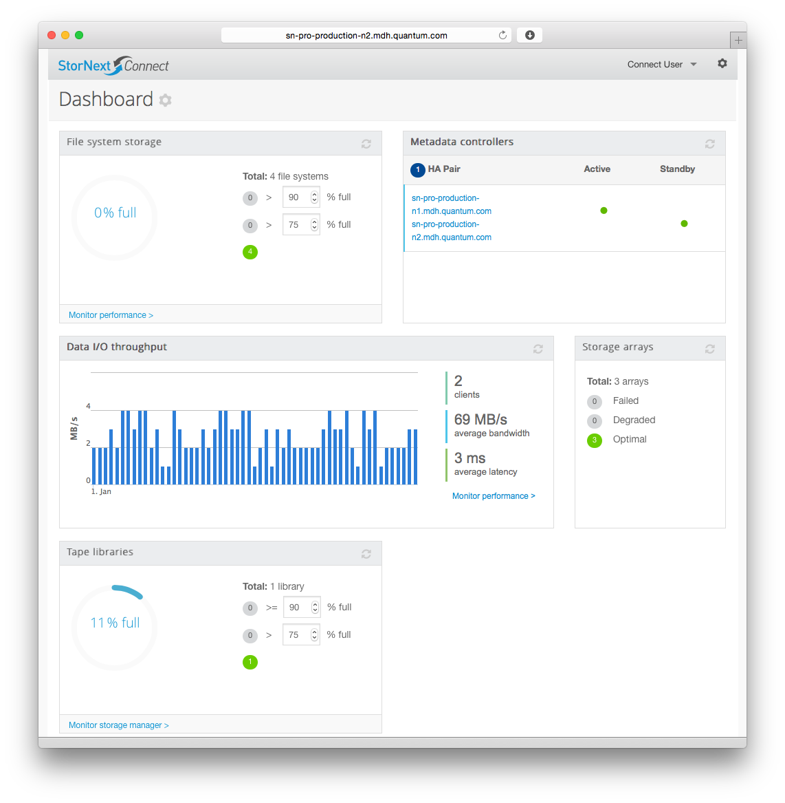
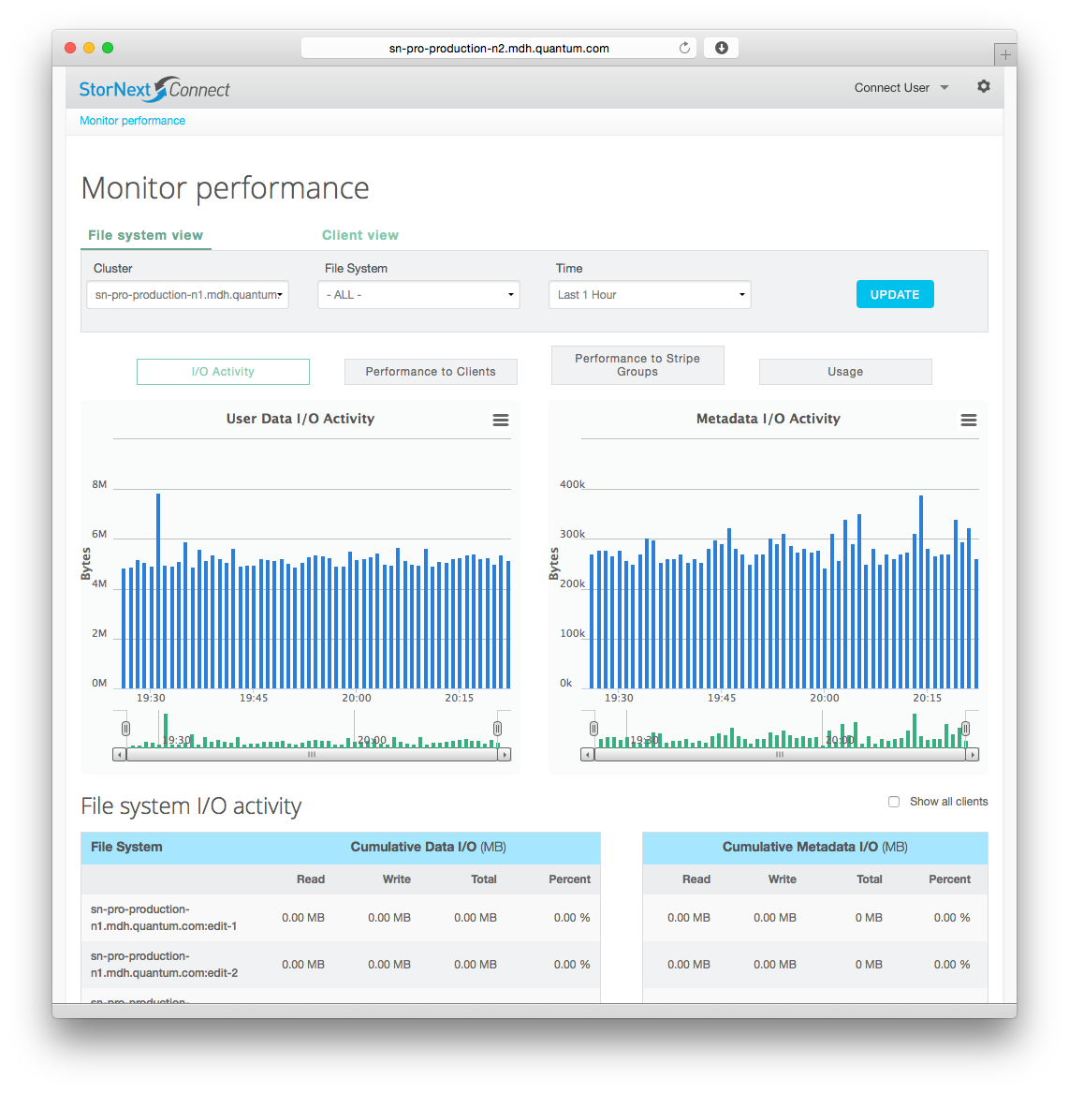
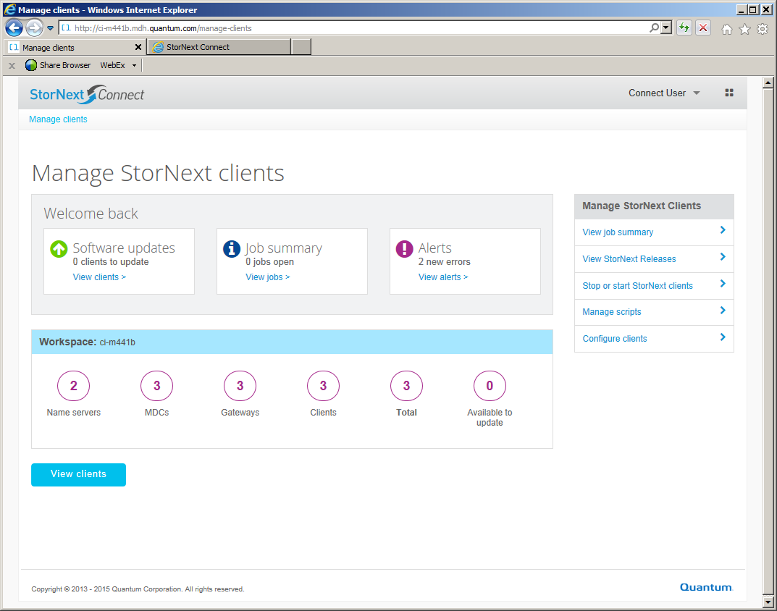
StorNext Connect
StorNext Connect v1.0.3 released
Fast, easy, and comprehensive discovery, management and monitoring of StorNext 5 environments
Simplified StorNext environment deployment
System planning tools for capacity and performance
Consolidated system views and reporting for daily operation
Complete client management

Slide 6
StorNext Connect Pro Solutions
StorNext Appliances
M660,M661, M662, M665
M440, M441D/Q
M330 (monitor only)
System Attributes | Max
Total number of Systems (MDC HA Pairs) | 4
Total number of clients (monitor/managed) | 100
Total number of Tape Libraries | 10
Total historical data retained (yrs) | 3
Pro Solutions
Pro Studio
Pro 4K
Pro Workgroup
Pro Production
Pro Foundation
Disk Arrays
QXS-412, QXS-424, QXS-456
Tape Libraries
AEL500 and AEL6000

Slide 7
StorNext Connect Deployment
StorNext Connect available for all Quantum Appliances
Start Here
Product Registration
Hardware Setup
Software
Configuration
System Operation
Current | Product Registration | Hardware Setup | Software Configuration * | System Operation
New Quantum Appliances from Manufacturing | Pro Solution: Quickstart w/Auth Code M-series: Quickstart (revision planned) Beachhead: Quickstart w/Auth Code | Pro Solution: Pro Install M-series: Pro Install (Auth Code required) Beachhead: Pro Install | Pro Solution: Pro Install M-series: Pro Install (Auth Code required) Beachhead: Pro Install | Browse to StorNext Connect on the Appliance Video references - “Day in the life of StorNext Administrator” “What and Why”
Existing Quantum Appliances (M-series/Pro Solutions) | Request Auth Code by email, Customer Registers product w/Serial Number ** | N/A – Equipment already installed | Use PS Installation Guide for remote or onsite Use the Network Planning Worksheet (Quickstart)
* All Appliances must meet system prerequisites requirements
** Email address StorNextConnectRequest@Quantum.Com

Slide 8
StorNext Connect
Deployment process

Slide 9
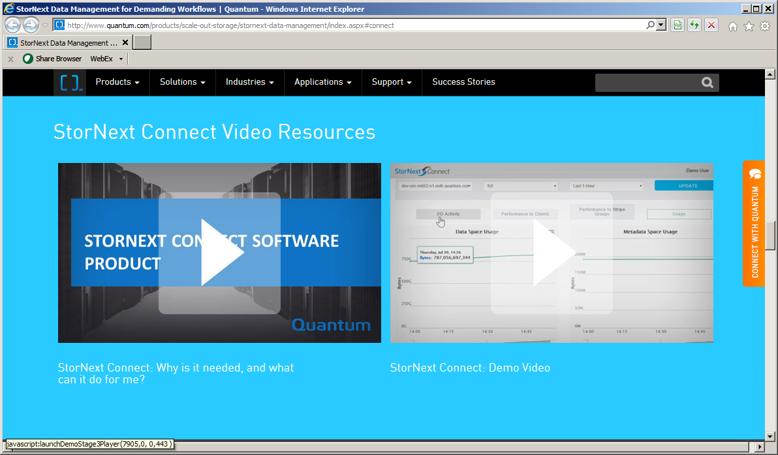
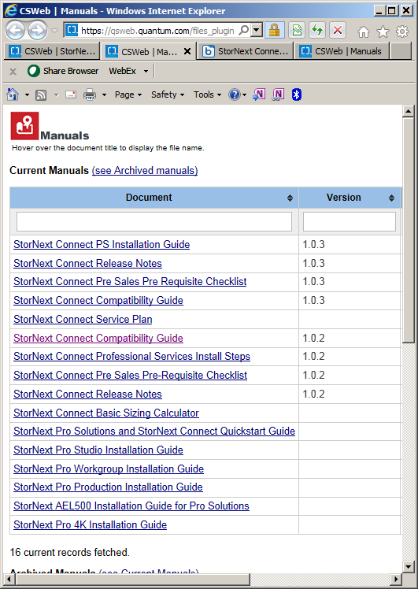
StorNext Connect Deployment process (existing IB)
Request Authorization Code
Customer request via Web Page or email (StorNextConnectRequest@Quantum.Com)
There is a set of 1000 Authorization codes that have been reserved for existing IB
Customer Registers their system (ref: StorNext Connect At-a-glance)
Goto StorNextConnect.Quantum.Com with Authorization Code and Appliance Serial Number
Customer/Partner/SE/QFE/SE/PS installation
Validate system prerequisites with StorNext Connect Pre Sales Pre Requisite Checklist
Use StorNext Connect PS Installation Guide for installation remotely or onsite

Slide 10
StorNext Connect Required Training
Anyone that will be preforming an ‘onsite’ or ‘remote’ installation will need to perform the self training
There is a 2 day StorNext training session available on internal site…everyone should at least perform the following for preparation of installation
Introduction and StorNext Connect Websites - Neil Bannister (Intro) and AJ Lewis (StorNext Connect Websites)
StorNext Connect Installation Overview - Mark Reinhardt
StorNext Connect Training and Documentation - Keith Lenehan
StorNext Connect Bootstrap and Customer Install (aka StorNext Pro Install) Demo - John Koniges
StorNext Connect Customer Install Debugging - John Koniges
There is also an video of a Pro Installation

Slide 11
StorNext Connect Prerequisites
Quantum Appliance with StorNext software v5.2.0.1 or later
StorNext Environment with 2 networks
A management network for access to web tools
DNS Server with updated/valid lookup and hostnames
NTP Server access or local NTP server
SMTP server for delivery of email notifications
A storage network for dedicated configuration and performance
QXS storage array with firm level GL105P005
Configuration of AEL library on dedicated Fibre Channel zone

Slide 12
StorNext Connect
Support of StorNext IB

Slide 13
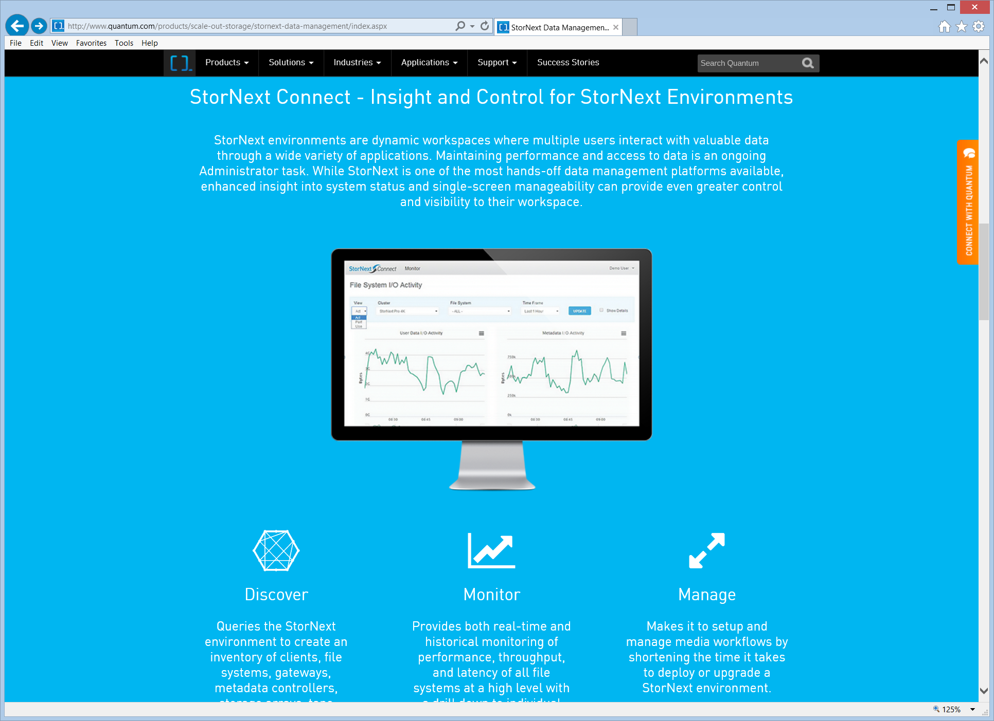
Product Resources for Deployment
StorNext Connect Product Information
Quantum.COM and StorNext.COM product page
StorNext Connect Request Form
StorNext Connect Customer Presentation (update in progress)
StorNext Connect Demo
Schedule a Demo hosted in SuperNAP with your SE
Documentation is available to on CSWeb
All documents related StorNext Connect to v1.0.3
Product videos available:
Product video on “DemosOnDemand” (link)
Product video on YouTube channel QuantumKnowHow (video)
Utilize eXpress process for customer configurations that are not documented

Slide 14
StorNext Connect Request Page
Customer Connect request form
Quantum and StorNext product page
StorNextConnect.Quantum.Com page
Requests from customers that have a Quantum Appliance will be scheduled for installation
Request for information on Quantum Appliance, StorNext Connect, and any other product will be a sales lead.

Slide 15
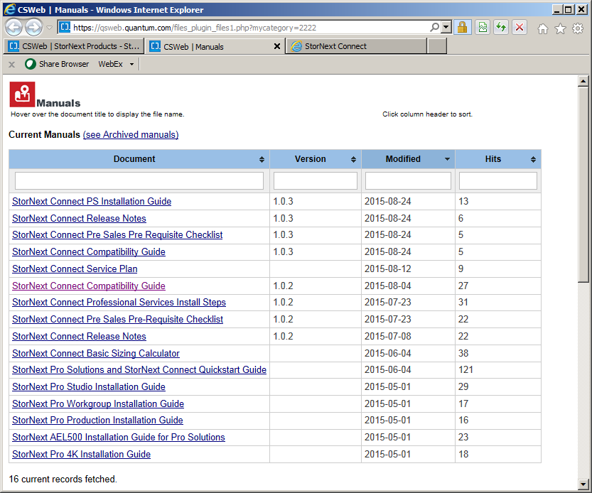
CSWeb resources (v1.0.3)
Resource updated for each product revision
Maintenance releases will have specific checklist of deliverables
Only the latest version of StorNext Connect is available
When Connect is deployed, it is with the latest version of the software

Slide 16
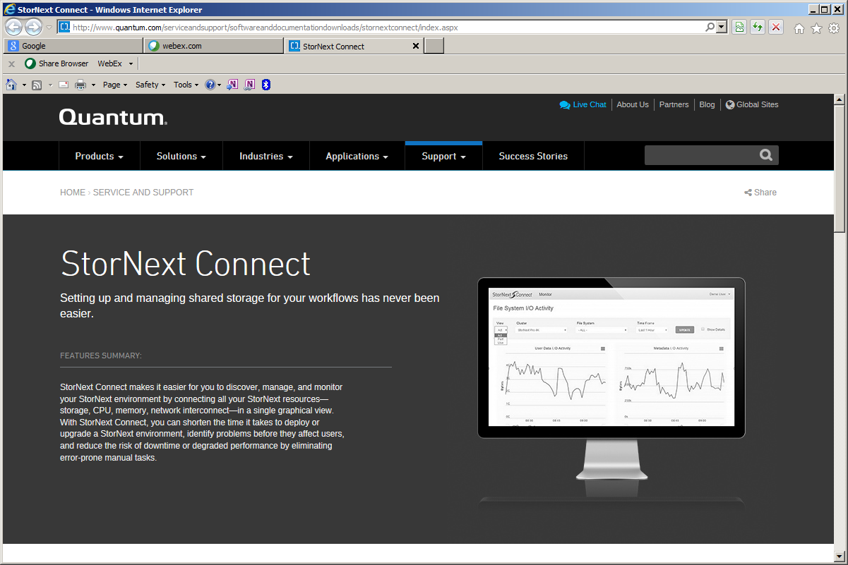
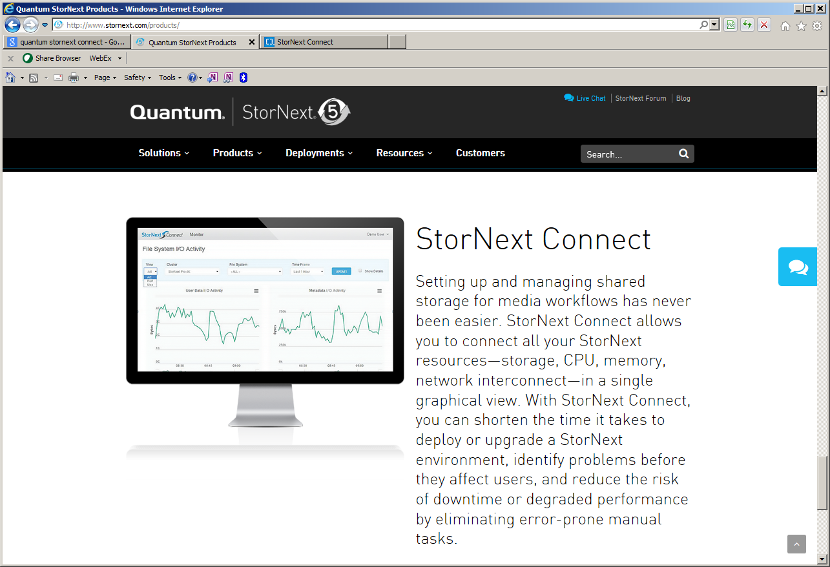
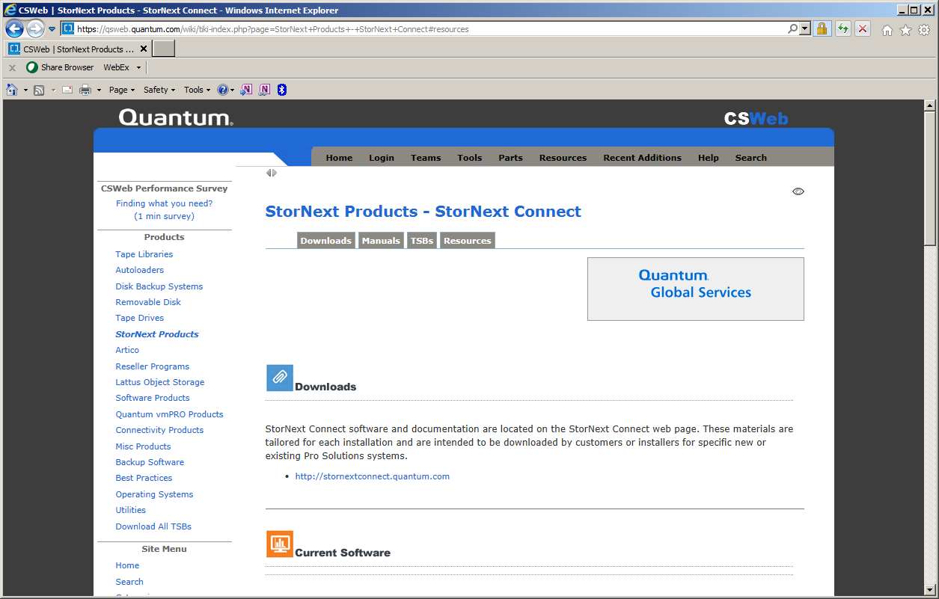
StorNext Connect References
StorNext Website
Model Number | Description
9-04455-01 | StorNext Connect
Quantum Website
CSWeb Partner Portal
To request StorNext Connect send email to
StorNextConnectRequest@Quantum.COM
To send feedback to email
StorNextConnectFeedback@Quantum.COM

Slide 17
Call to Action for StorNext Connect
Identify the 20 Partner systems
Assign a person and date for each of the systems. See list in Appendix.
Have all 20 systems with StorNext Connect by end 3QCY2015
Additional goal of 10 “existing IB” customers identified and installed by end of the quarter
All feedback to sent to “stornextconnectfeedback@quantum.com”

Slide 19
Partner Systems that need StorNext Connect installed
Partner | Qty | Serial Number | Assigned to | Date for installation
Aces | 1 | 10484581
Key Code Media | 1 | 10482232
Intervision | 1 | 10484952
Alliance IT | 1 | 10484997
1303 | 1 | 10484965
Simplemente | 2 | 10484522
FCP Works | 1 | 10484547
AD Digital | 1 | 10484714
RIVAS Y NAVA CONSULTORIA SA DE CV | 1 | 10484654
Simplemente | 1 | 10484928
Reboot CS | 1 | 10484750
Omega Broadcast | 1 | 10484698
Bridge Digital | 1 | 10484745
CEV | 1 | 10484993
HCS/Webistix | 1 | 10484894
Chesapeake | 1 | 10484917
Chesapeake | 1 | 10484922
Vernick Technology Inc. | 1 | 10484916

