Slide 1
StorNext Connect
Customer Install debugging
“John Koniges”
April 21st & April 22nd, 2015
Mendota Heights

Slide 2
Customer Install overview
The parts that install and configure a StorNext Pro Solution.
http://stornextconnect.quantum.com
Bootstrap
SNC Installer
Customer Install
The other parts that customer install uses to complete
Connector
StorNext GUI API
QXS API
The steps that are part of a Customer Install
How to examine your install once completed

Slide 3
Defining Parts of Customer Install
Terms
http://stornextconnect.quantum.com
Bootstrap
The mechanism for which load our package that includes all of StorNext Connect
All of the code for this is pre-loaded on appliances and expects a tar.gz package
SNC Install
The Mechanism for which our package is installed.
All of the code for this step is included in the package and executed in two parts
Part 1 Installs binaries needed by connect through a shell script
This also configures Apache’s vhosts
Part 2 is triggered when the first http request hits the connect site
Database is installed
User inserted into the database
StorNext Connect Applications are installed
Customer Install
Starts once you see the Customer Install Overview

Slide 4
Customer Install Parts
Quantum Connector
Service running on MDCs
Communicated with via ZMQ
Runs Python scripts
Use callback to system
/opt/quantum/connector/etc/connecthostname contains address for connect
StorNext GUI Webservices
API layer on top of existing StorNext GUI
Called from POST, GET URLs
JSON based returns from GUI
QXS API
Called from URLs with authentication in header
URLs same format as command line with / in place of spaces
Returns XML document

Slide 5
Customer Install Steps – Behind the scenes
EULA
Also sets Apache ports to *:80 and restarts Apache
Default ports are only 169.254.21.2:80
Cables for detection
Updates Quantum Connector on node 2
Configures connecthostname to 169.254.21.2
Customer Settings
Configure Node 2’s Management Network (eth1<M440> / Bond1:2 <M660>)
Will attempt to use the entered IP Address, Gateway and Netmask
Will configure DNS for Node 2
Will validate the Gateway defined with arping.
Will validate IP addresses to make sure they are available (QXS / Node 1)
Will Resolve hostnames and then validate services to exist (dns, ntp, etc…)
Will display all the settings that have been saved, and give the user a chance you go back and change them if they are incorrect.
Set up bond0:3 as temp bonding on 10.0.0.1 for tmp QXS communication
Bonding M660 Only
Nothing behind the scenes

Slide 6
Customer Install Steps – Behind the scenes
QXS Disk Setup
Verify connection between node 2 and QXS Controller A
Verify QXS disk count and disk health
If more than 1 QXS array, this is where it will detect unbalanced arrays
Set QXS Controller B’s IP address
Will query A to determine if Controller B’s IP is set correctly.
Verify Controller B’s IP address via ping
Out Node 2, in QXS Controller B
Set QXS Controller A’s IP address
Will query B to determine if Controller A’s IP is set correctly.
Verify Controller A’s IP address via ping
Out Node 2, in QXS Controller A
Set QXS NTP, Hostname
QXS Disk Provision
Calls one button install once per enclosure at 10+2 configuration
If multiple Arrays, repeat for each

Slide 7
Customer Install Steps – Behind the scenes
Node 1 Management Network
Remove bond0:3 tmp bonding used for QXS
Configure Node 1’s Management Network (eth1<M440> / Bond1:2 <M660>)
Verify IP address was set by pinging Node 1 from Node 2
Node 2 Metadata Network
Configure Node 2’s Metadata Network Bond0:2
Node 1 Metadata Network
Configure Node 1’s Metadata Network Bond0:2
Verify IP address was set by pinging Node 1 from Node 2

Slide 8
Customer Install Steps – Behind the scenes
Cable Fibre Channel
Send GUI settings to GUI on both nodes
Force NTP to sync
Add hostname to /etc/hosts for paired MDC
SCSI rescan
Validate SAS / fiber cables
Setup VIP on MDCs
Restart Mintd
Restart Syslogd
Restart Hwmond
Restart snapism
Restart Sendmail
Restart StorNext GUI
Wait for StorNext GUI to respond again

Slide 9
Customer Install Steps – Behind the scenes
HA Pair
Make sure license on Node 1 has information for both nodes
Convert Node 1 to HA Pair
Convert Node 2 to HA Pair
Create Volume(s)
Trigger cvadmin rescan
Validate all LUNs exist
Metadata
M44X 2 (4 w/ expansion)
M660 8 (16 w/ expansion)
Validate both MDCs can see all QXS LUNs
Send message to GUI to create volume(s)
Repeat for each volume

Slide 10
Customer Install Steps – Behind the scenes
Configure Library (if exists)
Send command to StorNext GUI to list all Libraries visible over Fibre
Iterate over list to find a match with the serial number specified in BOM
Send a message to the StorNext GUI add the given library
DNS must resolve correctly for Node 2’s management IP
The AEL i500 will try to communicate back to the node via Ethernet
Control path must be configured on the AEL i500
After Library is added we send a generic policy to the StorNext GUI
Should modify policy for specific needs
Customer Install Complete
We enable all StorNext Connect apps, disable Customer Install
Starts supervisord managed workers that monitor beanstalkd
Configure cron to run for StorNext Connect
Start carbon-cache with supervisord
Add setting to database that Connect has completed the Install
Enables Dashboard
One final restart of Apache

Slide 11
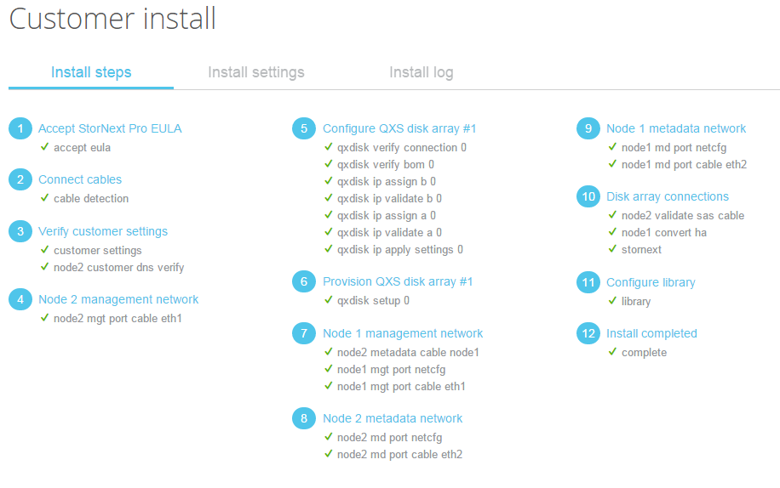
View Install history
Manage Other Components

Slide 12
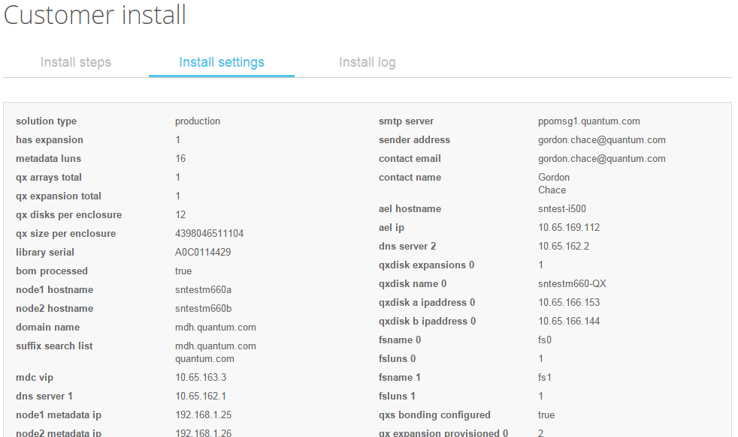
View Install history
Manage Other Components

Slide 13
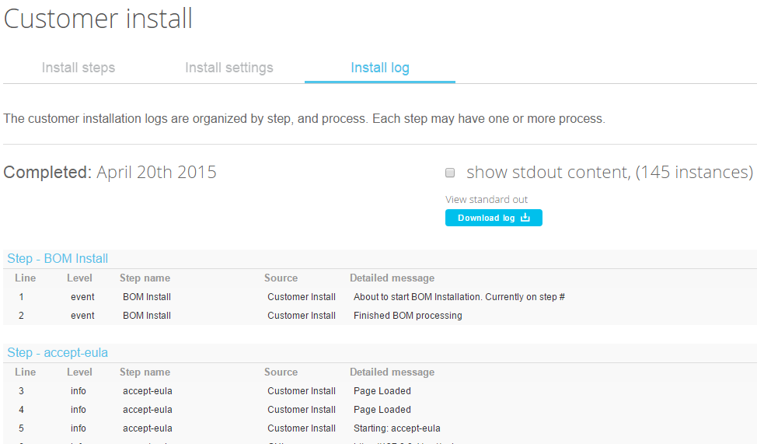
View Install history
Manage Other Components

Slide 14
CI Log – <connect ip|169.254.21.2>/install-pro/logs
[0109 12:53:30-0600] fatal - cable-detection - Connector - failure - Command completed - Installed client release (51487) did not match expected 1.0.0
**Std out: {
"snconnect_client": {
"version": "1.0.0",
"graphite_host": "10.1.1.2",
"components": {
"connector": {
"release": "602.1",
"version": "1.0.0"
},
"mintd": {
"release": "51487",
"version": "1.0.0"
},
"snupdate": {
"release": "604.1",
"version": "1.0.4"
},
"connectplugins": {
"release": "51487",
"version": "1.0.0"
},
"service_router": {
"release": "537.4",
"version": "0.1.0"
}
},
"snchostname": "10.1.1.2",
"release": "51487",
"graphite_port": "2004"
}
}
**Std err:
**error code: 0
[0109 12:53:30-0600] fatal - cable-detection - Customer Install - failure - - cable-detection failed with the following error: Installed client release (51487) did not match expected 1.0.0

Slide 15
Reference
http://php.net
http://supervisord.org/
https://www.python.org/
http://zeromq.org/
http://czmq.zeromq.org/
https://developers.google.com/protocol-buffers/

Slide 16
Q&A

