Slide 1
StorNext Connect
Bootstrap & CI Demo
“John Koniges”
April 21st & April 22nd, 2015
Mendota Heights

Slide 2
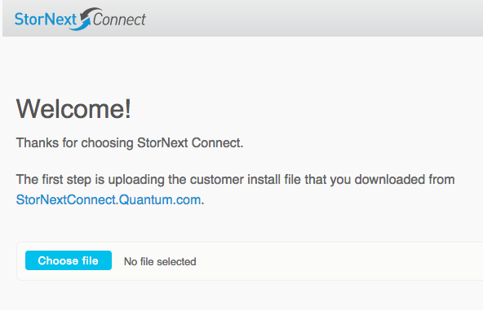
Bootstrap / SNC Install overview
What is Bootstrap?

Slide 3
Bootstrap & Customer Install Overview
Stages of Bootstrap
  Upload File
  Unpack File
  Install
  Configure SNC
Install File Contents
  bom.json
  Encrypted tar.gz file of connect
  Version files
bom.json - Bill of Materials
  Contains Solution Type
  Line items of what should be installed
  Data for first user

Slide 4
Bill of Materials
{
"bom-descriptor": {
"customer-install": true,
"solution-name": "StorNext Pro4K",
"solution-type": "4k"
},
….
"order-line-items": [
{
"quantity": "1",
"item-description": "MODULE,BASE SERVER,DUAL PORT,SSD,TPM,M445 - (Appliance includes 3 rackmount units: 2 servers and the metadata array)",
"product-line": "Stornext M440",
"item-tier-1": "Base Module",
"serial-number": "AV1413CKD00002"
},
….
{
"quantity": "1",
"item-description": "QUANTUM,QXS-1200,BASE,4TB,NON-FDE",
"product-line": "QX-Series",
"item-tier-1": "Base Module",
"serial-number": "QTMCHOU-15511ABCD",
"disk-count": 12,
"disk-capacity": 4398046511104
},
…
"user": {
"email-address": "john.koniges@quantum.com",
"password": "82d4389b349df2dd6acda83bcc8d48d6ad68e8a6a82f6a766bd0c88144c24a25",
"first-name": "John",
"last-name": "Koniges",
"phone-number": “5555551234",
"time-zone": "America\/Chicago"
},
"app-store": {
"endpoint": "api-stornextconnect.quantum.com",
"api-version": 1,
"customer-name": "QUANTUM CORPORATION (QUS)",
"customer-id": "8825cabca1bfa7399a02e6ec7e5c3b396cf0623fe101fba6d2b74ff0b12a9d09",
"connect-name": "AV1413CKD00002",
"connect-id": "5831ab618ca442185382a1cb12e5b5381aca2c5bd184a9ff91e6d98d2b603d1f" }

Slide 5
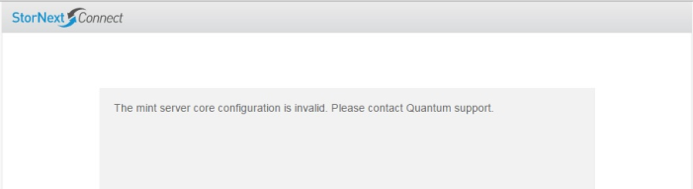
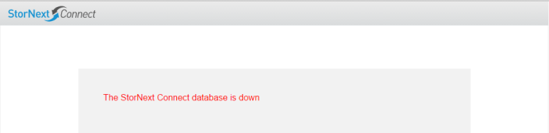
Bootstrap
Release Note
  What is going on? Why does this happen?
  Using F5(Refresh) to get past

Slide 6
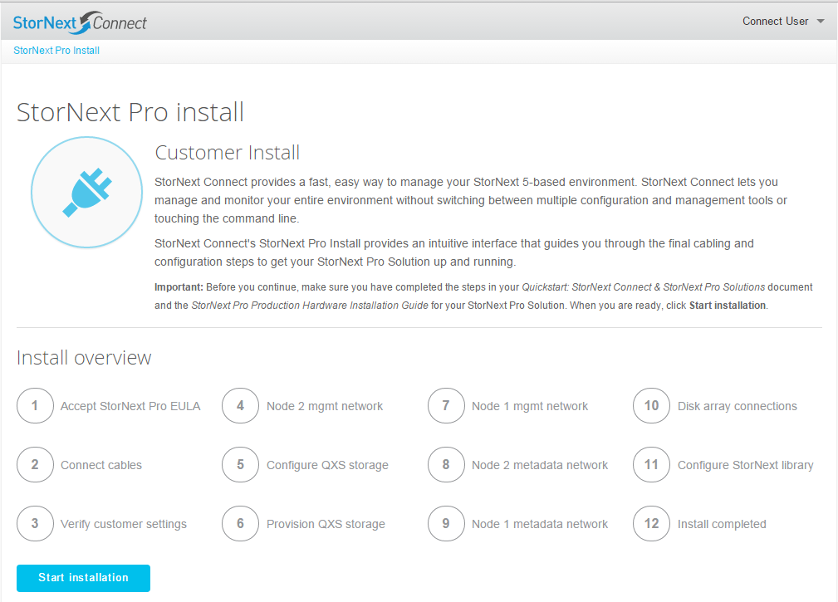
StorNext Connect – Customer Install
Overview

Slide 7
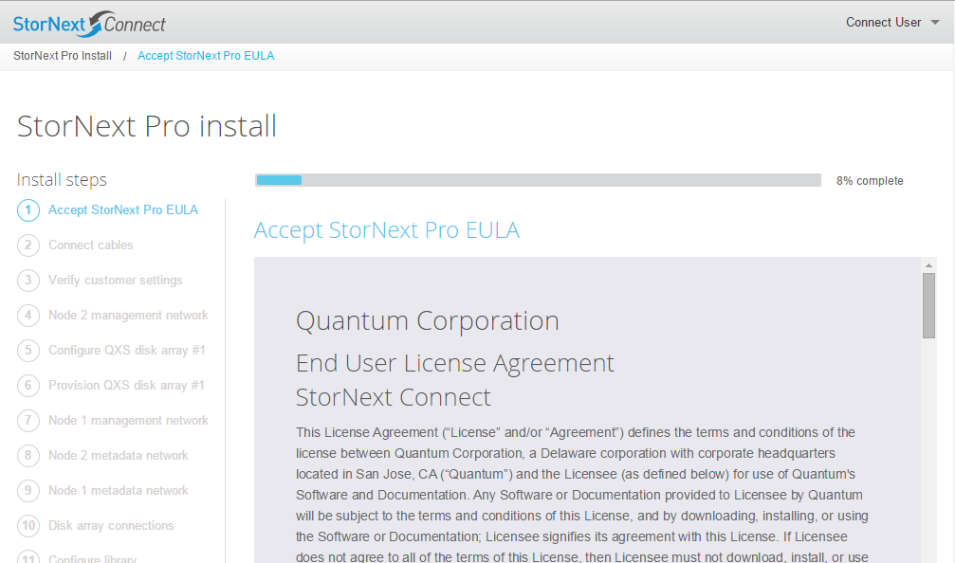
StorNext Connect – Customer Install
Accept EULA

Slide 8
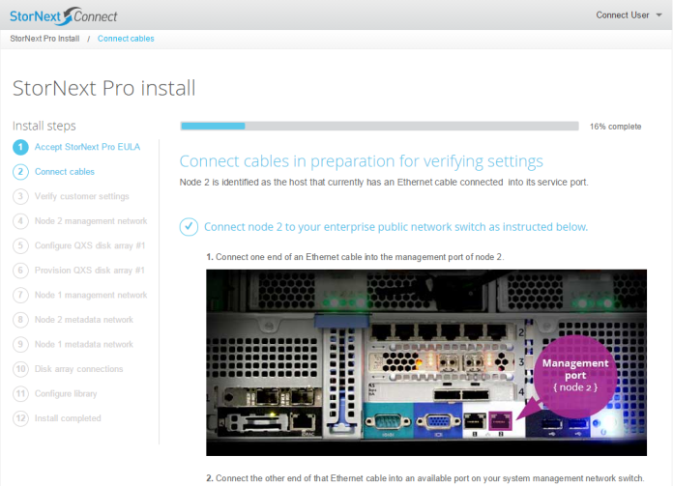
StorNext Connect – Customer Install
Connect Ethernet Cable to Management Network

Slide 9
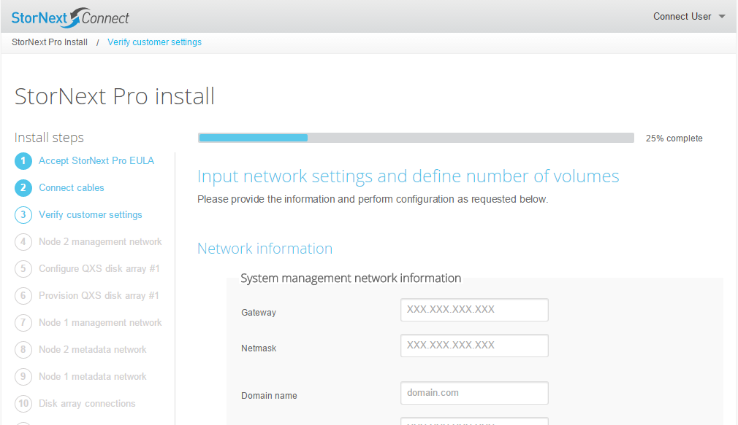
StorNext Connect – Customer Install
Customer Settings

Slide 10
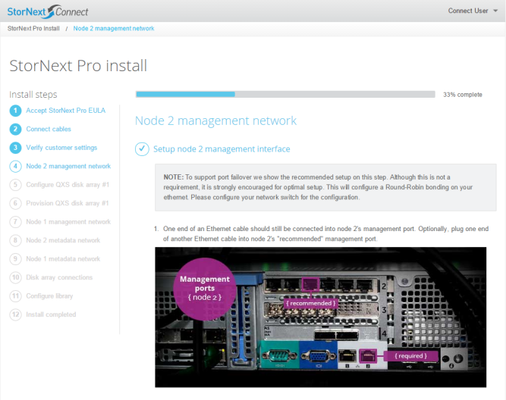
StorNext Connect – Customer Install
M660 Management Network Bonding

Slide 11
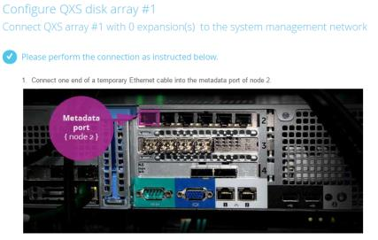
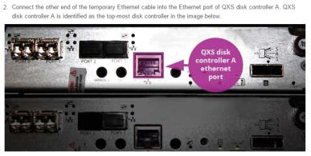
StorNext Connect – Customer Install
QXS Disk

Slide 12
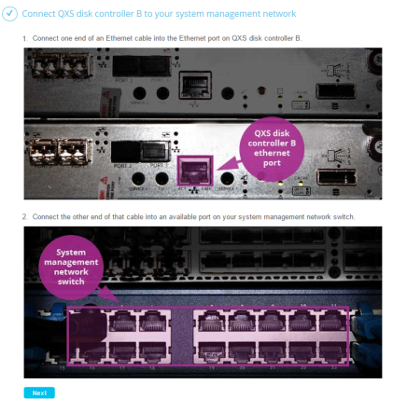
StorNext Connect – Customer Install
QXS Disk

Slide 13
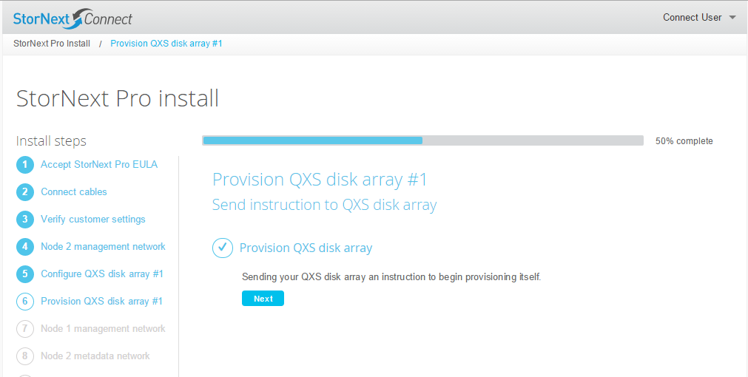
StorNext Connect – Customer Install
QXS Disk Provision

Slide 14
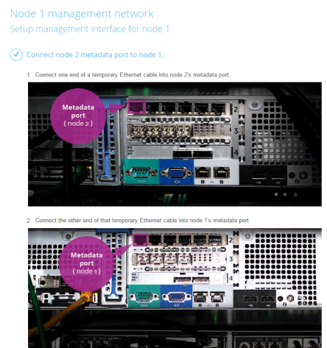
StorNext Connect – Customer Install
Node 1 Management Network

Slide 15

StorNext Connect – Customer Install
Node 1 Management Network

Slide 16
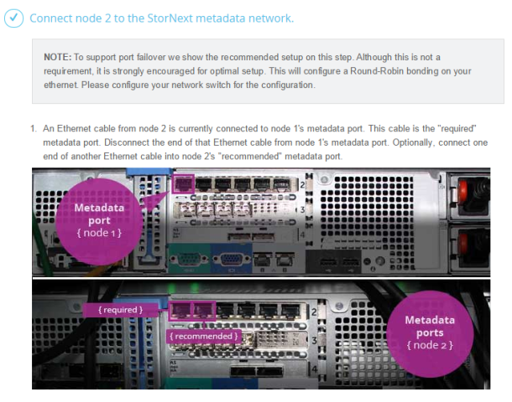
StorNext Connect – Customer Install
Node 2 Metadata Network

Slide 17
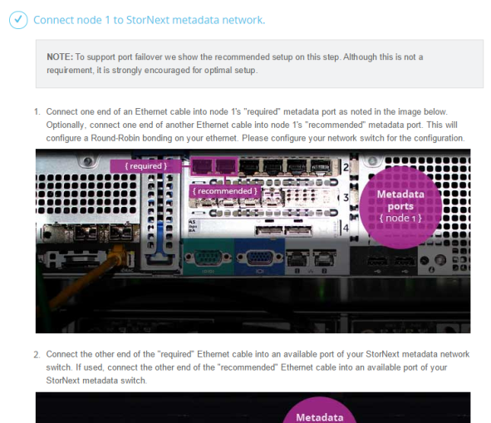
StorNext Connect – Customer Install
Node 1 Metadata Network

Slide 18
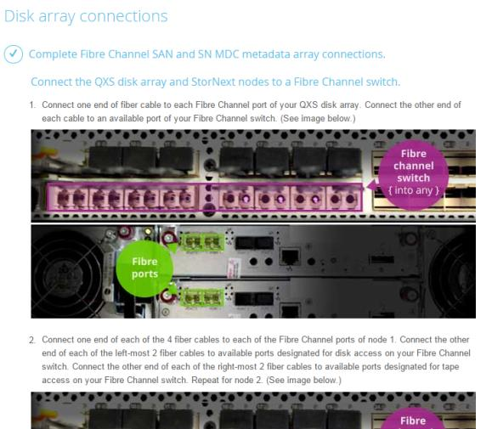
StorNext Connect – Customer Install
Disk array connections

Slide 19
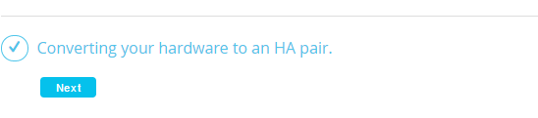
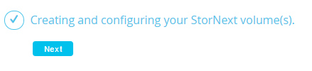
StorNext Connect – Customer Install
HA Pair
Create Volume(s)

Slide 20
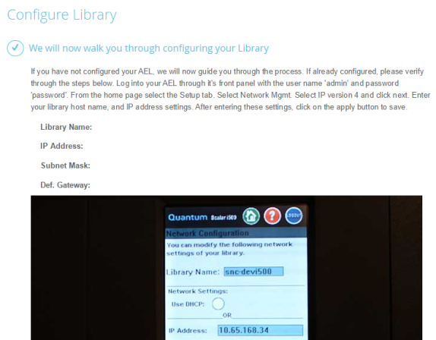
StorNext Connect – Customer Install
Configure Library

Slide 21
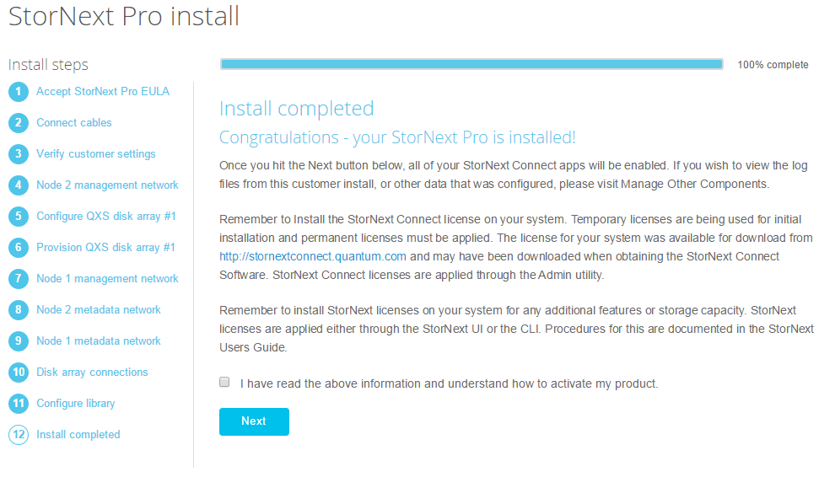
StorNext Connect – Customer Install
Install Complete

Slide 22
Q&A

