Slide 1
StorNext Connect
SNC TOI – App Store
Paal Olsen
April 21st & April 22nd, 2015
Mendota Heights

Slide 2
SNC App Store TOI Agenda
Overview
  What is the app store all about?
App Store Components
  StorNext Connect public web site
  Quantum Cloud public web-services site (api)
  Quantum Cloud internal admin web site
  Customer App Store app on Connect server
App Store features
  Initial download of Connect install bundle for Pro-Solution orders
  Download license file and customized documentation
  Browse, install and update Connect applications
  Download application content (Discover connector, StorNext client software)
  Direct downloads or offline file-based installs to support dark sites
Q&A

Slide 3
SNC App Store Overview
What is it?
  The App Store is a digital distribution platform for Connect apps and content
  Allows users to browse and download applications for Pro-Solution systems
  Familiar concept to most users thanks to iOS and Android devices
What is an app?
  Stand-alone software that can be downloaded to Connect servers
  Asynchronous releases and updates – not tied to StorNext release cycles
  Currently not individually licensed – free downloads
    Model supports paid or customized apps per customer in the future
  Supports app dependencies
    An app can depend on other apps
    Automatically handled when upgrading, installing, and enabling/disabling apps
  Current apps
    Two required framework apps (‘Connect Core’ and ‘App Store’)
      Used to administer and manage the Connect system
      Cannot be deleted or disabled
    Six stand-alone apps to discover, manage, and monitor StorNext HA clusters
    Install Pro Solution app – disabled after successful install and config
    Latest certified app versions are installed during initial setup of the system

Slide 4
App Store Components
App Store consists of four functional areas
  StorNext Connect web site - stornextconnect.quantum.com
    A public web site which is used by customers to download a Connect “bundle” for the initial install of the pro-solution system based on the MDC serial number and authorization code.
    Used by customers to download license files, documentation, and xsan “gizmo” utility
    Used by customers to download connect app bundle files for app and app-content offline installs on Connect servers not connected to the internet (eg dark sites).
  Quantum Cloud App Store – api-stornextconnect.quantum.com
    A public web site (web-services only) which is used by the App Store app to download Connect apps and app content to the customer’s Connect servers.
  Quantum Admin web site
    An internal Quantum administrative web site which is used to configure the public app store and manage customer settings. This admin web site is only accessible to Quantum users inside the Quantum network.
  Customer App Store
    A Connect framework app used to install, administer, configure and manage all applications and components on the customer’s Connect server.

Slide 5
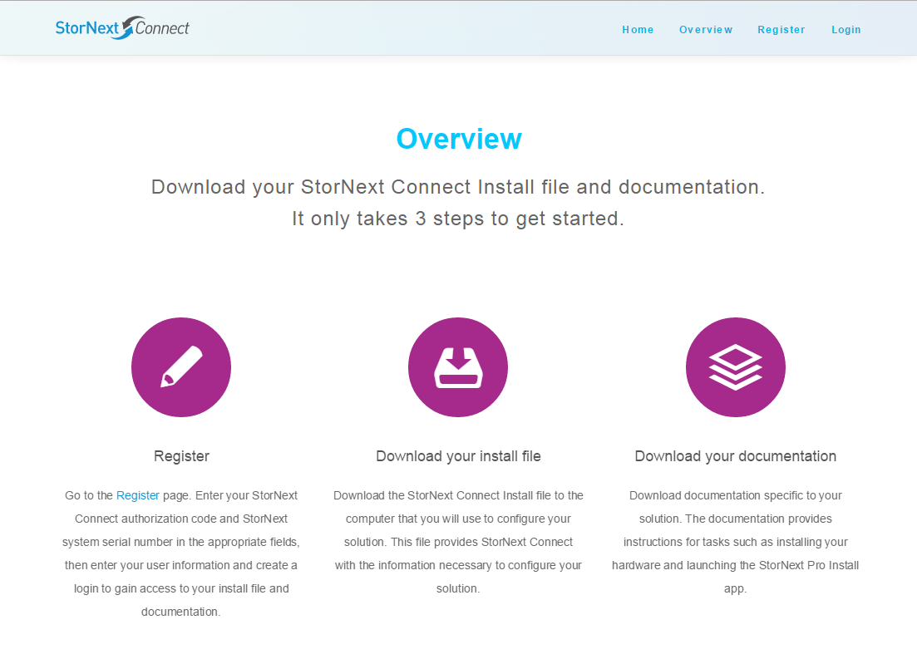
stornextconnect.quantum.com

Slide 6
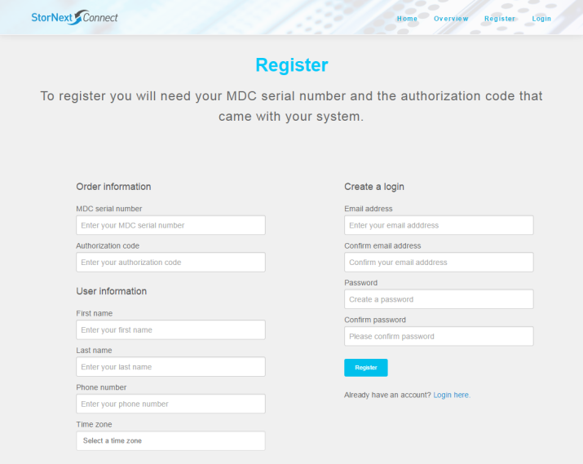
stornextconnect.quantum.com – Registration

Slide 7
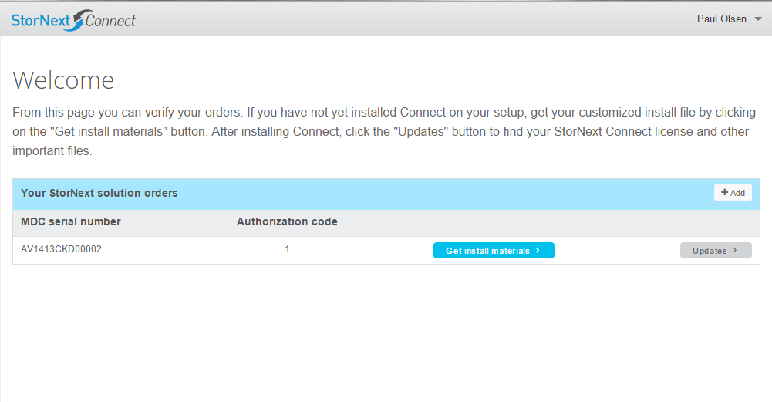
stornextconnect.quantum.com – Download Install file

Slide 8
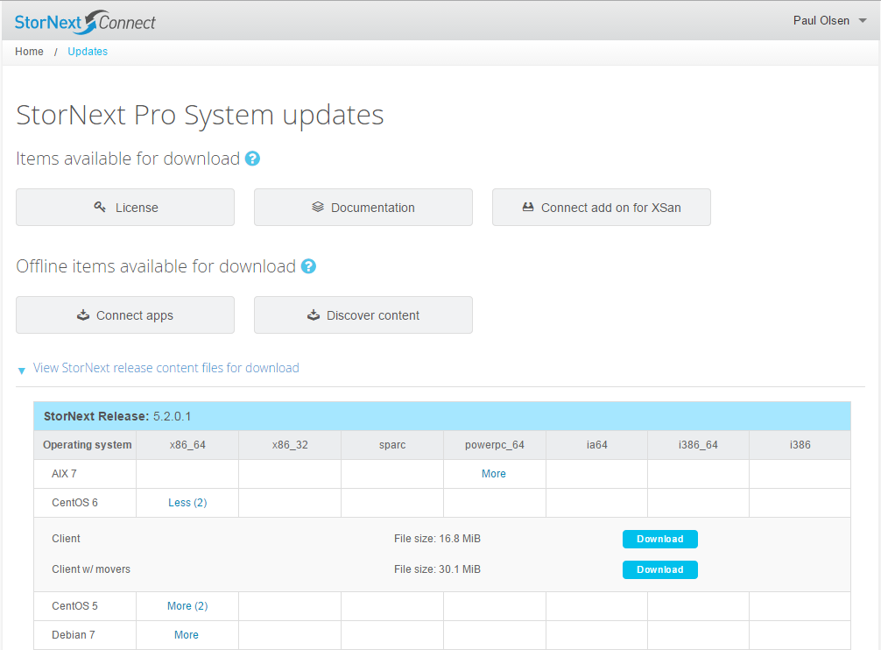
stornextconnect.quantum.com – Download Updates

Slide 9
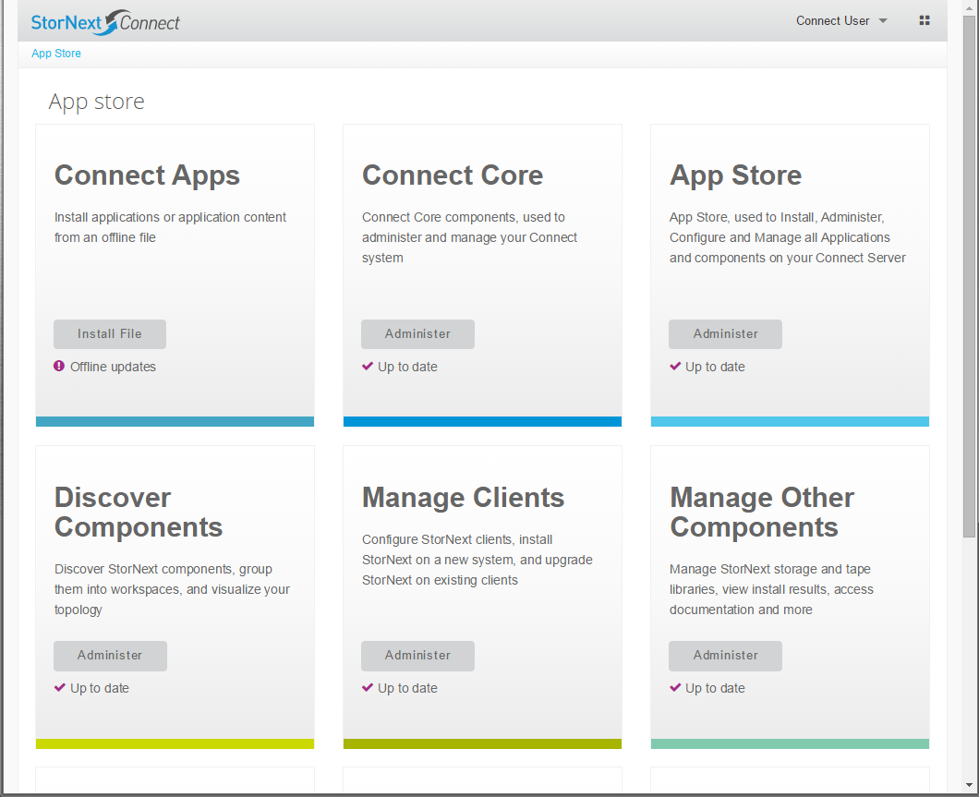
Connect Server App Store dashboard
App Status: Up to Date, Update Available, or Not Installed

Slide 10
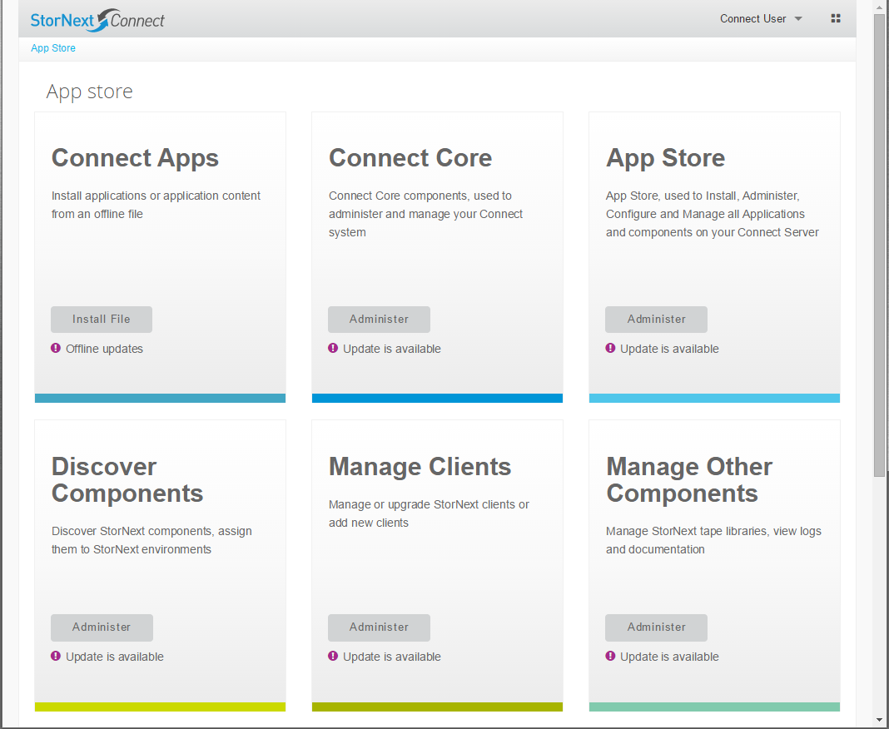
Connect Server App Store dashboard: Update Available

Slide 11
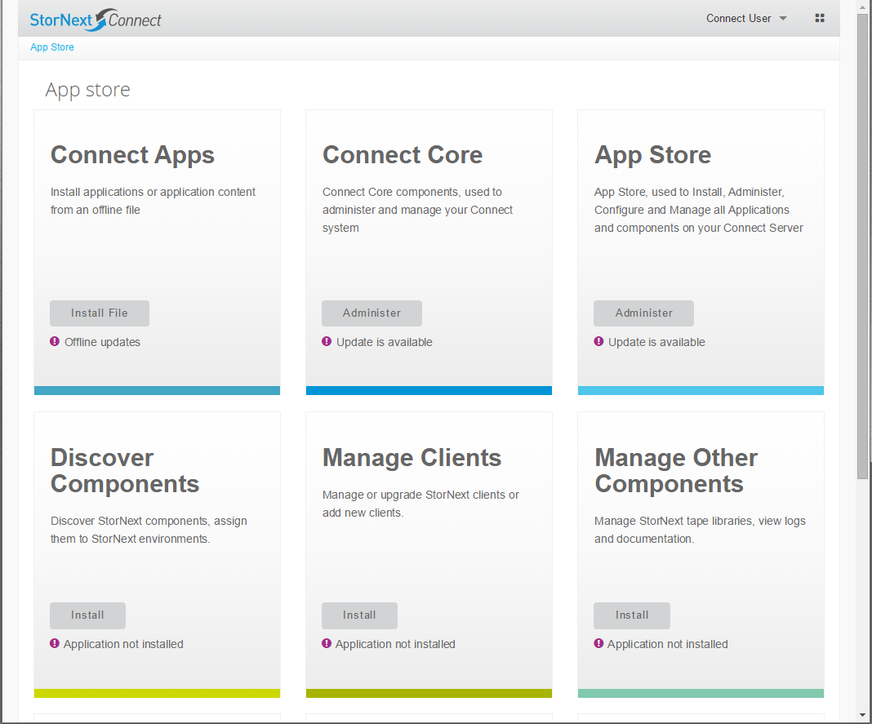
Connect Server App Store dashboard: Application not installed

Slide 12
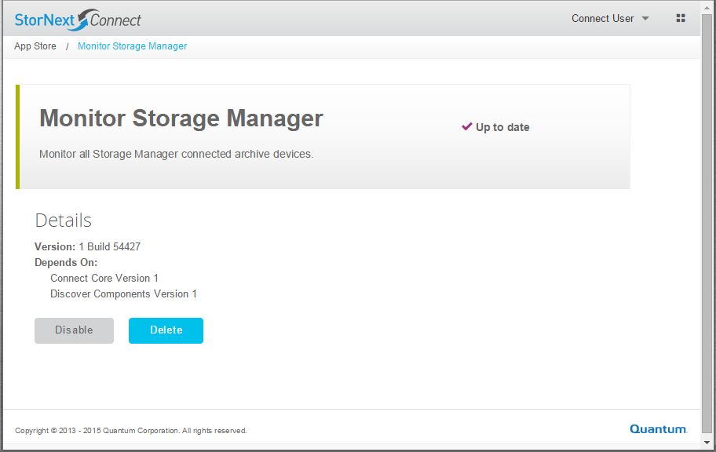
App Store Administer app – Up to Date
Enable/Disable or Delete

Slide 13
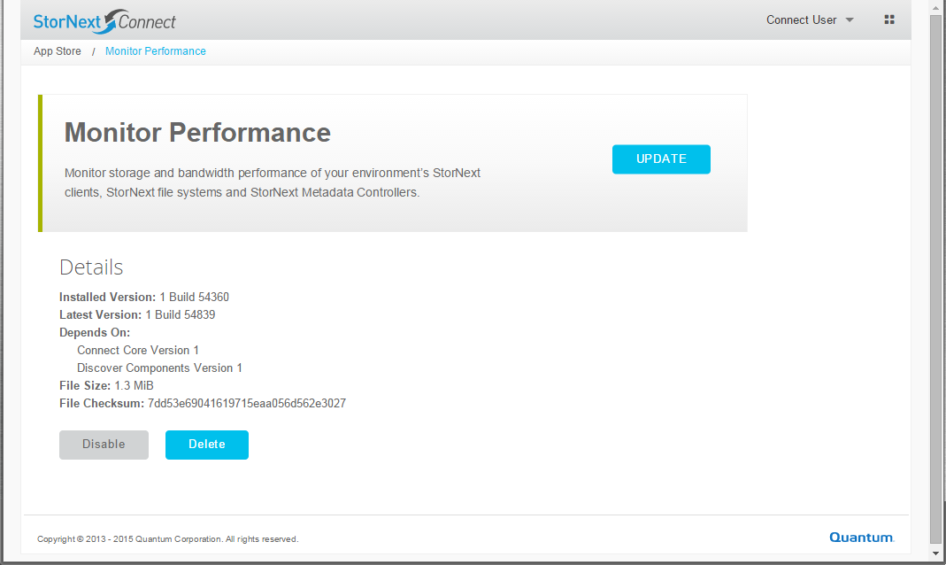
App Store Administer app – Update available
Update, Enable/Disable or Delete, display app metadata

Slide 14
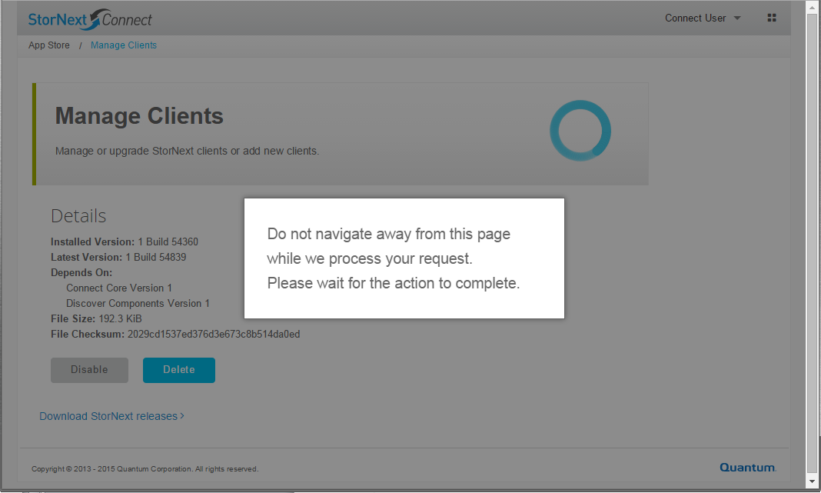
App Store Administer app – Download and install update

Slide 15
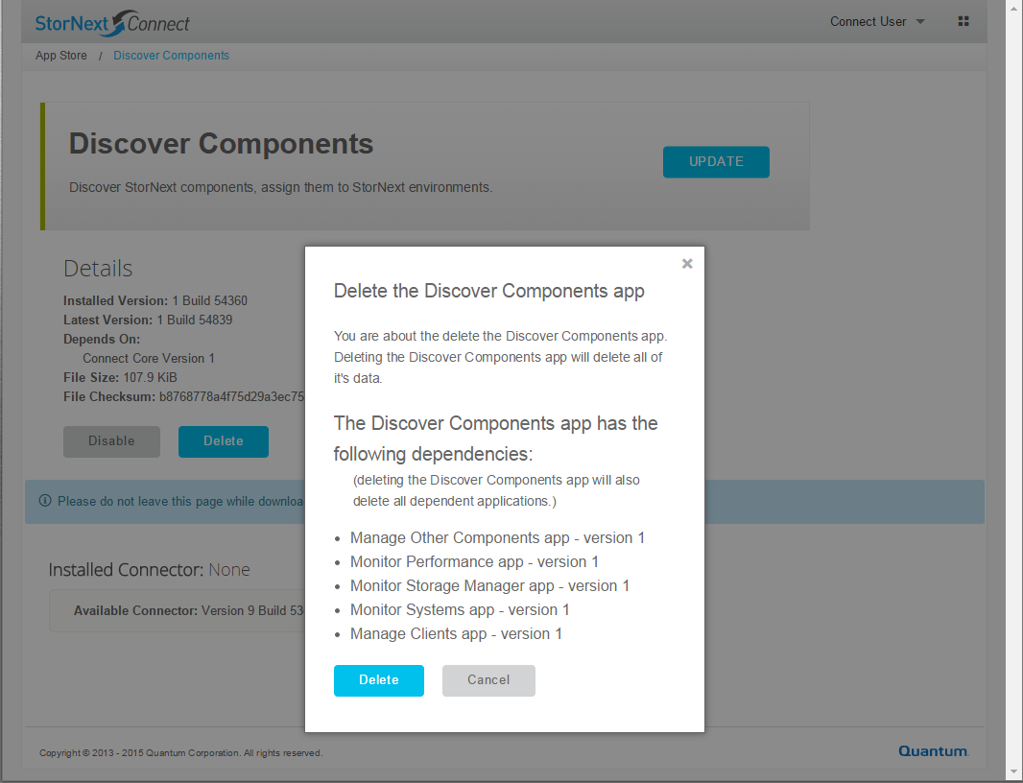
App Store supports app dependencies
Install, Delete, Enable/Disable operations

Slide 16
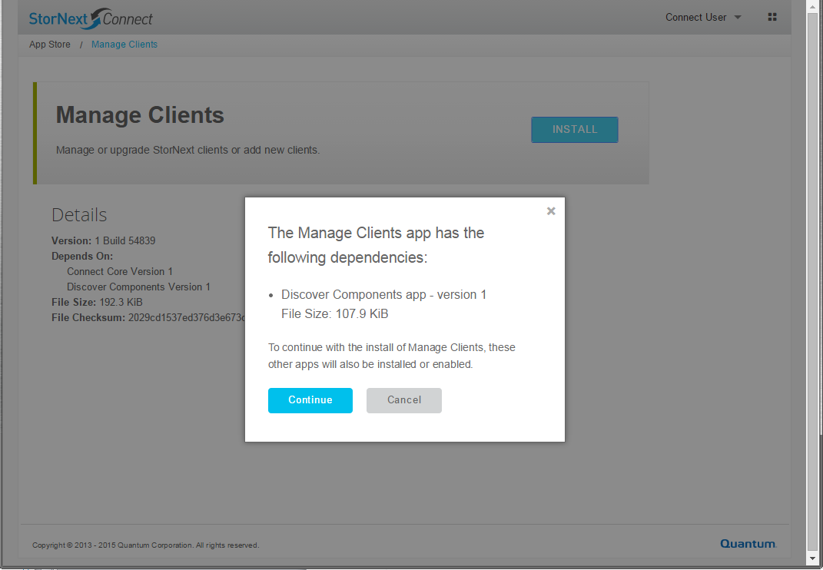
App Store supports app dependencies
Installing Manage Clients will also pull down Discover app

Slide 17
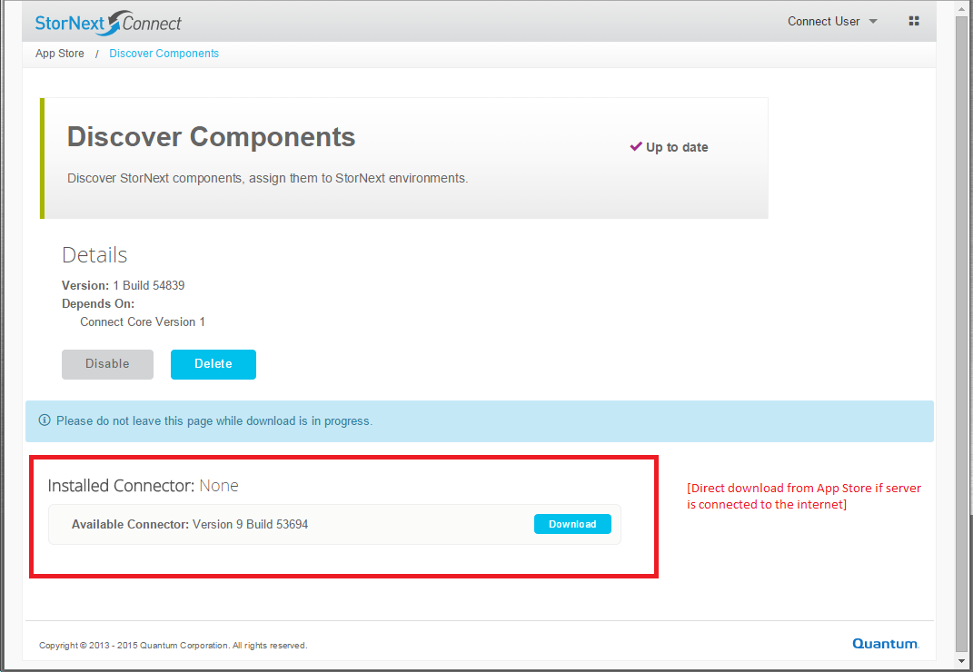
Download App Content
Discover Connector

Slide 18
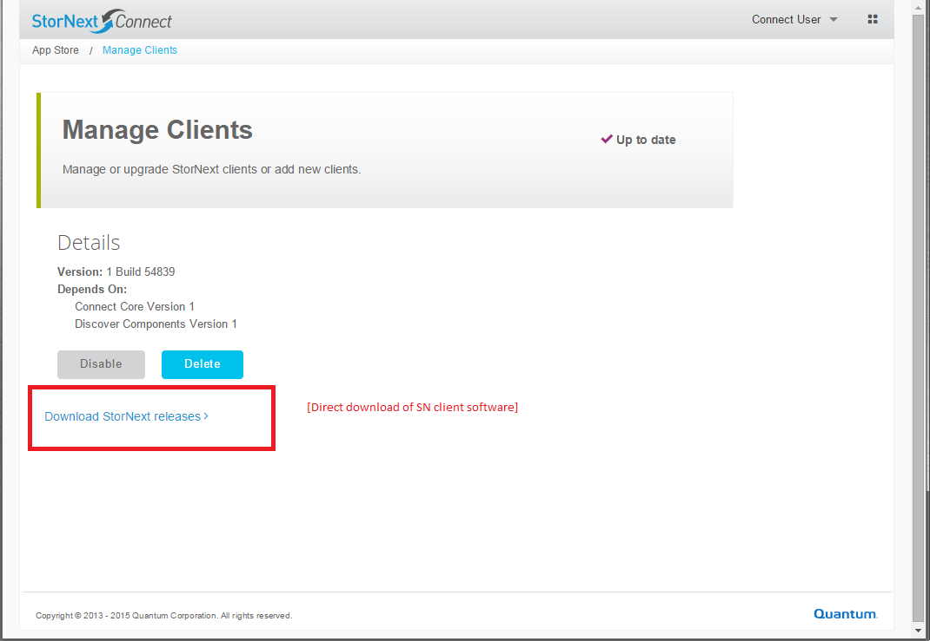
Download App Content
Manage Clients: StorNext client software

Slide 19
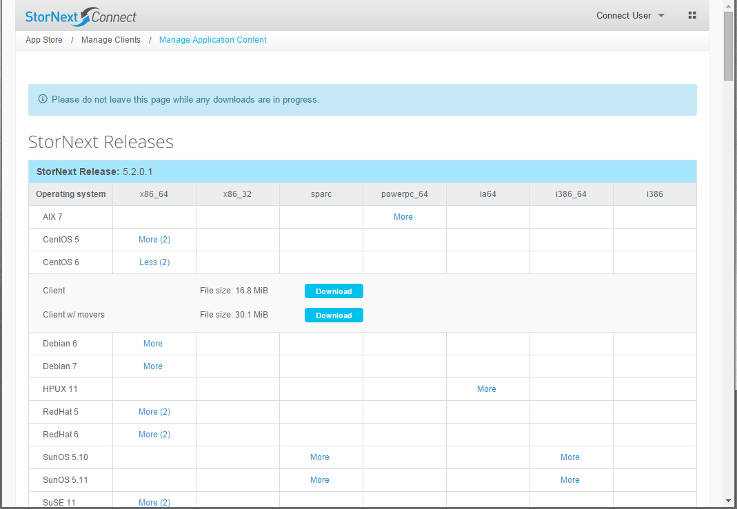
Download App Content
Manage Clients: StorNext client software

Slide 20
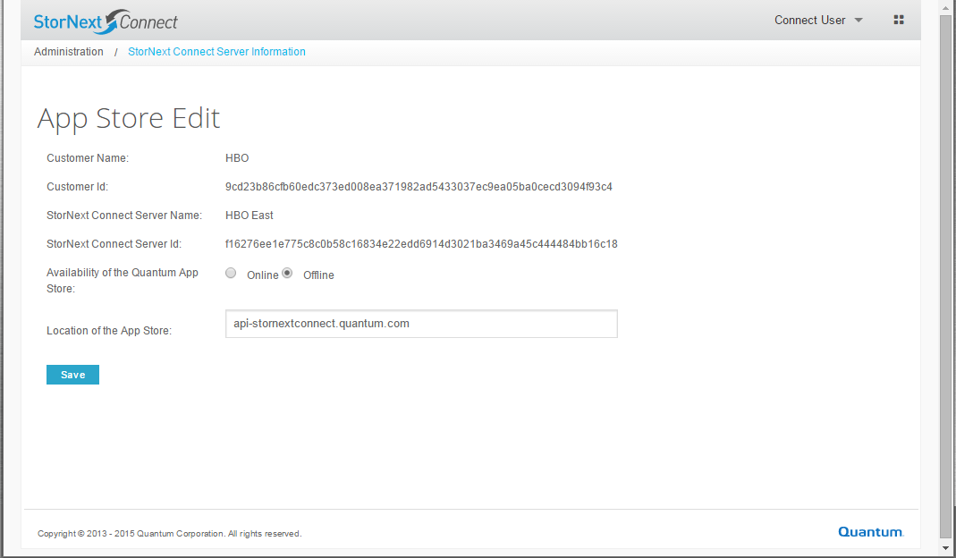
App Store Offline mode (Black sites)
Users can toggle the cloud app store state

Slide 21
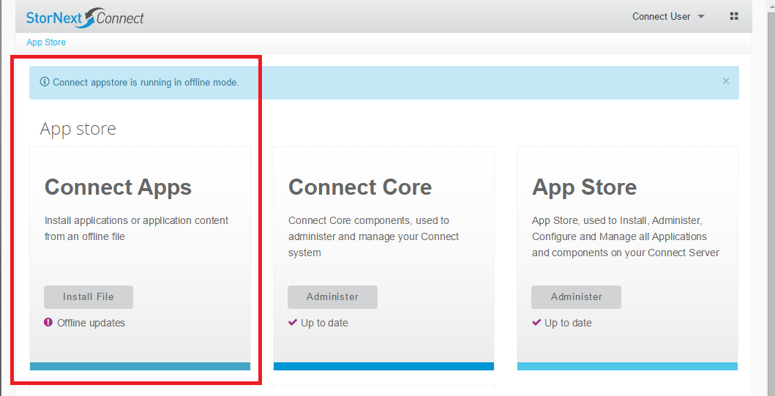
App Store Offline mode (Black sites)
Use file-based installer to update apps or app content

Slide 22
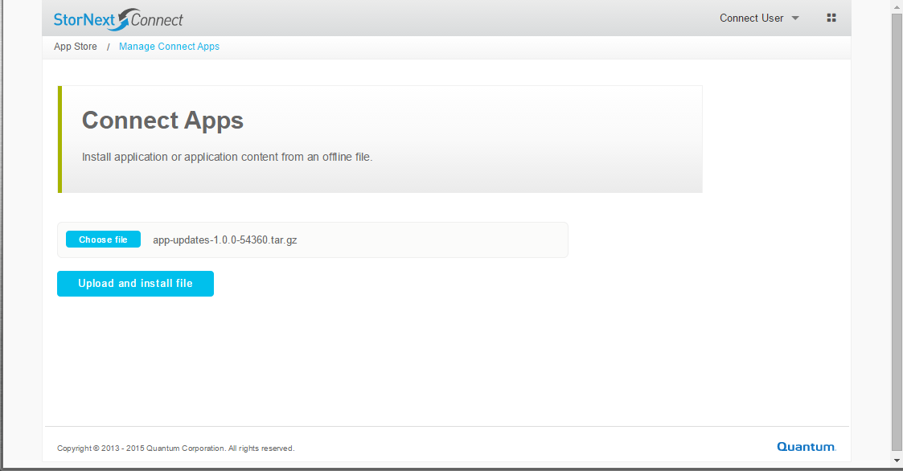
App Store Offline mode (Black sites)
Use file-based installer to update apps or app content

Slide 23
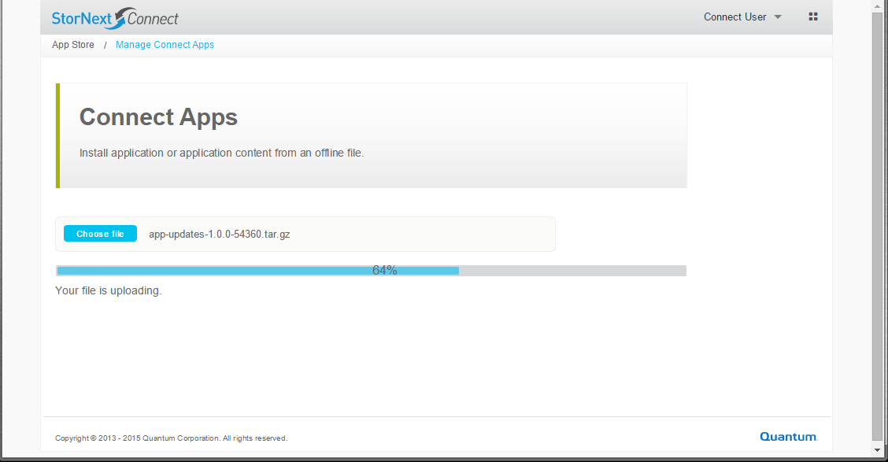
App Store Offline mode (Black sites)
Use file-based installer to update apps or app content

Slide 24
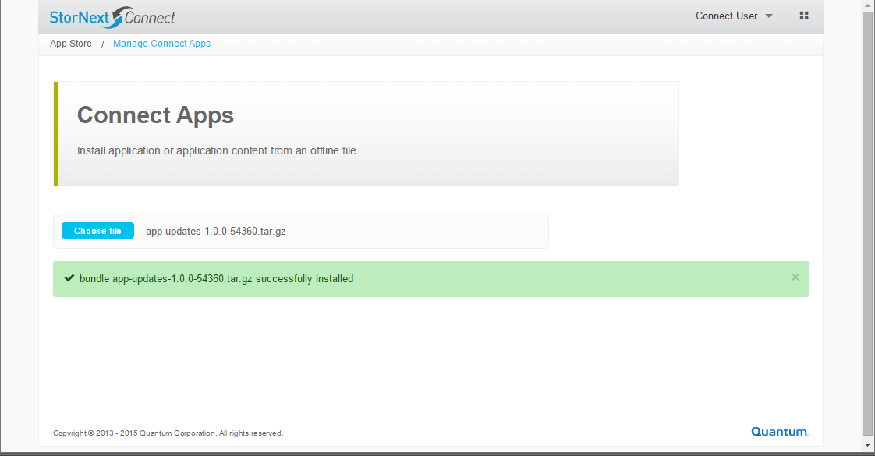
App Store Offline mode (Black sites)
Use file-based installer to update apps or app content

Slide 25
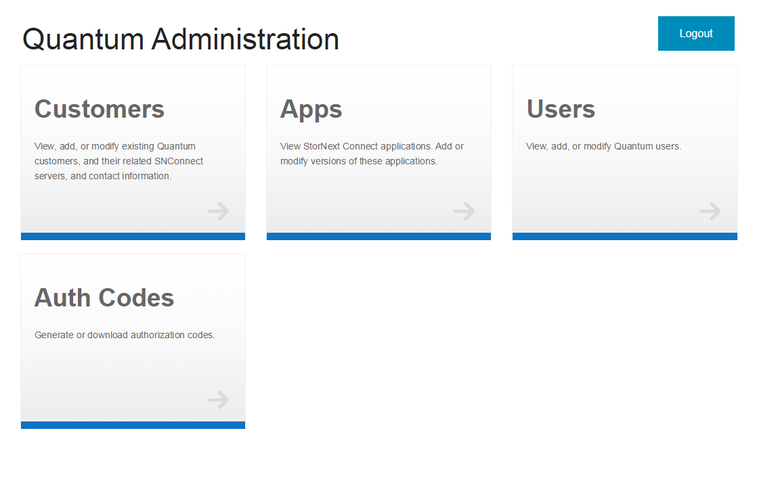
Quantum Internal Admin site

Slide 26
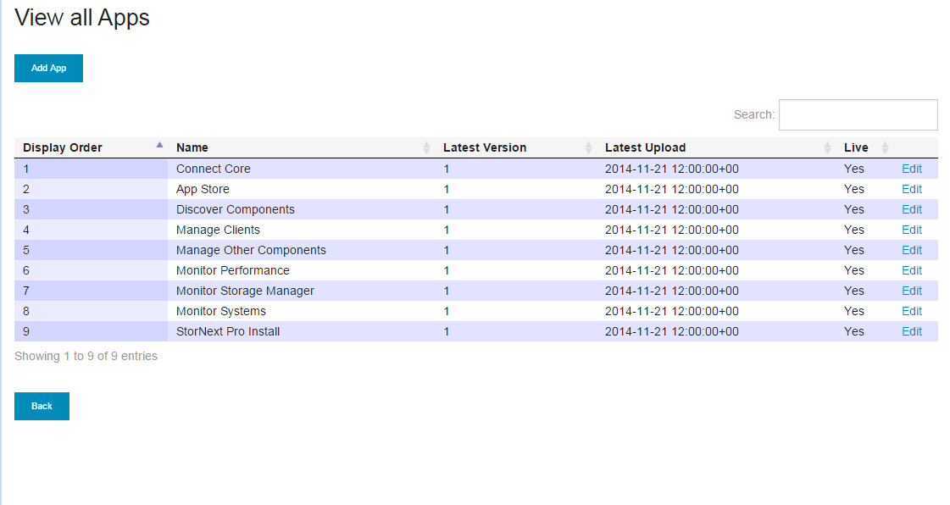
Quantum Internal Admin site – View and Manage Apps

Slide 27
SNC App Store TOI
Q & A

