Slide 1
StorNext Advanced Architecture
Presented by Steve Cole
August 2012

Slide 2
Why Should you Attend this Hot Topic?
Why should you attend?
Job involves being a problem solver
Build a knowledge base that helps to hone that craft
Developing a deeper understanding of how things work leads to faster problem solving
This will be accomplished by looking at component interfaces within StorNext, looking at code, and examining customer SRs.

Slide 3
Overview
Look at kernel components of StorNext and how it fits in Linux
Examine kernel components and user level software; how it communicates
Interface between CVFS and TSM
Follow flow of operation from File system to Media
Tools that can be used to follow flow from kernal to TSM
Use the source Luke!
Cscope
Examples of system problems pulling all this together

Slide 4
Introduction
Getting Started

Slide 5
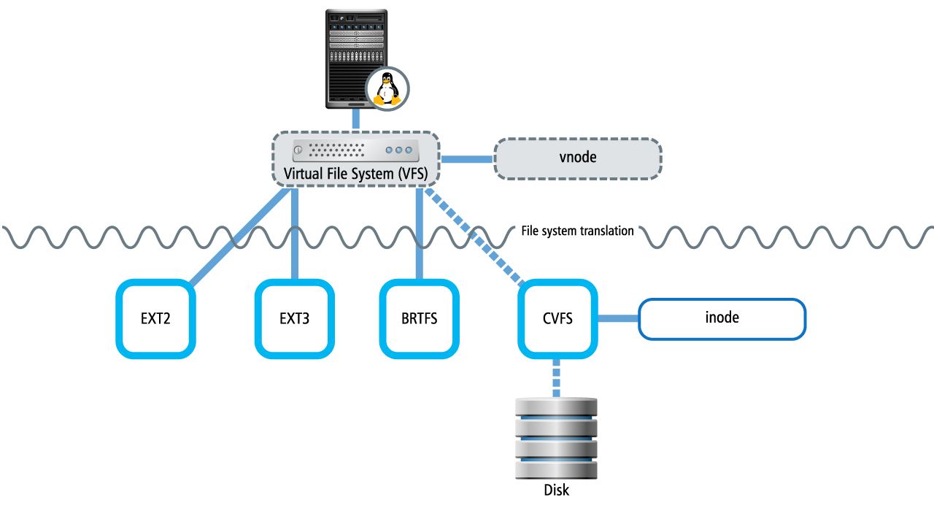
VFS layer

Slide 6
VFS layer in Linux (file_operations)
Code representation of defining file system operations at VFS level.
struct file_operations {
struct module *owner;
loff_t (*llseek) (struct file *, loff_t, int);
ssize_t (*read) (struct file *, char __user *, size_t, loff_t *);
ssize_t (*aio_read) (struct kiocb *, char __user *, size_t, loff_t);
ssize_t (*write) (struct file *, const char __user *, size_t, loff_t *);
ssize_t (*aio_write) (struct kiocb *, const char __user *, size_t, loff_t);
int (*readdir) (struct file *, void *, filldir_t);
unsigned int (*poll) (struct file *, struct poll_table_struct *);
int (*ioctl) (struct inode *, struct file *, unsigned int, unsigned long);
long (*unlocked_ioctl) (struct file *, unsigned int, unsigned long);
long (*compat_ioctl) (struct file *, unsigned int, unsigned long);
int (*mmap) (struct file *, struct vm_area_struct *);
int (*open) (struct inode *, struct file *);

Slide 7
File Operations Structure in CVFS Kernel
struct file_operations cvfs_local_reg_fileops_loopdev = {
read: cvfs_read_wrapper,
write: cvfs_write_wrapper,
.
.
.
open: cvfs_open_wrapper,
release: cvfs_close_wrapper,
flush: cvfs_flush_wrapper,
fsync: cvfs_fsync_wrapper,
lock: cvfs_flock_wrapper,
static int
cvfs_open_wrapper(
struct inode *f_inode,
struct file *f_file)
{
return cvfs_open(f_inode, f_file->f_mode, f_file->private_data != NULL);
}
Source file: client/vfs/linux26/linuxif_fs.c

Slide 8
CVFS Kernel Module in Linux (1 of 2)
Contains code to extend the running kernel
Typically used to support new hardware and/or file systems or for adding system calls
Without loadable kernel modules, functionality would have to be directly compiled into the kernel.
Modules are located in /lib/modules with extension .ko since version 2.6
Tainting a kernel means loading a proprietary on non-GPL compatible LKM will set a ‘taint flag’
Loading CVFS taints the kernel
kernel: cvfs: module license 'Proprietary' taints kernel.

Slide 9
CVFS Kernel Module in Linux (2 of 2)
The kernel part is a module.
The kernel module gets loaded when you mount a file system.
When you load CVFS, you are loading something extra.
QUESTION: What Linux modules are needed for CVFS?

Slide 10
Installing CVFS kernel module
[root@dopey install]# make clobber
CLEAN /usr/cvfs/install/.tmp_versions
[root@dopey install]# make install
CC [M] /usr/cvfs/install/linuxif_fs.o
CC [M] /usr/cvfs/install/linuxif_fs_common.o
CC [M] /usr/cvfs/install/linuxif_fsctl.o
LD [M] /usr/cvfs/install/cvfs.o
Building modules, stage 2.
MODPOST
CC /usr/cvfs/install/cvfs.mod.o
LD [M] /usr/cvfs/install/cvfs.ko
INSTALL /usr/cvfs/install/cvfs.ko
DEPMOD 2.6.18-194.el5

Slide 11
CVFS module in action
[root@doc kernel]# lsmod
Module Size Used by
cvfs 1151664 1
exportfs 38849 1 cvfs
autofs4 63049 3
[root@doc extra]# uname -a
Linux doc 2.6.18-194.el5 #1 SMP Tue Mar 16 21:52:39 EDT 2010 x86_64 x86_64 x86_64 GNU/Linux
[root@doc extra]# pwd
/lib/modules/2.6.18-194.el5/extra
[root@doc extra]# ls -l
total 19648
-rw-r--r-- 1 root root 20092331 Mar 1 14:43 cvfs.ko

Slide 12
SR 1389552 ExpressCopy Down System
Real World Example

Slide 13
Description of Situation
Situation: Customer had been down for a number of hours. StorNext wouldn’t come up. Problem was escalated to Sustaining. A webex was able to resolve the issue but I went back over the logs and found clues that showed the same problem that was found during the webex.
Some clues revealed in the logs:
Linux swebfs.expresscopy.com 2.6.9-67.ELsmp
Linux webfs.expresscopy.com 2.6.9-67.EL
Linux_swebfs.expresscopy.com_web2.messages:Feb 23 06:18:40 swebfs cvfsbuild: No kernel build tree at /lib/modules/2.6.9-67.ELsmp/build
In /usr/cvfs/install/Makefile
KERNELRELEASE ?= $(shell uname -r)
LINUX_LOCATION ?= /lib/modules/$(KERNELRELEASE)/build
Tells you where to go in the system to find the kernel that is running.
Gives you the release

Slide 14
Also in Makefile
MODULES = /lib/modules/$(KERNELRELEASE)/extra
On a properly configured system we have the following:
[root@happy install]# uname –r
# This gives you the release of the kernel that is running
2.6.18-194.el5
[root@happy install]# cd /lib/modules/2.6.18-194.el5/extra
[root@happy extra]# ls -l
total 19656
-rw-r--r-- 1 root root 20102005 May 16 12:37 cvfs.ko

Slide 15
Solution
The directories didn’t exist on the customer’s system. The fact that there were 2 different kernel versions it seemed we might have a dual boot system. We found in the boot configuration file there were a couple of versions of the kernel. We suggested a reboot and bring up the other kernel. This had CVFS loaded on it and everything came up.

Slide 16
Interface Between kernel and FSM
Where is the problem?

Slide 17
Is the Problem in the Kernel or in the FSM?
The most important thing to remember is that the communication between the CVFS kernel and the FSM is through messages.
When the kernel needs to have something done it sends a message to the FSM. It waits for a response from the FSM before completing the kernel operation.

Slide 18
CvOpen
If you were to walk the open code which used to open a file in CVFS you would go through the following routines:
cvfs_open -> open_cvp -> CvOpen
In CvOpen you have the following comments:
* PURPOSE
* Common open code.
*
* NOTES
* We only go to the FSM on the very first open.
*

Slide 19
FsmOpen
If we go further in CvOpen we would see the a call to FsmOpen:
FsmConnection_t *fsmcon = CVTOCOMM(f_cvp);
error = FsmOpen(fsmcon, f_cvp, f_mode, FSM_PENDOK, 0);
FsmOpen is going to make a call to FsmOpenMsg:
error = FsmOpenMsg(f_fsmcom, f_cvp, rwflags, msgflags);

Slide 20
FsmOpenMsg
Within FsmOpenMsg routine, a message will be built and sent to the FSM.
error = InitFsmRequest(&reqbuf,
reqhdrlen, reqdatalen,
ReqNoDataZone, MsgTypeFileOp, VopSubTypeOpen );
if (error)
goto out;
reqmsg = FSM_MSG(reqbuf);
reqmsg->file_cookie = htonq( filecookie );
reqmsg->flags = htons( f_rwflags );
error = InitFsmReply(&replybuf, replydatalen, ReplyNoDataZone );
if (error)
goto out;
replymsg = FSM_MSG(replybuf);
replydata = (VopOpenRD_t *)FSM_DATA(replybuf, sizeof(cvfsmsg_t));
error = SendFsmMsg( f_fsmcom, reqbuf, replybuf, &f_msgflags );

Slide 21
Fsm binary
In the code that makes up the fsm binary, there’s a check on the message type:
case MsgTypeFileOp: /* Vnode Ops Request */
VopsRequest(pmsgq);
break;
Source file: fsm/msgdecode.c
Within the VopsRequest routine is a call to do an open:
case VopSubTypeOpen:
qustat_evt_id = QUSTAT_FSMVOP_OPEN;
VopOpen(pmsgq);
break;
Source file: fsm/vops.c

Slide 22
Observe Flow from Kernel to fsm
There’s a way to observe this flow with tools that exist in CVFS. The kernel flow can be observed with the tool cvdb. I can enable tracing in the kernel and capture what’s happening within the kernel.
[root@happy dir1]# ls -l
total 32
-rw-rw-r-- 1 root root 65 May 18 09:27 steve_file.1
[root@happy dir1]# cvdb -e
[root@happy dir1]# cat steve_file.1
---- I don’t get any reponse; things seem to be hung? Is it a kernel problem? What to do?

Slide 23
Collect a cvdb Trace and Redirect Output
I collect a cvdb trace and redirect the output to a file so I can see what’s going on:
<1:29653:395.695418> CvOpen cvp 0xffff81012edc7ad0 opencnt 0 flags 0x801 flags2 0x4000 mode 0x2 wantwrite 0x0
<1:29653:395.695421> FsmOpenMsg 0x8c rwflags 0x2 msgflags 0x1
Further down there is a call to SendFsmMsg:
<1:29653:395.695457> SendFsmMsg FsmCon 0xffff810132044000 req 0xffff81003965feb0 flags 0x1 requestbuf 0xffff8100370dbe78 replybuf 0xffff810057cc2070 msg ID 0x89c24
With some code inspection there are a couple of traces that would happen with a
successful open.
Log1(LOGINFO, cvENTRY, "cvfs_open cvp/" ARGP "", cvp);
Log2(LOGINFO, cvEXIT, "cvfs_open cvp/" ARGP " return error %d",
cvp, syserr);

Slide 24
cvfs_open Messages in the Trace
The only cvfs_open messages in the trace don’t show a return:
<1:29653:395.695408> cvfs_open cvp/0xffff81012edc7ad0
<1:29653:395.695409> cvfs_open cvp-0xffff81012edc7ad0 cv count-0 f_mode-0xd
For this illustration I made it be a problem with communicating with the FSM. I did
a kill -STOP on the FSM pid. This kept the message from reaching the FSM.
Once I did a kill –CONT on the FSM pid. Processing resumed. Another capture
with cvdb shows the cvfs_open completion.
<1:29653:1005.191315> open_cvp cvp 0xffff81012edc7ad0 return 0 cv_flags 0x801
<1:29653:1005.191317> cvfs_open cvp/0xffff81012edc7ad0 return error 0
[root@happy dir1]# cat steve_file.1
I meant to update this file.
It's a beautiful day in Minnesota.
Notes:
This gives you insight into why clients don’t notice a failover.

Slide 25
fsm debugging Turned On
If we happened to have fsm debugging turned on, we would get trace messages
telling us what the fsm is doing:
[0519 16:38:29.039689] 0x4248b940 (Debug) [Node 8] Pmsgq:0x2aaaac17de70
Vop Open of node [0x0] shflgs=0x0 seqno=0x0 succeeded
[0519 16:38:29.040109] 0x4250d940 (Debug) VopsRequest[Index 13] START: pmsgq/0x2aaaac17fa30
[0519 16:38:29.040117] 0x4250d940 (Debug) [Node 8] Pmsgq:0x2aaaac17fa30
Open Request Inode[0x8c] Flags: 0
[0519 16:38:29.040128] 0x4250d940 (Debug) InodeOpen: inode/0x8c flags/0x0
[0519 16:38:29.040166] 0x4250d940 (Debug) InodeOpen: initialized optr/0x3e87ba0
[0519 16:38:29.040170] 0x4250d940 (Debug) InodeOpen: optr/0x3e87ba0 busy flags 0x1
[0519 16:38:29.040174] 0x4250d940 (Debug) InodeOpen: optr/0x3e87ba0 flags/0x1 count/1 writers/0 ret/0 refs/1
[root@happy dir1]# ls -li steve_file.1
140 -rw-rw-r-- 1 root root 65 May 18 09:27 steve_file.1

Slide 26
Addition of SNMS component to StorNext
Originally CVFS was file system only (MountainGate)
When purchased by ADIC the goal was integrate with another ADIC product (FileServ) which was an HSM.
FileServ was based on DMAPI
Data Management Applications Programming Interface (DMAPI)
Developed by Data Management Interfaces Group consortium (DMIG) 1993-1996
Provides standardized access to filesystems for HSMs
DMAPI capability needed to be added to CVFS it could work with FileServ.

Slide 27
DMAPI Standard
Not a rigorous standard
~70 function calls
~40 structures
24 events
Events are messages from the kernel to a DMAPI application
Provide notification of accesses/changes to a file or filesystem
Sample events nospace, create, remove, rename, read, write, truncate
Uses sessions as the primary communication channels between DM application and kernel component

Slide 28
DMAPI Session
# dm_session (3.5 system)
Num_sessions = 1
SID 4 "/usr/adic/TSM fs_dmapi(8856)"
dispositions (fshandles in hex):
0004b92b921fb0c6 <0x270400>
#tokens = 0:
[root@dopey ~]# dm_session (4.2 system)
Num_sessions = 3
SID 1 "DM_SNPOLICYD"
dispositions (fshandles in hex):
#tokens = 0:
SID 8 "/usr/adic/TSM fs_dmapi(27249)"
dispositions (fshandles in hex):
0004bd5842b5c26e <0x270400>
RENAME READ WRITE TRUNCATE NOSPACE
#tokens = 0:
SID 9 "TSM fs_fcopyman(27265)"
dispositions (fshandles in hex):
#tokens = 0:
Note: A handle is a file system ID.

Slide 29
TSM Code: dm_create_session
In TSM code we have an example of dm_create_session:
// Create a session using the specified session information.
dm_sessid_t
DmapiSession::create(
const string& info)
{
string rtn = "DmapiSession::create";
dm_sessid_t sid;
int32_t rc = dm_create_session( DM_NO_SESSION,
const_cast<char*>(info.c_str()),
&sid );
if (rc != 0)
{
Logging_log(ETAC_ERR,
"%s: dm_create_session() failed: errno %d",
rtn.c_str(), errno);
sid = DM_NO_SESSION;
}
else
{
Logging_log( ETAC_INFO1,
"%s: created session info='%s' sid=%d",
rtn.c_str(),
}
return sid;
}

Slide 30
CVFS Kernel: Code for DMAPI Session (1 of 2)
In the CVFS kernel is the code to set up a DMAPI session.
Source file: cvdmapi/cvdmapi_session.c
/*
************************************************************************
*
* dm_create_session
*
* Create or replace a session.
*
************************************************************************
*/
int
dm_create_session(dm_sessid_t old, char *info, dm_sessid_t *new)
{
.
.
.
/* Set up message to PM */
sess.dm_create_sess_old = old;
error = cvdmapi_call_driver(DM_FUNC_CREATE_SESSION, &sess,
sizeof(sess));
/* Return the new session id */
*new = sess.dm_create_sess_new;

Slide 31
CVFS Kernel: Code for DMAPI Session (2 of 2)
In the CVFS kernel is the code to set up a DMAPI session.
Source file: client/dmliglib/dmig.c
case DM_FUNC_CREATE_SESSION: {
DMIG_SIZE_CHECK(f_bufsize, dm_create_sess_t, error);
error = dmig_create_session(f_buf);
break;
}
Source file: client/dmiglib/dmig_session.c
/*
************************************************************************
* dmig_create_session
*
* Create a new session number.
*
* Move all sessions from <old> to the <new>, if any.
*
* NOTE!: Operates mostly using dmig_SESSq_global_lock
************************************************************************
*/
CvError_t
dmig_create_session(user_addr_t f_arg)

Slide 32
SR 1413622 NAS Langley
Real World Example

Slide 33
Description of Situation
This type of SR is where an understanding of the flow of data through the system is crucial. The description was written that data was not being written from file systems /archive1,2,3,4 to tape. This gives the impression that the problem is on the TSM side. The file could be created on the file system but it wasn’t making it to tape. What must be remembered is there is a linkage between the file system and the TSM. If the linkage is broken that could be the reason for the file not making it to tape.
Setting the stage: The customer had experienced a problem with the root file system becoming full due to excessive log messages in the tac logs. Filling up the root file system affected a number of directories in StorNext. One such directory was /usr/adic/TSM/internal/event_dir.
[0423 09:39:53] 0x432d6940 (**Error**) Error on write to event file /usr/adic/TSM/internal/event_dir/0x0004af8504102be4.blocklet: No space left on device.

Slide 34
Situation After Initial Review
After space was cleaned up on the root file system and TSM restarted
files weren’t making it to tape. A showc was showing growing candidate
numbers. A df of the file systems showed space utilization continuing to
grow.
What about the interface between the file system and TSM?
Source file: include/cvfs.h
/* Default event file directory */
#define EVENT_FILE_DIRECTORY "/usr/adic/TSM/internal/event_dir"
.cfgx files have provisions for event files:
<snfs:eventFiles>true</snfs:eventFiles>
<snfs:eventFileDir/>

Slide 35
In fsmlib/cfgparse.c:
if (!cfgdata->cfg_globals.gl_EventFiles.ctx && Dmig) {
EventFiles = TRUE;
}
if (EventFiles && (EventFileDir[0] == '\0')) {
sprintf(EventFileDir, EVENT_FILE_DIRECTORY);
}
In fsm/dm_processing.c:
void
dm_processing_init (void)
{
if (!EventFiles) {
if (Dmig) {
Log_Dmig(CVFSLOG_WARN, "Event File processing not configured.\n");
}
return;
}
THREAD_ONCE(&DM_init_once, do_dm_init);
#if defined(DMIG_CAPABLE)
if (Blocklets) {
register_discard_handler(BFST_EA_NAME, &blob_delete_record);
}
#endif
return;
}

Slide 36
Further Look at fsm Code
Looking at fsm code further there’s intialization code that’s done if event file processing needs to be done:
do_dm_init (void)
{
dm_file_index_t index;
Debug_Dmig("Initializing dmig event file processing.\n");
/*
* If we are setting up for event file processing, the event file
* directory must be configured.
*/
ASSERT(EventFileDir[0] != '\0');
for (index = 0; index < NUM_DM_EVENT_FILES; index++) {
snprintf(event_file[index].path, MAXIMUM_PATH_LENGTH, DM_FILE_FORMAT,
EventFileDir,
icSB->sb_Epoch,
event_file_suffix[index]);
Source file: fsm/dm_processing.c

Slide 37
Deeper Look at Code
Going through the code there’s an association between the file system and the TSM. If we need further proof
we can create some files in the file system and see what happens on the TSM side:
# cd /stornext/snfs1/
# cd pc2
# ls -l
total 0
# ls -l /usr/adic/TSM/internal/event_dir
total 0
# for i in 1 2 3 4 5 6 7 8 9
> do
> echo "Howdy" > sample_file_$i
> done
# ls -l /usr/adic/TSM/internal/event_dir
total 8
-rw-rw---- 1 root adic 3652 May 21 12:39 0x0004b92b921fb0c6.create_f
On the TSM side we have the following in the fsDmapi.h:
// Event file definitions */
#define CREATE_D_EV_SUFFIX "create_d"
#define CREATE_F_EV_SUFFIX "create_f"
#define DESTROY_EV_SUFFIX "destroy"
So, what happens if these files are not being created, where does the problem lie now, with the file system or TSM?

Slide 38
Tracing Turned On
Since it was determined that the event files weren’t being generated, the problem was on the file system side. On a webex
tracing was turned on so we could see what was happening. Here’s some messages that show some problems:
[0503 16:20:08.671867] 0x44af9940 (Debug) No file /usr/adic/TSM/internal/event_dir/0x0004af8476f3dfc0.replicate_src to roll.
[0503 16:20:08.671882] 0x44af9940 (Debug) DmigFsDispatch replying PmsgQ:0x10a6fee0 local func-37 with msg_len-48 error-2
[0503 16:20:29.838629] 0x45a35940 (Debug) DmigFsDispatch replying PmsgQ:0x106b2020 local func-37 with msg_len-48 error-27
The function 37 translates to:
#define DM_FUNC_ROLL_EVENTFILE 37
The return code of 27 translates to:
#define EFBIG 27
These seemed to be odd messages for the fsm to be generating especially since everything had been restarted or had it?
It turned out that the TSM had been restarted on May 1st but the file system software had last been started on March 5th.
This meant that the fsm was dealing with file descriptors when the root file system had filled up. Some of those files no
longer existed because they had been removed. In other words the FSM was dealing with old file descriptors.
Solution: All services were restarted. Rebuild policies were issued. Files started being stored to tape.

Slide 39
Use the Source LUKE!
This my pitch to encourage you to start getting into the source code that
makes up StorNext. It provides the definitive answer as to how things
work. It helps to understand how data flows through the system. This
knowledge is extremely beneficial in solving problems.
Source code is under source control with a management tool called
subversion.
You don’t need to be a developer to pull a source tree for reading
purposes.
There are different branches relating to the different release levels of
StorNext.

Slide 40
Checking Out a Source Tree
[scole@tumbleweed sandbox]$ mkdir sample42X
[scole@tumbleweed sandbox]$ cd sample42X
[scole@tumbleweed sample42X]$ pwd
/sandbox/sample42X
[scole@tumbleweed sample42X]$ svn co svn://bo.quantum.com/jo/branches/4.2.2/sn
.
.
.
This checks out the whole StorNext source tree…
.
A sn/examples/SNAPITest/SNAPITest/MediaMoveInfoWindow.cs
A sn/examples/SNAPITest/SNAPITest/CancelOperationWindow.resx
A sn/examples/SNAPITest/README.txt
U sn
Checked out revision 25729.
Sample subdirectories under sn
[scole@tumbleweed sn]$ ls
buildinfo emasslog last_build offlinenotify scmlib tsm
cmake examples makedefs perl scripts
CMakeLists.txt externals.in Makefile product.xml snfs
config_server gui msm pse srvclog
database gui_docs mysql README.build swtools
dbinterface install nxdi rev.pl tomcat

Slide 41
CSCOPE: Tool for Looking at Source Code
[scole@tumbleweed snfs]$ cs -b
Creating file list ... 2326 files.
Constructing list of include directories
[scole@tumbleweed snfs]$ which cs
~/bin/cs
[scole@tumbleweed snfs]$ file /home/scole/bin/cs
/home/scole/bin/cs: Bourne shell script text executable
At that point I can run cs to get into a menu driven interface:
Cscope version 15.5 Press the ? key for help
Find this C symbol:
Find this global definition:
Find functions called by this function:
Find functions calling this function:
Find this text string:
Change this text string:
Find this egrep pattern:
Find this file:
Find files #including this file:
Find all function definitions:
Find all symbol assignments:

Slide 42
CSCOPE: Put in Text Strings
From here I can put in text strings that I am interested in looking for and the tool will pull up the occurrences it
finds in the code.
Text string: jtk
File Line
0 client/dmiglib/dmig_attributes.c 179 * XXXjtk: Need some token validation
here..
1 client/dmiglib/dmig_attributes.c 259 /* XXXjtk: fix this */
2 client/dmiglib/dmig_attributes.c 264 /* XXXjtk: get # from inode */
3 client/dmiglib/dmig_attributes.c 267 /* XXXjtk: get from inode */
4 client/dmiglib/dmig_attributes.c 270 /* XXXjtk: get # from inode */
* 72 more lines - press the space bar to display more *
Find this C symbol:
Find this global definition:
Find functions called by this function:
Find functions calling this function:
Find this text string:
Change this text string:
Find this egrep pattern:
Find this file:
Find files #including this file:
Find all function definitions:
Find all symbol assignments:

Slide 43
Wrap Up
Questions?

Slide 44
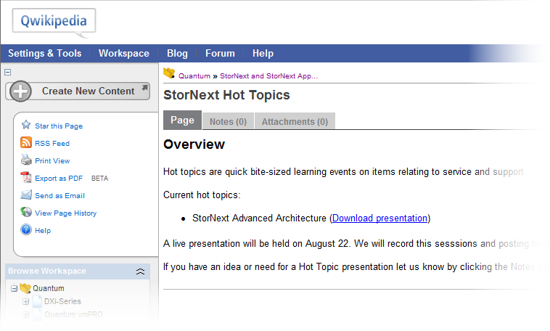
Review Content on Qwikipedia

