Slide 1
Stornext 5.4.0.4
Alain Renaud with Sustaining Engineering
2017-05-26

Slide 2
Bugs Referencing the problem
Bug that introduced the regression in 5.4.0.3
Bug 65242 - FSM panic - PANIC: /usr/cvfs/bin/fsm ASSERT failed "free_ip->i_idinode.idi_flags & InodeFlagFree" sn/snfs/fsm/inode.c, line 2302
Bug that fixed the problem in 5.4.0.4
Bug 68503 - File system objects are created without SNEA attribute leading to unprotected files and rename problems
Bug that introduced snsnms_scan in 5.4.0.4
Bug 68543 - Tool needed to detect and fix 5.4.0.3 Storage Manager regression bug 68503

Slide 3
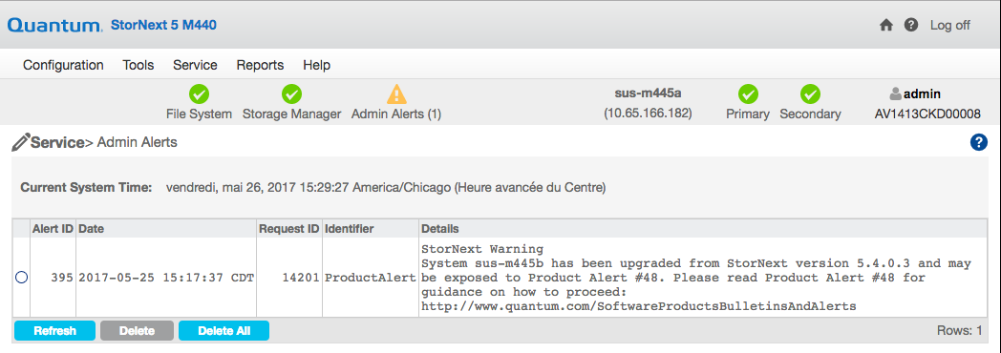
Admin Alert when upgrading from 5.4.0.3

Slide 4
Notes from the TOI
Need to warn the customer not to stop the fix process since you will lose track of files already repaired.
Always make a backup of the files generated by snsnms_scan since they get overwritten every time you run the program.
file_<rel-point>.txt
dir_<rel-point>.txt
Make sure the customer understands that running the fschfiat command on all the files will trigger an immediate store request for all of those files and might keep the ‘TAPE’ very busy. Therefore it hould be run during off hours.

Slide 5
Notes from the TOI (cont.)
It is recommended to run a final scan when everything has been repaired to make sure no files were missed. It is possible to have a race between listing the files and repairing them.
Upgrade path to 5.4.0.4.
We don’t want any appliances upgrading from versions of StorNext earlier than 5.4.0 to anything but 5.4.0.2 then they can upgrade to 5.4.0.4.
If a customer is already at 5.4.0 / 5.4.0.1 / 5.4.0.3, they can upgrade directly to 5.4.0.4.

Slide 6
Reference
Bug 68503 - File system objects are created without SNEA attribute leading to unprotected files and rename problems
Bug 65242 - FSM panic - PANIC: /usr/cvfs/bin/fsm ASSERT failed "free_ip->i_idinode.idi_flags & InodeFlagFree" sn/snfs/fsm/inode.c, line 2302
http://www.quantum.com/SoftwareProductsBulletinsAndAlerts
http://qsweb.quantum.com/wiki/tiki-index.php?page=Homepage+-+Employee

