Slide 1
Q-Cloud Vault
StorNext 5.3.0 TOI
Colin Ngam / Ani Bhattacharya (GUI)
December 2015

Slide 2
Q-Cloud Vault Product
Sold By Quantum
Cheap, Cheaper than Q-Cloud Archive
Cold Storage – Data Almost Never Retrieved
Retrieving Incurs Additional Charges
Retrieving Is High Latency – Up to 5 Hours
Can Be Considered as On The Way To Shredding
Installed On StorNext Just Like Q-Cloud Archive – QCAI/QCPK

Slide 3
Q-Cloud Vault – Characteristics
Like Q-Cloud Archive
S3 RESTfull API
S3 Bucket
Unlike Q-Cloud Archive
S3 is only a temporary cache location
Objects will eventually move to Deep Archive(Glacier)
Latency increases once it is in Glacier
Lifecycle Policy moves objects into Glacier – NO StorNext Control
Lifecycle Policy defined and set by QCC
Every Bucket has the same Lifecycle Policy – Move to Glacier in 24 hours
http://docs.aws.amazon.com/AmazonS3/latest/dev/object-lifecycle-mgmt.html

Slide 4
Q-Cloud Vault – Object Operation
A StorNext Store – PUT Object Into Q-Cloud Vault
S3 PUT is initiated to copy File into S3
In 24 hours, the Object is MOVED into Glacier – Lifecycle Policy
When the Object is in Glacier, the S3 copy is automatically deleted
Objects cannot be retrieved directly from Glacier
A restoration from Glacier to S3 is required
A StorNext Retrieve – GET Object From Q-Cloud Vault
If the Object is in S3, a S3 GET is issued
If the Object is in Glacier, a RESTORE from Glacier to S3 is issued
When the restore is complete, a S3 GET is issued
The File is now in StorNext

Slide 5
Q-Cloud Vault – Object Operation .. continued
A StorNext Remove – DELETE Q-Cloud Vault Object
S3 DELETE
Does not matter if the Object is in S3, Q-Cloud Vault or Cached in S3

Slide 6
Q-Cloud Vault – Object States
Object has 3 States
It is in S3 and not yet in Glacier – Initial store operation completed
It is in Glacier and NOT in S3 anymore – Lifecycle Policy has happened
It is in Glacier and also Cached in S3 – A Restore has completed
Object State Different Longevity
24 hours as an S3 Object on Initial Store
After 24 hours – Lifecycle Policy moves it to Glacier and deletes the S3 copy – Glacier Object
If a restore operation is initiated and successful – stays CACHED in S3 for 48 hours – Glacier Object and Cached
A StorNext Retrieve can be cancelled, but the actual restore operation CANNOT be cancelled. The restore continues.

Slide 7
Q-Cloud Vault – Latency
PUT Latency and Performance
Same as Q-Cloud Archive
GET Latency
If the Object is in S3 – Same as Q-Cloud Archive
If the Object is only in Glacier, a Restore is required – Up to 5 Hours
When restore completes – Same as Q-Cloud Archive
Q-Cloud Vault Restore Process
An Asynchronous Request
Takes Up To 5 Hours – Independent of size
Need To Query If Object is in S3 or Cached in S3
If Object is in S3 – A GET is isued
If Object is in Glacier and NOT Cached in S3, A restore is issued
Poll for Restore completion – takes up to 5 hours

Slide 8
Q-Cloud Vault – Latency .. continued
When it is restored, it is Cached in S3, issue GET
Restored Object stays in cache for 2 days.
After 2 Days, Object is automatically deleted from S3 Cache Some Storage Manager Design Choices

Slide 9
Q-Cloud Vault – StorNext Supported Features
Supported as a Media Type – QVAULT
Can be Copy 1 to 4
Encryption and Compression supported
fsfilecopy – QVAULT as source device NOT supported
fsmedcopy – Source or Destination NOT supported

Slide 10
GUI – Storage Destination -> Q-Cloud
One page for Q-Cloud Archive and Q-Cloud Vault
Product Key is masked for security
New parameters – Policy Class, Evaluation key, Expiration date, Overused & Region

Slide 11
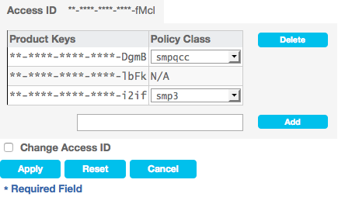
GUI – Storage Destination -> Q-Cloud -> Manage Keys
Access ID is masked for security. Change Access ID will provide user a text box to update the access ID.

Slide 12
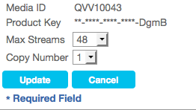
GUI – Storage Destination -> Q-Cloud -> Preferences
Product Key is masked for security.

Slide 13
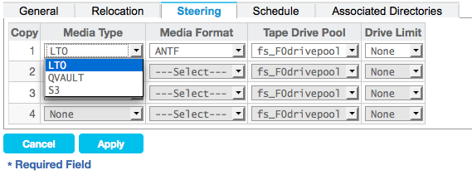
GUI – Storage Manager Policies
Media type – QVAULT

Slide 14
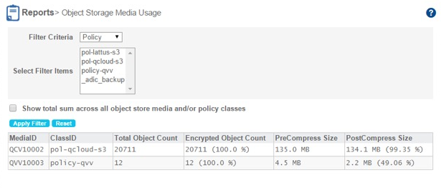
GUI – Object Storage Media Usage Report
Report for object storage media usage.

Slide 15
Q-Cloud Vault
Questions…

