Slide 1
Q-Cloud Encryption
StorNext 5.3.0 TOI
Yingping Lu / Ani Bhattacharya (GUI)
December, 2015

Slide 2
Q-Cloud Encryption Overview
StorNext client-side encryption encrypts data on-the-fly before writing to the cloud.
AES 256 CBC encryption algorithm is used.
Data are encrypted in transit and at rest in the Q-Cloud
Client side generates and manages encryption keys.
Two keys: master key and data protection key (dpk) are used together for data encryption and decryption.
Requires encryption license

Slide 3
Master Key
Master keys are stored in a local master key store file.
Each master key store should have a unique store id if multiple MDCs share the same QCAI.
Each master key has a user supplied name that must be unique within a local master key store.
Each master key derives from a user supplied passphrase.
Master key is used to protect (wrap/unwrap) the data protection key (DPK).
Master key passphrase can be changed, resulting in a new key to protect all DPKs associated with that master key, and also a new DPK to encrypt files with.
Master key store ID, master key names and associated passphrases should be remembered in case of disaster recovery.

Slide 4
Data Protection Key
Used to encrypt data before uploading to Q-Cloud and decrypt data for retrieval
AES 256 CBC algorithm
Is associated with a master key.
Each time a new master key instance is generated, a new DPK is also generated, and then wrapped by the master key.
In addition, new DPK can be generated on-demand.
In contrast to master keys, DPKs (in encrypted form) are stored in Quantum NVS (name-value store).

Slide 5
NVS (Name-Value Store)
Located in QCC EBS (Elastic Block Store, different from S3)
Generic key-value pair store service
Treated DPK data as opaque data blob
NVS instance is created after registering QCAI/QCPK.

Slide 6
Encryption Configuration
Can be configured on a policy basis using fsaddclass and fsmodclass; or on a file copy basis using fsfilecopy, fsmedcopy, fsmedwrite, and fsmedread.
Option -e is used to specify encryption type, for applicable commands:
0 No encryption
1 Server side encryption
2 Client-side AES256 encryption
Option –M specify the master key name to be used
Works in conjunction with client-side compression, but also independently by itself. A policy can have both compression and encryption enabled, or just either compression or encryption enabled.
Configuration via GUI (select encryption method, create/select master key)

Slide 7
Encryption Key Management
This is done by master key management tool fskey.
Create a master key store (first time)
fskey -c mkstoreid
Create a new master key name
fskey -a -n mkname -p passphrase
Change the passphrase of a master key, need old passphrase (-o)
fskey -m -n mkname -o passphrase -p passphrase
List master keys in the master key store
fskey [-l] [-n mkname] [-F type]
Create a new Data Protection Key for a master key
fskey -u -n mkname

Slide 8
Master Key Recovery
If master key store is lost, e.g. in the case of disaster recovery, and there is no backup copy. Need to recover the master key store file first.
First, enable to access the Name Value Store (NVS) in Quantum Cloud Storage, using the following command:
fskey -R -I QCAI -P QCPK
Second, recover all the master keys by running the following command for each master key:
fskey -r mkstoreid -n mkname -p passphrase

Slide 9
GUI – Encryption License
New license for Encryption feature

Slide 10
GUI – Encryption Key Page
List of all master keys

Slide 11
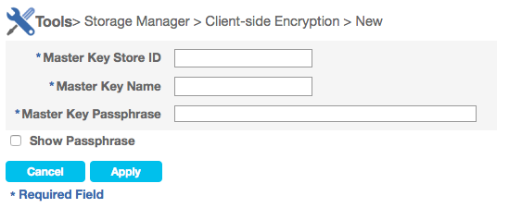
GUI – New Encryption Key
Master Key Store ID is only shown the first time on using this feature
Show Passphrase will show the passphrase for verification

Slide 12
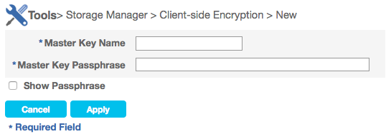
GUI – New Encryption Key (contd…)
After the Master Key Store ID has been entered once, subsequent key creation only requires key name and passphrase

Slide 13
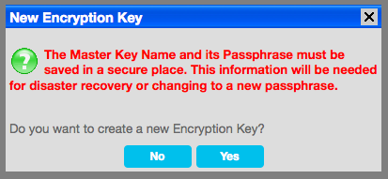
GUI – Save the Master Key Credentials
Warning message to store the key name and passphrase.

Slide 14
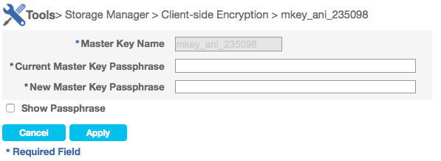
GUI – Edit Encryption Key
Master Key Name is disabled

Slide 15
GUI – Storage Manager Policies
New option for Encryption – Client-side Encryption
New parameter – Encryption Master Key, Compression Type

Slide 16
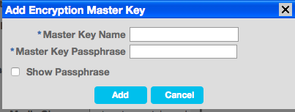
GUI – Storage Manager Policies (contd..)
User can use an existing encryption key or create a new one

Slide 17
GUI – Storage Manager Policies (contd..)
Compression parameter has also been added

Slide 18
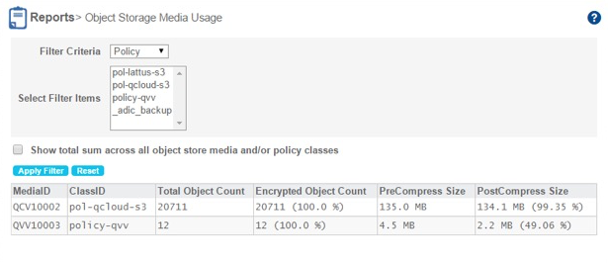
GUI – Object Storage Media Usage Report
Report for object storage media usage.

Slide 19
Q-Cloud Encryption
Questions…

