Slide 1
Q-Cloud Compression
StorNext 5.3.0 TOI
Dzung Pham
December 2015

Slide 2
Q-Cloud Compression Overview
StorNext client-side compression compresses data on-the-fly before writing to the cloud.
Saves space on Q-Cloud storage tier.
Reduces data transmission time between StorNext and Q-Cloud systems.
Initial release supports one compression type - LZ4. Subsequent releases may support more compression types.

Slide 3
Compression Mechanics
Can be configured on a policy basis using Stornext GUI or fsaddclass and fsmodclass; or on a file copy basis using fsfilecopy, fsmedcopy, fsmedwrite, and fsmedread.
Option -q is used to specify client-side compression type, for all applicable commands:
0 No compression
1 Client-side LZ4 compression
Works in conjunction with client-side encryption, but also independently by itself. A policy can have both compression and encryption enabled, or just either one enabled.

Slide 4
Compression Mechanics Continued
Actual compression and/or encryption of file data will take place inside the StorNext mover (fs_fmover) process. If both compression and encryption were enabled:
File content will be compressed first then encrypted, before writing to the cloud.
In reverse, when a compressed and encrypted file copy is retrieved from the cloud, the file content will be decrypted first then decompressed, before writing to the destination device.
Detailed debugging compression information is available in Stornext trace_05 file, if SL_TAC_MASK’s DEBUG2 and SL_TRACE_MASK’s fmover bits are set in log_params.

Slide 5
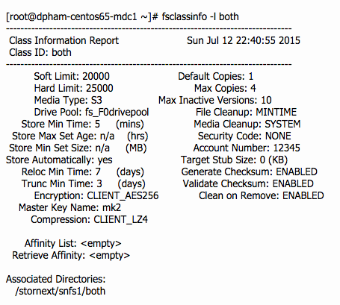
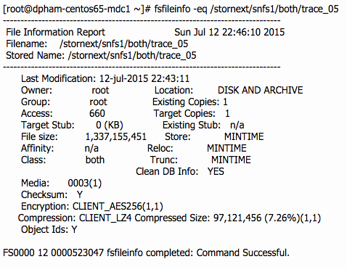
Compression Mechanics Continued
Commands fsclassinfo and fsfileinfo were updated to report compression and encryption related information on a given policy class or file:

