Slide 1
StorNext OBE
Eva Morrell
Product Quality Manager
July, 2013

Slide 2
What is an OBE?
The Out of Box Test is a method to observe how intuitive the set-up procedure is for the user and an opportunity to validate the accuracy of the installation and configuration documentation .
In many cases, the OBE is the first time all of the product parts are together as a final product.
2

Slide 3


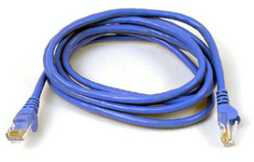

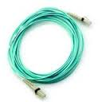
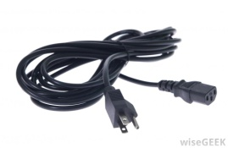




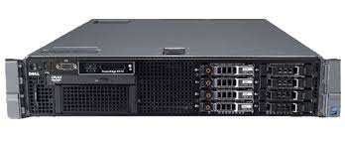
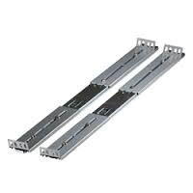
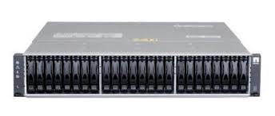

What’s In The Box?
3

Slide 4
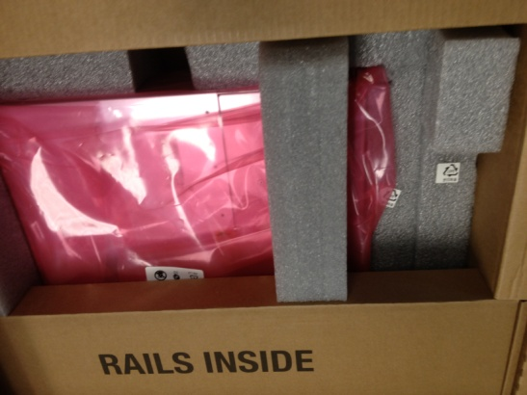
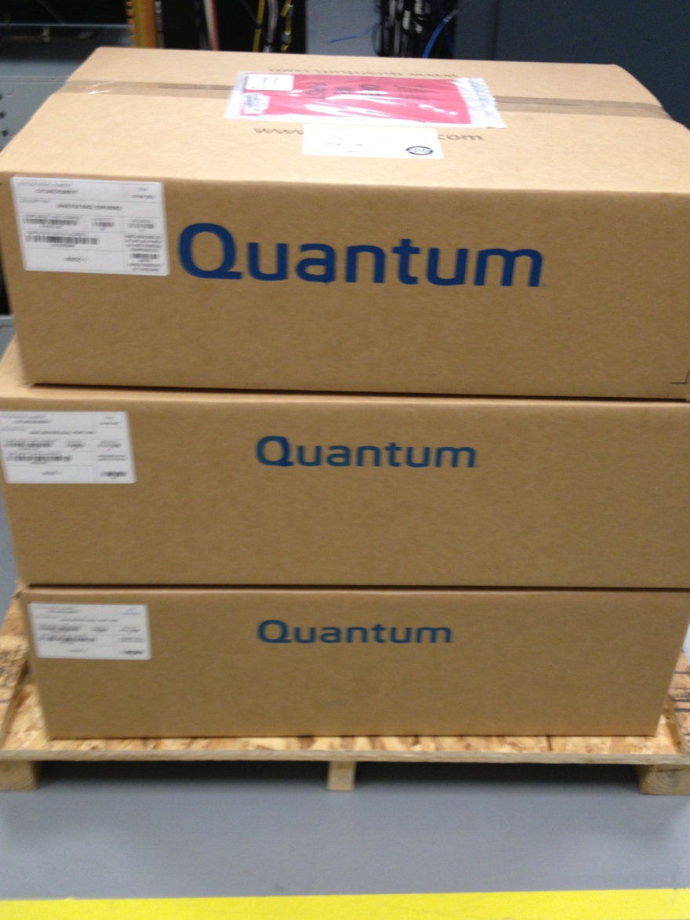
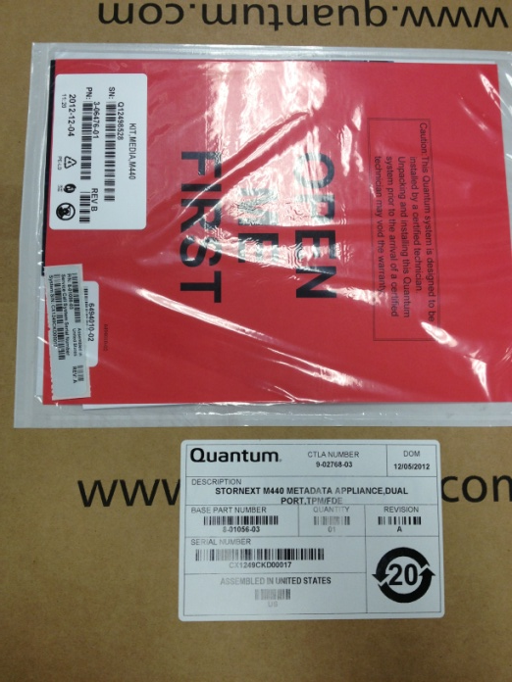
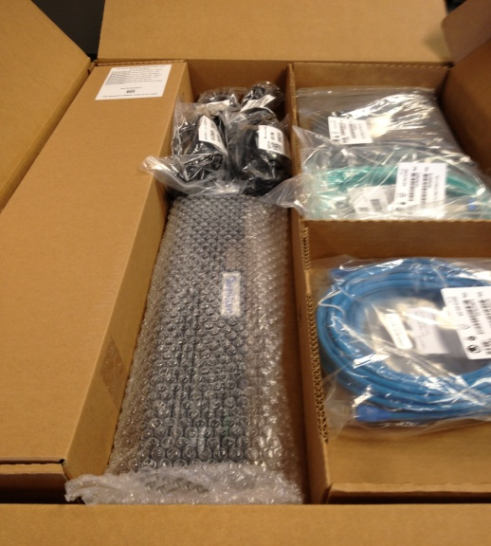
Packaging and Contents Checked Against the BOM
4

Slide 5
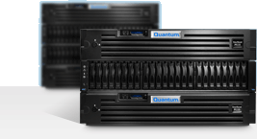
OBE Steps
Check Packaging/Contents
Installation of the system per the instructions and documentation
Initial power-on of the system
Configuration of file systems
Client mount
I/O to file system(s)
File bugs for any issues found
5

Slide 6
IBIS-2 OBE Plan of Action
Label | Resource(s) | Task | Summary
Prep | Charlotte Taylor | Work with Thornton Prime on spreadsheet design | Thornton is working on the spreadsheet
Prep | Fritz Parsons Eva Morrell | Update IP assignments in spreadsheet | Make sure we have the IP addresses required for the configuration
Prep | Fritz Parsons Steve Cole | Lattus configured with 3.1.0 | Validation of the state of the system. Other groups will be using the lattus for training the week prior to the OBE.
Prep |  | Hand off from Pre-Sales to PS | Review spreadsheet for completeness and understanding
Prep | Eva Morrell | Install SN 4.3.3 on M662 | Configure system as it would be shipped from the factory
Prep | James Schnepp | Provide Lattus 3.1.0 USB
Prep | James Schnepp | Provide A10 4.6.1 USB
Prep | Brian Raccuglia | SN 4.6.1 files???
Prep | Charlotte Taylor | Print Docs | All docs required for the OBE will be printed and delivered upon request
Prep | Charlotte Taylor | Create a list of Customer hand-off tasks
Prep | Alan Creekmore | Download Lattus 3.1.3 and 3.1.4 | Ops provides a USB with the base installation of 3.1.0 -- all updates are downloaded prior to site visit
Lattus | Alan Creekmore | Upgrade Lattus to 3.1.3
Lattus | Alan Creekmore | Upgrade Lattus to 3.1.4
Lattus | Ken Nelson | Test data movement: writes, reads, etc | Make sure the lattus is configured properly before proceeding
M662 | Alan Creekmore | Upgrade unit from 4.3.3 to 4.6.1 | M662 ships with SN 4.3.3. SN 4.6.1 must be installed
M662 | Alan Creekmore | Configure file system and WAN policies
M662 | Ken Nelson | Configure library
M662 | Ken Nelson | Test data movement on SN filesystem and WAN
A10 | Alan Creekmore | A10 Installation | Install 4.6.1 software from USB
A10 | Alan Creekmore | A10 Configuration | Configure A10 to access the data on the Lattus system
A10 | Ken Nelson Alan Creekmore Fritz Parsons | Full configuration testing | Test data movement on SN filesystem, lattus and the A10
Wrap-up | Alan Creekmore Fritz Parsons | Customer Hand-off | Assure the customer is provided information about their configuration, serial numbers, etc
Recap | All | Team Meeting | Sync notes and review the OBE
6

Slide 7
Comments? Ideas? Suggestions?

