Slide 1
STORNEXT QA OVERVIEW – SN 4.6, 4.6.1, 4.7
Transfer oF information (TOI)
John Hilgers
Senior Software Engineering Manager
StorNext QA
July 17, 2013

Slide 2
StorNext Quality
Vast improvement in StorNext Quality in past years.
Medicus frequency remains low
Exceeded our quality target goals two years running:
Overall StorNext SR/SN/YR (SM + FS) = 1.00
Last Quarter = 1.07; Previous Quarter = 1.06
Significant drop from 1.8 in 2012 and 2.6 in 2011.
Goal: Storage Manager SR/SN/YR = 4.20
Last Quarter = 3.95; Previous 4 quarters was below the goal
Significant drop from 5.34 in 2011. Improved to 3.90 in 2012 .
Quality Improvement is a cross-functional effort.

Slide 3
StorNext QA Wiki Sites
SN 4.6
http://dxwiki.quantum.com/dxwiki/SN_4.6_(IBIS)_Object_Storage_Appliance#Testing_Information
SN 4.6.1
http://dxwiki.quantum.com/dxwiki/StorNext_4.6.1#Testing_Information
SN 4.7
http://dxwiki.quantum.com/dxwiki/StorNext_4.7#Testing_Information

Slide 4
StorNext 4.6, 4.6.1 (Ibis)
Lattus-only releases
SN 4.6 = Ibis Phase 1, delivered with AmpliStor 3.1.3
SN 4.6.1 = Ibis Phase 2, delivered with AmpliStor 3.1.4
Test Schedules
SN 4.6 : 2/25 – 5/15 (12 weeks)
SN 4.6.1 : 5/20 – 8/9 (12 weeks)
Test Resources = 11
Test Lead: Bob Albers

Slide 5
StorNext 4.6 Phase 1 Feature List
AmpliStor 3.1
Storage Manager Lattus media
Object API
Lattus https
Storage Manager backup and restore Lattus media
Storage Manager disaster recovery Lattus media
Storage Manager high availability Lattus media

Slide 6
StorNext 4.6.1 Phase 2 Feature List
Username/Password
Namespace Encryption
M662 Storage Manager Multi-Geo
A10 snpolicyd
A10 snpolicyd performance
SN 4.6.1 – additional fixes
AmpliStor 3.1.4 - additional fixes

Slide 7
SN 4.6 Bugs
237 Product Defects
StorNext = 128
Amplidata = 91
Platform = 16
Hardware = 2
190 Bugs Fixed
Critical Bugs – Amp=10, SN = 2, MySQL = 1

Slide 8
SN 4.6.1 Bugs
84 Product Defects
StorNext = 43
Amplidata = 41
93 Bugs Fixed
Critical Bugs – Amplidata=5, StorNext=0

Slide 9
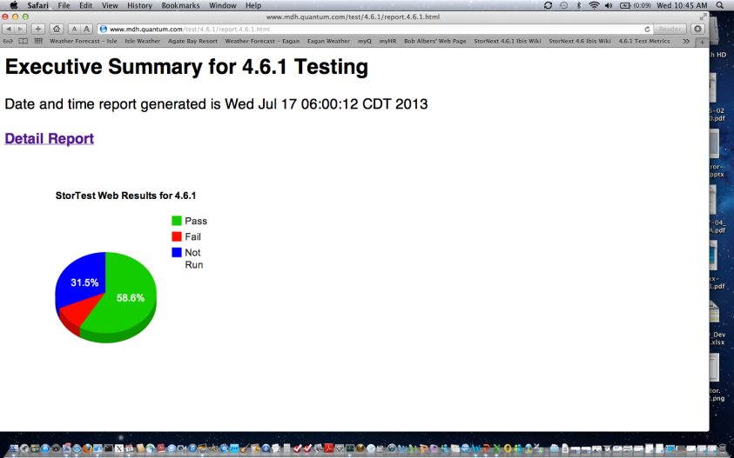
SN 4.6.1 Test Metrics

Slide 10
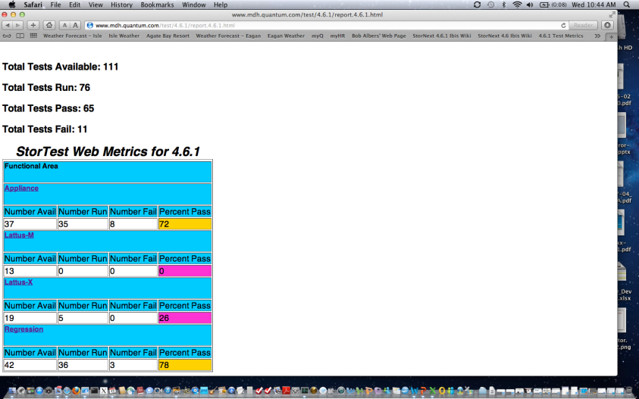
SN 4.6.1 Test Metrics

Slide 11
Lattus Test Configurations
MDH-1
12 S10 AS30 Storage Nodes, 3 C10s
2 S60s, S4810, 8132F
2 M662s, QD6000, 510-Gbit clients
MDH-2
20 S10 AS-36 Storage Nodes, 3 C10s
2 S60s, S4810, 8132F
M662, QD6000, 8 G301 10-Gbit clients
MDH-MG
20 S10 AS-36 Storage Nodes, 3 C-10s
2 S60s, 2 S4810s
M662, DDN Raid
RTX-1
16 S10 AS-30 Storage Nodes, 3-C10s
2 S60s, 2 Fujitsu XG2600s
M662, QD6000, 4 Dell R320 10-Gbit clients

Slide 12
Test Processes/Docs
Test Planning
Requirements-based test approach (PRD)
Test Strategy Doc
Test Plan
Test Status
Weekly detailed Test Report to Engineering
Weekly status to Lattus Core Team
Metrics generated via StorTest
Traceability Matrix on wiki (TRM)
Final Test Report
Bug Dispositions
Bi-weekly bug scrubs (StorNext & Amplidata)
Bug queries, reports, verifications

Slide 13
StorNext 4.7
Test Schedules
4/15 – 8/16 (18 weeks)
Test Resources = 12
Test Lead: Bill Schoofs
Platform Engineering also tested SN 4.7
Not covered in this presentation

Slide 14
StorNext 4.7
New Features (1 of 2)
Windows Shared Mode
Turner Omneon (CE)
Lattus 3.1.4 (regression-only)
Appliances – M330, M440, M660[R], G300[R]
Operating System Support
SLES 11 SP2
RHEL 6 SP4
Windows 2012 MDC (FS + Clients)
Solaris 11 SAN/LAN client
Debian 6.0 SAN/LAN clients (for nPulse)
FS support as clients for Xsan MDCs

Slide 15
StorNext 4.7
New Features (2 of 2)
Device Qualifications
Dual Robot Queing Feature
Quantum S10K Library with LTO-5 tape drive
LTO-6 WORM
Oracle T10KD Tape Drive
Oracle SL150 Tape Library
HP MSL 6480 Tape Library

Slide 16
SN 4.7 Bug Fixes
250 Bugs Fixed
Filesystem = 45
Storage Manager = 45
GUI = 43
Docs = 71
Other = 46
Customer Bugs = 54
SN 4.6/4.6.1 Rollup = 43

Slide 17
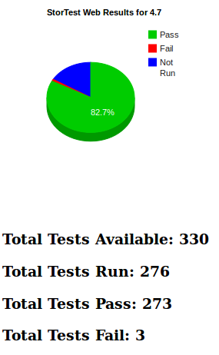
SN 4.7 QA Metrics

Slide 18
Test Processes/Docs
Test Planning
Requirements-based test approach (PRD)
Test Strategy Doc
Test Plan
Test Status
Weekly detailed Test Report to Engineering
Weekly status to StorNext Core Team
Metrics generated via StorTest
Traceability Matrix on wiki (TRM)
Final Test Report
Bug Dispositions
Bi-weekly bug scrubs (StorNext)
Bug queries, reports, verifications

Slide 19
Test Automation
Investment in test automation is paying off
Tripled automated tests in last 18 months with SnTest.
35% of StorNext Test cases are automated.
Functional areas automated in FY13:
Replication/Deduplication
Install/Upgrade
Connectathon NFS
High Availability (HA)
Client Tests
DDM Test Suite
TSM sysparam Suite
MySQL Scaling
Directory Quotas
Parker Metadata.

Slide 20
STORNEXT QA OVERVIEW – SN 4.6, 4.6.1, 4.7
THANK YOU
John Hilgers
Senior Software Engineering Manager
StorNext QA
July 17, 2013

