Slide 1
StorNext TOI
Information Solutions
Presenters: Charlotte Taylor, Keith Lenehan, Fedri Marrugo
July 17, 2013

Slide 2
Acted on Consultant Feedback
Intentional focus on customer/user experience
Targeted information solutions based on what users (customer, service, partner) need
Improved access to information, more tightly integrated with product
Links (vanity urls) to docs and video demos on Q.com
Customer-facing video demos and new user task guide
Newly-structured service/support deliverables

Slide 3
NEW AND UPDATED
StorNext 4.6, 4.6.1, 4.7

Slide 4
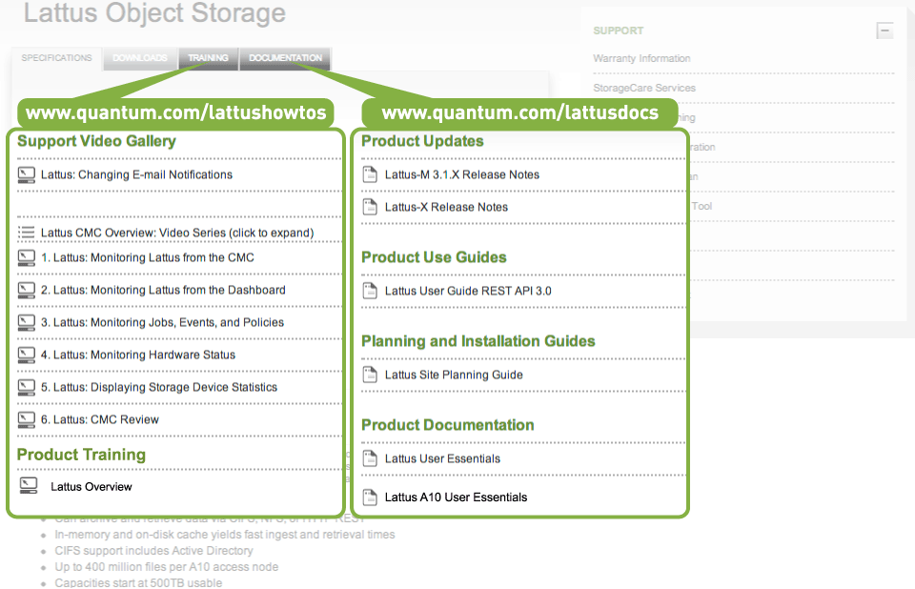
Q.com Resources: Customer-facing
Plus StorNext docs

Slide 5
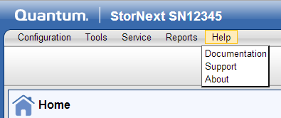
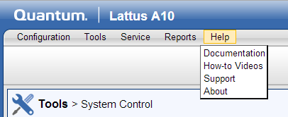
Lattus A10 Online Help and GUI Links
Docs, Training, and Job Support is integrated with the product
Lattus A10 Online Help and GUI links
Before: StorNext 4.3.x GUI
After: Lattus GUI
User is re-directed to the Lattus Object Storage page (Documentation tab and Training tab)

Slide 6
A10 GUI Links Point to tabs on Q.com

Slide 7
What resources are available for Service?
Quantum Service and Service Partners: CSWeb
Quantum Service: SCL, CSWeb, and Qwikipedia

Slide 8
StorageCare Learning
Lattus Overview (1-4548 online self-paced) * Also available for customers on Q.com.
Lattus Hardware & Network Architecture (2-4552 online self-paced)
Lattus Installation Overview (2-4539 online self-paced)
Lattus Support Overview (2-4540 online self-paced)
StorNext 4.6.1 Service Update (2-4550 online self-paced)
Lattus Installation and Configuration (2-4541 classroom)
Lattus Support and Troubleshooting (2-4542 classroom)

Slide 9
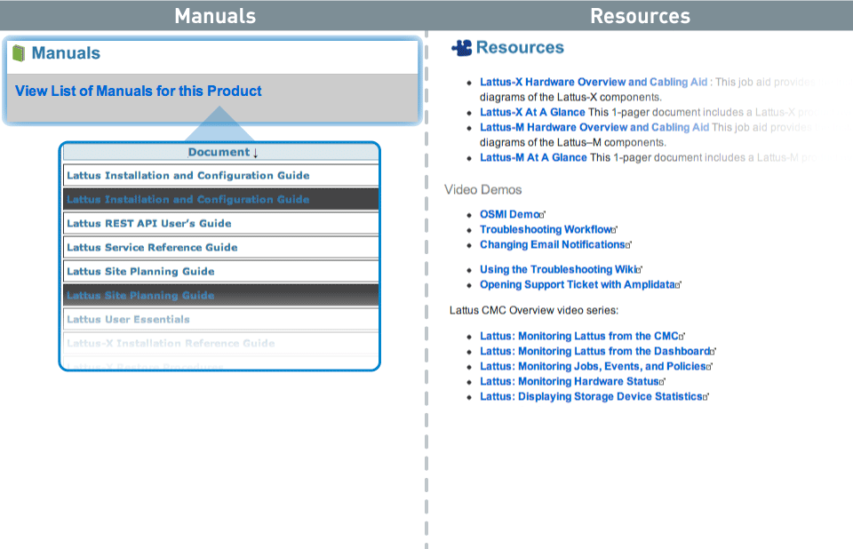
CSWeb Resources > Lattus Page
NEW
Will add a link from this page to the StorNext docs and M660 docs.
Will add Lattus A10 Installation Guide.

Slide 10
Qwikipedia Resources: Quantum Service Only

Slide 11
IMPROVEMENTS
StorNext 4.6, 4.6.1, 4.7

Slide 12
Lattus Installation Guide
Lattus Installation and Configuration Guide
Unpack and Rack Components
Cable the Components
Configure the Switches
Configure the Controller Nodes
Configure the Storage Nodes
Create Storage Policies and Namespaces
Apply Software Patches
Configure Interfaces
Run Performance Verification
Install/Configure the Lattus A10 Access Node or M662
Includes content from Lattus Hardware Overview and Cabling Aid
Points to Lattus A10 Installation Guide
Points to Lattus MDC Configuration and Conversion Guide

Slide 13
M660 Docs Include StorNext Content
Install/Configure the M662
StorNext content is now included in these guides.
No need to jump back and forth between guides.
Lattus MDC Configuration and Conversion Guide
StorNext M660 Installation Guide

Slide 14
StorNext Document Enhancements: (Example1)

Slide 15
StorNext Document Enhancements: (Example1)

Slide 16
StorNext Document Enhancements: (Example2)

Slide 17
StorNext Document Enhancements: (Example2)

Slide 18
StorNext Document Enhancements: (Example2)

Slide 19
Online Help is Single-sourced
Online Help: Single-sourced for RYO, StorNext
appliances, and Lattus A10

Slide 20
StorNext / Lattus A10 Online Help Enhancements
Timeframe
Subversion Work-flow
Single-sourcing Methodologies and Techniques
Cross-functional Collaboration

Slide 21
StorNext / Lattus A10 Online Help Enhancements
Timeframe
Implemented in Ibis / Lattus-M / StorNext 4.6.0

Slide 22
StorNext / Lattus A10 Online Help Enhancements
What the?!?
4.3.1
4.3.3
4.5.0
4.3.2
4.4.0
4.3.0
4.5.1
4.6.0 and 4.6.1

Slide 23
StorNext / Lattus A10 Online Help Enhancements
Subversion Work-flow
We now have a unified / centralized Subversion work-flow for the StorNext / Lattus A10 Online Help source / deliverable files
Each Subversion branch (Trunk or Release) contains the following three sub-directories for the Online Help deliverables:
online_help (equates to RYO)
online_help_a10 (equates to the Lattus A10)
online_help_mxxx (equates to the M-series appliances)

Slide 24
StorNext / Lattus A10 Online Help Enhancements
Demonstration of 4.6.0 File Structure
Demonstration of 4.3.3 File Structure

Slide 25
StorNext / Lattus A10 Online Help Enhancements
Single-sourcing Methodologies and Techniques
We are now single-sourcing the StorNext / Lattus A10 Online Help
Using Adobe RoboHelp's "Conditional Build Tags" feature/functionality, one RoboHelp project is used to "build" multiple deliverables (e.g. one for RYO, one for Lattus A10, and one for the M-series appliances)

Slide 26
StorNext / Lattus A10 Online Help Enhancements
Cross-functional Collaboration
Collaborative efforts between Engineering, Info. Solutions, and SCM allowed the GUI developers to "link" to the respective Online Help deliverable prior to the ISO/build process
The GUI developers enhanced/improved the StorNext software code to "link" to one of the respective Subversion directories above, depending on which type of system is being delivered
This is an enhancement/improvement over the previous SCM ISO/build process
Reduces the risk for errors that may occur post-build

Slide 27
Acknowledgements / Contacts
Aniruddha Bhattacharya, GUI Engineer
Irvine, CA
Michael Lund, Software Configuration Management
Englewood, CO
Adam Manthei, Software Engineer
Mendota Heights, MN
Dana Nelson, Information Developer
Englewood, CO
Paal Olsen, GUI Engineer
Boston, MA

Slide 28
Contributing Team Members
Docs and Training
Fedri Marrugo, Keith Lenehan, Steve Ino, Dave Goff, Matthew Howell
Media
Dave Mason, Jason Wyatt, Matthew Howell
Edit/QA and Production
Ed Winograd and Jason Wyatt

