Slide 1
StorNExt 4.6 / 4.7 TOI
GUI Wide area storage cONFIGURATION
Paal Olsen
July 2013
Notes:
Add other products before deck.
GEO iNt as announcement time for Lattus

Slide 2
GUI Wide Area Storage Configuration
SN GUI users can configure the WAS appliance, protocol, controllers, I/O paths, namespaces, and storage policies
Requires ‘Manage Wide Area Storage’ user admin access
Amplidata integration
Users cannot create Amplidata namespaces from the SN GUI
Users can Launch the Amplidata UI Manager from the SN GUI
SN GUI scans controllers for defined namespaces using native REST client
Lattus-M (RYO, M-662)
Storage Manager solution
Requires snsm_was license key
SN GUI wraps /usr/adic/TSM/exec/fswascfg cli
Lattus-X (A10)
snpolicyd solution
Requires snfs_was license key
SN GUI wraps snpolicyd /usr/cvfs/config/was.conf config file

Slide 3
Lattus-M Storage Destination
New ‘Wide Area Storage’ Storage Destination tab
WAS Component states are read from SM database
‘Launch Manager’ opens a new browser window displaying the Amplidata UI login screen
Set WAS components online/offline

Slide 4
Lattus-M Storage Destination > New

Slide 5
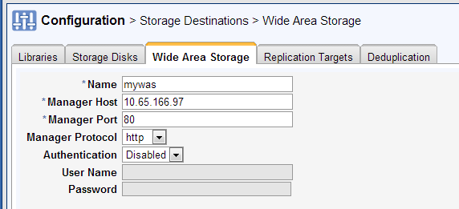
Lattus-M Storage Destination > New
Appliance Configuration
Manager Host can be IP or DNS
Select http or https protocol for Manager traffic
Enable/Disable Authentication
Global Username/Password for all namespaces

Slide 6
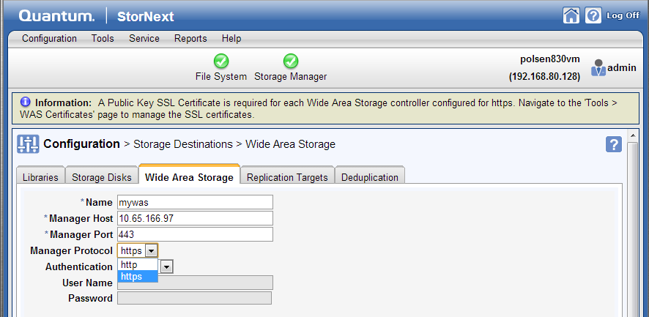
Lattus-M Storage Destination > New
Selecting ‘https’ will generate SSL warning

Slide 7
Lattus-M Storage Destination > SSL
New ‘Tools > WAS Certificates’ page
A Public Key SSL Certificate is required for each WAS controller configured for https
Import existing public key SSL certificate(s) from controller(s)
Controllers require .pem format
Tools to create, convert, and export certificates
Extensive online help section

Slide 8
Lattus-M Storage Destination > New
Adding a new Controller
Click ‘Add’ to insert new Controller row, give it a name
Select protocol (http or https)
Selecting ‘https’ will generate the SSL warning
Configure up to two ports per controller from the GUI
Max Streams default and range from TSM sysparms

Slide 9
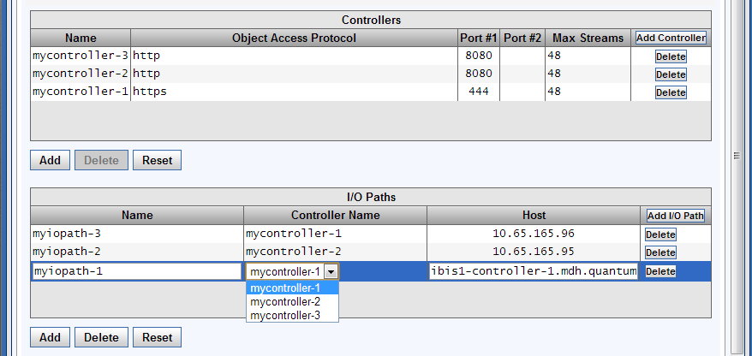
Lattus-M Storage Destination > New
Adding new I/O Path
Click ‘Add’ to insert new I/O path row, give it a name
Select configured controller from drop-down list
Host can be IP or DNS

Slide 10
Lattus-M Storage Destination > New
Adding a new Namespace
Click ‘Add’ to insert new Namespace row
Namespace Selection: Scan or Manual
Scan: GUI will query the controllers and create drop-down list
Manual: Users manually type in Amplidata Namespace
Enter the SN Media ID for the selected Amplidata Namespace
Enable/Disable/Override Authentication
Select Copy Number

Slide 11
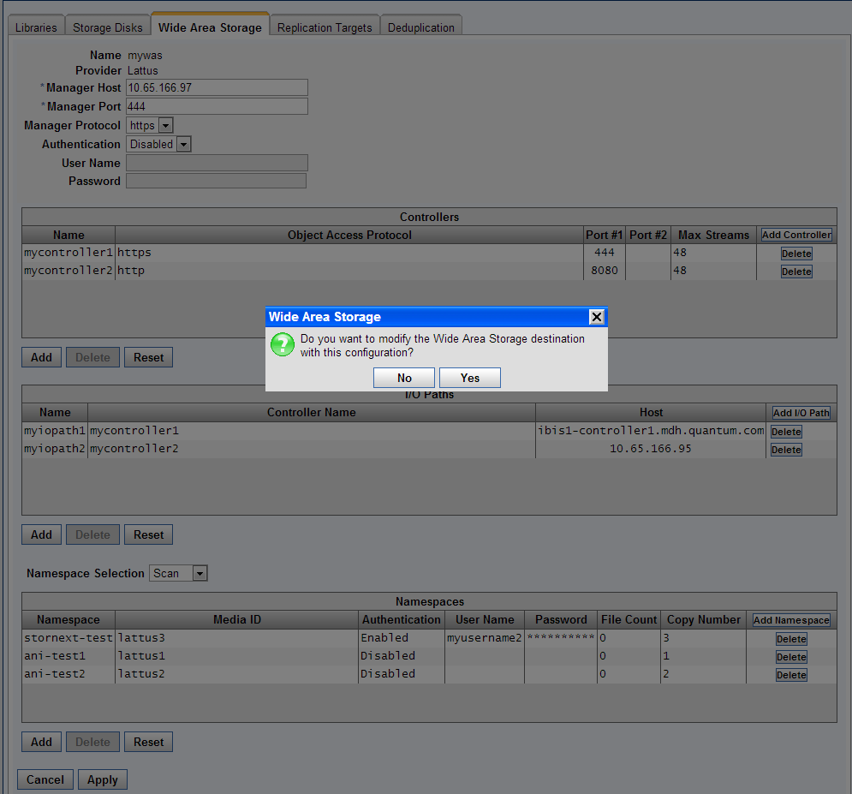
Lattus-M Storage Destination > New
Click Apply to create (or edit) WAS configuration

Slide 12
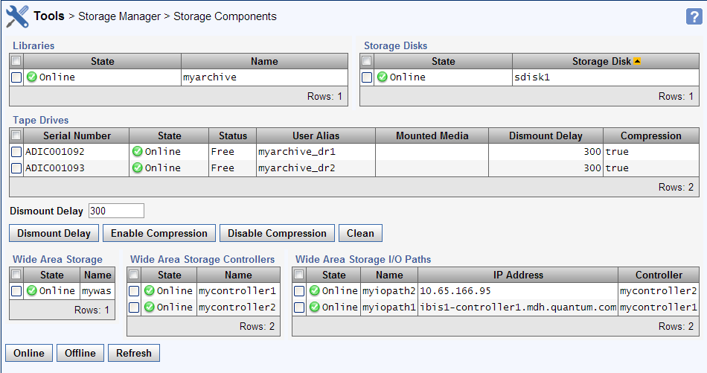
Lattus-M Storage Components
Set WAS Components online/offline

Slide 13
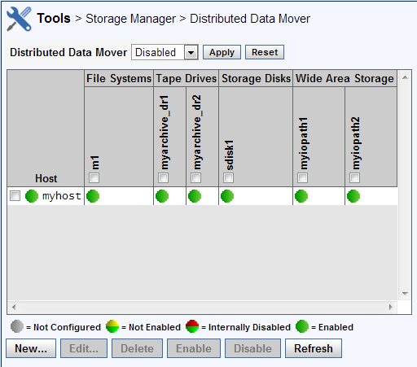
Lattus-M DDM Configuration
Wide Area Storage I/O Paths added to DDM Configuration page

Slide 14
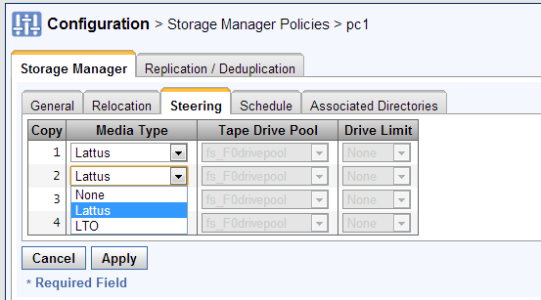
Lattus-M Storage Manager Policies
Storage Manager Policies and WAS media
‘Lattus’ is available in the Media Type pull-down if a WAS media has been configured for the selected copy number on the Steering tab
‘Lattus’ is available in the Media Type pull-down for the Default Media Type on the General tab if a WAS media has been defined for copy 1
Note: The _adic_backup default media type will be automatically changed to ‘Lattus’ iff a WAS media has been defined for copy 1 and no tape libraries have been configured when a WAS storage destination is initially created.

Slide 15
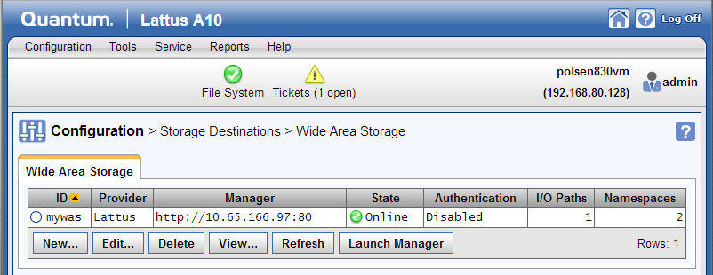
Lattus-X Storage Destination
New ‘Wide Area Storage’ Storage Destination tab
‘State’ field is Green if all controllers can be reached
‘State’ field is Yellow if at least one controller can be reached
‘State’ field is Red if no controllers can be reached
‘Launch Manager’ opens a new browser window displaying the Amplidata UI login screen

Slide 16
Lattus-X Storage Destination > New

Slide 17
Lattus-X Storage Destination > New
Appliance Configuration
Select http or https protocol for Manager traffic
Manager Host can be IP or DNS
Default http manager port is 80
Default https manager port is 443

Slide 18
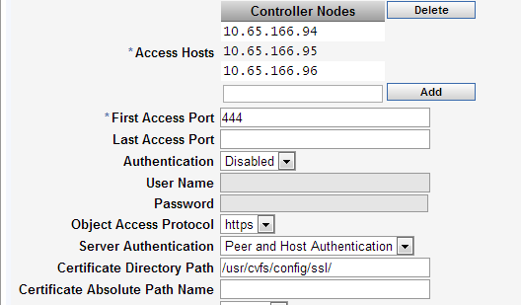
Lattus-X Storage Destination > New
Controller Nodes Configuration
Controller nodes can be IP or DNS format
Select http or https protocol for Object Access protocol traffic
Specify a single port or a port range for controllers
Enable/Disable Authentication
With https: No authentication, Peer Only, or Peer and Host
Specify either a SSL directory path or a specific certificate file

Slide 19
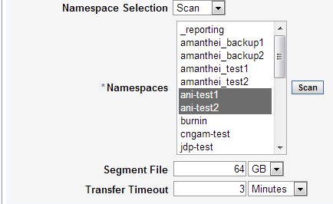
Lattus-X Storage Destination > New
Namespace and Segment Configuration
Namespace Selection: Scan or Manual
Scan: GUI will query the controllers and create drop-down list
Manual: Users manually type in WAS Namespace
Enter File Segment Size and Transfer timeout settings

Slide 20
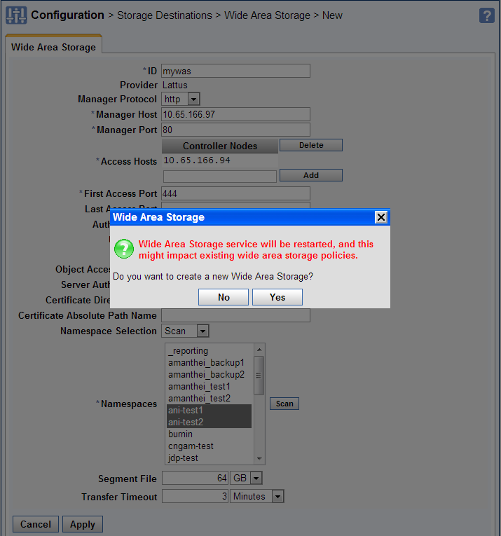
Lattus-X Storage Destination > New

Slide 21
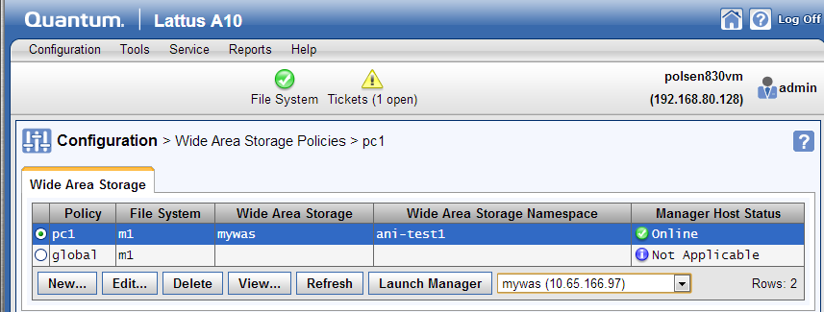
Lattus-X Wide Area Storage Policies
Lattus-X WAS policies
A10 GUI has limited menu selections and no Storage Manager functionality
Lattus-X storage policy engine is powered by snpolicyd; requires rep-enabled file system
Very similar to replication policies in RYO systems
‘Launch Manager’ opens a new browser window displaying the Amplidata UI login screen

Slide 22
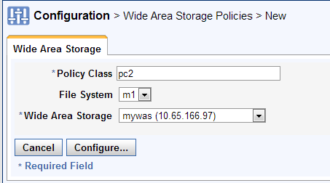
Lattus-X Wide Area Storage Policies > New
Lattus-X WAS policies > New
Enter policy class name
Select source File System
Select Wide Area Storage appliance
Click ‘Configure’

Slide 23
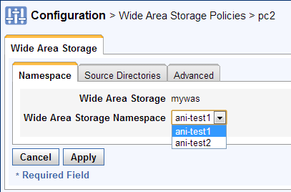
Lattus-X Wide Area Storage Policies > New
Lattus-X WAS policies > New > Namespace
Select WAS Namespace for this policy

Slide 24
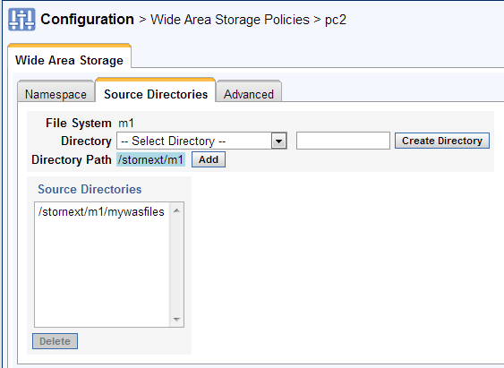
Lattus-X Wide Area Storage Policies > New
Lattus-X WAS policies > New > Source Directories
Select one or more source directories

Slide 25
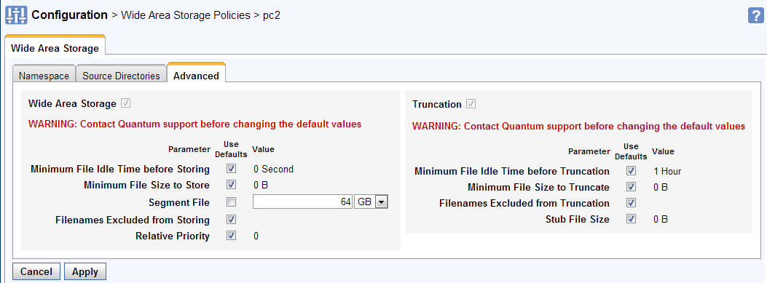
Lattus-X Wide Area Storage Policies > New
Lattus-X WAS policies > New > Advanced
Customers should contact Quantum support before changing the Advanced parameter default values

Slide 26
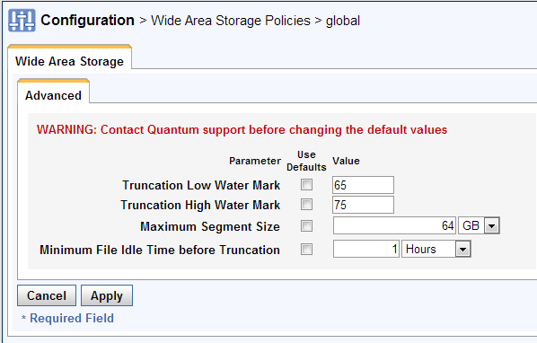
Lattus-X Wide Area Storage Policies > Global
Lattus-X WAS policies > Edit > global
One global policy for each wide-area storage enabled file system
Individual policies inherit from global
Customers should contact Quantum support before changing the global policy default values

