Slide 1
Lattus and AmpliStor Software

Slide 2
Partnered Solution
Amplidata
Founded 2008
Quantum & Amplidata
POC
Fall 2011
AmpliStor 3.0
Summer 2012
Agreement
Spring 2012
Lattus
Lattus-X Winter 2012
Lattus-M Spring 2013
Lattus-Mv2 Summer 2013
….

Slide 3
Lattus is:
Notes:
hardware, software and a lot of connections

Slide 4
Lattus Hardware
Storage Nodes
Access Node
Network Switches
Controllers
Lots of Cables
Notes:
Storage Nodes are Amplidata’s design
- 3 TB drives, 4TB coming
Everything else we source from people like Dell

Slide 5
Lattus Software
Lattus 3.0, 3.1, 3.2

Slide 6
Lattus Documentation
Notes:
Amplidata documents are always located on Box, and off the Amplidata wiki page
These should only be used as reference, the official Quantum guides are in the standard places

Slide 7
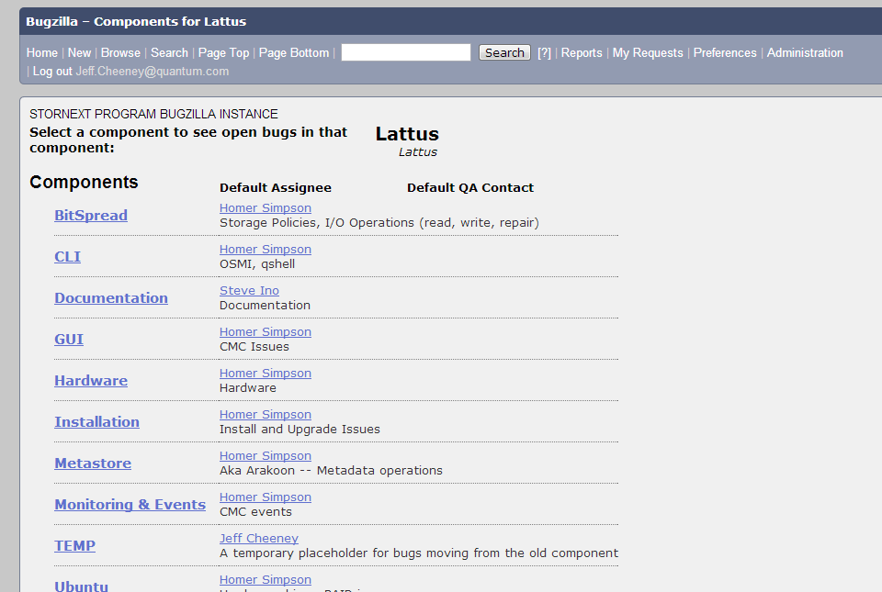
Lattus Defects
http://bo.quantum.com/bugzilla
Notes:
http://bo.quantum.com/bugzilla

Slide 8
Lattus Support
Quantum Service
Amplidata
Engineering
First Call
Installation Support
support@amplidata.com
http://dxwiki/dxwiki/Lattus

