Slide 1
StorNext Distributed LAN Client Performance
March 12, 2012
Jeff Koniges
651-6884360
Mendota Height, MN office
Jeffrey.Koniges@quantum.com

Slide 2
Distributed LAN Client/Server Performance
Overview
dpserver settings
Client load balancing options

Slide 3
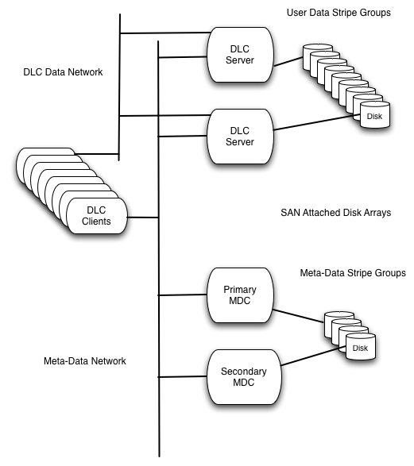
Distributed LAN Client/Server Overview

Slide 4
Client/Server settings in dpserver file
/usr/cvfs/config/dpserver
/usr/cvfs/config/dpserver.fsname
Template created with “sndpscfg –e”
File is required to be present on server – must select at least one interface
Performance tuning options are used by servers and clients
Windows servers use Distributed LAN tab in Client Configuration utility

Slide 5
Client/Server settings in dpserver file
Parameter | Default | Range | Notes
tcp_window_size_kb | 64 | 32-1024 | Client and Server
transfer_buffer_count | 16 | 4-128 | Windows only
server_buffer_count | 8 | 4-32 | Server only
daemon_threads | 8 | 2-32 | Kernel threads

Slide 6
Client load balancing options
Client mount options – /etc/fstab or Client Configuration Utility (Windows)
man mount_cvfs
proxypath=balance (default)
proxypath=rotate
proxypath=sticky (disk sticky)
proxypath=filestickybalance
proxypath=filestickyrotate

