Slide 1
StorNext Connect
Documentation and Training Updates for NAS Apps Version 3
Matthew Howell
April 2016

Slide 2
StorNext Connect Documentation Updates

Slide 3
New Customer Documentation
StorNext Connect Documentation Center
Includes all customer-facing Connect documentation (and replaces FAQs released in November 2015)
Available on Quantum.com
HTML format, searchable, responsive design (sizes appropriately to the device)
Includes Resources section for PDF downloads of other documents (Quickstart, Release Notes, Compatibility Guide)
Accessible by vanity URL after 4/11 (previously used for StorNext Connect Support page): http://www.quantum.com/sncdocs

Slide 4
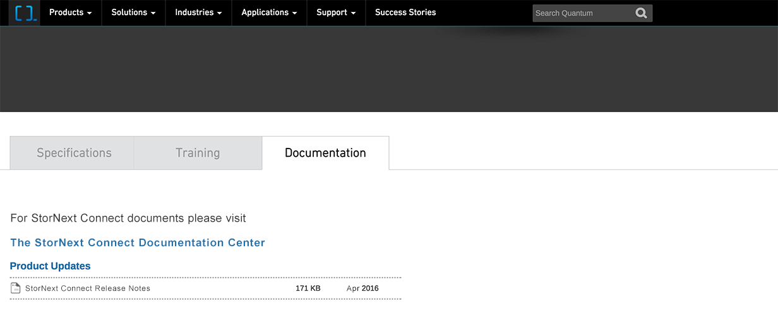
StorNext Connect Documentation Center

Slide 5
Updated Customer Documentation
StorNext Connect Release Notes
Updated with NAS apps v3 information
Content also integrated directly into the StorNext Connect Documentation Center
PDF available from StorNext Connect Documentation Center > Resources
StorNext Connect Compatibility Guide
Updated with NAS apps v3 information
PDF available from StorNext Connect Documentation Center > Resources
Quickstart: StorNext Connect
Updated to change Network Settings Worksheets to electronic forms so settings can be edited/saved in a local copy of the PDF
PDF available from StorNext Connect Documentation Center > Resources
PDFs listed above are also available in the documentation bundles from the StorNext Connect website

Slide 6
Updated Service Documentation
StorNext Connect Service Reference Guide
Updated with NAS apps v3 information
StorNext Connect Deployment Guide
Updated with new information about Xcellis QXS configurations supported by StorNext Pro Install application
PDFs available from CSWeb > StorNext Products > StorNext Connect > Manuals

Slide 7
Documentation Availability
New/updated documents available April 11, 2016
StorNext Connect Documentation Center
StorNext Connect Release Notes
StorNext Connect Compatibility Guide
StorNext Connect Service Reference Guide
StorNext Connect Deployment Guide
Updated documents currently available
Quickstart: StorNext Connect

Slide 8
StorNext Connect
Training Updates

Slide 9
Updated Training
The Basics of StorNext Connect (1-4565 Online Self-Paced)
NAS apps v3 information
Miscellaneous enhancements and added clarification
Updated resource references (e.g., StorNext Connect Documentation Center replaces FAQs)
Customer-facing version on Quantum.com: http://www.quantum.com/snctraining
Service-facing version on StorageCare Learning: http://scl.quantum.com
StorNext Connect Deployment for Quantum Service Partners (2-4570 Online Self-Paced)
Updated title: “Providers” changed to “Partners”
Updated information about which systems can be fully deployed using StorNext Pro Install
Updated resource references

Slide 10
New Training
StorNext Connect NAS Apps V3 Service Update (2-4566a Online Self-Paced)
For Service team members who have taken “Basics” and “Deployment” courses already
Primarily covers NAS apps v3 information
Also covers updated resources (e.g., StorNext Connect Documentation Center)
Course available on StorageCare Learning: http://scl.quantum.com
Content in PDF contained in course resources file downloaded from the course
StorNext Connect NAS apps video
Provides overview of the version 3 NAS apps
Will be available on QuantumKnowHow channel on YouTube
Will be added to the StorNext Connect Documentation Center sometime after initial release

Slide 11
Training Availability
New/updated courses available April 7, 2016
The Basics of StorNext Connect (1-4565 Online Self-Paced)
StorNext Connect Deployment for Quantum Service Partners (2-4570 Online Self-Paced)
StorNext Connect NAS Apps V3 Service Update (2-4566a Online Self-Paced)
StorNext Connect NAS apps video available April 11, 2016

