Slide 1
Service Model Updates
Bob O’Brien/Jim Hibbard

Slide 2
Service Updates for StorNext 6.0
DAE is now Customer Installable via GUI
StorNext Connect Updates
New Single-Node Options for XWD, Artico
Single Node to Dual-Node Upgrades

Slide 3
DAE is now Customer Installable via GUI (XWD Only)
StorNext 6.0 now supports installation & configuration of DAE via the GUI
DAE install no longer PS required
Documented in the Xcellis Workflow Director Service Documentation Center:
http://www.quantum.com/xcelliswfddocs
For a list of Quantum-certified applications that can be used with DAE, visit:
http://www.quantum.com/partners/techpartner/
Once on this page, look for the DAE-certified logo: next to the vendor name

Slide 4
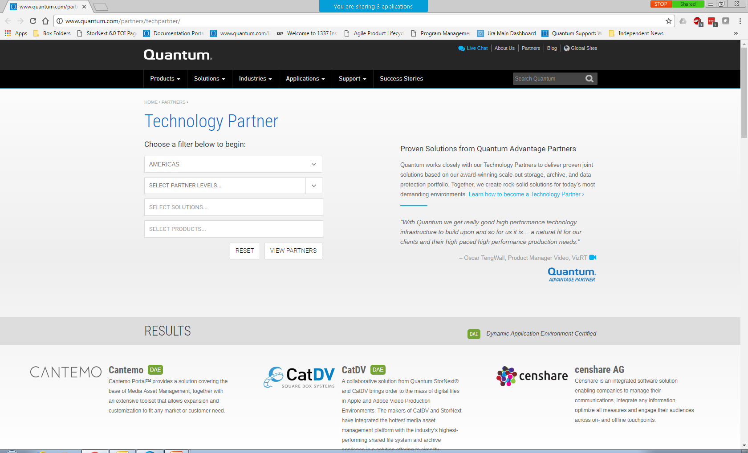
Technology Partners Web Page (DAE-Certified logo circled)

Slide 5
StorNext Connect Updates
StorNext Connect now supports Artico installation
Both Single-Node and Dual-Node Artico & XWD installs supported
PS no longer required for Artico installs (XWD was already supported by Connect)
StorNext Connect does not support upgrade of a Single Node system to Dual Node
StorNext Connect updates for Xcellis Workflow Director:
Adds support for QXS-3 & 4, iSCSI and FC
StorNext Connect does not support install of Xcellis Workflow Extender

Slide 6
New Single-Node Options for XWD, Artico
Starting in CQ3 2017, a new Single-Node option will be available for Xcellis Workflow Director and Artico
New PNs to differentiate from the Dual-Node option
Customer can upgrade a Single-Node system to a Dual-Node system at a later date
Service model for Single-Node remains the same as for Dual-Node
Service plans will be updated to reflect support for the single-node option
Three possible configurations in the IB:
Dual-Node system shipped as Dual-Node from the factory (current product)
Single-Node system (new)
Single-Node system upgraded to Dual-Node after initial sale (new)
The Dual-Node Upgrade (second node) will not be serial controlled
The solution will take on the S/N of the parent Single-Node system

Slide 7
New Single-Node Options for XWD, Artico (cont.)
Sample of PNs in IB (for XWD):
Dual-Node XWD (i.e. current model)
8-01811-02 XCELLIS WORKFLOW DIRECTOR,BASE SYSTEM,DUAL SERVER,FC,324,24X900GB,21.6TB,HDD METADATA,NON-SED
Single-Node XWD (new):
8-01512-06 XCELLIS WORKFLOW DIRECTOR,BASE SYSTEM,SINGLE SERVER FC,412X4TB,48TB,NON-SED
Single-Node XWD upgraded to Dual-Node after initial sale:
8-01512-06 XCELLIS WORKFLOW DIRECTOR,BASE SYSTEM,SINGLE SERVER FC,412X4TB,48TB,NON-SED
8-01768-01 BASE ASSY,XWD,SINGLE NODE,UPGRADE
Same type of structure for Artico

Slide 8
New Single-Node Options for XWD, Artico (cont.)
SW visibility to dual-node conversion is in the GUI (will show both primary and secondary) and in the /var/log/DXi/service.log file on Node 2 (part of the collect logs):
When the system was initially configured as a single node, you will see in the service menu log file that the “Make Single Node” option was run as part of the first few steps on the system.
Upgrading a Single-Node system to Dual-Node:
Will be partial Service Menu/partial GUI – PS required
StorNext QuIL has been updated to support entry of a single cvfsid enter for XWD and Artico, later addition of a 2nd cvfsid (new license set required at time of upgrade)
The HA (High Availability) license is included in the Single-Node BOM (so HA does not need to be added at the time of the 2nd node addition)
The IB will be updated with the 2nd node PN captured under the single-node parent
After upgrade, both nodes will display the original system S/N in the GUI

