Slide 1
DMZ Enhancements
Tom Etzel

Slide 2
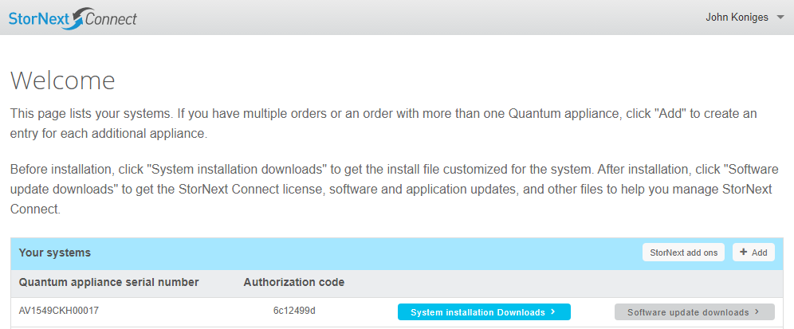
StorNext add ons page
New page added to the DMZ for customers to download new add ons
FlexSync
FlexSpace
Offline File Manager
Customer is required to register with a valid appliance serial number and authorization code
Accessed from the “Welcome”
page when customer logs in

Slide 3
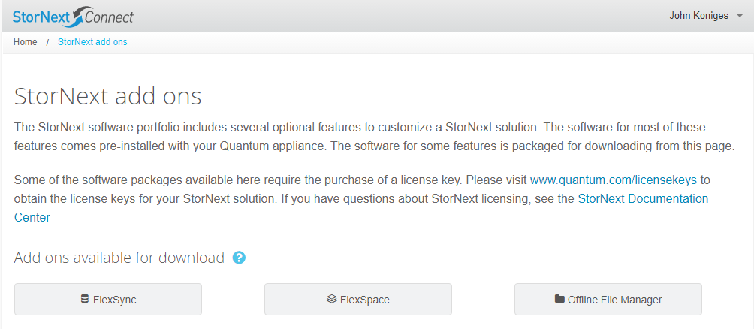
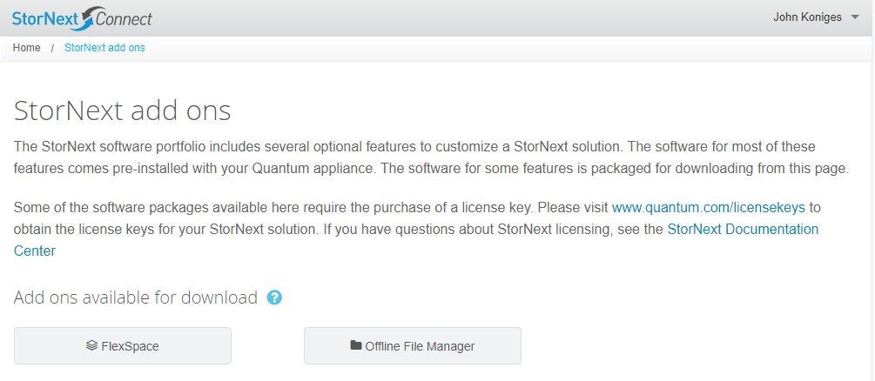
StorNext add ons page cont.
Add on buttons are dynamically generated based on whether an add on is available on the server
All add ons available
Missing an add on
Notes:
Make sure to mention why an app might not be available.

Slide 4
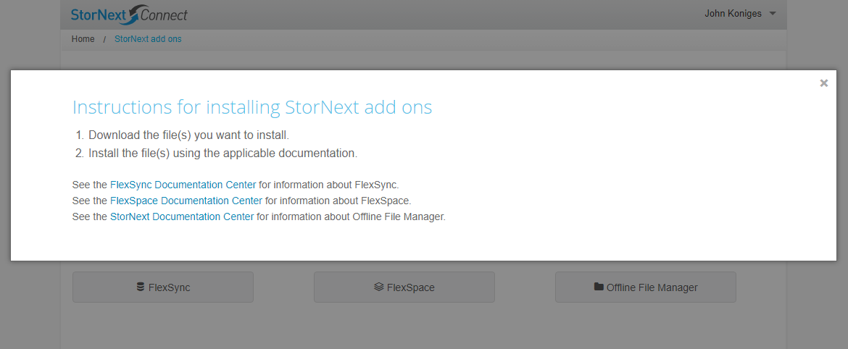
StorNext add ons page cont.
Contains help text directing the user to individual add on Documentation Centers

Slide 5
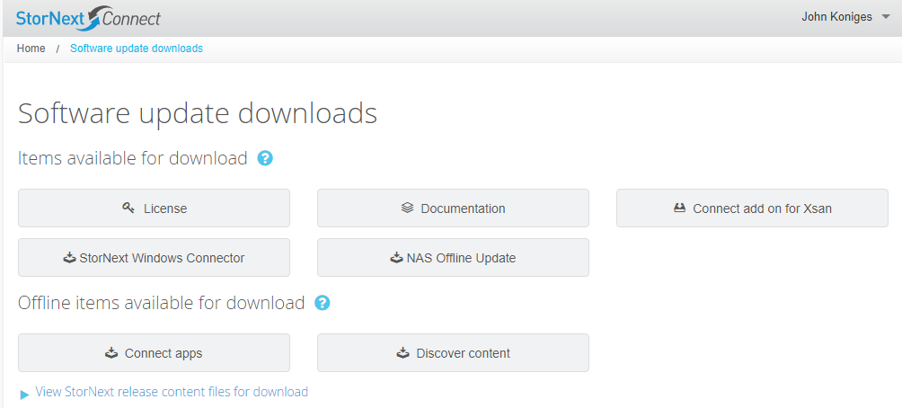
General DMZ Enhancements
The “Documentation” button on the Software update downloads page now opens the Connect Doc Center instead of downloading a .tar.gz bundle of documentation

Slide 6
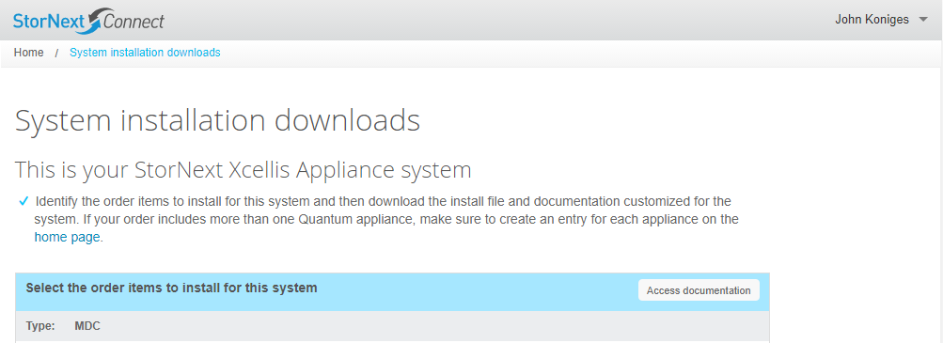
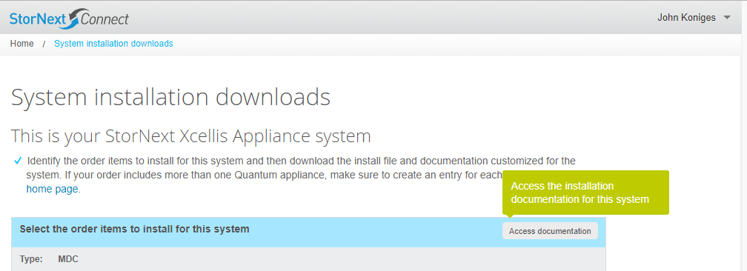
General DMZ Enhancements cont.
The “Download documentation” button on the System installation downloads page has been renamed to “Access documentation” and now opens the Hardware Install Doc Center instead of downloading a .tar.gz bundle of documentation

Slide 7
General DMZ Enhancements cont.
Appliances on the “Welcome” page are now listed in alphanumeric order by serial number
The Add appliance form on the “Welcome” page now automatically clears it’s own form fields when the form has been submitted or closed
Customer previously had to clear all fields manually
The Add appliance form is no longer case sensitive when adding appliance serial numbers or auth codes
Previously, case mismatch lead to “Unknown serial number or auth code” error being presented to user

Slide 8
System installation downloads changes
Page used to be driven by order information captured in the IB
If an order contained an appliance or other piece of hardware that the DMZ was unaware of (usually new appliances or other hardware pieces) customers would not be able to download a Customer Install compatible BOM
CI would subsequently fail leaving customer frustrated
To make the DMZ aware of new parts/part numbers from the IB required code changes and new builds of the DMZ to be pushed live
Time debt for pushing a new DMZ build through the QA process and eventually live is the same, regardless of number of parts added to the system

Slide 9
System installation downloads changes cont.
Need a more reliable way for customers to download CI compatible BOMs
Need a more efficient way of adding new parts/part numbers into the DMZ
Need to increase the percentage of successful, support free CIs

Slide 10
System installation downloads changes cont.
Parts/Part numbers are now stored in a relational database vs. directly within the DMZ code
When new part numbers are introduced by the IB we can now add them to the database
Eliminates the need to push a completely new build of DMZ code every time there is a new part/part number
Will drastically reduce turn around time for supporting new parts/part numbers with the DMZ
In the future there will be an admin interface for managing this parts database

Slide 11
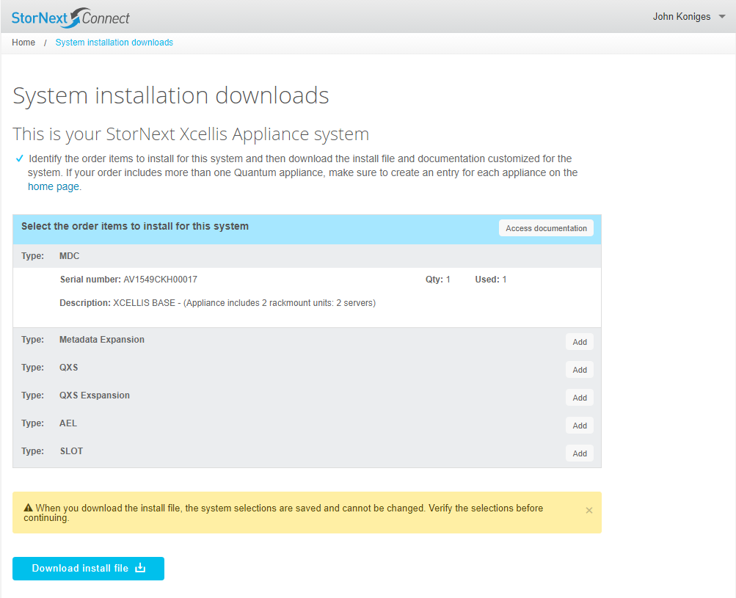
System installation downloads changes cont.
The UI for downloading your CI BOM has been updated to allow customers to choose the parts they want to install with their appliance
When a customer registers a new appliance on the DMZ, the System installation downloads page presents a new interface for the customer to add parts to the BOM that they are building for their CI
The only part that is added for the customer is the appliance that they just registered

Slide 12
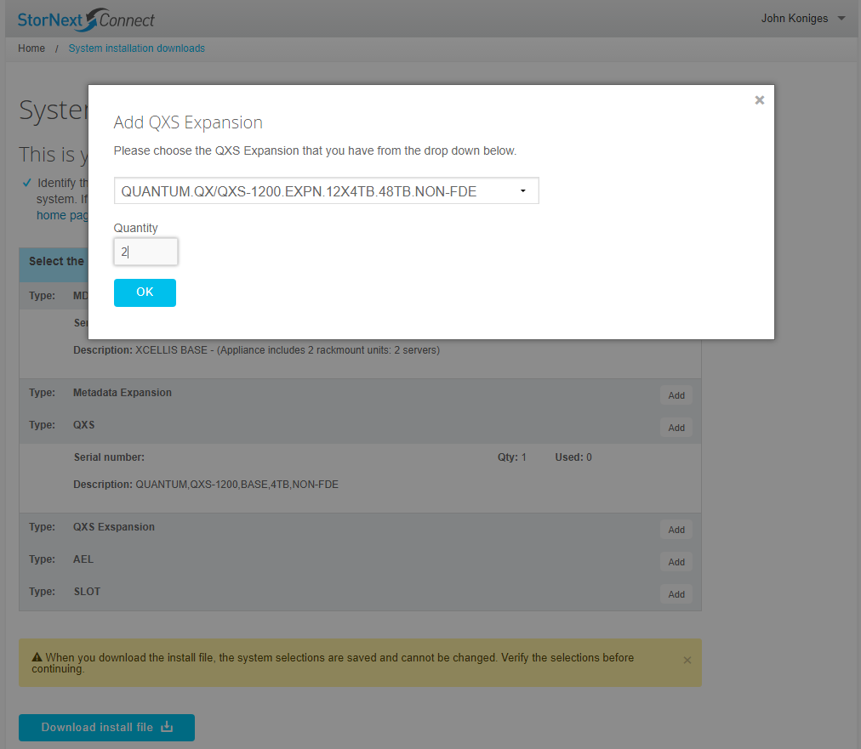
System installation downloads changes cont.
The customer chooses each item they want to install with their appliance
List of items is populated from the DMZ database
Customer is able to specify a quantity where appropriate

Slide 13
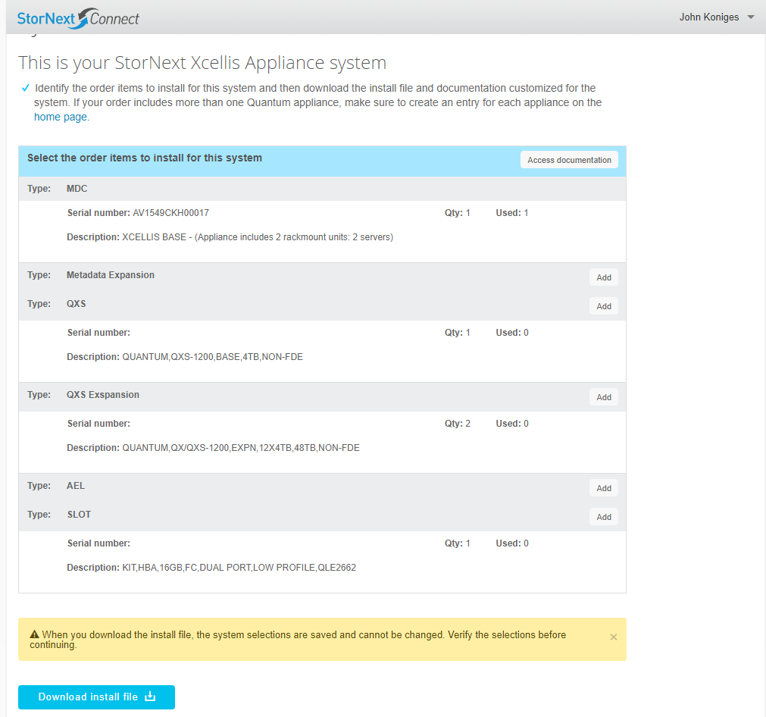
System installation downloads changes cont.
Once the customer has chosen all the parts that they would like to install they are able to download a CI compatible BOM

