Slide 1
StorNext Connect Install V10
By John Koniges

Slide 2
Removal of Required Settings
No SMTP Requirement
Useful is customer has no SMTP server local with connect server not on public network
Means password cannot be reset by reset password command. Requires Service to recover
No VIP Requirement
Used for a consistent IP to the active MDC
If StorNext is stopped on both nodes the VIP is not active (Most noticed on Single Node systems)
Current Items that require a VIP
StorNext Replication
Partial File Retrival only allows 1 address, so it should really use the VIP
MAM(Media Access Managers)s may use the VIP in M&E Setups
Altstore/retrieve uses the VIP

Slide 3
Single Node Install
Same install package is used
Uses /opt/DXi/maxnodes to identify single/dual nodes
If customer adds another node to single node system, connect will still install correctly
Serial Numbers on Appliances must match
What is different:
Settings will now ask for “The appliance” in place of “Node 1/Node 2”
Connect will no longer disable if running on the same node as the Primary MDC
Things staying the same:
HAFS is still setup/configured
VIP still configured (if settings provided)
Connect still sets a -meta hostname in the /etc/hosts

Slide 4
File System Performance Changes
Install v9 changed the file system configuration settings:
ASR on by default with 1GB size
inodeCacheSize 128k (This is a count of number of inodes, not bytes)
inodeStripeWidth 4GB (needed this large to support ASR)
stripeBreadthWidth
Used to be hardcoded from the Mseries, but now takes this setting from cvlabel
LUNs created by the platform’s scripts correct populate the data for this field.
bufferCacheSize is now variable sized based on Metadata Use
Kept in memory all the time, as file systems increase we need to shrink this or run out of memory
8GB: Less than 4 file systems ( Dedicated: Also more than 90% of metadata space allocated)
2GB: 4-15 file systems (Dedicated: Also 50%-90% of metadata space allocated)
256MB Default if not the above cases

Slide 5
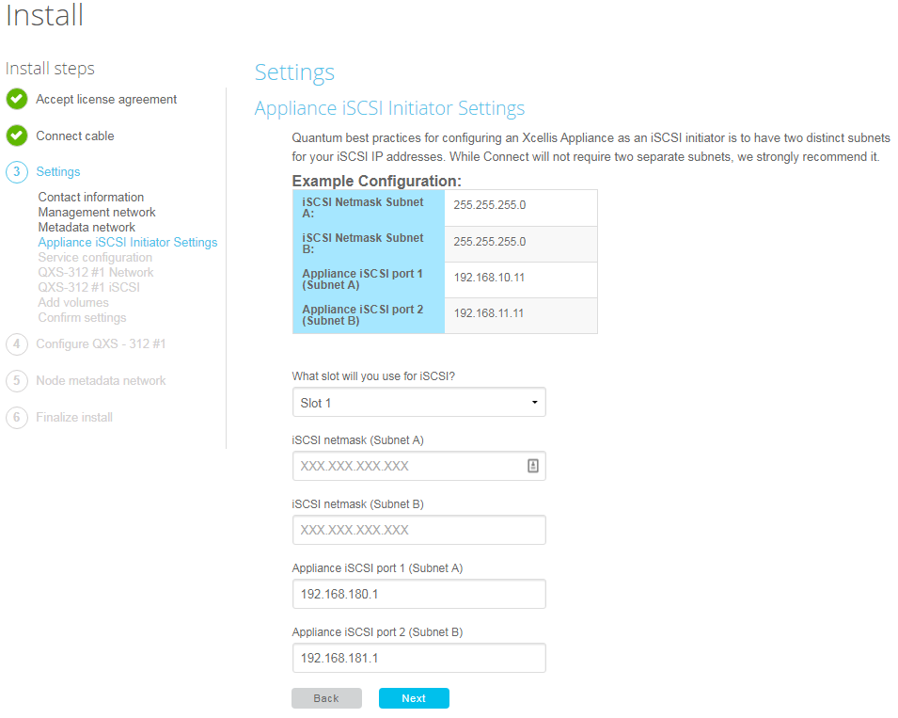
iSCSI Support – Appliance Initiator Configuration
One iSCSI QXS Array is allowed to be attached/configured.
Appliances are configured as initiators only.
You must specify which slot your 10Gb Card is located
Slot must be the same on both appliances
Slots with wrong hardware will not be dispayed

Slide 6
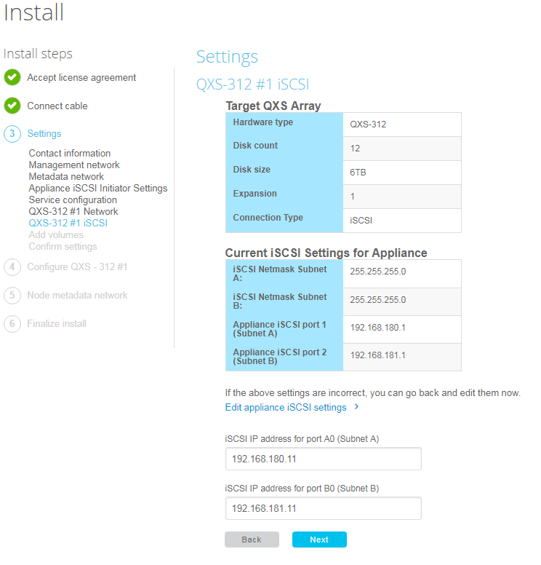
iSCSI Support – QXS Array Target Configuration
QXS Arrays are Targets only.
IP Addresses will be verified to be on the same subnet as the corresponding network

Slide 7
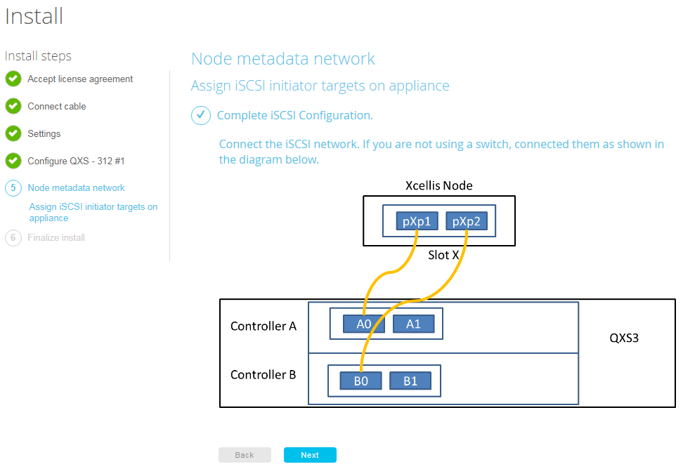
iSCSI Support – Connect Cables
iSCSI enabled on QXS array required reboot of array
This can take 5 minutes
Connection Options
Direct connect iSCSI
10Gbs switch
Verify Jumbo frames enabled on switch

Slide 8
Artico (Gen 2) Support
Xcellis based hardware
File System configuration
If QXS-412 has an expansion, the expansion will be configured as a pure data LUN
The smaller data LUN on the RBOD and the larger LUN on the JBOD will be two separate stripe groups.
All other settings will be similar to their Xcellis install variations.

Slide 9
New QXS Arrays Supported
300/600 Series Controllers
QXS-*48 Arrays
Performance Tier license no longer required for Metadata array

Slide 10
References
Variable BufferCacheSize Design Discussions
https://symform.jira.com/wiki/display/CON/Variable+BufferCacheSize+in+Connect+Install+based+on+System+Configuration
Making VIP Optional Design Discussions
https://symform.jira.com/wiki/display/CON/Make+VIP+optional+for+Connect+driven+installs
Artico File System Design Discussion
https://symform.jira.com/wiki/pages/viewpage.action?pageId=159550199
BOM Changes to support iSCSI in Connect
https://symform.jira.com/wiki/display/CON/Artico+Gen+2+in+Install+v10+-+BOM+Updates
https://symform.jira.com/wiki/display/CON/iSCSI+Support+for+Xcellis+Artico+in+Install

Slide 11
Questions?

