Slide 1
Xcellis platform iSCSI

Slide 2
6.0.0 Platform iSCSI
iSCSI: Xcellis as iSCSI initiator, QXS array as iSCSI target
Hardware requirements
How to setup iSCSI for QXS array and Xcellis node using controller iscsiadm commands
Models of cabling between Xcellis node and QXS array
Controller panshell, and iscsiadm qxsarray notes
Fully detailed reference document: Platform iSCSI whitepaper
Q/A

Slide 3
6.0.0 Platform iSCSI (initiator) service for Xcellis Nodes
What is iSCSI?
iSCSI protocol provides disk I/O (SCSI protocol) service on top of network I/O (TCP/IP protocol)
iSCSI initiator is the host side of the protocol providing access to data on the iSCSI storage target units
iSCSI target is the storage side of the protocol providing access to storage data to the host side iSCSI initiator
Platform iSCSI provides iSCSI initiator service only
6.0.0 Platform iSCSI supports access to QXS storage array iSCSI target only

Slide 4
6.0.0 Platform iSCSI (initiator) service for Xcellis Nodes
Platform iSCSI supports direct-attached or switch-attached connections to QXS storage array
Platform iSCSI uses a dual-port 10GbE card exclusively for the redundant networking needs of iSCSI service
Platform iSCSI leverages the use of 10GbE switches for iSCSI connection between Xcellis node and QXS array, however the switch is not a part of platform iSCSI support.
Xcellis node may use either iSCSI or FC, but not both, for connecting to QXS storage array

Slide 5
6.0.0 Platform iSCSI Hardware Requirements
Xcellis node(s) equipped with a 10GbE NIC card for iSCSI exclusive use
QXS array iSCSI-configured controllers ports equipped with 10GbE SFP’s
Optionally a 10GbE switch for a switch-attached connection between Xcellis node and QXS array
10GbE cables for connection between Xcellis node(s), switch, and QXS array

Slide 6
6.0.0 Platform iSCSI Administration via Controller
Administration/management of platform iSCSI is provided via panshell or web services of the controller iscsiadm functions on Xcellis nodes
Controller’s iscsiadm set of functions provides for setting up both the QXS array target-side iSCSI as well as the Xcellis node initiator-side iSCSI
Controller Web services is for web (mainly remote) access to the iscsiadm functions. These web services are used by Connect Install.
Controller Panshell is for command-line access to the iscsiadm functions
N.B. In general, the use of Connect Install is recommended for setting up iSCSI on both QXS array and Xcellis nodes. This presentation shows the command-line iscsiadm use for iSCSI setup for demonstration purposes

Slide 7
6.0.0 Platform iSCSI Setup Requirements
Two private subnets shall be designated for exclusive use by platform iSCSI
Optional: 10GbE switch, preferably with support for Port VLAN configuration (for grouping of iSCSI-used ports to isolate QXS/Xcellis iSCSI traffic from rest of the traffic in the switch)
Set MTU to jumbo frame on:
QXS array iSCSI-assigned ports
Xcellis node iSCSI-assigned ports
10GbE switch ports where Xcellis node(s) and QXS array iSCSI-assigned ports are attached

Slide 8
6.0.0 Xcellis-QXS Storage iSCSI Setup: Overview
Perform the cabling for the specific use case model (single-/dual-node Xcellis with direct-attached/switch-attached QXS storage)
The cabling details will be addressed at the end of this section
Using the service menu, setup freshly installed 6.0.0 Xcellis node system as always, up to and including all the needed networking setups, including bringing up the interfaces. (not covered further in this presentation)
Setup QXS array controllers for allowing iSCSI access to the array
Setup Xcellis node(s) platform iSCSI for accessing the QXS array via iSCSI

Slide 9
6.0.0 QXS Storage iSCSI Setup: Step by Step
Setup QXS array controllers management port with public IP addresses accessible from any of the networks that the Xcellis node will have access to. (QX and QXS Setup Guide)
Enter controller panshell on Xcellis node to setup QXS array for iSCSI:
Setup QXS array management IP addresses (So that Xcellis can have access to the array for its management)
Setup QXS array controllers host ports for iSCSI use and set their MTU to jumbo
Setup QXS array controllers iSCSI ports with IP addresses

Slide 10
6.0.0 QXS Storage iSCSI Setup: Step 1
Enter panshell on Xcellis node
# sudo rootsh –I –u sysadmin
Setup QXS array controllers management port with public IP addresses:
Within panshell, execute the following commands
iscsiadm qxsarray assign <IP address of QXS array Controller A management interface> [<login> <password>]
iscsiadm qxsarray assign <IP address of QXS array Controller B management interface> [<login> <password>]
The login and password are the credentials for the QXS array management. The default credentials are manage/!manage.

Slide 11
6.0.0 QXS Storage iSCSI Setup: Step 2
Setup QXS3 array controllers host ports (A0, A1, B0, B1) to iSCSI mode
iscsiadm qxsarray set ports_mode=iSCSI
Setup QXS4 array controllers host ports (A2, A3, B2, B3) to iSCSI mode
iscsiadm qxsarray set ports_mode=FC-and-iSCSI
Setup QXS3/QXS4 MTU size to jumbo
Iscsiadm qxsarray set jumbo=yes

Slide 12
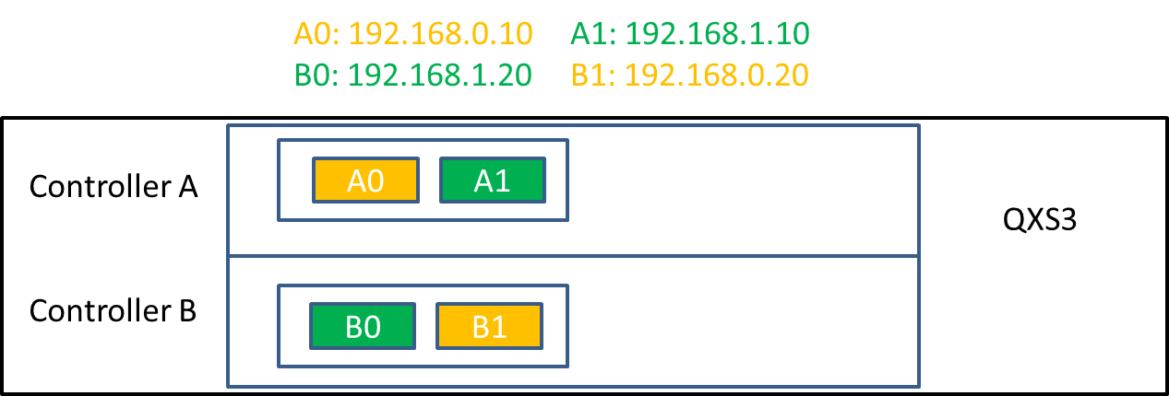
6.0.0 QXS Storage iSCSI Setup: Step 3
Setup QXS3 array controllers iSCSI ports with IP addresses
iscsiadm qxsarray address A0 192.168.0.10 255.255.255.0
iscsiadm qxsarray address A1 192.168.1.10 255.255.255.0
iscsiadm qxsarray address B0 192.168.1.20 255.255.255.0
iscsiadm qxsarray address B1 192.168.0.20 255.255.255.0

Slide 13
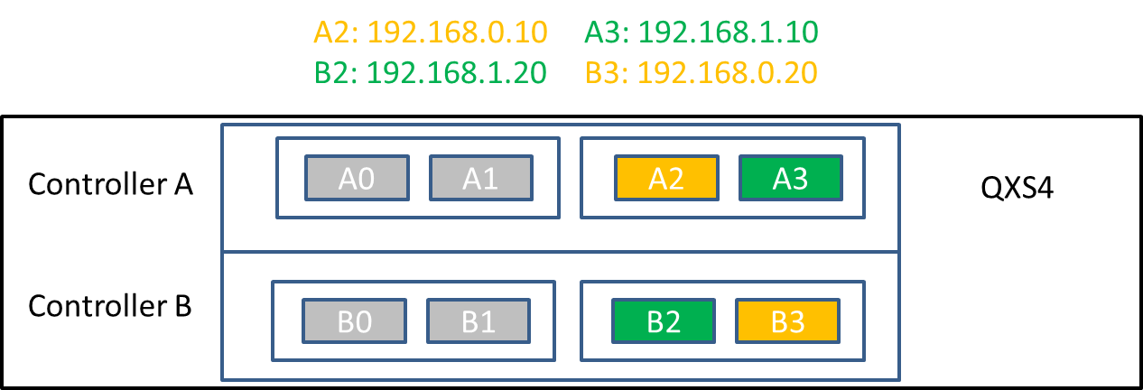
6.0.0 QXS Storage iSCSI Setup: Step 3
Setup QXS4 array controllers iSCSI ports with IP addresses
iscsiadm qxsarray address A2 192.168.0.10 255.255.255.0
iscsiadm qxsarray address A3 192.168.1.10 255.255.255.0
iscsiadm qxsarray address B2 192.168.1.20 255.255.255.0
iscsiadm qxsarray address B3 192.168.0.20 255.255.255.0

Slide 14
6.0.0 Xcellis iSCSI Setup: Step by Step
Configure Xcellis nodes iSCSI for accessing the QXS array (using panshell)
Assign 10GbE interfaces for iSCSI use
Configure iSCSI-assigned interfaces with IP address information, set their MTU to jumbo, and bring the interfaces up
Assign QXS array target addresses
Login to iSCSI sessions between Xcellis node and QXS array

Slide 15
6.0.0 Xcellis iSCSI Setup: Step 1
Assign 10GbE interfaces for iSCSI, using panshell command:
iscsiadm interfaces assign p3p1 p3p2
In this example, 10GbE NIC in slot 3 is assigned to iSCSI
Note that the 10GbE NIC in slot 3 interfaces must not have any IP address configuration on them at the time of this assignment
Note that the 10GbE NIC in slot 3 interfaces are assigned for “exclusive use” by iSCSI and will no longer be available for user networking configuration

Slide 16
6.0.0 Xcellis iSCSI Setup: Step 2
Configure iSCSI-assigned interfaces with IP address information, set their MTU to jumbo, and bring the interfaces up
iscsiadm network setup p3p1 192.168.0.100 255.255.255.0 jumbo
iscsiadm network setup p3p2 192.168.1.100 255.255.255.0 jumbo
iscsiadm network service start
At this point the QXS array target iSCSI-assigned ports IP addresses on the two subnets 192.168.0.0/24 and 192.168.1.0/24 shall become accessible to Xcellis node via either of the above two Xcellis interfaces (you may verify this outside panshell on Xcellis via pinging the QXS array iSCSI port IP addresses)

Slide 17
6.0.0 Xcellis iSCSI Setup: Step 3
Assign direct-attached QXS array target addresses
iscsiadm target address assign 192.168.0.10 192.168.1.20
Assuming QXS array port with 192.168.0.10 IP address is connected via cable to Xcellis node port with 192.168.0.100 IP address and assuming QXS array port with 192.168.1.20 IP address is connected via cable to Xcellis node port with 192.168.1.100 IP address
Note that if the wiring is incorrect, this step would return an error regarding inaccessibility of the QXS target address(es). In which case the cabling need to be checked, and likely connections need to be switched at one end (QXS or Xcellis) to correct it.
Assign switch-attached QXS array target addresses
iscsiadm target address assign 192.168.0.10 192.168.1.10 192.168.0.20 192.168.1.20
Note: All 4 QXS array ports IP addresses are visible to Xcellis node, due to switched connections, and are added as target addresses.

Slide 18
6.0.0 Xcellis iSCSI Setup: Step 4
Login to iSCSI sessions between Xcellis node and QXS array
iscsiadm sessions login
After this last step is executed successfully, the iSCSI setup is completed between the Xcellis node and QXS array
You can check the status of the iSCSI setup, via panshell command:
Iscsiadm status
This command returns “OK” if the iSCSI setup is in a working state
Iscsiadm show
This commands returns full details of the iSCSI setup
At this point you may exit the panshell and continue with the remaining system configuration steps as normal (create shared file system, etc.)

Slide 19
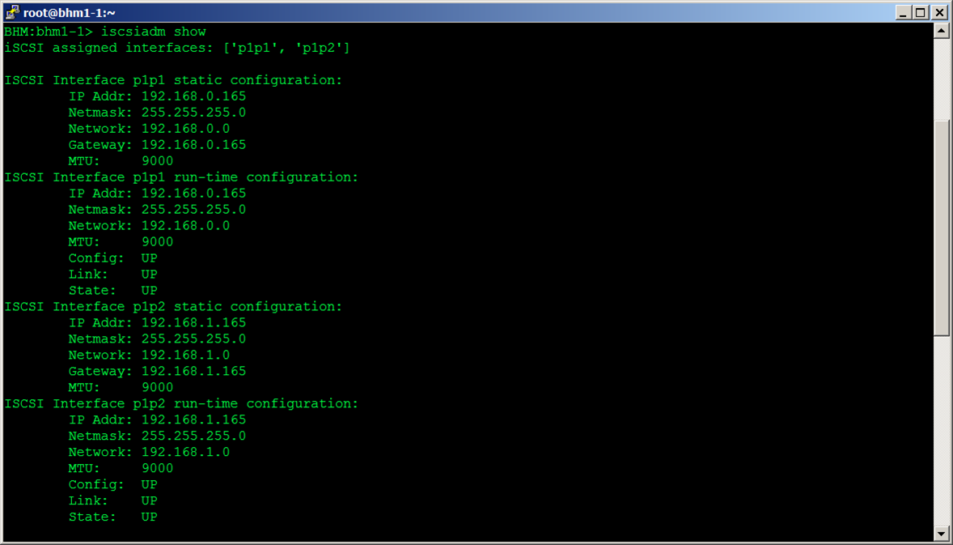
6.0.0 Xcellis iSCSI Setup: Example iscsiadm show (part 1)

Slide 20
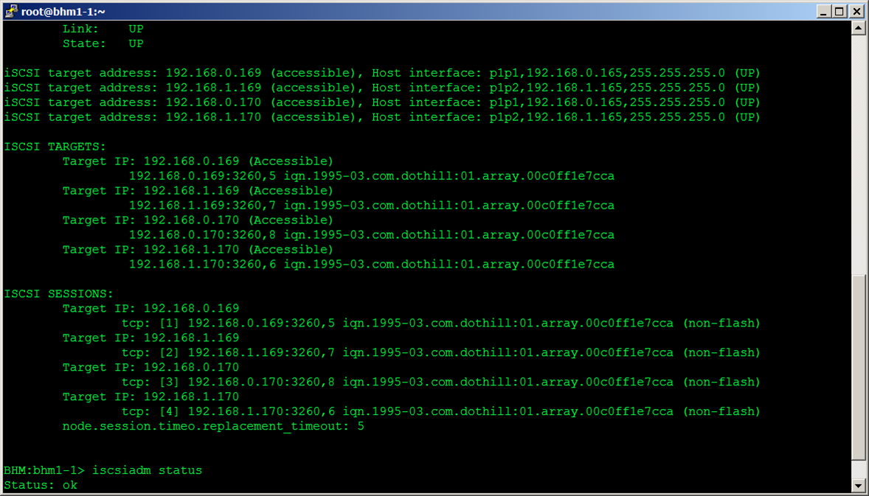
6.0.0 Xcellis iSCSI Setup: Example iscsiadm show (part 2)

Slide 21
6.0.0 iSCSI Cabling Models
There are 4 iSCSI cabling models:
Single-node Xcellis with direct-attached QXS array
Single-node Xcellis with switch-attached QXS array
Dual-node Xcellis with direct-attached QXS array
Dual-node Xcellis with switch-attached QXS array
Note: All the cabling needs to be in place before going through the software steps for QXS array and Xcellis node setups described in previous slides
Note: All iSCSI setups on QXS array and Xcellis node are identical for all these models, with the exception of:
The target assignments as described previously in “Xcellis iSCSI setup: Step 3” slide
The IP addresses used for QXS/Xcellis node interfaces for a specific setup

Slide 22
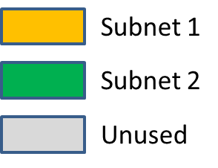
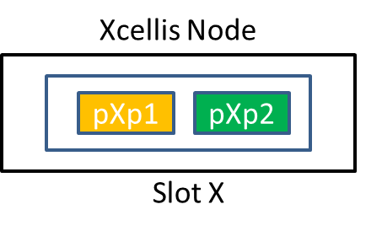
6.0.0 iSCSI Cabling Models: General Information
Throughout the rest of this presentation, the following diagrams with color-coded ports and cables for subnet 1 and subnet 2 will be used.

Slide 23
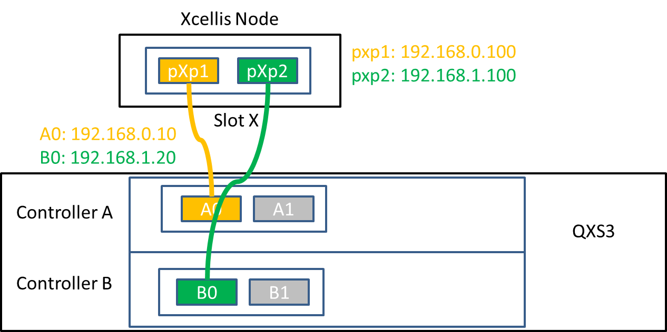
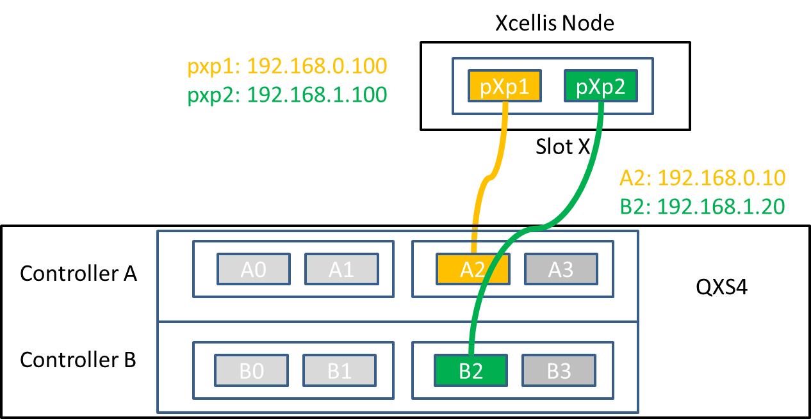
6.0.0 Single node Xcellis with direct-attached QXS array

Slide 24
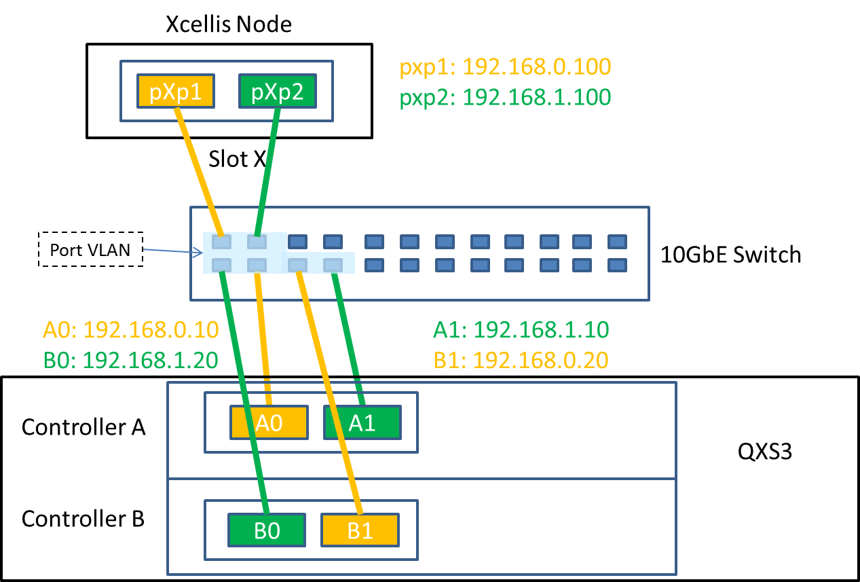
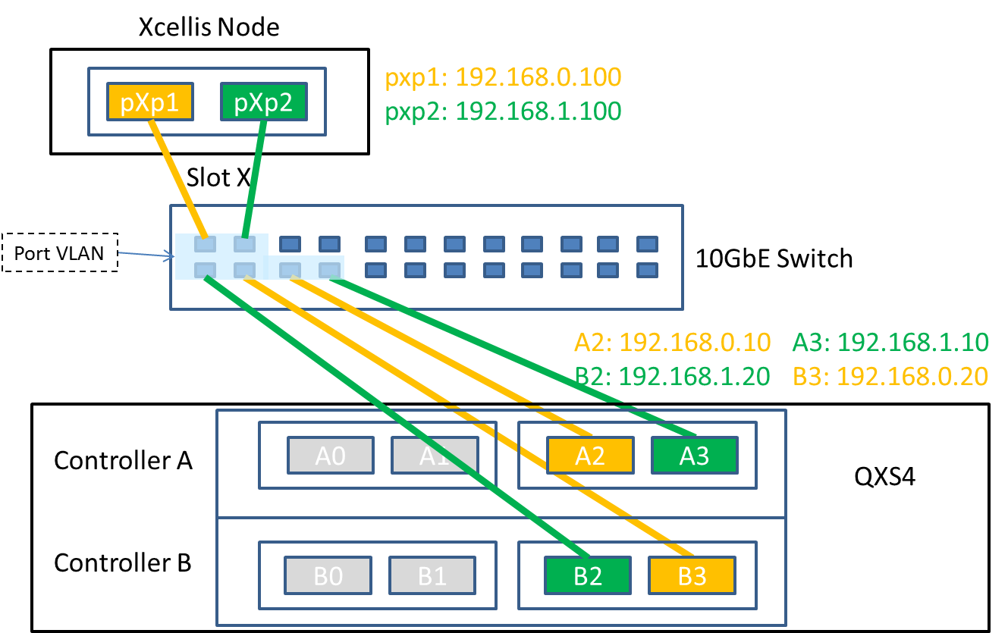
6.0.0 Single node Xcellis with switch-attached QXS array

Slide 25
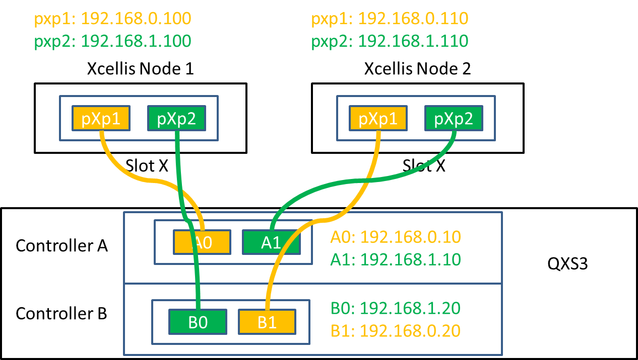
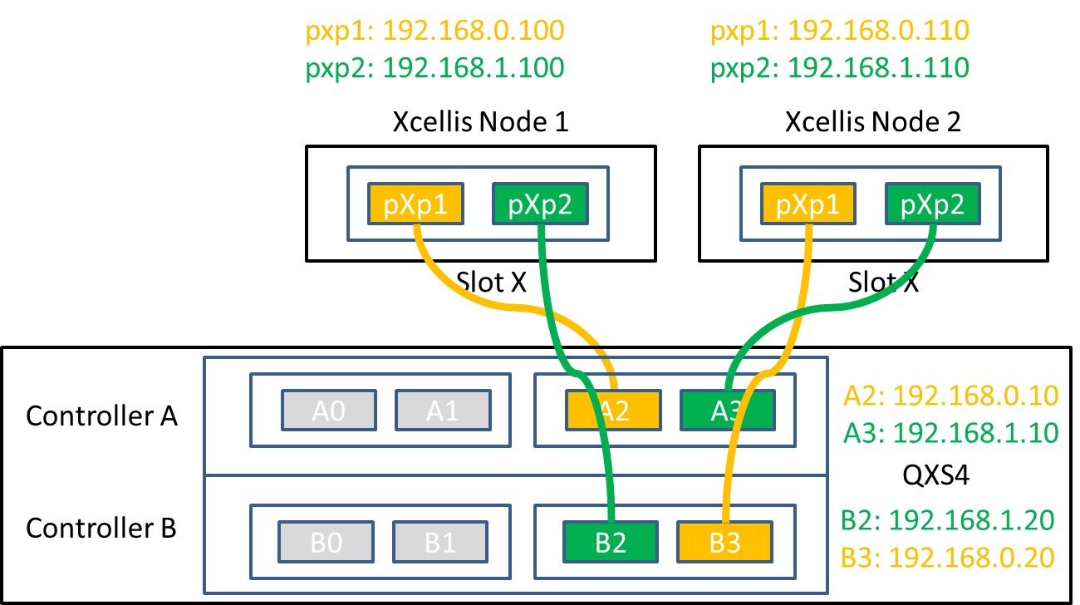
6.0.0 Dual node Xcellis with direct-attached QXS array

Slide 26
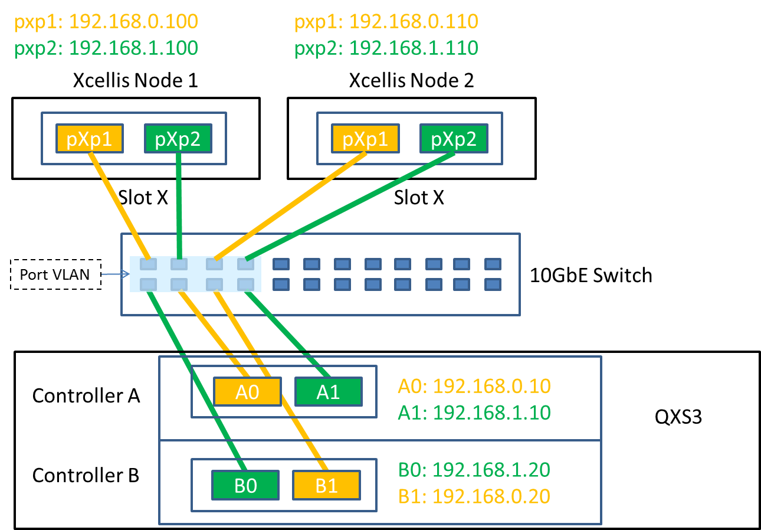
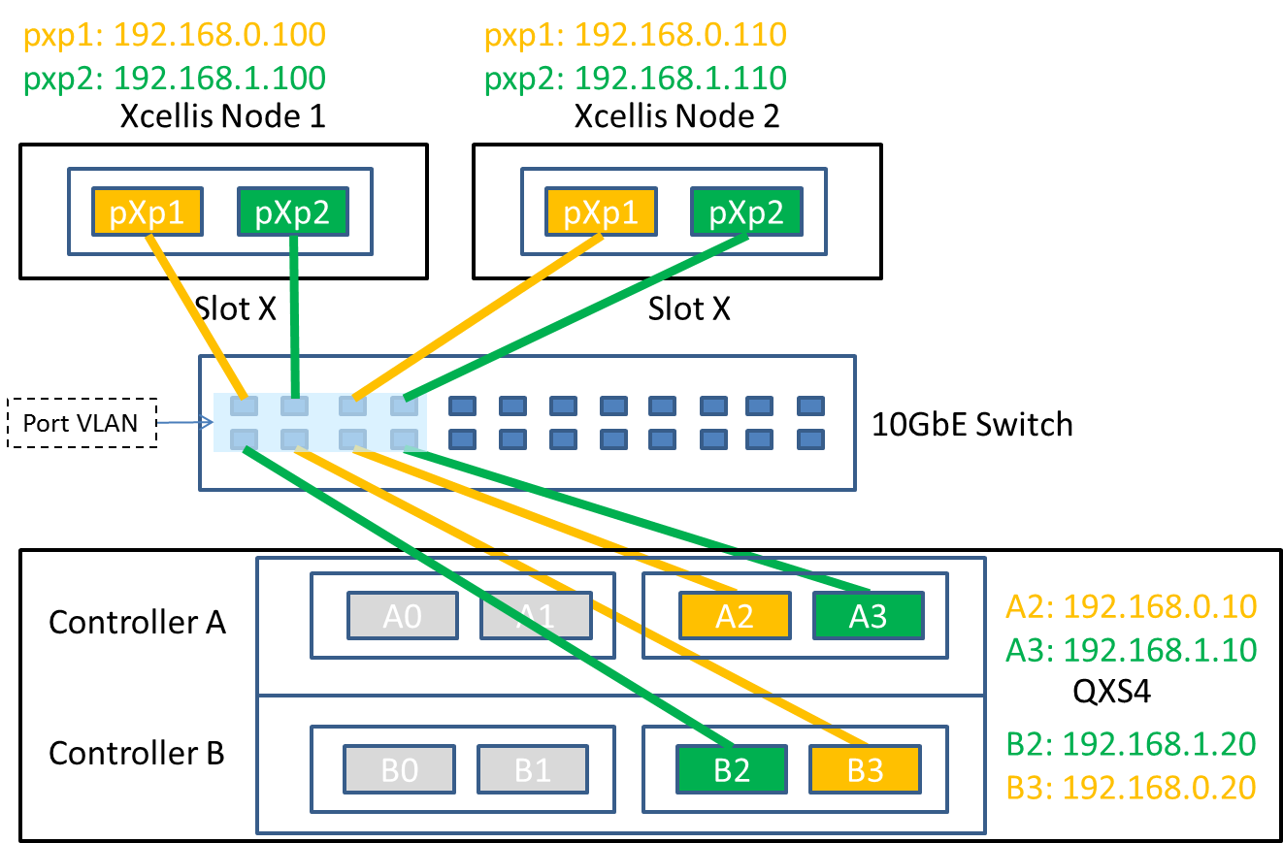
6.0.0 Dual node Xcellis with switch-attached QXS array

Slide 27
6.0.0 Platform iSCSI: Controller Panshell notes
For 6.0.0, Platform is using NAS controller menu instead of service menu for new iSCSI (and SNMP) configuration. Why?
Forward looking: Controller will be standalone and provide a single non-root CLI interface for configuration. (NAS will become a plugin.)
Provides a web service interface that Connect is already using.
StorNext Appliances iSCSI documentation is online.
http://qsupport.quantum.com/kb/Flare/Content/Sandbox/ACC_DocSite/iSCSI/iSCSI_About.htm
Configuration instructions and cabling diagrams.
Internal wiki for Controller iSCSI menu.
http://panwiki.quantum.com/index.php/Controller_Iscsiadm_Reference

Slide 28
6.0.0 Platform iSCSI: Panshell iscsiadm qxsarray notes
Iscsiadm ‘qxsarray’ commands support >1 array
Only one QXS array is supported for iSCSI in 6.0.0!
Express configuration with > 1 QXS iSCSI array may use ‘qxsarray’ commands to configure QXS array targets.
iscsiadm qxsarray address <qxs_port> <ipaddr> <netmask> [gateway=<ipaddr>, def_router=<ipaddr>] [<qxs_ipaddr>]
iscsiadm qxsarray set (ports_mode=(FC | FC-and-iSCSI | iSCSI ), jumbo=(yes | no), speed=(auto | 1gbps)) [<qxs_ipaddr>]
Benefit: A platform collect invokes ‘iscsiadm qxsarray show’ and lists QXS iSCSI array(s) configuration.

Slide 29
6.0.0 Platform iSCSI: Panshell iscsiadm qxsarray notes
‘Iscsiadm qxsarray set’ parameters cannot all be set all at once.
The QXS array controller reboots immediately when the host port mode is changed from FC to iSCSI (or vice versa)
iscsiadm qxsarray set ports_mode=FC-and-iSCSI
(response indicates wait a couple minutes…)
Iscsiadm qxsarray set jumbo=yes

Slide 30
6.0.0 Platform iSCSI: Conclusion
iSCSI: Xcellis as iSCSI initiator, QXS array as iSCSI target
Hardware requirements
How to setup iSCSI for QXS array and Xcellis node using controller iscsiadm commands
Models of cabling between Xcellis node and QXS array
Controller, panshell, and iscsiadm qxsarray notes
Fully detailed reference document: Platform iSCSI whitepaper
Q/A ?

