Slide 1
StorNext 5 Test Cycle Review
Ted Pogue
January 17, 2014

Slide 2
Notes:
We are making the presentation sessions available to a small group of team members via WebEx.
The main purpose of the presentations is to record the sessions for future use.
If you are attending a WebEx session, please keep your questions relevant to the purpose of the meeting, support of MySQL in SN 4.3.
If you do have questions and feedback about things outside the main focus you can either send them by email or give them to the presenters outside the class.

Slide 3
Overview
Review of coverage, criteria, and results
Hit the highlights, not a comprehensive review
Focus on file system and platform testing
Overall test results positive

Slide 4
DVT Entrance and Exit Criteria
DVT1 Entrance criteria
Relaxed to meet the 12/13 test complete date
Allowed development to complete necessary work while simultaneously starting DVT1 QA efforts
Slow ramp of resources
DVT1 Exit Criteria
The following DVT1 exit criteria was not met due to the slow initial ramp of resources and some key bug fixes that required significant retest.
95% Test execution – 74% achieved
80% Tests Passing - ~90% passing
DVT2 Entrance Criteria
DVT2 entrance criteria were relaxed to continue driving towards the release date
DVT1 exit criteria was only partially met
Critical test blocker bugs resolved by development – 2 remained open
DVT2 Exit Criteria
DVT2 exit criteria were met
99% Test execution
95% Tests Passing

Slide 5
Final DVT Exit (Release) Criteria
Final DVT exit criteria were partially met (4 criticals deferred)
Successful completion of Maturity test
All QA bugs verified
4 critical bugs were deferred based on management decision
Bug 45763 - Storage Manager Component f.685:1:sdisk1 : A Checksum error has occurred
Turned out to be an issue with old FC HBA Firmware
Bug 45715 - Data corruption was seen on LAN client running Vdbench
Very difficult to hit replication/deduplication issue
Duplicate of 4.3.3 filed Bug 46191- snpolicy retrieval race can cause client to read zeros in file
Problem present since 4.0.0. Hasn’t been customer reported to date.
Resolved in 5.0.1
Bug 46089 - PANIC: /usr/cvfs/bin/fsm "bt_merge_and_free failed" file sn/snfs/fsm/alloc_btree.c, line 835
Only saw this once and have been unable to reproduce since.
Bug 46108 - PANIC: /usr/cvfs/bin/fsm ASSERT failed "ext.idiext_frblock >= next_frblock" file
This is not a regression
Seen when running FSX test
Issue is overlapping extents (frblocks)
cvfsck resolves the issue in SN5
Resolved in 5.0.1

Slide 6
Deferred Testing
Some testing was deferred to SN 5.0.1 to meet schedule
Windows MDC
Some Xsan testing
Windows MDC with Xsan client
Xsan MDC with FX client
MAS Agent
Lattus
Timing of Lattus 3.3.1 release
Completed Lattus-X/Lattus-M on 1/9/14

Slide 7
Configurations
Scalability
Gigafiles – 1+ billion managed files
Sagan – New for SN 5 – 5 billion unmanaged files
Performance, includes SSD
Fragmentation
Storage Manager
Sntest Automation
Platform
VMware

Slide 8
OS Coverage
Each tester used a mix in their testing
Tested install/upgrade – SN 4.3.2, 4.3.3, 4.7, 4.7.0.1, 5
Tested with back rev clients
Extensive testing with multipathd
Saw minimal OS specific issues
Linux
SLES 11, RHEL5, RHEL6, Centos5, Centos6
MDC and client
Various service packs
SNTest covers Linux only currently
Windows
7, 2008, 8, 2012R1
Windows MDC some testing, not full regression
Platform
M660, M662, M440, M330, G301, G301
Performed by SN QA and Platform QA teams
M662 commonly used as MDC for various clients
Xsan
Tested as client to Linux MDC
Umami, 3.0, 2.3, 2.2
Unix – Solaris 10 & 11, HPUX, AIX

Slide 9
Platform Test Upgrade Matrix

Slide 10
SNTest Automation Code Coverage
SNTest has two types of code coverage which overlap
Development integration code coverage – minimum set of tests
Run against all branch checkins
Does not cover GUI
Function coverage increased from 28% (SN 4.7) to 49% (SN 5).
Condition/Decision coverage increased from 22% (SN 4.7) to 28% (SN 5).
DVT Automation code coverage
Automation was run weekly
Does not cover GUI
Cumulatively executed 1457 test suites, 1296 test suites passed, 5953 machine hours were used and 42 regression bugs were generated
Function coverage increased from 49% (SN 4.3.3) to 59% (SN 5).
Condition/Decision coverage increased from 29% (SN4.3.3) to SN 5 38% (SN 5).
Definitions
Function coverage – subroutine function entered
Condition/Decision – if, then, else, etc.

Slide 11
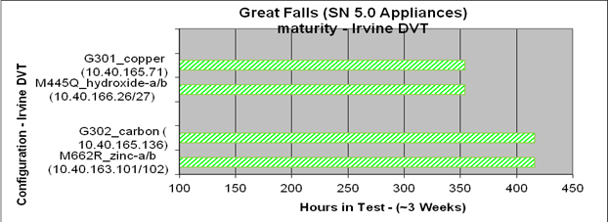
Platform Test Results
DVT Results
Total Tests Executed – 221
Pass 220
Fail 1
All high priority bugs resolved
Stability Maturity Results
Maturity test started 11/25/13 and ended on 12/13/13
The M662R system was installed with SN 4.7 and i/o run for 3 days then upgraded to the latest SN 5

Slide 12
File System Test Highlights
Created ~588 new tests, including:
Metadata Upgrade
Didn’t observe performance hit during conversion
SNtest performed many conversions with customer metadata
Tested upgrades with ACLs, quotas, xattrs, affinities, corrupt fs, fault injection during conversion, small inode
4K blocksize - Data integrity after conversion, many starting block sizes
Creation and restore of metadump
Cvfsck – recovery after fault injection
Journaling – replay and resizing
New Buffer Cache
Btree
New Allocator – File system aging, stripe alignment
Affinities – auto affinities, affinity preference
Fragmentation – Vidio, file system space test
New File System specific tests
fslt - file system load test
fslst - file system ls test
fsfst - file system file synchronization (consistency) test

Slide 13
Other Test Highlights
Replication/Deduplication
HA environment
Replication with TSM Policy as source and target
New blockpool 3.8 was tested
Back-rev source and target were tested (SN 4.3.3 and 4.7)
Upgrade from SN 4.3.3 and 4.7 to SN 5 tested
Replication with 30M files and 2M directories
Part of Maturity Test
Memory usage
Noticed increased overall memory usage
Profiling/quantifying memory usage changes in SN 5.0.1 versus 4.7
Fragmentation
Overall looked good
Still working allocator changes in SN 5.0.1 for specific cases
Snfsdefrag struggles to do its work in nearly full FS cases

Slide 14
Scalability
Action | Definition | SN 4.3.3 Result | SN 5 Result
Carl Sagan
File creation | files/second | N/A | 6400
Metadump rebuild | elapsed hh:mm | N/A | 35:53
Restore from metadump | elapsed hh:mm | N/A | 88:54
cvfsck | elapsed hh:mm | N/A | 6:40
Gigafiles
TSM rebuild policy | elapsed hh:mm | 17:15 | 13:05
Full snbackup | elapsed hh:mm | 135:52 | 12:45
Partial snbackup | elapsed hh:mm | 88:38 | 5:51
Clean versions | elapsed hh:mm | 3:00 | 3:32
cvfsck | elapsed hh:mm | 76:05 | 4:42
Metadump rebuild | elapsed hh:mm | 8:58 | 27+ hours*
Upgrade metadata | elapsed hh:mm | N/A | 92:23
Upgrade MySQL schema | elapsed hh:mm | N/A | 35:33
File creation | files/second | 800 | 1400
Store to sdisk | files/second | 274 | 300
Size of metadump | bytes | 1.235 trillion | 476+ billion
* SN 5 rebuild occurs in the background without downtime as in SN 4.x

Slide 15
Maturity Test
The primary goal of the Maturity Test is to monitor performance of the product within a complex system configuration over time and under a continuous load that would be representative of a customer workflow. The product is monitored for memory usage, data integrity, disk and resource consumption, and fragmentation while the systems are populated with test data.
The StorNext 5 Maturity Test bed was run informally for the entirety of DVT2 with weekly updates to the latest interim build.
The StorNext 5 Maturity Test was formally started on 11/25/2013 with RC1 build 39009.
The Test met its goal on 12/9 of 5 days contiguous and 10 days total running time with 3 days of reset for upgrades. At that time, failovers under load were successfully performed as specified in the Test Plan. The test continued until 12/16 when the Lattus WAS storage system was taken down for upgrade.
Total file ingest via Replication/Storage Manager: 2119950, via Windows: 228492

Slide 16
Summary Metrics
SN5 Metrics Summary
Test Type | Percent Run | Percent Pass | Percent Fail | Total | Run | Pass | Fail | Defer
SNTest Automation | 100% | 98% | 2% | 173 | 173 | 169 | 4 | 0
StorTest Manual | 82%* | 98% | 2% | 1923 | 1568 | 1544 | 24 | 355
Platform | 100% | 99.5% | 0.5% | 221 | 221 | 220 | 1 | 0
Total | 85%* | 99% | 1% | 2317 | 1962 | 1933 | 29 | 355
*100% of non-deferred test cases were run. These percentages include deferred test cases.

Slide 17
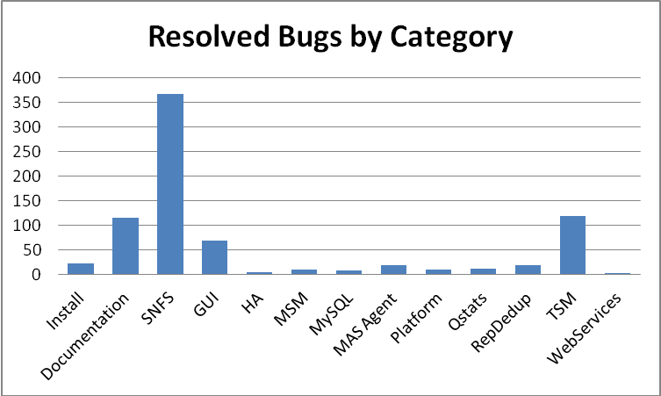
Defect Breakdown
Unsurprisingly, the majority of the bugs were in the core SNFS category.

Slide 18
Summary
DVT entrance and exit criteria were relaxed in the interest of meeting the release
First run testing continued through DVT2 and resulting bug discovery rates remained high until the end of DVT2
Significant development help was required to complete all bug verifications prior to release.
Some non-critical areas of concern were deferred for further analysis to 5.0.1, including:
Memory usage
Fragmentation
4 critical bugs were deferred that were either not regressions or had an expected HW RCA
SN5 met final release criteria (except 4 critical bugs deferred) and some significant milestones
98% pass rate overall of 1962 total test cases/suites run.
The goals established in the PRD were generally met and verified
Performance for backups showed significant improvement over SN 4.3.3
Test was able to scale up to 5 Billion files per single MDC.
Sntest automation code coverage increased significantly
Function coverage increased from 49% to 59%.
Condition/Decision coverage increased from 29% to 38%

