Slide 1
StorNext 5
QA Overview
Lynn Wasson
January 17, 2014

Slide 2
Notes:
We are making the presentation sessions available to a small group of team members via WebEx.
The main purpose of the presentations is to record the sessions for future use.
If you are attending a WebEx session, please keep your questions relevant to the purpose of the meeting, support of MySQL in SN 4.3.
If you do have questions and feedback about things outside the main focus you can either send them by email or give them to the presenters outside the class.

Slide 3
Warnings
Standard Text From Neil

Slide 4
StorNext Quality
New behaviors for increased quality
Test /Dev meetings to flush out feature and area testing
Larger more complex configurations
Developed metrics to provide additional focus on
Bug activity
Test case execution
Added staffing to focus on areas of change
Quality Improvement is a cross-functional effort

Slide 5
Wiki Site and Site Information
SN 5 Wiki
http://dxwiki.quantum.com/dxwiki/StorNext_Parker
QA information centralized
Test plans/report
Bug Queries
High-level metrics

Slide 6
Test Processes / Documentation
Test Planning
Requirements-based test approach (PRD)
Test Strategy Doc
Test Plan
Project Test Case Execution Rate
Test Status
Weekly detailed Test Report to Engineering
Weekly status to StorNext Core Team
Weekly Test Case and Bug Metrics
Traceability Matrix on wiki (TRM)
Final Test Report
Bug Dispositions
Bi-weekly bug scrubs (StorNext & Platform)
Bug queries, reports, verifications

Slide 7
Details about test schedule and effort
Test Areas
What was tested
Larger more complex configurations
Testing with multiple features / functions running concurrently
More complex replication / deduplication policies
New features
Targeted regression testing
Testing at PPO
What was not tested
Windows MDC
MAS Agent
Partial XSan and FX
Lattus compatibility testing with 3.3.1 was completed on 1/9
Test Schedule & Resources
Duration 22 calendar weeks (7/2 – 12/13 )
Effort 221 person days (12 testers)

Slide 8
Test Automation
Investment in automation provides high returns
40% increase in test suites
Significant increase in machine hours
Metrics from the last SN5 run:
173 Test Suites Executed
98% Pass Rate
685.7 Machine hours for a single run
Tests run continuously against all 40 release branches
SN 3.5.0 through SN 5
VMWare capacity expected to double in the next year

Slide 9
Other Interesting Automation Metrics
Specific Counts
722,714 StorNext nodes have been deployed
1,255,309 SCSI LUNs have been created
Totaling 7825 petabytes of provisioned StorNext space
20,363 tape libraries provisioned
7,322,414 commands executed
Customer Data Testing
Conversion in SN 5 has been tested 5042 times against several dozen different customer file systems
Metadump restore has been tested 1634 times against customer file systems
Code Coverage
28% Functional code coverage
22% Conditional coverage

Slide 10
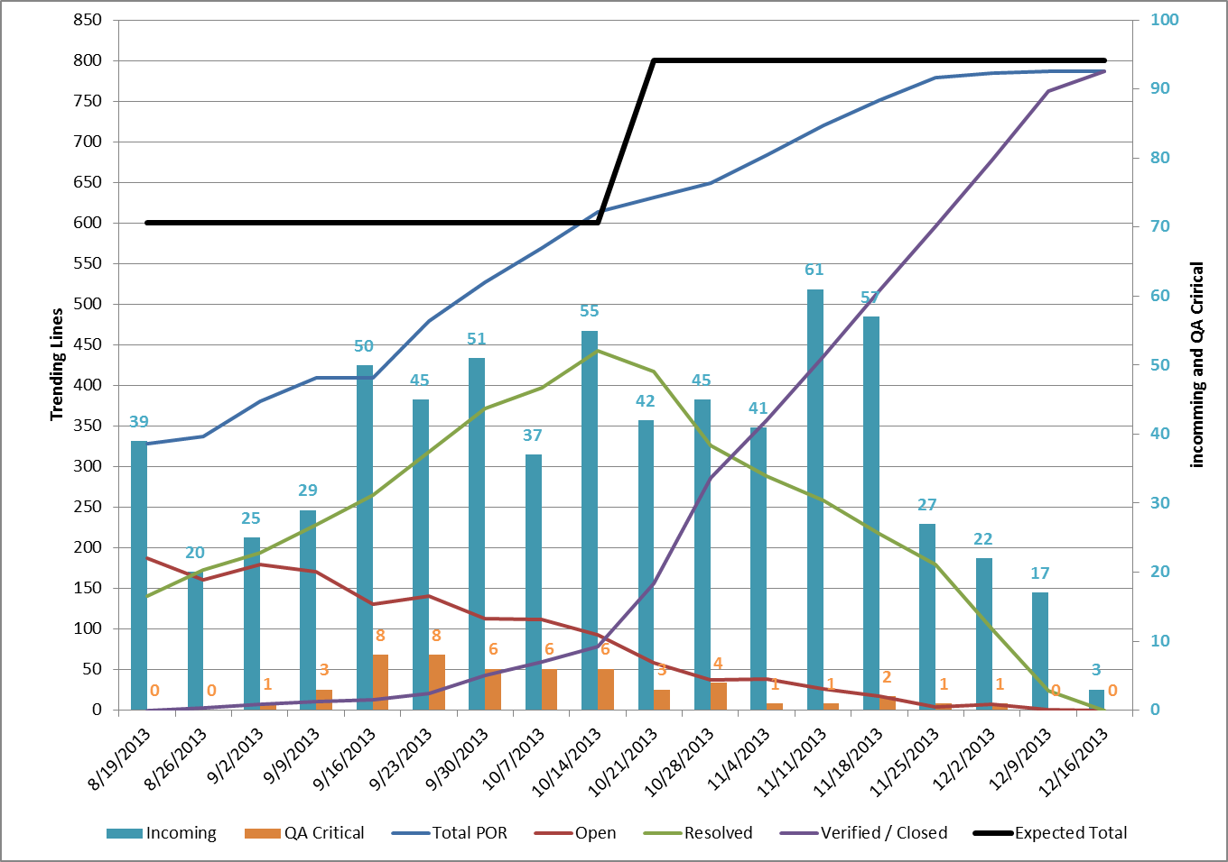
SN 5 Bugs
Total Product Defects
878 Opened
Total Bugs Fixed
787 Verified
Breakout
SNFS 368
TSM 120
Docs 115
GUI 70
Install 23
MSM 11
Misc. 80

Slide 11
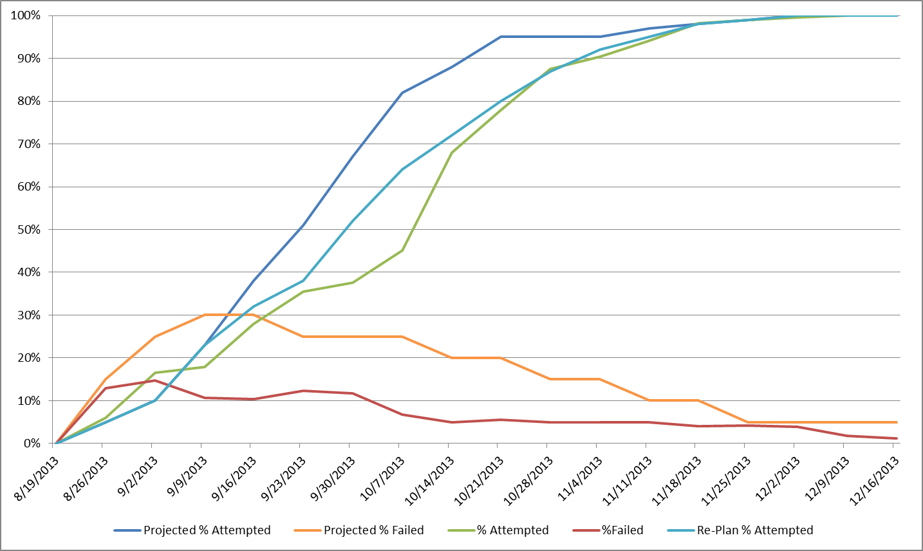
SN 5 Manual Test Metrics
1923 Manual Test Cases Executed
1544 Passed
24 Failed
355 Deferred

