Slide 1
StorNext 5 TOI
GUI Update
Paal Olsen
Ani Bhattacharya
21 January 2014

Slide 2
Notes:
We are making the presentation sessions available to a small group of team members via WebEx.
The main purpose of the presentations is to record the sessions for future use.
If you are attending a WebEx session, please keep your questions relevant to the purpose of the meeting, support of MySQL in SN 4.3.
If you do have questions and feedback about things outside the main focus you can either send them by email or give them to the presenters outside the class.

Slide 3
StorNext 5 TOI GUI Agenda
File System
Configuration Parameters
Auto-Affinities
Storage Manager / Library Maintenance
Archive Compare utility
Device Path updates without TSM restart
LTFS Support
Tape Media Import with multi-slot CAP
Reports
StorNext Metrics
Replication Progress
Misc.
Q & A and Live Demo of Replication Progress Report

Slide 4
StorNext 5 GUI File System
Configuration Parameters
Removed obsolete or hidden SNFS configuration parameters
fsBlockSize (now fixed at 4K for new file systems)
maxConnections
threadPoolSize
dataMigrationThreadPoolSize
restoreJournal
dirWarp
‘Average Files Per Directory’ selection for new file systems
fsBlockSize calculation no longer needed with fixed 4K
Metadump
Removed from File System Actions pull-down
Removed from File System create sequence

Slide 5
StorNext 5 GUI File System cont.
Allocation
Auto Affinities
Designate the affinity (stripe group[s]) to which allocations will be targeted for all files on this file system whose name has the specified file extension.
Each unique file extension can be targeted at only one affinity. However, each affinity may serve as the allocation target for more than one file extension.
Use the file extension * (asterisk) to indicate "all other" file extensions that are not explicitly listed.
File extension is case in-sensitive (e.g. mp4 == MP4).
Affinity Preference
If checked, permits files of a particular affinity to have their allocations placed on other available stripe groups (with non-exclusive affinities) when the stripe groups of their assigned affinity do not have sufficient space. Otherwise, allocation attempts will fail with an out-of-space error.

Slide 6
StorNext 5 GUI File System Auto-Affinities

Slide 7
StorNext 5 GUI Library Maintenance
Archive Compare
The primary purpose of this utility is to update Storage Manager's configuration after an archive has had tape drive maintenance performed such as a tape drive replacement
GUI wraps SM cli utility /usr/adic/MSM/util/archive_cmp
Verifies that the MSM tape drive configuration matches TSM’s
Verifies that configured tape drives still exist within the actual archive
Ignores tape drives configured within a vault
Report Mode
list any discrepancies, no database updates performed
Update Mode
Sync MSM with archive information if discrepancies found
Update any misconfigured tape drive device paths within TSM
Drive Replacement
Delete or replace orphaned (in TSM, but not in archive) drives
Replaced drives maintain the SM drive id (useful for drive pools)
DDM updated if replaced drive was configured for DDM

Slide 8
StorNext 5 GUI Archive Compare

Slide 9
StorNext 5 GUI Drives Validation Update

Slide 10
StorNext 5 GUI Drive Replacement

Slide 11
StorNext 5 GUI Archive Compare Log File

Slide 12
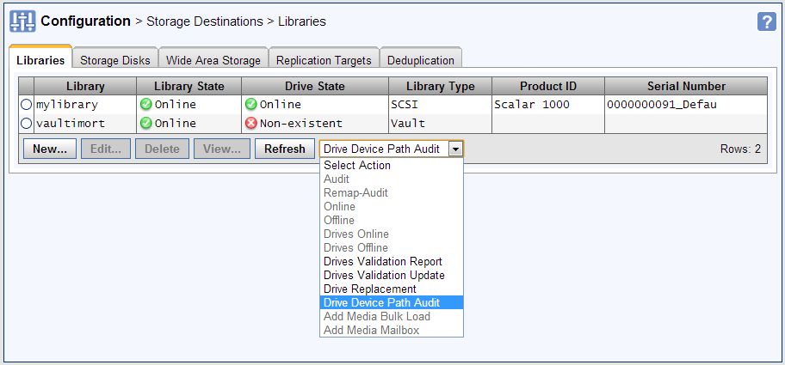
StorNext 5 GUI /dev/sg Device Path Audit
Update /dev/sg device path without a restart of TSM
GUI executes ‘fsconfig –m –h componentID –v <newdevpath>’
Audit individual or all configured archives
Reports > Jobs > View
The device path has been reset for the following devices: [ADIC000092]
Automatically done when setting a drive online

Slide 13
StorNext 5 GUI LTFS Media Format
ANTF Media Format
Quantum internal media format (Adic Native Tape Format)
Single partition
LTFS Media Format
Open source media format (Linear Tape File System)
Two partitions (‘index’ for LTFS metadata and ‘data’ for SN data)
Only applicable to LTO media generation 5 and beyond
Any attempt to assign to non-LTO media will result in an error
Any attempt to assign to _adic_backup will result in an error
LTFS Media Format GUI support
Storage Manager Policy Management and Reports
Media Actions > Transcribe Media
File Actions > Store Files
File Actions > Move Files

Slide 14
StorNext 5 GUI LTFS Policy Steering

Slide 15
StorNext 5 GUI LTFS Policy Steering cont.

Slide 16
StorNext 5 GUI Policy View

Slide 17
StorNext 5 GUI Add Media with multi-slot CAP

Slide 18
StorNext 5 GUI Reports
Reports > StorNext Metrics
Port of ‘Advanced Reporting’ “3rdparty” Quantum tool
Tools > Advanced Reporting link removed from SN GUI
DART and Apache packages removed from Metadata appliances
Available on all flavors of StorNext (RYO, Appliances, A10)
Advanced Reporting was only available on Appliances and RH RYO
Displays Ethernet, Fibre, CPU, Memory and File System metrics
30 Days of data stored in MySQL sn_metrics db
REST web-service interface
‘bart’ collector runs on the MDC (primary node only on HA systems)
bart is managed by DSM_control start|stop
root 62100 1 0 Jan15 pts/0 00:00:02 /usr/cvfs/bin/bart
/usr/cvfs/config/bart.conf config file
# How many seconds between samples
interval 60
Will eventually be moved to MINT along with Gateway Metrics report

Slide 19
StorNext 5 GUI StorNext Metrics Report

Slide 20
StorNext 5 GUI StorNext Metrics Report cont.

Slide 21
StorNext 5 GUI Reports cont.
Replication Progress Report
Replication has been somewhat of a black-box, especially in GUI
New report displays state and stage metrics for active policies
Tools > Reports > Replication/Deduplication > Policy > Summary

Slide 22
StorNext 5 GUI Replication Progress Report

Slide 23
StorNext 5 GUI Replication Progress Report

Slide 24
StorNext 5 GUI RAS
Delete RAS Tickets
Permanently delete RAS tickets and event details from MySQL
Prior to SN 5, had to be done manually to clean up database
Delete individual or filtered tickets
Filter tickets by priority, component, event and date

Slide 25
StorNext 5 GUI Delete RAS Tickets

Slide 26
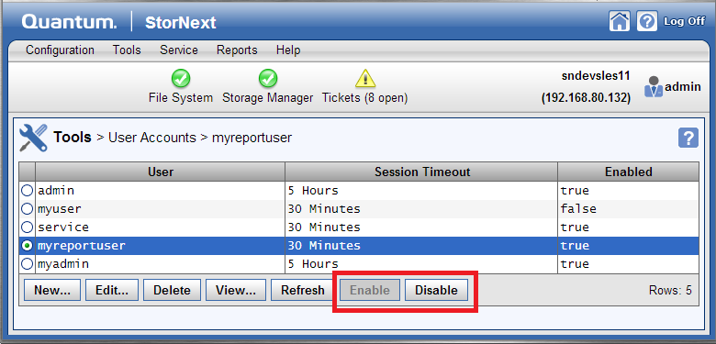
StorNext 5 GUI Security & Legal
Disable/Re-enable GUI logins
Including admin and service users
Requires ‘Admin : Manage Users’ Access Control

Slide 27
StorNext 5 GUI Security & Legal cont.
GUI EULA acceptance
Prior to SN 5, only required for Metadata Appliance installs
Required for all flavors of SN (RYO, Appliance, A10) installs
Required after any software upgrade if the EULA was updated

Slide 28
StorNext 5 GUI EULA Acceptance

Slide 29
StorNext 5 GUI TOI
Q & A
Live Demo of Replication Progress Report

