Slide 1
Allocator Changes for 5.0
Jim Mostek
January 6th, 2014

Slide 2
Notes:
We are making the presentation sessions available to a small group of team members via WebEx.
The main purpose of the presentations is to record the sessions for future use.
If you are attending a WebEx session, please keep your questions relevant to the purpose of the meeting, support of MySQL in SN 4.3.
If you do have questions and feedback about things outside the main focus you can either send them by email or give them to the presenters outside the class.

Slide 3
Agenda
What problems were we trying to solve?
What was changed to solve the problems?
How was Allocation Session Reservation changed?
New features for affinities:
Auto Affinities and Affinity Preference
Future work … we aren’t done yet!

Slide 4
What problems were we trying to solve?
Bitmaps didn’t scale.
Block based allocation was very difficult so not done.
Allocations used the SG of the first extent (if any).
Then, did “best fit” using requested size.
Allocation were all single threaded.
Free space fragmentation a nightmare.
Too much to track, just in memory.

Slide 5
Bitmaps don’t scale.
One bit per block on disk so need in-memory trees
Read whole space map on startup to build two trees per SG
Splay (block based) and red-black tree (size based)
Expensive to update bitmap from transactions
Much I/O for bigger chunks.
Doesn’t scale - tell customers (increase block size)
Led to expensive and large metadata
Memory footprint too big, ignore/forget free space.
ignore many free chunks if fragmentation was too great! ABMfreelimit …
When free space is ignored, coalescing can’t happen.
Internal development FS -- ignoring 25% or more!
Some customers are in this bucket, too.
Upgrade to 5.0 may show more free space for some customers!
Notes:
Search for a run of bits? Flip bits when alloc or free.
ABMfreelimit
Start ignoring some at 100,000 free space pieces.

Slide 6
Slice & Dice Free Space!

Slide 7
Use new btrees instead of bitmaps.
Each SG split into slices.
Slices and provide scalability – one tree could be too big.
Need to have potentially many slices to scale.
Mapping tree of slices – one per SG.
Map slice index -> inode holding btree.
Slice configuration:
Slice size: try 64GB for MD or 128GB for Data.
Require at least 8 slices per SG – for concurrency.
Try to limit to 512 slices – more manageability.
But a slice can’t be larger than 4,294,967,295 (4+ billion) blocks.
With 4k blocks, that’s 16 TBs max size per slice.
512 slices @ 16 TB is 8 Petabytes (for a SG)
Slices also provide concurrency.
Multiple threads can allocate concurrently.
Allocates and frees can operate independently, too.
Also, files/sessions can be kept separate (using slices).

Slide 8
Each slice has one btree.
Elements in the slice are of two types:
SNBT_PAYLOAD_BLOCK
SNBT_PAYLOAD_SIZE
64bit key
Type: BLOCK – 32 bit block # and 32 bit size
Type: SIZE – 32 bit size and 32 bit block #
2 entries per free chunk.
At cvmkfs time, all slices have 1 chunk so 2 entries in each btree.
64bit block
8 bits for Type.
Rest contains SG and actual block # (47 bits)
140,737,488,355,327 –> 128 TB -- block #
Limits SG to 524,288 TB (largest possible metadata SG)
Payload is empty
Notes:
Why the two keys? SIZE and BLOCK
SIZE to do best fit search.
BLOCK to find neighbors when freeing.
BLOCK also used to do block based allocation.

Slide 9
Stripe group 0 – small MD SG.
Notes:
New partition table entry (using cvfsdb).

Slide 10
Inode holding mapping to slice inodes
Notes:
Inode mapping table using btree. Used to map slice # to inode # holding btree.

Slide 11
One slice with all space free.
Notes:
Leaf of slice tree (inside inode since so small).
For brevity, just have one free space chunk.
9 is BLOCK and 10 is SIZE.

Slide 12
Space Metadata linkage

Slide 13
One slice with 3 free space chunks.
Notes:
For Brevity just have 3 chunks, … trees can hold millions of chunks.
One example, 11 TB SG, very fragmented, with 130 slices.
1.3 million free space chunks.
Just over 10,000 btree entries (5,000) chunks.
This results in about 160 btree blocks for each slice.
Root points to 1 node. Node points to 158 or so leaves.

Slide 14
Btree growth
When splitting a btree:
Look in the parent node for the largest block #.
Pass to the allocator (block based allocation).
Put the “higher” content into the new, likely larger block.
This causes trees to mostly move up in block #’s.
As btrees grow, leafs split randomly.
The previous version would grow mostly down.
The smallest logical blocks wound up rightmost in the tree, towards the end of the extent space.
The reverse is now true in 5.0.
Read-ahead and RAID cache then helps more when scanning a tree.

Slide 15
Metadata space trees: within!
How do MD trees, themselves, grow/shrink?
When a metadata slice tree grows (doing insert):
We are adding more free space to it (and splitting!).
There must be a free block in the cached “handle”
Steal one (or more) and just use it.
When done doing the insert of free space, just fix it.
This does a block/size remove of block(s) used.
When a metadata slice tree shrinks (doing remove):
Remember the block(s).
When done doing the remove of free space, just fix it.
This does a block/size insert.
More than this but … no extra metadata!

Slide 16
Challenges with slices
Slices add a level of complexity
How do we pick a slice?
What is the best piece across all slices?
Extents can cover multiple slices.
Potential locking problems between slices:
use trylock and handle EBUSY.
Track “biggest chunk” per slice …
Search for the first OK slice: use request size to search.
Initial design distributed allocations across the slices.
Performance showed too much seek time.
Final design minimizes moving to a new slice.
Aged file system, though, uses all slices.

Slide 17
Allocator Algorithms

Slide 18
Allocation path
How must we allocate to a file?
must probe for existing extents.
If one found, return it.
Need to make sure previous/next extent don’t overlap space to allocate.
Automatic expansion and alignment.
If allocation at EOF:
Try to stripe align big requests
Try to expand request size as files grow
Retries if no space.
New system may retry if slices are BUSY – rare.
Not much changed here in 5.0.

Slide 19
Inodes contain extents as btree payload
Use new btree to store extents.
Rework/redesign allocation path in the fsm.
Always look for existing space first
RETAIN btree state and cached blocks and use later.
Allocation path is primed with extent tree information.
Easily/quickly have left (or right) neighbor.
Leverage this to attempt block based allocation.
Backwards allocations implemented and work some of the time.
Extents are stored in file location order.

Slide 20
Allocation Strategies
Specified in the config file.
Round Robin, Fill, and Balance.
how to select a SG for an allocation?
Round Robin – oldest (from alloc perspective). default
Fill – fullest.
Balance – emptiest.
Nothing changed externally with this.
Completely redone internally, however.
Sorting and selecting SGs now scales
Old design used arrays and would visit all SGs (in many cases).
The same mechanisms used when affinities are involved.
Metadata and Data are typically separate.
Now we need to pick a slice after we pick a SG.
Some long standing bugs fixed.

Slide 21
Allocation Flow (Data allocation) ASR off
Call allocator with requested size (after expand/…).
Pick SG based on affinity, strategy, or existing neighbor.
Pick slice within SG.
Locality or block based may specify first SG and slice to try.
Search for piece using previous btree state (if any).
Possibly clip the piece for alignment.
Return any piece(s) left from free chunk.
Update counts and insert new extent.
Return space to client.

Slide 22
Allocation Flow (Data allocation) ASR on
Call allocator with requested size (after expand/…).
Map size/file/offset/affinity to a session.
If no session, create or steal a session.
Get helper inode from the session.
If helper empty, call allocator to get a new chunk.
See previous slide for what happens there.
Move space from the helper to the user’s inode.
Update counts.
Return space.

Slide 23
Bulk create with allocations
Multiple files and allocates in ONE Transaction.
The transaction may lock many different slices.
Operation must be atomic:
Either all files and allocates succeed or fail.
Locking of multiple slices can cause deadlock.
A->B B->A -- Between other allocations or other bulk creates.
Semantics do not guarantee all allocates work.
Can even have partial allocation for one of the files.
Can have 0 space allocated to one or more files.
Used lack of guarantee to avoid deadlock without failure.
Allocations may not happen or happen partly.
At least one allocation must succeed for contention. Need slice locked.
Races causing missed allocations are rare.

Slide 24
Allocation Session Reservation

Slide 25
Allocation Session Reservation (ASR)
ASR review:
Designed for video streams. Frames per directory.
Keep them in sequence and close (on disk).
ASR has 3 types of sessions:
Small (under 1MB)
Folder (between 1MB -> 1/10th ASR configured size)
File (larger than folder).
ASR sessions are also per client.
Files allocations can start in one type and jump to another (most common is Folder -> File).

Slide 26
Allocation Session Reservation (ASR)
Configured by setting AllocSessionReservationSize
Chunk size for Folder Sessions.
From 128MB -> multiple Gigabytes up to 1 TB.
1 GB is a well tested size.
Small sessions use ASR Size divided by 32.
File Sessions use InodeStripeWidth or ASR size.
Whichever is bigger.
InodeStripeWidth tells the allocator -> change SG.

Slide 27
Allocation Session Reservation (ASR)
One change, externally.
Internals new: bitmap and red black trees gone.
Use a “helper inode” per session to hold the chunks.
A layer on top of the base allocator.
Helper inodes get chunks as if regular allocations.
Space accounting counts helpers as free space.
Some pictures … ignoring slices for now:

Slide 28
ASR off

Slide 29
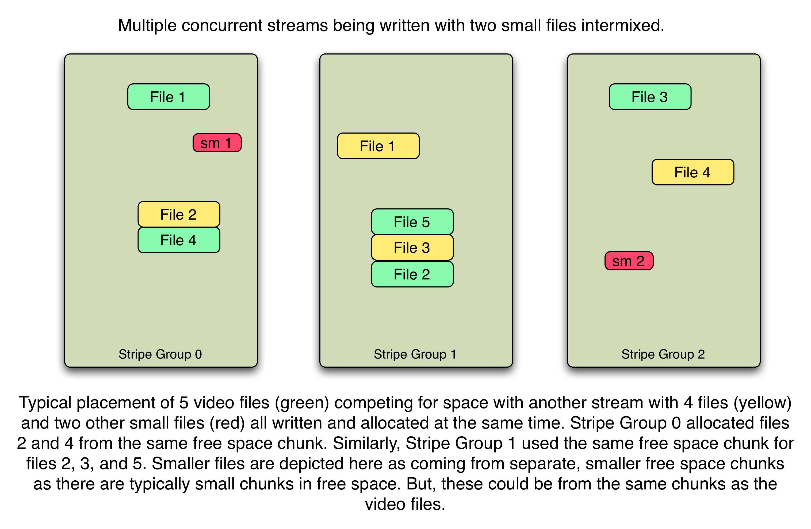
ASR off

Slide 30
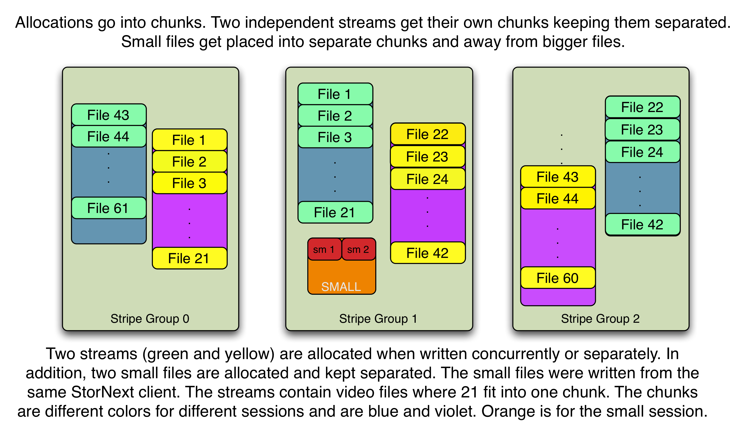
ASR on and InodeStripeWidth non-zero.

Slide 31
ASR on & InodeStripeWidth 0 - new for 5.0

Slide 32
ASR off and InodeStripeWidth 0

Slide 33
ASR on & InodeStripeWidth at 2 GB
Notes:
ASR on and ISW off file would stay on the same SG and possibly be like 2 slides ago --- depending on fragments/activity.

Slide 34
New Features for Affinities

Slide 35
General Affinity Overview
Affinities steer files to storage.
Stripe Groups (SG) are assigned affinities.
Affinities 1-8 character tags: specified in the config file.
A SG can also have exclusive=true set.
Disallows allocations of files without a matching affinity.
Files have at most one affinity.
Files with an affinity must use SG with that affinity
independent of exclusive setting!
Files without an affinity -> any SG with exclusive=false.
Files can have their affinity changed:
cvaffinity command or EXTAPI.

Slide 36
Affinity Issues
To use affinities:
Use EXTAPI – library to set or change affinity.
StorNext commands: cvmkdir(1), cvaffinity(1), cvmkfile(1)
Some customers cannot do this!
ENOSPC when an affinity is all used up.
Customers would like to steer files based on filename extensions …
*.dpx -> DPX format frames steered or grouped.
Some problems exist between SM and SNFS (affinities)
SM limits affinities to 2 for managed file systems.
Limited interaction for truncation and retrieve.

Slide 37
Affinities in 5.0
Basic idea hasn’t changed.
But, there are two new capabilities:
Automatic affinities
Affinity preference

Slide 38
Automatic Affinities – NEW to 5.0
Config file specification -> file extensions -> affinity
Assigned at file creation time: file extensions.
Extensions are case insensitive
Some applications – tmp file – rename to extension.
Affinity tag name must exist in SG definitions.
<autoAffinities>
<autoAffinity affinity="Video"> <extension>dpx</extension>
</autoAffinity>
<autoAffinity affinity="Audio"> <extension>wav</extension>
</autoAffinity>
<noAffinity> <extension>sh</extension>
</noAffinity>
</autoAffinities>

Slide 39
Affinities: auto vs. other API/commands.
Auto affinities override inherited affinities.
Create does auto after inheritance.
No affinity means files in a directory with affinity -> 0 affinity.
APIs can be used to change auto affinity.
File copy (not rename) could change the affinity.
Tar and untar … affinities could change
Examples:
cvmkdir –k Movie movies ## files under movies get Movie
cp script.sh movies/script.sh ## noaffinity overrides inheritance
capture_movie > movie.dpx ## didn’t put in directory, still Movie
capture_audio > movies/audio.wav ## auto affinity overrides Movie

Slide 40
Affinity Preference – NEW to 5.0
Reduce ENOSPC problems.
New parameter: “preferred” instead of “enforced.”
The default is false – enforced – as before 5.0.
true try affinity, if ENOSPC -> try without affinity (affinity == 0)
<AffinityPreference>false<AffinityPreference/>
Preferred could help with SM affinity placement on retrieves.

Slide 41
Allocation Sessions and Affinities
ASR sessions have the affinity of first alloc.
An allocation with a different affinity cannot use a session.
With Automatic Affinities:
Different file extension can be easily separated.
Frames (*.dpx) separated from audio (*.WAV) or others.
Etc.
All SGs can have the same affinities.
No storage steering -> file/session organization.

Slide 42
Not Done Yet!
Notes:
Give 3 more years and see what happens.
Skip rest if out of time.

Slide 43
More or future considerations
Auto Affinities:
Use regex type symantics instead of just extensions.
Have mapping for directories as well as files.
E.g. <AutoAffinity dir=1 pattern=“movie.*” affinity=”Video”/>
Problems between the file system and Storage Manager.
Must be addressed soon!
Some apps use a temporary file and rename happens after the file is written and allocated. How do we solve this?
Affinity Preference could use list of affinities instead of 0.
Syntax alternatives (parameter, new global) for empty extension.

Slide 44
More or future considerations
Free space defragmentation
Track used space (by file/inode)
Move data to reduce free space fragments.
Coalesce used and free space by moving some used space.
Improved allocation strategies.
ASR both ways (allocation AND remove)
Smarter session management.
Skip sessions in some cases?
More allocation policies besides affinity mappings.
Not just affinities at create time but other target/mgmt. information.

Slide 45
THANK YOU
For meeting with Quantum, the LARGEST Data Protection and Big Data management specialist in the world.
© 2013 Quantum Corporation. Company Confidential. Forward-looking information is based upon multiple assumptions and uncertainties, does not necessarily represent the company’s outlook and is for planning purposes only.

