Slide 1
STORNEXT 5.3.1 and NAS 1.2.x TOI
TRAINING AND DOCUMENTATION
Steve Ino, Keith Lenehan, John Love, Fedri Marrugo, Tabar Smith
5 April 2016

Slide 2
Agenda
StorNext 5.3.1 Software Documentation Updates (Fedri Marrugo)
Overview
Highlights
StorNext 5 Licensing Guide
StorNext 5 Online Help, and StorNext 5 User’s Guide
StorNext 5 Installation Guide

Slide 3
Agenda
Appliance Documentation Updates – StorNext 5.3.1 POR (Keith Lenehan)
5.3.1 Appliance Release Notes (Xcellis, Artico, Pro Foundation, M660, M440, M330, and G300)
Xcellis Field Service Manual
Appliance Documentation Updates – Not StorNext 5.3.1 POR (Keith Lenehan)
Xcellis User’s Guide
Xcellis Hardware Installation Guide
Xcellis Field Service Manual
G300 Field Service Manual
Artico Hardware Installation Guide

Slide 4
Agenda
Appliance Training Updates – Not StorNext 5.3.1 POR (John Love)
StorNext NAS 1.2.x Documentation Updates (Steve Ino, Tabar Smith)
StorNext NAS 1.2.1 Release Notes (Rev A and Rev B)
StorNext NAS Command Line Interface Guide
Q&A

Slide 5
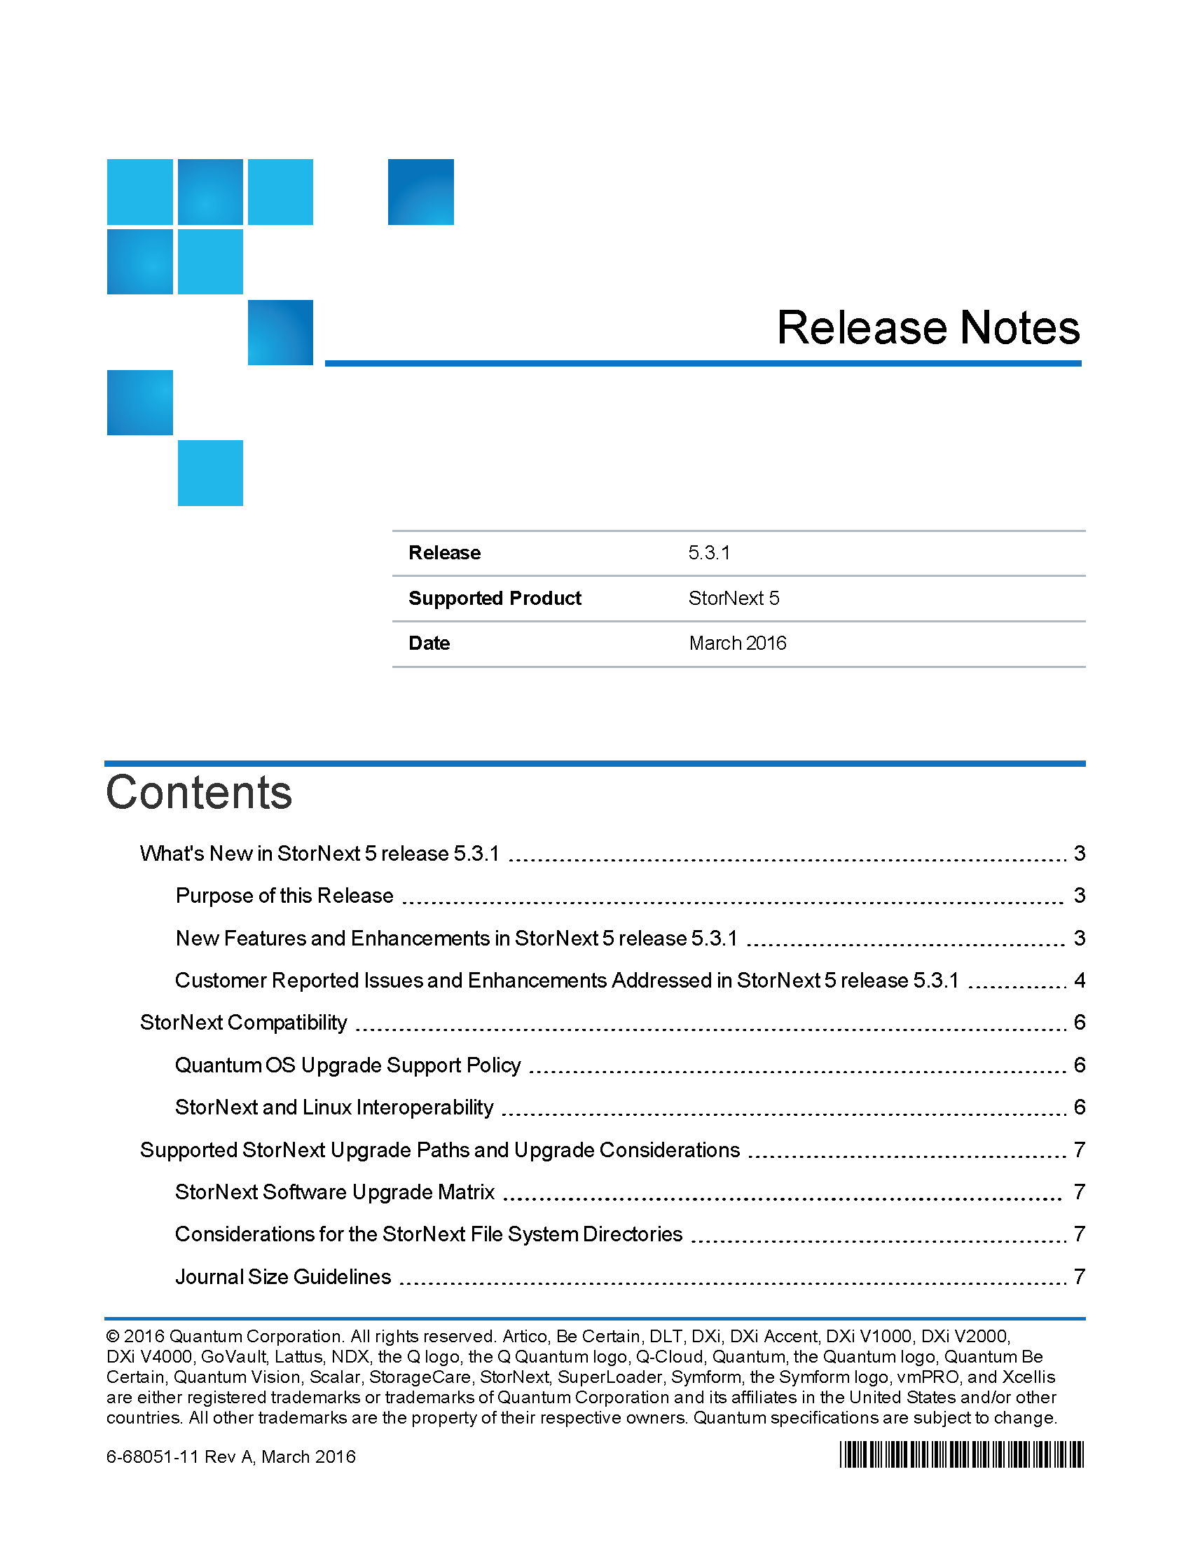
StorNext 5.3.1 Documentation Updates: Overview
New Software Documentation
Available on CSWeb and Quantum.com
www.quantum.com/sn5docs
StorNext 5 release 5.3.1 Release Notes
Highlights new features and enhancements
Lists known issues
Other relevant information

Slide 6
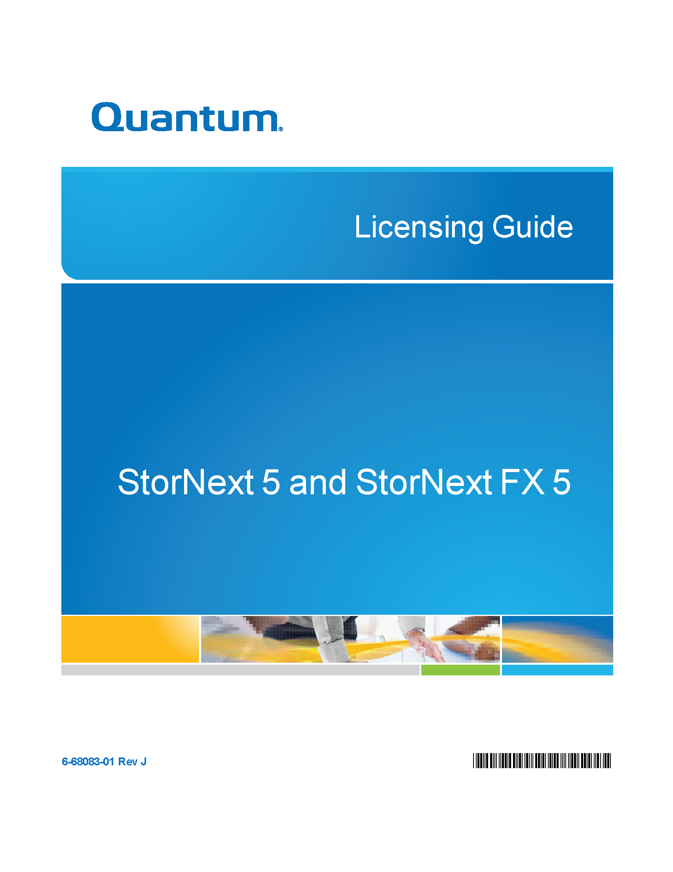
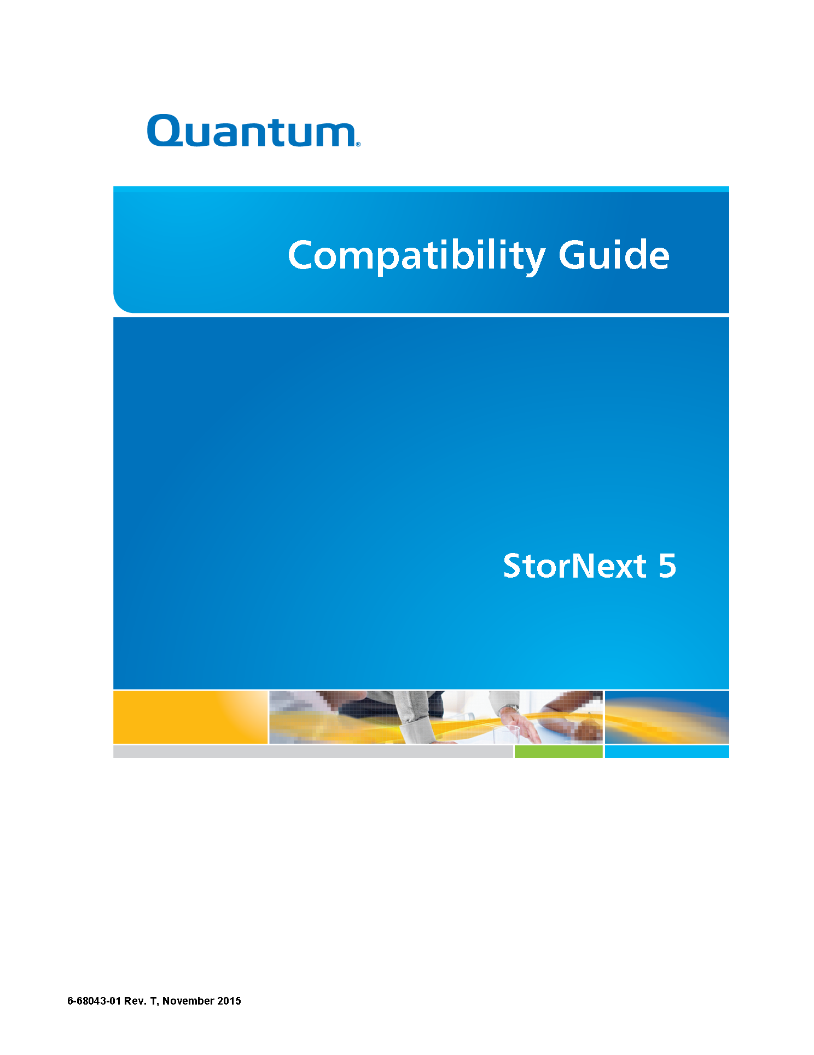
StorNext 5.3.1 Documentation Updates: Overview (cont’d)
Updated Software Documentation
Available on CSWeb and Quantum.com
www.quantum.com/sn5docs
StorNext 5 and StorNext FX 5 Compatibility Guide
StorNext 5 and StorNext FX 5 Installation Guide
StorNext 5 and StorNext FX 5 Licensing Guide
StorNext 5 and StorNext FX 5 Upgrade Guide
StorNext 5 and StorNext FX 5 User's Guide
StorNext 5 MAN Pages Reference Guide
StorNext 5 Online Help
StorNext 5 Web Services Guide
Xsan MDC to StorNext Conversion Procedures Guide

Slide 7
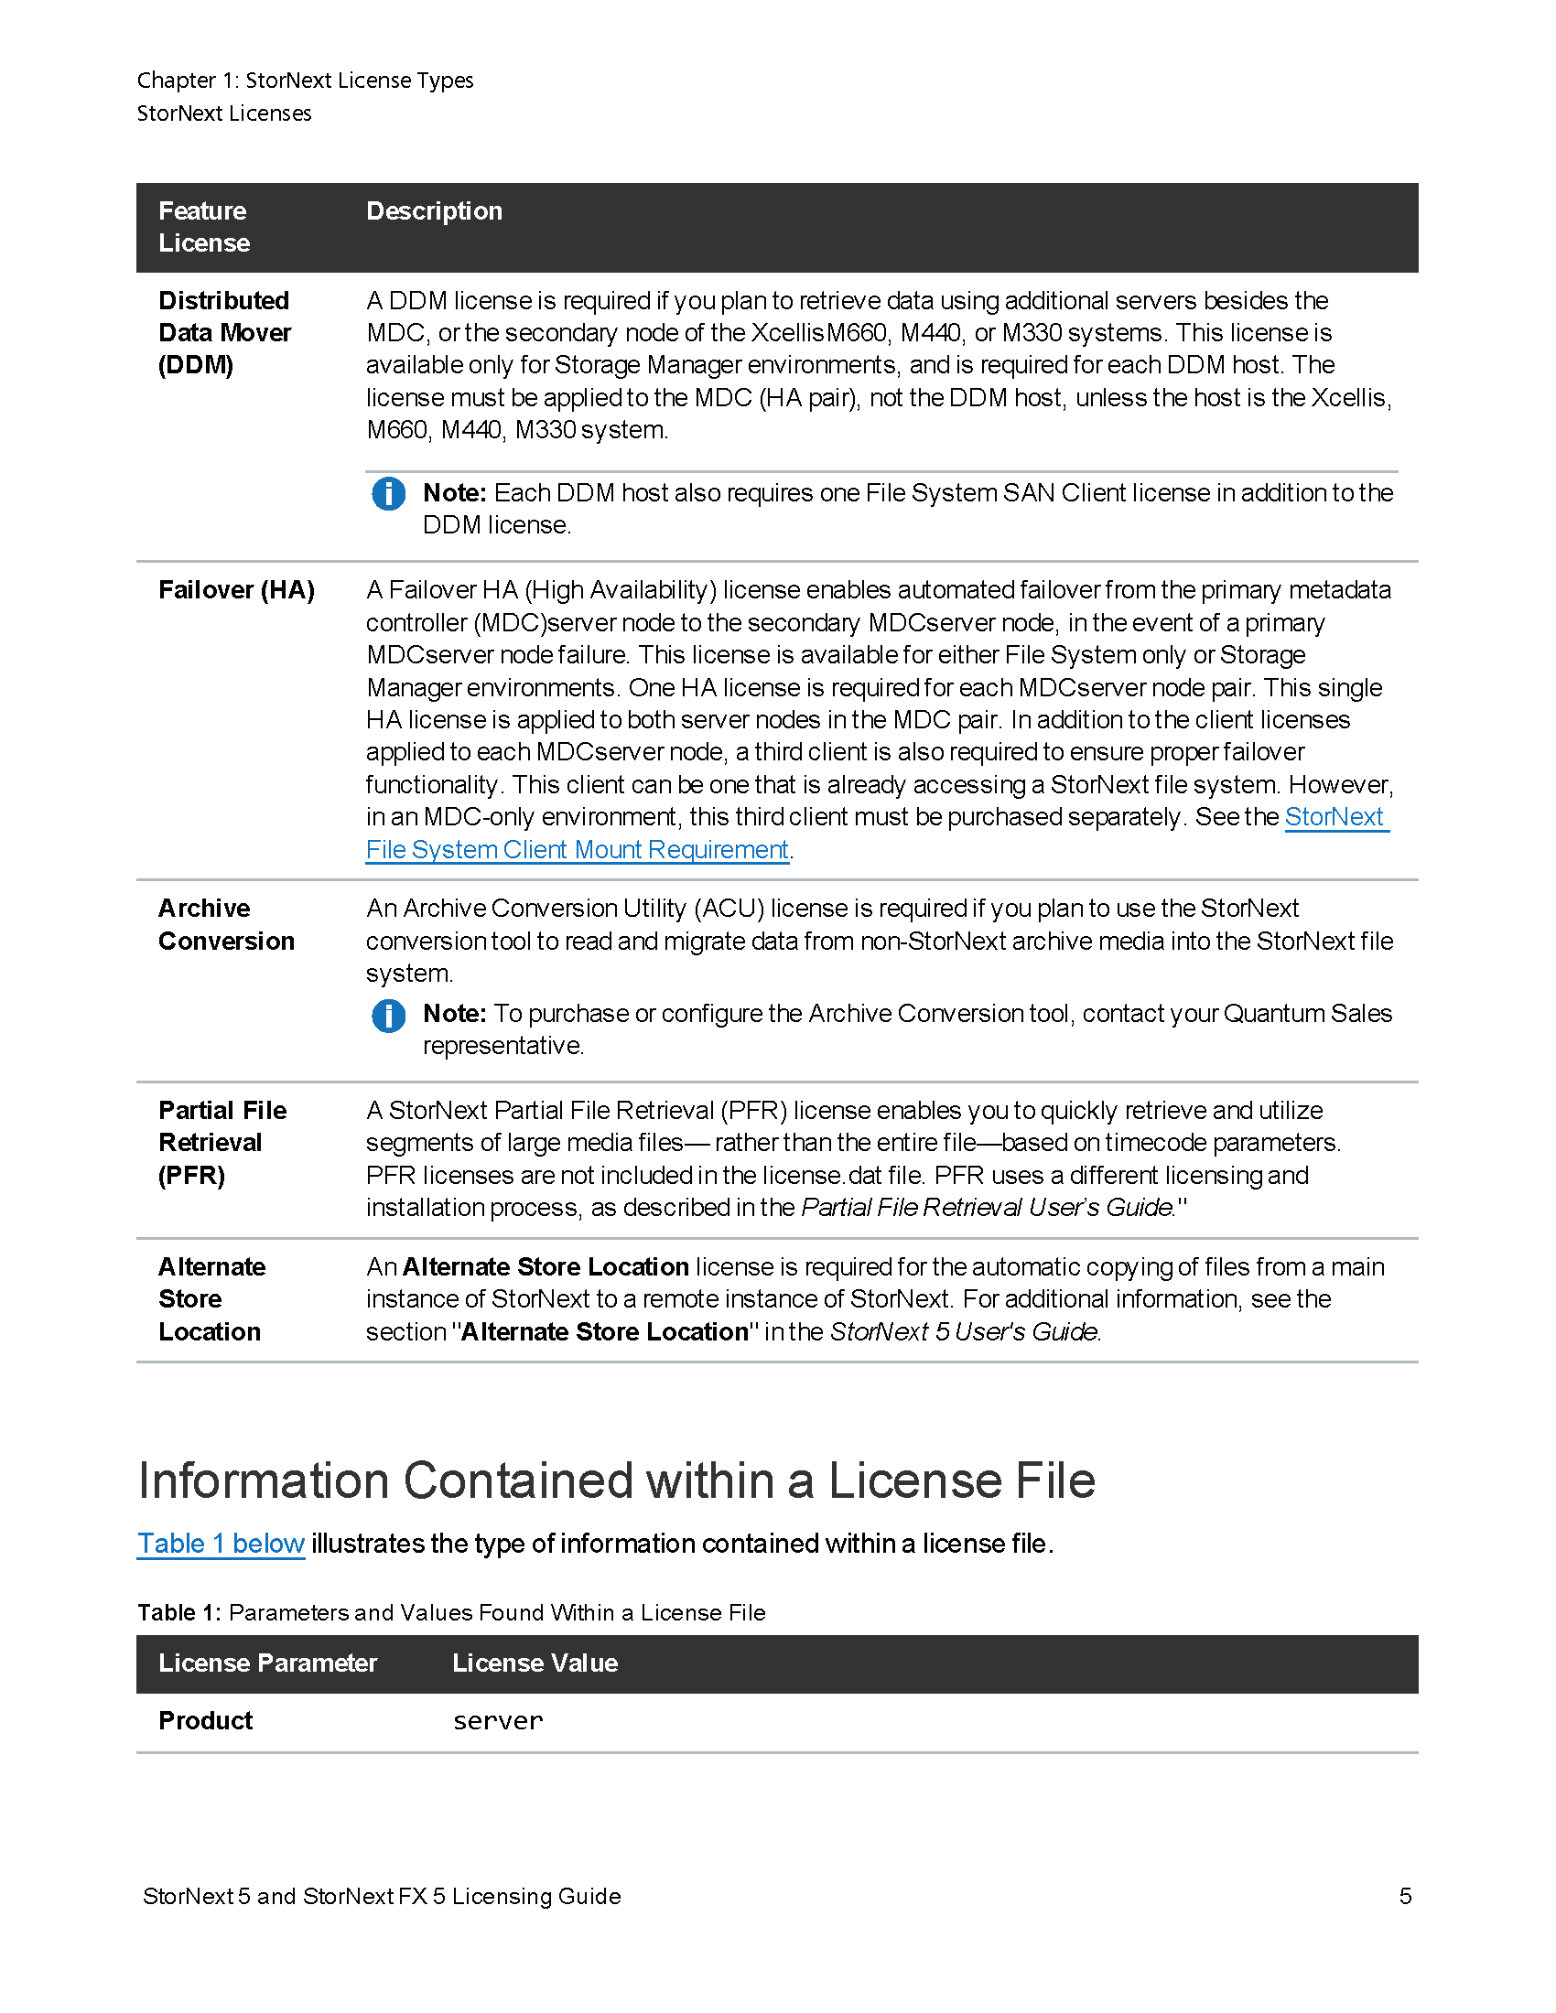
StorNext 5.3.1 Documentation Highlights: Licensing Guide
New Feature License
Alternate Store Location
StorNext 5 Licensing Guide
Chapter 1: StorNext License Types

Slide 8
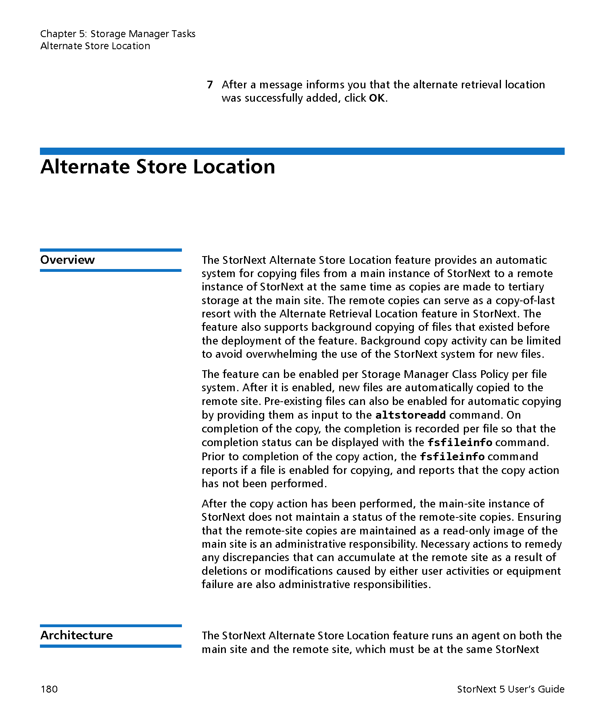
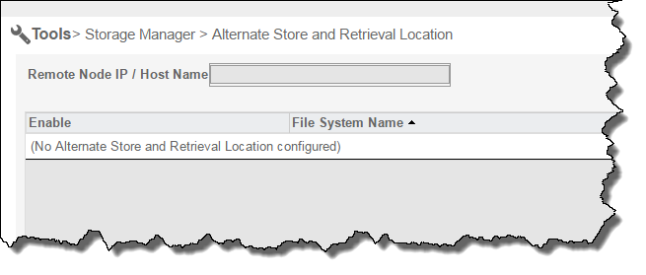
StorNext 5.3.1 Documentation Highlights: Online Help/User’s Guide
New Feature License
Alternate Store Location
StorNext 5 User’s Guide
Chapter 5: Storage Manager Tools
StorNext 5 Online Help
Configuration menu, Licenses
Tools menu, Storage Manager, Alternate Store and Retrieval Location

Slide 9
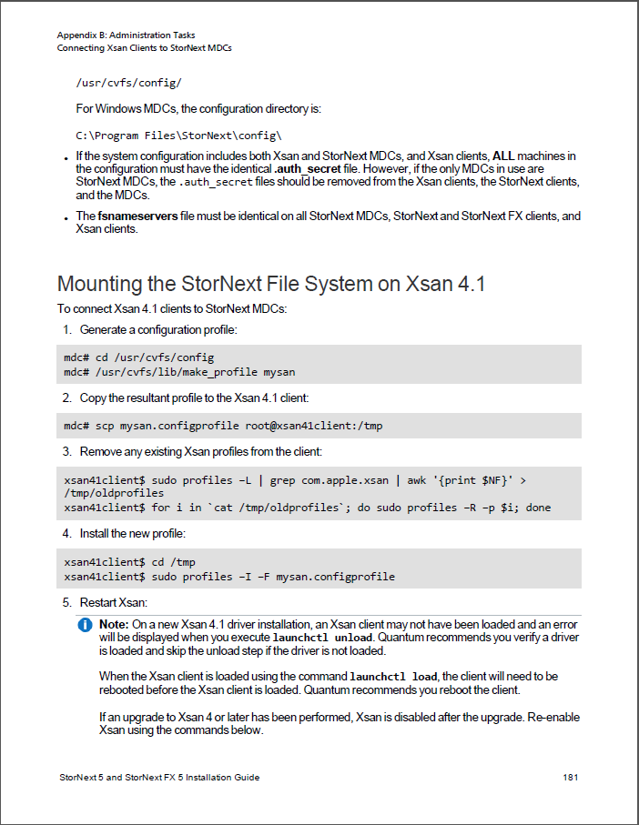
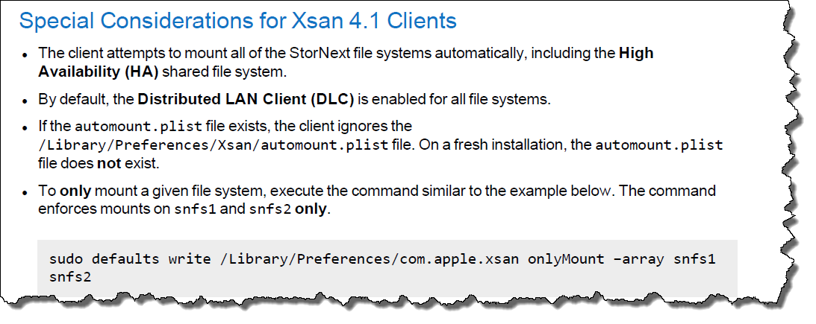
StorNext 5.3.1 Documentation Highlights: Installation Guide
Updated Procedure
Configuration/mounting on Xsan 4.1 (OS X El Capitan v. 10.11)
StorNext 5 Installation Guide
Appendix B: Administration Tasks
Section “Mounting the StorNext File System on Xsan 4.1”
Section “Special Considerations for Xsan 4.1 Clients”

Slide 10
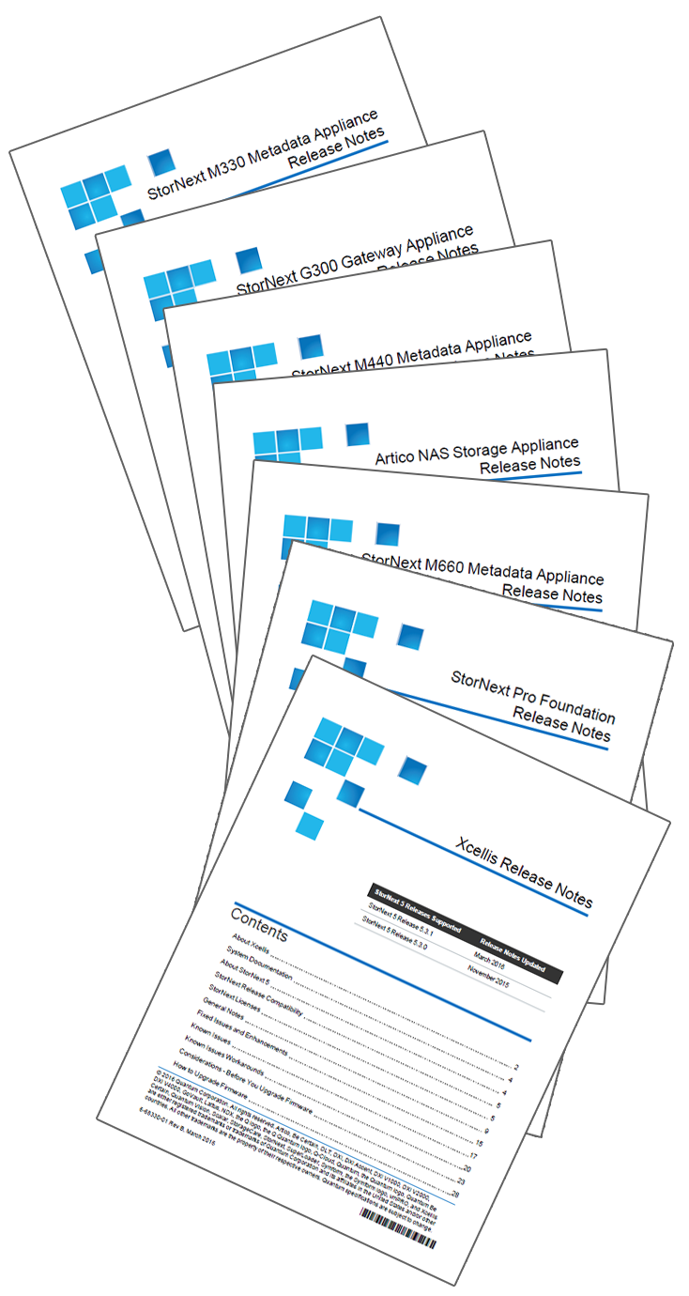
StorNext 5.3.1 POR Appliance Documentation Updates
Appliance Release Notes updates for 5.3.1 (Xcellis, Artico, Pro Foundation, M660, M440, M330, and G300)
Updates for StorNext 5 Release 5.3.1, including:
Appliance Enhancements
Known issues
Enhanced firmware upgrade section
All content converted to our new development tool – Madcap Flare
License definitions driven from single-sourced content shared with the StorNext Licensing Guide – so more consistent from the Licensing Guide to the Appliance Release Notes. Side benefit in the Licensing Guide - appliance information now consolidated in a single area, so it’s much easier to keep updated to reflect appliance changes.

Slide 11
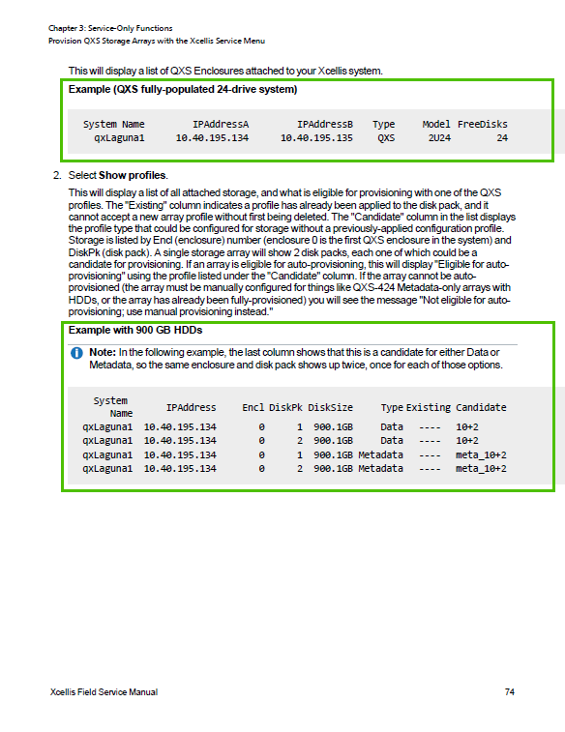
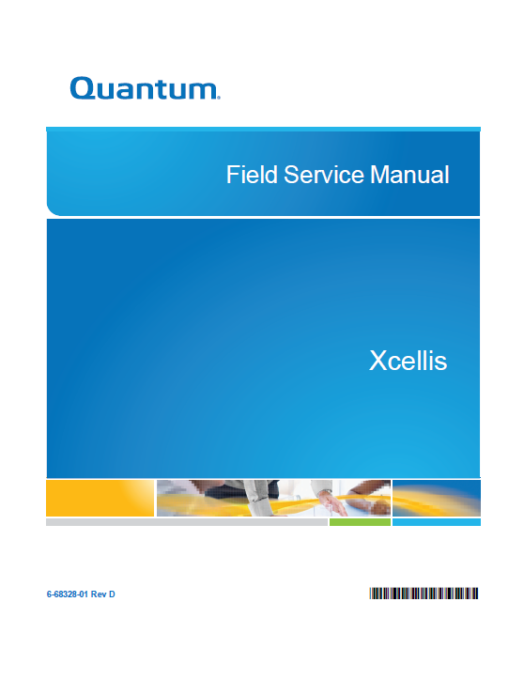
StorNext 5.3.1 POR Appliance Documentation Updates
Xcellis Field Service Manual
Updated the procedures for configuring arrays using the Service Menu to include information for differences in the procedures for StorNext 5 Release 5.3.0 and Release 5.3.1, and added array configuration examples.

Slide 12
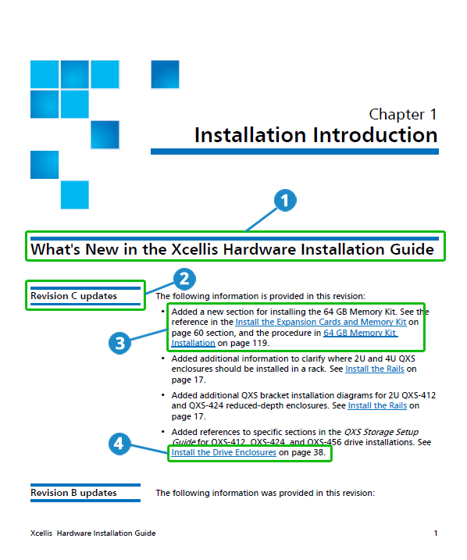
Appliance Documentation Updates – Not StorNext 5.3.1 POR
Introducing “What’s New”
Scope:
All Guide updates going forward
Contains:
What’s New specific to each guide.
Separate section for each revision.
Overview of all the changes/enhancements.
Links to modified/added sections.

Slide 13
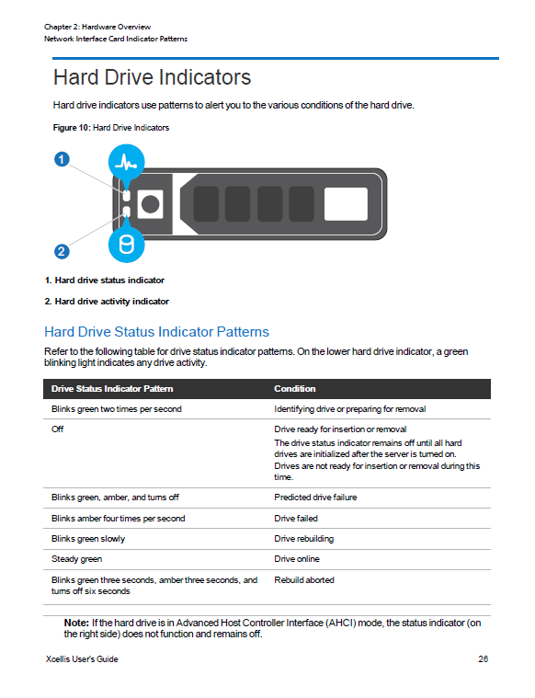
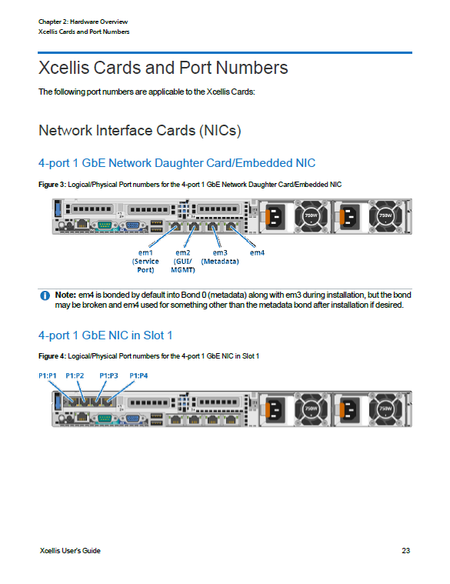
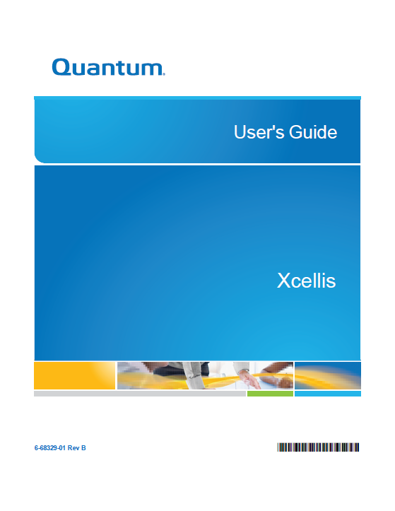
Appliance Documentation Updates – Not StorNext 5.3.1 POR
Xcellis User’s Guide
Added Xcellis Card configs and Port Numbers.
Added server node indicator information, for NICs, Hard Drives and Power Supplies.
Added Xcellis and QXS serial number locations.
Updated cvfs services stop and power off commands to reflect the new commands supported by SystemD (i.e. systemctl) in CentOS7 on Xcellis.

Slide 14
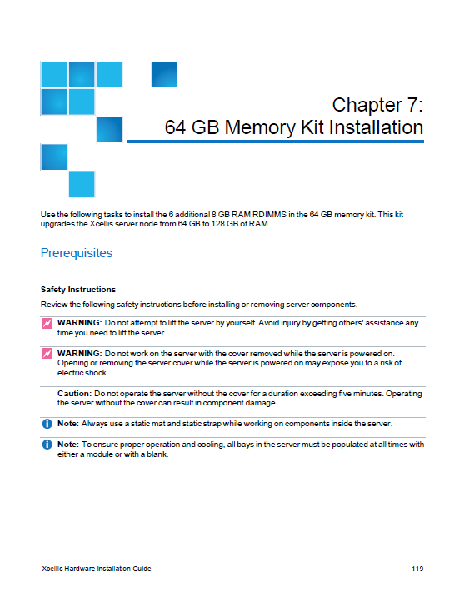
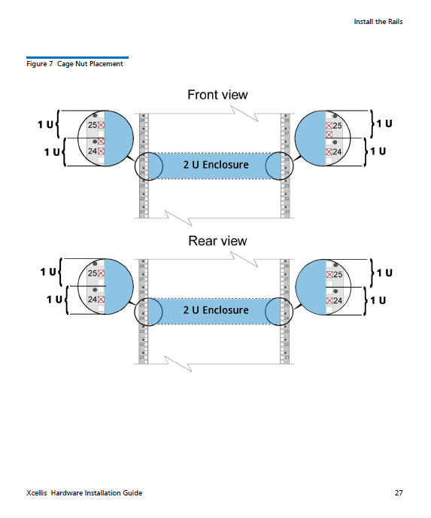
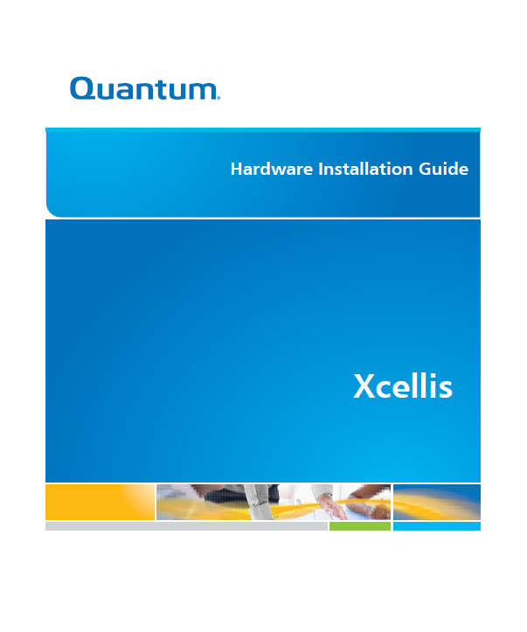
Appliance Documentation Updates – Not StorNext 5.3.1 POR
Xcellis Hardware Installation Guide
Added 64 GB Memory Kit installation instructions.
Enhanced rack installation instructions for QXS arrays.
Added additional QXS bracket installation diagrams for 2U QXS-412 and QXS-424 reduced-depth enclosures.
Added references to the QXS Storage Setup Guide for 12, 24, and 56 drive installations.

Slide 15
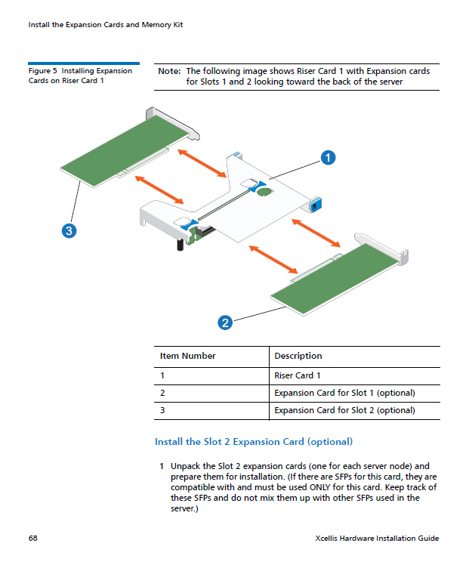
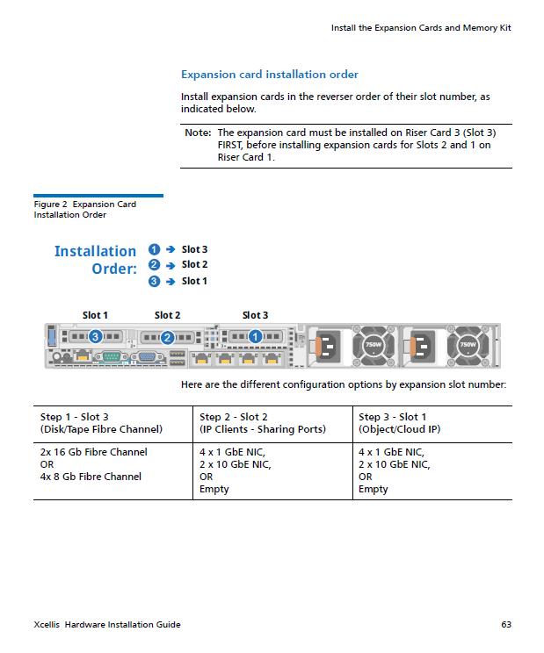
Appliance Documentation Updates – Not StorNext 5.3.1 POR
Xcellis Hardware Installation Guide (cont’d)
Enhanced instructions for card installation sequence.
Enhanced instructions for installing expansion cards on Riser Card 1.
Added references to use the StorNext Connect Quickstart before continuing the installation.
Moved SFP installation procedure higher up in the installation procedure for QXS enclosures.

Slide 16
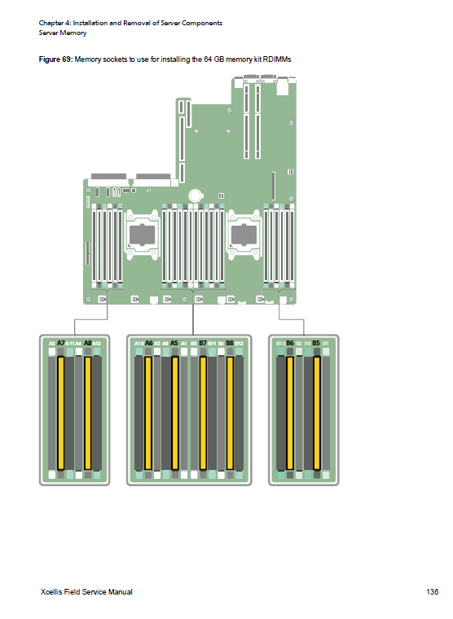
Appliance Documentation Updates – Not StorNext 5.3.1 POR
Xcellis Field Service Manual
Added location of QXS serial numbers.
Updated the procedures for configuring arrays using the Service Menu to include information for differences in the procedures for StorNext 5 Release 5.3.0 and Release 5.3.1, and added array configuration examples.
Added 64 GB Memory Kit installation instructions.
Added Xcellis Card configs and Port Numbers.

Slide 17
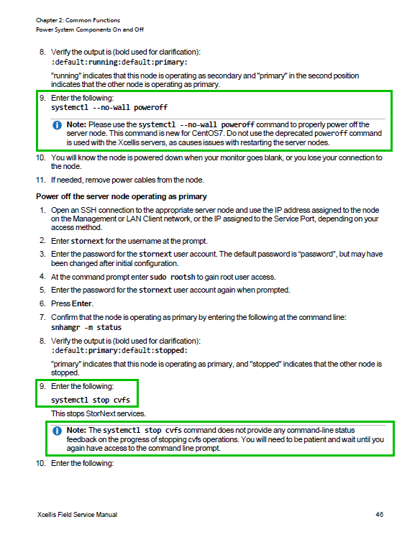
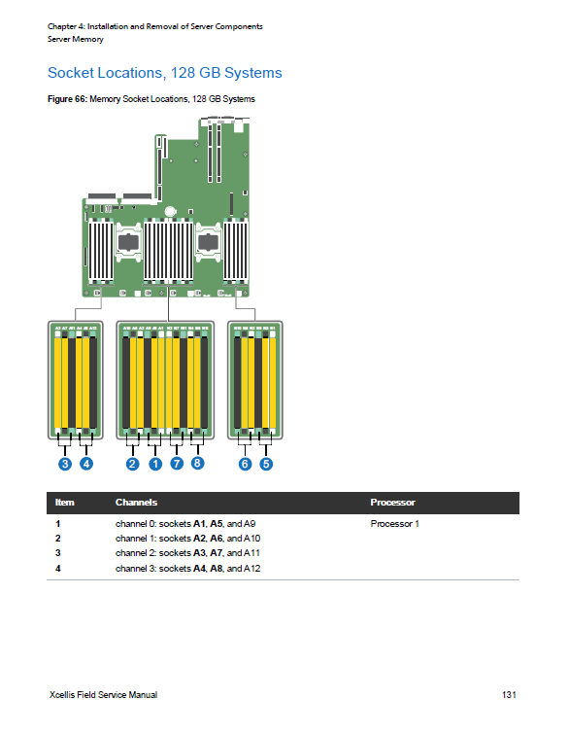
Appliance Documentation Updates – Not StorNext 5.3.1 POR
Xcellis Field Service Manual (cont’d)
Updated cvfs services stop and power off commands to reflect the new commands supported by SystemD (i.e. systemctl) in CentOS7 on Xcellis.
Updated the images that depict the populated memory bank locations for both 64 GB and 128 GB memory configurations.
Updated the regulatory model to reflect an updated certification number.

Slide 18
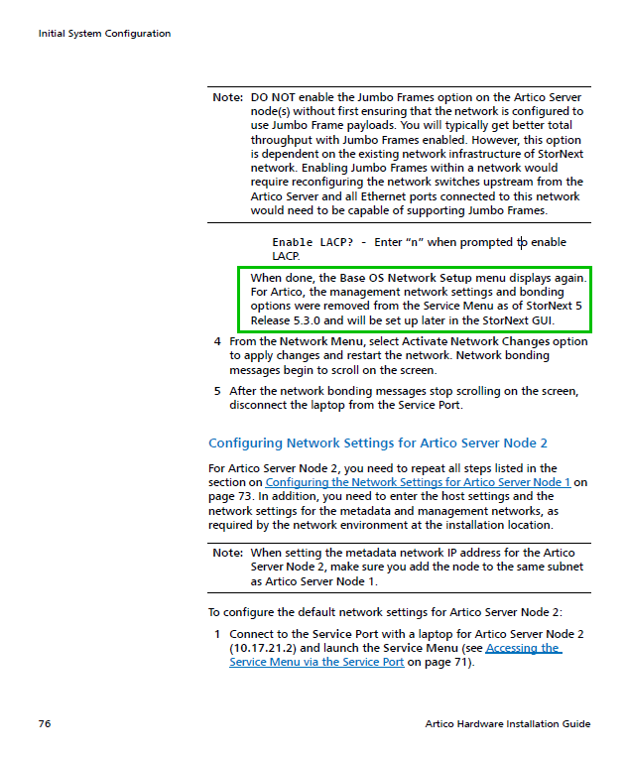
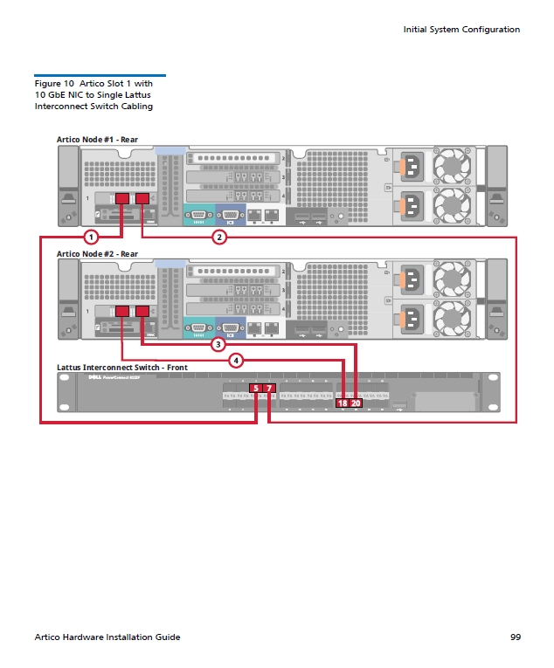
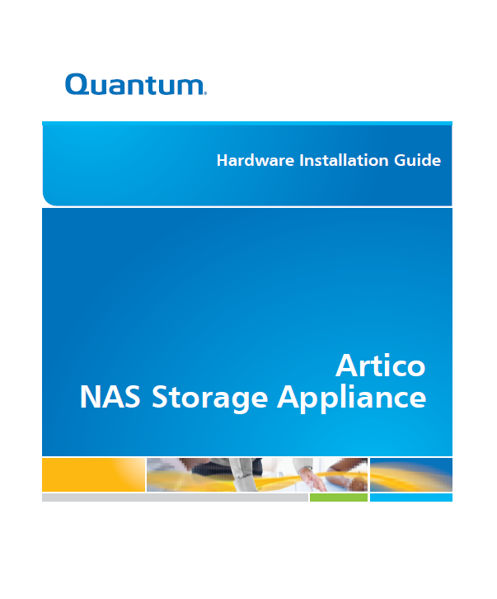
Appliance Documentation Updates – Not StorNext 5.3.1 POR
Artico Hardware Installation Guide
Removed option 3, Configure Management Network option from the Service Menu screenshot and steps to configure the management network and bonding from the procedure.
Updated the Network Configuration table to account for the fact that the eth1 is now configured by default in the Service Menu for GUI and Metadata, and added Lattus cabling diagrams.

Slide 19
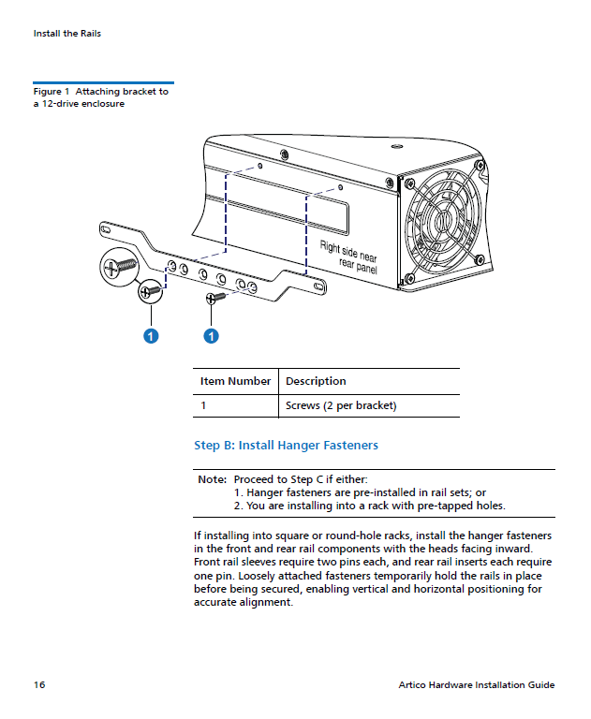
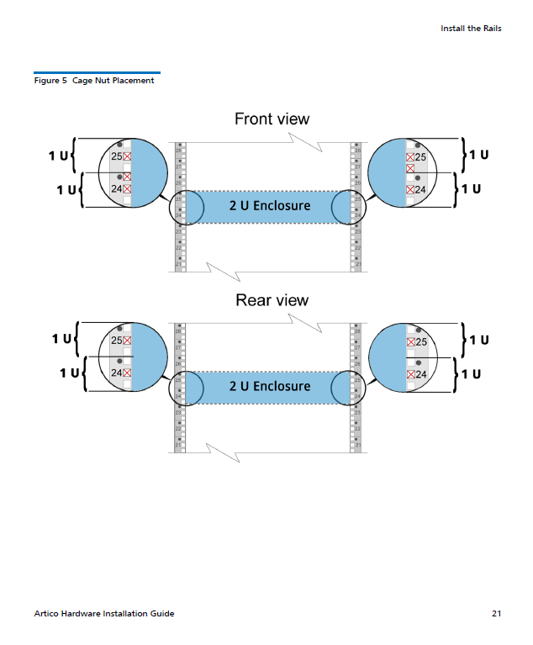
Appliance Documentation Updates – Not StorNext 5.3.1 POR
Artico Hardware Installation Guide (cont’d)
Added information to clarify where 2U QXS enclosures should be installed in a rack.
Updated the QXS bracket installation diagram for the 2U QXS enclosure.
Added references to specific sections in the QXS Storage Setup Guide for QXS drive installations.

Slide 20
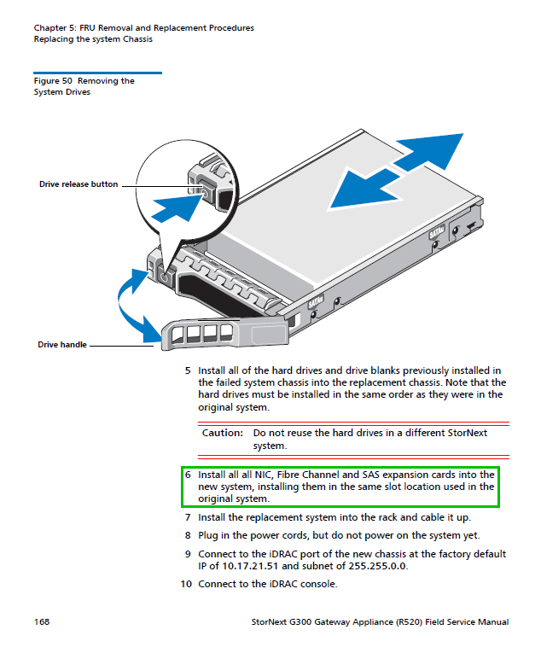
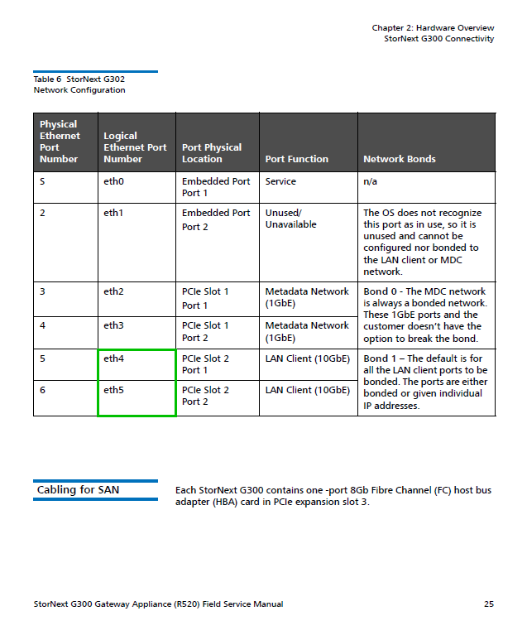
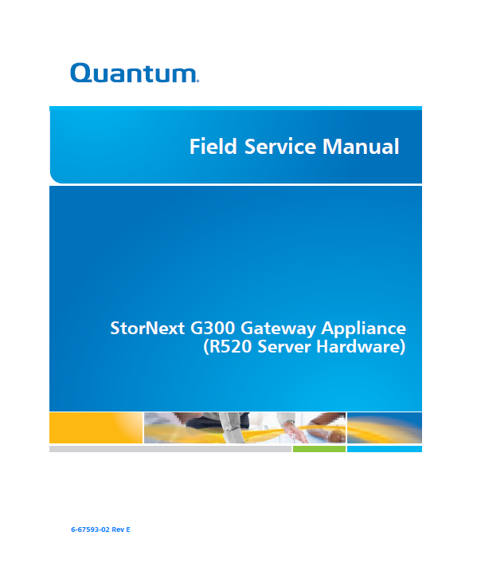
Appliance Documentation Updates – Not StorNext 5.3.1 POR
G300 Field Service Manual
Updated the Chassis Replacement section to include removal and installation of all system HBAs.
Updated the eth4 and eth5 port designations in the G302 Network Configuration section.

Slide 21
Appliance Training Updates – Not StorNext 5.3.1 POR
Break/Fix Course for Third Party Maintainers
In development
To be released in April

Slide 22
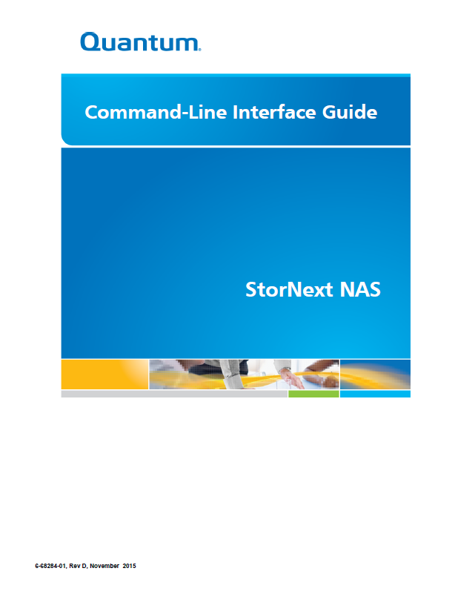
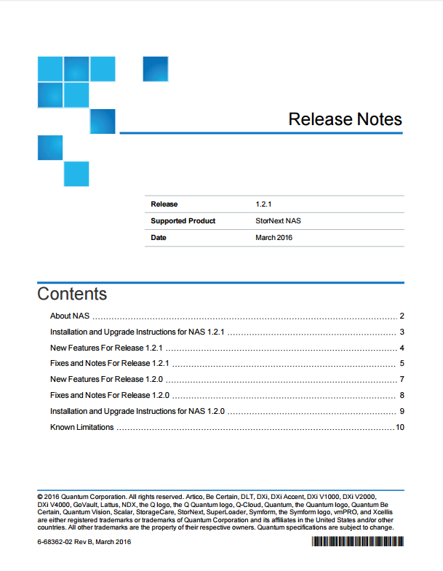
StorNext NAS 1.2.1 Documentation Updates
NAS 1.2.1 Release Notes – Rev A
New Features:
A node in a NAS cluster can now be fully managed from the master node
NAS services no longer attempt failing back to the preferred master. (This new behavior ensures greater stability for customers running NAS in an HA cluster.)
Various Bug Fixes
NAS 1.2.1 Release Notes – Rev B
Additional Bug Fixes
StorNext NAS Command Line Interface Guide
Converted to Flare development tool format
Some content updates, guide will be released to support 1.2.3 GA

Slide 23
Questions & Answers

