Slide 1
5.3.1 TOI
Reporting Script
Bill Middlecamp
5 April 2016

Slide 2
SNNAS_USAGE REPORTING SCRIPT
Yale uses SNNAS shares to provide Artico space to users for final storage of academic-project files.
Yale required comma-separated values (CSV) reports of tertiary storage per share for chargeback accounting.
Automatically getting the share list from SNNAS, so no extra administration needed.
Disk usage is not needed.
Running as an infrequent job is OK, so not necessary to be dynamic.
Solution comprises:
snnas_usage script to collect source information from mysql and SNNAS, and to iterate through file systems.
snnas_usage_engine executable binary to accumulate and report per-share information from the source files.
Man pp for those.

Slide 3
SNNAS_USAGE REPORTING SCRIPT
Description of the Feature:
Command: snnas_usage
In /usr/adic/TSM/util
Accumulates per-file-system source data from snnas and mysql and passes this to /usr/adic/TSM/util/snnas_usage_engine
Iterates through file systems, creating directories and placing results in /var/shareUsageReports using the file-system mount point and current time as follows: /var/shareUsageReports/CCYYMMDDhhmmss/stornext_snfs1/stornext_snfs1_CCYYMMDDhhmmss
Command: snnas_usage_engine
Maps dirpath<#> rows to SNNAS share directories
Accumulates active and inactive segment lengths from filecomp<#> rows for any copy number
Produces CSV report having the following information:
Share Path below the Mount Point
Share Name
UID
Bytes Used

Slide 4
SNNAS_USAGE REPORTING SCRIPT
Description of the Feature (continued):
Runs on Primary MDC, so output files may collect on both MDCs
Depends on SNNAS
SNNAS controller port gleaned from /usr/local/quantum/etc/brand.txt configuration file
Currently, does not work with SNNAS Gateways
Provides tertiary-storage usage, not disk usage
Project under consideration to mash-up with Disk Quotas to:
Define share directories
Provide disk-usage information
Nested shares are not supported
Highest-level share directory is used
Lower-level nested shares are reported and ignored

Slide 5
SNNAS_USAGE REPORTING SCRIPT
Description of the Feature (continued):
Other Caveats:
Files outside of all shares are accumulated into one row for pseudo-share path: non-share files, and pseudo-share name: non-share files
Size is bytes, and there is no adjustment for compression
Commas that occur within pathnames are protected by double-quote characters for Excel import
Does not currently work with SNNAS running on Gateway Clients
May fail if security prevents access to SNNAS

Slide 6
SNNAS_USAGE REPORTING SCRIPT
Example invocation:
snnas_usage
Example Output:
“share path below mount pt”, “share name”, UID, Bytes used
"p1/a/a","aa",128,124
"p1/a/a","aa",129,124
"p1/a/a","aa",130,95
"p1/a/a","aa",131,124

Slide 7
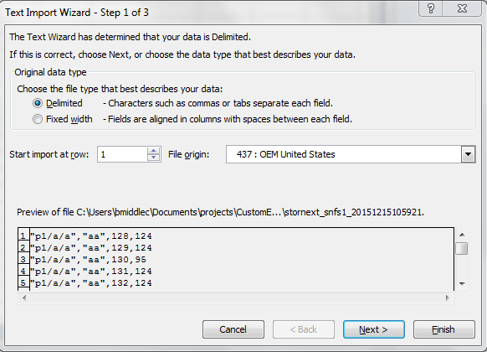
SNNAS_USAGE REPORTING SCRIPT
Excel Examples
Import CSV file
Double-quote characters protect commas in names

Slide 8
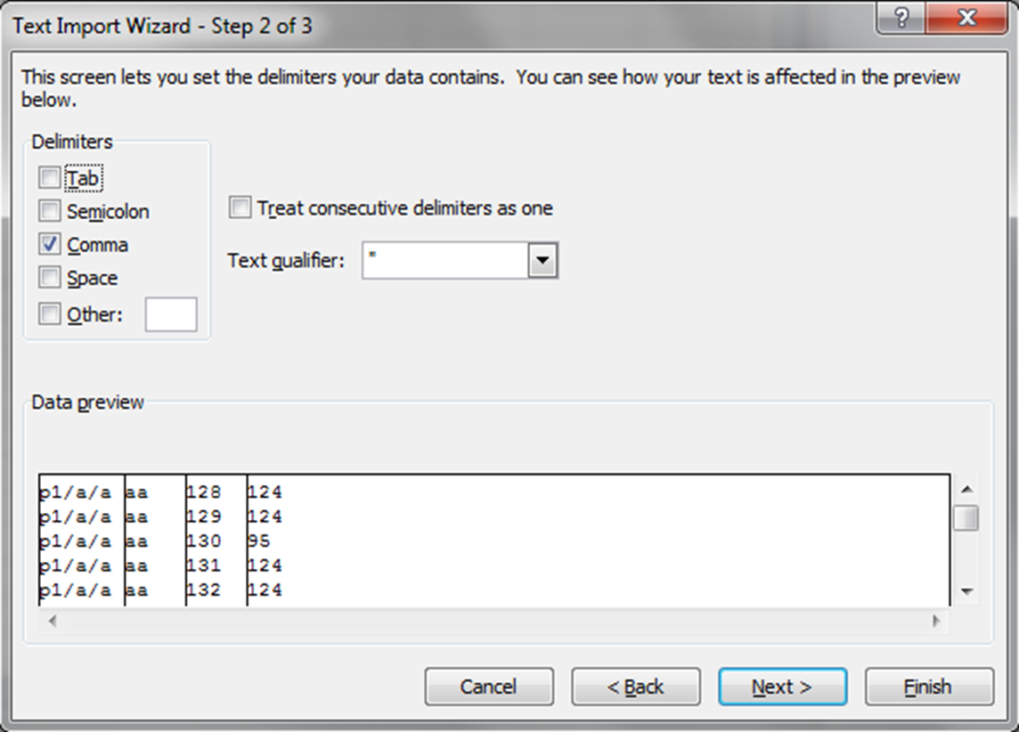
SNNAS_USAGE REPORTING SCRIPT
Excel Examples
Select delimiter, and see results

Slide 9
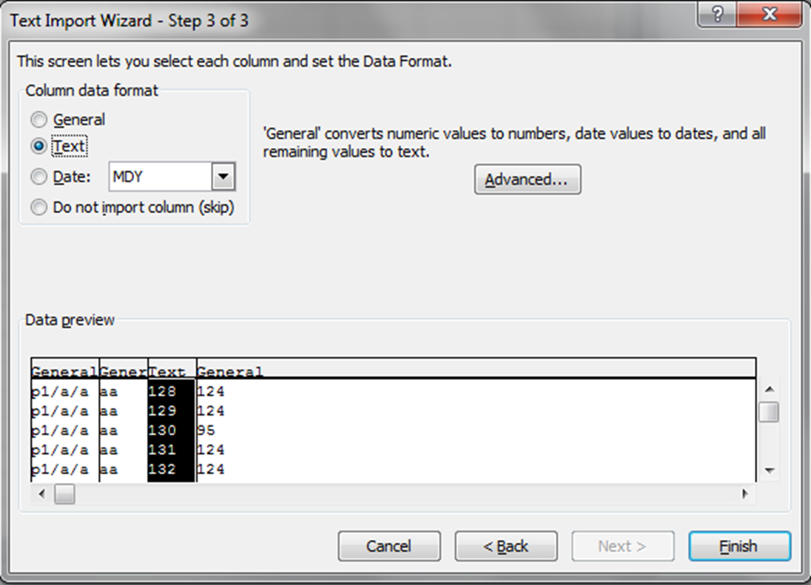
SNNAS_USAGE REPORTING SCRIPT
Excel Examples

Slide 10
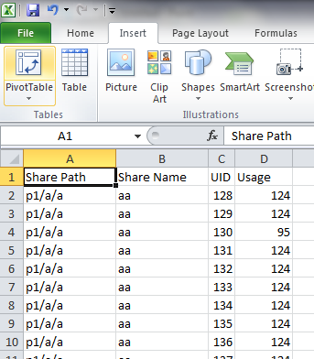
SNNAS_USAGE REPORTING SCRIPT
Excel Examples
Headers added by hand

Slide 11
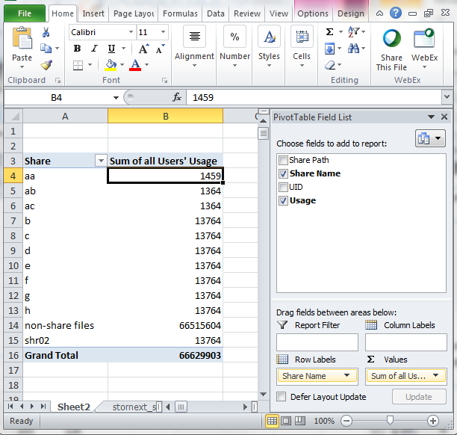
SNNAS_USAGE REPORTING SCRIPT
Excel Examples
Usage per share

Slide 12
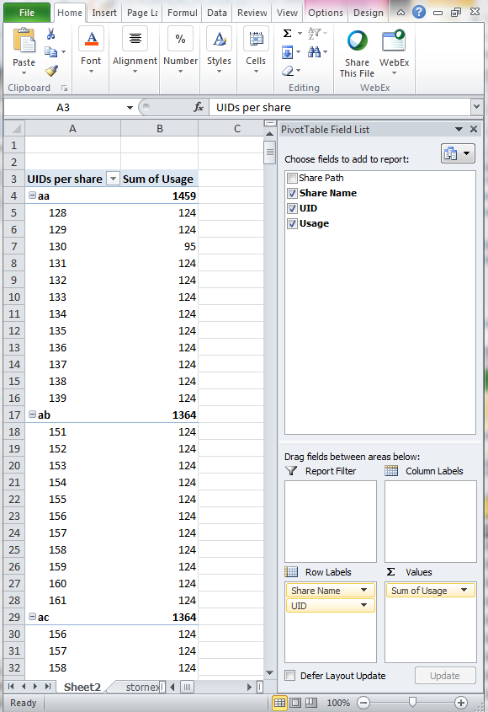
SNNAS_USAGE REPORTING SCRIPT
Excel Examples
Usage per share per UID

Slide 13
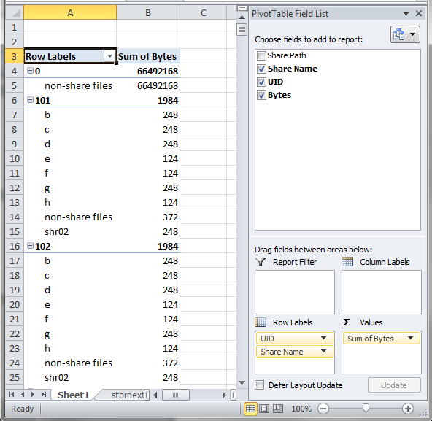
SNNAS_USAGE REPORTING SCRIPT
Excel Examples
Usage per UID per Share

