Slide 1
NAS 1.2.1 TOI
Mike Zeis, Michael Sevy
5 April 2016

Slide 2
Agenda
What’s new in NAS 1.2.1
Enabling, Licensing, Upgrading
Creating a NAS cluster
Reporting
Troubleshooting

Slide 3
What’s new in NAS 1.2.1
NAS Cluster –
HA and Load Balancing (actually released in NAS 1.2.0)
Synchronizes config changes from master to other nodes in cluster
Master fully controls other nodes
Change in fail-back behavior
Export/Import of SMB configurations
Improved share show command
Notes:
Details about NAS cluster will be discussed later in the presentation
Load Balancing was, actually, released as part of NAS 1.1.0
HA for SMB shares was, actually, released with NAS 1.2.0
Synchronizing config changes … Before NAS 1.2.0, it was the user’s responsibility to keep all nodes synchronized (i.e. if a share was added to one node, the user needed to add the share to another node). With 1.2.0, and improving in 1.2.1, auth and share commands are issued from the master node
With NAS 1.2.1, you can issue all nascluster commands from the master node
Details about “export/import” in next slide
share show now allows you to specify a “share type” or “share name”; wild cards or pattern matching not, currently, supported

Slide 4
What’s New NAS 1.2.1 (key fixes)
61146 Fixed a condition that generated an error when attempting to change ID mapping.
61443 Previously, NAS cluster required the reg set cifs.bind_interface CLI command to be run for proper load balancing.
60873 Fixed a condition in which the NAS Gateway server failed to join Active Directory if the NetBIOS domain name was different from the DNS domain name.
61213 Added provision for larger winbindd logs.
61190 The net rpc rights grant call no longer fails while smbd is starting up
61189 The nascluster set virtual ipaddr command now checks whether the IP address provided is in use.
55993 Fixed an issue where setting Unix permissions on an OS X Samba client sometimes silently failed.
Notes:
61146 Fixed a condition that generated an error when attempting to change ID mapping.
61443 Previously, NAS cluster required the reg set cifs.bind_interface CLI command to be run for proper load balancing.
Beginning with NAS 1.2.1, this is now done internally.
60873 Fixed a condition in which the NAS Gateway server failed to join Active Directory if the NetBIOS domain name was different from the DNS domain name.
61213 Added provision for larger winbindd logs. By default, the winbindd logs were 5Mb.
Under many circumstances, this size was too small.
This size can now be increased by using the max log size option with the share change smb global command. The value is expressed in Kb. For example, to increase the max log size to 100Mb, you would enter the following: share change smb global max log size = 100000
61190 The net rpc rights grant call no longer fails while smbd is starting up
61189 The nascluster set virtual ipaddr command now checks whether the IP address provided is in use.
This prevents a user from specifying a VIP used by another StorNext appliance or network.
55993 Fixed an issue where setting Unix permissions on an OS X Samba client sometimes silently failed. This problem occurred when:
1. The Samba mount is done using sysadmin credentials.
2. Active Directory is not used.
3. Local Mac credential authentication is used when creating files

Slide 5
What’s new in NAS 1.2.1 (cont.)
Export/Import of SMB configurations
Use to export SMB share information. “Export” file can be edited to modify share options, then “imported”
x86_64:snt559732-gwcli1> share show
2 shares:
1: tstsmbshare1 | smb | /stornext/snfs1/smbshare | public = no,writable = yes |
2: tstsmbshare2 | smb | /stornext/snfs2/smbshare | public = no,writable = yes |
x86_64:snt559732-gwcli1> share export config
Share configuration written to ‘/var/smb_shares.config’
bash-4.1# cat /var/smb_shares.config
# Share export file '/var/smb_shares.config' generated at Wed Mar 30 20:37:30 2016.
[tstsmbshare1]
path = /stornext/snfs1/smbshare
public = no
writable = yes
[tstsmbshare2]
path = /stornext/snfs2/smbshare
public = no
writable = yes
Notes:
Currently does not support exporting/importing NFS share information (coming … )

Slide 6
Enabling, Licensing, Upgrading
NAS is enabled from the factory
NAS shipping with StorNext 5.3.1, it’s enabled; no more needing the service menu
NAS Licenses
Artico: Licenses factory installed
Xcellis: Installed via StorNext GUI
G30x: license.dat file to be placed (manually) in /usr/cvfs/config
NAS 1.2.1 requires StorNext 5.3.0 (minimum)
Upgrading StorNext to 5.3.1 will upgrade NAS 1.2.1
Upgrading NAS 1.2 0 -> 1.2.1 is supported.
Notes:
Enabling:
From the factory, the Controller and PostgreSQL database are enabled and running. Supporting services are enabled by NAS. Example, SMB, HAProxy, keepalived are started by NAS if an appropriate license is installed.

Slide 7
Enabling, Licensing, Upgrading (cont.)
Upgrade NAS 1.2.0 -> 1.2.1, follow these steps:
Copy NAS 1.2.1 RPM to /var/upgrade
From CLI, issue command: system upgrade local
NAS 1.2.1 RPMs available from CSWeb
For OS7 (Xcellis): quantum-snfs-nas-1.2.1-4854.el7.centos.x86_64.rpm
For OS6 (all others): quantum-snfs-nas-1.2.1-4854.el6.x86_64.rpm

Slide 8
NAS Upgrade (sneak-peek, futures)
For NAS 1.2.3, we’ll provide a mechanism for updates from an external YUM repository
This means customers can get updates or upgrade by using the
system upgrade command

Slide 9
NAS Cluster
A NAS Cluster is two or more machines running the NAS Gateway Server software and being accessed via a common Virtual IP (VIP) or hostname
Clusters provide high-availability access to NAS shares; some configurations provide load balancing capabilities
Two or more nodes can be clustered to provide HA
Two or more G30x machines can be clustered to provide Load Balancing
New Connect Manage NAS App covered in separate TOI
Notes:
Load Balancing is only supported between G300’s
If put two MDC-type nodes into a cluster, then add a G300, you will not get load balancing between the three nodes.

Slide 10
Creating a NAS Cluster
Planning
The VIP for a NAS Cluster is different from VIP for MDC-type
Know the static IP address for all nodes to be included in the cluster * IP addresses must be static. Assigning via DHCP may cause unpredictable behavior
StorNext file system with file locking enabled (on FS used to hold cluster config information)
Preferred master
Order nodes are added to the cluster has significance
Recommend adding Node-2 as first node
A VIP is required for HA
Simply created a NAS cluster does not make it an HA cluster
Order for executing the nascluster commands is important
Enable the master, set the VIP, join the master … enable and join other nodes
Notes:
Preferred Master:
For MDC-type machines, we recommend adding Node-2 first …
61189 The nascluster set virtual ipaddr command now checks whether the IP address provided is in use. This prevents a user from specifying a VIP used by another StorNext appliance or network. Will help to prevent using the same VIP for both MDC and NAS

Slide 11
Creating a NAS Cluster (cont.)
nascluster commands:
nascluster join <snfs-root-where-cluster-info-stored> [ipaddr]
nascluster leave [ipaddr]
nascluster enable node <ipaddr>
nascluster enable master <ipaddr> <snfs-root-where-cluster-info-stored>
nascluster disable node <ipaddr>
nascluster set virtual ipaddr <virtual_ipaddr> ...
nascluster show
Commands executed on the master node
Notes:
Some commands must be executed on the master node; others can be executed on the master or the specific node
With NAS 1.2.1, recommend issuing the nascluster join from the node

Slide 12
Creating a NAS Cluster (cont.)
nascluster : Enable Master Node
x86_64:snt480113> nascluster enable master 10.65.188.89 /stornext/snfs1
Verifying NAS cluster configuration for 10.65.188.89 ...
NAS cluster enable master node 10.65.188.89 starting...
Updating system NAS cluster configuration ...
Check for master takeover ...
Publish master configuration ...
Setting master local auth config ...
Applying local configuration settings ...
Master node successfully enabled for NAS cluster using 10.65.188.89

Slide 13
Creating a NAS Cluster (cont.)
nascluster : next node(s)
x86_64:snt480113> nascluster enable node 10.65.188.91
Verifying NAS cluster configuration for 10.65.188.91 ...
Node 10.65.188.91 successfully enabled for NAS cluster

Slide 14
Creating a NAS Cluster (cont.)
nascluster : Set the VIP, for the cluster
x86_64:snt480113> nascluster set virtual ipaddr 10.65.166.179
Virtual IP addresses ['10.65.166.179'] successfully stored

Slide 15
Creating a NAS Cluster (cont.)
nascluster : Join the master to the cluster
x86_64:snt480113> nascluster join /stornext/snfs1
Preparing to join NAS cluster as node 10.65.188.89
Applying NAS cluster join settings ...
Updating system NAS cluster configuration ...
Check for master takeover ...
Publish master configuration ...
Cluster verification for 10.65.188.89 in-progress ...
Node state: pnn:0 10.65.188.89 UNHEALTHY (THIS NODE), waiting ...
Node state: pnn:0 10.65.188.89 OK (THIS NODE)
Cluster verification of 10.65.188.89 successful ...
Updating system NAS cluster configuration ...
Check for master takeover ...
Publish master configuration ...
Successfully joined NAS cluster
Notes:
If is doesn’t go “OK” within 3 minutes, the join will report failure

Slide 16
Creating a NAS Cluster (cont.)
nascluster : Join other node(s) to cluster
x86_64:snt480113> nascluster join /stornext/snfs1
Preparing to join NAS cluster as node 10.65.188.91
Verifying local configuration with master 10.65.188.89 ...
Synchronization of local configuration with master 10.65.188.89 starting...
Applying local auth config sync settings ...
Applying local configuration settings ...
Applying NAS cluster join settings ...
Updating system NAS cluster configuration ...
Verifying local configuration with master 10.65.188.89 ...
Cluster verification for 10.65.188.91 in-progress ...
Node state: pnn:1 10.65.188.91 UNHEALTHY (THIS NODE), waiting ...
Node state: pnn:1 10.65.188.91 OK (THIS NODE)
Cluster verification of 10.65.188.91 successful ...
Updating system NAS cluster configuration ...
Verifying local configuration with master 10.65.188.89 ...
Successfully joined NAS cluster
Notes:
Note, this example, the nascluster join command was issued on/from the non-master node.
This could have issued by including the IP address for the ‘remote’ node
Recommended to run from node itself, until NAS 1.2.3, which fixed propagating messages back to master node

Slide 17
Creating a NAS Cluster (cont.)
nascluster : Info about the NAS cluster (Load Balancing example)
x86_64:snt480113> nascluster show
NAS Cluster IP: 10.65.188.89/eth0, Master: Yes, SNFS Root: /stornext/snfs1, Joined: Yes
Load balancing: leastconn
Master IP: 10.65.188.89
VIP: 10.65.166.179 active
Nodes: 2
1: 10.65.188.89 (Joined)
2: 10.65.188.91 (Joined)
We’re on the master
Load Balancing
Node State
Notes:
Nodes in a NAS cluster can be in several states.
Enabled A node is enabled.
Joined A node has joined the cluster.
Not-Ready A node has been enabled for the NAS cluster, but has not joined.
Disabled If this is a master node, the node has not joined the cluster. For non-master nodes, this indicates that a node has ‘left’ the cluster.

Slide 18
Creating a NAS Cluster (cont.)
nascluster : Info about the NAS cluster (Non-load balancing example)
x86_64:snt480142-mdc-p> nascluster show
NAS Cluster IP: 10.65.180.94/eth0, Master: Yes, SNFS Root: /stornext/snfs1, Joined: Yes
Load balancing: Disabled
Master IP: 10.65.180.94
VIP: 10.65.167.22 active
Nodes: 2
1: 10.65.180.94 (Joined) (MDC-No load balancing)
2: 10.65.181.227 (Not-Ready)
Load Balancing
Enabled, not joined

Slide 19
NAS Cluster failover
In the event a node goes down, NAS will failover to the next available node
In clusters with several nodes (more than two), preference is given to a node which precedes another node in the list. For exampe:
Three nodes: A, B and C. Nodes are added to the cluster in this order Node A is current master node
Node A goes down; Node B is now master
Node A comes back online
Node B goes down; which node is the master?
Node A

Slide 20
NAS Cluster failover (cont.)
If you do need to manually failback/failover NAS, perform the following:
From Node-1 rootsh, issued the following
service keepalived restart
This works because when keepalived restarts, it will see it’s no longer master. **
** This has been fixed in NAS 1.2.3 with a new nascluster release master command

Slide 21
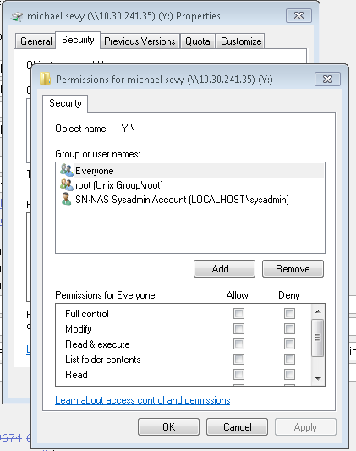
Authentication
Bug 59219 - SMB: ACLs do not work when in conflict with Unix permissions
Need SN 5.3.1 for this to fully work
For Windows, right click on file from Windows Explorer
Select Properties, then Security tab

Slide 22
Troubleshooting: Logs
Logs are located in /var/log
Logs can be directly viewed from NAS CLI/shell
log list
log search <phrase>
log view <log-file>
log watch <log-file>
Example: log view snnas_controller

Slide 23
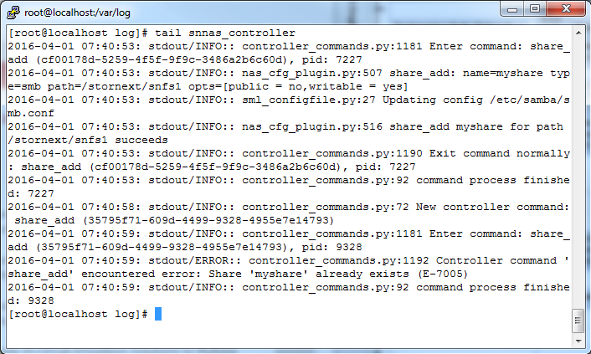
Troubleshooting
Controller Log: commands and errors are logged
Success
Error

Slide 24
Troubleshooting
Enabling Samba Debugging
share change smb global log level = X, max log size = 5000
Will increase logging for all samba clients
Logs are in /var/log/samba/samba.log.<username>
Make sure you turn it back!
share change smb global log level = 1
Other logs
/var/log/messages
If you stop smbd from rootsh, it will restart because of our watchdog
Can disable the watchdog by setting a Controller Regsitry key
reg set nas.check_state_secs = 0
To reanable,
reg reset nas.check_state_secs
Notes:
5000 == 5Mb (default)
50000 == 5Gb

Slide 25
Troubleshooting
x86_64:snt559732-gwcli1> system show smb
16 connections:
PID | User | Group | Machine
---------------------------------------------
1: 3:17435 | sysadmin | root | 10.30.242.5
2: 2:15500 | sysadmin | root | 10.30.241.42
3: 1:24850 | sysadmin | root | 10.30.241.73
…
14: 2:26784 | sysadmin | root | 10.30.242.15
15: 1:16161 | sysadmin | root | 10.30.241.247
16: 1:567 | sysadmin | root | 10.30.242.13
…
32 services:
Service | PID | Machine | Connected at
---------------------------------------------------------------------------
1: IPC$ | 1:20516 | 10.30.241.253 | Wed Mar 30 22:34:11 2016
…
12: tstsmbshare1 | 3:17435 | 10.30.242.5 | Wed Mar 30 22:27:44 2016
13: tstsmbshare1 | 2:15500 | 10.30.241.42 | Wed Mar 30 23:00:53 2016
…
21: IPC$ | 2:31323 | 10.30.241.43 | Wed Mar 30 22:38:22 2016
22: IPC$ | 2:15500 | 10.30.241.42 | Wed Mar 30 23:00:54 2016
…
32: tstsmbshare1 | 2:6508 | 10.30.241.243 | Wed Mar 30 22:48:37 2016
x86_64:snt559732-gwcli1> nascluster show
NAS Cluster IP: 10.65.190.48/eth0, Master: Yes, SNFS Root: /stornext/snfs1, Joined: Yes
Load balancing: leastconn
Master IP: 10.65.190.48
VIP: 10.65.169.152 active
Nodes: 3
1: 10.65.190.48 (Joined)
2: 10.65.185.16 (Joined)
3: 10.65.189.200 (Joined)

Slide 26
Troubleshooting: Support Bundles
The supportbundle create command gathers logs related to NAS. The support bundle file, snnas_auto_support.sh.tar.b2 is placed in the /var directory
With StorNext 5.3.1, running the “collect logs” script trigger a NAS support bundle to be created.

